Slide 1
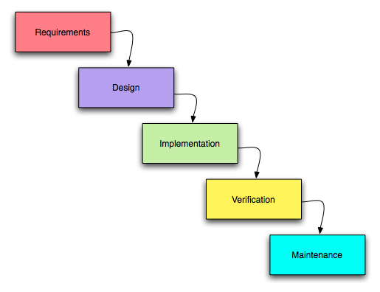
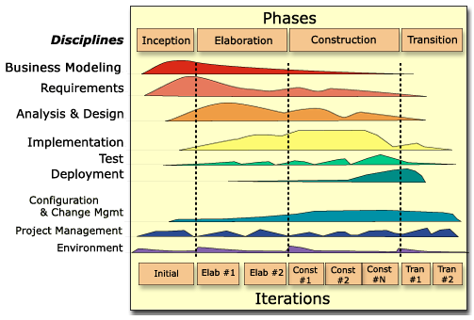
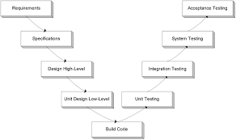
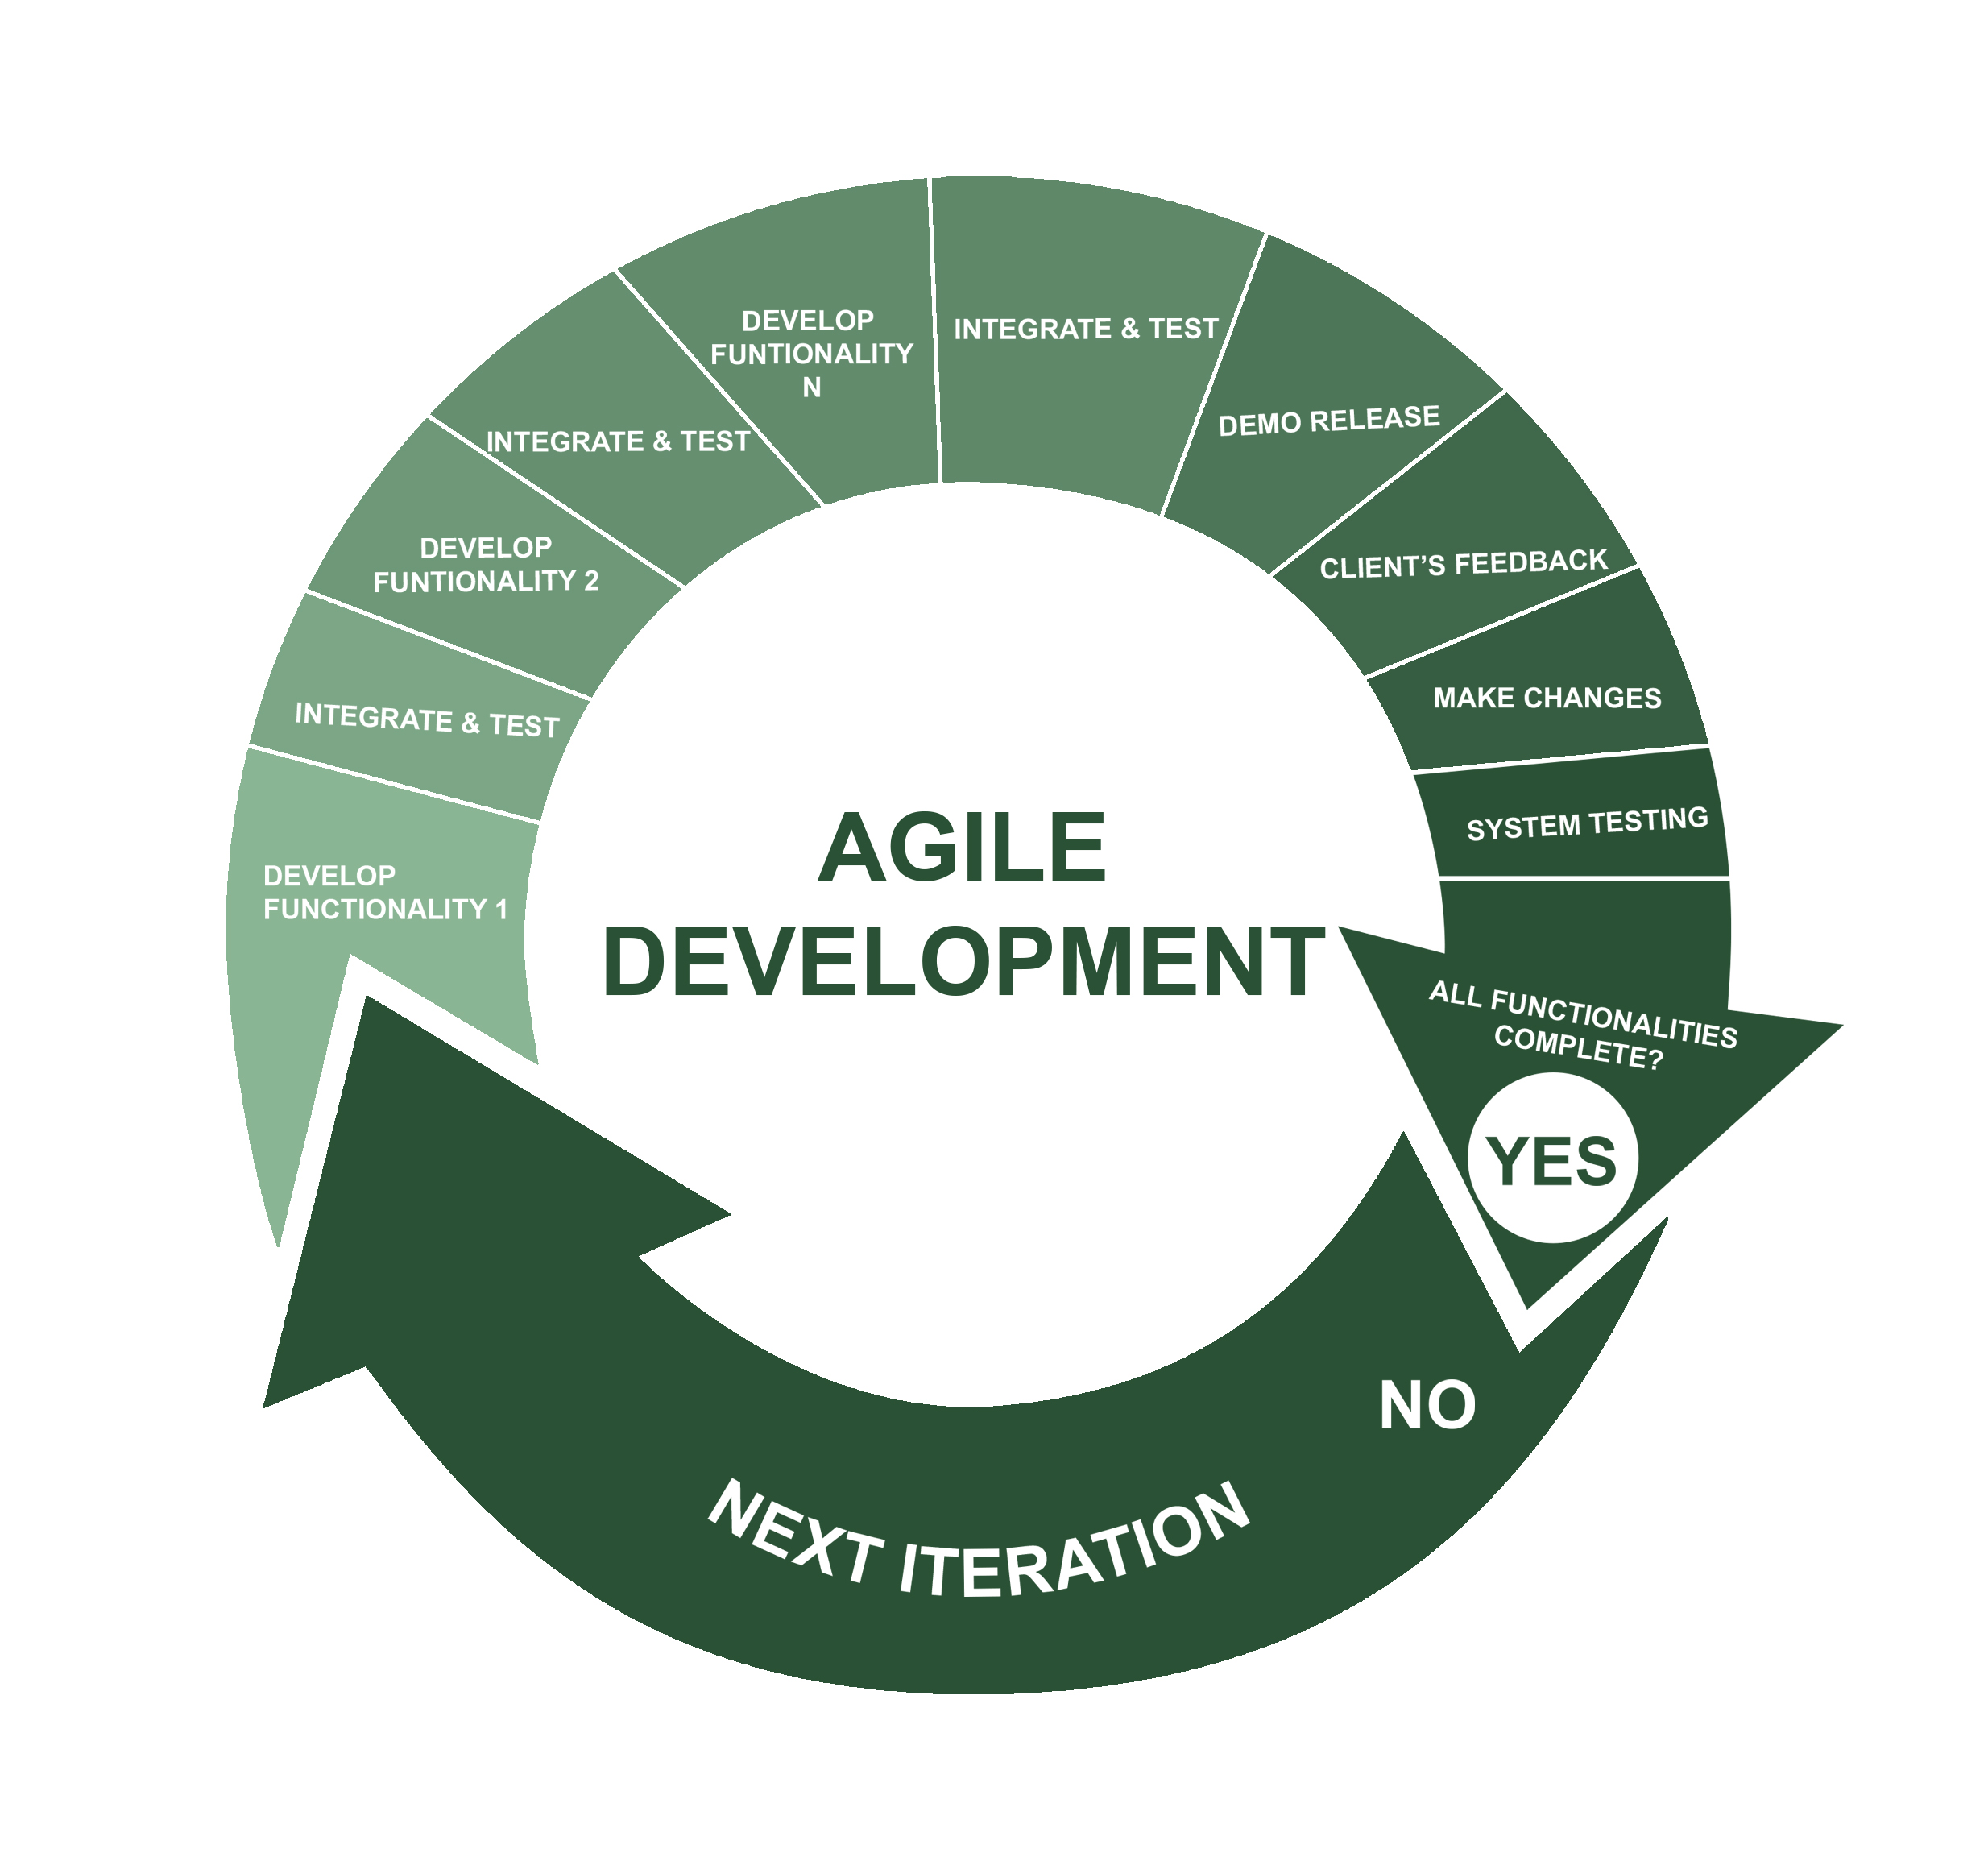
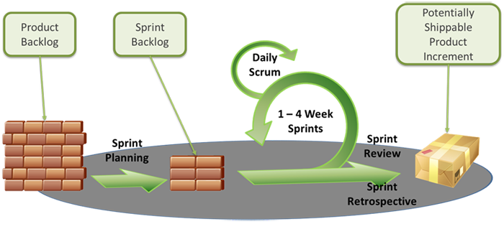
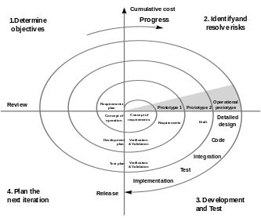
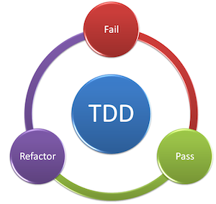
The software development process
Food for thought
Maria Grazia Pia
INFN Genova, Italy
Maria.Grazia.Pia@cern.ch
http://www.ge.infn.it/geant4/training/APC2016/

Slide 2

the software development process in ½ hour
Introduce concepts and methods,
which will be discussed in following lectures
Pills of wisdom
Food for thought
Curiosity
Background for further learning
…feel free to contact us after the school!

Slide 3
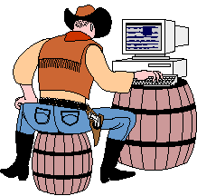
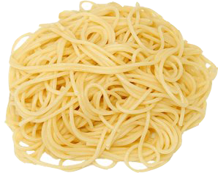
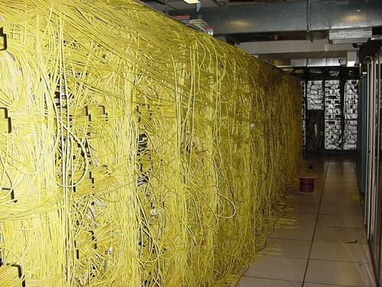
Cowboy programming
Emphasis on ingenious artistry
Galloping off on one's own without a prior plan
Brute-force programming
Uncertain design requirements, code rewrite
Quick and dirty: code and fix later
Lack of comments, documentation, reviews
Reinventing the wheel
The results are often spotty and difficult to duplicate
Inexperienced developers are unfamiliar with technologies and methodologies
that support producing quality software effectively
Software development methods and techniques are seldom part of academic programs for physics degrees

Slide 4
F. P. Brooks,
“No Silver Bullet - Essence and Accidents of Software Engineering”
IEEE Computer, vol. 20, no. 4, pp.10-19, April 1987
As we look to the horizon of a decade hence, we see no silver bullet. There is no single development, in either technology or in management technique, that by itself promises even one order-of-magnitude improvement in productivity, in reliability, in simplicity.
...
Not only are there no silver bullets now in view, the very nature of software makes it unlikely that there will be any - no inventions that will do for software productivity, reliability, and simplicity what electronics, transistors, and large-scale integration did for computer hardware. We cannot expect ever to see twofold gains every two years.
...
Although we see no startling breakthroughs - and indeed, I believe such to be inconsistent with the nature of software - many encouraging innovations are under way. A disciplined, consistent effort to develop, propagate, and exploit these innovations should indeed yield an order-of-magnitude improvement. There is no royal road, but there is a road.

Slide 5
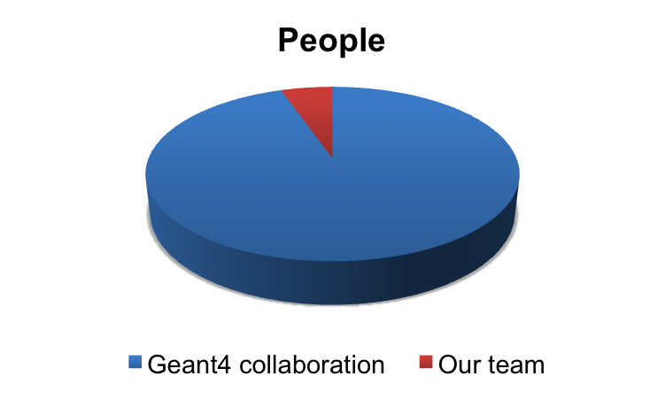
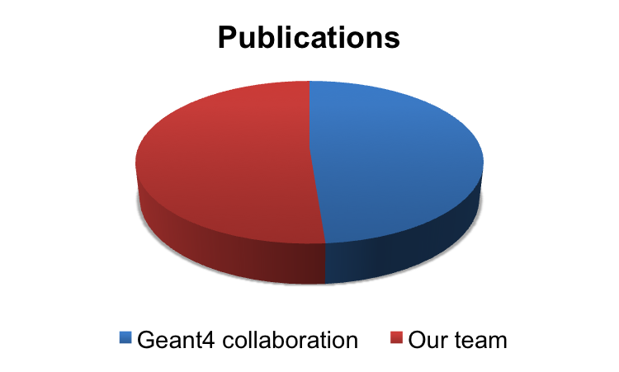
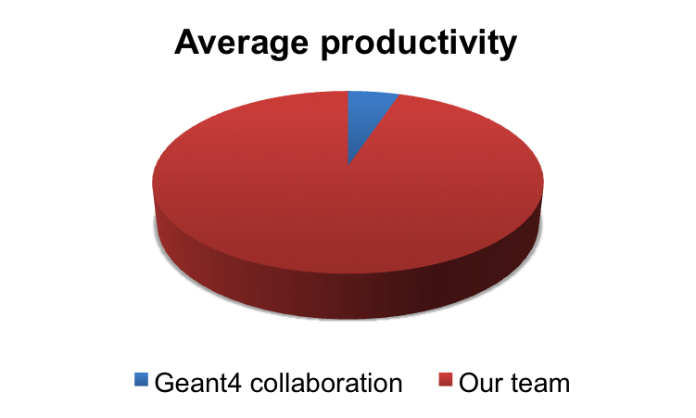
Producing results
Including flawed papers...
2003-2013
Geant4 core subjects
(no applications)
2 Geant4 general papers excluded
Sources:
http://geant4.web.cern.ch/geant4/results/publications.shtml
http://www.ge.infn.it/geant4/papers/

Slide 6
Much more than just hacking code…
Implementation
Configuration management
Test
Design
Project management
Change management
Requirements
Software development environment
Business modeling
Deployment
e.g. in your experiment
Life-cycle
early stage, elaboration, construction, use in production…
Activities
Workflows
Products

Slide 7
in a nutshell
Software specification
Software
design and implementation
Define the functionality
of the software and constraints on its operation
Produce software that meets the specification
Ensure that the software does what one wants
To meet change
Software
validation
Software
evolution
These complex activities include other sub-activities
e.g. requirements validation, architectural design, unit testing etc.
All of the above generate products
e.g. code, documentation, design diagrams, test results etc.
and involve responsibilities in various roles

Slide 8
Software development methodologies
schedule
(delivery date)
What we want
functionality
(features)
quality (defects)
Software development methodologies
are conceptual frameworks to structure, plan, and control
the process of developing the software
Usually built on best practices derived from experience on the field
Highly prescriptive
Adaptable to the context
Wide variety
Small projects
Large scale projects

Slide 9
Old, risky… and most common
Waterfall
Cascade of phases:
the output of one is input to the next
Difficult to accommodate change
Emphasis on planning
Risk of discovering problems at a late stage of the project
Best-suited to solving well-understood problems

Slide 10
“For most projects, the first system built is barely usable: too slow, too big, too hard to use, or all three.
Plan to throw one away; you will, anyhow.”
Fred Brooks, The Mythical Man-Month, Addison-Wesley, 1975-1995

Slide 11
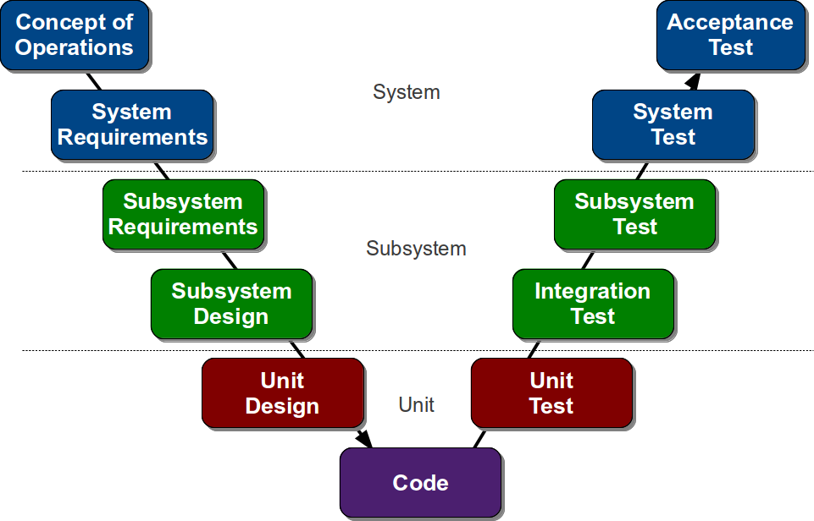
Variants of waterfall development
System
Emphasis on
testing
at all levels of software development
Subsystem
functional side
verification side
Unit
The software development proceeds once the details have been defined both on the functional side and on the verification side

Slide 12
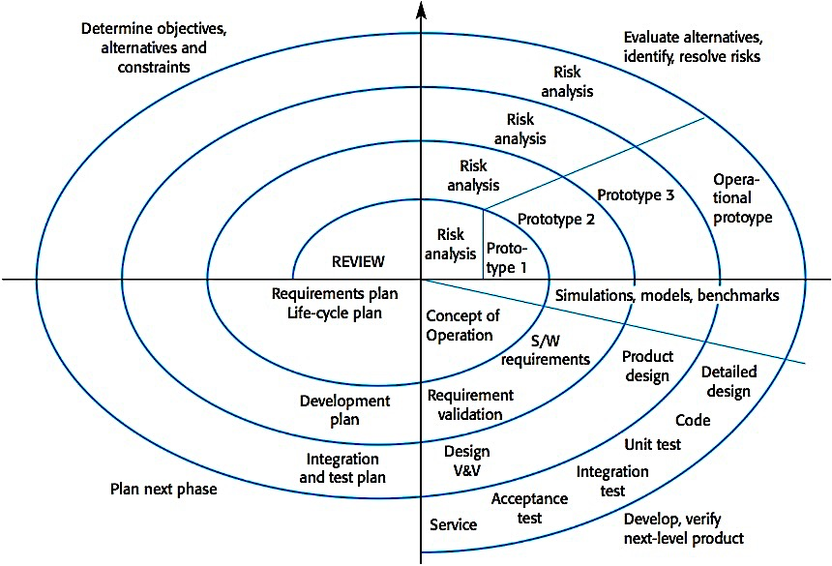
Spiral development
It is a meta-model:
it can incorporate
other models
Non-linear view of the software life cycle
Set objectives
Assess and mitigate risks
Emphasizes
risk management
Identify risks
Assign priorities to risks
Develop a series of prototypes for the identified risks
Use a waterfall model for each development loop
Planning
Develop and test
loop in the spiral = phase of software development
Barry W. Boehm, A Spiral Model of Software Development and Enhancement, IEEE Computer, vol. 21 no. 5, pp. 62-72, 1988

Slide 13
Multiple perspectives
Dynamic perspective
How the process is articulated over time
Static perspective
How activities are enacted
Practice perspective
Suggests good practices
to be adopted in the software development
Risk management
Software reuse

Slide 14
Unified Process (UP, USDP, RUP)
6 core process workflows
Iterative, incremental process
Emphasis on modeling
UP designed along with UML
Apparently complex, but highly customizable
3 supporting workflows
“use case driven, architecture-centric”

Slide 15
Best practices
Develop software iteratively
High priority features developed first
Document requirements
Keep track of changes to requirements
Analyze the impact of changes before accepting them
Manage requirements
Use component-based architectures
Structure the system into components
Visually model software
UML: static and dynamic views
Verify software quality
Testing (and more)
Control changes to software
Change management system
Configuration management procedures and tools

Slide 16
The agile manifesto
Kent Beck et al. (2001)
“We are uncovering better ways of developing software by doing it and helping others do it. Through this work we have come to value:
Individuals and interactions over processes and tools
Working software over comprehensive documentation
Customer collaboration over contract negotiation
Responding to change over following a plan
That is, while there is value in the items on the right,
we value the items on the left more.”
Emphasis on
Effective communication among all stakeholders
Adaptive response to change
Rapid, incremental delivery of software
B. Boehm, “Get Ready for Agile Methods, With Care”, IEEE Computer, 2002, http://dx.doi.org/10.1109/2.976920
A thoughtful critique of agile methods, their strengths and weaknesses, written by a very experienced software engineer
B. Meyer, Agile!: The Good, the Hype and the Ugly, Springer, 2014

Slide 17
Extreme Programming (XP)
Pushes recognized good practices to the extreme
Software Engineering Practice | XP Principles
Code reviews are good | Review code all the time
Testing is good | Everybody tests all the time
Design is good | Part of daily business
Simplicity is good | Enough design to meet requirements and no more
Architecture is important | Simple shared story of how the system works
Integration testing is important | Continuously integrate and test
Short iterations are good | Make iterations really short
Pair programming
Unit tests, TDD
Refactoring
Metaphor
Continuous integration
Planning game
Highly prescriptive, but often organizations adopting XP pick and choose
Emphasis on quick, incremental, test-first development
K. Beck, Extreme Programming explained, Addison-Wesley, 2000

Slide 18
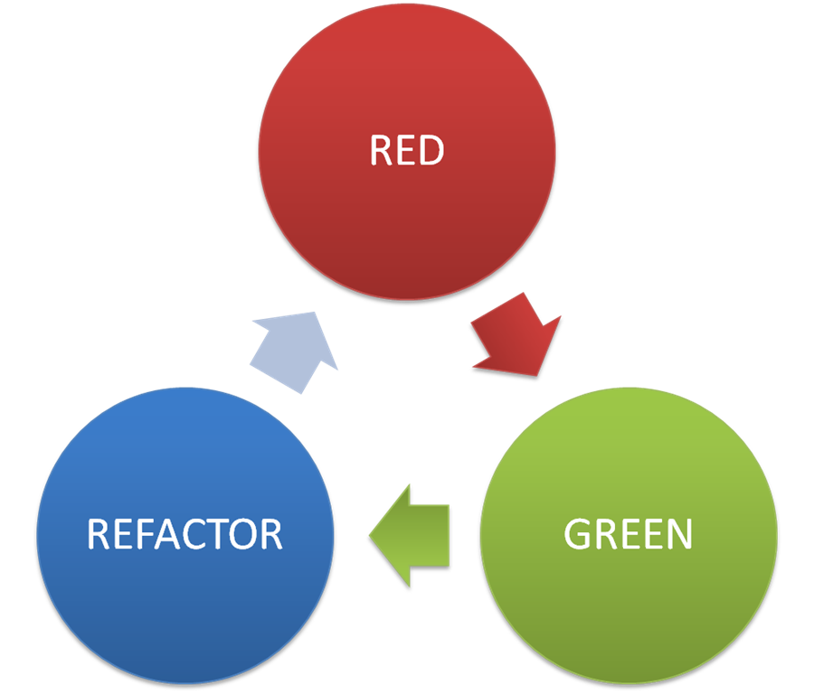
Test-driven development (TDD)
Essential: an
automated testing environment
Write a test that fails
(before writing the code implementing new functionality)
Improve the design of the existing code
Write code that makes the test pass
Facilitates regression testing
Discover problems early during the software development
Limited to unit testing,
still need system testing, performance, reliability testing etc.
Suitable to small-size projects
D. Astels, Test Driven Development: A Practical Guide, Prentice Hall, 2003

Slide 19
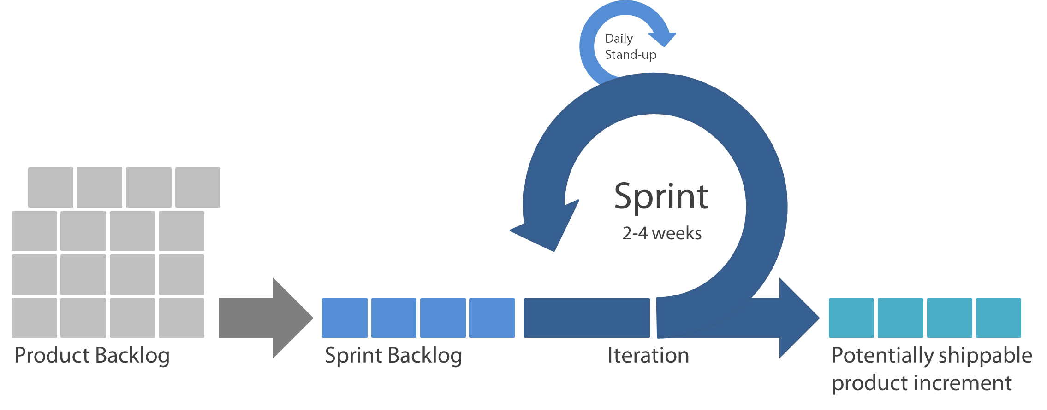
Scrum
Project management for agile (incremental) development
Short, daily meetings to review progress, reprioritize
Starting point for planning
review, prioritize
fixed length
whole team is empowered
Who/what defines the product backlog?
arranges daily meetings
tracks the backlog of work to be done
records decisions
measures progress against the backlog
communicates with customers and management
Scrum master
is a facilitator
K. Schwaber, and M. Beedle, Agile Software Development with Scrum, Prentice Hall, 2001
K. Schwaber, Agile Project Management with Scrum, Microsoft Press, 2004

Slide 20
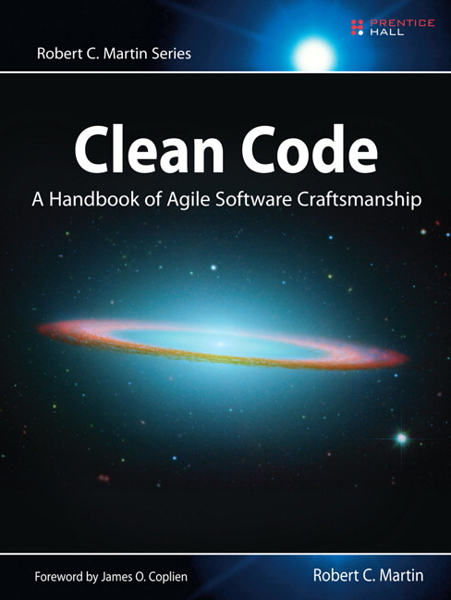

Clean code
Programming hygiene
“Even bad code can function. But if code isn't clean, it can bring a development organization to its knees. Every year, countless hours and significant resources are lost because of poorly written code. But it doesn't have to be that way.”
Meaningful names
  Classes, functions etc.
Comments
  Do not make up for bad code…
  Good/bad
Functions
  Small!
  Do one thing
  No side effects
  Arguments: zero, few
Objects
  expose behavior, hide data
Classes
  Small!
  Encapsulation
  Cohesion
  Single Responsibility Principle
Unit testing
  Clean
  Single concept per test
Smells
  Heuristics
  More in Refactoring

Slide 21
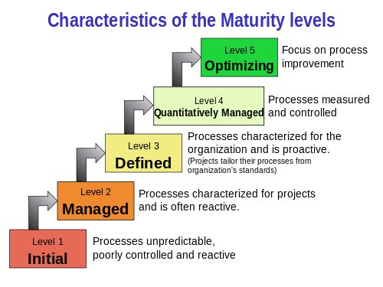

Improvement
Can we improve the way we develop software? How?
Improvement requires measurement: before/after
Software Capability Maturity Model
ISO/IEC 15504 standard for
process assessment
CMM, CMMI
Measure
Change
Analyze
Set of key practices associated with each level
Helpful guidance towards adopting good practices
even without formal assessments

Slide 22
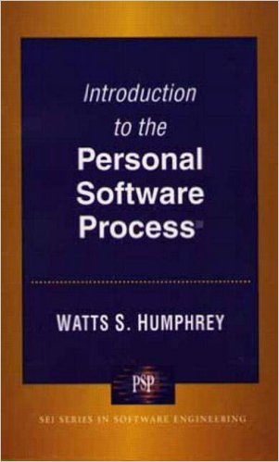
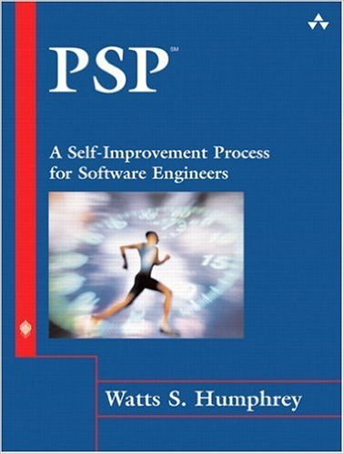
For singles
Emphasis is usually on software development
teams
What if I work at a project where I am the only software developer?

Slide 23
One size does not fit all
A software process model is a simplified representation
of a software process
  From a particular perspective
Many different approaches are possible
  Positive and negative sides in any of them
Good or bad often depends on the context
  Small/large scale project, short/long lifetime etc.
Process frameworks may (should) be adapted and extended
  A good software process is tailored to the project
Grain of salt
  Commercial vs. scientific environment
  …let’s not forget that we are not only the developers,
  but also the customers!

Slide 24
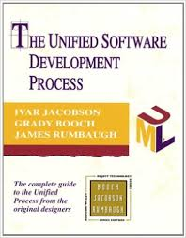




Further learning
Get a mentor!

