Slide 1


Refactoring Exercise
Maria Grazia Pia
INFN Genova, Italy
Maria.Grazia.Pia@cern.ch
http://www.ge.infn.it/geant4/training/APC2016/

Slide 2
Exercise: The Video Store
Grab basic concepts
Get into the habit of refactoring
M. Fowler, Refactoring, Addison-Wesley Professional, 1999, Chapter 1
(translated from Java into C++)

Slide 3
Setting up the computing environment
Details at https://www.ge.infn.it/geant4/training/APC2016/
The exercise has been tested on Scientific Linux 6 with gcc 4.9.3 and on Mac OS 10.11 (El Capitan) with Xcode 7.2.1
  Presumably it would work smoothly on other platforms too
The following tools should be installed
  cmake, available from https://cmake.org/
  googletest, available from https://github.com/google/googletest
  git (not strictly necessary)
Quick instructions for googletest installation
https://www.ge.infn.it/geant4/training/APC2016/gtest.html
Define an environment variable corresponding to googletest path
setenv GTESTPATH $HOME/Documents/g4dev/googletest/gtest_install
Follow the guidance for the exercise at https://www.ge.infn.it/geant4/training/APC2016/exercise.html

Slide 4
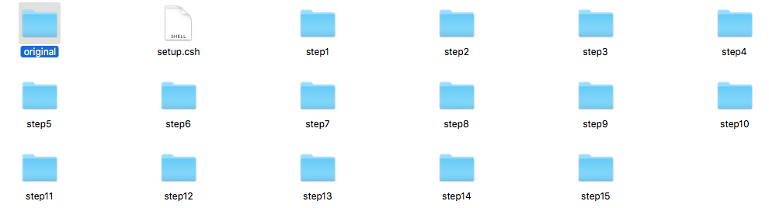
Download the source code for the exercise
Download a copy of the exercise source code from https://github.com/mariagraziapia/VideoStoreAPC/releases/tag/v2.0
Unpack the source code and go into the source directory
  unzip VideoStoreAPC-v.2.0.zip
  cd VideoStoreAPC-v.2.0
15 steps of the refactoring process
Original code

Slide 5
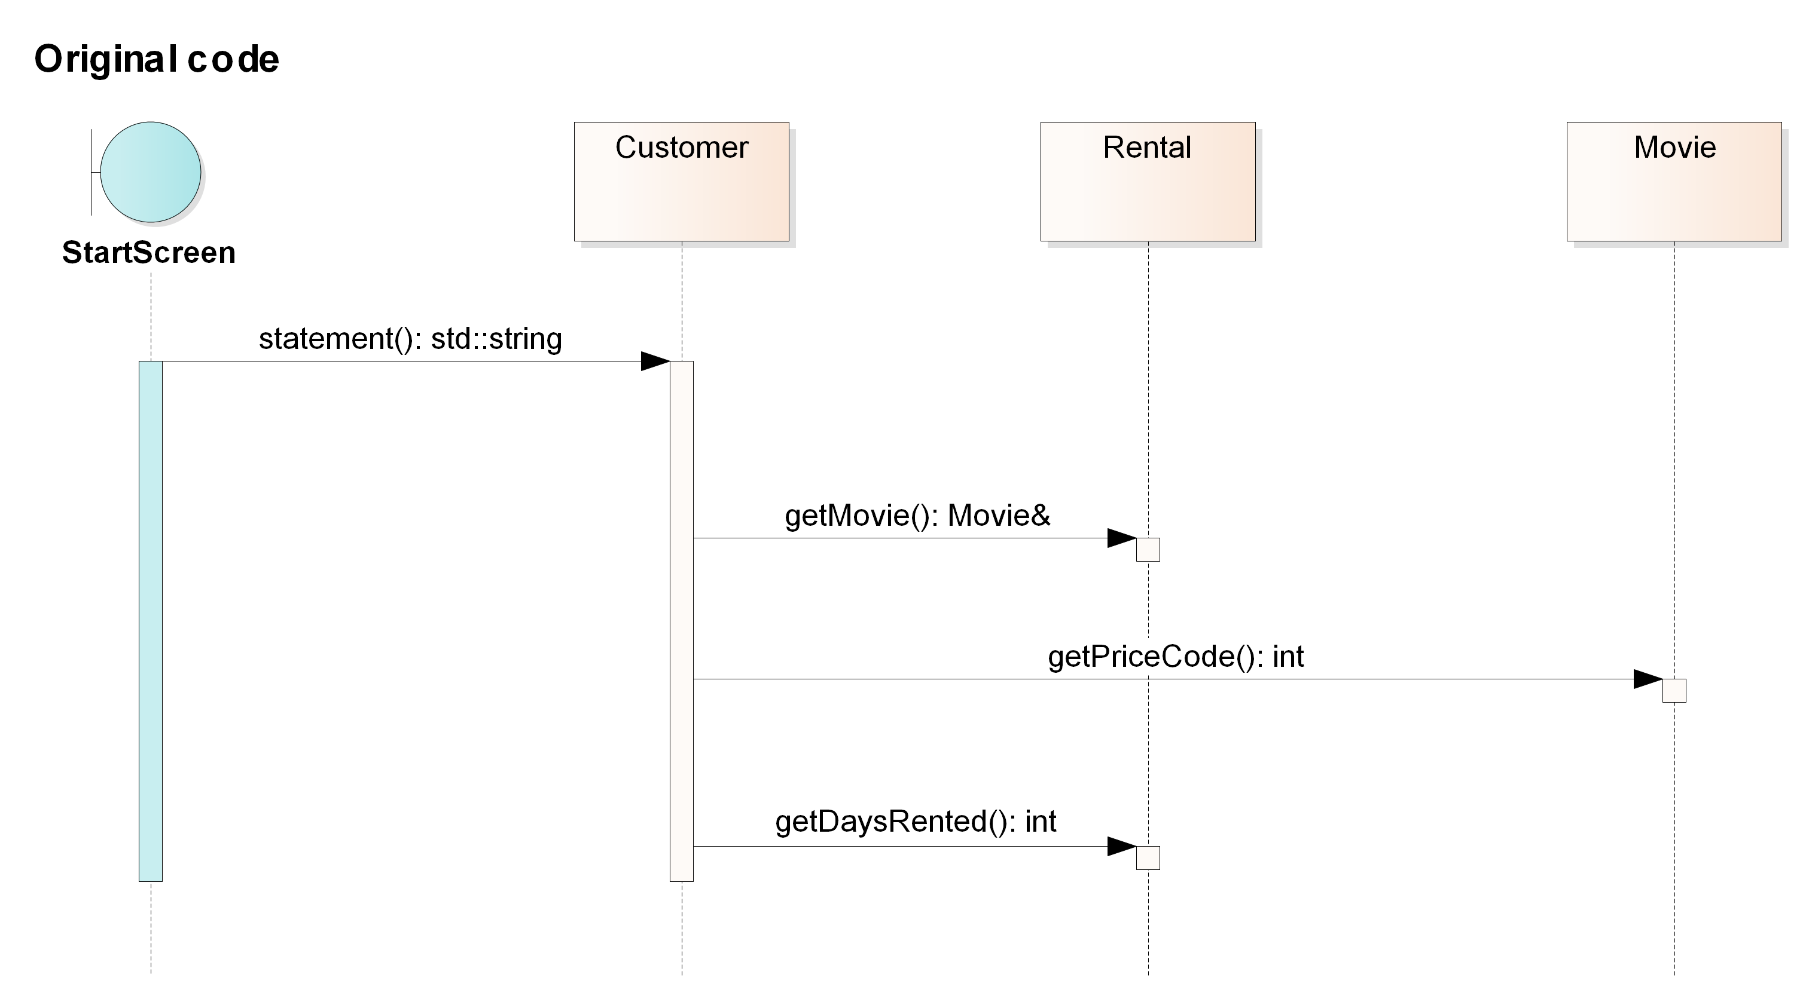
Original code

Slide 6
A first look at the code
Not well designed and certainly not object oriented
  The long routine in the Customer class does far too much
  Many of the things that it does should really be done by the other classes
Difficult to change
  Suppose that they want a statement printed in HTML
  It is impossible to reuse any of the behavior of the current statement method for an HTML statement.
  One would end up with writing a whole new method that duplicates much of the behavior of statement.
  But what happens when the charging rules change? You have to fix both statement and htmlStatement and ensure the fixes are consistent.
  The users want to make changes to the way they classify movies, but they haven't yet decided on the change they are going to make.
  The statement method is where the changes have to be made to deal with changes in classification and charging rules

Slide 7
Step 0: Tests
One needs a solid set of tests for that section of code.
  Risk of introducing bugs while modifying the code
Tests must be self-checking
  They either say "OK”
  or they print a list of failures

Slide 8
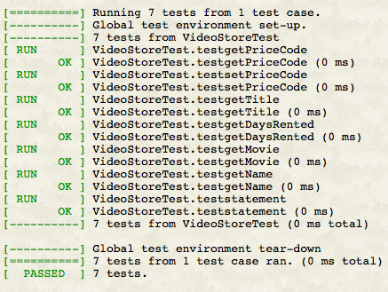
Running the unit tests
Build testVideoStore.cc
cd original
make
the test is automatically run
The output should look like
Build and run the tests in the same way at each step
make clean
to remove *.o and executable
To rerun the tests:
./testVideoStore

Slide 9
Refactoring in 15 steps
For each step N:
Refactor the code in VideoStoreAPC-v.2.0/stepN-1/
The solution is in VideoStoreAPC-v.2.0/stepN/
Try to do the suggested refactoring yourself
following the guidance inhttp://www.ge.infn.it/geant4/training/APC201/exercise.html
Whenever you modify the code, run the tests

Slide 10
Step 1: Extract Method
Bad smell:
the long metod in Customer
Decompose it in small pieces
The first phase of refactorings in this exercise shows how to split up the long method and move the pieces to better classes
Find a logical clump of code and use Extract Method
Candidate: switch statement to extract into its own method
Solution in step2/

Slide 11
Step 2: Renaming Variables
No design change
Some of the variable names in amountFor could be better renamed
Is renaming worth the effort? Absolutely. Good code should communicate what it is doing clearly, and variable names are a key to clear code.
Solution in step3/

Slide 12
Step 3: Move Method
Smell of Feature Envy
amountFor uses information from the rental,
but it does not use information from the customer
In most cases a method should be on the object whose data it uses:
the method should be moved to the rental
Use Move Method
Rename the method (getCharge) as we do the move
Replace the body of Customer::amountFor to delegate to the new method

Slide 13
Step 4: Replace Temp with Query
thisAmount is now redundant.
It is set to the result of each.getCharge and not changed afterward
Thus we can eliminate thisAmount by using
Replace Temp with Query

Slide 14
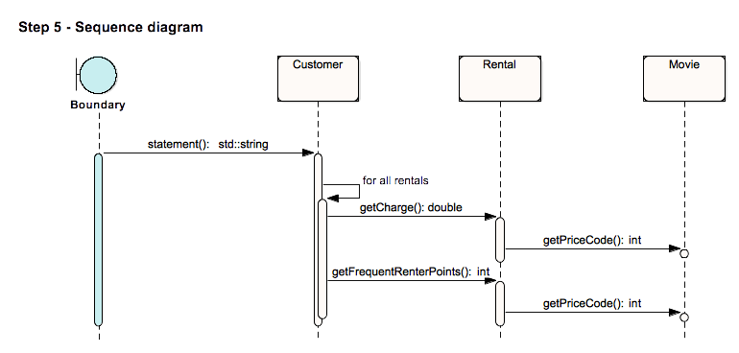
Step 5: Extracting Frequent Renter Points
We do a similar thing for the frequent renter points.
Extract Method on the frequent renter points part of the code

Slide 15
Step 6: Removing Temps
In this case we have two temporary variables, both of which are being used to get a total from the rentals attached to the customer. Both the ASCII and HTML versions require these totals.
Use Replace Temp with Query to replace totalAmount and frequentRenterPoints with query methods
Queries are accessible to any method in the class, thus encourage a cleaner design
We begin by replacing totalAmount with a charge method on customer

Slide 16
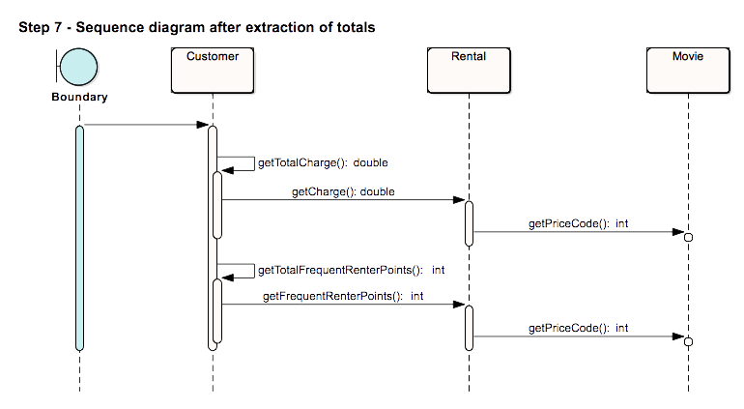
Step 7: Still about removing temps
Do the same as in step 6 for frequentRenterPoints

Slide 17
Step 8: Adding new functionality
Add htmlStatement() to Customer

Slide 18
Step 9: Replacing the Conditional Logic on Price Code with Polymorphism
The first part of this problem is that switch statement.
It is a bad idea to do a switch based on an attribute of another object.
If you must use a switch statement, it should be on your own data, not on someone else’s
This implies that getCharge should move onto movie

Slide 19
10: Still about replacing the Conditional Logic with Polymorphism
Do the same as in step 9
with the frequent renter point calculation

Slide 20
Step 11: At last... Inheritance
Replace the switch statement by using polymorphism
We have several types of movie that have different ways of answering the same question
This sounds like a job for subclasses
A movie can change its classification during its lifetime
An object cannot change its class during its lifetime
Solution: use the State pattern
Replace Type Code with State/Strategy: Self Encapsulate Field on the type code
Move Method to move the switch statement into the price class
Replace Conditional with Polymorphism to eliminate the switch statement

Slide 21
Step 12: Adding new classes
Provide the type code behavior in the price object
Do this with an
abstract method on price
and concrete methods in the subclasses
Change the movie's accessors for the price code to use the new class
Add the new classes

Slide 22
Step 13: Move Method
Apply Move Method to getCharge

Slide 23
Step 14: Replace Conditional with Polymorphism
Take one leg of the case statement at time and create an overriding method
Start with RegularPrice, override the parent case statement, which we just leave as it is
Compile and test,
then take the next leg, compile and test
When done with all the legs, make Price::getCharge a pure virtual function

Slide 24
Step 15
Apply the same procedure to getFrequentRenterPoints
In this case do not make the superclass method pure virtual
Create an overriding method for the new releases and leave a defined method (as the default) on the superclass

Slide 25
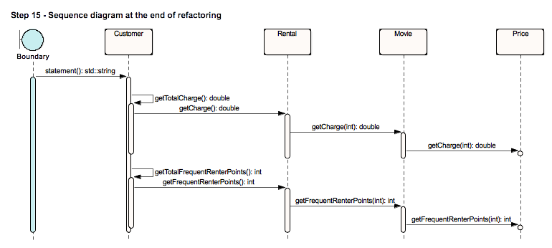
Step 15: The End

