Slide 1

“Once upon a time there was a Good Software Engineer whose Customers knew exactly what they wanted.
The Good Software Engineer worked very hard to design the Perfect System that would solve all the Customers’ problems now and for decades.
When the Perfect System was designed, implemented and finally deployed, the Customers were very happy indeed.
The Maintainer of the System had very little to do to keep the Perfect System up and running, and the Customers and the Maintainer lived happily every after.”
We are all aware that this is a fairy tale…
Could it be because there are no Good Software Engineers?
Could it be because the Users don’t really know what they want? Or is it because the Perfect System doesn’t exist?

Slide 2
Lehman laws
M. M. Lehman,
Programs, Life Cycles, and Laws of Software Evolution,
Proc. IEEE, vol. 68, no. 9, Sep. 1980
Continuing Change
  A program that is used and that as an implementation of its specification reflects some other reality, undergoes continual change or becomes progressively less useful. The change or decay process continues until it is judged more cost effective to replace the system with a recreated version.
Increasing Complexity
  As an evolving program is continually changed, its complexity, reflecting deteriorating structure, increases unless work is done to maintain or reduce it.

Slide 3
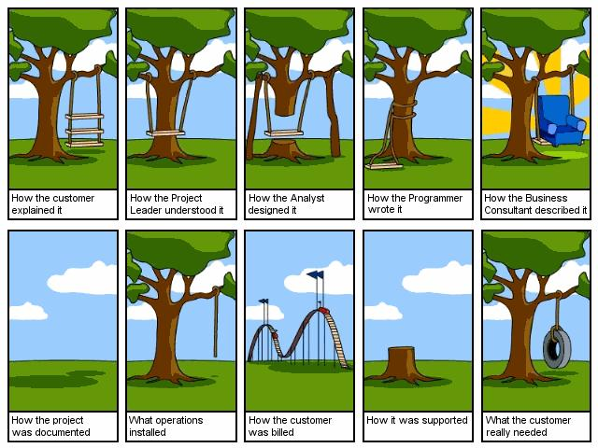
Refactoring
Maria Grazia Pia
INFN Genova, Italy
Maria.Grazia.Pia@cern.ch
http://www.ge.infn.it/geant4/training/APC2014/

Slide 4
Refactoring
…is a disciplined technique for
improving the design of an existing code
In the ideal world
there would be hardly any need for refactoring
In the real world of HEP (and related fields)
most software needs to be refactored
By learning refactoring
you also learn writing code that minimizes the need to be refactored

Slide 5
“If it ain’t broken, don’t fix it”
conventional wisdom
A piece of software can be broken in many ways
Functional
it no longer delivers the function it is designed to perform
Maintenance
it can no longer be maintained
Obsolete or no documentation
Missing tests
Original developers or users have left
Inside knowledge about the system has disappeared
Limited understanding of the entire system
Too long to turn things over to production
Too much time to make simple changes
Need for constant bug fixes
Big build times
Difficulties separating products
Duplicated code
Code smells
Warnings you are heading into trouble
usually do not occur isolated
S. Demeyer, S. Ducasse, O. Nierstrasz,
Object Oriented Reengineering Patterns

Slide 6
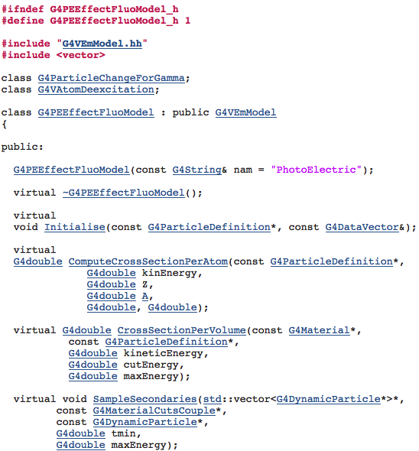
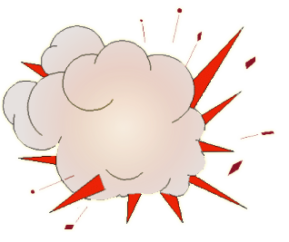
Geant4 photoelectric cross section
Is it consistent with experimental measurements?
A simple test:
instantiate a G4PEEffectFluoModel
invoke ComputeCrossSectionPerAtom
in predefined configurations of photon energy and target element
compare calculated cross sections with experimental data in the same E, Z, A configurations
G4PEEffectFluoModel
class

Slide 7
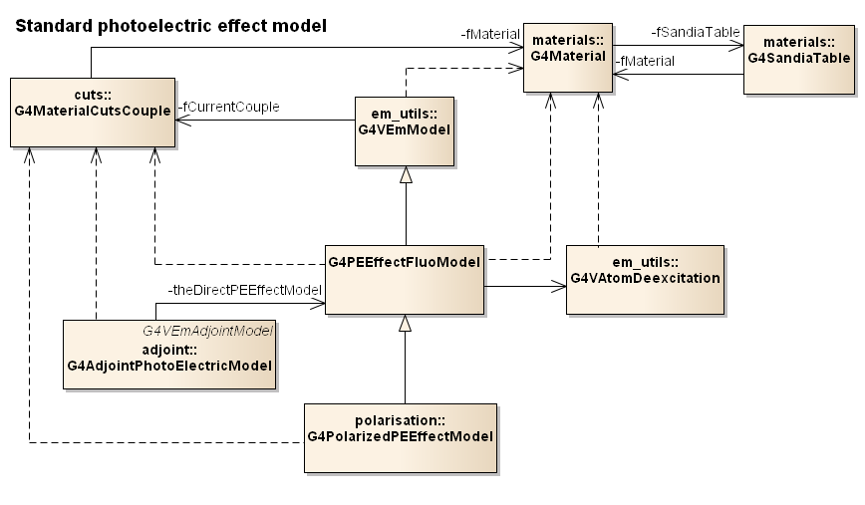
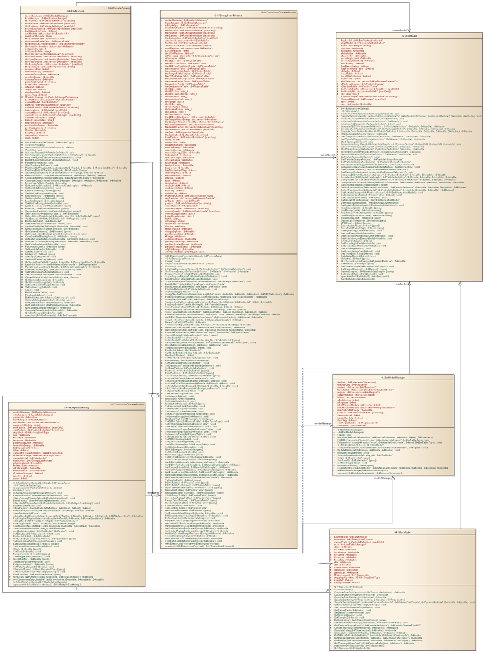
Hidden dependencies
One needs a geometry
(and a full scale application)
to test a photon cross section
Difficult to test
often…
no testing
Post-RD44 electromagnetic design

Slide 8
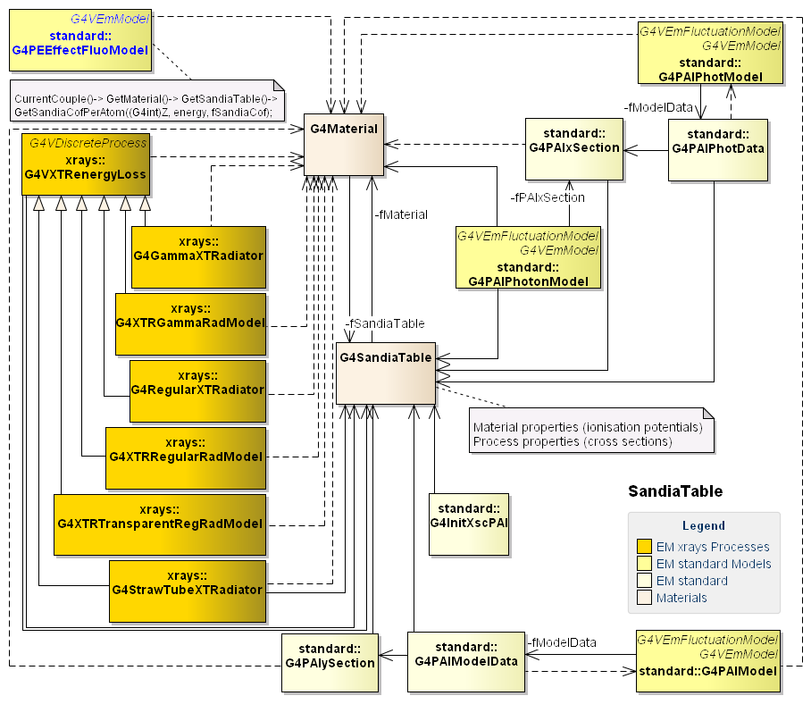
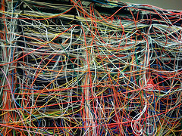


Slide 9
Photoionisation cross section
Cross sections in Geant4 “standard” photoelectric model are based on “improved” Biggs-Lighthill parameterisation
F. Biggs and R. Lighthill, Analytical Approximation for X-ray Cross Sections III, Sandia Lab. Report SAND-0070, 1988
“improved”
“improved”
Test made possible by refactoring the code
IEEE Trans. Nucl. Sci., vol. 63, no. 2, Apr. 2016
http://arxiv.org/abs/1601.06514

Slide 10
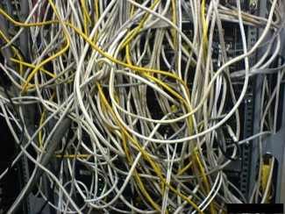
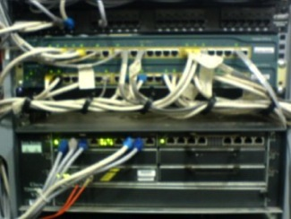
“With rapid development tools and rapid turnover in personnel,
software systems can turn into legacies more quickly than you might imagine.”
S. Demeyer, S. Ducasse, O. Nierstrasz,
Object Oriented Reengineering Patterns
software
evolution
legacy
software
Methods and techniques
  to deal with software evolution
  to manage complexity
  to work with legacy code
in a disciplined and effective way
Refactoring
Reengineering

Slide 11

legacy
a gift by will especially of money or other personal property
something transmitted by or received from an ancestor or predecessor or from the past
“A legacy is something valuable that you have inherited.”
S. Demeyer, S. Ducasse, O. Nierstrasz,
Object Oriented Reengineering Patterns

Slide 12
evolution
one of a set of prescribed movements
a process of change in a certain direction
the process of working out or developing
the historical development of a biological group
the extraction of a mathematical root
a process in which the whole universe is a progression of interrelated phenomena
“The code slowly sinks from engineering to hacking.”
M. Fowler, Refactoring

Slide 13
Software maintenance
“The modification of a software product after delivery
to correct faults,
to improve performance or other attributes,
or to adapt the product to a modified environment.”
IEEE Standard 1219
Accommodate changes in the software environment
Incorporate new user requirements
Fix errors
Prevent future problems
OO techniques promise better
but they do not come for free!
flexibility,
reusability,
maintainability
…

Slide 14
Reengineering
(0) requirement
analysis
Requirements
(2) problem
detection
(3) problem
resolution
Designs
(1) model
capture
Code
(4) program transformation
S. Demeyer, S. Ducasse, O. Nierstrasz,
Object Oriented Reengineering Patterns

Slide 15

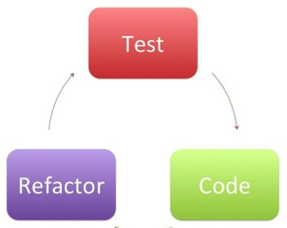
Evolution of legacy systems
New Functionality
Hack it in ?
duplicated code
complex conditionals
abusive inheritance
large classes/methods
First …
refactor
restructure
reengineer
Take a loan on your software
⇒ pay back via reengineering
Investment for the future
⇒ paid back during maintenance
S. Demeyer, S. Ducasse, O. Nierstrasz,
Object Oriented Reengineering Patterns

Slide 16
Does it pay back?

Slide 17



S. Agostinelli et al., Geant4: a simulation toolkit, NIM A, vol. 506, pp. 250-303, 2003
>6000 citations, most cited particle physics paper
Physics
V&V
UQ
State-of-the-art, quantified simulation
Software design
Series of
pilot projects
going on since 2008:
refactoring, reengineering, evolution
Archival literature
http://www.ge.infn.it/geant4/papers

Slide 18
Refactoring Geant4 Radioactive Decay
Steffen Hauf PhD Thesis
Well defined responsibilities and interactions

Slide 19
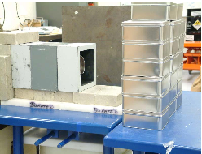
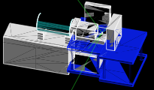
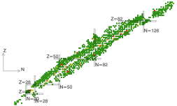

Motivations
Gain understanding of the code
Assess its capabilities and accuracy
Improve physics performance
Improve computational performance
Absolute validation
Experiment: Z. W. Bell (ORNL)
Enabled by refactoring
Performance
New algorithm
Faster computation
Improved physical accuracy
Geant4
refactored
new algorithm
²³³U decay

Slide 20
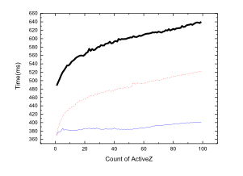
Refactoring
Geant4 physics data management
Today’s technology
  …keeping an eye on the new C++ Standard
Optimal container
Pruning data
Splitting files
Software design
original code
refactored
Min Cheol Han
Hanyang Univ., Seoul, Korea
Undergraduate student project
reengineered

Slide 21
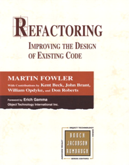

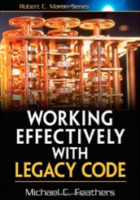
Outline
Problems
Methods
Techniques
to deal with evolving/legacy software
Software technology
Overview
Focus on basic concepts
Guidance for further personal study
no time to enter into details in this lecture
Peculiarities of refactoring physics software
Hands-on practice

Slide 22
Common problems of legacy code
Insufficient documentation
  non-existent or out-of-date
Improper layering
  too few or too many layers
Lack of modularity
  strong coupling
Duplicated code
  copy & paste code
Duplicated functionality
  similar functionality by separate teams
Misuse of inheritance
  code reuse vs. polymorphism
Missing inheritance
  duplication, case-statements
Misplaced operations
  operations outside classes
Violation of encapsulation
  type-casting; C++ "friends”
Class abuse
  classes as namespaces
S. Demeyer, S. Ducasse, O. Nierstrasz,
Object Oriented Reengineering Patterns

Slide 23

Refactoring
“Refactoring is the process of changing a software system in such a way that it does not alter the external behavior of the code yet improves its internal structure.”
“When you refactor you are improving the design of the code after it has been written.”

Slide 24
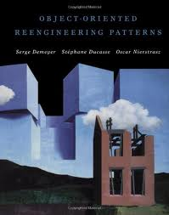
Reengineering
Reengineering “seeks to transform a legacy system into the system you would have built if you had the luxury of hindsight and could have known all the new requirements that you know today.”
“Reengineering […] is the examination and alteration of a subject system to reconstitute it in a new form and the subsequent implementation of the new form.”
“Reverse Engineering is the process of analyzing a subject system
to identify the system’s components and their interrelationships and
create representations of the system in another form or at a higher level of abstraction.”
“Forward Engineering is the traditional process of moving from high-level abstractions and logical, implementation-independent designs to the physical implementation of a system.”
E.J. Chikofsky, J.H. Cross, Reverse engineering and design recovery: a taxonomy, IEEE Software, vol. 7, no.1, pp. 13-17, 1990.

Slide 25
Basic concepts
Refactoring
What they are
Why to refactor (reengineer)
When to refactor
What NOT to refactor
When NOT to refactor
Reengineering
Interplay with other processes: testing
Do not refactor what does not pass the tests
Do not refactor immediately before a critical deadline

Slide 26
Why?
To make software easier to understand and modify
When?
Refactor when you want to add functionality
  before adding it
Refactor when you have to fix a bug
Refactor while doing a code review (!)
Refactor when you want to gain understanding of some legacy code
…
Refactoring embedded in an iterative-incremental life-cycle
Set priorities while refactoring

Slide 27
Risks
The new code may be more “elegant” but it has bugs / is slower
Instead of just fixing a bug, you refactor the core code and screw up everything
Testing
When replacing old code that has been working fine for a long time, one risks reintroducing old problems that were fixed by some of the “ugly” (undocumented) code
Nobody remembers all of the requirements, but break a single one by refactoring, and you can be in deep trouble
Reengineering
Refactoring increases the amount of verification testing that has to be done: when you refactor a class, you need to retest everything that deals with it (and side effects too)
Planning
Refactoring is an excuse for lazy programmers
Refactor your own code
Refactor your colleague’s code

Slide 28
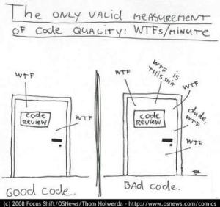
What to refactor
How does one identify code that needs to be refactored?

Slide 29

Identifying code to be refactored
Code Smells
If it stinks, change it.
Grandma Beck, discussing child-rearing philosophy
M. Fowler, K. Beck et al.,
Refactoring: Improving the Design of Existing Code
A code smell is a surface indication that usually corresponds to a deeper problem in the system
Smells are heuristics that help in deciding:
  When to refactor
  What to refactor
  How to refactor
Quick to spot
Don’t always indicate a problem

Slide 30
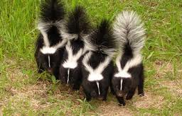
Code smells
Speculative generality
Temporary field
Comments
Refused bequest
Primitive obsession
Message chains
Middle man
Inappropriate intimacy
Alternative classes with different interfaces
Incomplete library class
Data class
Duplicated code
Long method
Large class
Long parameter list
Divergent change
Shotgun surgery
Feature envy
Data clumps
Switch statement
Parallel inheritance hierarchies
Lazy class
M. Fowler, K. Beck et al.,
Refactoring: Improving the Design of Existing Code

Slide 31

Common code smells
in the stink parade
Duplicated Code
  if you modify one instance of duplicated code but not the others, you may introduce a bug!
Large class
  tries to do too much
Long Method
  difficult to understand and maintain
  Martin’s Rule of Performance: Assume costs of lots of short functions are negligible and wait to be proven wrong!
Long Parameter List
  hard to understand, can become inconsistent

Slide 32
Code smells: dispensable
Data Class
  A data holder: a class that has attributes, getting and setting methods for the fields, and nothing else
  Objects should be about data and behavior
Speculative Generality
  “I may need the ability to do this kind of thing someday”
Lazy Class
  A class that no longer “pays its way”
  e.g. a class that was downsized by refactoring, or represented planned functionality that did not materialize
Dead Code
  Code that is not used

Slide 33
Code smells: OO abusers
Refused Bequest
  A subclass ignores most of the functionality provided by its superclass
Switch Statements
  Can be replaced by use of polymorphism
Temporary Field
  An attribute of an object is only set in certain circumstances
    but an object should need all of its attributes
  or fields used to hold intermediate results
Alternative Classes with Different Interfaces
  Two or more methods do the same thing but have different signature for what they do

Slide 34
Code smells: coupling
Middle Man
  A class delegates most of its responsibilities to another class
  Does it really have a reason to exist?
Message Chains
  A client asks an object for another object, then asks that object for another object etc.
Feature Envy
  A method requires lots of information from some other object
Inappropriate Intimacy
  Classes that know too much about each other’s private details

Slide 35
Code smells: hindering change
Divergent Change
  Lack of cohesion: one type of change requires changing one subset of methods; another type of change requires changing another subset
Shotgun Surgery
  A change requires lots of little changes in a lot of different objects
Parallel Inheritance Hierarchies
  Similar to Shotgun Surgery; each time I add a subclass to one hierarchy, I need to do it for all related hierarchies

Slide 36
…and more
Data Clumps
  Attributes that are used together, but are not part of the same object
Primitive Obsession
  A reluctance to use classes instead of primitive data types
Magic Number
  A literal value that appears in a program
Combinatorial Explosion
  Lots of code that does almost the same thing

Slide 37
How to refactor
Methods
Techniques
Reverse engineering
Not limited to deriving a UML class diagram form the code…
Motivation: understanding other people’s code

Slide 38
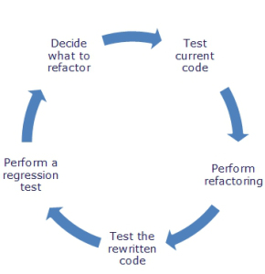
Testing
Refactoring is not meant to alter the behaviour of the code
To be tested!
Refactoring begins by designing a solid set of tests for the portion of code under analysis
Usually unit tests
Refactoring occurs as a series of small changes
Test original code
Apply one action at a time
Test
…
hands-on exercise

Slide 39
What may happen…
…if the software is changed
(“improved”) without testing
2.9 σ
P. Arce, M. Wadhwa

Slide 40


Today
6.2 σ
WenzelVI
Urban93
5.2 σ
Urban95
5.2 σ
Urban
8.4 σ
V. Ivanchenko, 14/4/2014
Beware:
experimental geometry is not reproducible!

Slide 41
p
E_{deposited}
9.3
9.1
9.2p03
9.1
9.3
8.1

Slide 42
Negative improvements…
IEEE NSS Best Student Paper, 2007

Slide 43

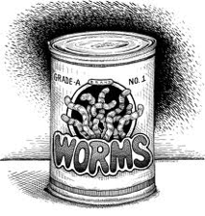
Sweeping under the carpet?
Refactoring aims to preserve correctness
Was the original code verified?
Was the original code validated?
IEEE Standard 1012
Software Verification & Validation
ISO 12207
What was the test coverage?
Were the test process and the test results documented?

Slide 44
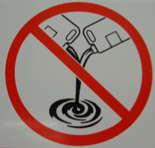
Do not mix!
Risk mitigation
One of the motivations for refactoring may be the need to introduce new features in the code
Refactoring
Adding
new features
Does not modify the code behaviour
Modifying the code behaviour
Test
Refactor
Test
Add new feature
Test
Add new feature
Test
…
hands-on exercise

Slide 45
Basic actions for common smells
Method invocation
  Consolidate recurring code into a single method
  OK when the recurring code doesn’t span methods and all methods containing code belong to the same class
Inheritance
  Common code in two different classes
  New superclass introduced
commonCode() {
…
}
class Child : public Super {
…
};

Slide 46
Extract commonality
Abstract interfaces are classes with no implementation
Abstract classes represent mixed design and implementation
Introduce abstract class
  a class with no or partial implementation
Add delegation
  Delegate the recurring code segments to a helper class
class Common {
void commonCode(...) {...}
virtual void contextSpecificCode () = 0;
...
} ;
  class Extension : public Common {
  void method1(...) {
  ...
  helper.SomeMoreCommonCode();
  }
  ...
  } ;

Slide 47
…sounds like common sense?
Many refactoring techniques are just
good practices of code hygiene
Apply them when writing new code!
The “legacy code” you may have to refactor in a few months/years may be your own…
A colleague collaborating at your project may have to refactor your “legacy code”…

Slide 48

Refactoring Techniques
Composing Methods
Extract Method, Inline Method,…
Moving Features Between Objects
Move Method, Move Field, Hide Delegate, ...
Organizing Data
Replace Data Value with Object, ...
Simplifying
Conditional Expressions
Decompose Conditionals, ...
http://www.refactoring.com/catalog/index.html

Slide 49

Duplicated code
in the stink parade
Same expression in two methods of the same class
  Use Extract Method refactoring
Same expression in two methods of sibling classes
  Use Extract Method and Pull Up Method
If code is similar, but not same
  Consider Form Template Method
Duplicated code in unrelated classes
  May need to Extract Class
  Or eliminate one of the versions

Slide 50
G4WentzelVIModel.cc
G4WentzelVIRelModel.cc
Identical member function!

Slide 51
G4PAIModel.cc
G4PAIPhotModel.cc
Identical but the instantiation of a “model data” object

Slide 52
How to find duplicated code?
Automated tools
  Some exist
By hand
  Still the most common way
  Not necessarily the most efficient (the most inefficient)
Reverse engineering
  Gain understanding of the code

Slide 53
G4KleinNishinaCompton.cc
G4KleinNishinaModel.cc
Beware:
Sometimes automated tools don’t catch code duplication effectively
Code reviews!

Slide 54
Long method
The longer a method is, the more difficult it is to understand
Decomposing methods
Most of the time: just Extract Method
  What to extract?
  Understand what the code does
  Comments in the code may help

Slide 55
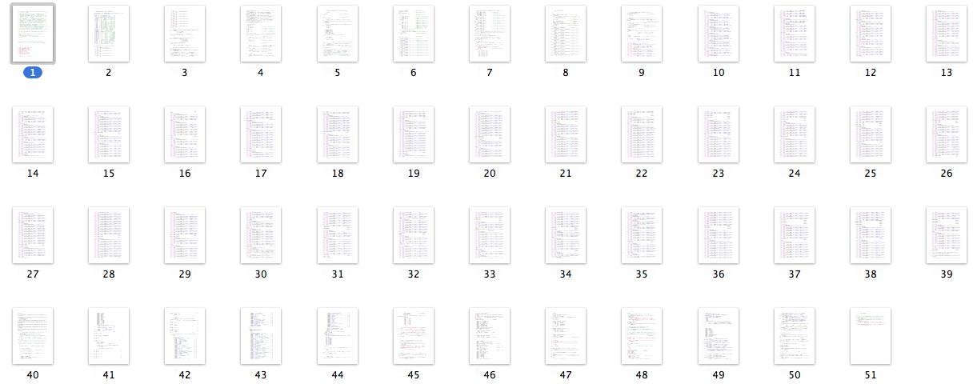
Large class
G4VEnergyLossProcess
A class that tries to do too much
Often has too many instance variables
Prone to duplicated code
Extract Class
Extract SubClass
Extract Interface
G4ChipsNeutronElasticXS.cc, 2112 LOC

Slide 56
Extract class
One class does work that should be done by two
Create a new class and move the relevant fields and methods from the old class into the new class
hands-on exercise

Slide 57
Extract interface
Several clients use the same subset of a class's interface, or two classes have part of their interfaces in common
Extract the subset into an abstract interface

Slide 58
Pull up method
Methods with identical results on subclasses
Move them to the superclass

Slide 59
Push down method
Behavior in a superclass is relevant
only for some of its subclasses
Move it to those subclasses

Slide 60
Replace inheritance with delegation
A subclass uses only part of a superclass interface or does not want to inherit data
Create a field for the superclass,
adjust methods to delegate to the superclass, and remove the subclassing

Slide 61
Refactoring mechanics
Catalog of refactoring techniques
Reference material in Fowler’s book and web site
Not meant to be learned by heart,
but to be exercised when a pertinent “smell” is identified

Slide 62
Composing Methods
Extract Method turns a code fragment into a function
Inline Method is the opposite of Extract Method
Inline Temp gets rid of a temporary variable by moving the expression to where the temp is used
Replace Temp with Query removes a temporary variable and instead uses a function call where the temp was used
Introduce Explaining Variable replaces comments and complex expressions with a temp variable that is well named
Split Temporary Variable splits a temp that is used for two different things into two different variables
Remove Assignments to Parameters removes assignments to function parameters within the function
Replace Method with Method Object moves a complex function to its own class
Substitute Algorithm

Slide 63
Moving Features Between Objects
Move Method moves a method from one class to a more appropriate class
Move Field moves a field (member object) from one class to another class
Extract Class pulls a set of methods and fields from one class into a new class
Inline Class opposite of Extract Class
Hide Delegate: a class that provides access to an object of another class instead provides the methods of that class by delegation
Remove Middle Man opposite of Hide Delegate
Introduce Foreign Method adds a method to an untouchable class by passing an instance of the untouchable class into the method
Introduce Local Extension adds methods to an untouchable class by deriving from it or by wrapping it

Slide 64
Organizing Data
Self Encapsulate Field creates accessors for private member objects
Replace Data Value with Object turns a member object into a full-fledged class
Change Value to Reference
Change Reference to Value
Replace Array with Object converts an array which has various fields in each entry into an object
Duplicate Observed Data introduces a Document/View architecture into an interactive application
Change Unidirectional Association to Bidirectional introduces a back pointer
Change Bidirectional Association to Unidirectional is the opposite
Replace Magic Number with Symbolic Constant

Slide 65
Organizing Data
Encapsulate Field adds getters and setters
Encapsulate Collection hides a collection within a class
Replace Record with Data Class makes a dumb data class to represent a record structure
Replace Type Code with Class replaces an enumeration type with a class that has a set of global instances of itself, one for each possible value
Replace Type Code with Subclasses introduces a polymorphic hierarchy to replace an enumeration
Replace Type Code with State/Strategy allows change at runtime
Replace Subclass with Fields is used when the subclasses no longer serve any real purpose

Slide 66
Simplifying Conditional Expressions
Decompose Conditional extracts the condition, the “then” part, and the “else” part into functions
Consolidate Conditional Expression combines a series of “if” into one
Consolidate Duplicate Conditional Fragments factors out code that is common to a “then” part and an “else” part
Remove Control Flag replaces flags that trigger exits with return, continue, and break
Replace Nested Conditional with Guard Clauses replaces nested “if” with returns
Replace Conditional with Polymorphism replaces case statements with polymorphism
Introduce Null Object replaces checks for null values with an object
Introduce Assertion uses assertions to describe a function's preconditions

Slide 67
Making Method Calls Simpler
Rename Method
Add Parameter to a function
Remove Parameter from a function
Separate Query from Modifier avoid side-effects
Parametrize Method reduces a set of similar functions to a single function with a parameter to differentiate amongst the functions
Replace Parameter with Explicit Methods
Preserve Whole Object passes an object to a method instead of selected fields
Replace Parameter with Method reduces a parameter list by using a value that is already available within the class
Introduce Parameter Object groups parameters into a single object
Remove Setting Method makes an attribute read-only
Hide Method makes a method private
Replace Constructor with Factory Method supports polymorphism Encapsulate Downcast hides a downcast within a method
Replace Error Code with Exception separates error-handling from normal paths
Replace Exception with Test provides a method for caller to avoid an exception

Slide 68
Dealing with Generalization
Pull Up Field factors a common field into a superclass
Pull Up Method factors a common method into a superclass
Push Down Method moves a unique method down into a subclass
Push Down Field moves a unique field down into a subclass
Extract Subclass creates a subclass and moves features into it
Extract Superclass factors common code into a superclass
Extract Interface promotes decoupling and partitioning of a class's responsibilities by extracting an interface class
Collapse Hierarchy combines a subclass and a superclass into one
Form Template Method factors out common behavior into a superclass
Replace Inheritance with Delegation Replace Delegation with Inheritance

Slide 69
Big Refactorings
Tease Apart Inheritance deals with a messy inheritance hierarchy
Convert Procedural Design to Objects
Separate Domain from Presentation moves domain logic out of the UI classes
Extract Hierarchy introduces polymorphism to replace complex conditional code

Slide 70
A Map of Reengineering Patterns
Tests: Your Life Insurance
Detailed Model Capture
Migration Strategies
Initial Understanding
Detecting Duplicated Code
Redistribute Responsibilities
First Contact
Transform Conditionals to Polymorphism
Setting Direction
program transformation
Code
S. Demeyer, S. Ducasse, O. Nierstrasz,
Object Oriented Reengineering Patterns

Slide 71
Computational performance
Refactoring may make the code slower
conventional wisdom
Yes, sometimes…
“First do it, then do it right, then do it fast”
Refactoring prepares the ground
for computational improvement
by providing clean code

Slide 72
Refactoring and reengineering physics software
Food for thought…

Slide 73
Quantify Geant4 physics capabilities
Identify experimental requirements
Refactor
Reengineer
Prune
Improve
Extend
New physics
New performance
Assess the
state of the art
prototype
current future
Code
Physics
V&V
theory exp.
MC
physics
software

Slide 74

Smells
Duplicated code
Long method
Large class
Long parameter list
Shotgun surgery
Feature envy
Data clumps
Switch statement
Parallel inheritance hierarchies
Lazy class
Speculative generality
Temporary field
Comments
Refused bequest
Primitive obsession
Message chains
Middle man
Inappropriate intimacy
…
Evolution away from
RD44 discipline

Slide 76
Magic number
// G4HadronElastic
// Author : […] 29 June 2009 (redesign old elastic model)
G4double dd = 10.;
G4Pow* g4pow = G4Pow::GetInstance();
if (A <= 62) {
bb = 14.5*g4pow->Z23(A);
aa = g4pow->powZ(A, 1.63)/bb;
cc = 1.4*g4pow->Z13(A)/dd;
} else {
bb = 60.*g4pow->Z13(A);
aa = g4pow->powZ(A, 1.33)/bb;
cc = 0.4*g4pow->powZ(A, 0.4)/dd;
}
G4double q1 = 1.0 - std::exp(-bb*tmax);
G4double q2 = 1.0 - std::exp(-dd*tmax);
G4double s1 = q1*aa;
G4double s2 = q2*cc;

Slide 77


Electromagnetic smells
“model”
Coupling
Total cross section
σ_{tot} and final state modeling have been decoupled in hadronic physics design since RD44
Whether a process occurs
Final state generation
How a process occurs
Dependencies
One needs a geometry
(and a full scale application)
to test (verify) a cross section
on other parts of the software
Difficult to test ➔ no testing
often
Problem domain analysis
Improve domain decomposition

Slide 78

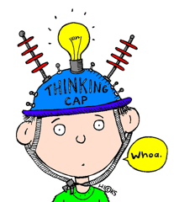


Benefits
Reengineered code
Transparency
Ease of maintenance
Simplicity of testing for V&V
Basic physics V&V can be performed by means of lightweight unit tests
Exploring new physics models is made easier
Quantification of accuracy is facilitated
Notes:
pickaxe

Slide 79
Prune
Number one in the stink parade is duplicated code
M. Fowler, Refactoring
physics
Objective quantification of smell
Two Geant4 models, identical underlying physics content (it used to be different)
Efficiency w.r.t. experiment
“Livermore” | Penelope
EPDL97 | EPDL97
0.38±0.06 | 0.38±0.06
σ_{total}
dσ/dΩ
σ = 0.008 %
σ = 1 %
Code bloat
Burden on
  Software design
  Maintenance
  User support
Unnecessary complexity
mean
7 10⁻⁵ %
mean
0.07%
Bremsstrahlung, evaporation, proton elastic scattering etc.
Notes:
Duplicated code is easy to detect, duplicated physics is not (in-depth review, experimental validation)

Slide 80

Trash and redo
Number one in the stink parade is duplicated code
numbers
Atomic binding energies
Bearden & Burr (1967)
Carlson
EADL
Sevier
ToI 1978 (Shirley)
ToI 1996 (Larkins)
Williams
{
{
Carlson + Williams
EADL
(
)
Carlson
Shirley
Source of epistemic uncertainties?
23 pages
p ionisation cross sections
difference w.r.t. experiment
KL₃ E_{γ} w.r.t. experiment
Carlson Williams
other
EADL
Carlson
mixed

Slide 81
An example of reengineering:
Photon elastic scattering simulation
State of the art
Form factor approximation:
non relativistic, relativistic, modified + anomalous scattering factors
2nd order S-matrix calculations
recent calculations, not yet used in Monte Carlo codes
Quantification
Statistical analysis, GoF + categorical
new
Differential cross sections
current Geant4
 | Penelope | Penelope | EPDL | Relativ. | Non-Rel. | Modified | MFF | RFF | SM
 | 2001 | 2008 |  | FF | FF | FF | ASF | ASF | NT
ε | 0.27 | 0.38 | 0.38 | 0.25 | 0.35 | 0.49 | 0.52 | 0.48 | 0.77
error | ±0.05 | ±0.06 | ±0.06 | ±0.05 | ±0.06 | ±0.06 | ±0.06 | ±0.06 | ±0.05
ε = fraction of test cases compatible with experiment, 0.01 significance

Slide 82
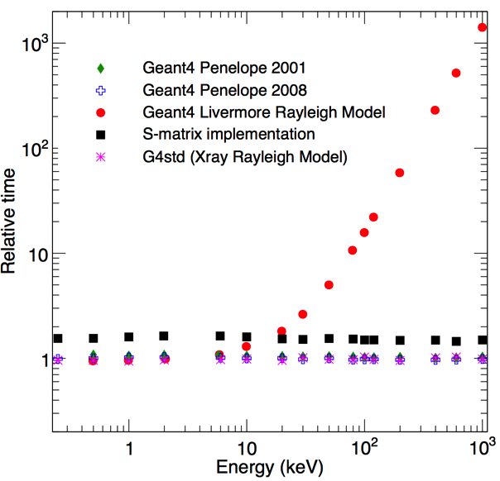
Computational performance
Popular belief
Physics model X is intrinsically slow
Baroque methods to combine it with “faster” lower precision models and limit its use to cases where one is willing to pay for higher precision
This design introduces an additional computational burden due to the effects of inheritance and the combination algorithms themselves
Truth
No code smell
Spotted through
in-depth code review in the course of software validation
Physics model X is intrinsically fast
But its computationally fast physics functionality is spoiled by an inefficient sampling algorithm
Change the sampling algorithm!

Slide 83

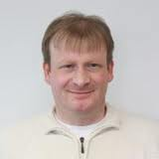




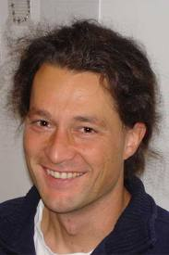


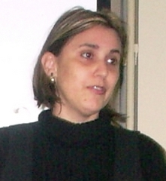



Slide 84
Dealing with legacy code
Legacy code often lacks tests
Techniques to make existing code testable

Slide 85
The legacy code dilemma
It works
It doesn’t hurt… so long as you don’t want to change it
When we change code, we should have tests in place
To put tests in place, we often need to change code
Lack of tests
distinguishes legacy code from non-legacy code
Most of the fear involved in making changes to large software systems is fear of introducing bugs
With tests, you can change (and improve) your code
Without tests, you just don’t know whether
things are getting better or worse

Slide 86
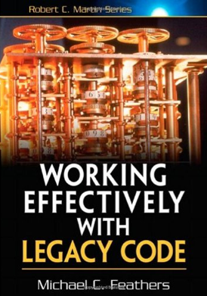
Legacy management strategy
Identify change points
Find an inflection point
Cover the inflection point
  Break external dependencies
  Break internal dependencies
  Write tests
Make changes
Refactor the covered code

Slide 87
Test Covering
A set of tests used to introduce an invariant on a code base
Usually cover a set of classes
Provide some “invariant” that let us know when we have changed the behaviour of our system
  get that invariant before refactoring or adding new behavior
Correctness is defined by original behaviour of the code base
  …but was the code base ever verified?
Identify change point
can’t get this class in a test harness
Inflection Point
A narrow interface to a set of classes
If anyone changes any of the classes behind an inflection point, the change is either detectable at the inflection point, or inconsequential in the application

Slide 88
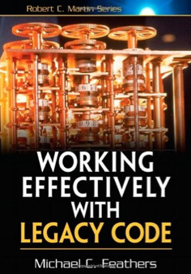
^{Cover an inflection point}
Hard point:
make it compile in a test harness
Write tests for it
Usually requires breaking dependencies
External dependencies
Internal dependencies
objects which we have to provide to setup the object we are creating
(e.g. in a constructor)
the class we want to cover creates its own objects internally
Write tests
Make changes
Refactor
Techniques for breaking dependencies

Slide 89
I can’t get this class in a test harness
Objects of the class can’t be created easily
The test harness won’t easily build with the class in it
The constructor we need to use has bad side effects
Significant work happens in the constructor, and we need to sense it
“Tricks” to make the class testable

Slide 90
Irritating parameter
How am I going to construct these parameters for the test?
public class CreditValidator {
public CreditValidator(RGHConnection connection,
CreditMaster master,
String validatorID) {
...
}
Certificate validateCustomer(Customer customer)
throws InvalidCredit {
...
}
... }
Setting up network connection is not possible

Slide 91
Solution to irritating parameter
Extract interface + create FakeConnection class
public class FakeConnection
implements IRGHConnection {
public RFDIReport report;
public void connect() {}
public void disconnect() {}
...
}

Slide 92
Solutions for irritating parameter
Pass null
  If an object requires a parameter that is hard to construct
  If the parameter is used during your test execution an exception will be thrown
  You can then still reconsider to construct a real object
Variant solution: “null object”
  A sibling to the original class with no real functionality
  Returns default values

Slide 93
Hidden dependency
mailing_list_dispatcher::mailing_list_dispatcher()
: service(new mail_service), status(MAIL_OKAY)
{
const int client_type = 12;
service->connect();
status = MAIL_OFFLINE;
…}
The constructor relies on the class mail_service
We don’t want to initialize the mail_service, because then we connect to the network and start sending actual mails...

Slide 94
Solution to hidden dependency
Parameterize constructor
mailing_list_dispatcher::mailing_list_dispatcher
(mail_service* service) : status(MAIL_OKAY)
Big improvement
Allows for introducing a fake mail service
Extract interface for mail_service
Introduce fake class that senses the things we do

Slide 95
Hidden method
How do we write a test for a private method?
Two obvious solutions:
Make the method public
Change the private method to protected and then subclass it
… and more
No time to go into details

Slide 96
Tip on software development
Most of these problems can be easily solved if we simply write tests as we develop our code
If a test is hard to write, that means that we have to find a different design which is testable
It is always possible

Slide 97
Provocative thought…
Need to refactor legacy code due to:
Requirements change
Computing environment changes (compilers, language standards…)
New technology becomes available
Need to refactor legacy code due to:
Laziness to adopt a sound software development process
Sloppiness
Refuse to invest in learning technology
Contempt for good practices
Lack of design and code reviews
Lack of adequate mentoring
…

Slide 98


Books and other resources
Martin Fowler et al.
Refactoring: Improving the Design of Existing Code
Addison-Wesley, 1999
http://www.refactoring.com/
Serge Demeyer, Stéphane Ducasse, Oscar Nierstrasz
Object Oriented Reengineering Patterns
Morgan-Kaufmann, 2003
Revised 2008: http://www.iam.unibe.ch/~scg/OORP
Micheal Feathers
Working Effectively with Legacy Code
Prentice Hall, 2005

Slide 99
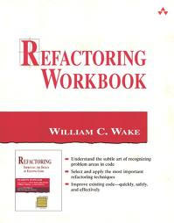
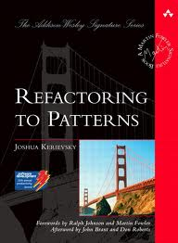
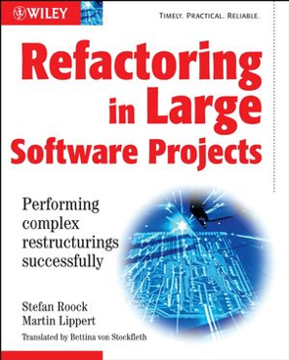
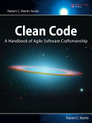
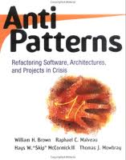
Other useful books
Get a mentor!

Slide 100

Conclusions
Dealing with legacy code
in a disciplined, effective way
Methods
Techniques
Sources for further learning
But don’t forget peculiarities of physics software!
Refactoring techniques and reengineering patterns contribute to improve computational performance and facilitate software validation (not only maintenance and evolution…)
Thorough testing is the key
…but also sound background in OO methods, healthy software engineering practices and physics insight

Slide 101
Hands-on exercises
“Video store” example
  M. Fowler, Refactoring, chapter 1
Simple problem domain
Practice a few refactoring techniques
Learn the method
  Write tests, change in small steps, test, change, test…
We’ll figure out together how many steps we do as an exercise and how many we’ll just review

Slide 102
Post-conclusion
Opportunities for real-life
refactoring/reengineering projects
after this school
with expert guidance, mentoring
Acquire “good habits”
Contribute to a widely used HEP tool
Contribute to concrete scientific advancement
Work will end up in journal publications
…beware that it would be real work

