Slide 1

On the way to operate CsK₂Sb photocathodes in Gun 1.0
Julius Kühn
High Brightness Electron Beams (HBEB)
Institute for Accelerator Physics
PCHB Meeting
Helmholtz-Zentrum Dresden-Rossendorf
4.12.2015

Slide 2
Outline
Status of the photocathode lab
Preparation of the first photocathodes
Photocathode preparation and characterization at EMIL
Photocathode roughness
PLUG Design
Status of the transfer systems and vacuum suitcase
Time schedule (Summary and Outlook)

Slide 3
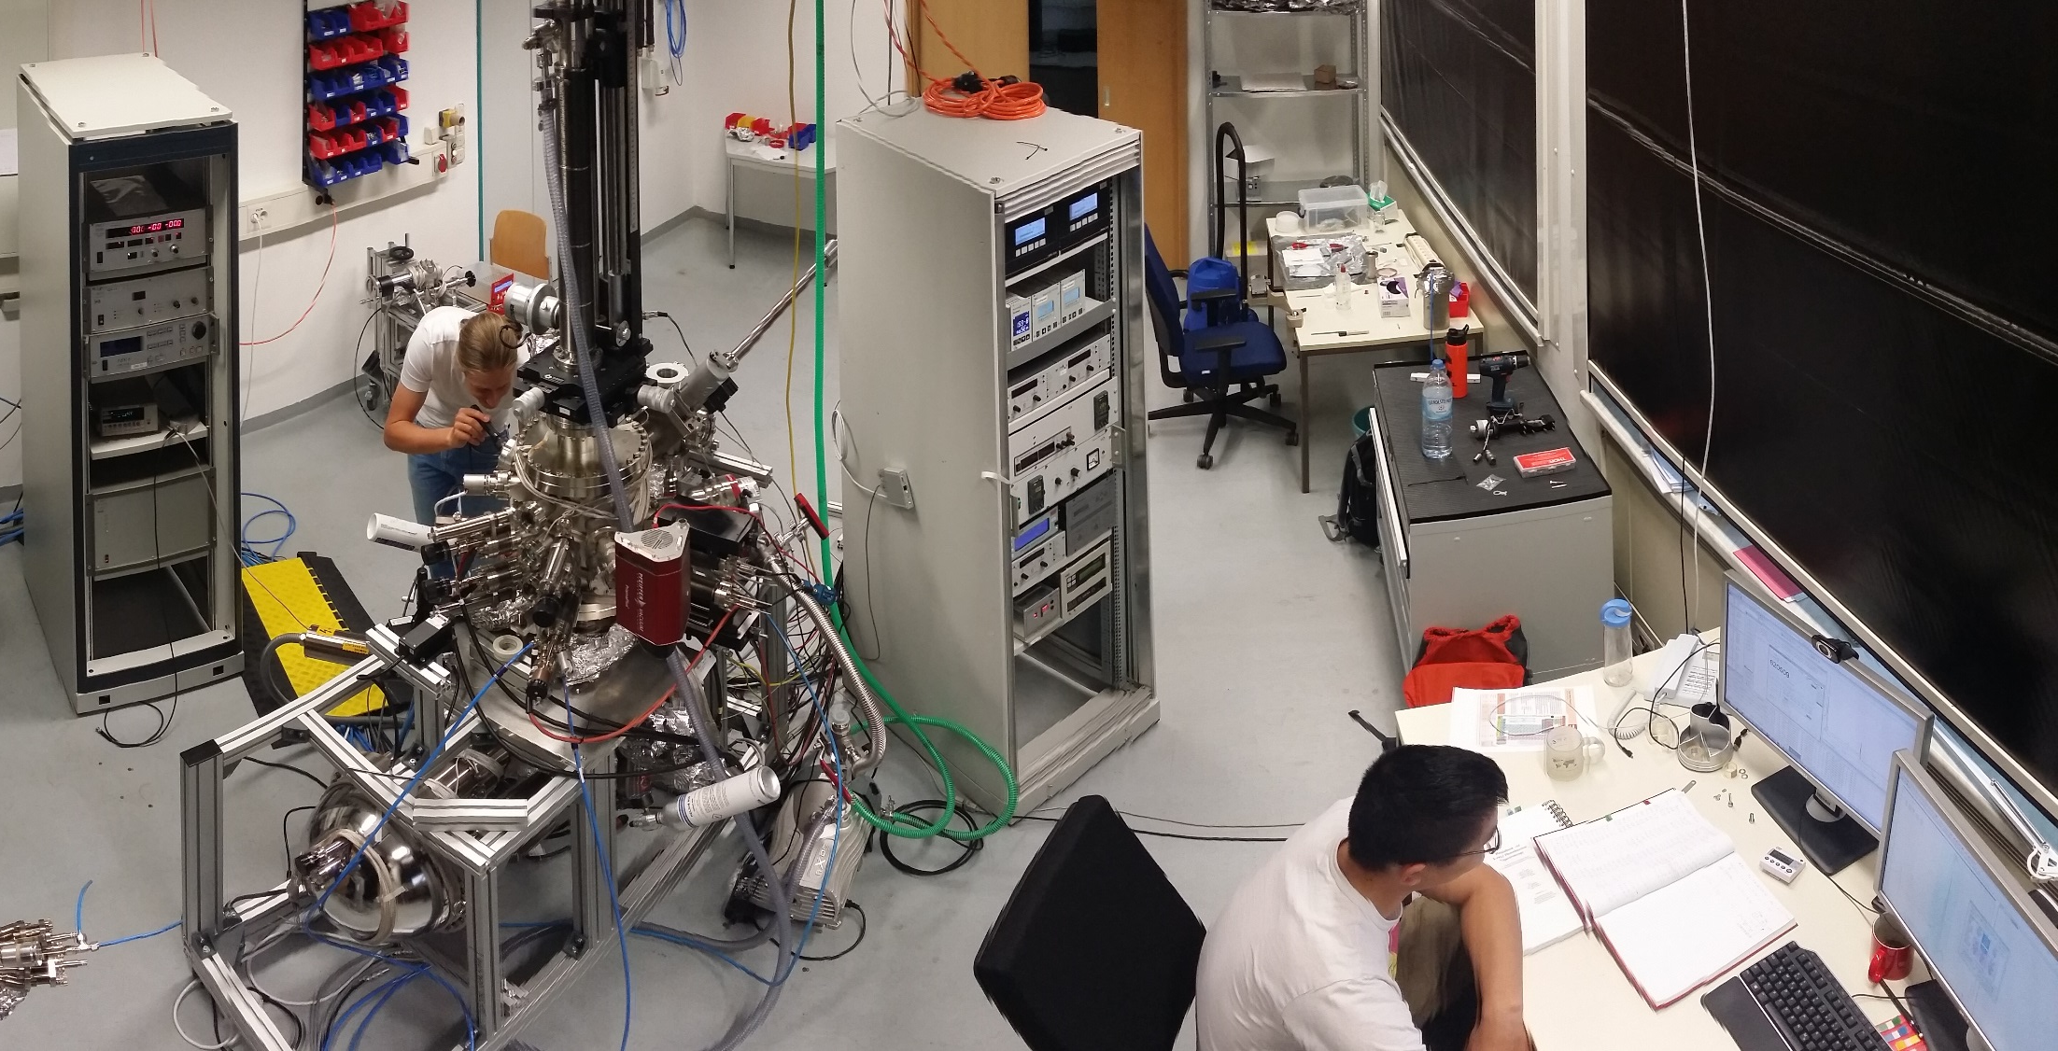
Photocathode Lab in operation

Slide 4
Our goals
High QE CsK₂Sb photocathodes
Allow high bunch charge and current 100 mA means 25 W laser power at 1% QE
Smooth substrates and films
Low emittance, low field emission
Reproducible growth procedure & robust lifetime
Necessary for operation

Slide 5

Status of the photocathode lab
Photocathode Preparation and Analysis System (PAS)
setup and commissioning after the return from
Preparation chamber
effusion cell for Sb, SAES Dispenser for K and Cs
sequential growth and co-deposition of K and Cs
spectral response measurement from 250 – 600 nm
  (H. Kirschner, Master Thesis, ready in MAR 16)
Surface Analysis chamber
XPS and LEIS (Specs),
Momentatron for emittance measurement (M. Schmeißer, Master Thesis, 2014)
Vacuum suitcase
Setup and commissioning is finished
disassembly and cleaning is done
reassembling and vacuum commissioning is on-going
Transfer system #1
transfer system #1 is complete, all parts were cleaned in the clean room
DEZ 15: setup of clean room tent in the photocathode lab
JAN 16: setup and commissioning of transfer system
Poster
M. Schmeißer
We have prepared a number of photocathodes with varying results

Slide 6
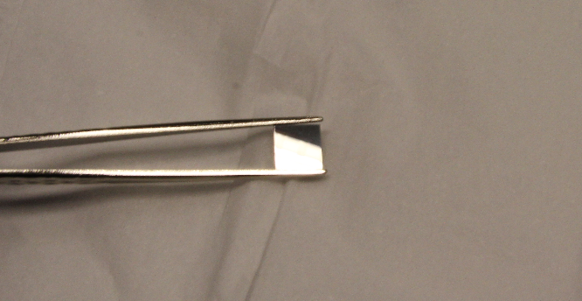
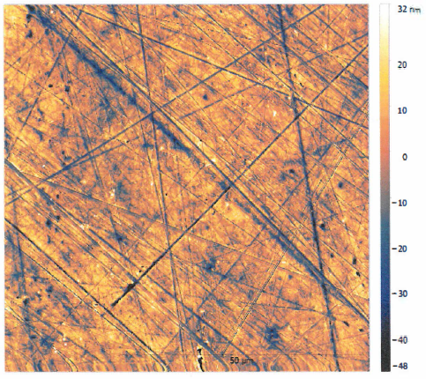
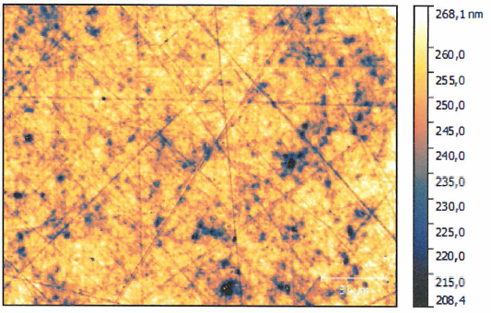
Substrate characterization
For cathode research:
polished Mo samples, 10x10 mm
roughness : ~10 nm rms, can be 1-3 nm rms
Sample 1; Pos 2
AFM; R_{q} = 10,66 nm rms White Light Interferometer 20x; R_{q} = 8,30 nm
work done by Grzegorz Gwalt, Frank Siewert
On-going: change in surface roughness due to heat treatment, sputter cleaning

Slide 7
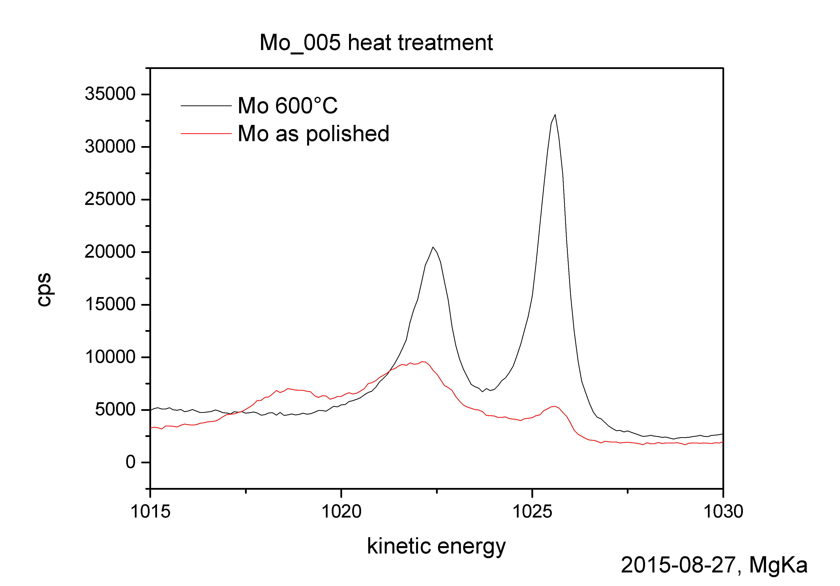
Substrate Characterization by XPS
For cathode research:
polished Mo samples, 10x10 mm
roughness : ~10 nm rms, can be 1-3 nm rms
Cleaning: heat to 450°C for 30 min, Ar⁺ sputter cleaning for 30 min
Or heat to 600°C for 60 min
Results in very low surface contamination, confirmed by XPS
Mo 3d

Slide 8
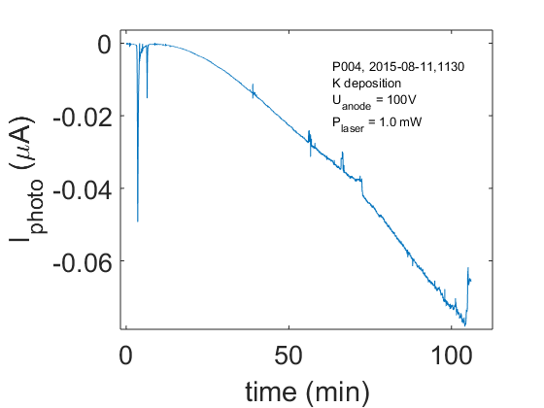
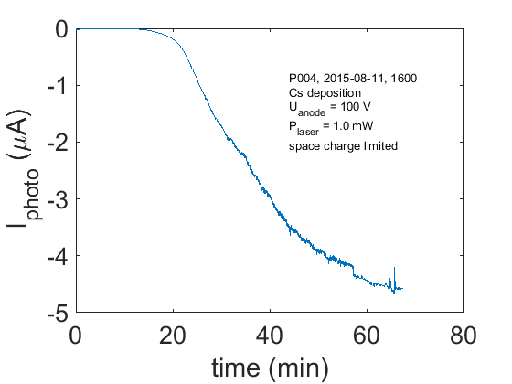
Cs-K-Sb PHOTOCATHODES
Results P004:
Polished Mo substrate
10 nm Sb film evaporated at 100°C
Surface composition KSb after K deposition
zero QE for green light, small QE for daylight
Surface composition Cs₂KSb after Cs deposition
QE ≈ 5%
3.8% and 3.6% QE after 1 and 2 days
Results P005 :
< 10nm Sb film evaporated at 100°C
K_{2.4}Sb surface composition after K deposition, strong oxygen impurities
K rich composition after Cs deposition, strong oxygen impurities
0.175% QE

Slide 9
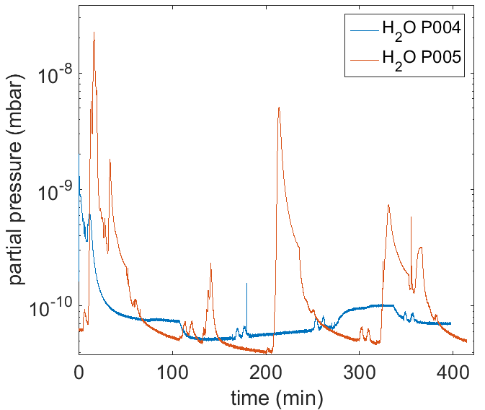
Cs-K-Sb PHOTOCATHODES: difference between good (P004) & bad (P005)
Same substrate, same cleaning, low contaminations confirmed by XPS
Same growth procedure, same type of sources
P005 Sb layer not as thick
Water and Oxygen partial pressure worse by 10²
Sb 3d / O 1s
Strong degasing of K source due to first use!
need to degas at higher temperatures
Control over vacuum conditions is essential. Mass spectrometer allows to ensure low residual gas pressures.

Slide 10
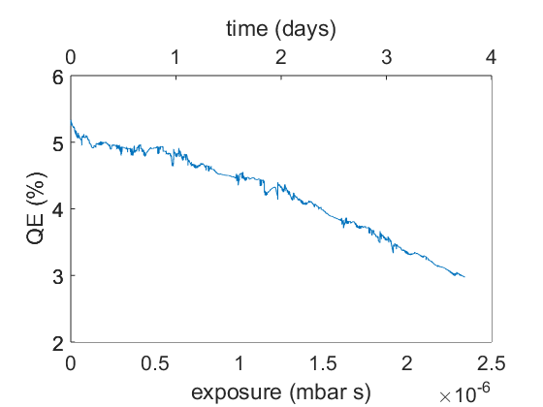
Cs-K-Sb PHOTOCATHODES
Results P006:
10 nm Sb film evaporated at 100°C
K_{1.7}Sb surface composition after K deposition
not all Sb reacted, some still in metallic state
0.05% QE for green light
Cs_{2.7}K_{1.7}Sb composition after Cs deposition
All Sb reacted, Alkali rich surface
5.2% QE
QE decays from 5 to 3%
in about 4 days
Combined exposure of H₂O and O₂ in 3*10⁻¹⁰ mbar vacuum

Slide 11
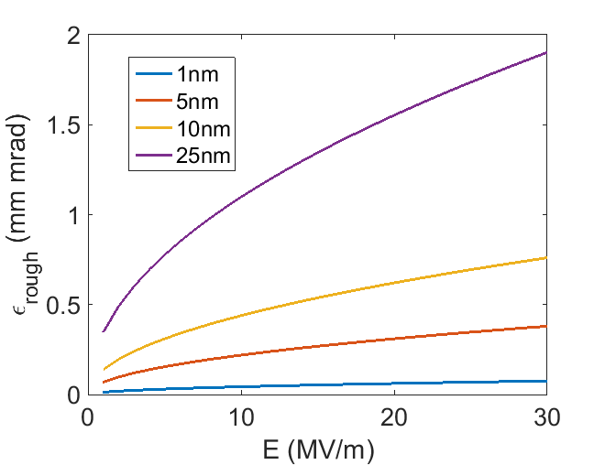
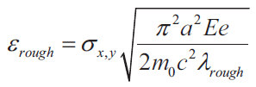
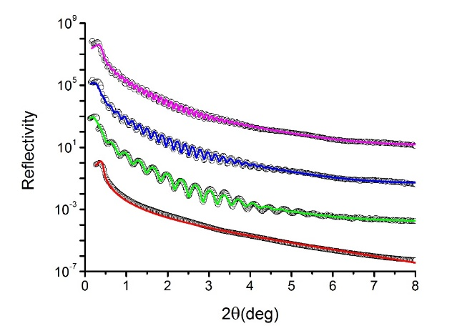



Photocathode roughness
Roughness introduces an increase in emittance:
λ=50nm
H. J. Qian et al. PRSTAB, 15, 040102, (2012).
We need to be better than 10 nm!
XRR yields roughness and thickness of the deposited layer
XRD allows to quantify crystallization processes
and correlate QE with certain phases
M. Gaowei et al.
XRR results for sputtered layers on Si
Layer | Roughness (nm) | Thickness (nm)
3rd layer | 0.69 | 51.2
2nd layer | 0.62 | 22.6
1st layer | 0.60 | 17.8
Substrate | 0.24

Slide 12

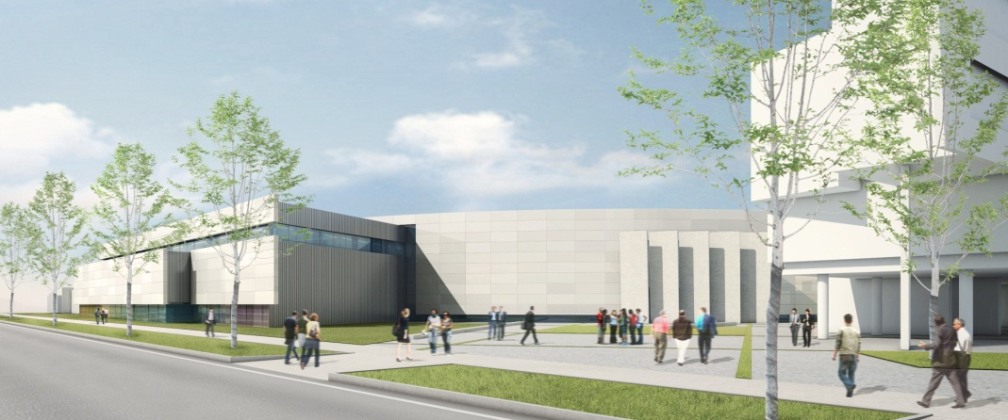
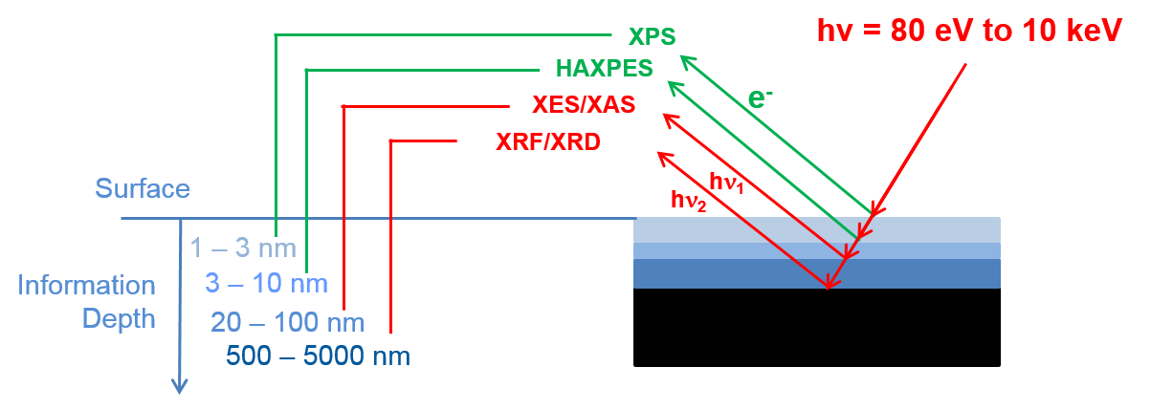
Photocathode preparation and Characterization at
Energy Materials In-situ Laboratory

Slide 13
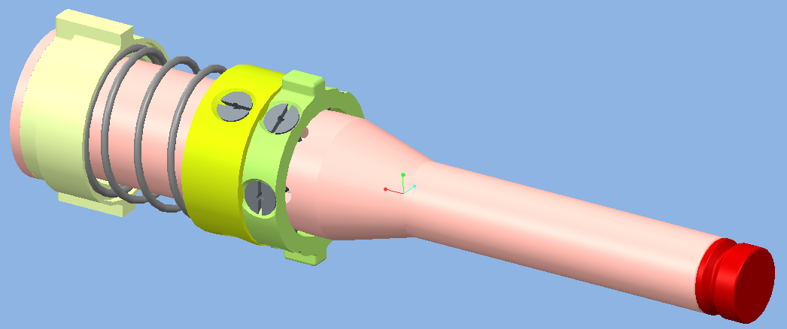
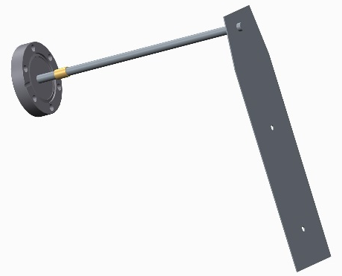
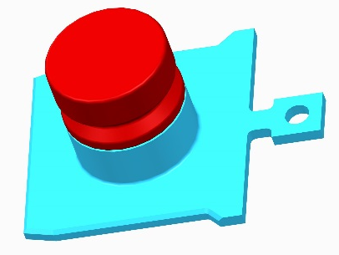
PLUG Design – Copper vs. molybdenum
PLUG-Holder w/ PLUG in GUN 1.0
For gun operation, consider:
Cooling of the thermal load from RF and drive laser:
Cu has low surface resisitivity and good thermal
conductivity and contact
Properties as a cathode substrate:
Mo is favorable for cathode QE
Cu migrates into Antimony layer, results in 50% lower QE
Thermocontact experiments:
cathode cooling with LN2 but GUN 1.0 80 K He – on going!
PLUG - Options :
Mo-Plug: sputter cleaned and heat treatment (Mo)
Mo-plug: sputter-cleaned only at the center where the cathode will be deposited → lower field emission from rim (MoO_{x})
Cu-plug with Mo film deposited as a diffusion layer at the plug center → Mo layer deposited by e-beam evaporation
Scenario Gun 1:
6 W RF losses
1.2 W laser power
Scenario Gun 2:
24 W laser power
Aperture and anode
for the PAS:
Omicron sample
holder with PLUG:

Slide 14
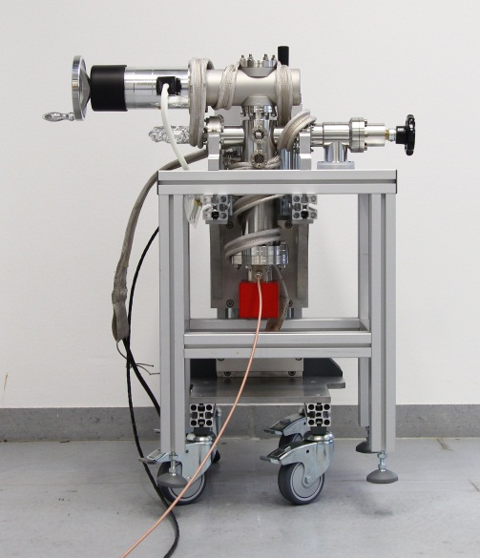
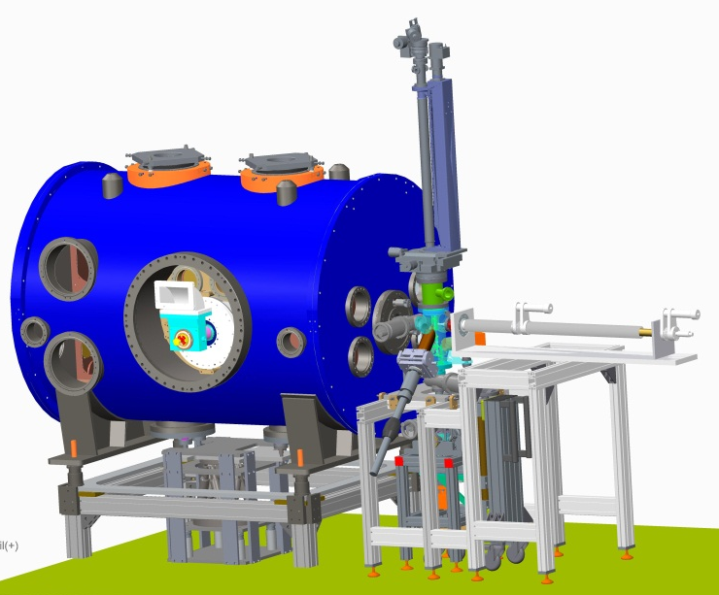
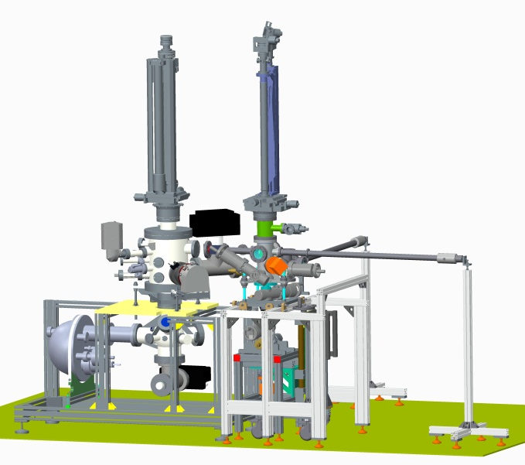
Vacuum Suitcase
Transfer systems and vacuum suitcase
Cathodes must be stored and handled in < 10⁻¹⁰ mbar UHV
Vacuum suitcase is available. Vacuum ~ 1*10⁻¹¹ mbar
Stability with NEG + getter pump is good for >3 months
Cleaning and assembly in ISO 5 clean room conditions done!
DEZ 15: Setup & commissioning of transfer system 1 @ PAS
Engineering: Petr Murcek (HZDR), Kerstin Martin, Andre Frahm
Transfer system #2 ordering process started!
PAS
Transfer System #1
Gun Module
Transfer System #2
14

Slide 15
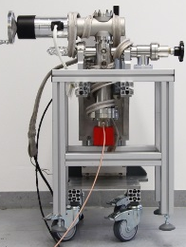
Vacuum Suitcase
Transfer systems and vacuum suitcase
Cathodes must be stored and handled in < 10⁻¹⁰ mbar UHV
Vacuum suitcase is available. Vacuum ~ 1*10⁻¹¹ mbar
Stability with NEG + getter pump is good for >3 months
Cleaning and assembly in ISO 5 clean room conditions done!
DEZ 15: Setup & commissioning of transfer system 1 @ PAS
Engineering: Petr Murcek (HZDR), Kerstin Martin, Andre Frahm
Transfer system #2 ordering process started!
PAS
Transfer System #1
Gun Module
Transfer System #2
15

Slide 16
Time schedule
NOV15
Design finished & start of ordering process of transfer system #2
DEZ15
setup and commissioning of transfer system #1 under clean room tent
JAN 15
Characterization of Cu photocathode for Gun 1.0
Characterization of sequential growth process of CsK₂Sb photocathodes
MAR 16
spectral response measurements on CsK₂Sb photocathodes
photocathode life time studies: Simulation of transfer to Gun 1.0
JUN 16
Setup and commissioning of transfer system #2 in the clean room
JUL 16
Operation of Gun 1.0

Slide 17
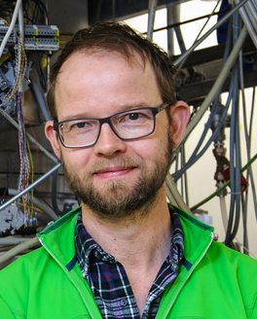
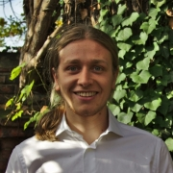
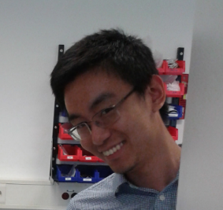
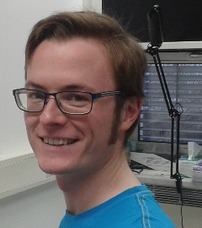


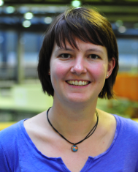

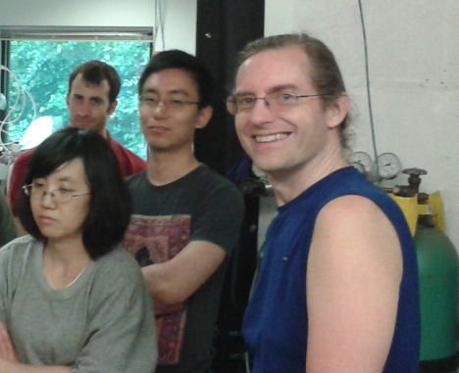

Acknowledgements
Martin Schmeißer, Zihao Ding, Hans Kirschner, Thorsten Kamps, Andreas Jankowiak
Mario Schenk, Alexander Büchel, Jörg Borninkhoff
Daniel Böhlick, Kerstin Martin, André Frahm
Grzegorz Gwalt, Frank Siewert
Susanne Schubert, Jared Wang, Howard Padmore
Petr Murcek
Zihao Ding, Mengjia Gaowei,
John Sinsheimer, John Smedley
Arthur Woll
Regan Wilks, Marcus Bär, Gerd Reichert, Simone Raoux

Slide 18
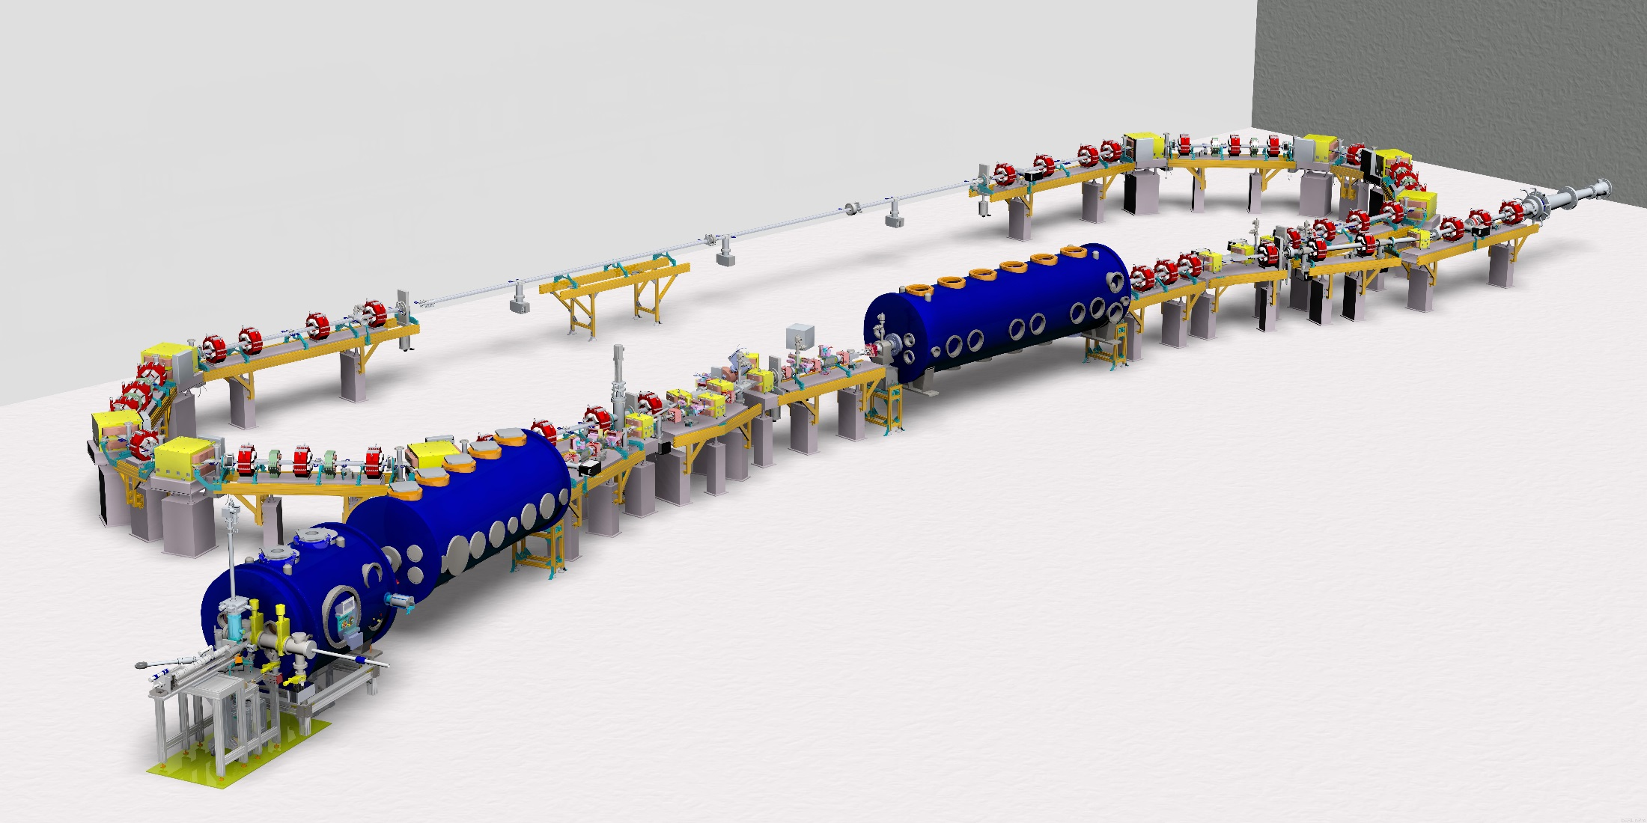
Thank you for your attention!

