Slide 1
Lab report : Johannes Gutenberg-Universität Mainz „Photocathodes for high brightness beams“ „HOPE“/“HOPE-II“
Kurt Aulenbacher, for JGU-team
K.A, Victor Bechthold, Monika Dehn, Simon Friederich,
Nahid Scahill

Slide 2
Mainz Labs
Photocathode research issues at JGU
Status: „PKAT“-LAB - Photocathode physics with time resolved techniques (PCHB-project)
New: - STEAM/MELBA-Set-up for high average bunch charge operation (Hope/Hope-II)

Slide 3
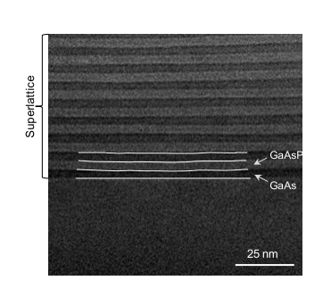
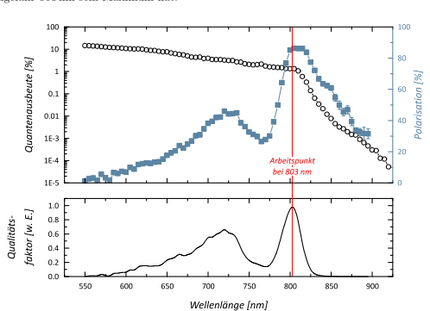
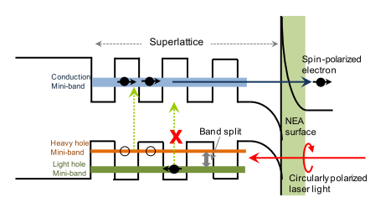
Photocathodes: Crystals….
Jin et al. , ULTRAMICROSCOPY
130 (2013) 44-48
L. Gerchikov, E. Riehn, JGU 2011
Φ~1,5eV
- Epitactically grown semiconductor (Superlattice) crystal
Grown in MBE-apparatus
Commercial supply (e.g. SVTA)
or research institution (e.g. SPTU)
Theoretically well understood
- Enables spin polarization
High(est?) brightness (NEA, thermalization)
Best Quantum efficiency
-but extremely sensitive...too sensitive?
Research issues:
-Extremely low work function:
→ field emission?
NEA&diffusion
→ diffusive longitudinal Halo?
Inelasitic escape process
→ transit time spread is limiting
response time

Slide 4
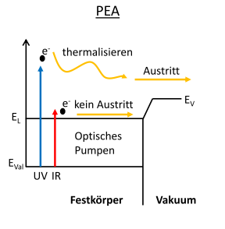
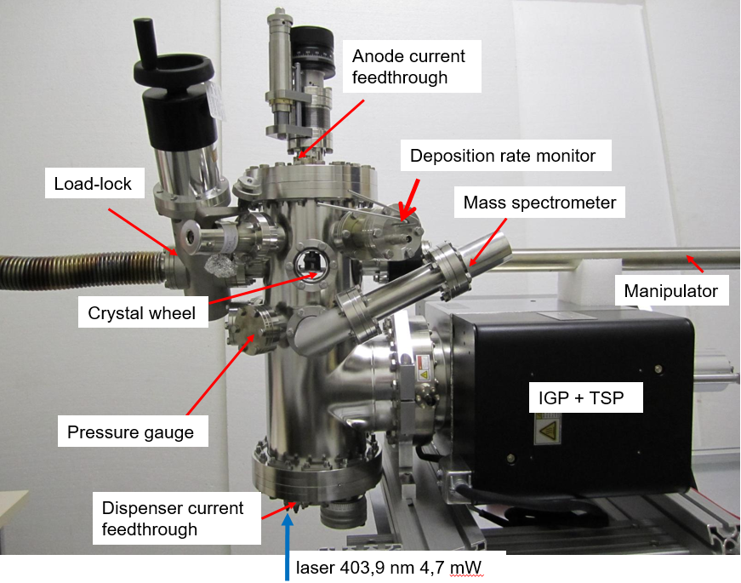
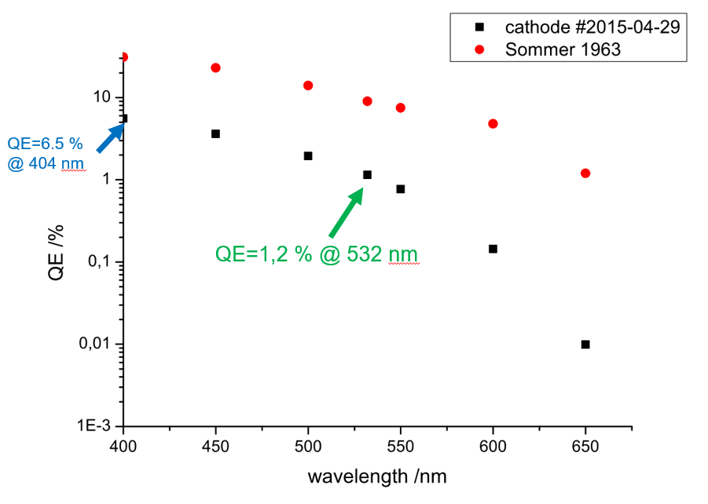
Photocathodes: …. and Films
KCsSb@JGU
V. Bechthold
V. Bechthold
Films on substrates
- KCsSb
-Cs2Te
Crystal composition
requires sophisticated
control→ see data
Lower QE
But More robust
Work function depends
on material 1-4 eV
Φ~2eV
Research issues:
- Energy spectrum?
Exponential longitudinal halo?
Field emission/field tolerance?

Slide 5
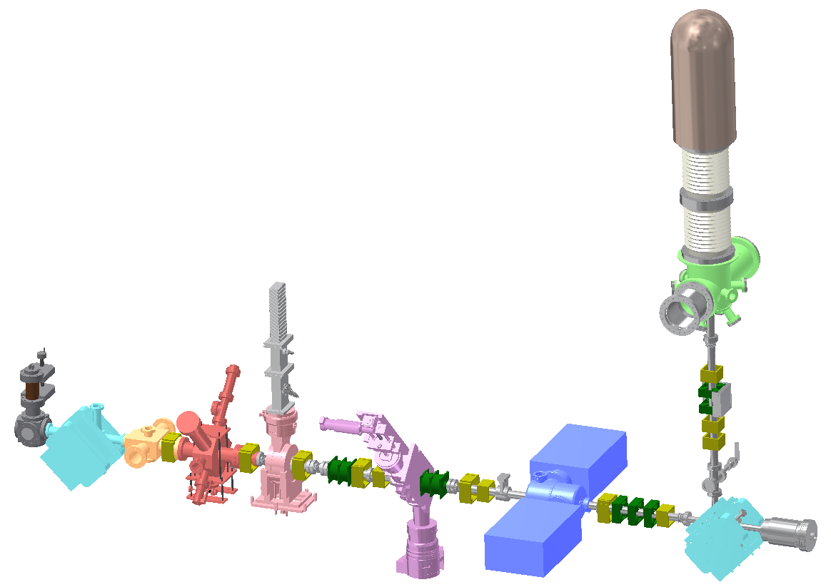
Experimental Setup at PKAT
Generation of short electron bunches:
Faraday Cup
Laser pulse (red), Electron bunch (green), synchronously with RF
Spin-detector
(Mott Polarimeter)
Electron Gun
Spin-rotator
Slit in
“Thomson-
Chamber”
Deflector Cavity
Channeltron
e⁻ Bunch
RF Deflection
700 mm
Laser

Slide 6
Experimental Setup at PKAT- 3 Functionalities
1.) Pulse response measurement
Generation of short electron bunches:
Laser pulse (red), Electron bunch (green), synchronously with RF
Electron Gun
Deflector Cavity
e⁻ Bunch
Short bunch, high
dynamic range diagnostics
Laser

Slide 7
Time Response Measurements Principles
RF Master
Solid State Amplifier
Phase Shifter
Freq. Divider
DBM
≈
:32
Active Phase Stabilization
76MHz-Filter/ Photodetector
Detector/
Channeltron
Slit
CCD Camera
YAG Screen
Deflector
Cavity
Cathode
Beamsplitter
Laser
Conversion of the longitudinal profile into transversal profile by TM-110 RF Deflector Cavity
Electron bunches must be emitted synchronously to RF Master
Longitudinal profile directly visible on the screen (intensity) or can be sampled by a Channeltron Detector
Time resolution essentailly limited by measurement speed, streak amplitude
(improved during PCHB project σ<1ps)

Slide 8
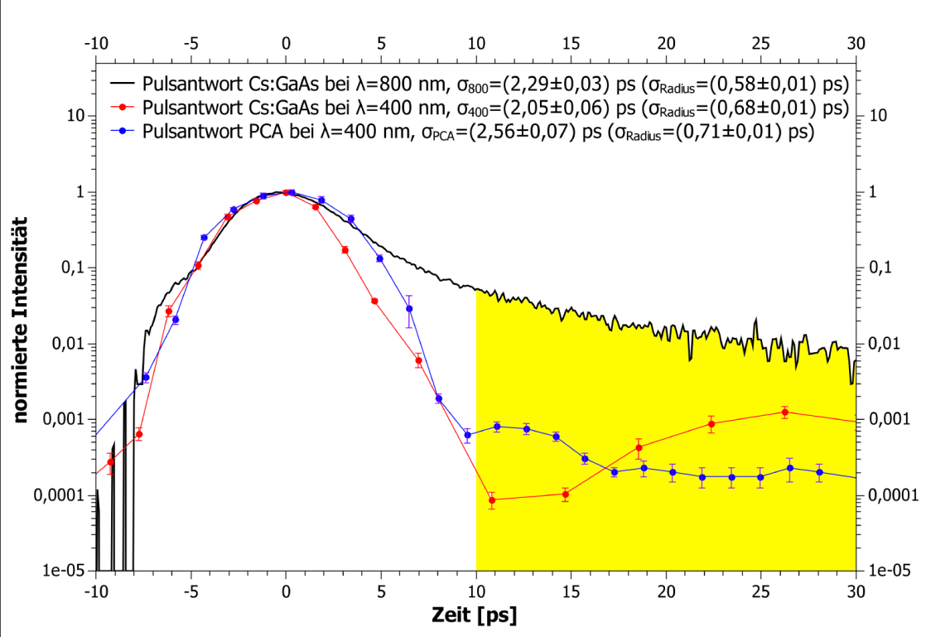
Time Response Measurements Comparison of Different Types of Photocathodes
Data obtained 2013
Long period of
Apparatus failures and
Repairs
Preliminary
M. Dehn, E. Kirsch
Surprise: GaAs at 400nm almost as good as PCA (higher absorption!)
10⁻⁴ long. Halo: Laser artefacts?
Present measurements (V. Bechthold, M. Dehn): Deconvolution + optimization Dynamic range, clarify systematic errors & artefacts
Source: Kirsch, E.: Johannes Gutenberg Universität Mainz, Diplomarbeit, 2014

Slide 9
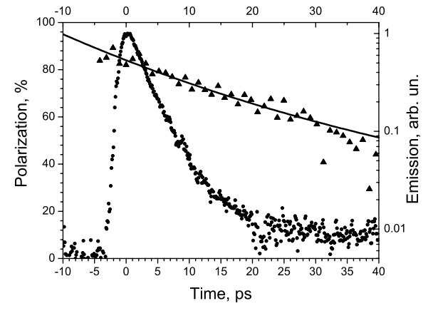
Polarization Response Measurements Comparison of Different Types of Superlattices
L. G. Gerchikov, K. Aulenbacher, Yu. A. Mamaev,
E. J. Riehn and Yu. P. Ya-
shin in Journal of Physics: Conference Series
298 (2011) 012013
Remark: Spin rotatator dismantled in 2011→ new arrangement based on Wien filter
(Nahid Scahill) is ready for installation.

Slide 10
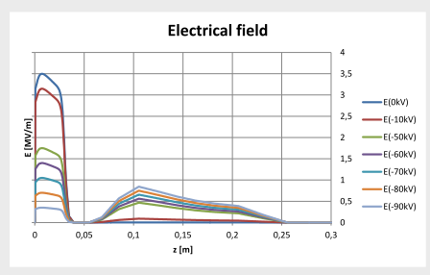
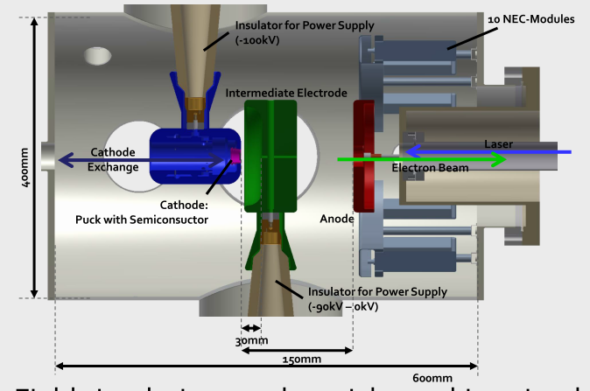
New SOURCE is available:
Inverted Gun with VARIABLE Extraction Field
Objectives (HOPE-II application)
- Measure Energy spectrum via transit time spread (0.4-3.5 MV/m)
- Measure field-tolerance of low workfunction cathodes to fields >3.5 MV/m
M. Dehn

Slide 11
The STEAM project (Hope/Hope-2):
- Assume that an accelerator has an acceptance given by ε_{lim} and electron
source is limited by (external) space charge
- In „flat field“ approximation on observes
Objective: Make use of thermalized ensembles T~300K
→ Small Thermalized Electron-source At Mainz (STEAM)
→ To achieve ‚relevant‘ bunch charges Potential and field should be large enough

Slide 12
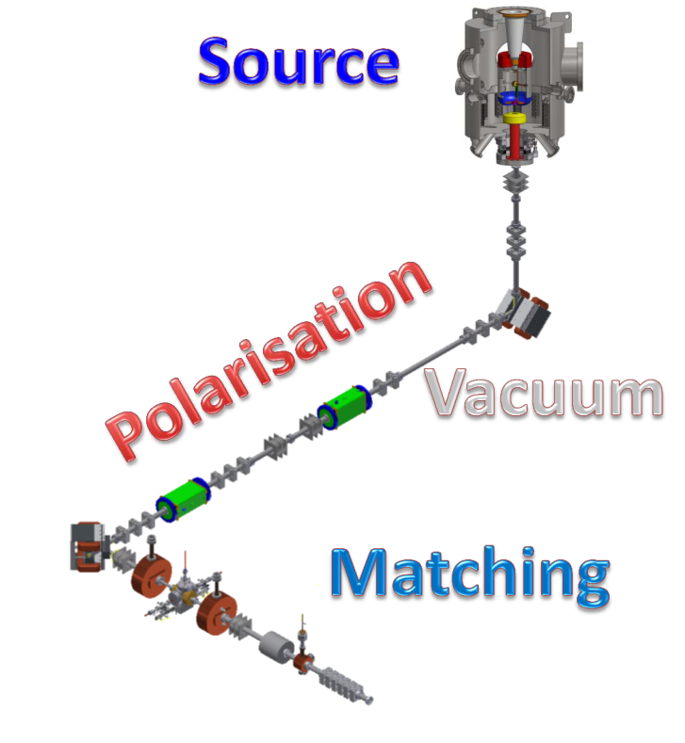
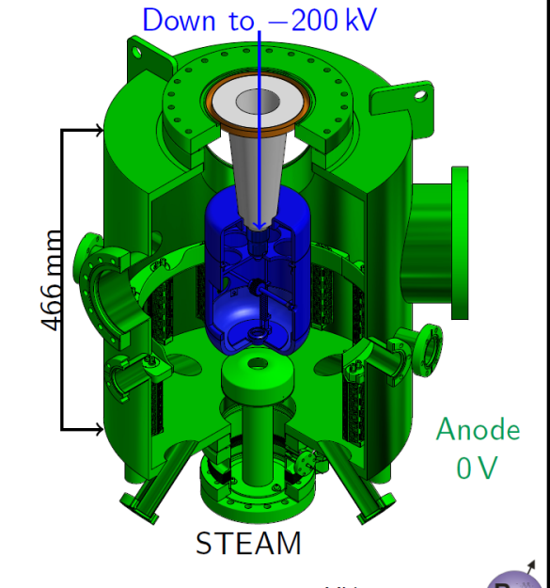
The STEAM project (Hope/Hope-2):
STEAM:= small thermalized Electron apparatus at MAINZ
high brightness at „reasonable“ Bunch charge?
Reasonable means FemtoScienceFacility or MESA
200keV source with Gradient ~5MV/m
Bunch characterization by MESA low energy beam apparatus (MELBA)

Slide 13
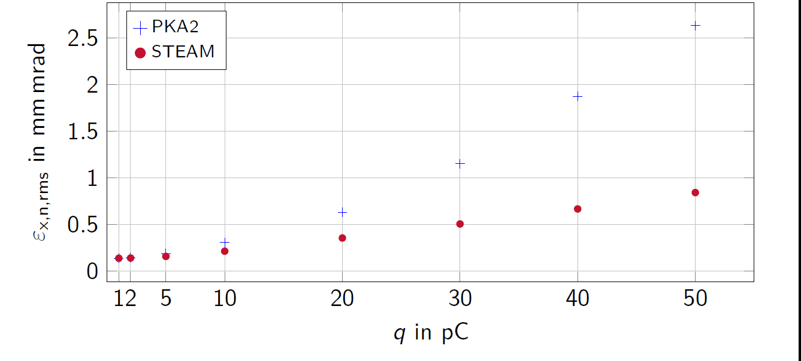
The STEAM project (Hope/Hope-2):
STEAM:= small thermalized Electron apparatus at MAINZ
Predicted vacuum space charge effects for ‚reasonable‘ MESA bunch length (200ps)
Compared to MESA standard source PKA2
Transverse normalized emittance (CST-simulations)
Preliminary)
MESA-1/2

Slide 14
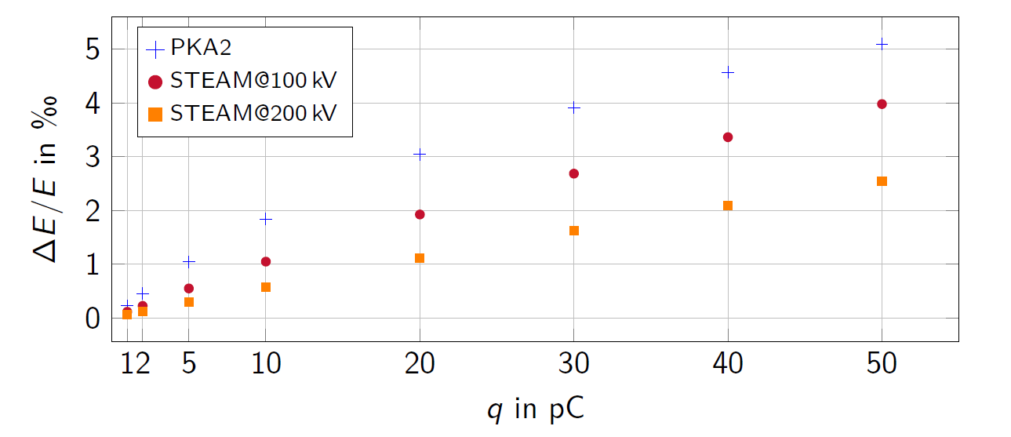
The STEAM project (Hope/Hope-2):
STEAM:= small thermalized Electron apparatus at MAINZ
Predicted vacuum space charge effects for ‚reasonable‘ MESA bunch length
Preliminary)

Slide 15
Conclusion
Two projects (PCHB, HOPE)
Photcathode apparatus are difficult to handle, slow progress
Nevertheless some good results (PCA available , GaAs response, )
New hardware developed which may clarify many issues concerning
field tolerance of low work function cathodes, low intensity halo, high brillance...

Slide 16
Time Response Measurements Limits of the Resolution
Limits by the Experimental Setup
Phase Stability (Jitter and Drift of the RF Cavity)
Jitter (fast) mainly due to the Laser Systems
Drifts (slow) by thermal effects
→ $τ_{jitter}$ depends on measurement time → $τ_{jitter}≈2\text{ps}$ (2002) → <0.5ps (1σ) (2015)
Finite transversal size of the electron bunch
“Deflection speed“ on the screen ~400µm/ps at minimum transversal size of ~200µm → $τ_{Beam}≈0.5\text{ps}$, can be improved by smaller emittance
Size of Laser spot on Cathode affects bunch size (Emittance) → $\sqrt{ε_{Beam}}∝d_{Beam}$ → $ε_{Beam}∝d_{Laser}$ → $d_{Beam}∝\sqrt{d_{Laser}}↔\sqrt{τ_{Laser}}$
→ $τ_{App.}=\sqrt{τ_{jitter}^{2}\left(t\right)+τ_{Beam}^{2}+τ_{Laser}^{2}+τ_{x}^{2}}$
“x”, Physical Limits (beam transport)
Longitudinal dispersion caused by distribution of kinetic energy at emission
→ $τ_{phys}=\frac{\sqrt{2{mE}_{NEA}}}{eF}$
➔ Varying electrical field gradient allows disentengling energy and time response!

Slide 17
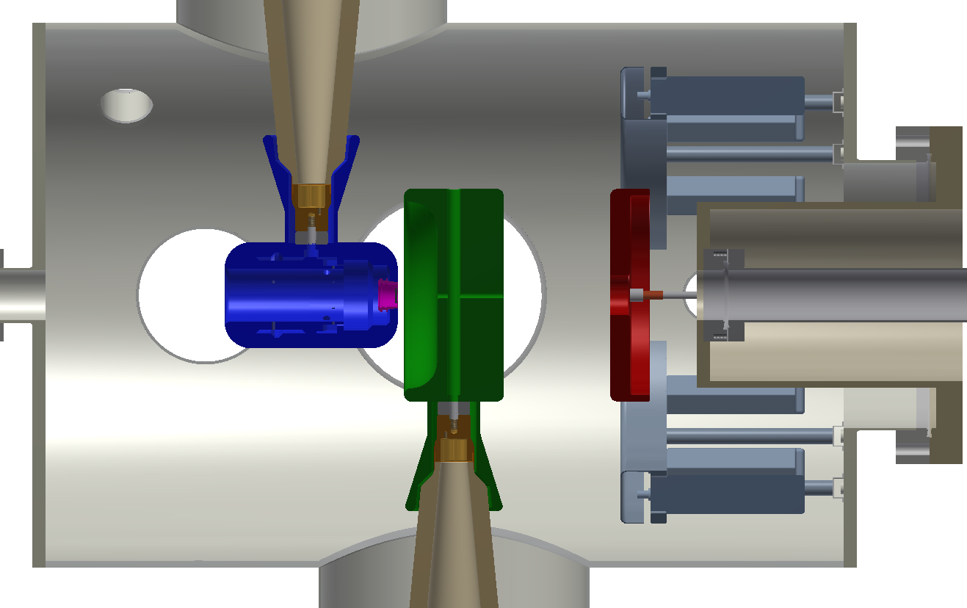
Inverted Electron Gun
Insulator for Power Supply (-100kV)
10 NEC-Modules
Intermediate Electrode
Cathode
Exchange
Laser
400mm
Electron Beam
Cathode: Puck with Semiconsuctor
Anode
Insulator for Power Supply (-90kV – 0kV)
30mm
150mm
600mm

Slide 18
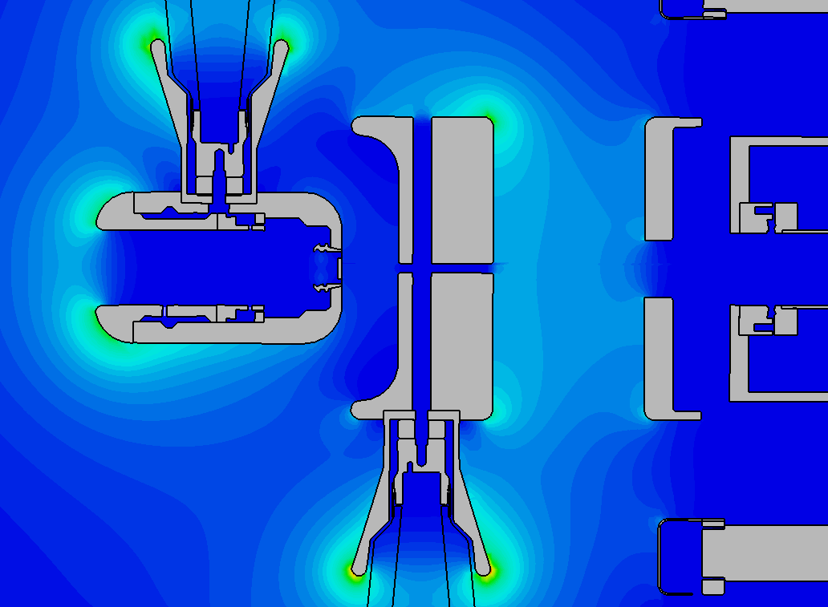
Inverted Electron Gun Electrical Field Simulations with CST© Studio Suite
Intermediate electrode:
U = 0kV
Intermediate electrode:
U = -90kV
3.5 MV/m
0.5 MV/m

Slide 19
Inverted Electron Gun Particle Tracking: Envelopes
The beam can come out of the source, with reasonable paramters
for all extraction fields

Slide 20
Inverted Electron Gun Particle Tracking: Emittances

Slide 21
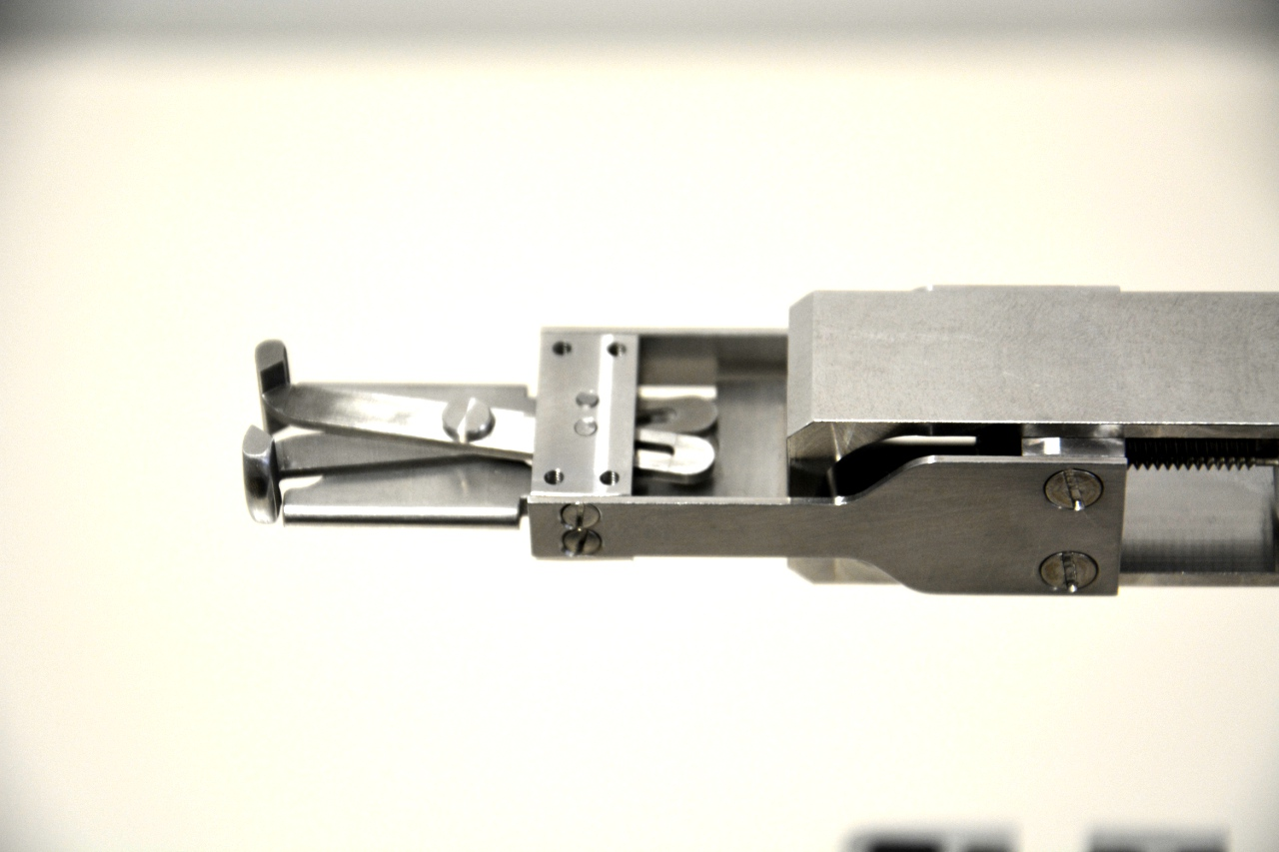
Inverted Electron Gun Mechanism for Cathode Exchange
A challenge for the workshop
A new cathode exchange mechanism was need
Moving the manipulator / closes the ‚scissors‘
30mm

Slide 22
Status and Outlook
Status
Vacuum chamber
The chamber is ordered and the company is finishing the blueprint.
Vacuum pumps
NEC-Modules and power-supply are already delivered.
IGP and power-supply is ordered.
Other mechanical components
The blueprints have to be finalized for the mechanical workshop in house.
Outlook and timescale
September 2015
All mechanical and electrical components should be delivered and/or manufactured.
Start of mounting the components.
October 2015 – January 2016
Mounting inside the laboratory.
February 2016 – August 2016
Commissioning of the new electron source.
Time resolved measurements.

Slide 23
Thank you for attention.

Slide 24
Backup

Slide 25
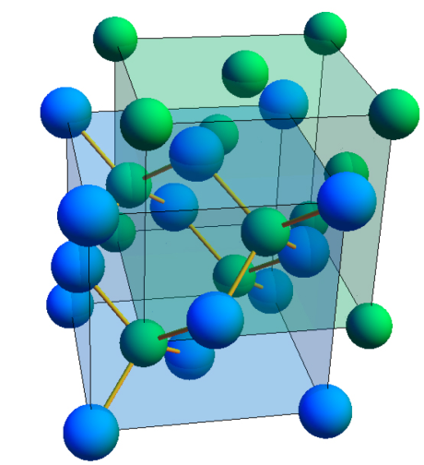
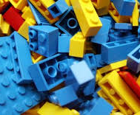
Fundamentals Semiconducting photocathodes
E
e⁻
thermalization
Cs:GaAs
Homogenous crystalline structure
Negative electron affinity (NEA)
K₂CsSb
= PCA (Potassium Cesium Antimonide)
Multicrystalline structure
Positive electron affinity (PEA)
e⁻
transport
tunneling
E_{L}
χ
optical pumping
E_{V}
E_{Val}
valence band
solid
vacuum
x
E
e⁻
thermalization
emission
e⁻
no emission
E_{V}
E_{L}
χ
optical pumping
E_{Val}
valence band
solid
vacuum
x

Slide 26
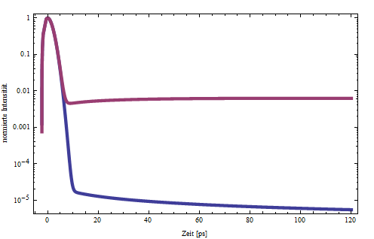
Fundamentals Photoemission from Semiconductors
Absorption
Condition: $E_{γ}>E_{gap}$
Absorption coefficient: $α\left(E_{γ}\right)=\frac{πe^{2}ℏ}{m^{2}cn_{r}ε}\frac{1}{E_{γ}}\frac{2}{3}{\left|p_{CV}\right|}^{2}ρ_{CV}\left(E_{γ}\right)$
Diffusion model for GaAs-photocathodes
Electron motion only by diffusion, not by scattering: $D\frac{d^{2}}{{dx}^{2}}c\left(x,t\right)−\frac{d}{dt}c\left(x,t\right)=0$ And the solution $c\left(x,t\right)=\sum_{k=1}^{∞}{A_{k}\sin\left(\frac{kπx}{d}\right)e^{−{\left(\frac{kπ}{t}\right)}^{2}Dt}}$
Emitted current: $j\left(t\right)∝\frac{d}{dx}c\left(0,t\right)∝\sum_{k=1}^{∞}{A_{k}^{′}e^{−{\left(\frac{kπ}{t}\right)}^{2}Dt}}$ with $A_{k}^{′}=kA_{k}$ and $A_{k}∝\frac{kπ\left[1−{\left(−1\right)}^{k}e^{−αd}\right]}{{\left(αd\right)}^{2}+{\left(kπ\right)}^{2}}$
λ=800 nm
Normalized Intensity
Normierte Intensität
λ=400 nm
Zeit [ps]
Time [ps]

Slide 27
Time Response Measurements Principles
RF Master
Solid State Amplifier
Phase Shifter
Freq. Divider
DBM
≈
:32
Active Phase Stabilization
76MHz-Filter/ Photodetector
Detector/
Channeltron
Slit
CCD Camera
YAG Screen
Deflector
Cavity
Cathode
Beamsplitter
Laser
Conversion of the longitudinal profile into transversal profile by TM-110 RF Deflector Cavity
Electron bunches must be emitted synchronously to RF Master
Longitudinal profile directly visible on the screen (intensity) or can be sampled by a Channeltron Detector

Slide 28
Time Response Measurements Experimental Setup at PKAT
Generation of short electron bunches:
Laser pulse (red), Electron bunch (green), synchronously with RF
Electron Gun
YAG Screen/
Slit
Deflector Cavity
Channeltron
e⁻ Bunch
RF Deflection
700 mm
Laser

Slide 29
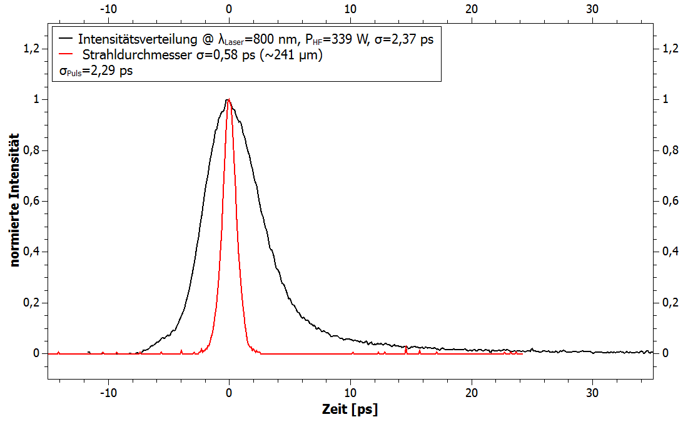
Time Response Measurements Measurements with Bulk-GaAs
$σ=$241 µm
$σ=$241 µm
Beam profile YAG-screen
CW-beam (no single bunch)
Intensity distribution complies to the convolution of the transverse beam profile and the time response
Time structure
Transverse beam profile
Longitudinal Beam Profile, σ = 2.37ps
Transverse Beam Profile, σ = 0.58ps
Bunch length, σ = 2.29ps
Without RF
With RF
Normalized Intensity
$σ_{trans}$ = 2.37 ps
$σ_{bunch}$ = 2.29 ps
Source: Kirsch, E.: Johannes Gutenberg Universität Mainz, Diplomarbeit, 2014
Time [ps]

Slide 30
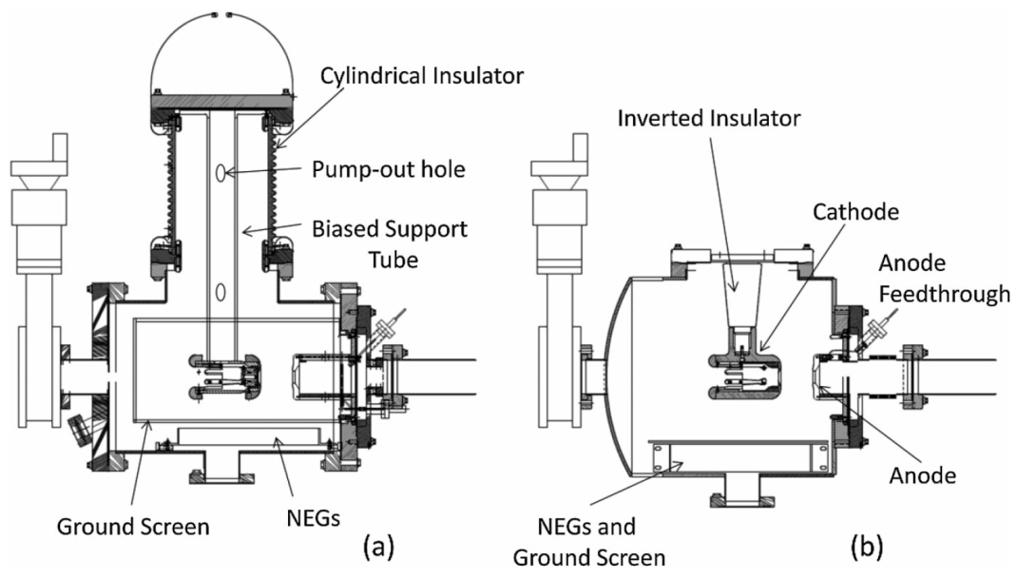
100keV Electron Gun Variable Extraction Field Gradient
Purposes of the new electron gun
Variable field gradient at the surface of the cathode
Examination of longitudinal divergence, i.e. comparison of different bunch lengths at same charge
Compact design based on the inverted gun of CEBAF at JLAB
HV supply with cone shaped Insulator reaching into the vacuum chamber
Lesser field emission compared to conventionally used larger ceramics
Well-proven design of the insulator (X-Ray tubes)

