Slide 1
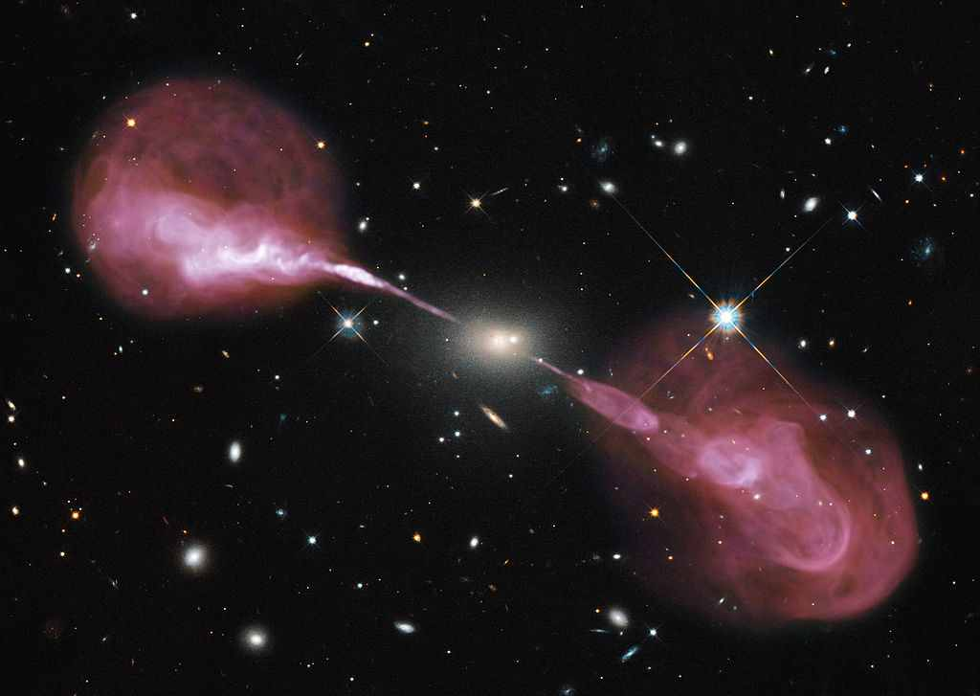




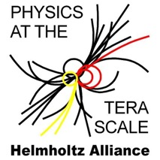


AstroPARTICLE Physics
Thomas Lohse
Humboldt-Universität zu Berlin
CTEQ & Mcnet QCD School on QCD and EW Phenomenology
09 July 2016

Slide 2
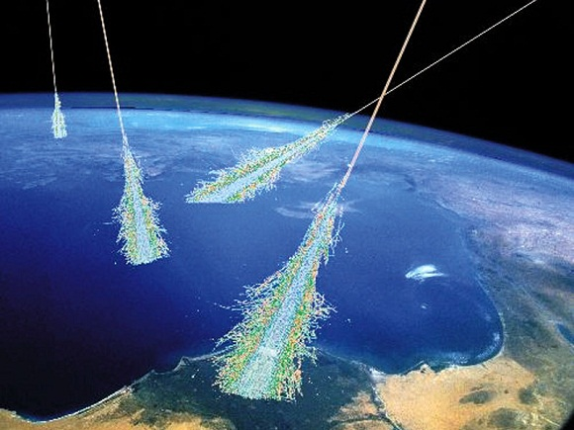
Introduction: Cosmic Rays

Slide 3
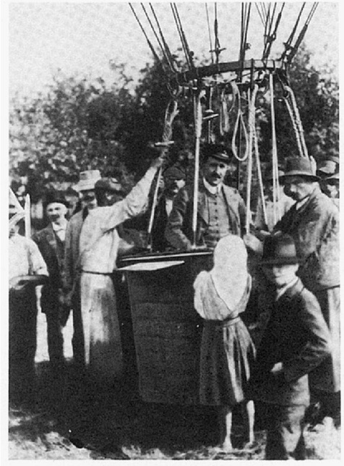
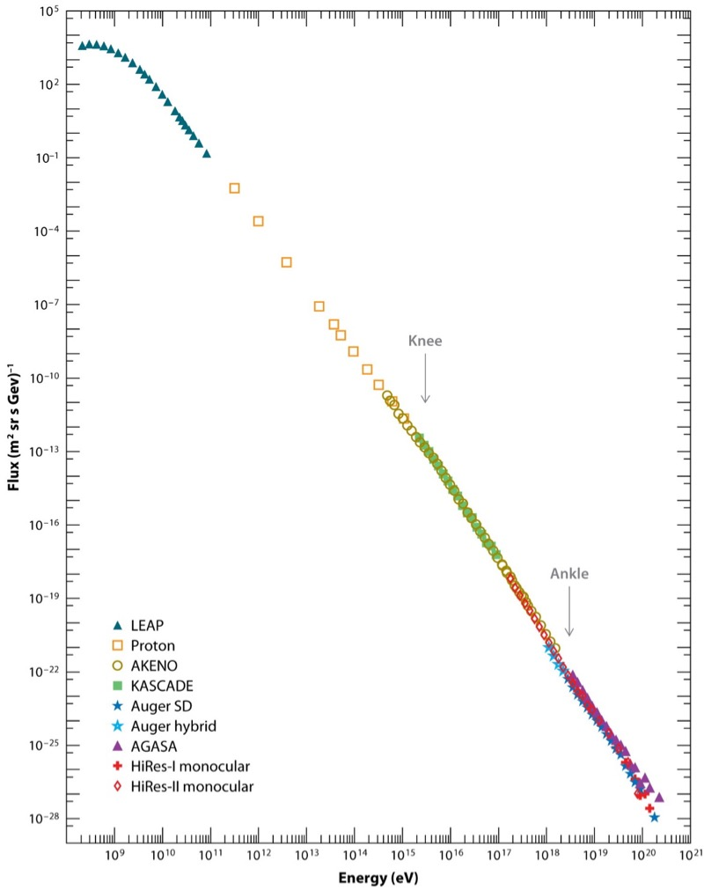

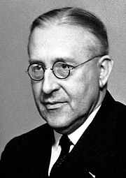
Cosmic Rays
∝E^{−2.7}, mostly protons
Flux (m² sr s GeV)⁻¹
First order Fermi acceleration:
power laws ↔ plasma shocks
solar modulation
Knee
∝E^{−3.1}
→ Fe
Discovery Balloon Flight Victor Hess, 1912
Ankle
Direct Measurements
Cut-Off
EAS Detectors
10⁸
Energy (eV)
10²¹

Slide 4
E^{2.5} × Flux
Protons
Iron
E_{max} ~ Z
Extragalactic
CR
Galactic CR
LHC beams
LHC collisions
Prog.Part.Nucl.Phys.63:293-338,2009

Slide 5
The relevance of power laws
thermal radiation
Sun, 5778 K
White dwarf, 20000 K
Neutron star
5×10⁶ K
Cosmic rays
Supernova, 5×10¹¹ K
Quark Gluon Plasma 2.3×10¹² K
Cosmic rays ↔ the non-thermal Universe

Slide 6
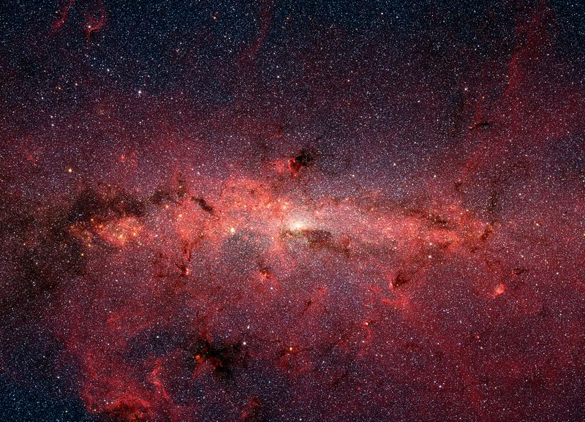
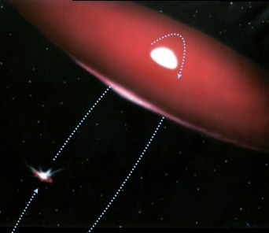
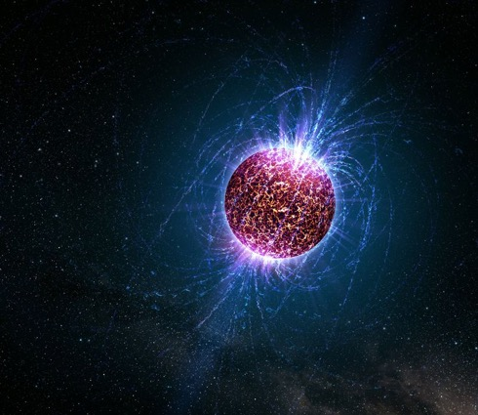
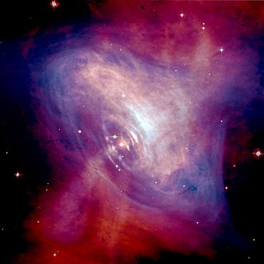
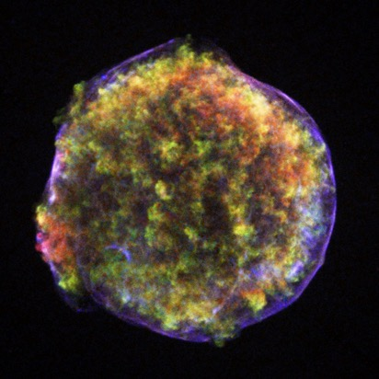
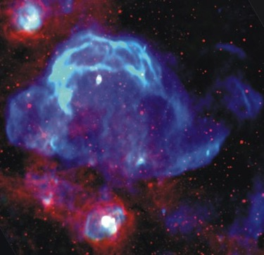
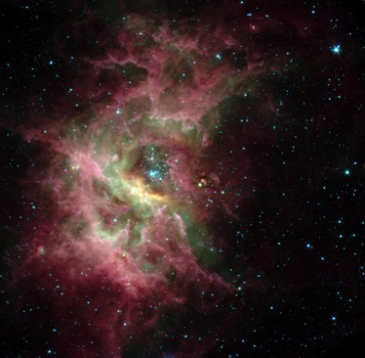
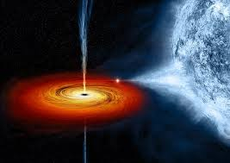
Origin of Galactic Cosmic Radiation
Pulsar Wind Nebulae
Binary Pulsars
Supernova Shells
Neutron Stars
Galactic Centre
Spitzer, NASA
Molecular Clouds
Stellar Winds
Black Holes

Slide 7
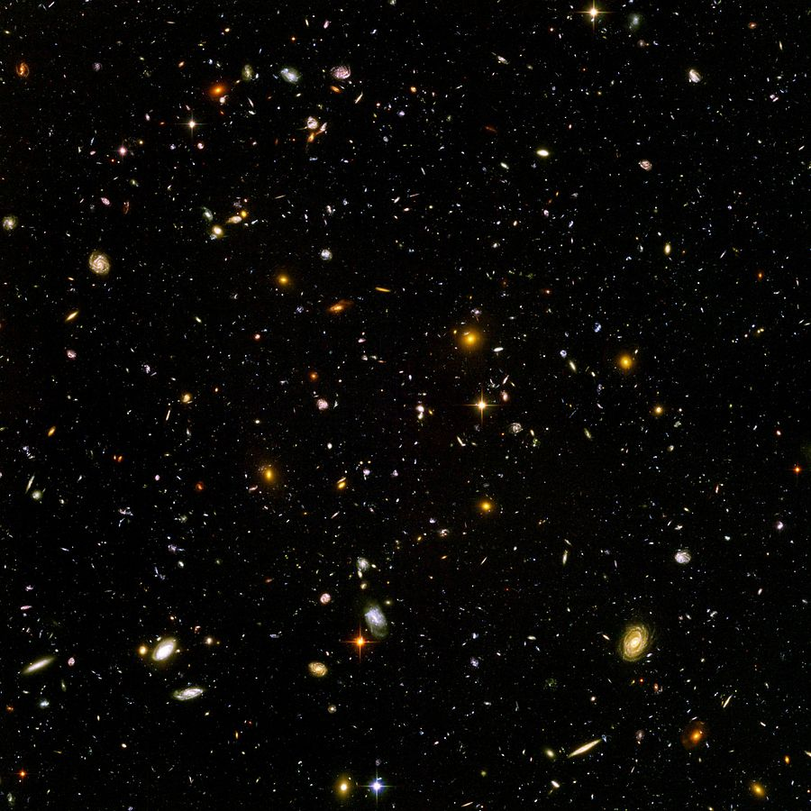
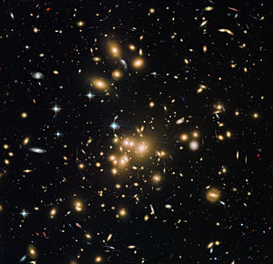
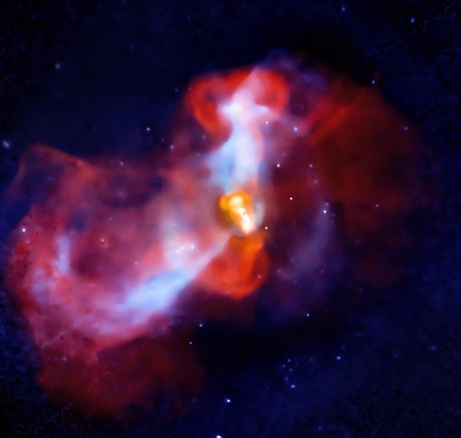
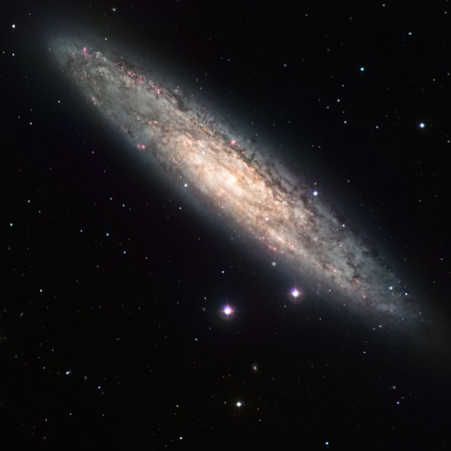
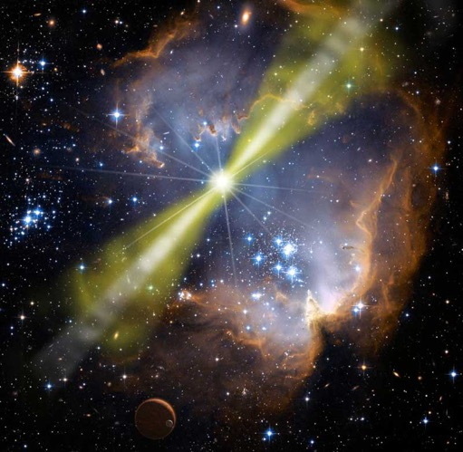
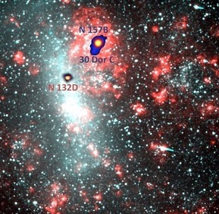
Origin of Extragalactic Cosmic Radiation
Active Galactic Nuclei
Starburst Galaxies
Galaxy Clusters
Large Magellanic Cloud
Gamma Ray Bursts
NASA

Slide 8
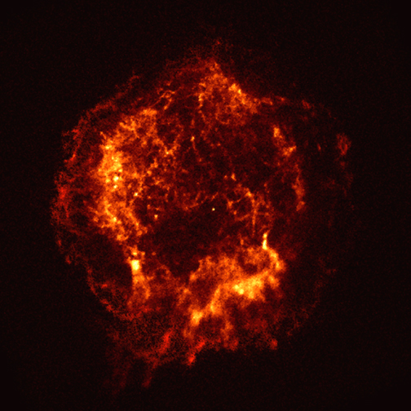
Production in Cosmic Accelerators
p, e±
𝜈
𝜋±
p
p
𝛾
𝜋⁰
e±
𝛾
Inverse Compton
(+Bremsstr.)
protons/nuclei
electrons/positrons
radiation fields and matter

Slide 9

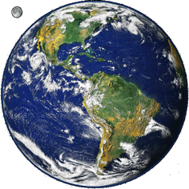
neutral messengers (𝛾, 𝜈) → not deflected in B fields → astronomy possible
𝛾
𝜈
charged cosmic rays at Galactic energies → isotropized in B fields

Slide 10
Detection Techniques for High Energy Cosmic Messengers

Slide 11
Primary (Hadron,Gamma)
Satellite
Air Shower
Fluorescence
Fluorescence Detector
Č
Scintillator or Water Č
Hadron-Detector
𝜇
Č-Telescope
R&D
Radio-Detection
Acoustic-Detection
Atmospheric 𝜈 (4𝜋)
𝜇
𝜇, e, 𝜏
𝜇, e
InstrumentedWater / Ice
Primary 𝜈 (4𝜋)

Slide 12
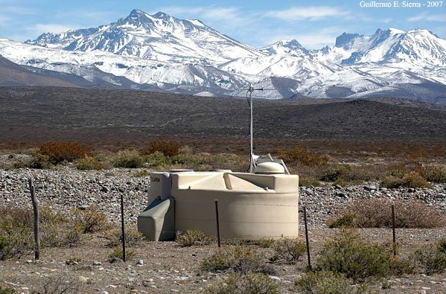
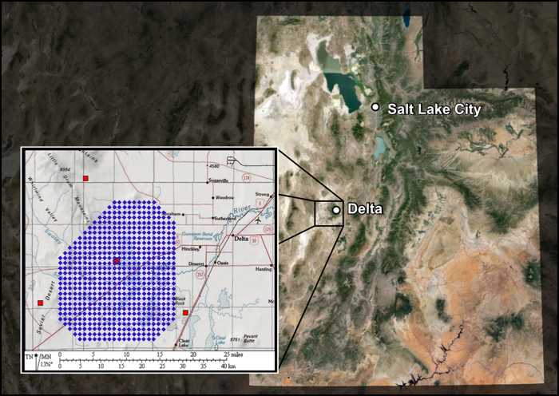
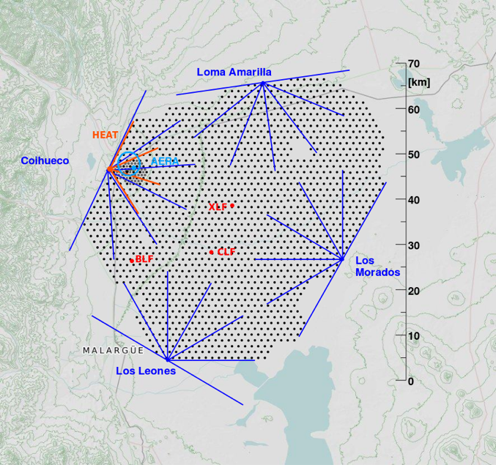
http://www.telescopearray.org
USA
Argentina
Cosmic Ray Detector Arrays
By Darko.veberic - gimp, inkscape, root, CC BY-SA 3.0, https://commons.wikimedia.org/w/index.php?curid=25179096

Slide 13
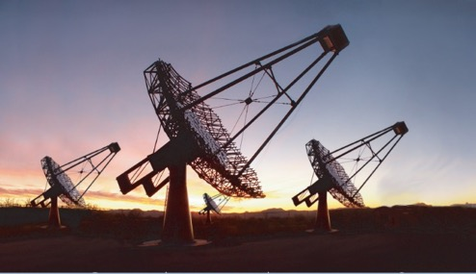
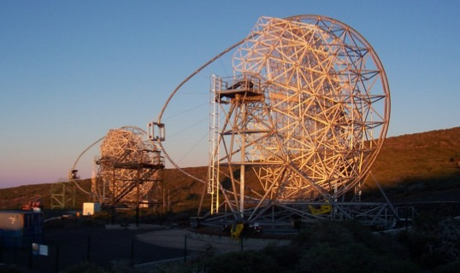
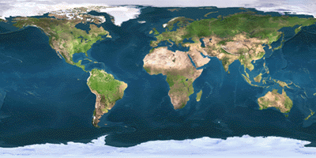
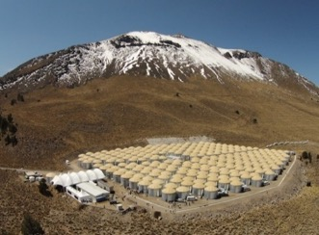
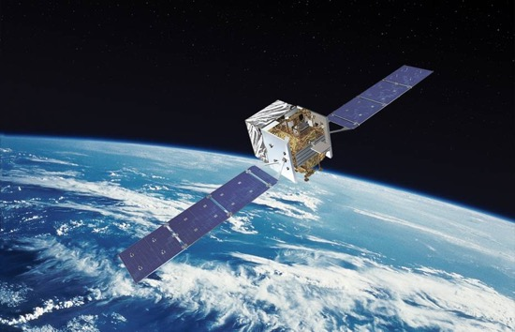
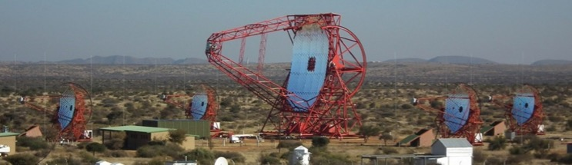
Gamma Ray Telescopes
Veritas
MAGIC
HAWC
Fermi-LAT
H.E.S.S.

Slide 14
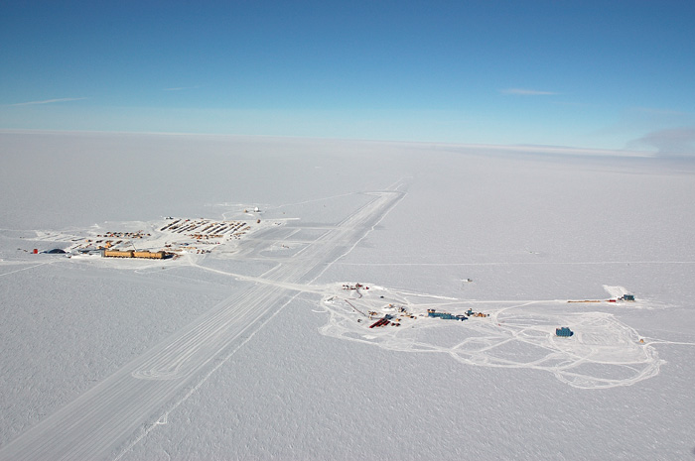
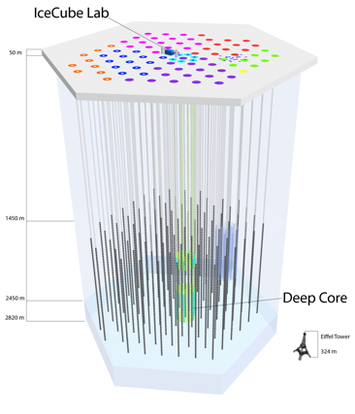
IceCube: Neutrino Telescope in Ice

Slide 15
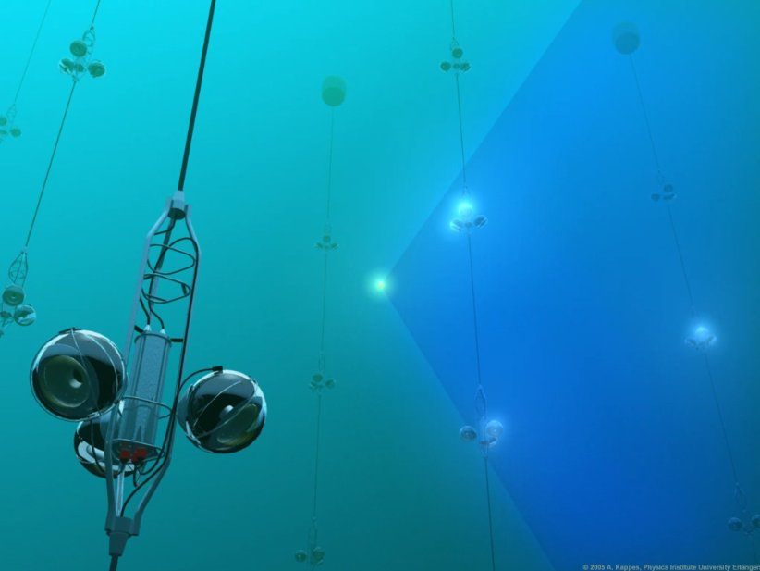
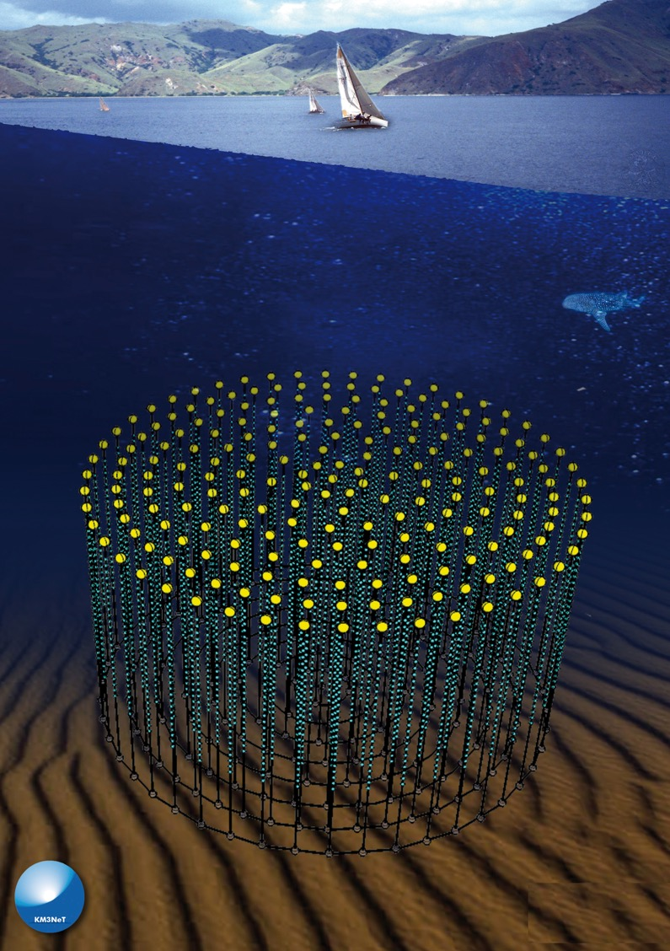
Neutrino Telescopes in Water
ANTARES
KM3NeT
ASPERA/Nikhef/M.Kraan

Slide 16
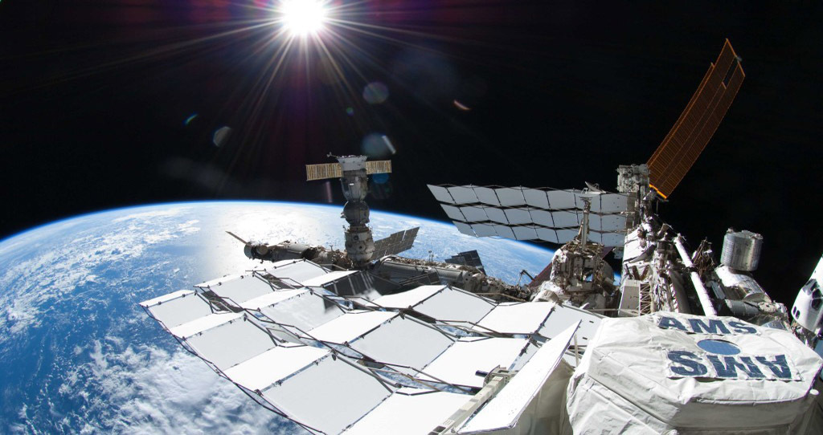
Anti-matter from the Universe
Alpha Magnetic Spectrometer on ISS

Slide 17
Outline
Cosmic Rays and Air Showers
Dark Matter: WIMPs and ALPs
Quantum Gravity

Slide 18
Outline
Cosmic Rays and Air Showers
Dark Matter: WIMPs and ALPs
Quantum Gravity

Slide 19
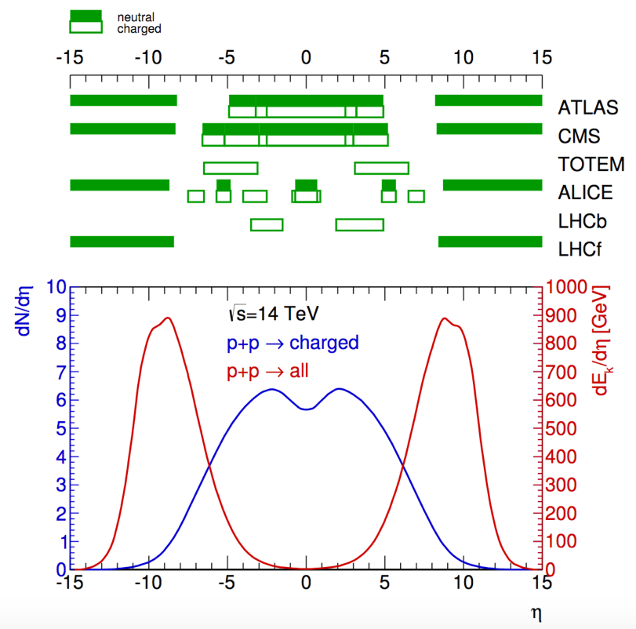
Air Shower Simulation
and tuning of interaction models
most energy goes very forward
LHC data extremely important to assess ultra high energy regime
R. Ulrich

Slide 20
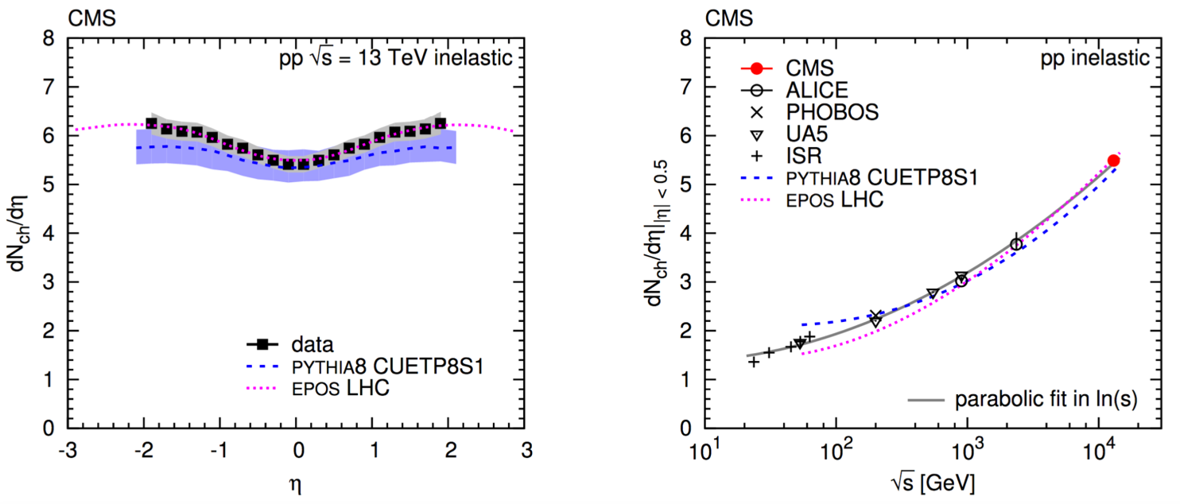
CMS (magnet off) multiplicity spectra at
arXiv:1507.05915
Air shower interaction models
EPOS-LHC QGSJet Sibyll
tend to perform better than particle physics generators for multi-particle spectra

Slide 21
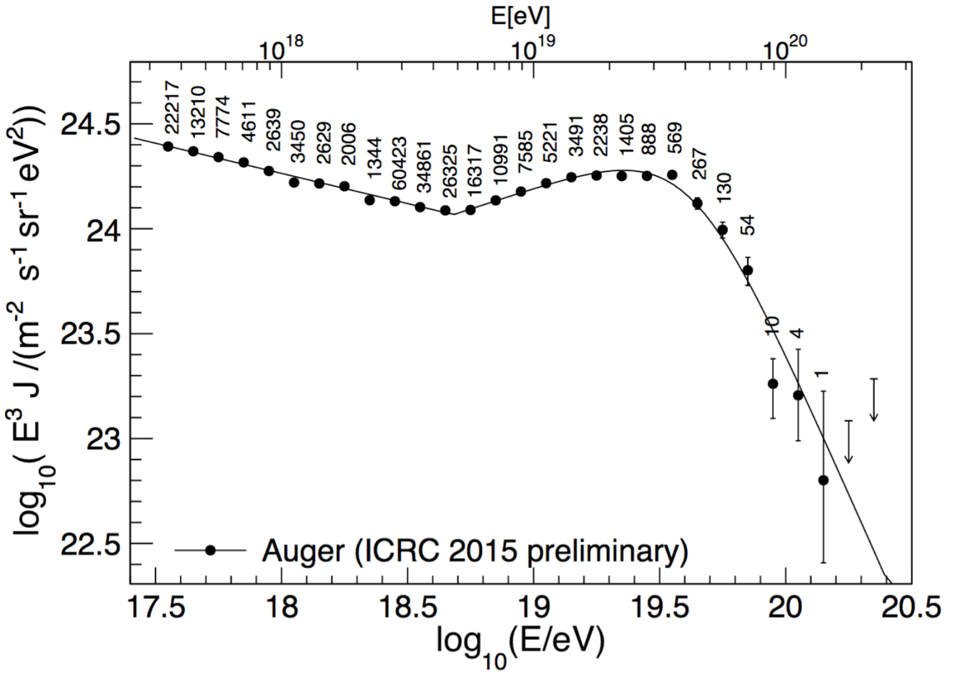
Mass Composition
golden key to understand spectral features
cut-off
ankle
but are these really protons?
I. Valiño, ICRC 2015

Slide 22
Shower Maximum X_{max} [g/cm²]
Shower Depth X [g/cm²]

Slide 23
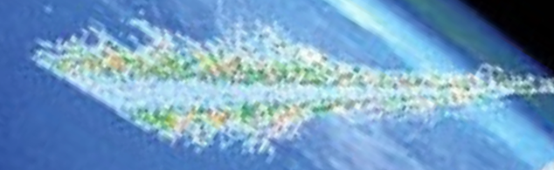
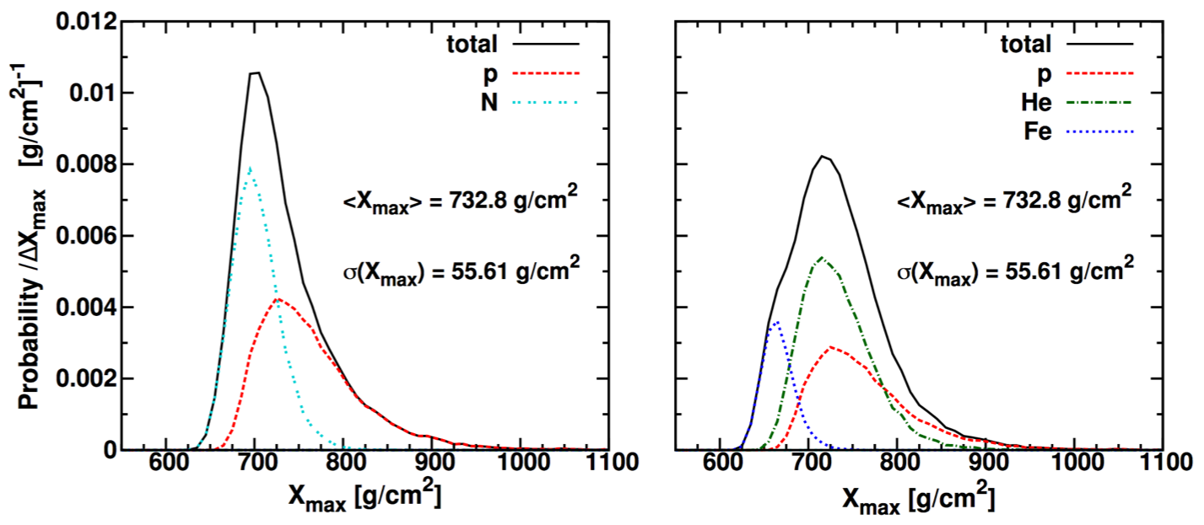
Mean and width of X_{max} distribution ⇒ mass mix
EPOS-LHC
Pierre Auger Collab., arXiv:1409.5083v1 [astro-ph.HE]

Slide 24
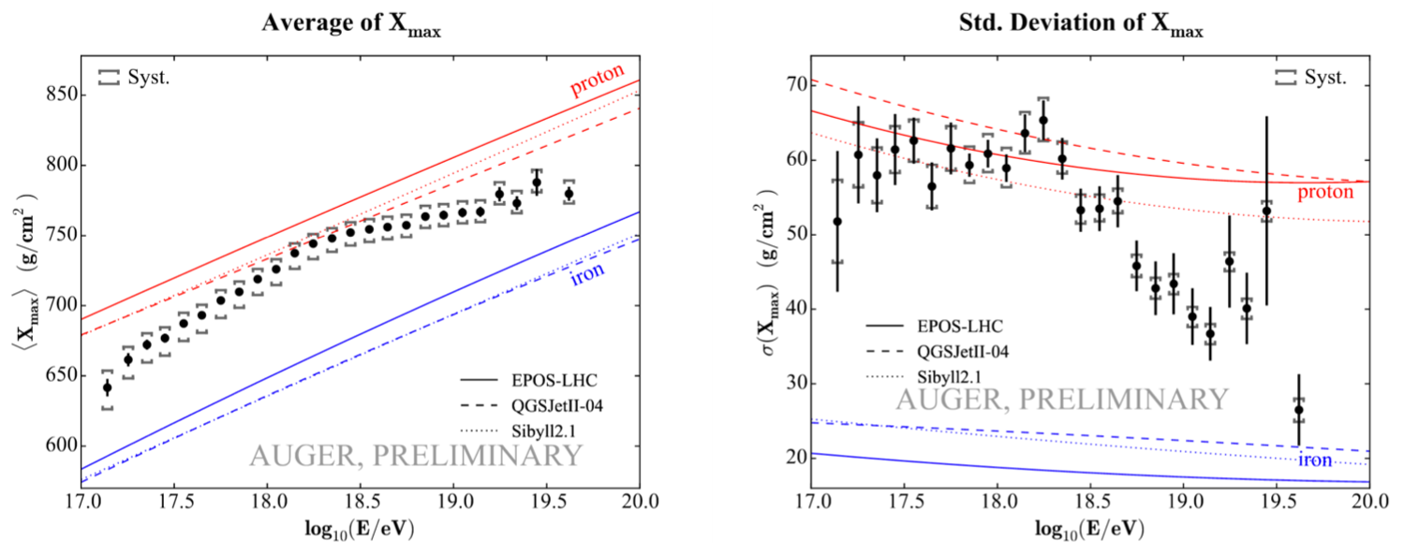
A. Porcelli, ICRC 2015
above knee: heavy
ankle: again light; dip due to
cut-off: mixture; NOT pure GZK cut-off

Slide 25
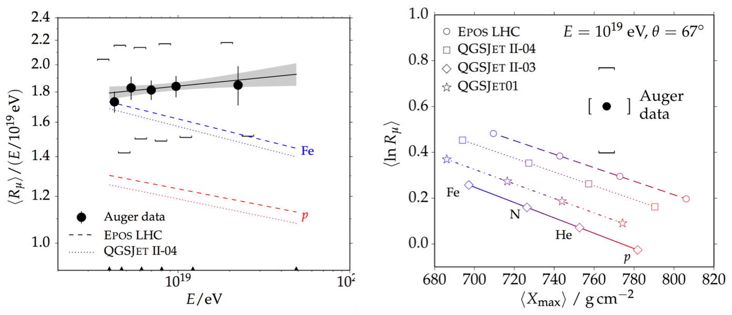
Mystery: Overproduction of myons at highest energies
L. Collica, ICRC 2015
Problem with interaction models? Very hard to solve!
New particle physics at highest energies?

Slide 26
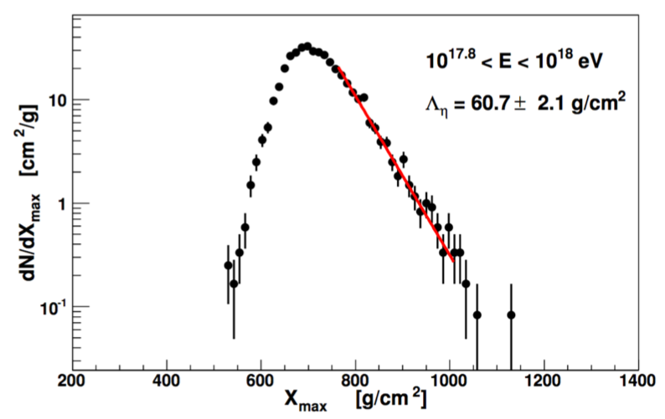
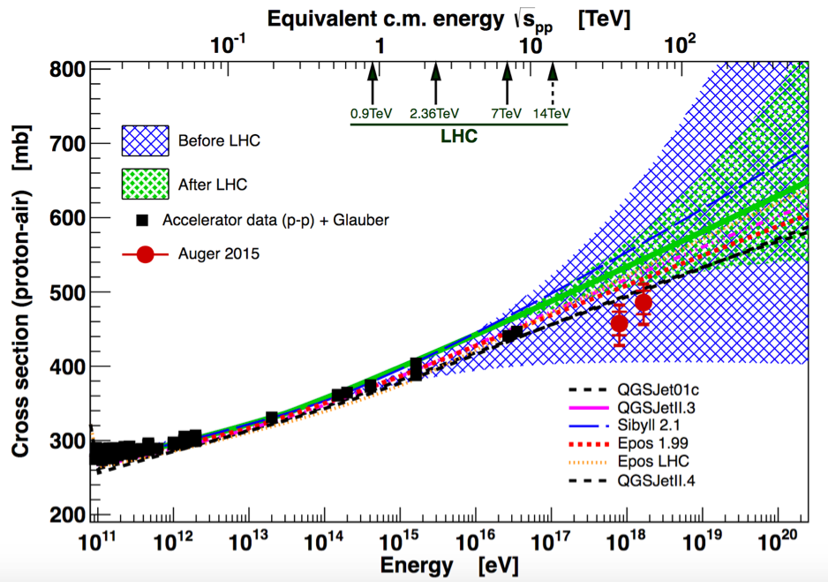
p-air Cross section
measure slope in X_{max} distr.
translation with interaction models
accelerator data: 𝜎_{inel}(p-p) to 𝜎(p-air) using Glauber model
R. Ulrich

Slide 27
Outline
Cosmic Rays and Air Showers
Dark Matter: WIMPs and ALPs
Quantum Gravity

Slide 28

Axion-Like-Particles (ALPs)

Slide 29
Axion-Like-Particles (ALPs)
non-thermally produced light DM candidates
Pseudo-Nambu-Goldstone Bosons
U(1) symmetries arising in string theory (Alps)
global U(1) Peccei-Quinn symmetry (QCD-Axion)
Coupling to photons:
Photon external B-field
ALPs field

Slide 30
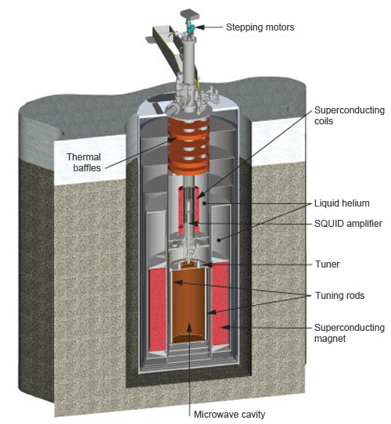
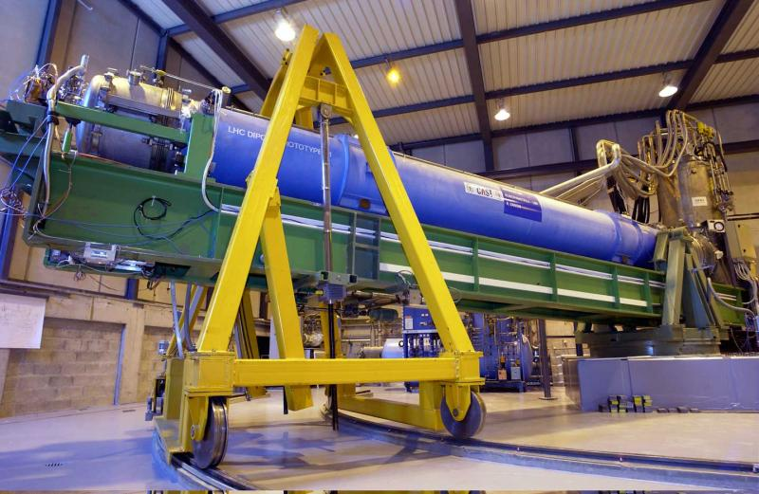
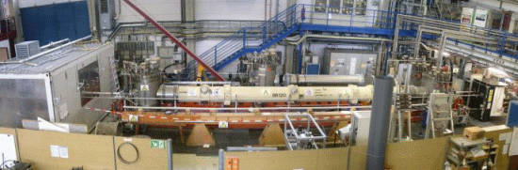
Rich experimental program
ADMX
CAST
LHC magnet pointing at the sun
ALPS
tunable high Q microwave cavity
laser shining through a wall in a magnet

Slide 31

Cosmological ”Walls“
dN/dE
intrinsic
Galaxy Clusters
𝛾
E
Active Galactic Nuclei in Galaxy Clusters
e⁺
dN/dE
e⁻
absorbed
E
Extragalactic Infrared Background (galaxies & early stars)

Slide 32
Cosmological ”Walls“
dN/dE
intrinsic
𝛾
Galaxy Clusters
×
E
Active Galactic Nuclei in Galaxy Clusters
a
dN/dE
enhanced
Intra-cluster magnetic fields
absorbed
E
×
Galactic magnetic fields
𝛾

Slide 33
Simulation of ALPs enhancements:
Intrisic source spectrum extracted from measured low-E spectrum
Meyer, Conrad: JCAP12 (2014) 016

Slide 34
H.E.S.S. search for ALPs-induced spectral wiggles
Photon survival probability
Flux from PKS 2155−304 (z=0.116)
simulated turbulent B fields
H.E.S.S.
reconstructed
Coupling [10⁻¹¹ GeV⁻¹]
Mass [neV]

Slide 35
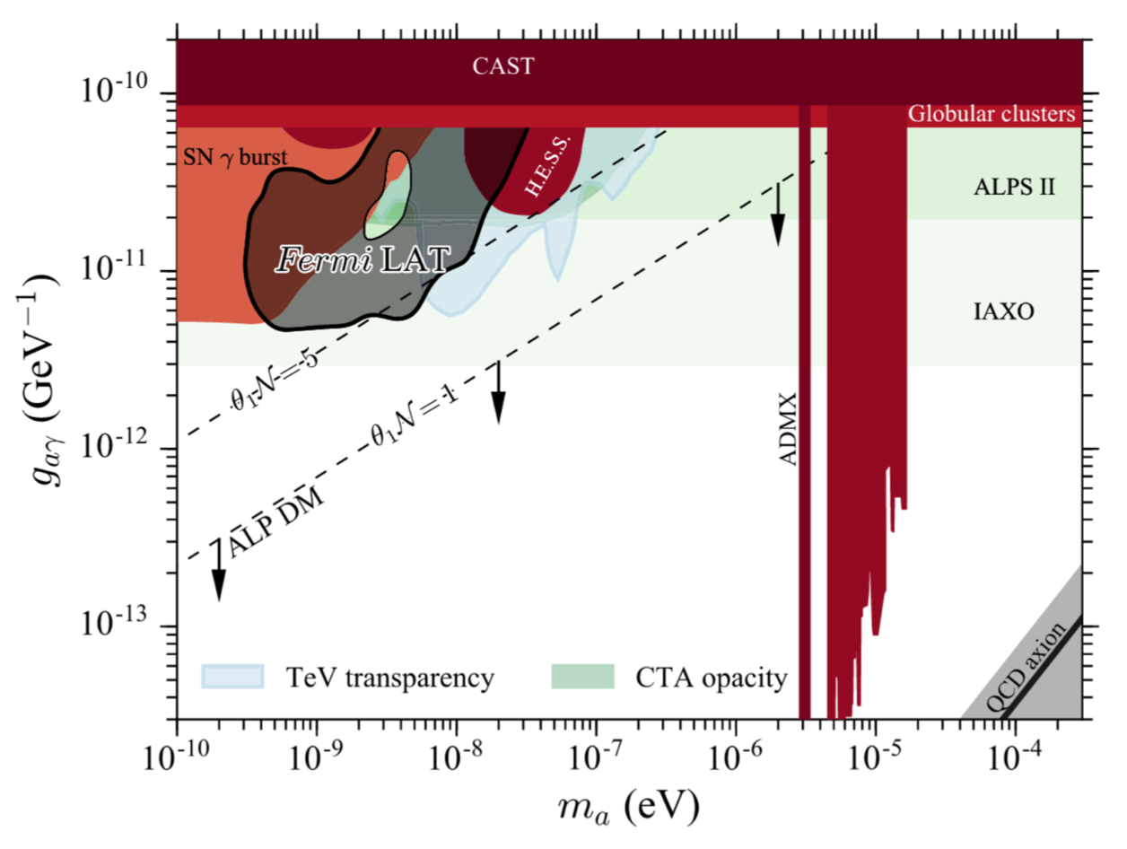
Status and prospects:
M. Ajello et al. (The Fermi-LAT Collaboration), Phys. Rev. Lett. 116, 161101

Slide 36
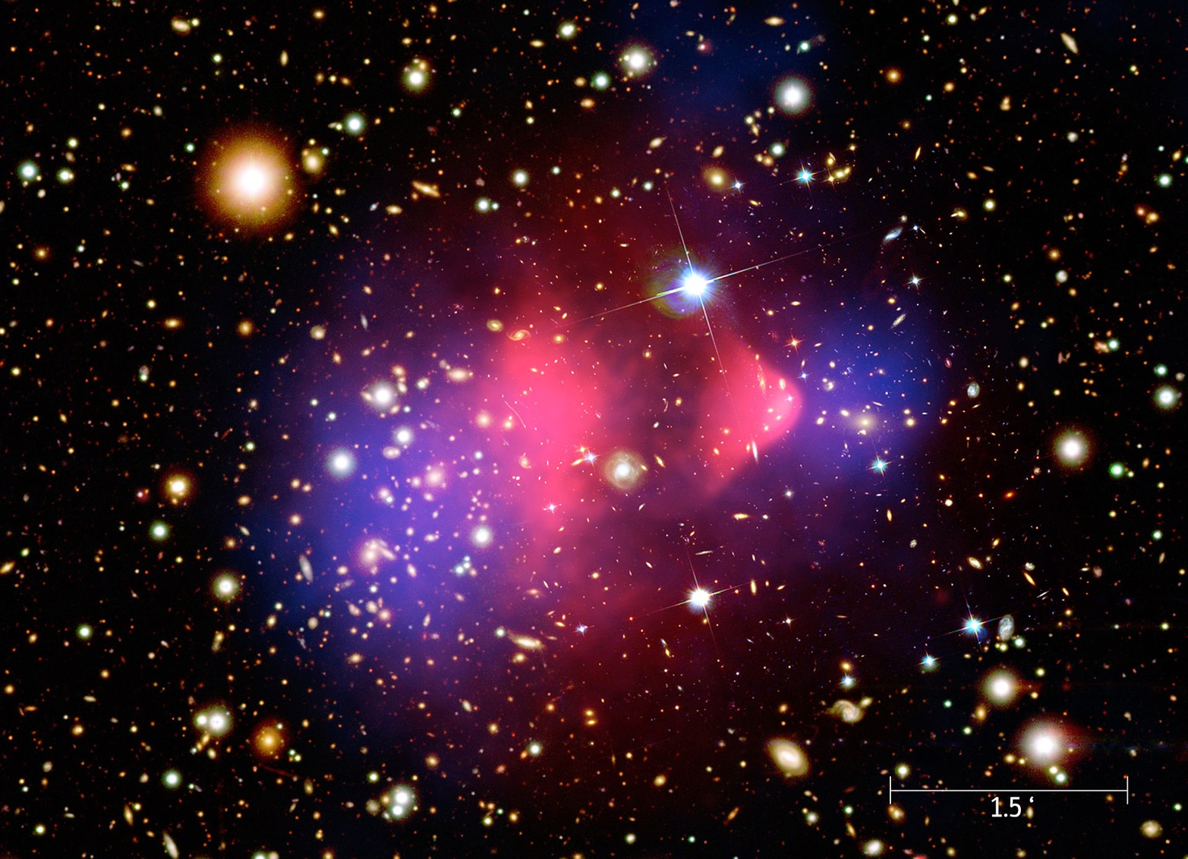
WIMP Dark Matter

Slide 37
WIMP detection - the threefold way
Standard Model particle
WIMP
indirect detection
?
direct detection
Standard Model particle
creation in the lab
WIMP

Slide 38



Where to look?
gravitational centres with small astrophysical backgrounds
NASA
Galactic Centre
Sun Core
Dwarf Spheroidal Galaxies

Slide 39
WIMP
What to look for?
WIMP
characteristic emission of high energy particles
gamma rays
neutrinos
detectable on earth?
anti-matter

Slide 40


Expected fluxes for neutral messengers (𝜈, 𝛾)
particle physics
astrophysical factor J
WIMP annihilation source at distance s
line-of-sight (los)
field-of-view (fov)

Slide 41

measure this
Constrain as function of
Decay spectrum for messenger, known for each annihilation channel
Example:
gamma-ray messenger,
“fragmentation”-functions for various channels

Slide 42
measure this
Needs DM density profile
from measured velocity dispersion in dwarf galaxies
from n-body DM simulations → cusped profiles
but baryons (stars, winds, supernovae, ...) dominate in galaxy centres → cored profiles ???
substructures (clumps) may boost signals
cusped
cored
H.E.S.S., Phys. Rev. Lett. 114, 081301 (2015)

Slide 43


𝛾-ray limits (examples)
preliminary
Dwarf Galaxies
large mass/light ratio
no astrophysical backgrounds
Search for gradient in halo signal
veto band
Galactic Centre

Slide 44


Beware: Model dependencies
Astrophysics:
DM profiles
(n-body simulations)
BSM particle physics: 𝛾 rays from various DM annihilation channels
sensitivities reaching thermal relic scale!!

Slide 45

Hot topic: GeV excess in Galactic Centre (Fermi LAT)
after subtraction of diffuse background and known sources
NASA/T. Linden, U.Chicago

Slide 46

New: gamma ray distributions claimed to be “clumpy”
⇒ huge source population just below threshold (e.g. millisecond pulsars)?
Bartels et al., Phys. Rev. Lett. 116 051102
Similar claims by
Lee et al., Phys. Rev. Lett. 116 051103

Slide 47
A neutrino special: WIMP annihilation in the core of the Sun (or earth)
only neutrinos can escape
IceCube

Slide 48
Age 4.5×10⁹ y ⇒ equilibrium capture vs annihilation rate reached for canonical thermal relic
capture rate →
← annihilation rate
Neutrino flux depends on , not on !

Slide 49
⇒ competitive limits for (spin-dependent x-sect.)
IceCube, JCAP 04 (2016) 022

Slide 50
Comparison to direct searches and LHC searches
XENON100
SuperK
SuperK
Icecube
CMS monojets, EFT assumptions
CMSSM
C. A,ole et al., Phys. Rev. D 93, 052014 (2016)

Slide 51


Antimatter Anomalies
predictions from diffusion-loss equation based propagation models (not as “trivial” as for neutral messengers)
PRL 110 141102
AMS, PRL 113, 121101 (2014)
possible DM hint
could be astrophysics (pulsars, supernovae...)
reduce uncertainties!
Giesen et al., arXiv:1504.042

Slide 52


LHCb: special p-He, p-Ne, p-Ar runs
originally for beam-profile/luminosity measurements
p-He cross sections for cosmic ray antiproton production

Slide 53
Outline
Cosmic Rays and Air Showers
Dark Matter: WIMPs and ALPs
Quantum Gravity

Slide 54


Quantum-Gravity
Vacuum Dispersion ⇒ energy dependent time delays
GRB / AGN flare
𝛾

Slide 55


Very distant objects with burst-like activity
Active Galactic Nuclei
Gamma Ray Bursts
https://www.mpi-hd.mpg.de/hfm/HESS/pages/home/som/2010/07/
P. T. O'Brien, R. Willingale Phil. Trans. R. Soc. A 2007;365:1179-1188

Slide 56
Photon propagation speed (Taylor expansion)
Power of first non-zero term
Quantum Gravity scale
Effective field theory with d = dim(leading operator):
unrestricted case:
theories with CPT symmetry:

Slide 57
The Blazar PKS 2155 - an exceptional flare
0.25 − 0.28 TeV
z = 0.116
0.2 − 5 TeV
HESS
28th July 2006
Crab Flux
H.E.S.S., Astropart.Phys.34:738-747,2011
peak flux > 50 times average
doubling times ≈ 3 min , R_{black Hole} /c ≈ 200 min

Slide 58
Current limits on E_{QG} (95% c.l.)
PKS 2155 flare:
(H.E.S.S.)
GRB 090510 (z = 0.9):
(Fermi-LAT)
Planck Scale:
Warning: analyses assume no energy dependent delays in the sources

Slide 59
Conclusions
strong astro & particle links really exist
some of the big questions will require tight cooperation of both fields
Stay fascinated!

