Slide 1
Some informations
BTTB workshop at LAL
February 3th to 5th, 2016
Clara Nellist & Abdenour Lounis

Slide 2
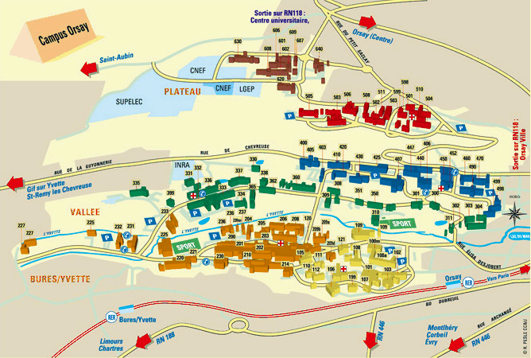
LAL – Laboratoire de l’Accélérateur Linéaire
Right side of River of l’Yvette

Slide 3
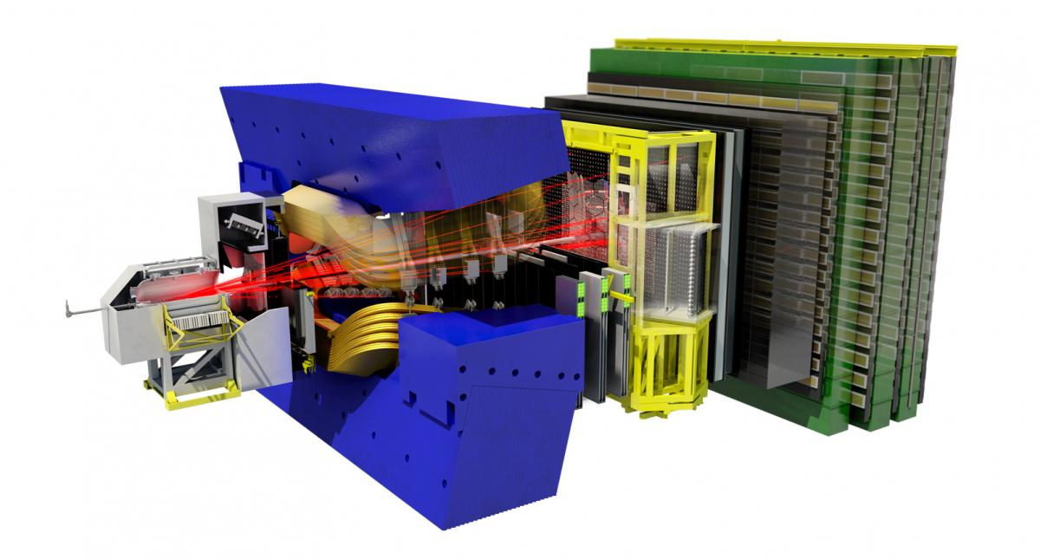
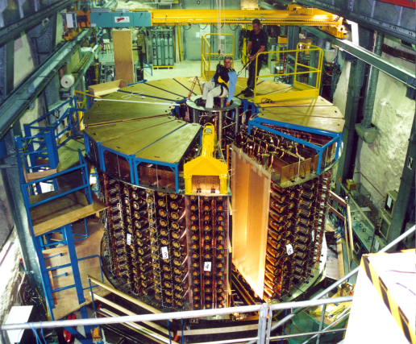
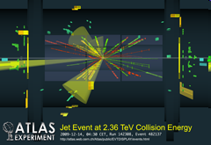
Some informations
Laboratory |  | Home institution | Personnels | Implantations
 | Laboratoire de l’Accélérateur Linéaire | CNRS/IN2P3 UPS UMR 86 07 | 221 permanents: 61 Physicists 14 Phd students 160 Engineers | 15 226 m² Bât 200-201-204-205-208
Projects Physics: ATLAS, LHCB, ILC, NEMO, SUPER NEMO, VIRGO, AUGER, PLANCK,…
Departments : Instrumentation, micro-electronics, CAO, Data acquisition systems, Mechanics, Informatics
NEMO
LHCB
Jean-Claude LE SCORNET Décembre 2008

Slide 4
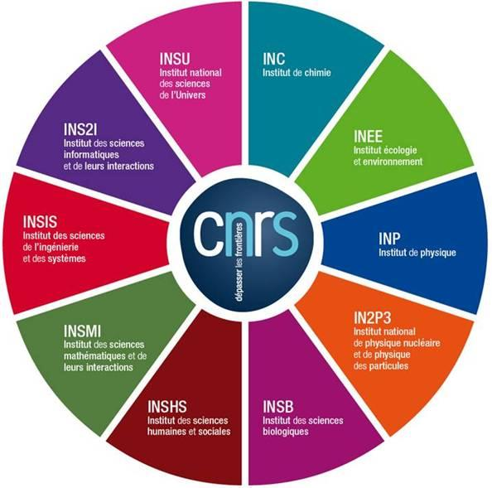
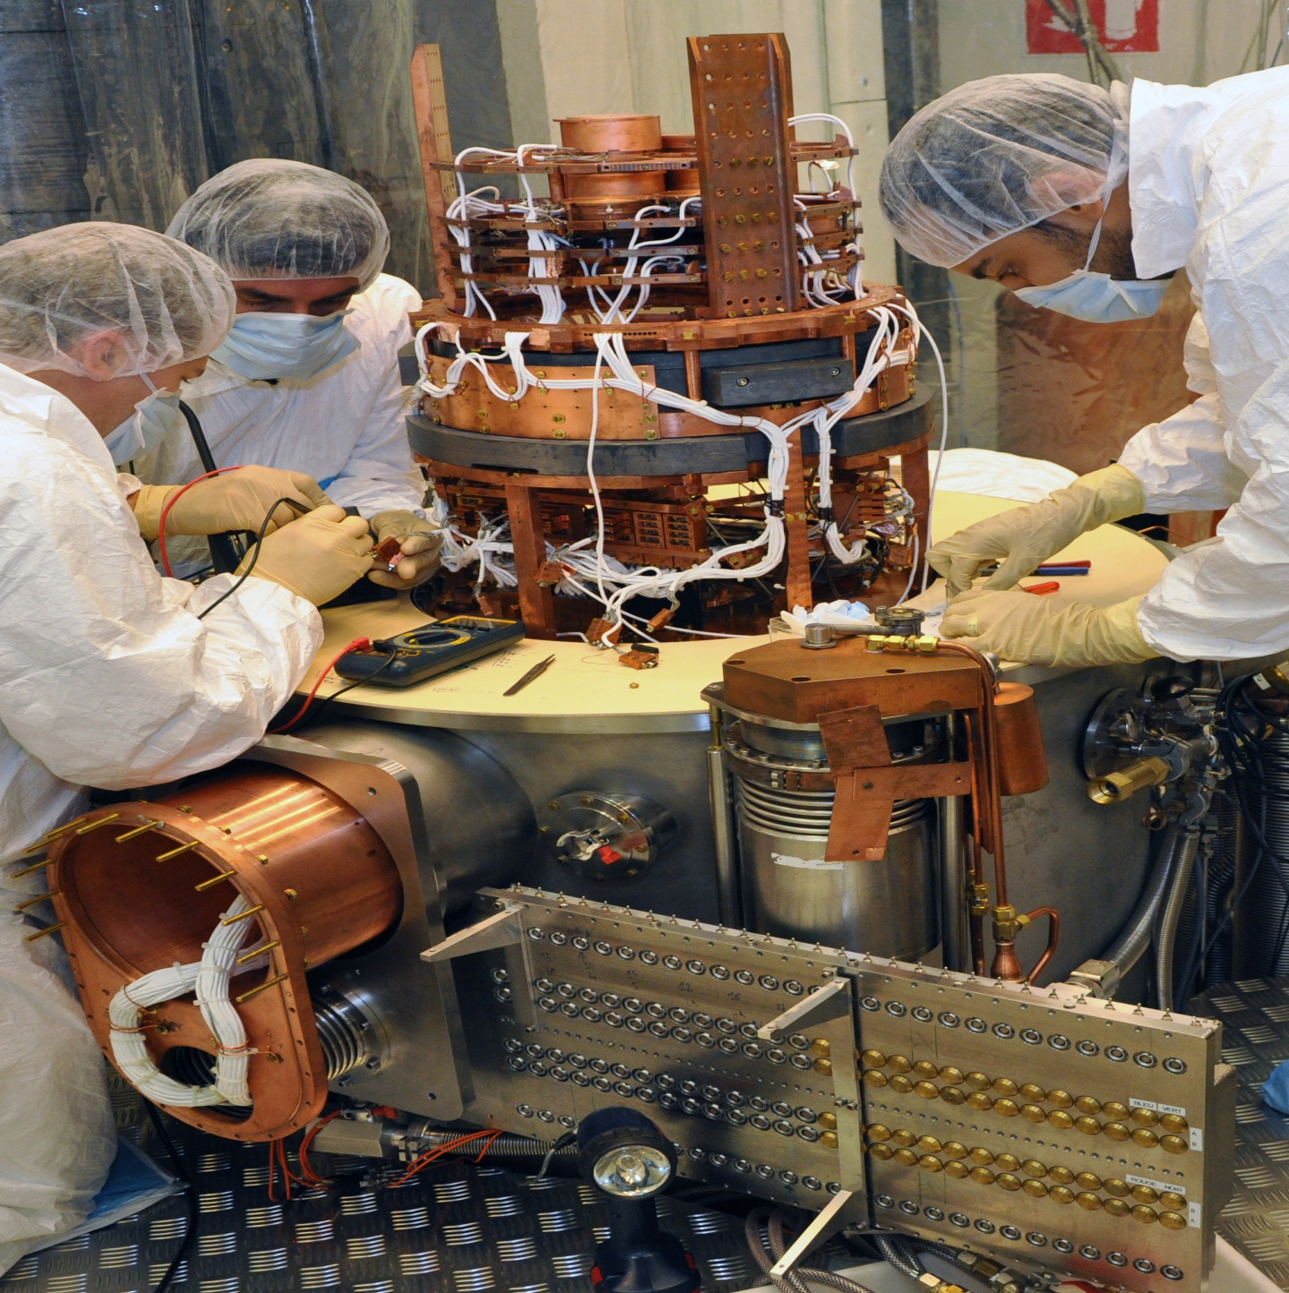
IN2P3, ONE OF CNRS INSTITUTES
3
The CNRS
10 institutes (3 national institutes: INSMI, INSU, IN2P3)
1,100 research units (95% in partnership)
34,000 researchers,
engineers, technicians
€3.3 billion budget
© CENBG, LSM Conception graphique : Anna Thibeau (IPNL)

Slide 5
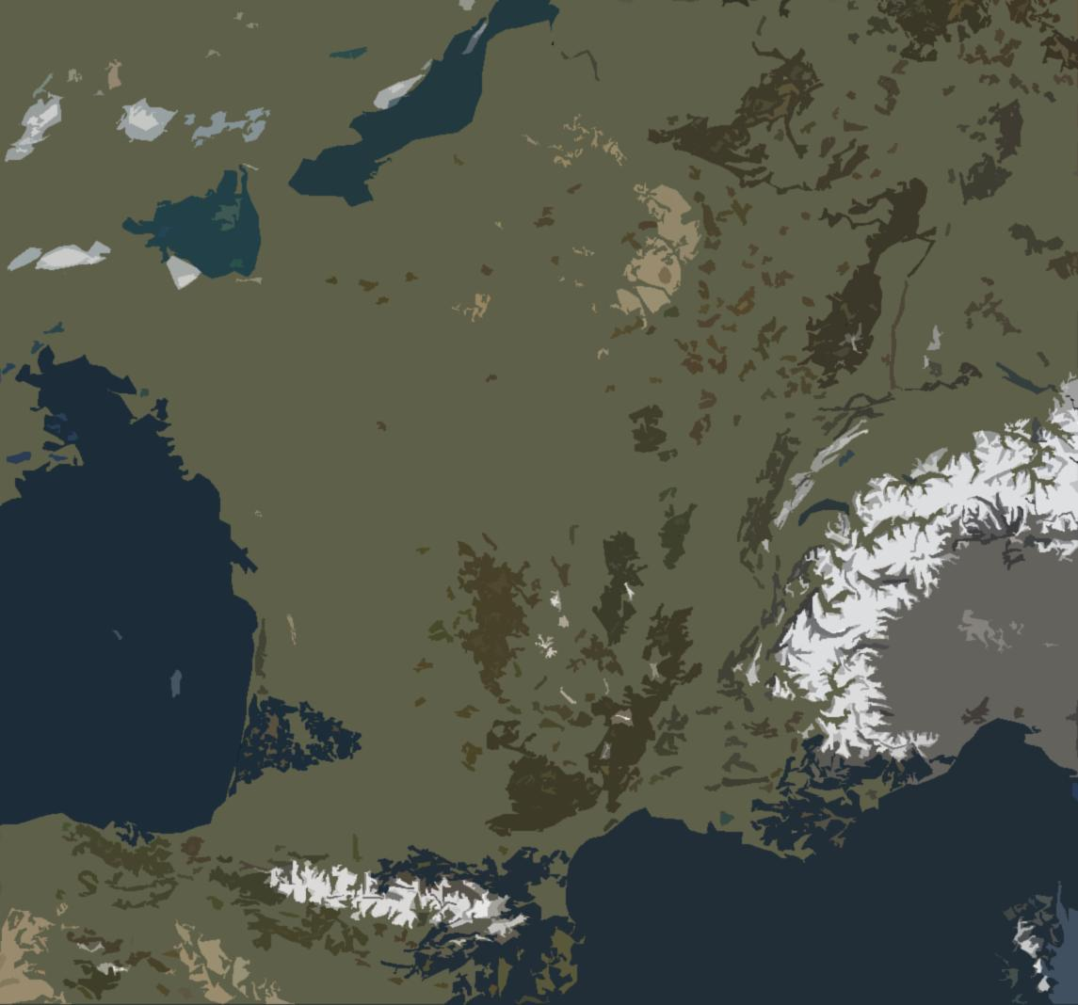
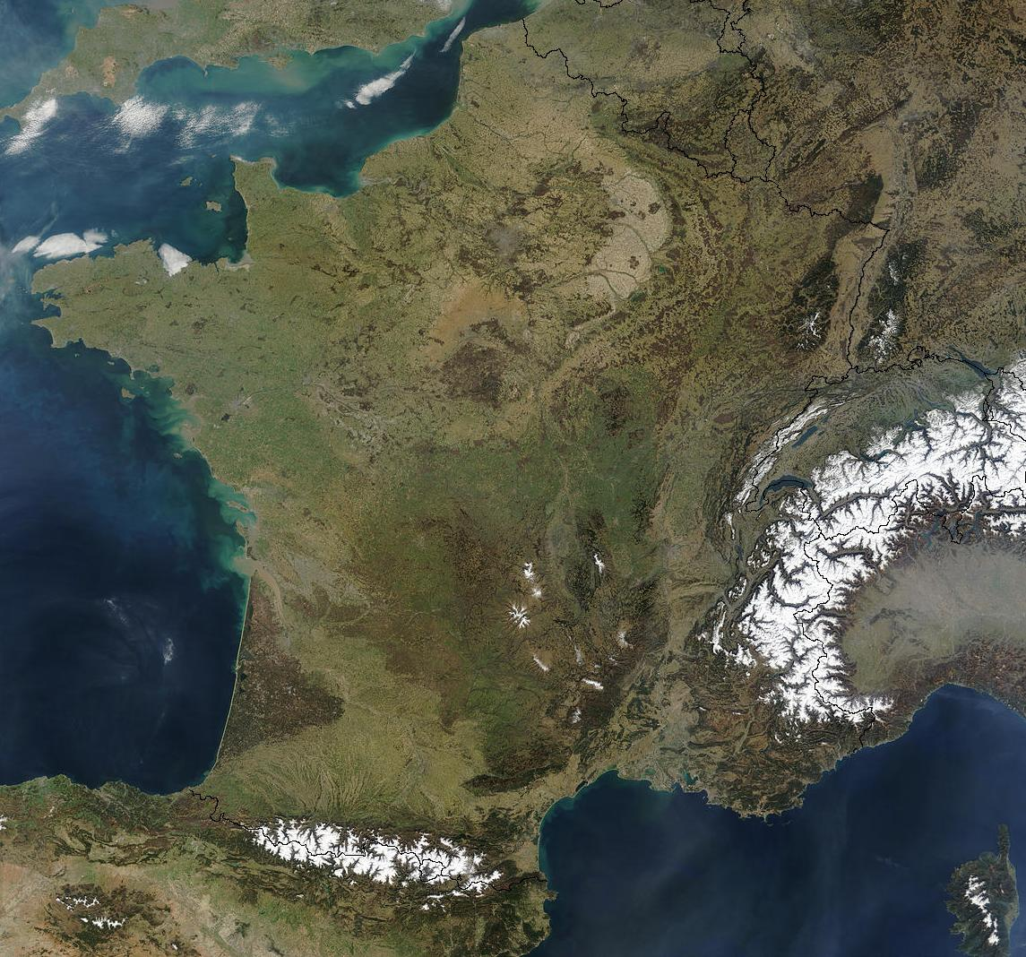
IN2P3: NETWORKED LABORATORIES
3
19 Laboratories
Ganil, LPC Caen
APC, LPNHE,
Musée Curie
IPHC
CSNSM
IMNC, IPNO,
LAL, LLR, Omega
Subatech
LNSA
LSM,
Lapp
CC, IPNL,
© CIA, LSM
LPC Clermont
CENBG
LPSC
LUPM
CPPM

Slide 6
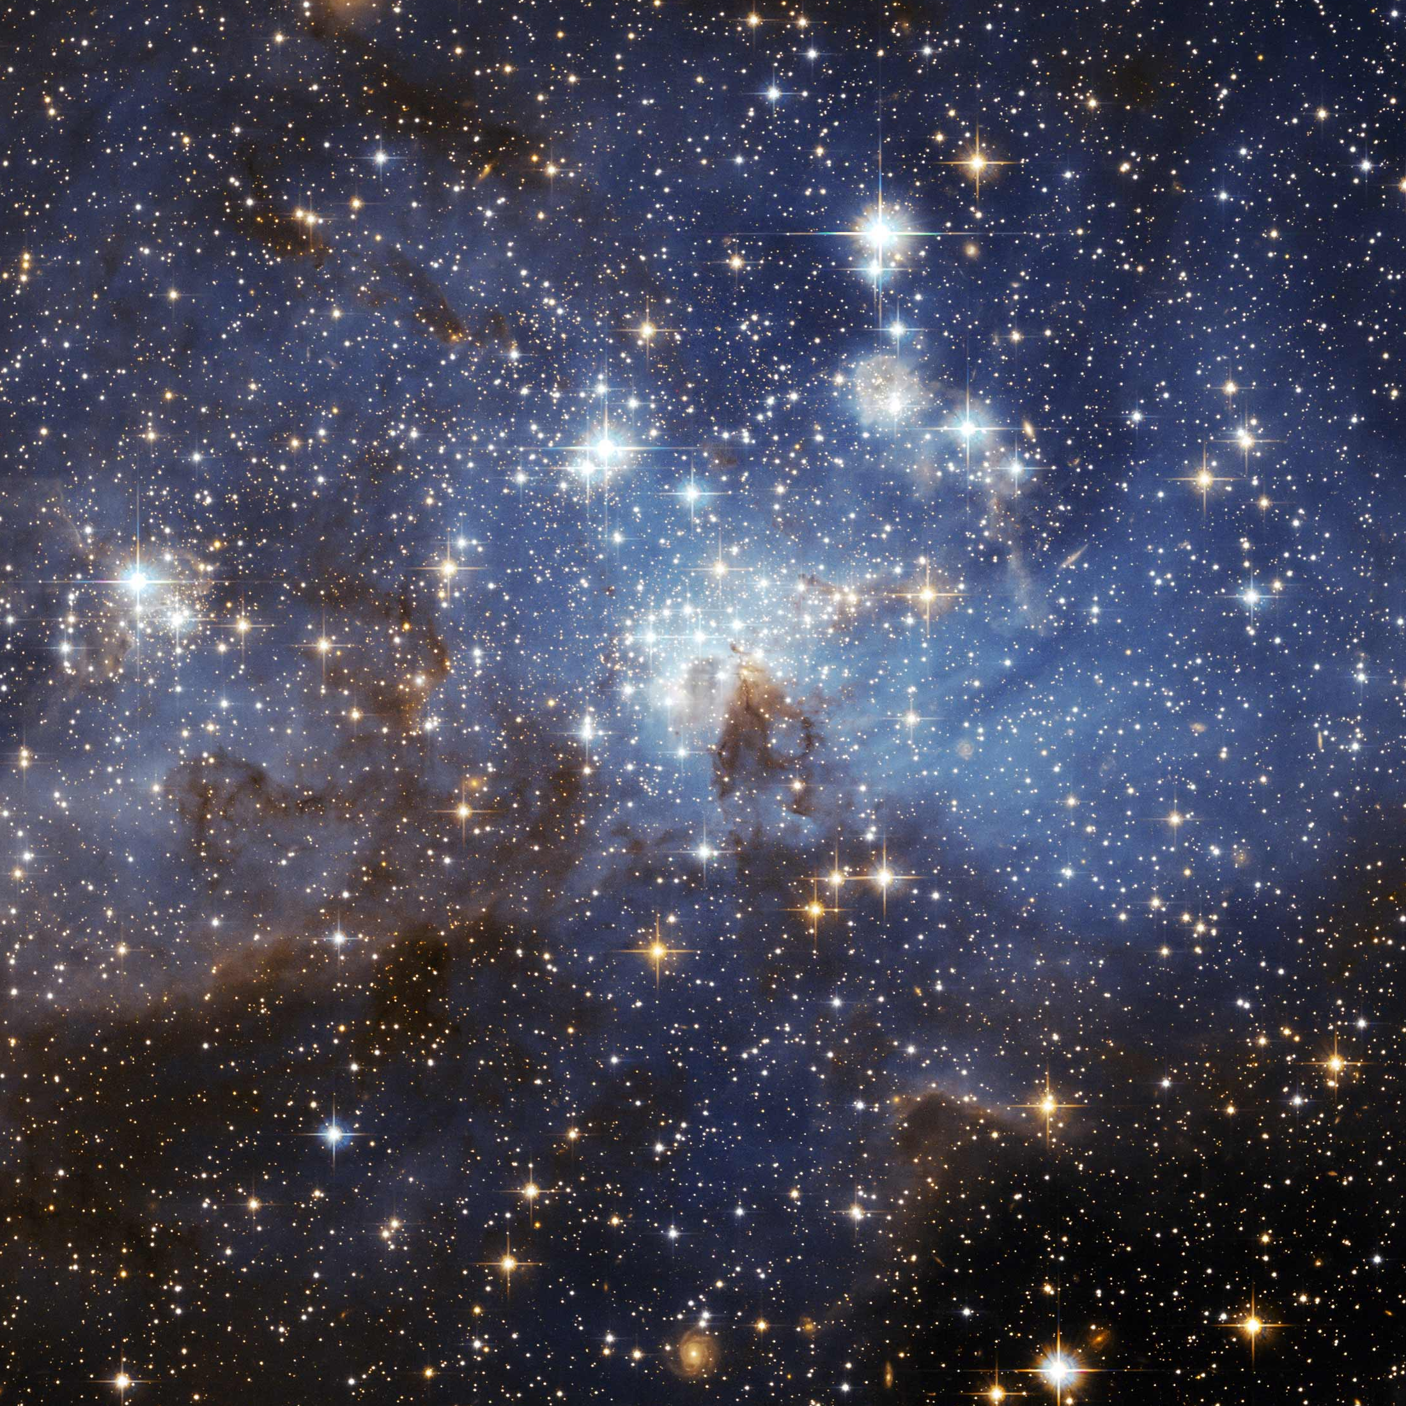
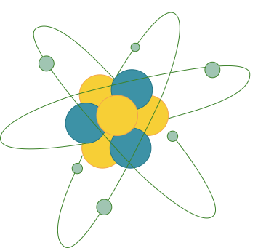
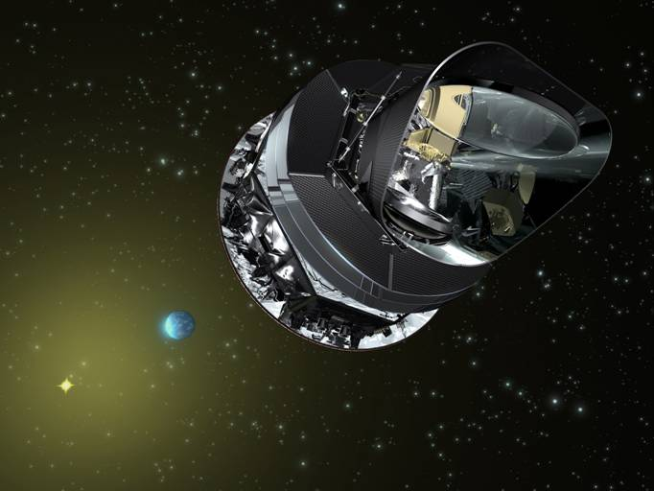
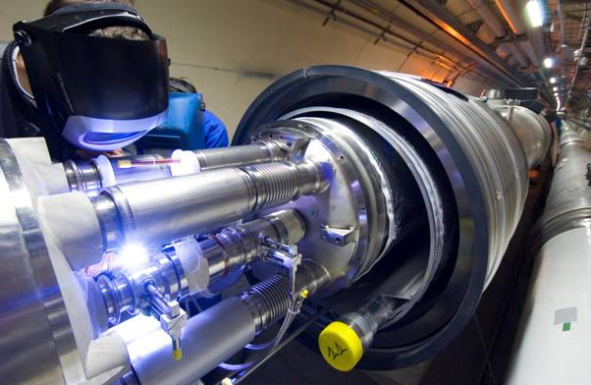
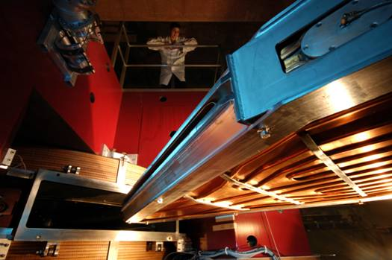
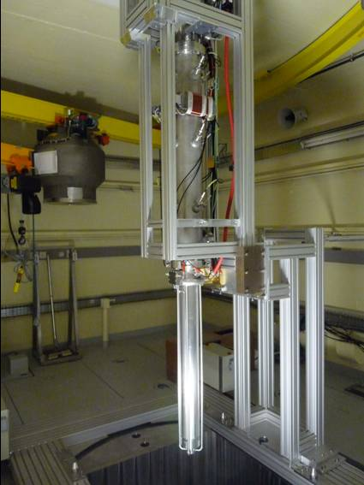
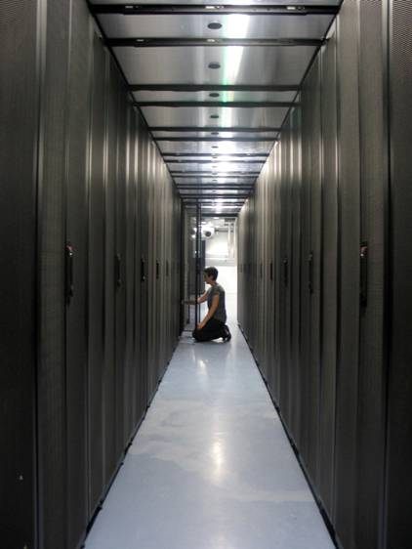
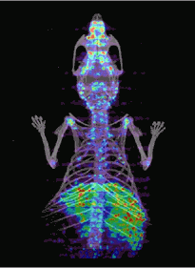
SCIENTIFIC THEMES at LAL
4
Particle physics & astroparticle
Matter’s most elementary constituents and fundamental interactions
Instrumentation
Accelerator R&D
Computing grids
Spin-off : Medical applications
Astroparticle physics and neutrinos
Universe’s composition and behaviour
© Ganil, Cern, CC-IN2P3, Guinevere, Amissa, Planck, LSM – Conception graphique : Anna Thibeau (IPNL)

Slide 7
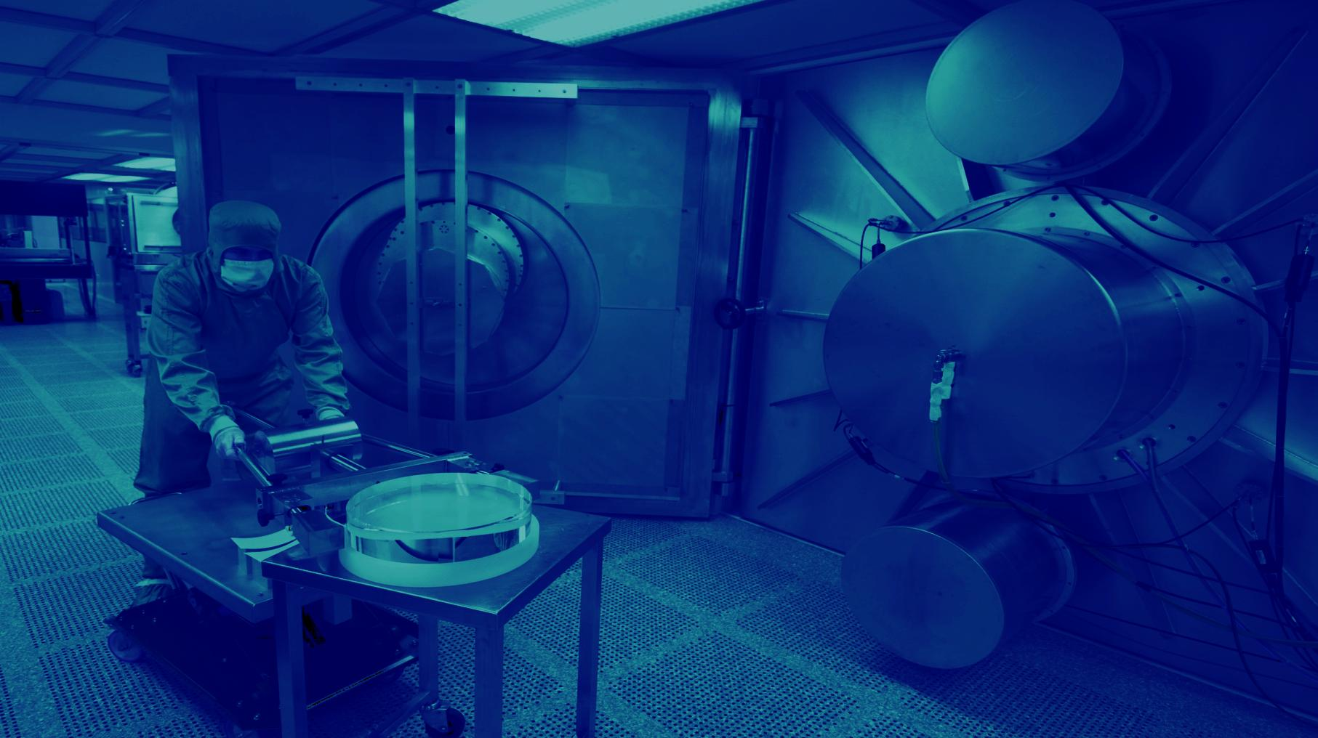
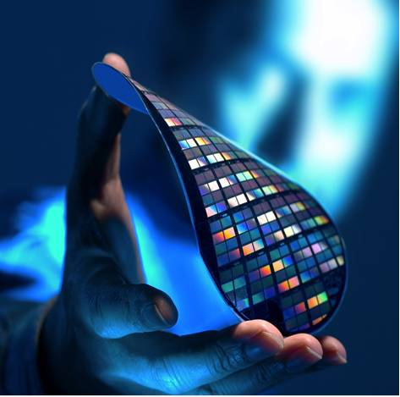
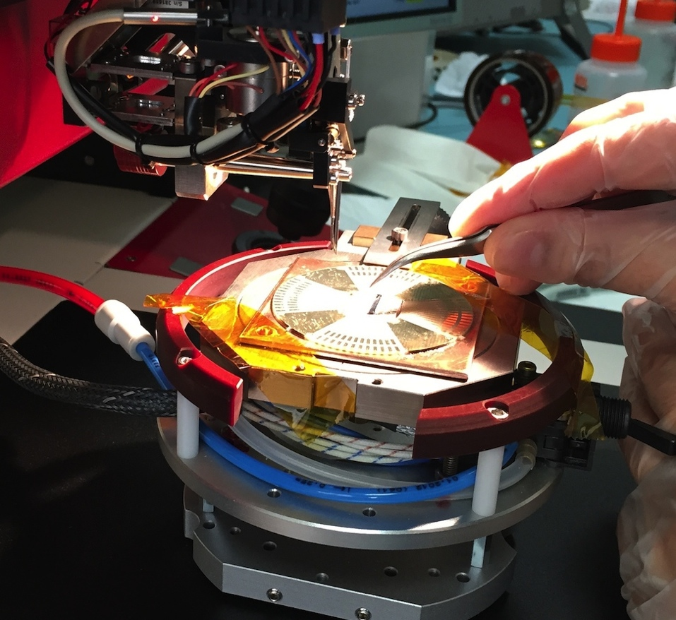
INSTRUMENTATION AND DETECTORS
5
INSTRUMENTATION, DETECTORS, TECHNOLOGY TRANSFER
INSTRUMENTATION
Instrumentation: Silicon detectors, Photo-detectors, SiPM
Gaseous detectors
Electronics & Microelectronics
Accelerator department
MICROELECTRONIcs
© LSM, D.R., IPNL – Conception graphique : Anna Thibeau (IPNL)

Slide 8
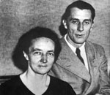
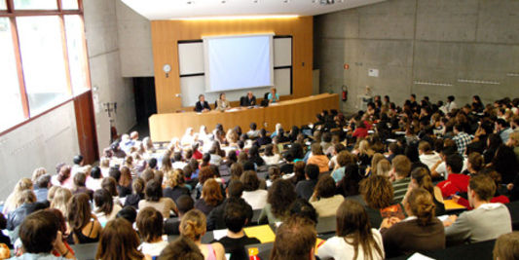
Université de Paris Sud XI
In 1954 (entry of France to CERN), the decision was taken to create a « French valley of scientific exellence in nuclear physics » : irene Joliot Curie took the decision for the creation of IPNO in Orsay
Teaching from la sorbonne Paris was transfered to Orsay in 1958
Decision in 1956 to construct the Laboratoire de l’Accélérateur Linéaire (Yves Rocard, Ecole Normale Superieure) to give the first electron accelerator : collider of 1.3 GeV electron : end of construction in 1962.
Date of creation of University of Paris Sud : 1st January 1971, under the initiative of Frederic and Irene Joliot Curie (in 1942)
One of major French university
Students : 27300
Employees : 5000
Assistant Professors and and Professors : 2000
Researchers : 1000
2 Nobel Prices in Physics:
1991 : Pierre Gilles de Genes
2007 : : Albert Fert
4 Field Medal in Math:
1994, 2002,2006, 2010

Slide 9
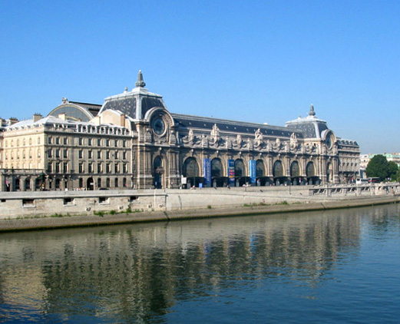
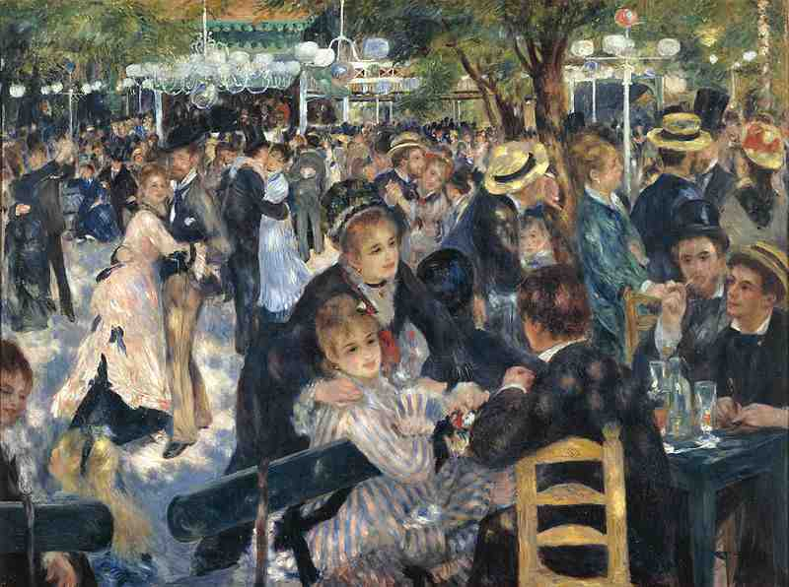
Social diner : Thursday 4th, 8PM
Metro 12, SOLFERINO

Slide 10
RER B
Direction saint remy les chevreuse
FROM PARIS
STOP AT ORSAY VILLE OR BURES SUR YVETTE

Slide 11
Informations
BTTB workshop
https://indico.desy.de/conferenceTimeTable.py?confId=13620#20160203
Coffee Breaks 10:20
Lunch at CESFO CNRS Cantine, 12h30-14h
Tutorial : Thursday 4th ; 2:20PM to 5 PM
Travel to Paris Thursday at 5PM
Visit of Museum at 6PM, Diner at 8PM
don’t forget your bagde
End of workshop : Friday at 12h30 and Lunch
Enjoy the workshop !!!

