Slide 1
Status of AIDA-2020 Trigger/Timing Logic Unit (TLU)
David Cussans (University of Bristol)

Slide 2
TLU Aims:
Provide a hardware mechanism for synchronising multiple devices in a common beam test.
Provide easy interface to beam scintillators.
Simple easy to use
Backwards compatible (at interface level) with EUDET TLU.
TLU Status:
~30-45 EUDET TLUs in use and no spares left. 10 AIDA mini-TLUs made for testing.
Issues:
“Bug” in mini-HDMI connector pin-out
mini-HDMI has proven unreliable in use.

Slide 3
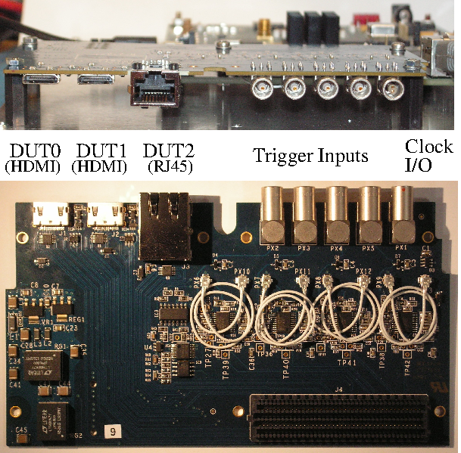
TLU Documentation
TLU Documentation http://www.ohwr.org/projects/fmc-mtlu/
Hardware design
Firmware
Test scripts
(EUDAQ producer in EUDAQ source tree)

Slide 4
TLU Fanout
Synchronous (AIDA) mode fan-out
Up to 30 DUT ( 50 channel version Q3 2016)
Compatible with miniTLU (in synchronous mode)
In use for LHCb TImePix telescope

Slide 5
Plans
Progress initially limited by available staff effort
Effort is now increasing:
~20% of engineer at UCL started working January 2016 (Samer Kilani)
Recruiting physicist/engineer at Bristol to work 50% on AIDA-2020 (interviews 3/Feb/16)
Gather requests for AIDA-2020 mini-TLU.
Produce batch of bug-fixed mini-TLUs for distribution Q2/2016.
Cost basis to be decided. WP5 has funds for “full” TLUs installed in beam-lines as AIDA-2020 deliverable, but not mini-TLU.
Tests to perform:
Chain CALICE CCC and one or more mini-TLU to check for stability of clock (“jitter peaking”)
Test timing precision of TDCs with beam particles.
Design and produce full TLU—more trigger inputs for DUT interfaces (AIDA-2020 WP5 deliverable)

Slide 6
mini-TLU Likely Changes
Abandon strict conformity with FMC standard outline.
Existing mini-TLU a double-height FMC. Described in standard, but didn’t fit on many low cost FPGA carrier boards.
Following FMC standard outline limits use of full-size connectors.
Can still use a uTCA AMC format FPGA board, just not plug it into a crate
E.g. Many CERN GLIB boards used on bench as FMC carrier boards.
Full-size (more robust) HDMI connectors rather than mini-HDMI.
Have heard that micro-HDMI acceptable
Many need to add cable supports to front of mini-TLU enclosure if using full size cables.

Slide 7
mini-TLU Likely Changes
Ability to accept clock from CALICE CCC or LHCb Timepix clock/sync fan-out on standard HDMI cable
Instead of hand-made custom cables with clock separated from trigger/busy/sync
Use jitter–reducing PLL chip ( Si53xx ) to generate/receive clocks
Sophisticated PLL circuit with adjustable parameters should reduce likelihood of clock instability if chaining TLUs or using TLU as slave from high-jitter clock.
Move from Spartan-6 to Artix-7 as default host FPGA
Avoid risk that Spartan-6 becomes difficult to obtain towards end of AIDA-2020
Better performance of TDC

Slide 8
Firmware status
Switch between synchronous ( AIDA ) and asynchronous ( EUDET ) interface modes implemented.
Not tested
Asynchronous mode:
Trigger (TLU→DUT)
Fixed latency from scintillators to trigger. Jitter ~ 3ns sigma ( cf. 20ps from EUDET TLU ).
Busy (DUT→TLU)
Optional clock from DUT to clock out trigger number
No common clock between systems
Synchronous mode:
Trigger (TLU→DUT)
Synchronous with clock
Clock (TLU→DUT)
Typically 80MHz, 40MHz, 20MHz, 10MHz or 5MHz
Busy (DUT→TLU)

Slide 9
Mini-TLU production
AIDA-2020 covers cost of supplying “full” TLUs to beam test areas.
Assumption - One per AIDA-2020 supported telescope.
Cost of Mini-TLU not covered by AIDA-2020
Production of first mini-TLU under AIDA programme funded by DESY, not AIDA
Plan to produce mini-TLU “at cost”
Negotiating with our administration to see if we have to add staff-effort
Cost likely to be ~ €1000 - €2000
Design and firmware are ( and will remain ) Open
You are welcome to make one or more yourself if you wish…..
Aiming for production end of Spring 2016
Please let me know if you are interested in first batch.

