Slide 1
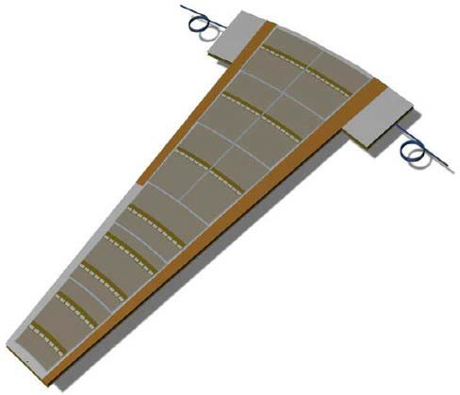
Forward

Slide 2
195.15
586.8
Petal Active Area
11.5⁰ 384mm to 969mm
76
969
76.94
384
11.5⁰

Slide 3
Trapezoid on top of active area
Petal Active Area
11.5⁰ 384mm to 969mm

Slide 4
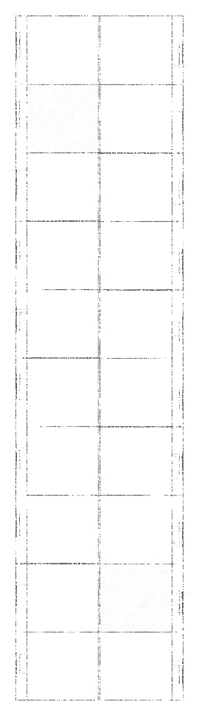
Bonding field
Periphery electronics
Sensor outline
Active area
19.508 x 24.250
Including 80u dicing street

Slide 5
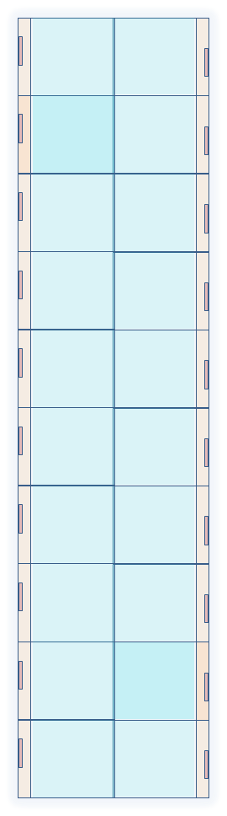
Proposal (Jens) – make modules the width of petals:
Maximum of 10 sensors on a single HCC
  Number decreases as radius decreases (matched rates?)
If necessary split bus
Barrel has five sensors per HCC
ABCn’
ABCn’
ABCn’
ABCn’
ABCn’
ABCn’
ABCn’
ABCn’
ABCn’
ABCn’

Slide 6
Bonding field
Periphery electronics
Sensor outline
Active area
19.508 x 24.250
Including 80u dicing street

Slide 7
Bonding field
Periphery electronics
Sensor outline
Active area
19.508 x 24.250
Including 80u dicing street

Slide 8
working

Slide 9
25
63
10

Slide 10
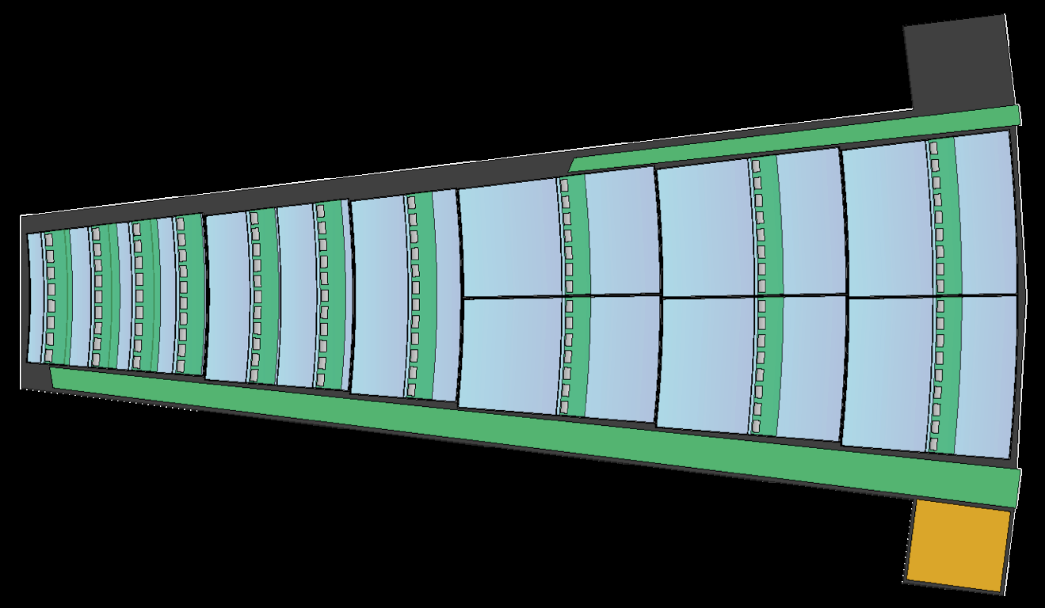

Slide 11
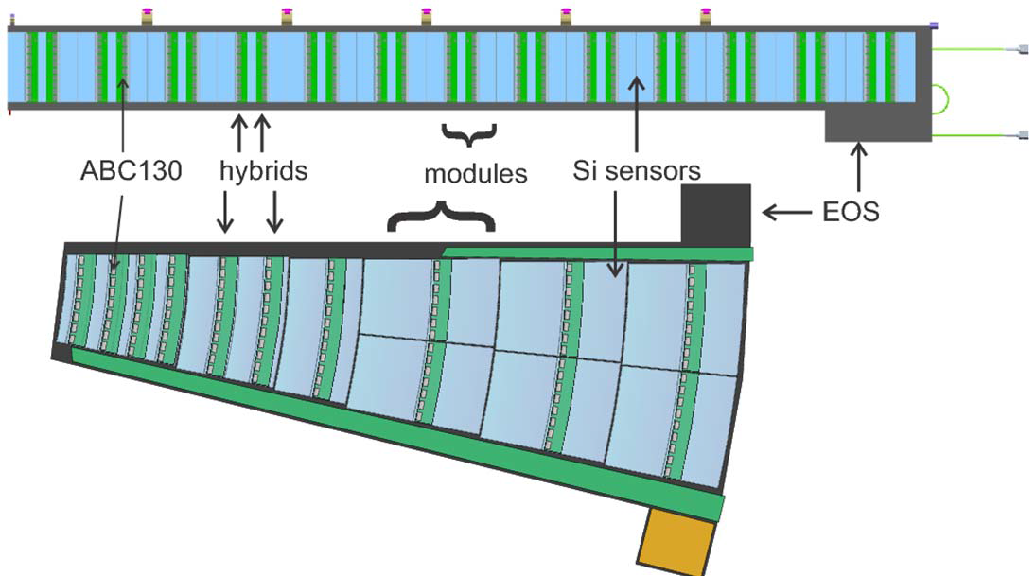
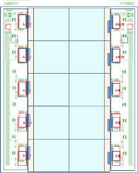

Slide 12
