Slide 1
Intelligent Programmable Electronics
Restructuring of work package started
Second work package responsible at the stage to be installed
Hardware work ongoing
Turbulences of the FAIR / PANDA project also effects one of our milestones → Hopefully solved in near future

Slide 2
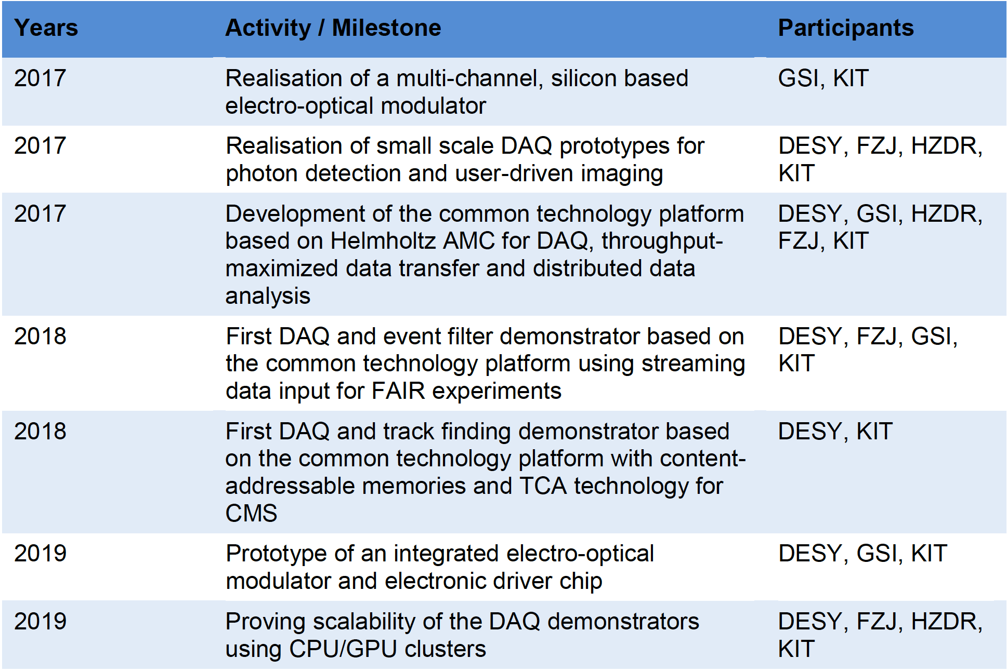
Milestones

