Slide 2
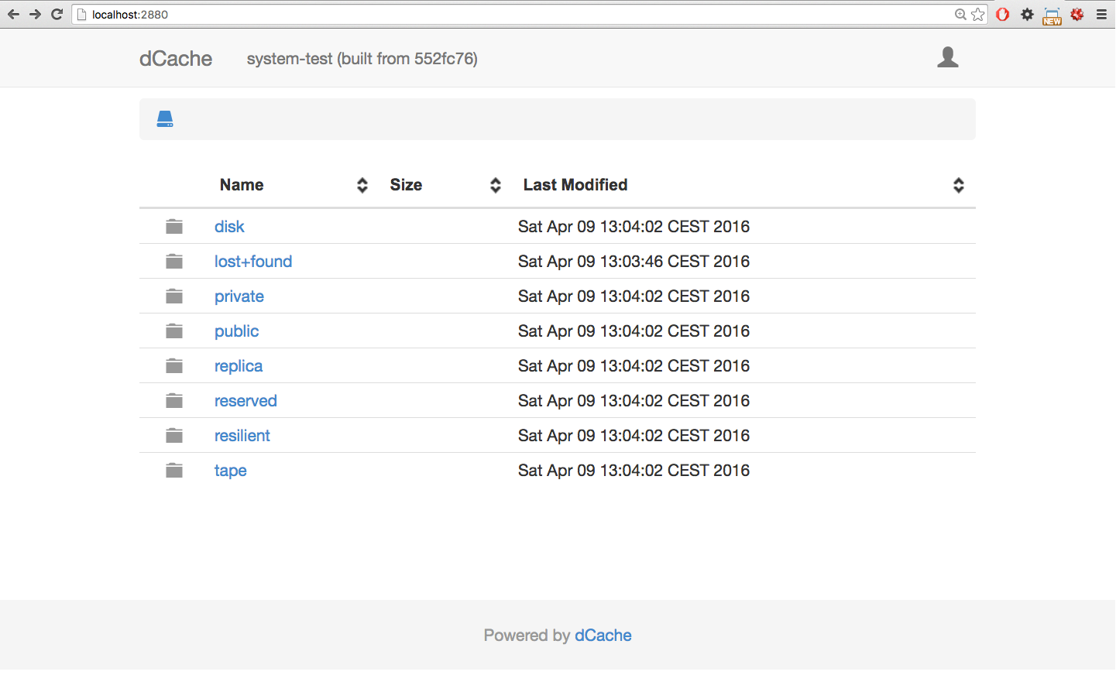
The Old Guy

Slide 3
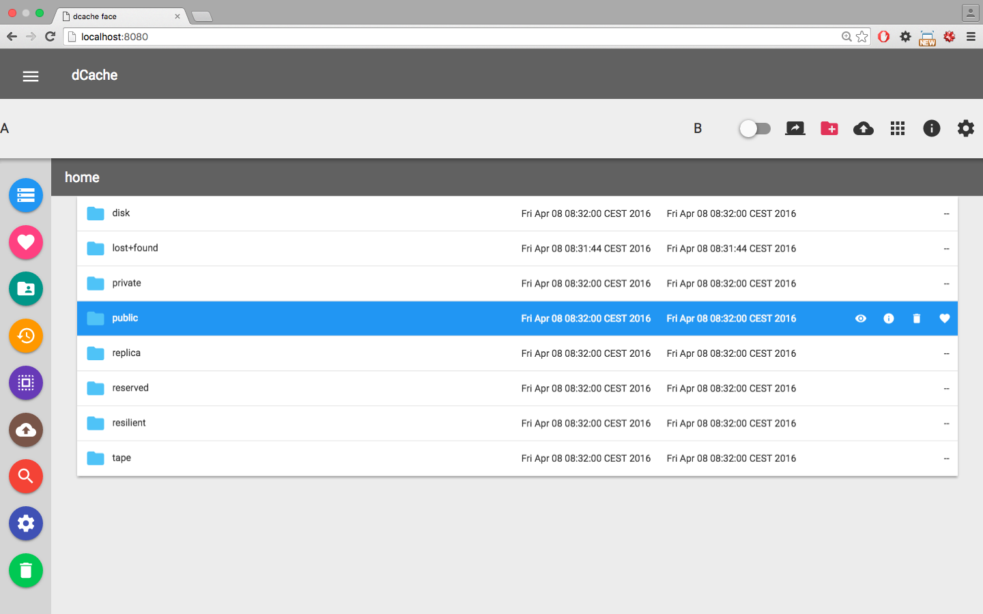
dFace

Slide 4
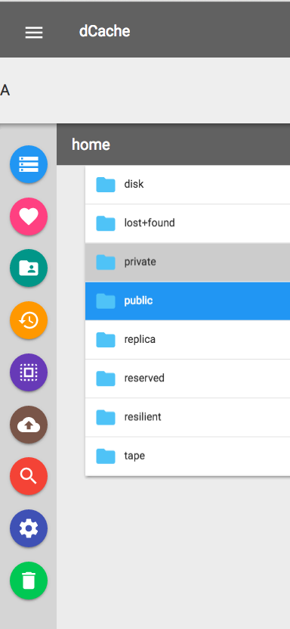



Slide 5
Objective
☑ create a user-friendly web application with all the necessary User
Interactions
☑ replace the current dCache webdav html pages
☑ integrate the user interface with dCache through “webdav door”
☑ easily maintained from both user and developer point of view

Slide 6
Memory Lane
HTML provides a set of built-in element like:
<button>, <form>, <table> …
Each element has its own API
attributes
properties
methods
events

Slide 7

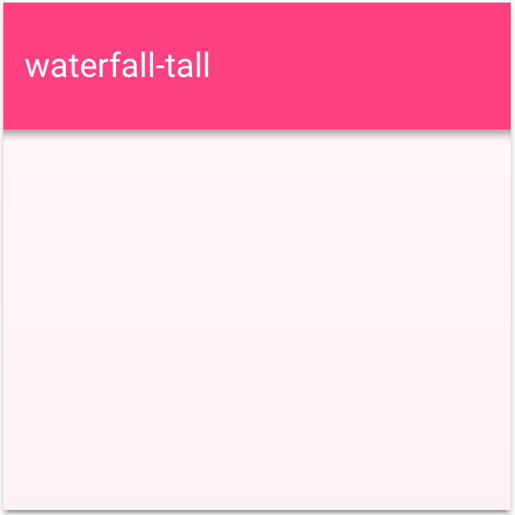
Memory Lane (2)
e.g.: To create a fixed header that will be minimize upon scrolling the page
It will take quite a few of HTML mark-up, CSS and JS

Slide 8
Memory Lane (2)
e.g.: To create a fixed header that will be minimize upon scrolling the page
What if, one can create the same widget with:
<my-header-panel></my-header-panel>

Slide 10
What is Polymer?
It is a software library developed by Google
It is used to define and style web components i.e. to create
custom elements
Objective:
“… designed to make it easier and faster for devolpers to
create great, reusable components for the modern web”
Advantage:
easily maintained from both user and developer point of view

Slide 11
What is Polymer? (2)
built on top of the web components standard and it helps to
build your own custom elements
Custom Elements
Polymer Library
Web Components (Primitives)

Slide 12
What is Polymer? (3)
“Web components are set of standards currently being produced
by Google engineers as a W3C specification that allow for the creation of
Reusable widgets or components in web documents and web application”
In reality you can build your own custom elements using the
“primitive” Web Components without POLYMER
the BUT is:
☒ it will take lot of work
☒ not all browser support W3C standard yet

Slide 13

What is Polymer? (4)
To make polymer available across most browsers
Web
Components
Web browsers
Web Components
Polyfills Library

Slide 14
What Polymer offer
Provides a declarative syntax that make it simpler to define custom elements
Provides feature like:
Templating
Two-way binding
Property observation
Provides some built-in custom elements like:
Iron-ajax
Iron-list
Paper-toolbar

Slide 15
Back to one of the new guys
dFace contents
dFace
bower_components
elements
scripts
routing.html
… others stuff
styles
bower.json
index.html

Slide 16
Deployment
dFace deployment
standalone
integrated

Slide 17
1
server
dFace

Slide 18
1
server
dFace
dCache
dRest

Slide 19
2
dCache
dRest
dFace

Slide 20
2
dCache
dRest
dFace
Jetty Server

Slide 21
2
dCache
dRest
dFace

Slide 22


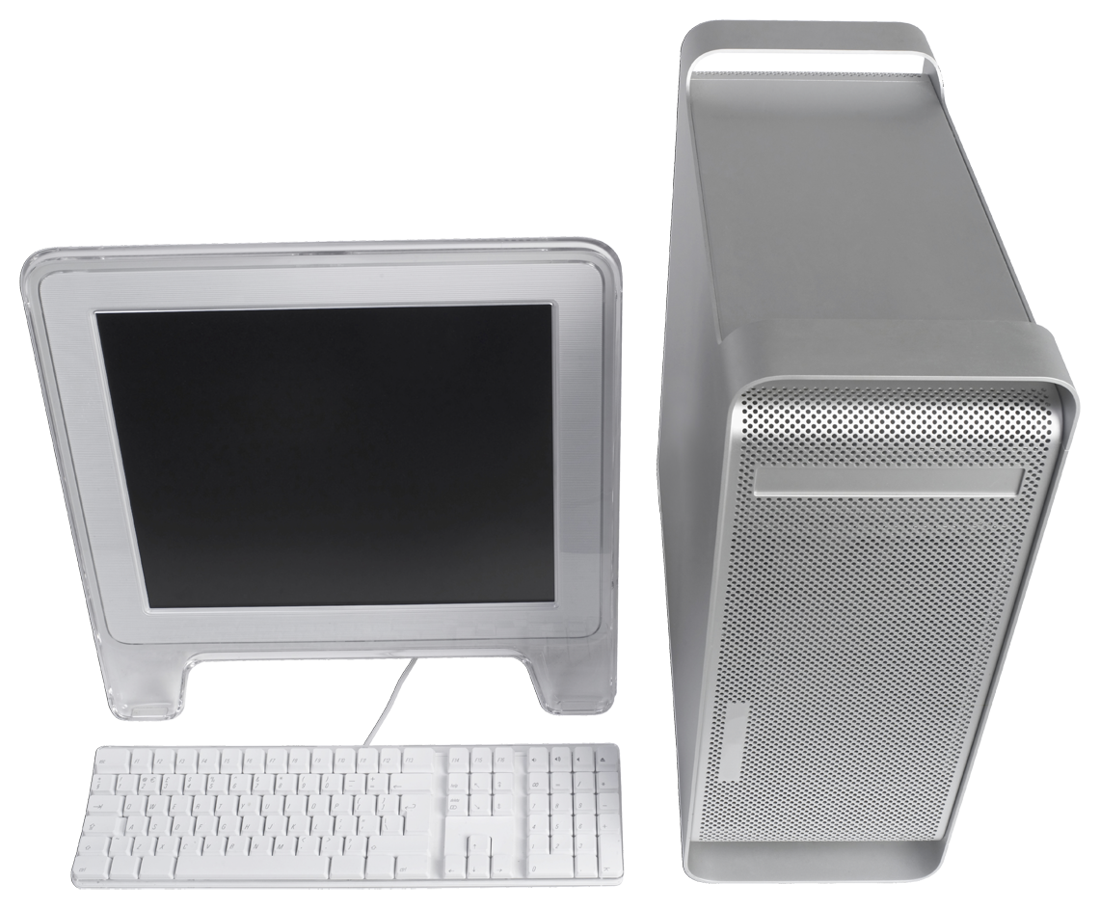
3
dCache
dRest

Slide 23
server
dFace
dCache
dRest
dFace

Slide 24
What dFace can do at the moment
Login with username + password
Listing of user root files
Shows files Metadata
Rename a file
Download a file
Move file(s) into another directory
Create a new directory

Slide 25
The second new guy: dRest
Goals of providing RESTful API service
Provide QoS features and expose them to the user
Expose dCache functionality to end user (e.g. web interface)
Stage, flush, replication, namespace manipulations...
Interact with dCache without the need to script against admin interface
    replacement for chimera-cli
Your software can talk to dCache
You can create your own Application

Slide 26
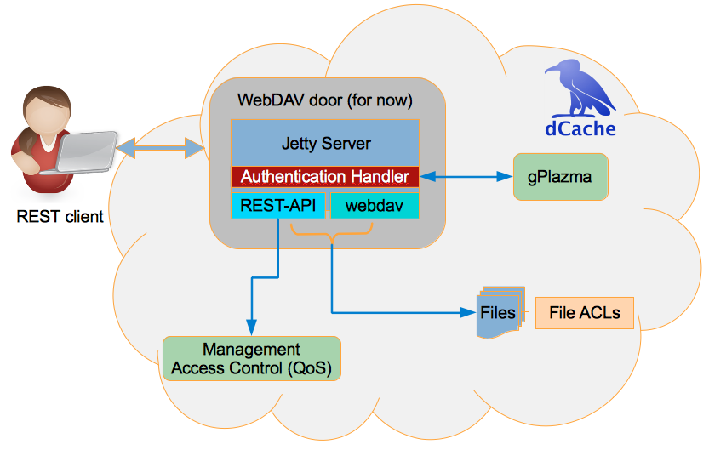
Architecture

Slide 27
List of Directories or Files
curl –user username:password
\-H "Accept: application/json”
\-H "Content-Type: application/json”
\-X POST http://localhost:2880/restapi/LIST/
\--data "{"directoryPath":"/public”}"

Slide 28
Result
{ "List":
[
{
"size": "378",
"creationTime": "Wed Apr 06 15:45:43 CEST 2016",
"mtime": "Wed Apr 06 15:45:58 CEST 2016",
"fileType": "REGULAR",
"storageInfo": "accessLatency=NEARLINE; retentionPolicy=CUSTODIAL,
"fileName": "testFile1",
"path": "/public/testFile1"
},
…
]
}

Slide 29
File Locality Query
curl --user username:password
-H "Accept: application/json”
-H "Content-Type: application/json”
-X GET http://localhost:2880/drestapi/LOCALITY/replica/test00001
RESULT:
{
“Locality”: “ONLINE”
}

Slide 30
Demo

Slide 31
Short Term Plans
House cleaning
More user friendly interactions like drag n drop
Login
-> with certificate, openID connect and any other supported implementation
of authenticating & authourisation system
upload
Management interface
like pin management, staging, etc.

Slide 32
Long Term Plans
Share and sync
Search and Selection
recycle bin
User interface for admin
.
.
.
and many more

Slide 33
Thank You

