Slide 1





OpenID Connect with dCache
Anupam Ashish
DESY Hamburg
On behalf of the project team

Slide 2


Identities
X
Identity Proof (Passport)
Identity Management
(Registration, Single SignOn)
Electronic Identity
Storage System
Read/Write to storage system

Slide 3
Multiple Organizations
X
Y
Z
Identity Management
(Registration)
Identity Management
(Registration)
Identity Management
(Registration)
Storage System
Storage System
Storage System

Slide 4
Federated Storage
Y
Identity Management
Federated Identity
Z
X
Identity Management
Identity Management
Storage System

Slide 5

Use Delegated Identities
X
Y
Identity Management
(Registration)
isValid ?
Identity Management
(Registration)
Yes, of course
Trust
Storage System
Storage System

Slide 6
Setting up the playfield..
Users (Subjects) maintain multiple identities
  Many service providers
    CERN
    EGI
  User maintains separate identity for each of them
Simplify identity management for sites
Variety of solutions
  Single Sign-On
    SAML, OpenID Connect
  Federated Identity
    Project Liberty, PRIME
  Anonymous Credentials
INDIGO-DataCloud & EGI will provide Single Sign-On
Germany building a SAML infrastructure
Notes:
Authentication process saved for sites.
Easy to allow access for visiting scientists
Infrastructures usually come with these feature

Slide 7
Single SignOn
OpenID Connect is also a Single SignOn
Electronic Identity maintained by the “Home“ organization (identity provider)
End-User can fetch an authenticated token
  Can be used with other service providers
In order for the user to log into a service
  Provides the login to identity provider
  Service Provider trusts the identity provider to validate the credentials and respond with an authenticated token
Made Possible through the use of open standards and openly published specifications
Notes:
Connecti Identity Management Systems ()
Identity Provider authenti
Identity Portability
Make the definition relatable to dCache

Slide 8
Access dCache with OpenID Connect
dCache
9. HTTP Requests (Bearer Token)
Identity Provider
Web Portal
7. Give me Tokens (code)
8. Access Tokens, ID Token (Signed)
Refresh Token
4. Redirect to OpenID Provider
3. Authenticate with OpenID
6. Code (Short Expiry)
2. Authenticate
1. Browser dCache
End-User
5. Authenticate and Authorize
Notes:
Portal not necessarily a part of dCache
Explain Code definitely

Slide 9
3 Layers of security
Identity
Provider
Validate credentials with Home Organization
Mapping the credentials to dCache Uid, Gid
Trusted Identity Providers
Validate the Bearer Token
Map OpenID credentials
Gplazma
Access Control
Permissions to access a file

Slide 10
Implementation
Gplazma Authentication Plugin (oidc)
  Authenticated HTTP requests with OpenID Connect
  Bearer Token with HTTP Header
    curl –H
    “Authorization: Bearer ya29.rQJKQt2ZzszDrt5F0P..”
  Bearer Token verified with the userinfo_endpoint
Gplazma Mapping Plugin (ldap, localmapper)
  Map to “username”, “uid”
    OpenID Connect Subject
    Email Address corresponding to OpenID credentials

Slide 11
Configuration
etc/gplazma.conf
  auth optional oidc
  map optional ldap
  map optional localmapper
share/defaults/gplazma.properties
  gplazma.oidc.hostnames = accounts.google.com
Notes:
Figure/Flowchart what will happen with dCache web-portal (femi)
Explain what oidc auth plugin does?
Map plugin should use existing plugins

Slide 12
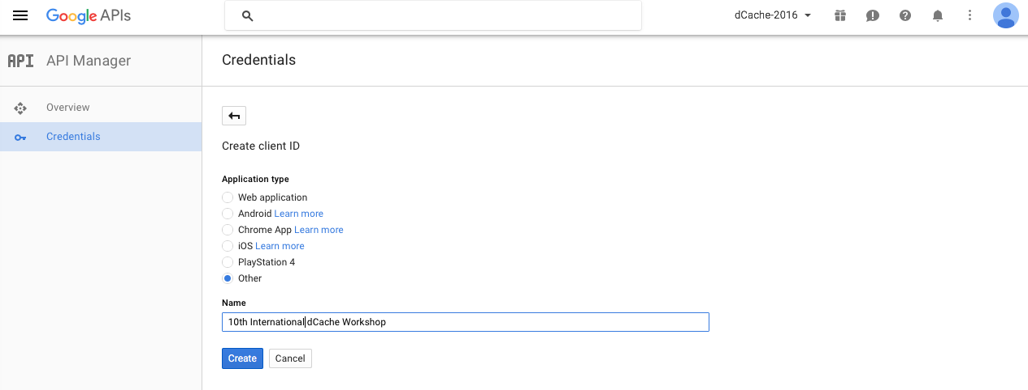
Demo
Already created client_id and client_secret for OpenID Connect
  Client is the Portal
  Client Id and Client Secret obtained by registering the portal with Identity Provider

Slide 13
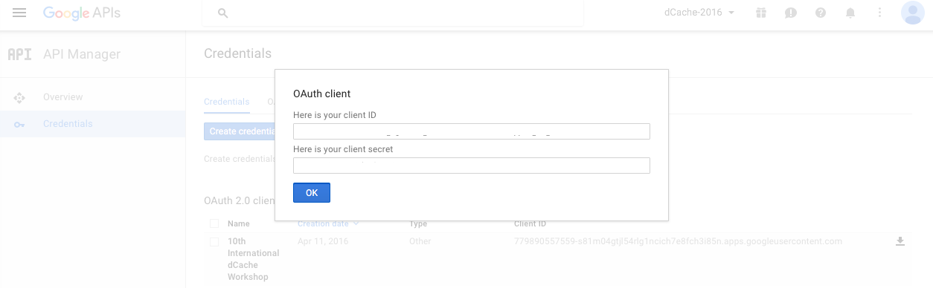
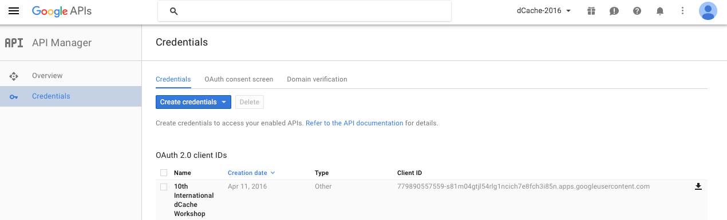
Demo

Slide 14
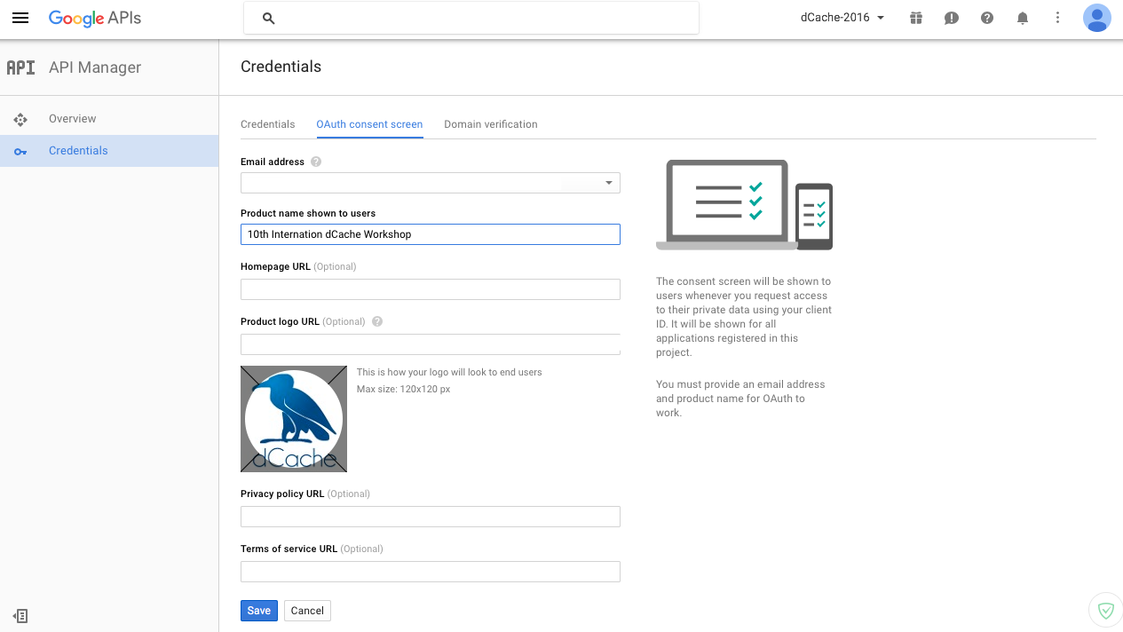
Demo

Slide 15
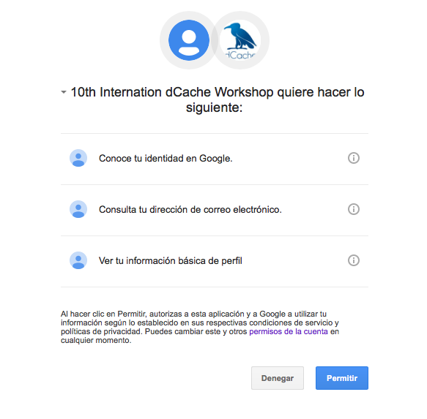
Demo
Make a HTTP request to
  https://accounts.google.com/o/oauth2/v2/auth

Slide 16

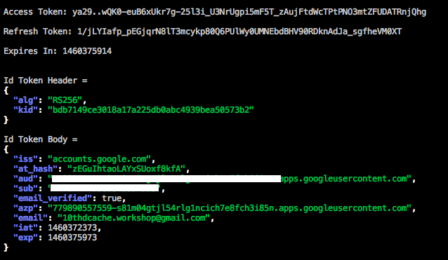
Demo
Obtain a short-lived code
Use the code to obtain
  access_token
  refresh_token
  expiry_time
  id_token

Slide 17
Demo
Use the access token to make requests to dCache
  HTTP Header
    Authorization: Bearer <access_token>
  Add a file to dCache via Webdav
  Delete a file from dCache via Webdav
curl -v -f
  -H "Authorization: Bearer <access_token>"
  -L -T /bin/bash
  http://localhost:2880/private/<copyfile>
Notes:
You have seen the REST API and you can directly use the Bearer token make REST Calls
curl -f -s -H "Authorization: Bearer ya29..vgKTW6l1Xn8Tbk2X-d7vvtWOU_3JoeCrPFM3LPGevscwTK_zuVU6TfUXFBwEBHc7UtE" -L -T /bin/bash http://localhost:2880/public/test-1455009257-45-webdav-temp
curl -f -H "Authorization: Bearer ya29..vgKTW6l1Xn8Tbk2X-d7vvtWOU_3JoeCrPFM3LPGevscwTK_zuVU6TfUXFBwEBHc7UtE" -X DELETE http://localhost:2880/public/test-1455009257-45-webdav-temp

Slide 18
Future Outlook
REST Calls using Bearer Token
Verifying access_token against
  token_introspection_endpoint (INDIGO-DataCloud)
Integration with INDIGO-DataCloud Identity Management
Session With Macaroons
Notes:
zookeeper

Slide 19
Thank you very much
Questions?

Slide 20
References
Federated Identity Management: A privacy-based characterization - Eleanor Birell, Fred B. Schneider | Cornell University
http://openid.net/specs/openid-connect-core-1_0.html
https://developers.google.com/identity/protocols/OpenIDConnect

