Slide 1
Nordic e-Infrastructure Collaboration
dCache head nodes on top of Ganeti
Ulf Tigerstedt

Slide 2
Old setup
2*database blades
2 * door blades
1 * headnode
1 * kvm VM hoster

Slide 3
Problems
HW got old
Rebooting took a long time
Limited diskspace

Slide 4
Problems
HW got old
Rebooting took a long time
Limited diskspace

Slide 5
Ganeti@NDGF-T1
VM data is kept on two nodes, in sync
Migration is transparent
No data loss (so far)

Slide 6
Load split
Ganeti runs on two beefy servers
Baremetal on them is PostgreSQL.
Everything else is on VMs
One dCache headnode
Two doors (with ~10G pools on them for ops data)

Slide 7
Workflow for updatesw
Patch+boot noncritical VMs
All VMs migrates to main DB machine
Reboot bachup DB machine
Migrate back
During an outage downtime, stop dcache, patch headnode+doors, patch+reboot main DB machine and when postgresql is up, reboot the headnode+doors in order.g

Slide 8
Workflow for updates
Downtime average: 6 minutes.

Slide 9
Ganeti@NDGF-T1
1
2
3

Slide 10
Problems with ganeti
One lock, one change at a time
Slowness when creating new VMs
Very nitpicky about DNS

Slide 11
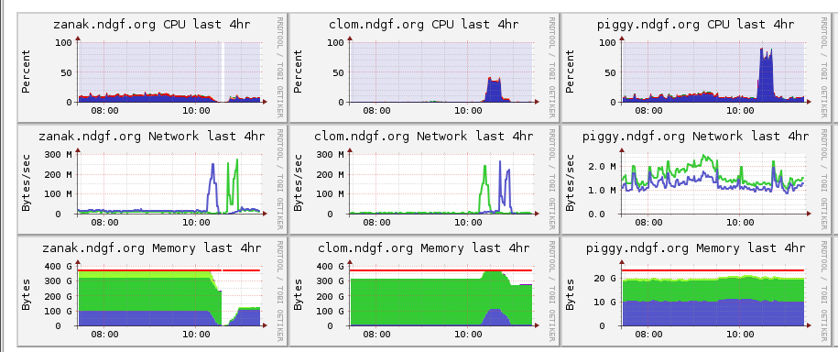
Problems with ganeti
Strangeness with CPU usage when migrating

Slide 12
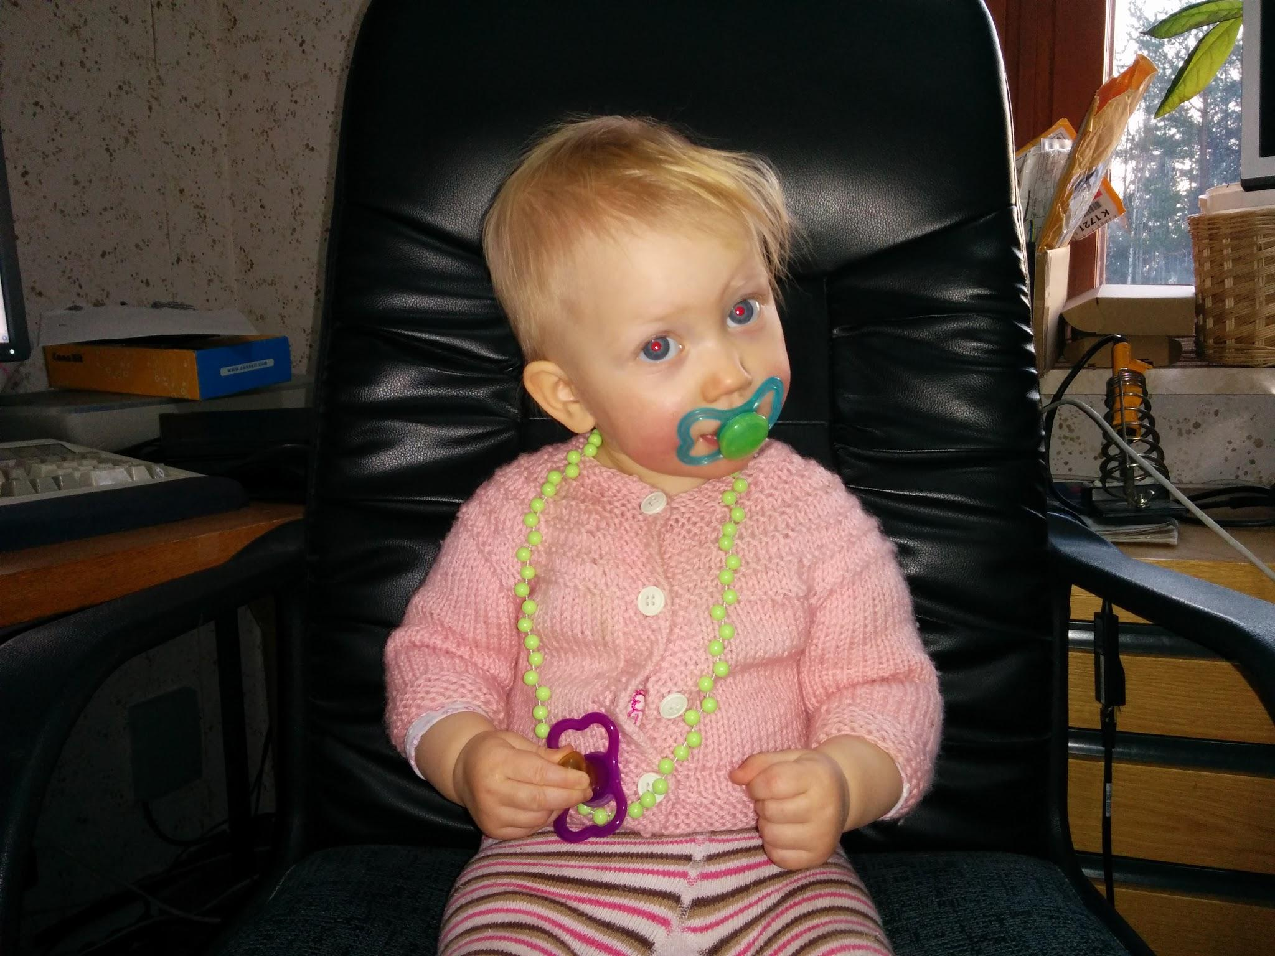
Questions?

