Slide 1
Introduction to Enstore
10th international dCache users workshop
April 11-12, 2016, Hosted by PIC
Barcelona, Catalunya
Brought to you by Enstore team: Dmitry Litvintsev and Alexander Moibenko

Slide 2
Some (ancient) History
1997
  April, CHEP’97: Patrick Fuhrmann presents A Perfectly Normal Namespace for the DESY Open Storage Manager (name obviously inspired by THGTTG)
  Fermilab is looking for alternatives to HPSS for mass storage needs of Run 2 Tevatron experiments (D0 and CDF)
  Don Petravick learns about PNFS and OSM
  December: Don Petravick visits DESY and develops Enstore prototype in python

Slide 3
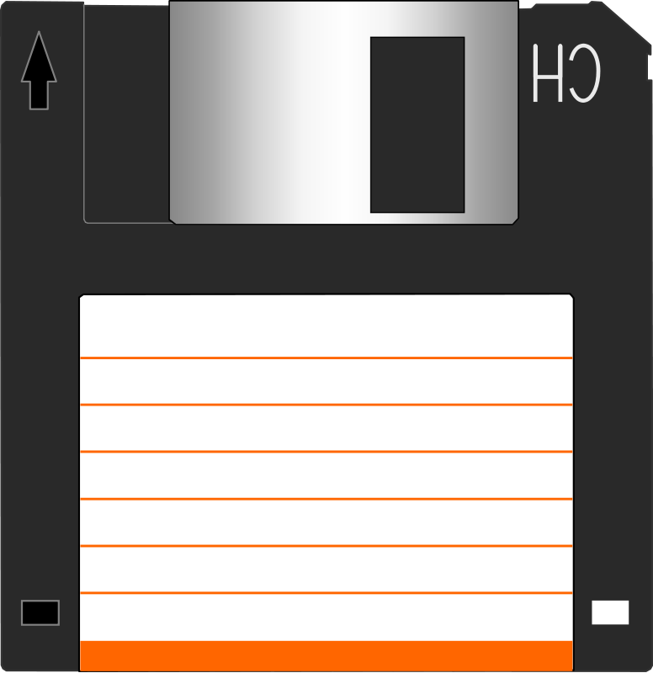
Christmas prototype
encp
Bit File Id (BFID)
Volume table
Mover
Library
Manager
￼
File table
Concept
s/OSM/Enstore/g
Use FTT library (Fermi Tape Tools) for tape I/O
Prototype:
133 MHz Pentium w/ 16MB RAM
Floppy emulating tape drive
Distributed design (multiple movers)

Slide 4
Continued large scale testing back at Fermilab showed that the basic principles were solid:
  Python is usable language for large scale system development
  Actual data transfers in C
  Network attached drives
  Distributed server components
Network
Client
PC
Robotic tape library
Client
PC
PC
Client
PNFS server

Slide 5
Purpose
Enstore system was designed to meet and exceed requirements of the Run 2 Tevatron experiments (~ 20 PB, 0.5GB/s aggregate throughput)
It has evolved into feature rich, primary data storage solution that underpins Fermilab scientific program that includes CMS T1 with total data capacity exceeding 100 PB and aggregate throughput approaching 5GB/s

Slide 6
Design considerations
Client/Server Architecture
  Reuse python server framework
Networked distributed drive access (crucial for meeting scalability requirements)
Portability
  Python
  Time critical code in C
Communication Protocols
  UDP for control request/response
    Messages fit in 1 datagram
    Retries, unique ID
    Clients can not hang servers
  TCP for data transfers
Products reuse
  Fermilab FTT − portable hooks for handling tape drives
  PNFS (later chimera) namespace
  Apache web server for web based monitoring and admin interface
  PostgreSQL DB
  Gnuplot utility for monitoring and performance metrics
  crond for scheduling various ancillary tasks

Slide 7
Enstore Zoo: a bird’s eye view
DB
DB
DB
Log server
Library Manager
drivestat
accounting
Inquisitor
File Clerk
Volume Clerk
Alarm Server
Media Changer
Inter-Process Communication
Event relay
Configuration Server
Mover
Robotic tape library
Mover
encp
Mover
Namespace

Slide 9
Namespace
PNFS/Chimera namespace is used to:
  Present user data as familiar hierarchical filesystem
  Store MSS related information associated with each file in layers. Enstore client, encp, uses:
    Layer1 to store Bit File ID (BFID)
    Layer4 to store additional (partially redundant) information that potentially would allow to reconstruct the entire MSS data catalog in case of loss
  Store per-directory data steering and resource management information by utilizing PNFS tags. The following tags are used:
    storage_group (usually name of an experiment)
    library (name of the virtual tape library)
    file_family (name of a dataset to be grouped on the same tape/set of tapes)
    file_family_width (how many movers can be used simultaneously)
    file_family_wrapper (file wrapper type)

Slide 10
Layer examples
Layer 1:
Layer 4:
cat ".(use)(1)(ep047d08.0042dila)"
CDMS139575977795761
cat ".(use)(4)(ep047d08.0042dila)"
VOO534
0000_000000000_0002378
1359778439
dcache
/pnfs/fnal.gov/usr/test/litvinse/world_readable/ep047d08.0042dila
0000B08FD2359604479283B589689FC8892B
CDMS139575977795761
stkenmvr218a:/dev/rmt/tps6d0n:1310297132
2886985789

Slide 11
Tags examples
grep "" $(cat ".(tags)()")
.(tag)(file_family):nova_production
.(tag)(file_family_width):6
.(tag)(file_family_wrapper):cpio_odc
.(tag)(library):CD-10KCF1
.(tag)(OSMTemplate):StoreName sql
.(tag)(sGroup):chimera
.(tag)(storage_group):nova

Slide 12
Enstore client: encp
encp copies data between media and user disk.
Mimics Unix cp command.
Writes: destination file/directory is located in PNFS/Chimera namespace.
Reads: source file is located in PNFS/Chimera namespace.
Distributed as statically linked executable produced with Python freeze tool => Requires no dependencies.
Control communication uses UDP => cannot hang shared Enstore servers.
Data transfer to/from Mover use TCP.
Provides end-to-end checksum.
encp --help
Usage:
encp [OPTIONS]... <source file> <destination file>
encp [OPTIONS]... <source file> [source file [...]] <destination directory>
encp [OPTIONS]... --get-bfid <bfid> <destination file>
encp [OPTIONS]... --get-cache <pnfs|chimera id> <destination file>
encp [OPTIONS]... --put-cache <pnfs|chimera id> <source file>

Slide 13
encp
Write:
  Extracts steering information from destination directory tags.
  Sends info to library manager.
  Enstore sets up file transfer.
  Reads data from disk and writes to mover on TCP socket.
Read:
  Reads file BFID from namespace
  Sends BFID to file clerk
  Enstore sets up file transfer
  Reads data from mover on TCP socket & write to disk

Slide 14
Configuration Server
Configuration Server maintains and distributes all information about system configuration such as host, port and other parameters of each server.
On startup, each Enstore server queries the Configuration Server for :
  Information on how to setup itself.
  Locations of other servers it needs to communicate.
A new configuration can be loaded into the Configuration Server from a file without disrupting the running system.
Configuration is stored in a file in a form of python dictionary
The only well known port in the system.
export ENSTORE_CONFIG_HOST=example.com
export ENSTORE_CONFIG_PORT=7500

Slide 15
Library Manager
Library Manager (LM) queues up and dispatches work for a virtual library. There is one LM for each virtual library.
Virtual library is a collection of tape volumes of the same media type in a physical tape library and movers that use these tapes.
Main job of LM is to submit transfer requests to its movers:
  Waits for mover to contact it and gives it request if mover in state IDLE or HAVE_BOUND
  Tells movers which volume to mount (draws volume from family or blank on writes, or volume containing file on reads)
Serializes independent requests on same volume and sorts them by file location on tape for efficient access.
Transfers can prioritized based on flexible criteria
Implements fair-share and discipline (controls how many simultaneous transfers can be made to/from the same host)
Checks if the "width" of volumes already active
Maintains two queues:
  Pending requests
  Work at mover requests

Slide 16
File Clerk and Info server
File Clerk tracks all files in the system.
There is one record for each file keyed on BFID.
File records are persisted to DB (PosgtreSQL is used for DB backend)
File Clerk serves as DB frontend and provides:
  Object to relation mapping of file records
  Unique BFID generation
  DB connection handling
  Request processing thread pool and request queuing
Info server is essentially read-only version of File Clerk and is used to query file records by command line tools and by other Enstore servers

Slide 17
Volume Clerk
Volume clerk tracks tapes in the system
There is one record for each volume keyed on unique volume label
Volume records are persisted to DB (PosgtreSQL is used for DB backend)
There is very simple DB structure one to many relation between file and volume table with foreign key in file table on volume id.
Volume Clerk is architected similar to File Clerk
Volume Clerk responsibility is to:
  Assign new volumes
  Draw volumes for write on request from Library Manager
  Provide interface to query and modify volume information
  Maintain tape quotas by storage_group and library

Slide 18
Media Changer
Media changer represents a physical device performing mounts/dismounts of volumes per request from Movers on drives by talking to library specific control micro
May serve multiple drives and Library Managers
The Media Changer issues multiple simultaneous commands by forking processes that do the work. There is a certain preset limit (MAXWORK) of forked processes.
If Media Changer receives mount/dismount requests while there are MAXWORK unfinished operations then new these requests are discarded, Mover requests time out and retried.

Slide 19
Log server
Receives messages from other processes and logs them into formatted log files.
Log files are labeled by dates.
Files are rotated at midnight.
Clients do not retry on UDP messages
System can not hang because of full logfile partition.
Format: timestamp clienthost UID Username ClientName message:
16:46:43 enmvr064.fnal.gov 006676 root I 10KC_064MV Updating stats Thread media_thread
16:46:43 enmvr064.fnal.gov 006676 root I 10KC_064MV Ejecting tape Thread media_thread
16:46:43 cmsstor271.fnal.gov 001553 root I ENCP using request cmsstor271.fnal.gov-1460225802-1553-0 instead for error processing
16:46:43 cmsstor271.fnal.gov 001553 root W ENCP ('RESUBMITTING', 'cmsstor271.fnal.gov-1460225802-1553-0')
16:46:43 cmsstor271.fnal.gov 001553 root I ENCP Sending /pnfs/.(access)(000001B0E8F6E19048A9A9CDE95E611FC772) read request to LM: unique_id: cmsstor271.fnal.gov-1460225802-1553-0 inputfile: /pnfs/.(access)(00007CFBDE0E9BCB44A9BFEAE8B9D6728FB2)/.(access)(000001B0E8F6E19048A9A9CDE95E611FC772) outputfile: /storage/data2/write-pool/data/000001B0E8F6E19048A9A9CDE95E611FC772

Slide 20
Mover
Reads files from tapes and sends data to user.
Reads data from user and writes file to tape.
TCP for data transfers.
Each tape drive has its own mover process
  One computer can run many movers
  One mover can belong to many library managers.
Steps in transfer:
  When idle, asks library manager for work
  Library manager tells mover to mount volume x
  Mover calls media changer to mount volume
  Library manager gives mover transfer requests
  Mover contacts encp
  Mover transfers requested data to user

Slide 21
Mover
Reads:
  Using the file location_cookie, position tape to the beginning of data.
  Read wrappering information that precedes the actual data.
  Fork a process that reads and calculates crc on the data from the volume and placing the data into a shared memory buffer.
  Write data from the shared memory to the encp process over TCP socket.
  Read any wrappering information that comes after the data.
  Close the data port.
  Tell the user done and all is well.
  Close the control port

Slide 22
Mover
Writes:
  Using the volume eod_cookie, fast forward to end of volume. Try to verify that we are actually at the end of volume.
  Write any wrappering information that precedes the data.
  Fork a process that reads and crc's data from the encp and placing the data into a shared memory buffer.
  Write data from the shared memory to the tape device.
  Close the data port.
  Write any wrappering information after the data.
  Compute new eod_cookie and tell Volume Clerk that the volume is writable. Update remaining bytes as well.
  Compute the file location cookie, and tell the bit File Clerk about the new file. Get a bit file ID in return.
  Give the bit file ID to encp. Done.

Slide 23
FTT
Fermi Tape Tools (ftt)
  Table driven method to add new tape drives
  Provides mt and raw SCSI access to tapes
  Supports multiple types of serial media
  Portable implementation
Parts of FTT that Enstore uses:
  Position media to correct file
    By filemarks
    By partitions
    Read/write data
  Write filemarks, both buffered and unbuffered
  Get remaining capacity of tape
  Drive statistics

Slide 24
Inquisitor
Monitors system status and activity.
html
Apache httpd
Inquisitor
jpg
ascii
Movrer
File Clerk
Volume Clerk
. . .

Slide 25
Alarm Server
Receives and maintains alarm messages send by Enstore components
Interfaces to ServiceNow to generate incident tickets and pages so support personnel.

Slide 26
Inquisitor
http://www-stken.fnal.gov/enstore/status_enstore_system.html

Slide 27
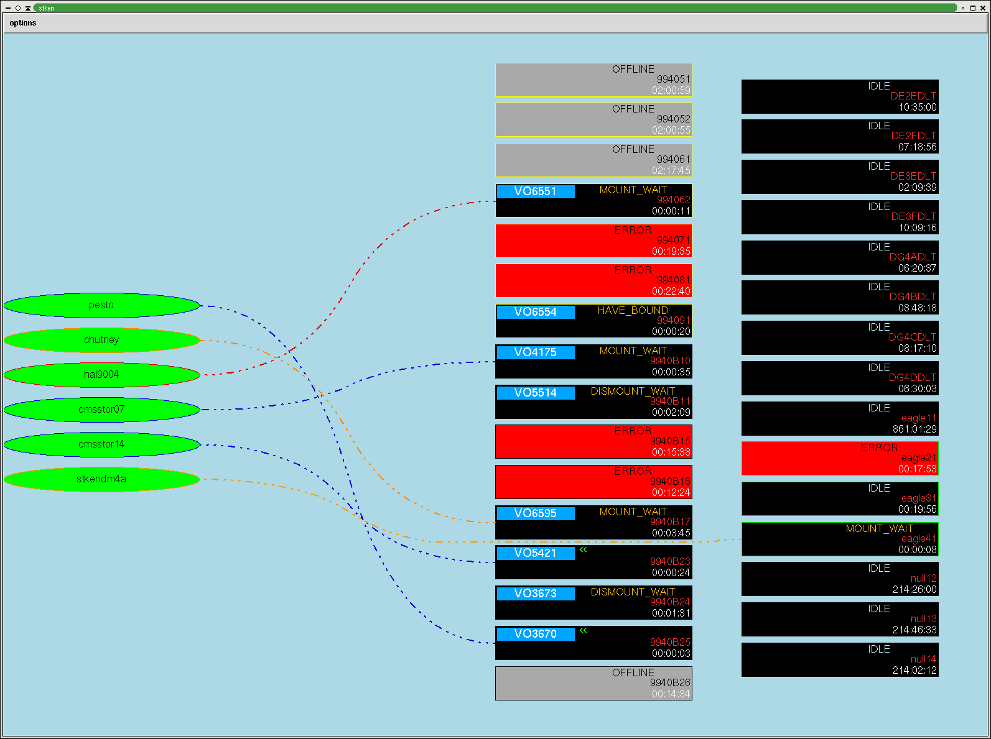
Monitoring
Server States
Resources (tape quota, drive utilization, drive hours)
Data movement rates
Volume usage (fill factor)
Alarms

Slide 28
Event Relay
Enstore services subscribe to receive notifications (events) via event relay
Typically configuration reloads are relayed to Enstore servers and they implement logic of how to react to these changes.

Slide 30
z

Slide 31
General Features
End-to-end checksums of data transfers.
Periodic checks of random volumes to detect data/media corruption.
Optimized access to user data by utilizing steering information stored in PNFS directory tags:
  Enstore puts files on tape in the order the files were submitted.
  Files are grouped on tape using file family and file family width scheme.
Utilities to query tape content.
Filesystem-like view of user stored data (thanks to PNFS/Chimera).
Policy driven small file aggregation.

Slide 32
Resource Management
Tape quotas based on storage group tags.
Movers (and hence drives) can by dynamically assigned to match the conditions and priorities.
Mount/dismount minimization: once tape is mounted, the queue is checked & all requests for volume are done before dismounting.
Priority based request handling.
Fair-share.
Discipline (allow only certain number of clients from the same host to use a movers at the same time because of bandwidth considerations).

Slide 33
Features
Tape import/export:
  Volumes in Enstore are self describing allowing for easy tape export.
  Conversely, provided metadata, it is relatively easy to import tape in Enstore
Read-only and other flags
  An CLI exist to set various flags on a tape (read-only, NOACCESS etc.)
Open format
  Tapes are self−describing with each file wrappered (cpio or cern wrapper)
  Unix utilities exist to read wrappered files
Data migration:
  Enstore provides semi-automated procedure to migrate data to new media

Slide 34
Availability
Unattended operation
Automatic error reporting and alarming on serious errors or when available resources drop below threshold (number of available movers, tape quota approaching etc.)
Robust against mover/drive failures because system is distributed.
Single point of failure servers are simple and very robust.
Extensive end−to−end error control and retry.

Slide 35
Small Files Problem
Issues with small files:
  Per file overhead to write a file mark (on writes)
  Tape back-hitching : when data streaming to tape is interrupted (e.g. for the next file in queue) (on writes)
  Mount latency (including load time) (on writes and reads)
  Unload (rewind time) (on writes and reads)
  Seek time (on writes and reads)

Slide 36
SFA: Small File Aggregation
Enstore automatically aggregates small files into larger containers (using tar utility)
  Implemented by utilizing so called disk mover
Transparent to user - packing and un-packing at server side, users sees only small files
Preserve end-to-end checksums
Assume custodial ownership of files in SFA disk cache
Per customer small files policies (that define what small file is and how many files per package)

Slide 37
Small File Aggregation
Volume
Volume
volume id
File
Package
package id
File

Slide 38
Policy driven aggregation
Enstore aggregates files by storage group and file family.
Policy is expressed using:
  Original library
  Resulting disk library
  Storage group
  File family
  File family wrapper
  Minimum file size
  Maximum # of files per package
  Maximum time to wait before files are packaged and written to tape

Slide 39
SFA Components
Policy engine: stores and appies file aggregation policies:
  receives event from File Clerk that file has arrived to disk cache or needs to be staged into disk cache
  Maintains 3 lists:
    Archive – files to be written to tape.
    Stage – files to be staged from tape
    Purge – files to be purged form disk cache
Migration Dispatcher : receives file lists from Policy Engine and dispatches them migrators.
Migrators: aggregate data in cache and write container to tape. They stage aggregated data and unpack files for read requests. All files in a container read from tape get unpackaged and cached, even if not requested.
Library Manager re-Director:
  receives write request from encp and determines if data needs to be send to disk mover instead.
Disk movers: transfer files to SFA disk
Communication layer between File Clerk, Dispatcher and Migrators are implemented using Apache QPID AMQP messaging system.

Slide 40
SFA package
SFA package is self described container (tar file)
Each SFA package contains a file manifest that includes:
  file path in cache
  file name in namespace
  file checksum
Package files are written into Enstore and places into a separate (user invisible) directory.

Slide 41
Writing Files
Library Manager Director
File Clerk
1
2
3
Disk Library Manager
8
encp
7
Policy Engine Server & Migration Dispatcher
5
4
Disk Mover
6
Cache
9
Tape Storage
(Enstore)
10
11
Migrator

Slide 42
Reading Files.
File Clerk
2
1
Disk Library Manager
encp
3
Policy Engine Server & Migration Dispatcher
9
4
Disk Mover
8
Cache
5
Tape Storage
(Enstore)
7
6
Migrator

Slide 43
Data Integrity in Cache
ZFS is used as Enstore fata cache for reliability (Nexenta Appliance, RAIDZ2).
Selective checksum verification before writing package files to tape.
Track files in transition in database. Alarms if there are stale, left over files.

Slide 44

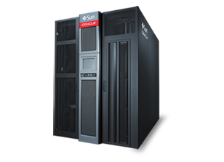
dCache and Enstore
TCP/IP
NFS
(G)FTP
XRootD
WebDAV
dCap
dCache
encp
TCP, UDP
Enstore
SCSI
Tape robot

Slide 45
SFA and dCache
Container
file1
file2
Policies
…
…
Migrator
Tape
Tape
Mover
Write Cache
(ZFS)
Enstore
Disk
Mover
HSM script
fetch container
….
rw pools
Write Client
SFA ro pools
Read Client
dCache
HSM script
untar file1
….

Slide 46
Enstore Deployments
Enstore is currently used:
  Fermilab (3 instances, total capacity 100 PB)
  PIC
  2 Russian Tier 1 sites

Slide 47
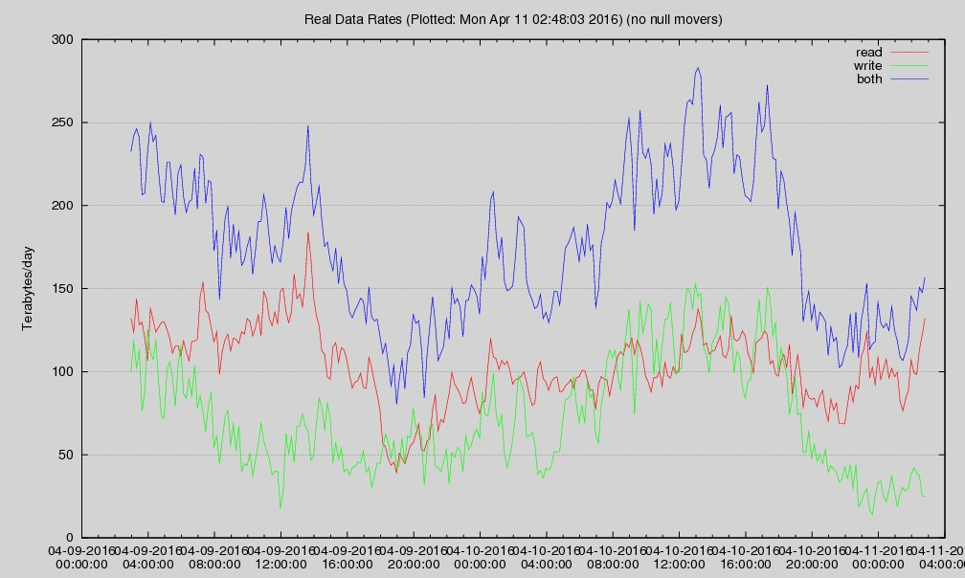
A performance plot (Fermilab)

Slide 48
Concluding remarks
Enstore meets and exceeds data storage requirements of Fermilab hosted (and collaborated) experiments.
Scales easily to higher throughput and capacity
Robust and fault tolerant
Uses commodity hardware and software (besides robotic livbrary)
Check current status and details here:
  http://www-ccf.fnal.gov/enstore/

