Slide 1
High Level Controls for the XFEL
Raimund Kammering
for the HLC team

Slide 2
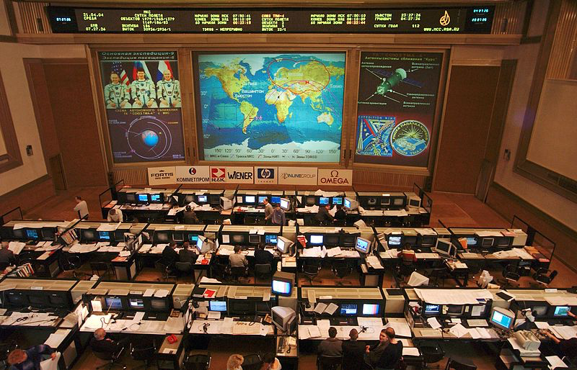
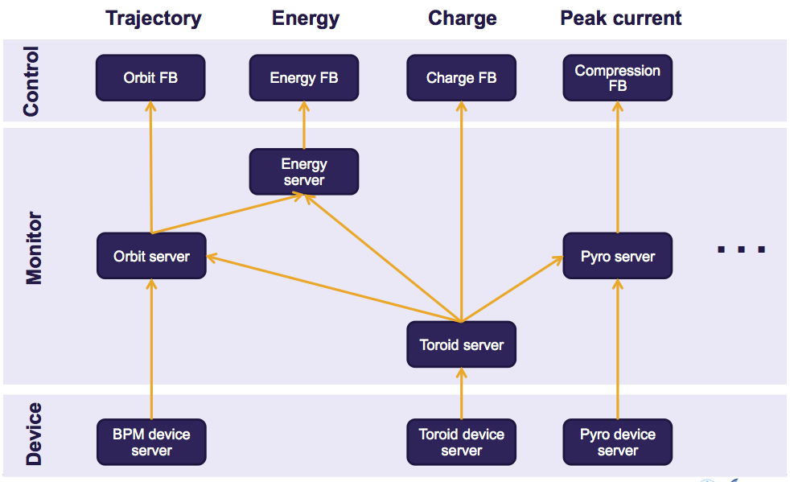
Outline
What's High Level Controls The need for a High Level View
High Level Control Concepts Architecture, Development and Testing
Summary and Status Be ready at the right point of time

Slide 3
The need for a High Level View
Machine Layout Coordination
HLC
MCS
MPY
MSK
Notes:
one could extend this list
Actively support/participate in commissioning
Enable smooth operation
Software infrastructures
User interfaces
Tools (physics, controls, etc.)

Slide 4
The need for a High Level View
Classic controls
physically
meaningful data
µTCA crate
0 | 0.205 mm
1 | 0.198 mm
2 | 0.194 mm
3 | 0.207 mm
4 | 0.210 mm
… | …
+
Server Code
→
→
→
typically DOOCS
C++ based server
display/work with
data

Slide 5
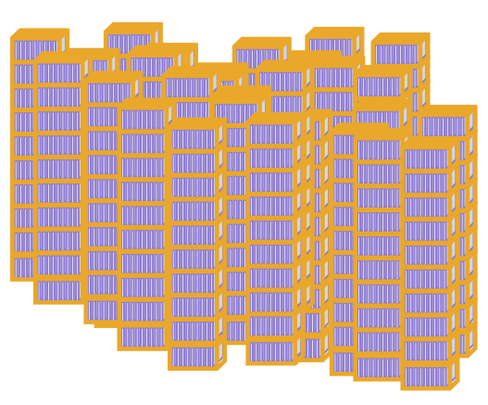
The need for a High Level View
0 | 0.205 mm
1 | 0.198 mm
2 | 0.194 mm
3 | 0.207 mm
4 | 0.210 mm
… | …
+
Server Code
→
→
→
O(kB/s)
x 200
…
0 | 0.215 mm
1 | 0.199 mm
2 | 0.198 mm
3 | 0.201 mm
4 | 0.209 mm
… | …
0 | 0.195 mm
1 | 0.196 mm
2 | 0.184 mm
3 | 0.187 mm
4 | 0.201 mm
… | …
0 | 0.205 mm
1 | 0.198 mm
2 | 0.194 mm
3 | 0.207 mm
4 | 0.210 mm
… | …
+
Server Code
→
→
O(GB/s)

Slide 6
The need for a High Level View
Have automation and analysis software ready from the beginning … and not only the front-ends interfaced
High amount of data produced by the machine requires data reduction!
… BPMs: 4 byte * 2700 bunches * 500 BPMs * 2 planes * 10 Hz → >100 MB/s
We need to think more in terms of physics entities … makes little sense to view 1 of 500 BPMs → think in terms of orbit as object
Provide an common interface to work with shoot synchronized data … to cope with the complexity of this multi-beam-line facility

Slide 7
HLC Architecture

Slide 8
HLC Architecture

Slide 9
HLC Architecture
Console Programs
SASE Control
High Level Servers
Orbit display, bumps
Energy Management and Bunch compression
Optics Measurement and matching
Machine State Control (Sequencing, Bunch Patterns)
Orbit Control
Peak Current Control
Optic
Energy Profile
Rf control
Sequencer
Toroid
Orbit
rf
BLM
DAQ
SASE
Magnet Server
Undulator Control
Beam Profile Monitors
Others
Middle layer servers for ‘fast’ components
Middle layer servers for ‘slow’ components
RF
BPM
BLM
Toroid
SASE Intensity
Magnet Controller
Screens
Wire Scanners
Others
Device servers which produce data for each bunch in pulse train
Device servers for ‘slow’ components

Slide 10
HLC Development and Testing
FLASH is the little brother of XFEL
Control System: DOOCS/TINE
Front-end Hardware: VME, µTCA
Timing System
Machine Protection System
Multi-Beam-Line Operation
…
➔ FLASH is the test bed for software to be used at XFEL
but …
XFEL is 10 times as big!

Slide 11
HLC Development and Testing
Console Programs
SASE Control
High Level Servers
✔
✔
Orbit display, bumps
Energy Management and Bunch compression
Optics Measurement and matching
Machine State Control (Sequencing, Bunch Patterns)
✔
✔
✔
✔
Orbit Control
Peak Current Control
Optic
Energy Profile
Rf control
Sequencer
Toroid
✔
status ~ early 2014
Orbit
✔
rf
✔
BLM
DAQ
SASE
✔
Magnet Server
Undulator Control
Beam Profile Monitors
Others
✔
Middle layer servers for ‘fast’ components
Middle layer servers for ‘slow’ components
✔
✔
✔
RF
BPM
BLM
Toroid
SASE Intensity
Magnet Controller
Screens
Wire Scanners
Others
Device servers which produce data for each bunch in pulse train
Device servers for ‘slow’ components

Slide 12
HLC Development and Testing
Console Programs
SASE Control
High Level Servers
Orbit display, bumps
Energy Management and Bunch compression
Optics Measurement and matching
Machine State Control (Sequencing, Bunch Patterns)
Orbit Control
Peak Current Control
Optic
Energy Profile
Rf control
Sequencer
Toroid
Orbit
rf
BLM
DAQ
SASE
Magnet Server
Undulator Control
Beam Profile Monitors
Others
Middle layer servers for ‘fast’ components
Middle layer servers for ‘slow’ components
RF
BPM
BLM
Toroid
SASE Intensity
Magnet Controller
Screens
Wire Scanners
Others
Device servers which produce data for each bunch in pulse train
Device servers for ‘slow’ components

Slide 13
HLC Development and Testing
Orbit display, bumps
1. calculate orbit for given optic
4. Display orbit
+
modify by bump program
Optic
6. new currents to
optic server
5. write new currents
Orbit
DAQ
Magnet Server
3. send orbit data
to DAQ/orbit server
2. write orbit to BPM server
BPM

Slide 14
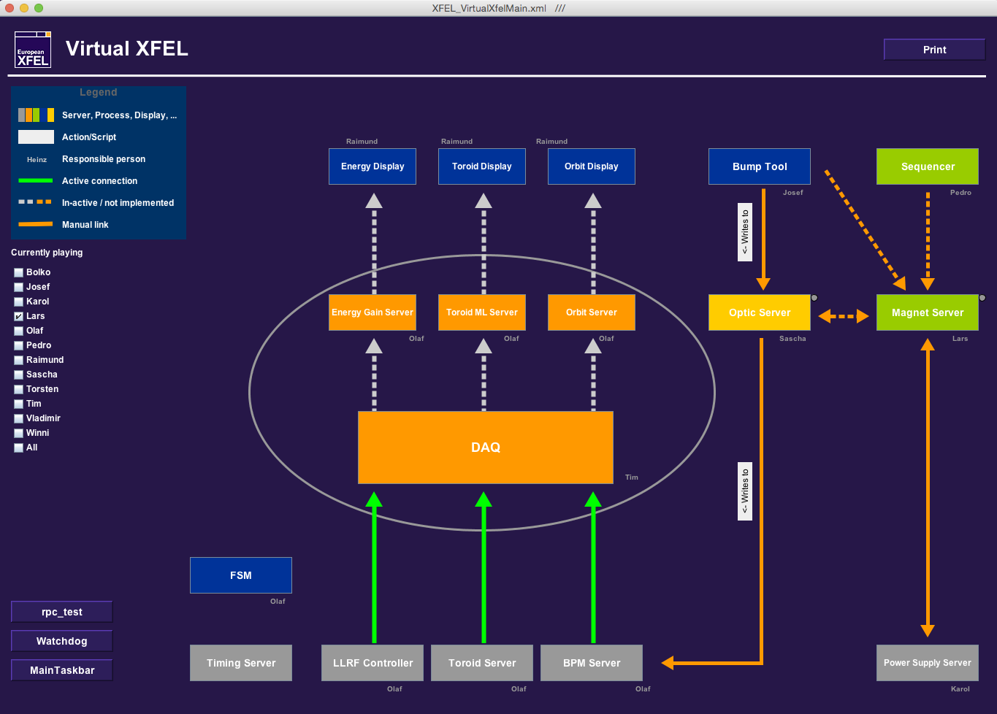
HLC Development and Testing

Slide 15
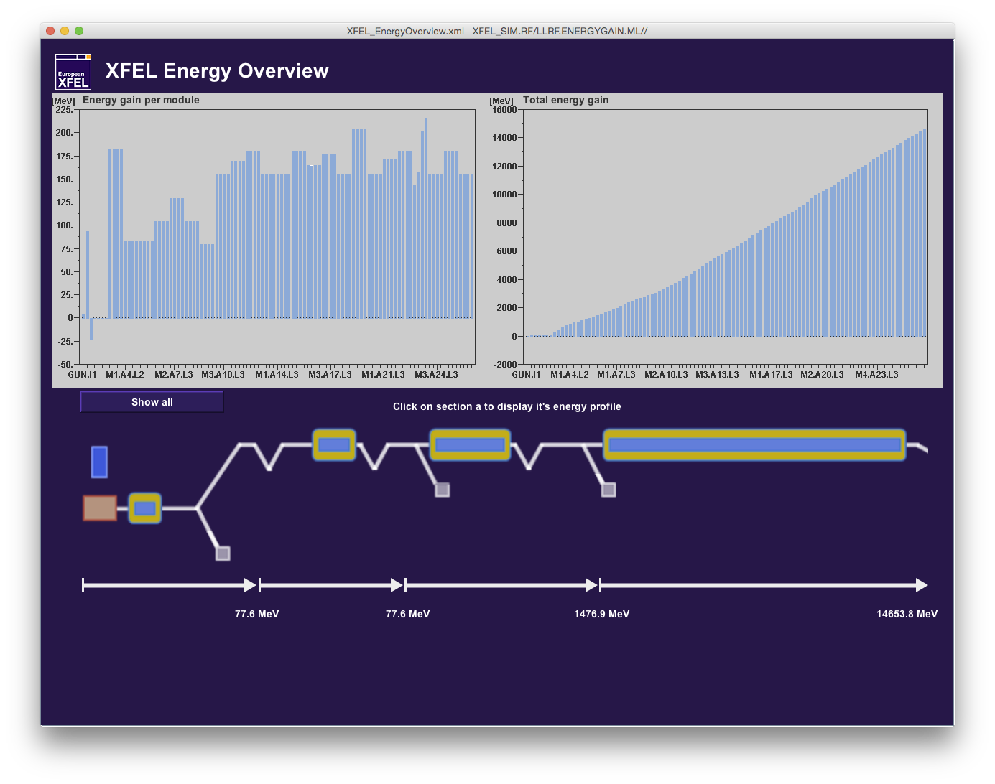
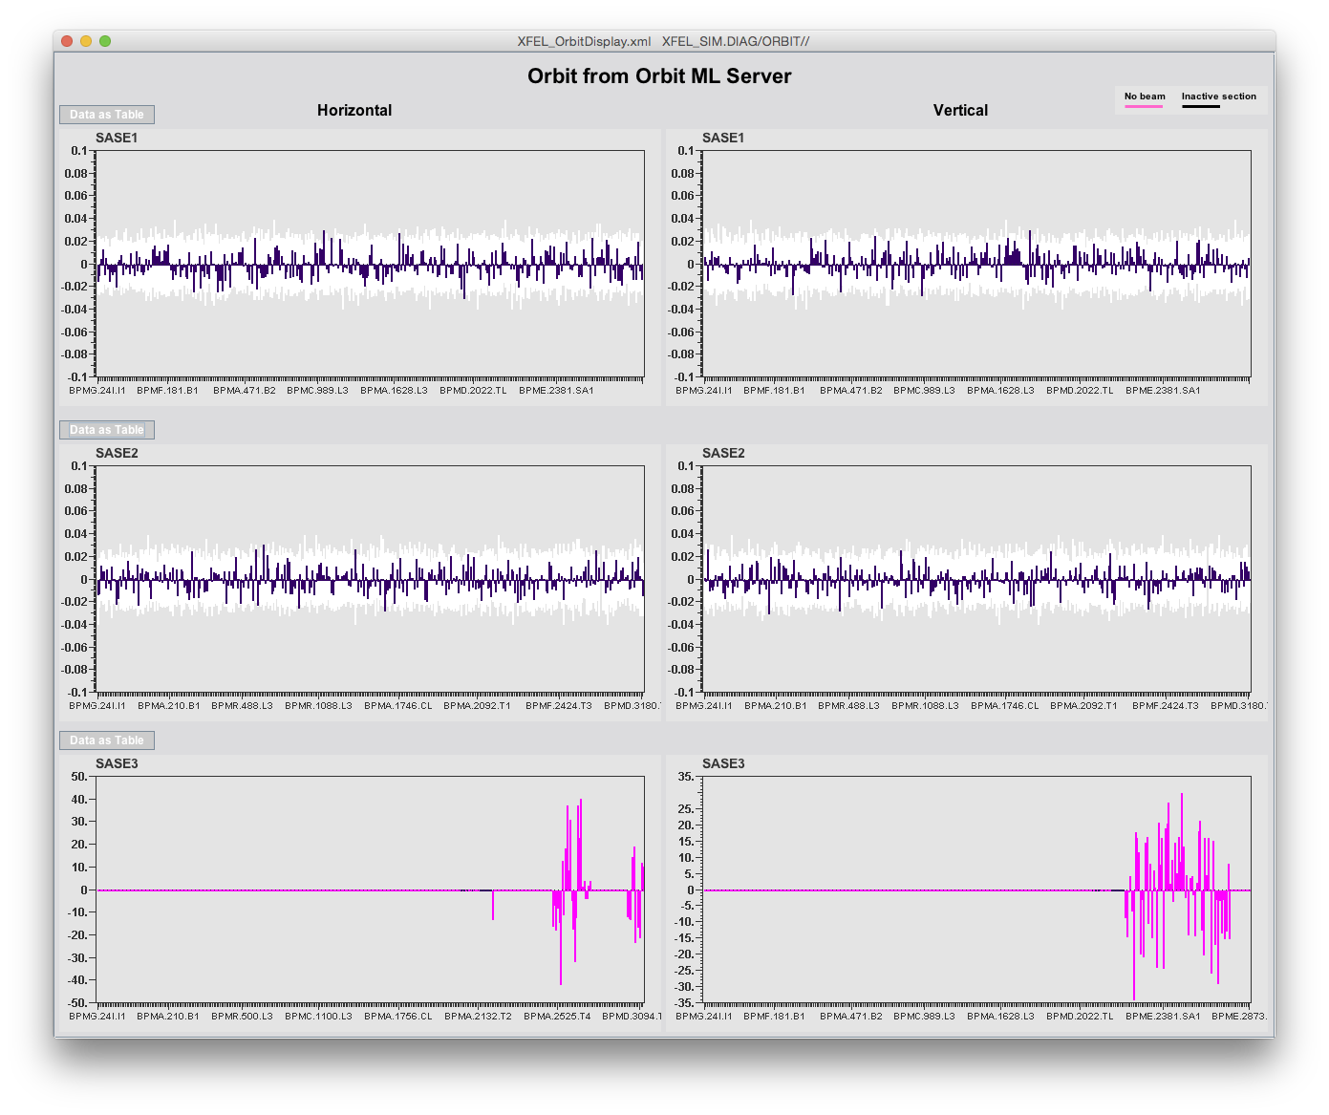
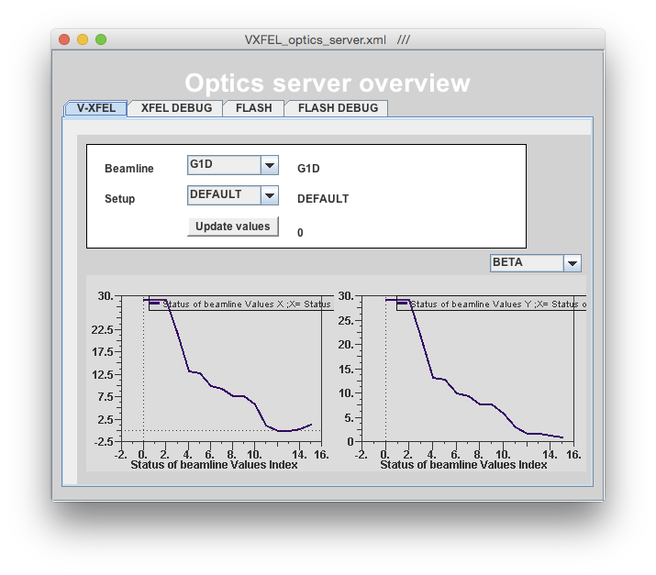
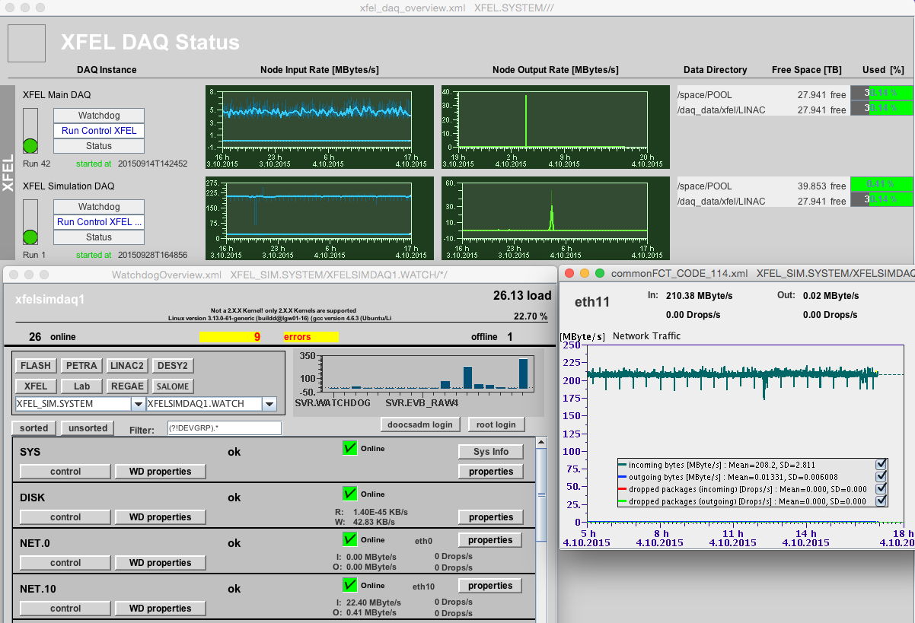
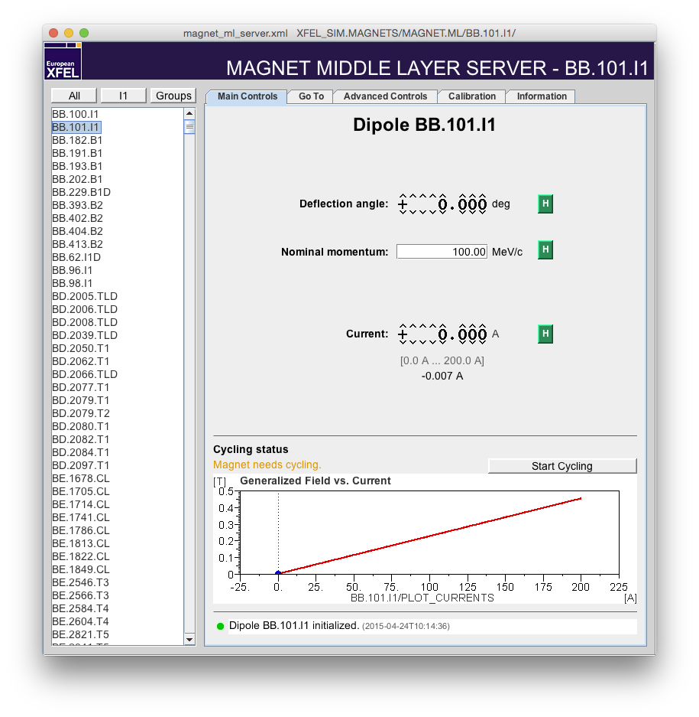
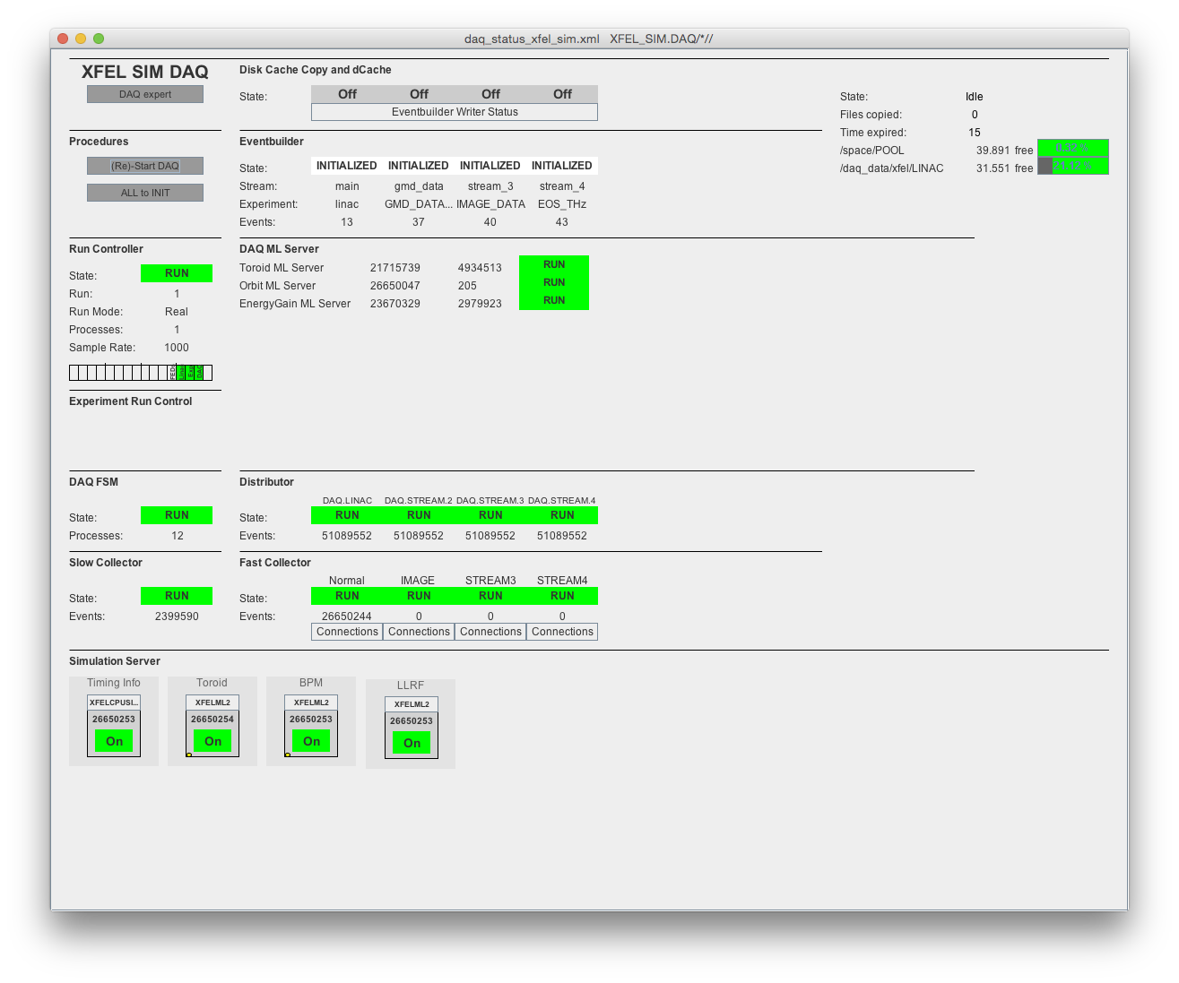
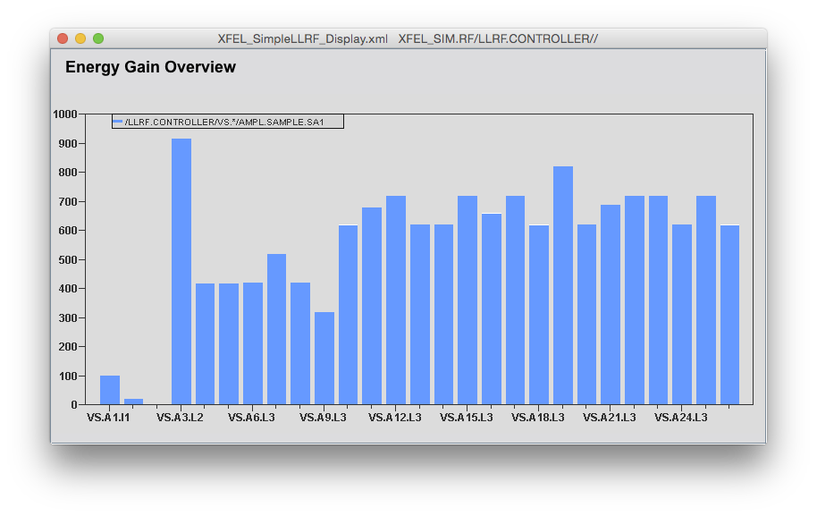
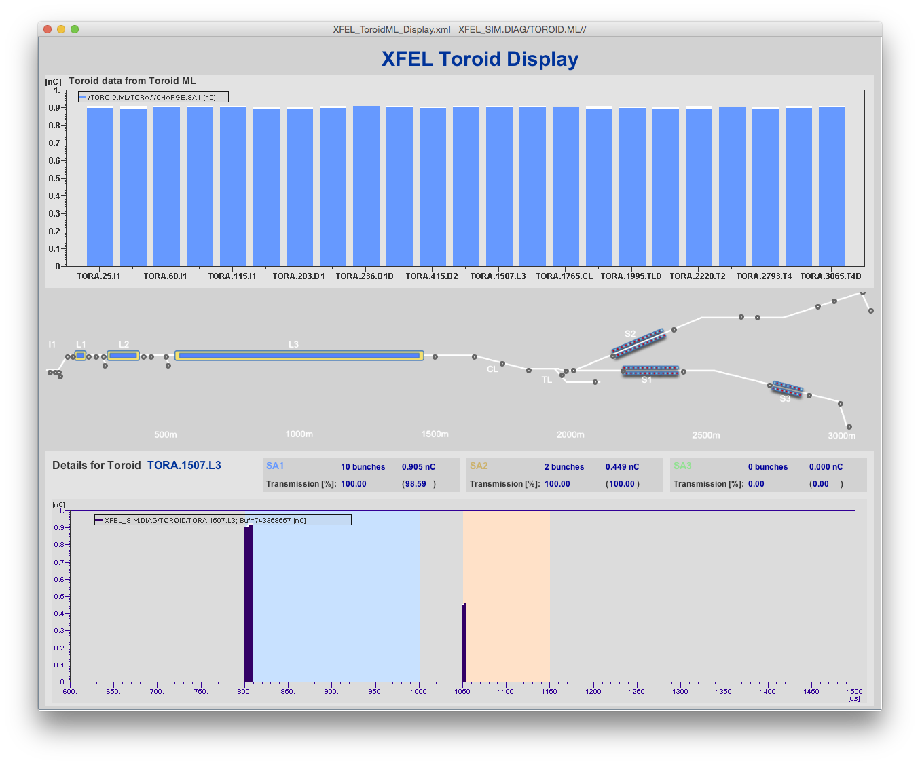
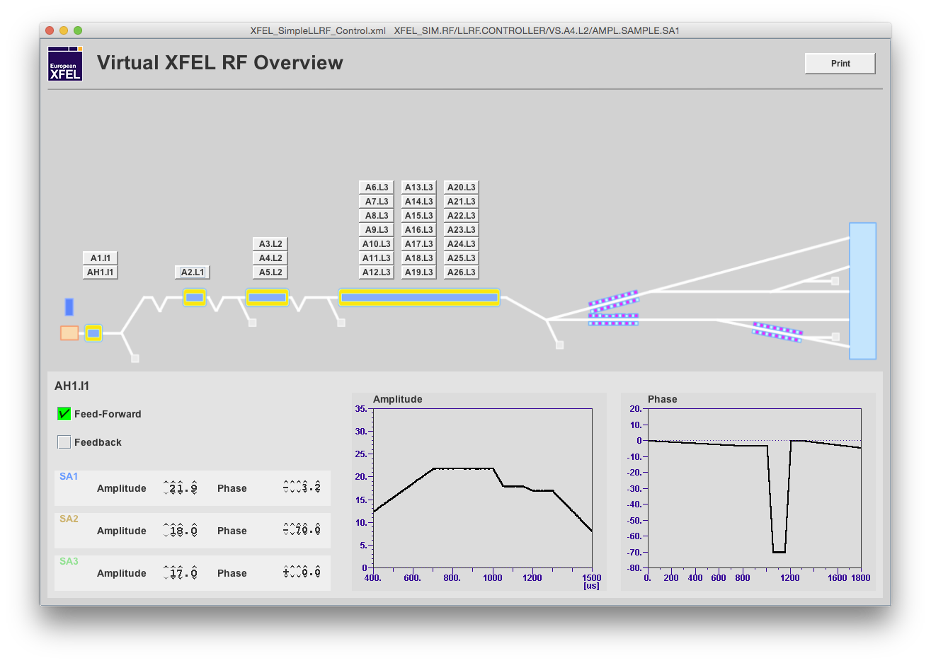
HLC Development and Testing

Slide 16
Summary and Status
Concepts have proven to be working
Overall architecture
Data throughput
Synchronization
…
With FLASH and the Virtual XFEL we have realistic test environments → many parts could be prepare in advance
Also GUI (representation layer) could be worked on and tested
Nonetheless are display(s) and GUIs in general a frequent source for discussions (jddd vs. Rich-Clients, Python, …)
Some interface(s) – photon diagnostics – still need work …!

Slide 17
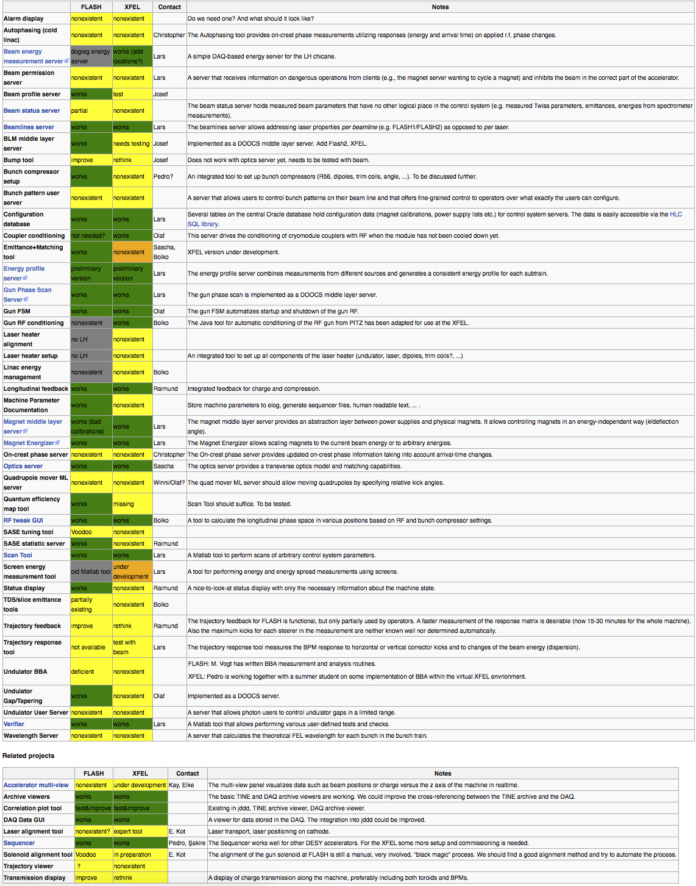
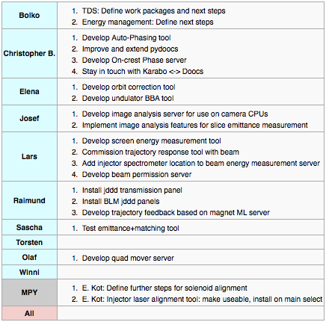
Summary and Status
Much effort has been put to set up a solid infrastructure (interfaces, libraries, standards, …)
Prioritized needed HLC software to match schedule
Ready for injector commissioning (monitor, control and stabilize charge, peak current, energy and trajectory)

Slide 18
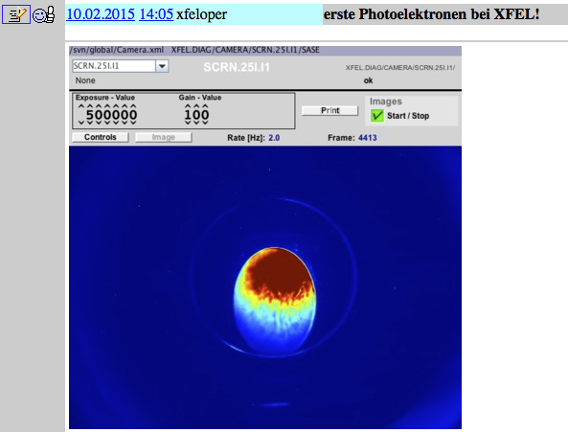
End
We are prepared and waiting for beam …!
Thank you for your attention!

