Slide 1
Laser test on CHESS1 chip
Vitaliy Fadeyev, Zach Galloway , Herve Grabas
Alexander Grillo , Zhijun Liang , Abe Seiden
Jennifer Volk, Forest Martinez-Mckinney
University of California, Santa Cruz

Slide 2
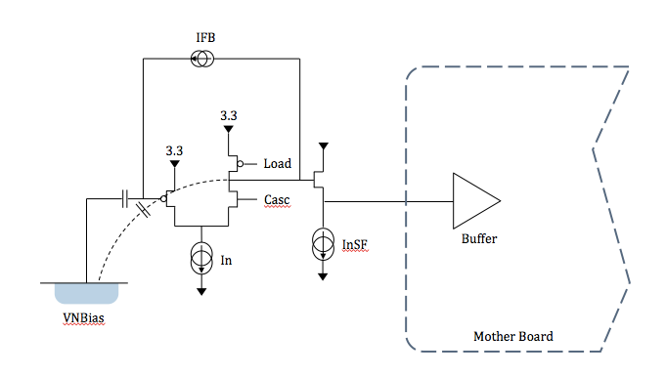
Amplifier biases setup for CHESS1active pixel testing
df
 | Config 7 | Config 8
VPFB | 2.664V | 2.7V
VNSF | 0.57 | 0.75
VCasc | 2.6V | 2.6V
VPload | 2.1V | 2.1V
VN | 1V | 1V
VNBias | 340mV | 150mV

Slide 3
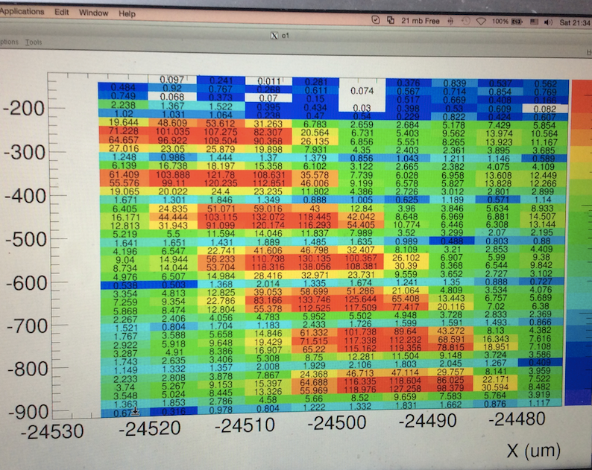
Laser focusing and 2D scan
IR Laser is focused to about 5um beam spot size.
A 2D scan on one pixel in APA07 (45X800um).
  N-well can be clearly seen.

Slide 4
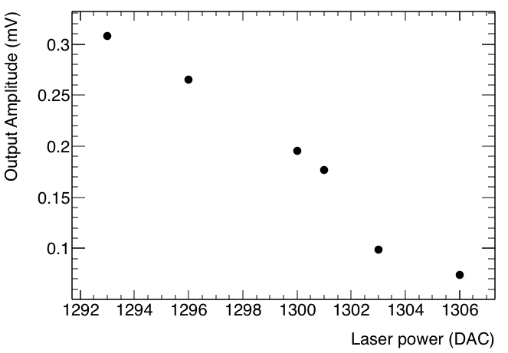
Laser power VS output amplitude
Try to reproduce the charge deposition of MIP using focused laser beam.
But it is not very sure which laser power value corresponding to MIP
  Check CHESS1 signal output in different laser power
V_bias =120V , config 8
MIP

Slide 5
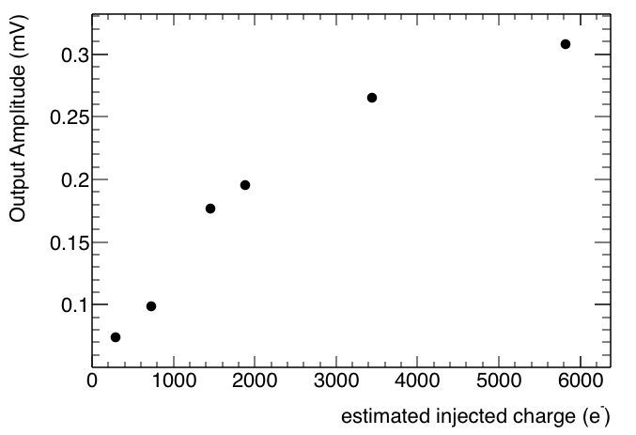
Injected charge VS output amplitude
Based on the calibration by Zach.
We correlated the laser power with estimated injected charge.
MIP

Slide 6
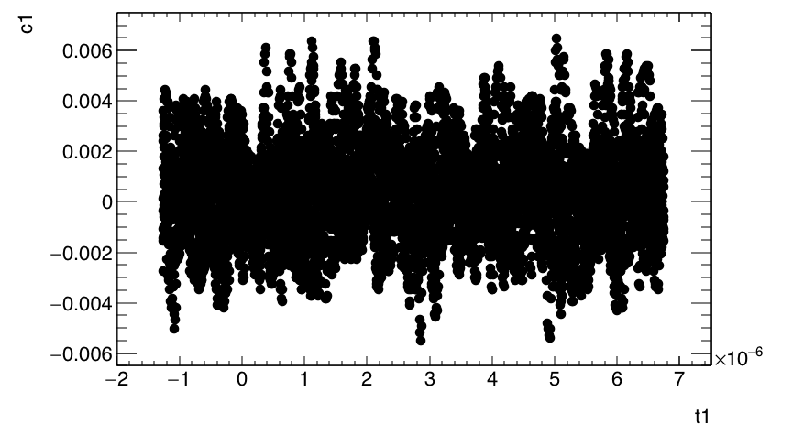
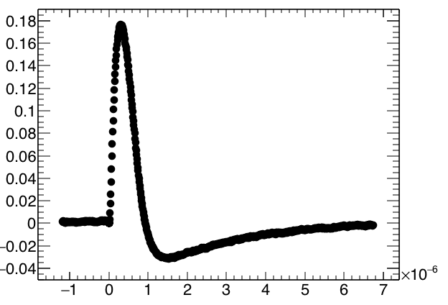
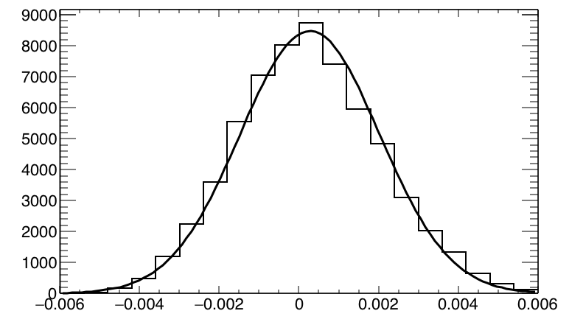
Signal pulse in MIP (config 8)
Signal to noise study
  Signal amplitude in charge deposition of MIP is about 180mV
  Noise level is about 1.8mV
  Signal to noise ratio is about 100 before irradiation using config 8.
Noise
MIP Signal (emulated with laser)
Output amplitude (V)
V_bias=120V, APA07
Time (s)
Output amplitude (V)
Time (s)

Slide 7
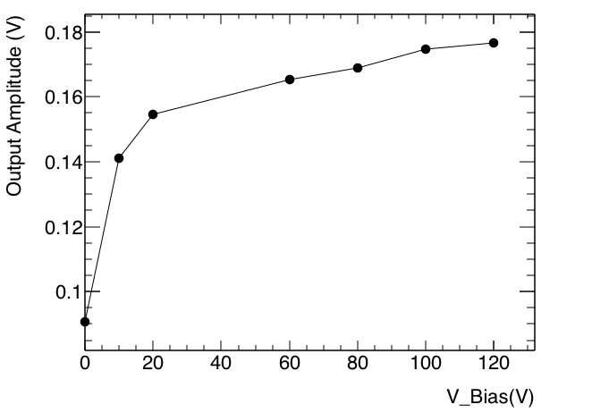
HV bias dependence
Output amplitude is about 90mV without HV bias.
After HV bias, output amplitude is 180mV
  Saturated at 20V ?
MIP Signal (emulated with laser), APA07

Slide 8
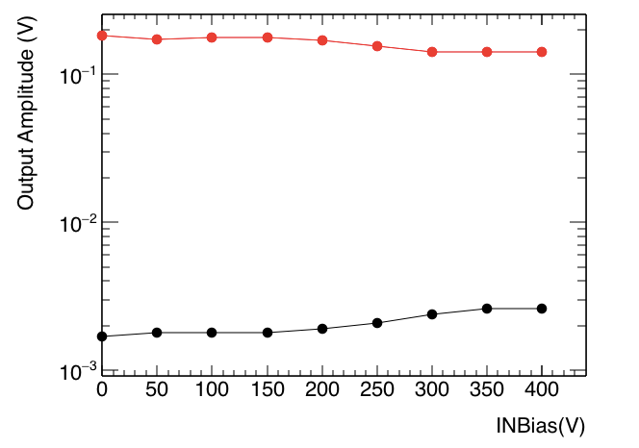
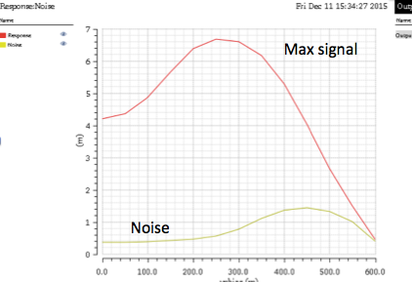
Modifying VNBias
VNBias controls the bias of the Pixel diode. Value shouldn’t be changed .
Simulations and measurements are quite different for VNBias dependence.
measurements
simulations
Signal amplitude
Noise level

Slide 9
Summary
Use laser to emulate the charge deposition of MIP.
Study signal to noise ratio of active pixel in CHESS1.
  Signal amplitude is about 180mV
  Noise level is about 1.8mV
  Signal to noise ratio is about 100.
V_bias dependence is also studied
  Saturated at 20V

