Slide 1
Status of test kit
5 January 2016
J. J. John
with help from many colleagues

Slide 2
Overall status
Preparing for testing of TJ-CHESS-1
Diced PonP chips with decent epi now expected at RAL ~18 Jan
Recent work
At RAL, laser testing needs to be done from back side
Have prepared new central cut-out for current PonP daughterboards for this (+ usual E-TCT)
Have updated PonP design to version 2 with a large central cut-out for back-side illumination
v2 PonP d/bs ordered; expected at RAL 21 Jan
6 v1 d/bs on way to Ljubljana as of today – 3 E-TCT, 3 standard
Capacitors for d/bs arrived at RAL yesterday, to cover CHESS-1 needs

Slide 3
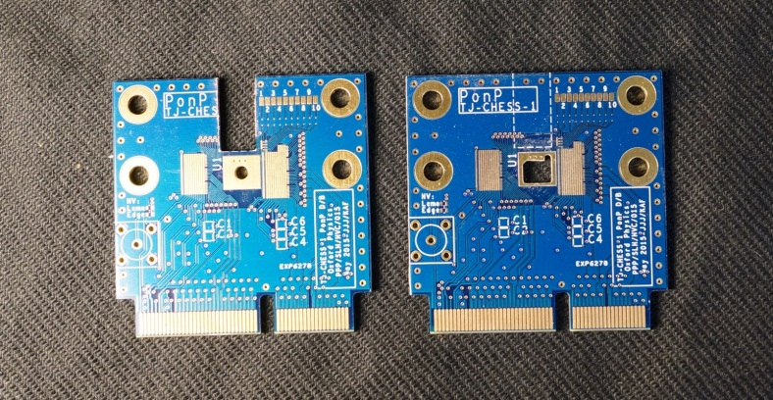
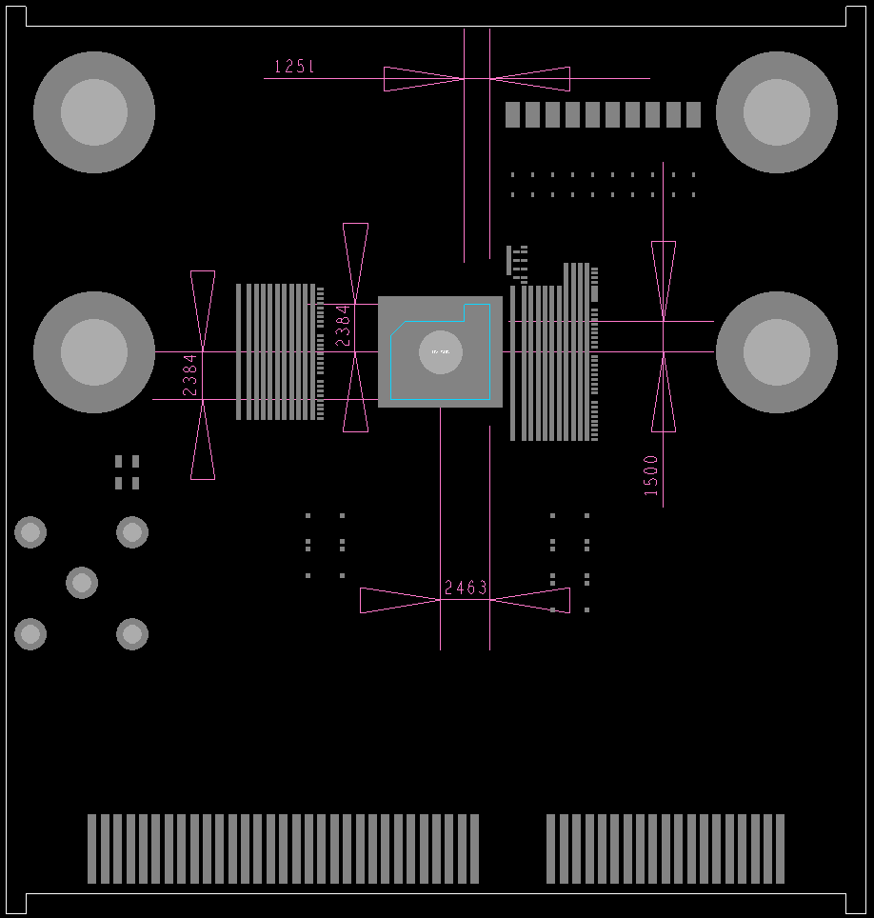
PonP v1 cut-out details
E-TCT and new central cut-outs
Dimensions of central cut-out in um

Slide 4
Next steps
Probe remaining cut boards, get to RAL for bonding
PonP daughterboard bonding diagrams x 4 to begin with
PonN daughterboard
  Update schematics for rotated chip
  Revise layout so that edge TCT will be done with same mounting as other boards
  See next slide for why
Firmware: update to provide reset of TJ-CHESS-1 chips
  Laser systems: do reset following laser trigger, variable delay
  Source testing: provide a periodic reset pulse, variable frequency
Test remaining motherboards

Slide 5
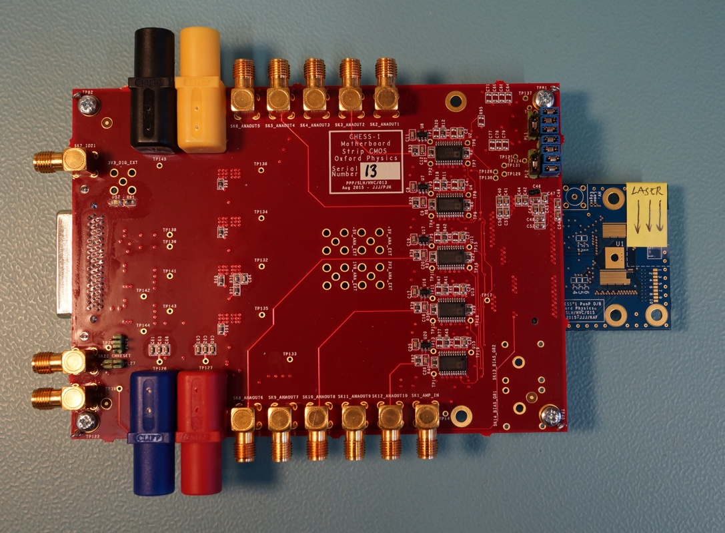
PonN – reason for revising
Original proposal for PonN orientation of Edge TCT cut-out – mock-up
This saved some work on the layout on the PonN d/b
but it requires a 3rd way of mounting in the Particulars laser system
=> false savings in the end

Slide 6
Planning questions
Please let me know:
Which institutes have edge TCT systems?
Which institutes are happy to bond their own TJ-CHESS-1 daughterboards?
Any institutes happy to mill out their own cut-outs for edge TCT? (co-ordinates will be provided)
Thanks.

