Slide 1
RD53 overview and status
Piotr Rymaszewski on behalf of the RD53 collaboration

Slide 2
Outline
Introduction
Status of working groups
Related prototypes
Summary

Slide 3
Introduction
Status of working groups
Related prototypes
Summary

Slide 4
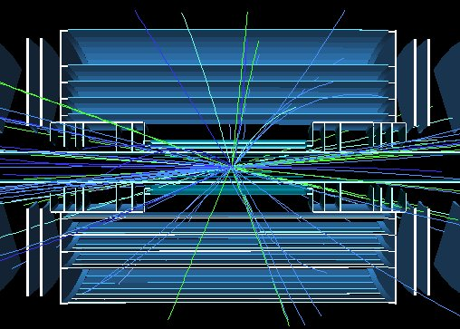

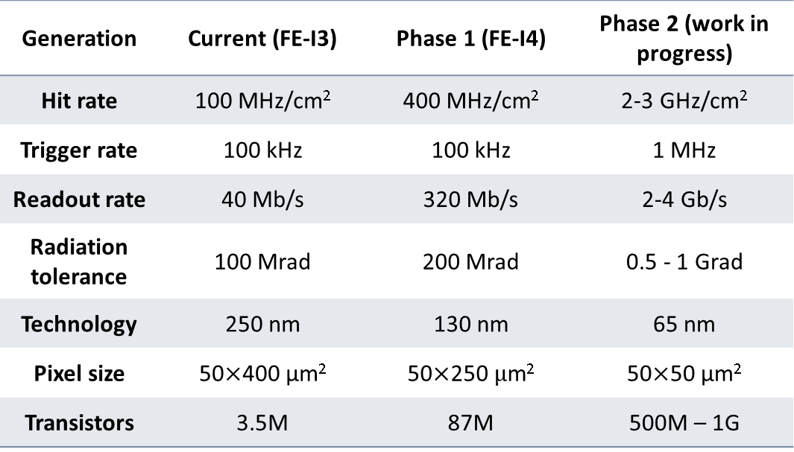
Characteristics of ATLAS pixel chip generations
Simulation of typical collision in ATLAS
Now (phase 0)
Generation | Current (FE-I3) | Phase 1 (FE-I4) | Phase 2 (work in progress)
Hit rate | 100 MHz/cm² | 400 MHz/cm² | 2-3 GHz/cm²
Trigger rate | 100 kHz | 100 kHz | 1 MHz
Readout rate | 40 Mb/s | 320 Mb/s | 2-4 Gb/s
Radiation tolerance | 100 Mrad | 200 Mrad | 0.5 - 1 Grad
Technology | 250 nm | 130 nm | 65 nm
Pixel size | 50$×$400 μm² | 50$×$250 $μ$m² | 50$×$50 μm²
Transistors | 3.5M | 87M | 500M – 1G
Phase 2

Slide 5


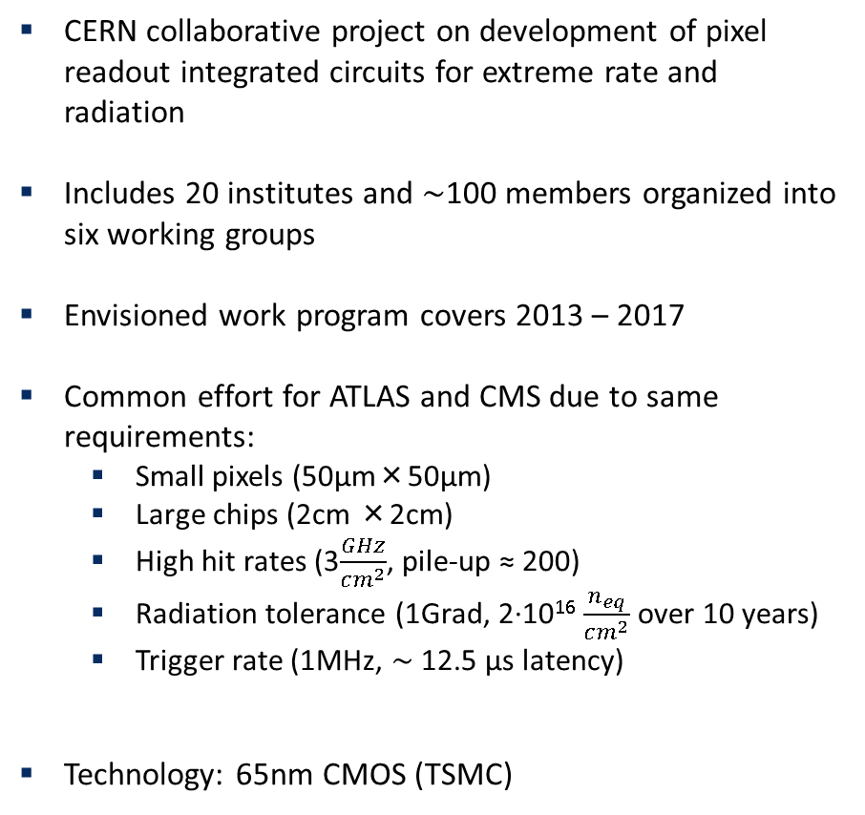
RD53
CERN collaborative project on development of pixel readout integrated circuits for extreme rate and radiation
Includes 20 institutes and $\sim$100 members organized into six working groups
Envisioned work program covers 2013 – 2017
Common effort for ATLAS and CMS due to same requirements:
  Small pixels (50μm×50μm)
  Large chips (2cm ×2cm)
  High hit rates (3$\frac{GHz}{cm^{2}}$, pile-up ≈ 200)
  Radiation tolerance (1Grad, 2·10¹⁶ $\frac{n_{eq}}{cm^{2}}$ over 10 years)
  Trigger rate (1MHz, $\sim$ 12.5 μs latency)
Technology: 65nm CMOS (TSMC)
RD53
Simulation
Radiation
IP
I/O
Analog design
Top design

Slide 6
Introduction
Status of working groups
Related prototypes
Summary

Slide 7
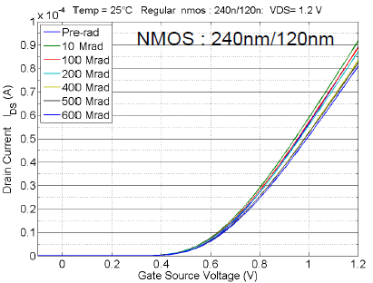
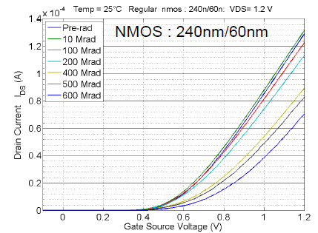
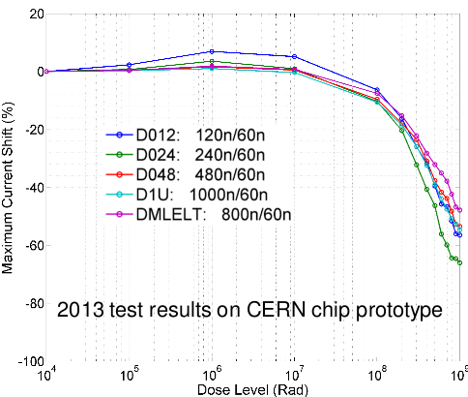
Radiation WG - nMOS
Devices with minimum length (L=60nm) are strongly affected by radiation
I_{on} degradation by 9% at 600Mrad
I_{on} degradation by 46% at 600Mrad
Influence of width on radiation damage is small
Low temperature operation reduces parameter degradation
Bias condition influence radiation effects
Moderate effects of annealing

Slide 8
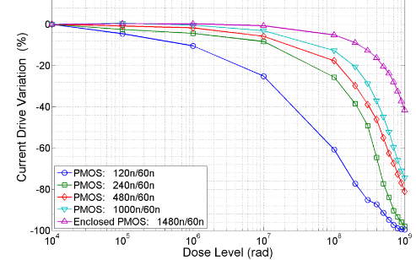
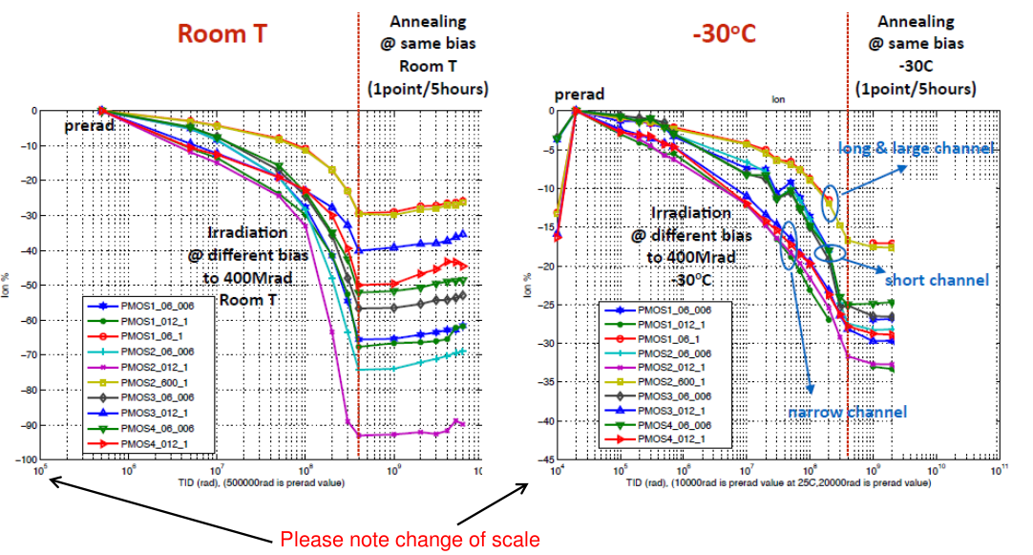
Radiation WG - pMOS
Moderate influence of device’s length on I_{ON} degradation
Strong dependence of I_{ON} on width
(min. size pMOS is off at TID>500Mrad)
Biasing condition strongly influence sustained radiation damage
Low temperature significantly reduces I_{ON} degradation

Slide 9
Radiation WG - summary
Extensive investigation at single transistor level (CERN, CPPM, FNAL, Padova) of sensitivity to various parameters
Current recommendations:
  Cold operation (T < -15ºC)
  Analog circuits: nMOS – L ≥ 120nm, any W; pMOS - L ≥ 120nm, W ≥ 300nm
  Digital circuits: still to be seen if small transistors can be used
Initial goal of 1Grad has been reduced to 500Mrad, a replacement strategy will be needed for innermost pixel layers
A model of transistors after 200Mrad and 500Mrad for use in simulations has been developed

Slide 10
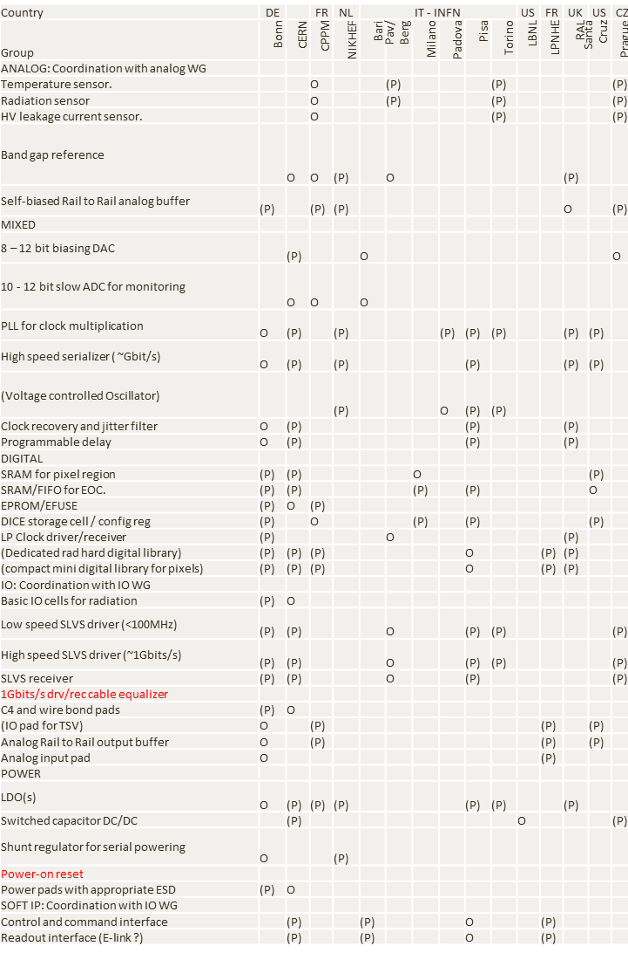
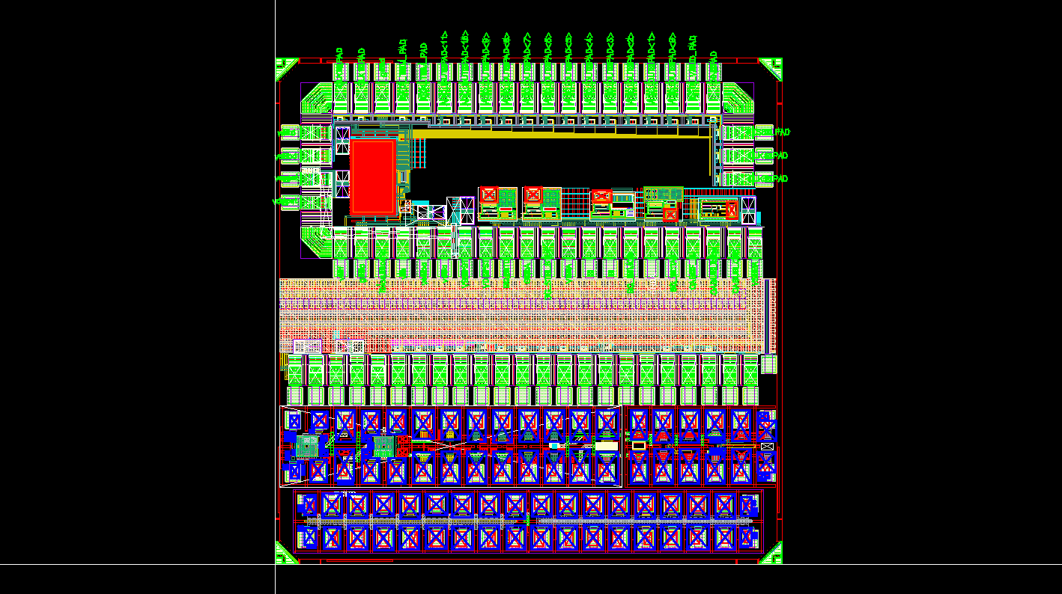
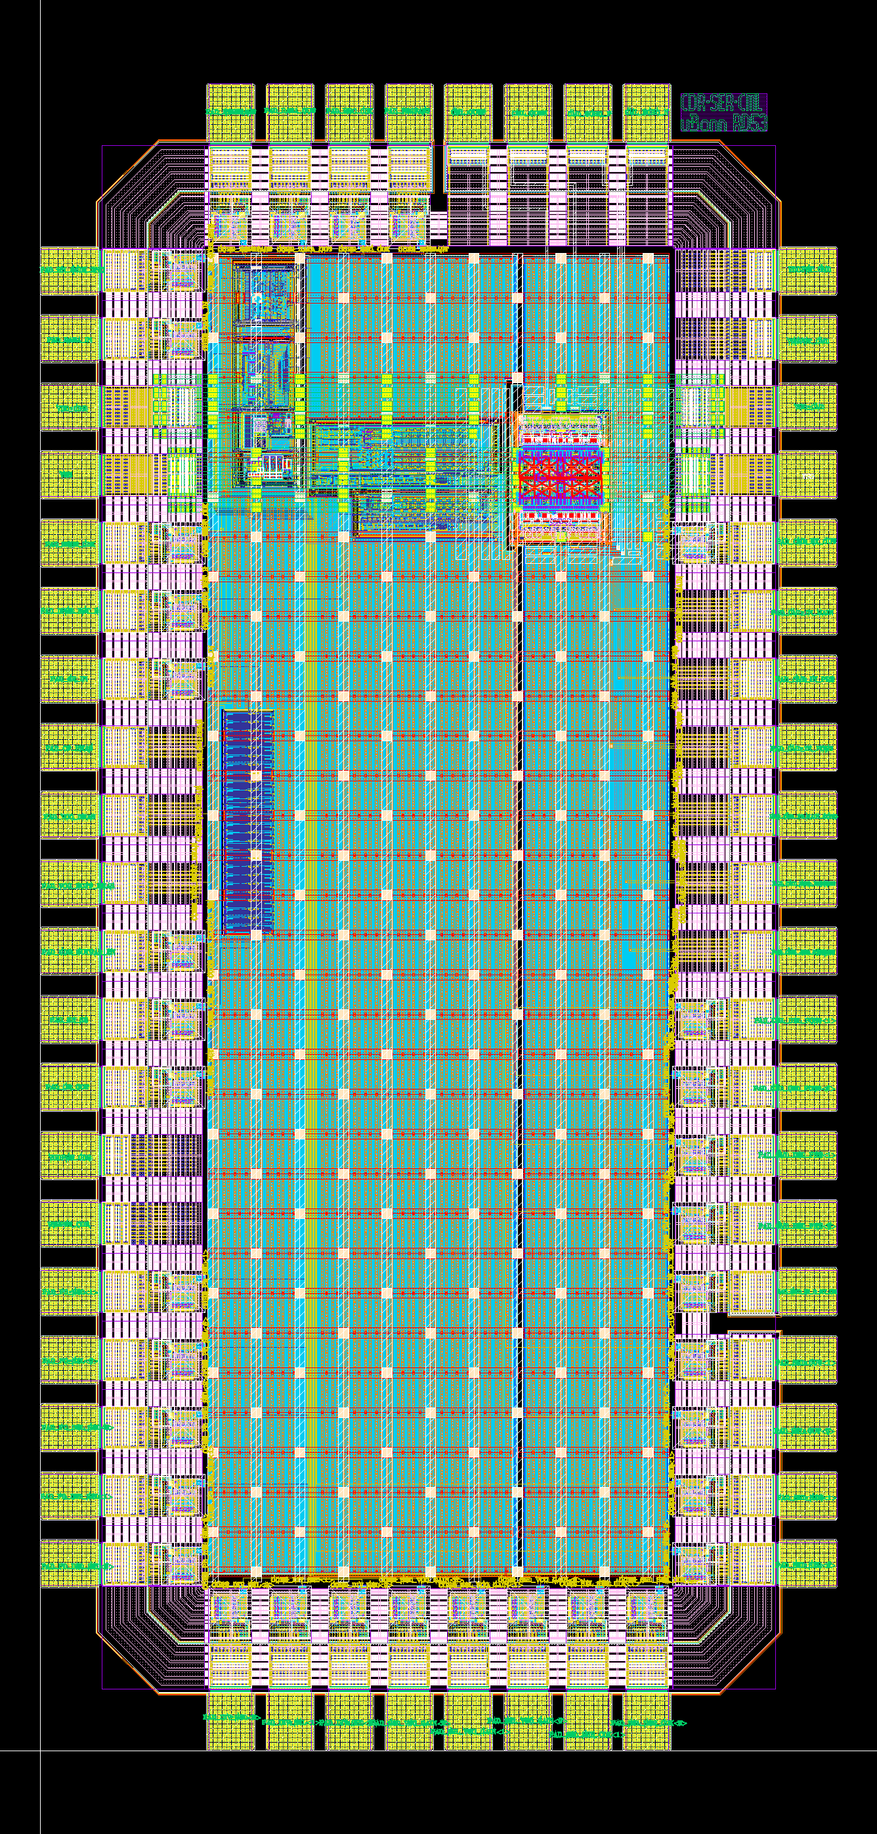
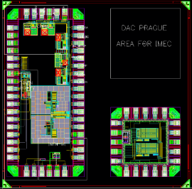
IP WG
About 30 IPs defined and assigned to 16 institutes
  Biasing and testing of front-ends
  Monitoring
  I/O
  Power
  Digital cells
All blocks have the same deliverable in order to integrate them into digital flow
Common IP repository
All blocks have been prototyped, most of them tested
INFN
Bonn
CPPM

Slide 11
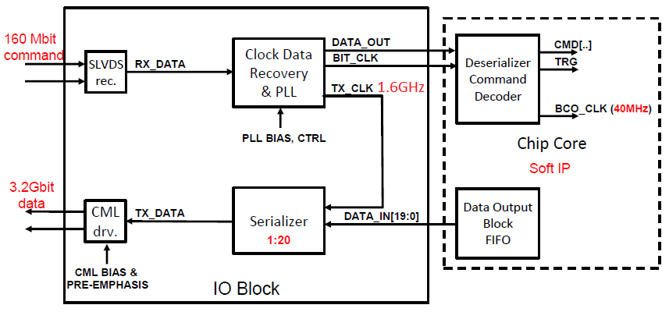
I/O WG
Input
  Single line
  160Mbps
  Clock decoding
  DC balanced data
  Protocol tbd. (e.g. 8b/10b)
  Fault tolerant (symbol duplication)
Output
  High speed link (up to 4 per chip)
  Up to 5Gbps bandwidth
  DC balanced data
  Protocol tbd. (simplified Xilinx Aurora?)

Slide 12
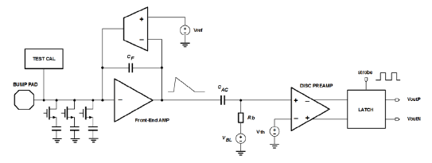

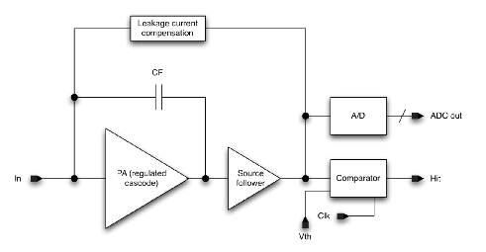
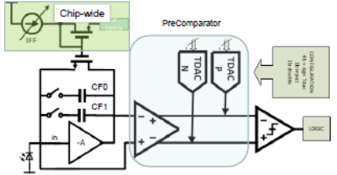
Analog design WG
Analog FE specification
  Supply current per pixel: 4μA
  Input capacitance < 100fF
  Leakage current compensation < 10nA
  Min. threshold: 600e⁻ (1200e⁻ for in-time threshold) for 50fF load
  Total noise < 130e⁻
  Average hit rate per pixel: 75kHz (to allow < 1% hit loss)
    INFN Torino – single stage with SAR-like ToT counter using synchronous comparator
    INFN Bergamo/Pavia – single stage with current comparator and ToT counter
    FNAL – synchronous, resets every bunch crossing with flash ADC
    LBNL – continuous reset integrator first stage + DC-coupled pre-comparator stage

Slide 13
Top design WG
Gradual change in pixel chip architecture
from “analog on top” to “digital on top”
Digital custom
Digital synthesized
Analog
Traditional full custom design
  Make one pixel
  Step and repeat identical
  copies
  Custom made digital
  Example: ATLAS FEI-3
More recently
  Make few pixel regions
  Step and repeat identical
  copies
  Synthesized digital
  Example: ATLAS FEI-4
New approach (RD53)
  Synthesized digital sea containing islands of analog pixels
  Example: FE65_P2

Slide 14
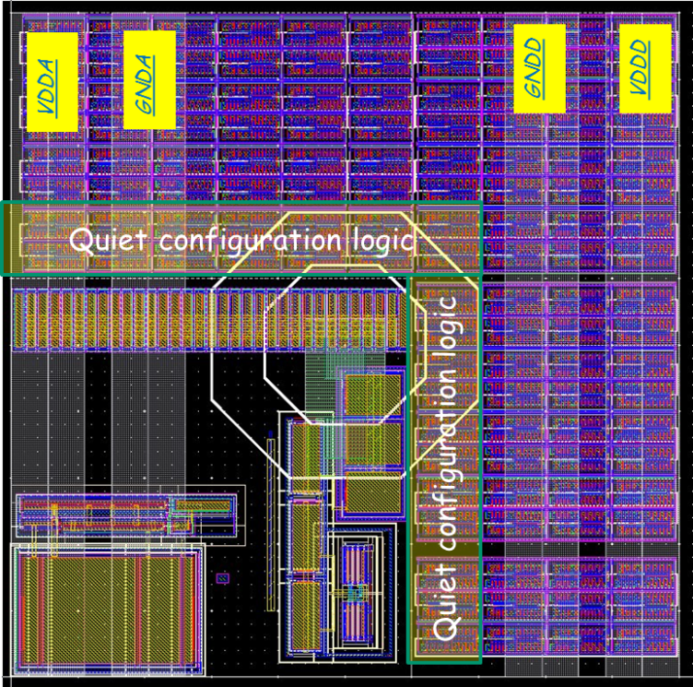
Top design WG
Gradual change in pixel chip architecture
from “analog on top” to “digital on top”
Architecture and floor-plan concept for RD53
  “Digital sea with analog islands“
  Pre-routed power
  A-D isolation with separate Deep N-wells
  Low, constant power
Digital custom
Digital synthesized
Analog
Traditional full custom design
  Make one pixel
  Step and repeat identical
  copies
  Custom made digital
  Example: ATLAS FEI-3
More recently
  Make few pixel regions
  Step and repeat identical
  copies
  Synthesized digital
  Example: ATLAS FEI-4
New approach (RD53)
  Synthesized digital sea containing islands of analog pixels
  Example: FE65_P2
Example of “digital sea with analog islands”
as implemented in FE65_P2 prototype

Slide 15
Simulation WG
VEPIX53 framework
  Based on system Verilog and UVM (industry standard)
  Benchmarked using FEI4 design
  Architecture study with behavioral (non-syntheizable) pixel chip model
  Different kinds of hit stimuli (internally generated or coming from ATLAS and CMS simulation data)

Slide 16
Outline
Introduction
Status of working groups
Related prototypes
Summary

Slide 17
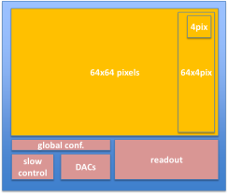

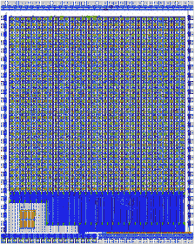
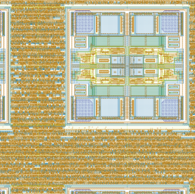
FE65_P2
Designed by Bonn and LBNL
Matrix of 64 × 64 pixels (50μm×50μm)
Digital on top approach (“digital sea with analog islands”)
Readout based on local hit storage in 2×2 pixel region
Analog – LBNL’s FE for RD53
Digital – modified FEI4, not including all RD53 features
Verification – not VEPIX53, but Python-based framework
Abstract view
Physical layout
Digital
sea
4 analog
front ends
island
4 mm
One pixel
3.5 mm

Slide 18
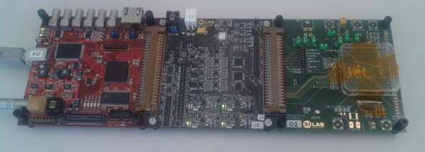
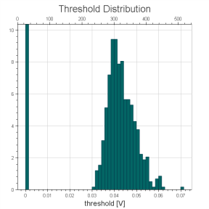
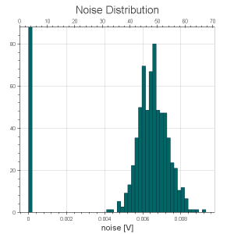
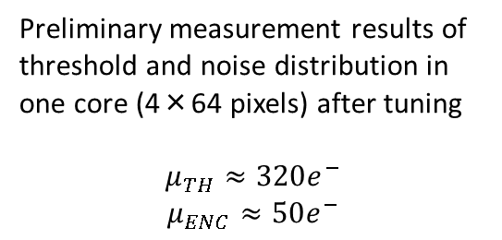
FE65_P2
Submitted in MPW in late 2015, chips came back recently
Software that was used to simulate circuit during design can be used directly in measurement process
Test hardware is ready (MIO + GPAC + FE65_P2 adapter)
Measurements are starting now
Preliminary measurement results of threshold and noise distribution in one core (4×64 pixels) after tuning
$$μ_{TH}≈320e^{−}$$
$$μ_{ENC}≈50e^{−}$$
preliminary

Slide 19

CHIPIX65
Designed by INFN Collaboration
Matrix of 64 × 64 pixels (50μm×50μm)
Digital on top approach (“digital sea with analog islands”)
Readout based on centralized hit storage with 4×4 pixel region
Analog – 2 types: Torino’s and Bergamo/Pavia’s FE for RD53
Verification – VEPIX53
Includes several IPs developed for RD53 (bandgap, DAC, etc.)
Submitted in March 2016

Slide 20
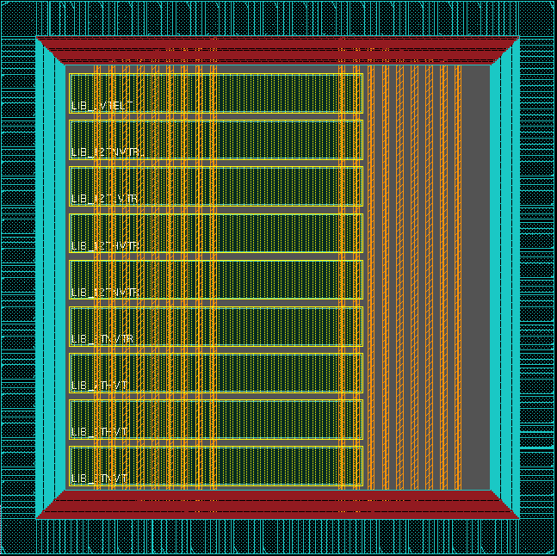
DRAD
Joint effort between RD53 and LP-GBT
Aim – test influence of radiation on performance of digital standard cells
  Speed degradation
  Power consumption
  SEU rate
Includes both standard libraries (different V_{T}) and modified cells
Submitted in March 2016
Shift register
9 libraries:
Different V_{T} flavours, transistor size and shape

Slide 21
RD53A
Full scale demonstrator chip
Goal – demonstrate the feasibility of concept in a large format IC
  Suitability of 65nm technology
  Radiation hardness (500Mrad) and SUE tolerance
  High data and trigger rates with low threshold operation and fast readout
  Power management and serial powering
Not intended as final, production chip (will includes several designs variation and testing features)
Architecture not defined yet (waiting for simulation and prototype measurements results)
Integration of all IPs
Following full design flow with complete verification
Scheduled for end of 2016
(wafer scale production, sharing run with other project)
Proposed size: 20mm×11.8mm (400×192 pixels)
Project A
Project B

Slide 22
Outline
Introduction
Status of working groups
Related prototypes
Summary

Slide 23
Summary
Phase II upgrade of LHC will pose challenges that require new generation of integrated circuits for pixel detectors
A RD53 collaboration was created by CERN as a common R&D effort for 65nm pixel chip for ATLAS and CMS
Working group progress:
  Radiation characterization of technology lead to design recommendation and changing target radiation harness to 500Mrad
  IPs and FEs are prototyped and partially tested
  I/O interface definition is converging
  Chip design moved to “digital on top” approach
  Dedicated simulation and verification framework was developed
Several small scale prototypes were made with specific goals to test circuits performance, design flow or radiation hardness
Design of full scale demonstrator has started, submission scheduled for end of 2016

Slide 24



Thank you

Slide 25
Backup

Slide 26

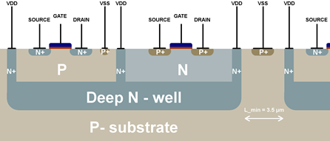
Chosen technology – TSMC 65nm
Desirable features of technology to be used in HEP
Reliable (well understood) manufacturing process
Reasonable price per mm²
Radiation hardness
Future sustainability (in terms of manufacturing)
Overview
Feature size 65 nm
Up to 9+1 metal layers
Core voltage 1.2 V
Deep N-well
Mature technology – available since 2007
Adopted Physical Design Kit (PDK)
Access to standard cells

Slide 27
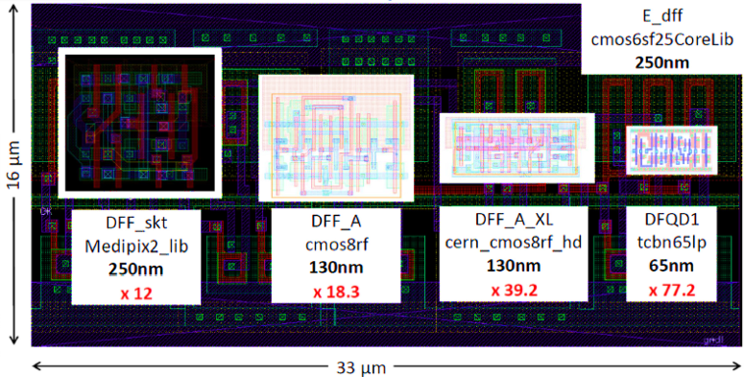
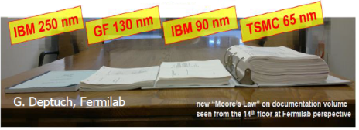
Smaller technology node – pros and cons
+
Increased density
Higher speed
-
More complicated design rules
More expensive
More complexity in equivalent area
Design process more difficult (higher parasitic influence)
J. Christiansen, M. Garcia-Scriveres, RD53: Development of pixel readout integrated circuits for extreme rate and radiation, PH newsletter 16.02.2014

Slide 28
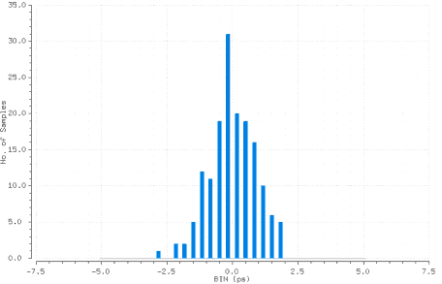
I/O WG
CDR
Recovers CLK from 160Mbps data
Produces 1.6GHz and 1.28GHz VCO CLK for SER
Current prototype include few PD and DIV variants
Simulation results (including thermal noise) show jitter of 5ps (peak to peak)
Histogram of simulated VCO clock jitter

Slide 29
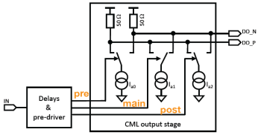
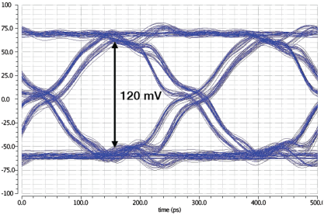
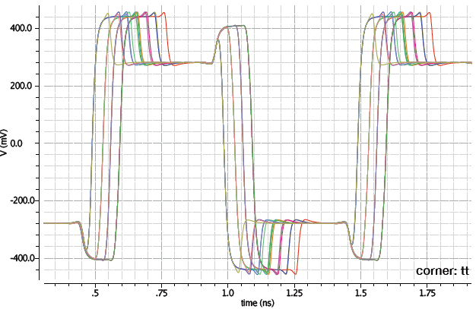
I/O WG
Cable driver
Current Mode Logic (CML) driver
Uses only nMOS
3 stages of pre-emphasis (to correct for losses due to signal losses in cable)
Designed to cope with data rate up to 6Gbps
Capable of transmission along 2m of ultra low mass cable
Driver output (no cable) for different delay settings
Simulated eye diagram after transmission of signal
along 2m of ultra-low mass cable

Slide 30
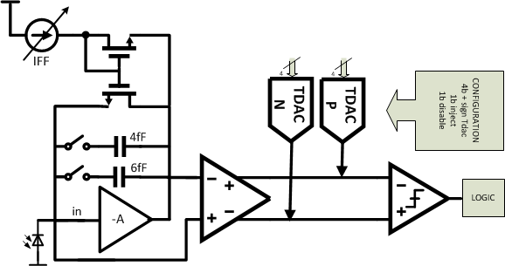
FE65_P2 - overview
Digital
4 pixels per digital region
7 latency memories
4-bit ToT per pixel
5.5μW per pixel
Analog
CSA + 2-stage comparator
Tunable CSA gain and comparator threshold
Few different flavors included in chip
Designed for 5μA per pixel for C_{det}=50fF
Chip-wide
Replica preamp
PreComparator

