Slide 1
CALICE as timing detector
Dirk Zerwas
LAL Orsay
April 5, 2016
CALICE
Challenges
Conclusions

Slide 2
CALICE
CALICE origin: A high granularity calorimeter system optimized for the particle flow measurement of multi-jet final states at the ILC running, with center-of-mass energy between 90GeV and ~1TeV
Electromagnetic and hadronic calorimeters
Different flavors/technologies:
SiW ECAL
Scintillator ECAL
Semi-digital HCAL
Analog HCAL
Characteristics:
Compact and granular:
EM thickness 20cm (R=1.8 to 2m)
up to 30 layers in depth
Lateral RO cell size 5.5mm x 5.5mm
High Granularity: 50M channels
Electronics/beam structure:
Bunch trains: 5Hz with 1ms length
Power-pulsed electronics
550ns between bunches
Triggerless running

Slide 3
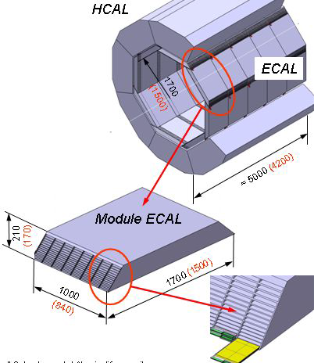
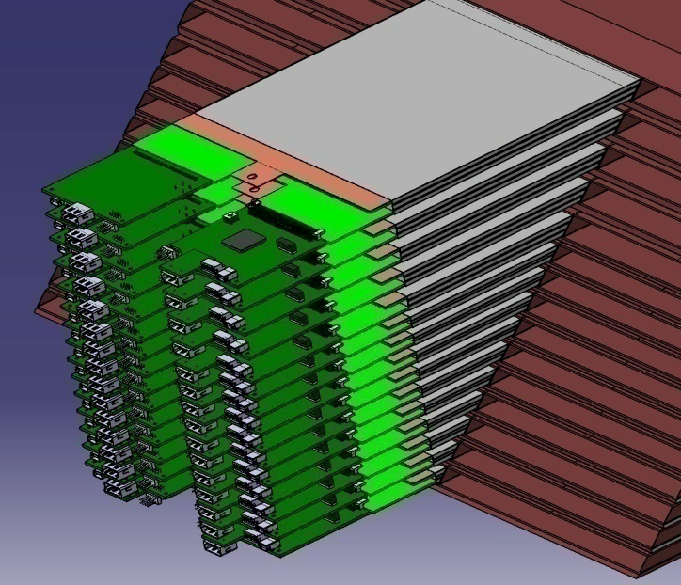
Alveola (trapezoidal structure)
Attached to HCAL
Absorber: tungsten (structure) (+carbon structure)
Detector modules (SLABS) are placed in drawers
FE electronics on-detector
Digital RO electronics at the end in 3cm (!)

Slide 4
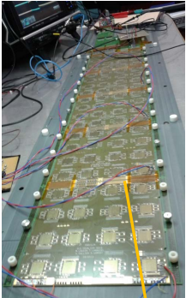
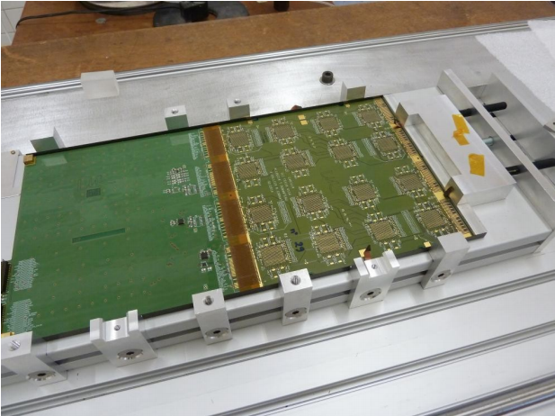
SLABs are subdivided into ASUs
ASUs connected via kapton foils
Up to 10 ASUs per Slab
Interconnection with kapton foils (soldered)
Active cells cover interconnection to minimize dead zones (0.5mm+0.5mm on 90mm)
ASU:
18cm x 18cm
4 Wafers (9cm x 9cm) glued to PCB
5.5mm x 5.5mm cells
1024 channels
« Only » 16 chips with 64 channels each on a PCB

Slide 5
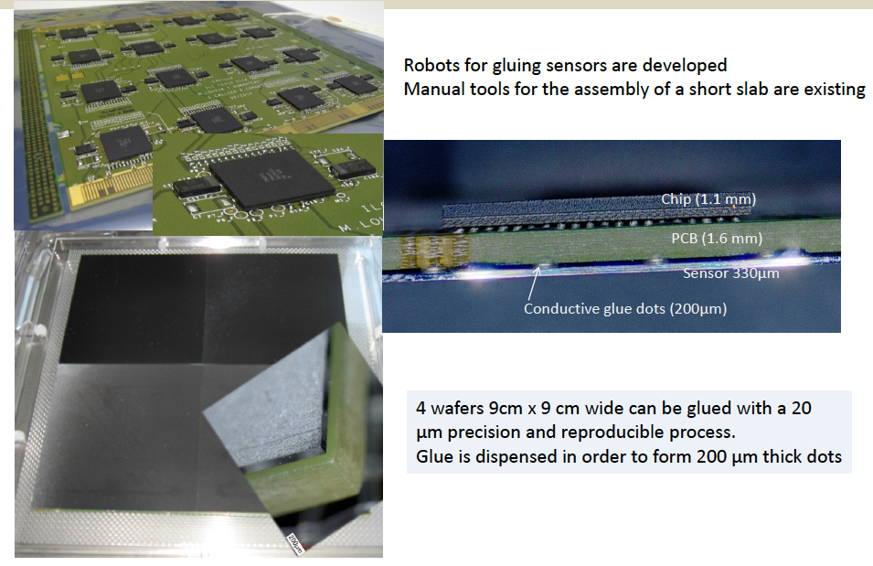
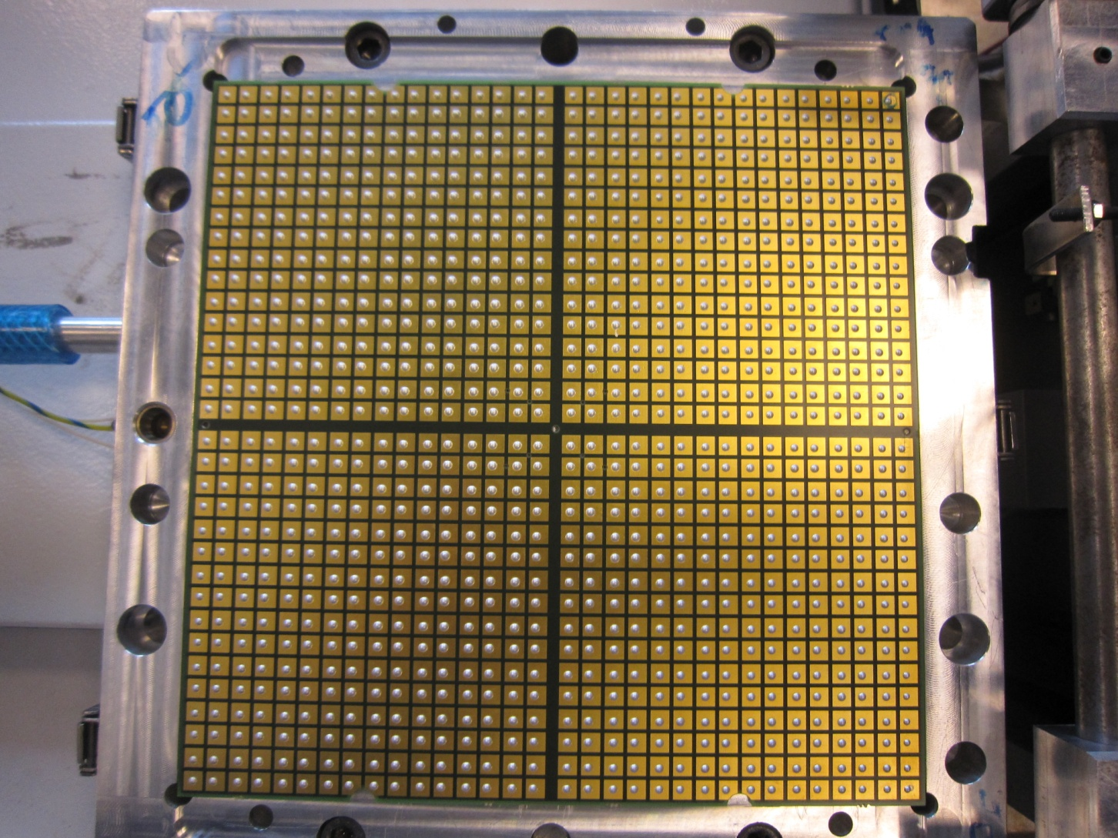
Alignment is essential:
PCB = 180.3 mm maximum
Wafer = 90 mm
As well as planarity/height of PCB+Chips
BGA
Wirebonded chips

Slide 7
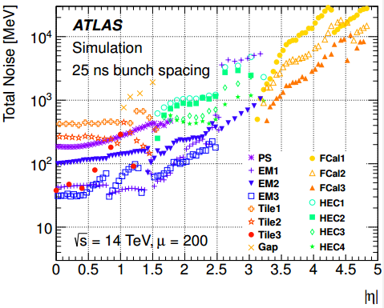
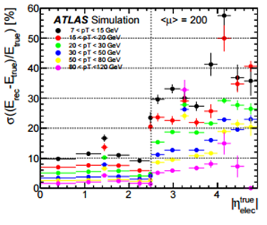
Calorimeter Noise
Calorimeter cell noise:
Large cells in the LArInnerWheel (>2.5): 0.1 x 0.1
Only 2 samplings:
Significant increase of noise for eta>2.5
Rough equivalence:
5mm
0.008 at η=2.5 R=600mm
0.017 at η=3.2 R=290mm
0.037 at η=4.0 R=130mm
0.096 at η=5.0 R=50mm
Reference:
Scoping document
https://cds.cern.ch/record/2055248/files/LHCC-G-166.pdf

Slide 8
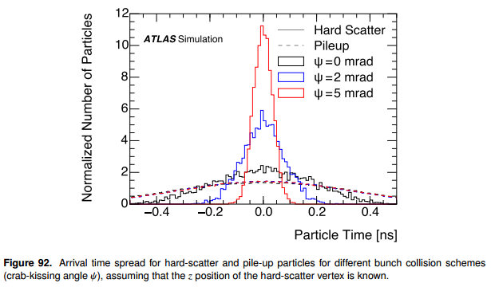
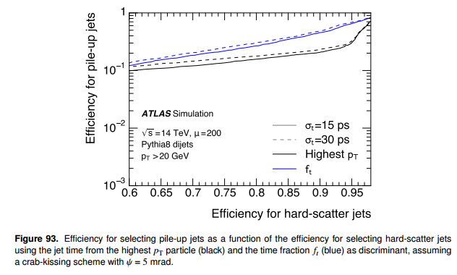
Arrival time spread for different BX schemes:
Assumption: z position is known
Crab kissing reduces the time spread of the hard scatter (today 200ps) to (greater than) 50ps
Efficiency hard scatter versus pileup:
Reduction of pileup as function of the timing resolution
pTjets>20GeV
Alg1: highest pT particle
Alg2: time fraction
Gain of factor 10 possible (depends on working point)

Slide 9
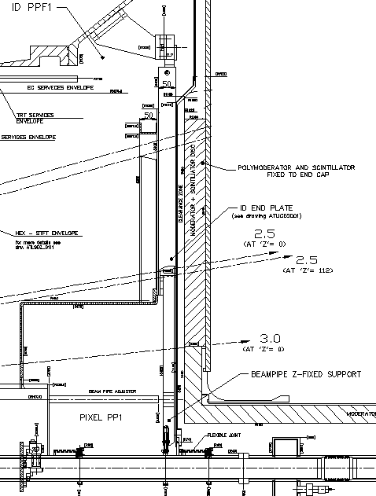
CALICE in ATLAS
HGTD:
Replaces MBTS
Reduce pileup in phase-2
timing to determine vertex
Order 50ps
HGTD position:
z=3500mm
2.5<η<5
600mm>r>48mm
HGTD envelope:
Δz=60mm
4 layers in depth
Cell size order 5.5mm x 5.5mm
Order 300k cells
HGTD timing detector:
No abs
HGTD preshower detector:
3 absorbers
Absorbers in front of LArg IW only: 2.5<η<3.2, 600mm>r>175mm

Slide 10
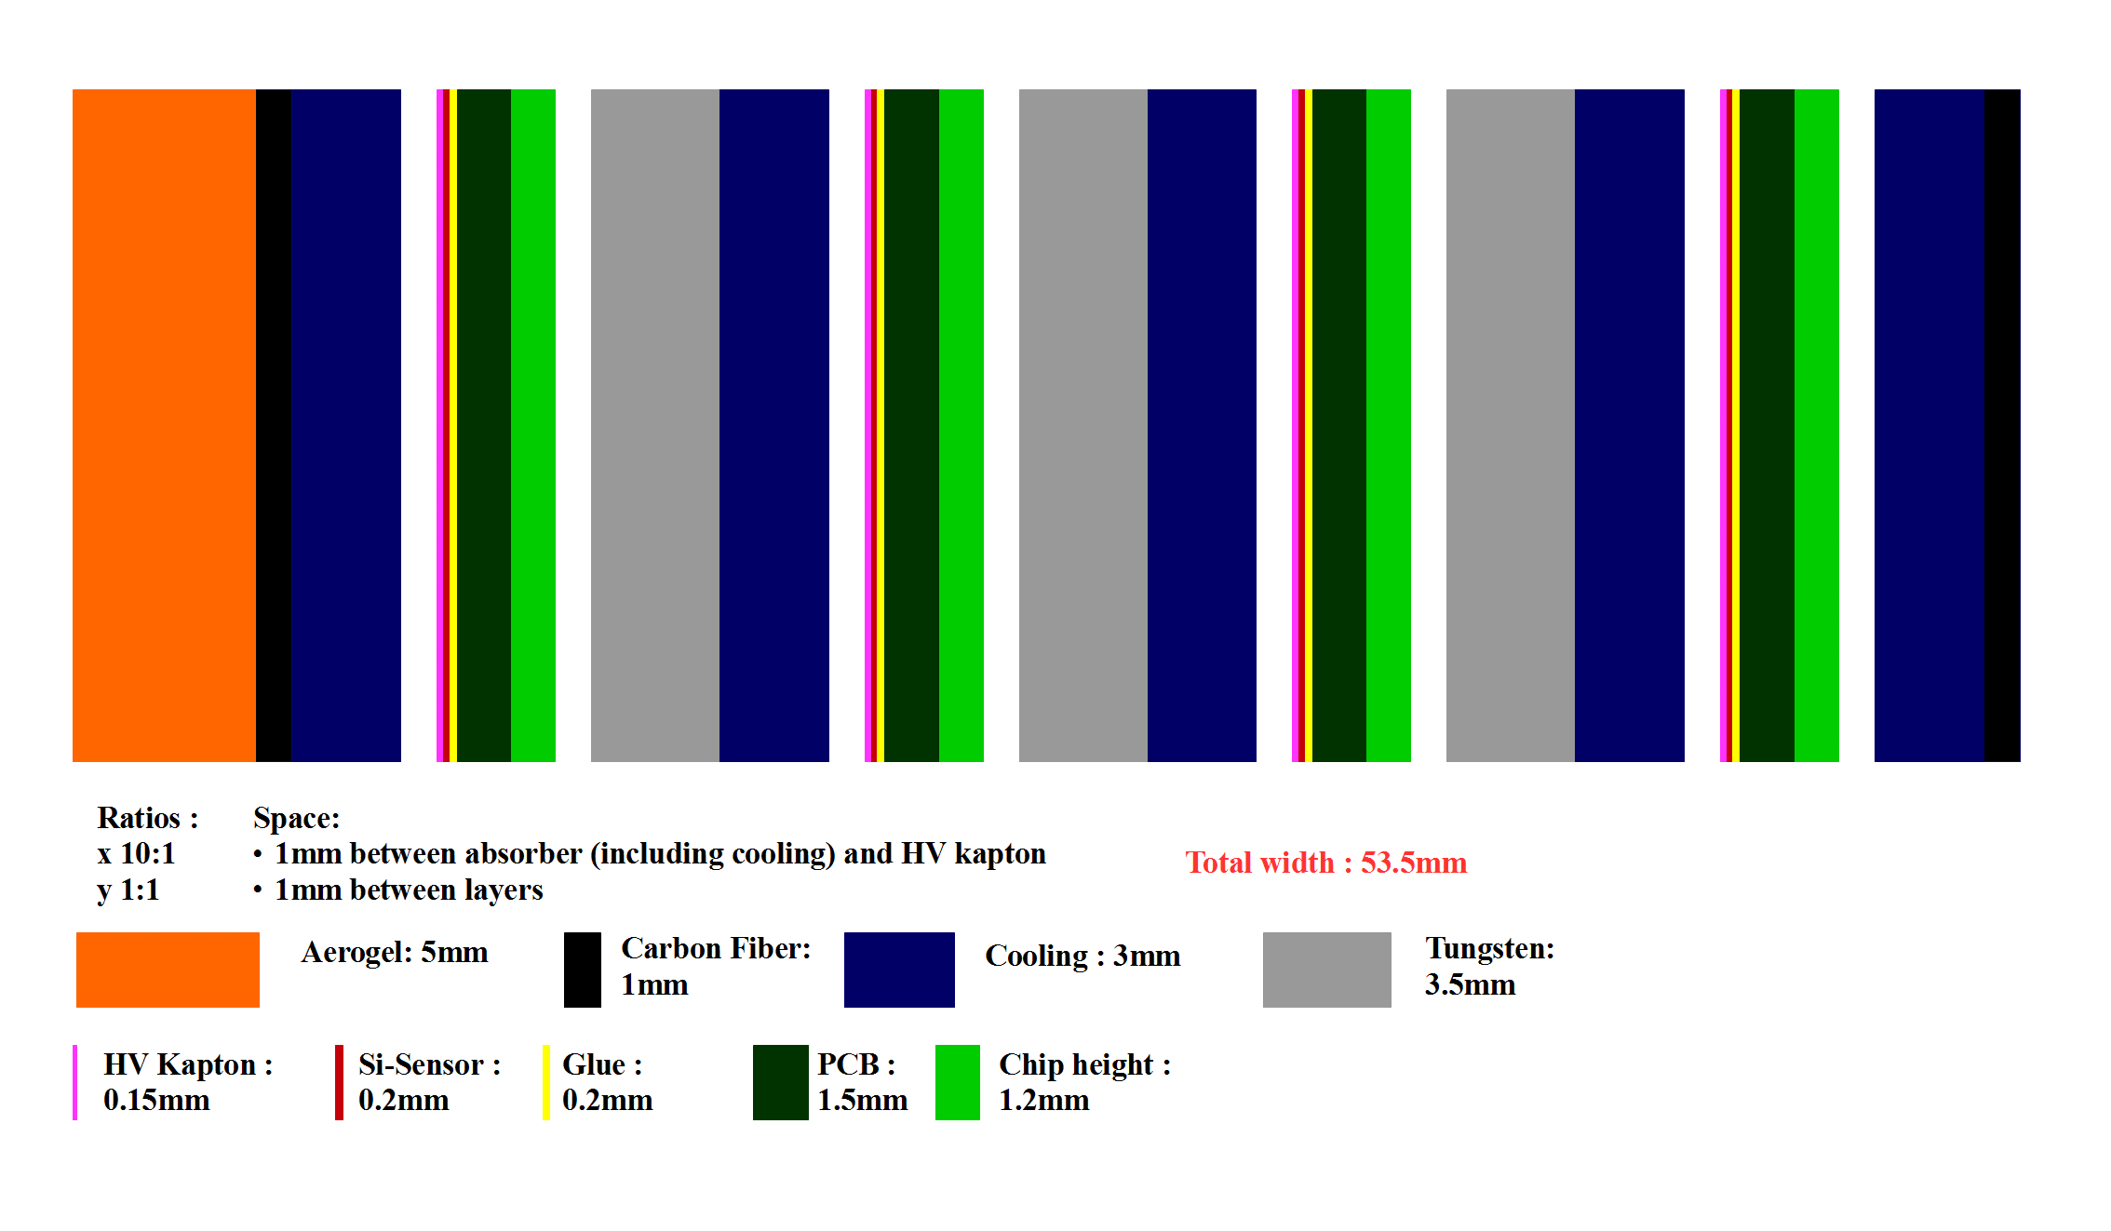
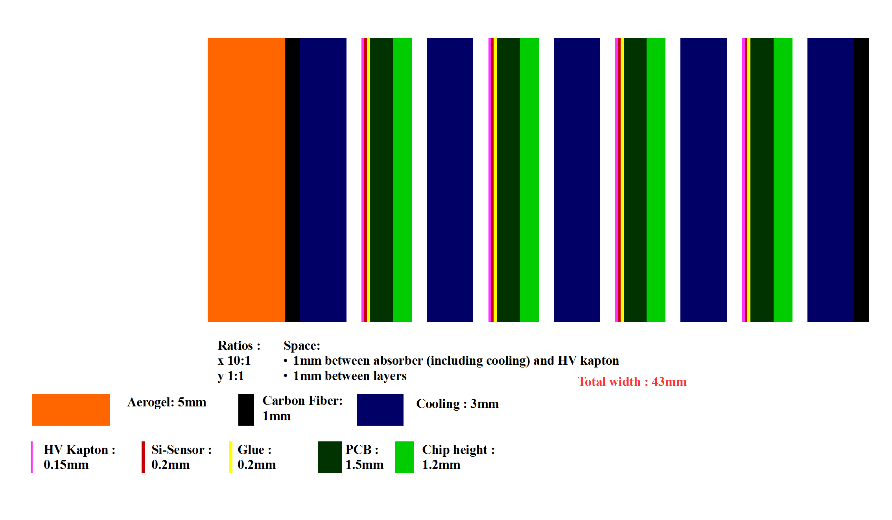
« Preshower »
53mm
« Timing »
43mm

Slide 11
HGTD LHC based on CALICE
LHC
measurement: t and E
4 layers in depth (z)
Granularity: 5.5mm x 5.5mm
option: mix with other granularities
Same basic structure
Timing detector
Preshower detector (Tungsten)
Weaker constraints:
4 layers in 6cm ~1.5cm per layer
Harsher constraints:
Cooling of sensors -20deg
RadHardness of FE electronics
RadHardness of Glue (done: 10^13, further foreseen in 2016)
Time measurement (order 50ps)
Shorter peaking time
40MHz
ILC
Measurement: E (and t)
30 layers
Absorber: tungsten
30 layers in 18cm ~0.6cm per layer
Cooling of electronics (passive)
Zero suppression/Power pulsing
5Hz 1ms bunchtrain

Slide 12
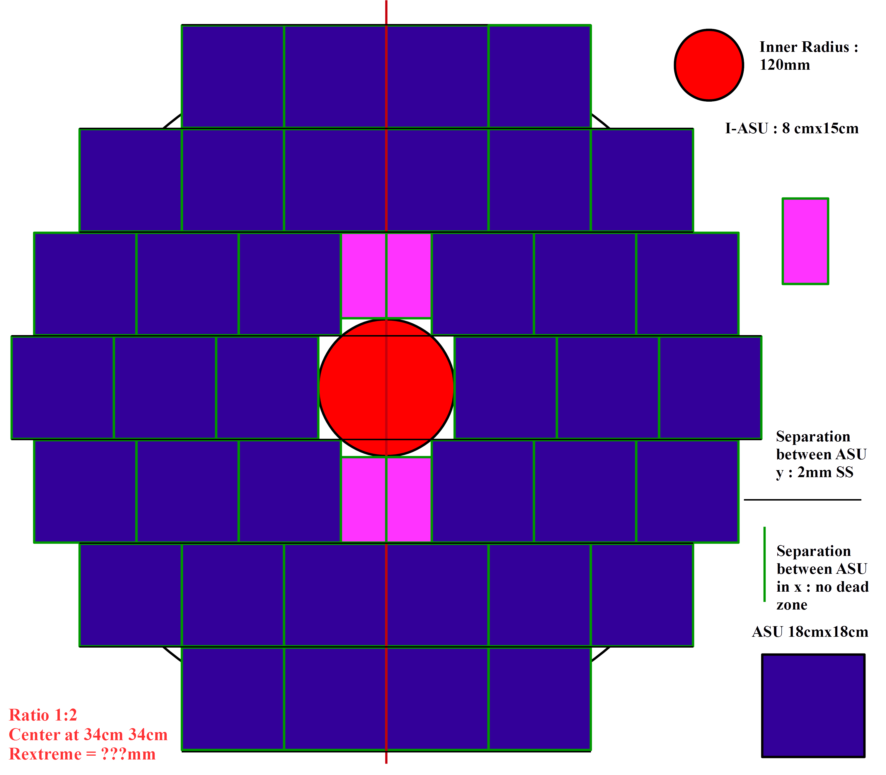
Sketch of an Endcap implementation
Preserve basic CALICE structure
Down to η=5 is challenging
Needs opening mechanics
R=110mm, η=4.1
R=600mm, η =2.4
Slabs CALICE-like:
2ASUs
3ASUs
Alternative:
Single PCB
Pro: less interconnections
Con: planarity
Signal out:
Large R
Space constraint

Slide 13
Sensor type:
CALICE: p in n sensor
LHC: n in p (radiation)
Sensor thickness:
CALICE: 330μm
LHC: (standard) 130μm (radiation, time resolution)
Can’t go thinner: handling
LHC: LGAD 50μm active (total order 250μm)
Signal:
CALICE large MIP signal (roughly 10-15, zero suppression)
LHC occupancy 5.5mm cells (rough estimate): ¼ (at η=4)
TTC jitter: 13ps
Detector jitter and Vin: C depends on pad size (the smaller the better)
PA+PCB: adds capa 2/3 in CALICE: system performance essential
Time+amplitude measurement? jitter: f(PAtype, tr, td)
CALICE TDC: 1ns….
Readout:
5.5mm x 5.5mm pads:
38x4x2 ASUs
304k channels (=1.5*LArg)
3mm x 3mm pads: 1M channels….
Data throughput:
3ASUs=3072channels : 4Tb/s
Zero suppression: ¼ (not sufficient)
Reduction to Gb/s (trigger or multiply the GBTs….)

Slide 14
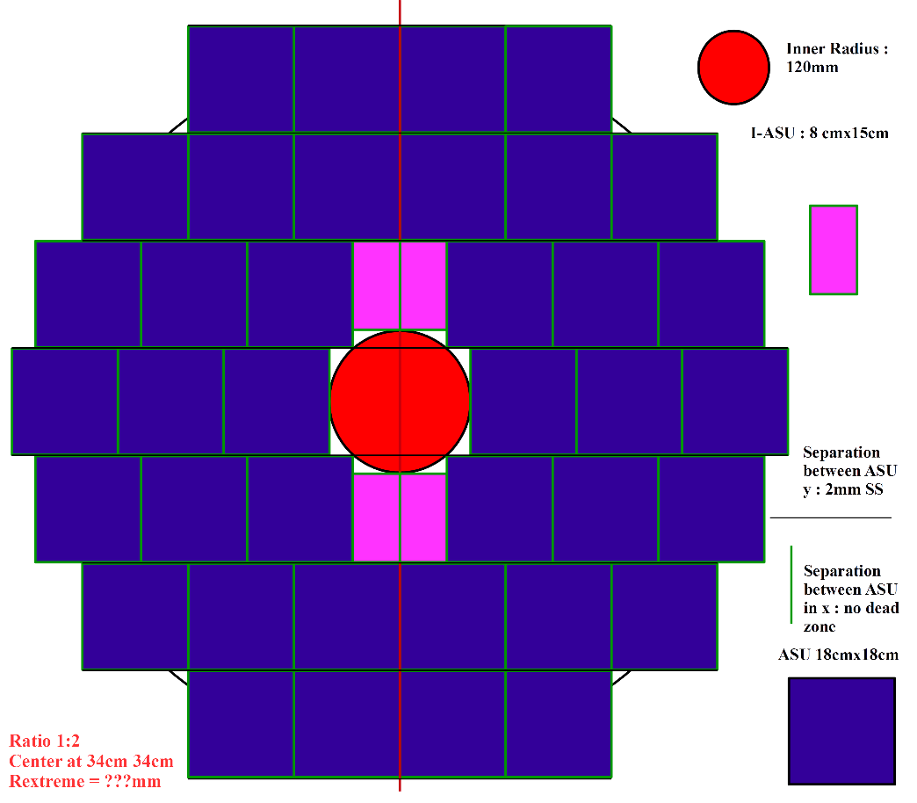
Conclusions
Using CALICE as timing detector
Conceptually possible
Common point: SiSensor with glueing as connectivity
No previous tests in CALICE with this precision…interesting challenge
Thank you: Didier Lacour

