Slide 1
ToF PET
Peter Fischer, Heidelberg University
9th Terascale Detector Workshop
Freiburg, 5.4.2016

Slide 2
Overview
Introduction to PET and ToF-PET
Limits in Time Resolution with Scintillator Readout
It's all about PDE
Module Design & Results

Slide 3
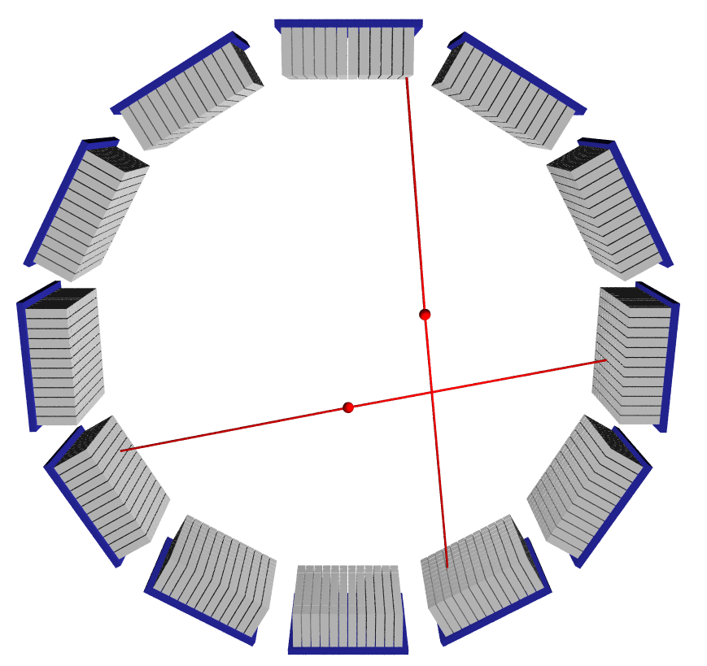

PET Scanners
e⁺ emitter is injected into body (¹⁸F, T_{1/2} ~ 2h)
e⁺ + e⁻ → γ + γ
γ (511 keV) pairs are detected in modules
Coincident (ns) hits
→ Pair
→ Line-of-Response 'LOR'
Backprojection gives 3D image
Modules often arranged in a ring
Note: 'pointing' geometry improves resolution only in centre of FOV
Field
of View
γ
γ

Slide 4
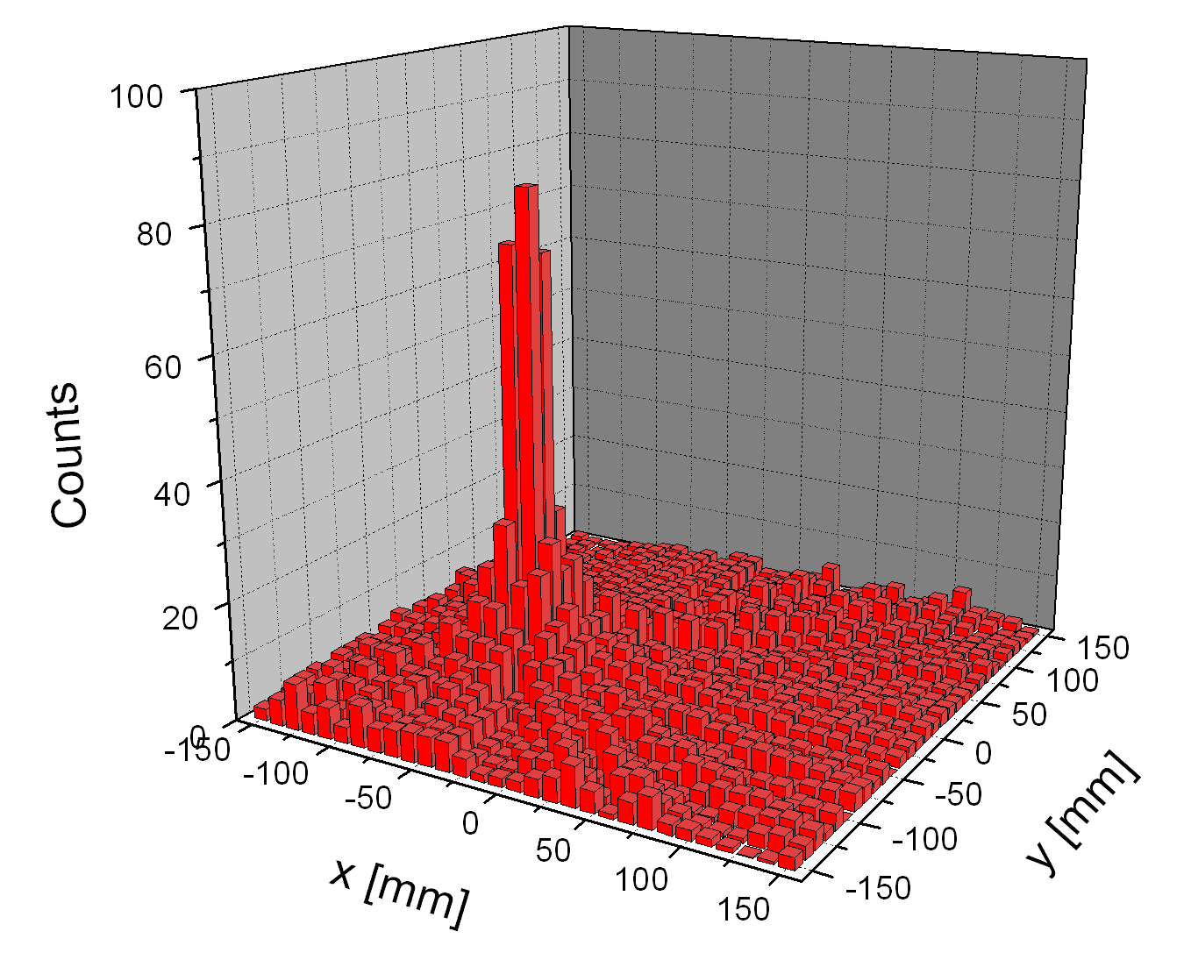
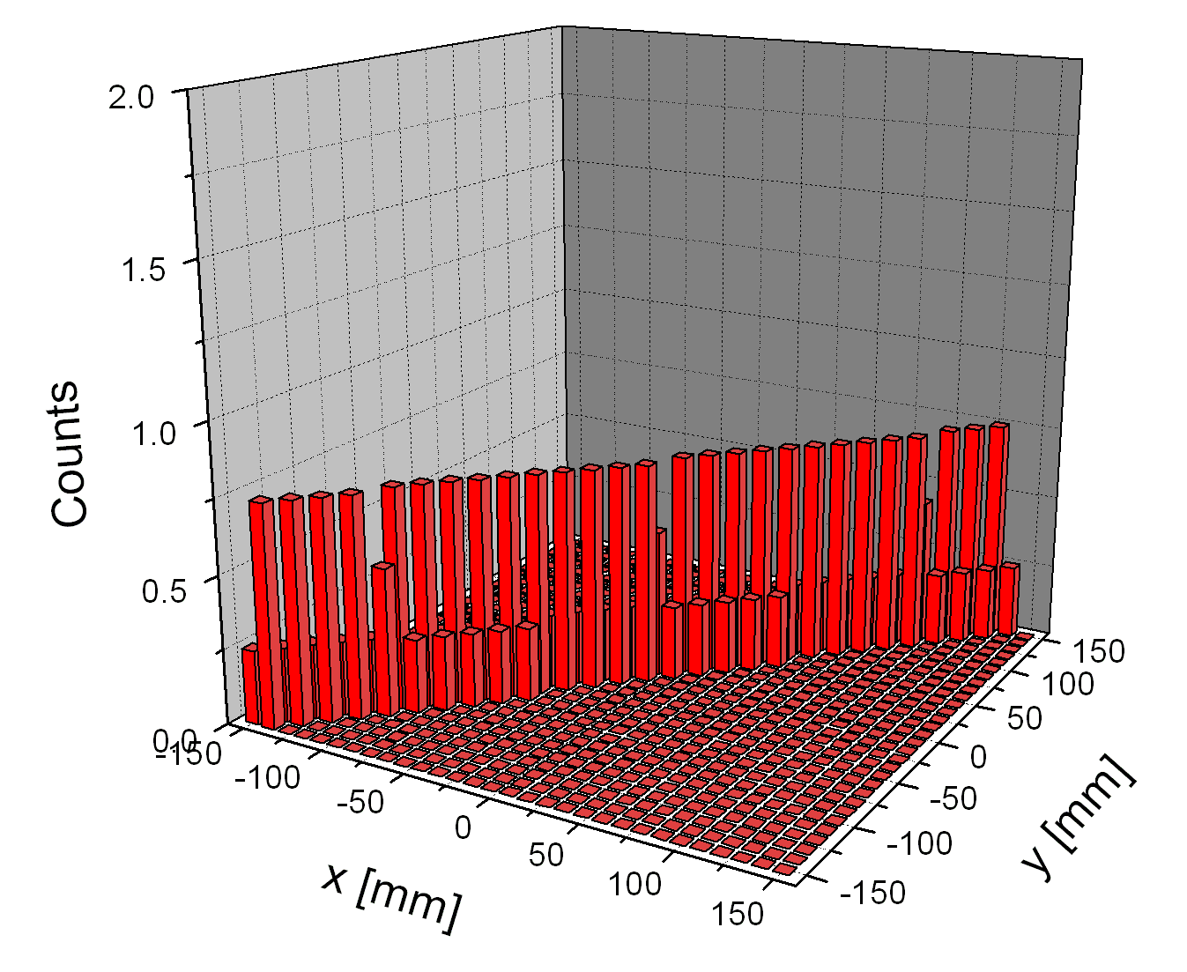

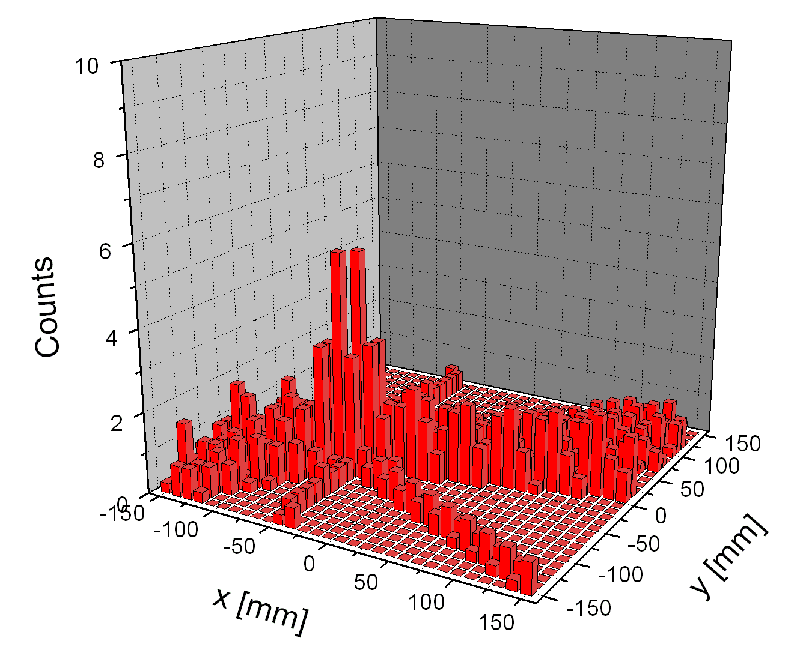
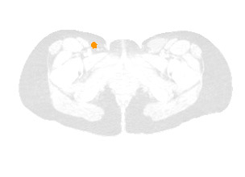
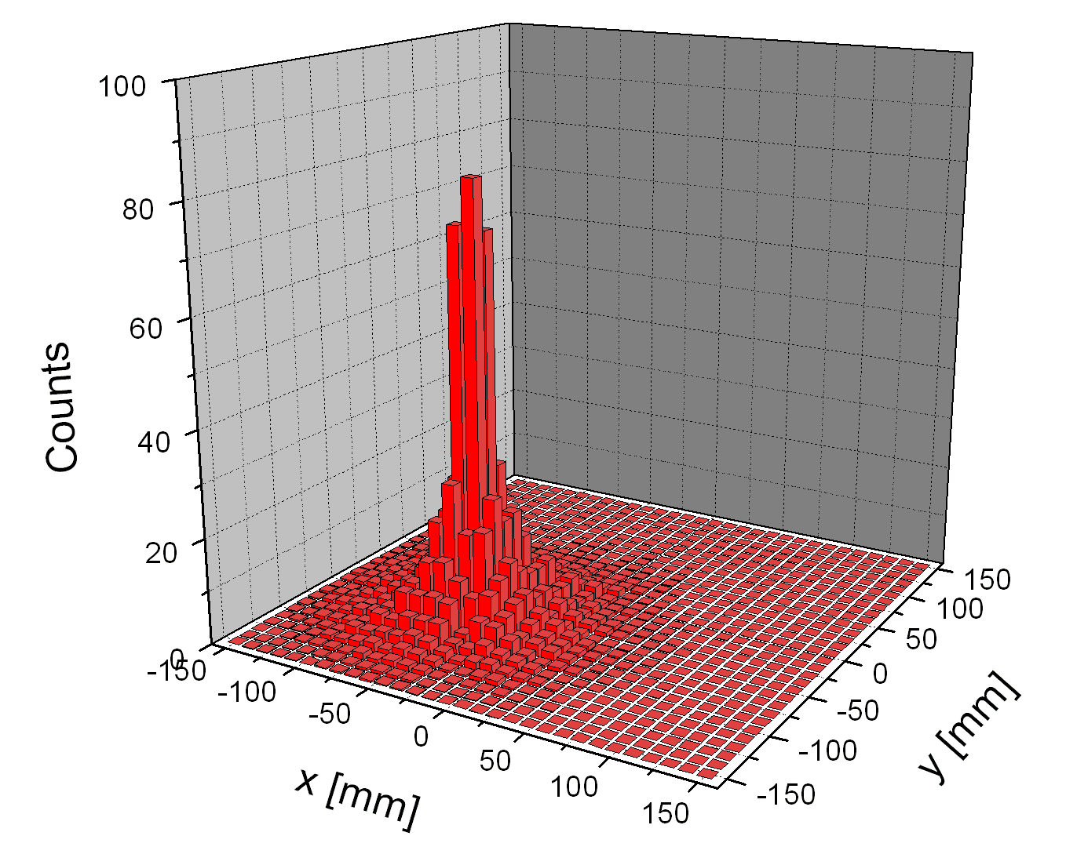
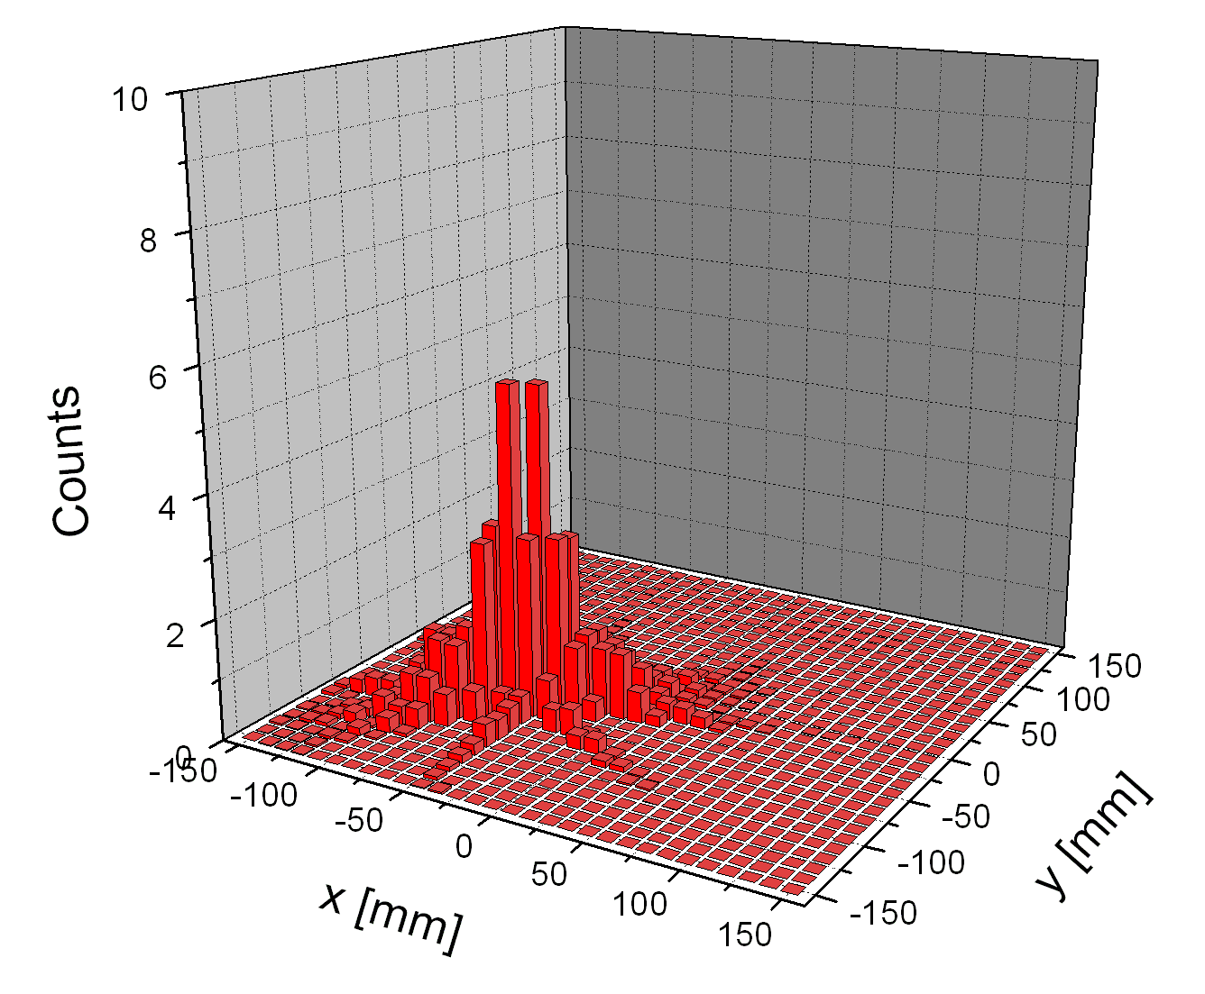
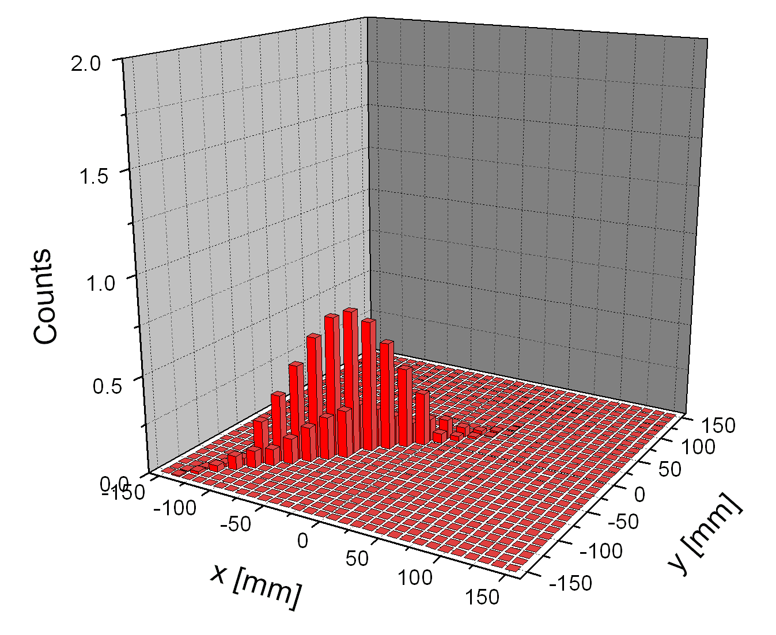

Benefit by Time-of-Flight (ToF)
t₂ = 1.7 ns
no TOF
Δx = c/2 Δt
t₁ = 1.3 ns
with TOF
CRT = 0.4 ns

Slide 5
Briefly: Definition of Time Resolution
In order to translate time resolution Δt directly to spatial resolution Δx:
CRT (Coincidence Resolving Time)
= CTR (Coincidence Time Resolution)
= FWHM of two channels in coincidence
CRT = FWHM₂ = √2 FWHM₁ = √2 × 2.35 σ = 3.33 σ
Remember:
  CRT = 100 ps ⟺ σ_{1chan} = 33 ps
  ⟺ FWHM_{X} = 15 mm
For comparison: TDC with 100 ps time bins
  σ = 100 ps / √12 ≈ 29 ps
1
½
t
FWHM

Slide 6
ToF Benefit: Simulations @ Uni Ghent
PET scanner with d = 65 mm
GATE5 – Geant4 Monte-Carlo
Effect of crystal size
@ CRT = 600 ps
Pixel size reduction gives benefits only down to about 2.6 mm
Effect of ToF
@ pixel = 2.6mm
ToF has large benefit
NPW-SNR: non-prewhitening signal-to-noise ratio
H.Tohen et al, Phys.Med.Biol. 58 (2013) 6459-6479

Slide 7
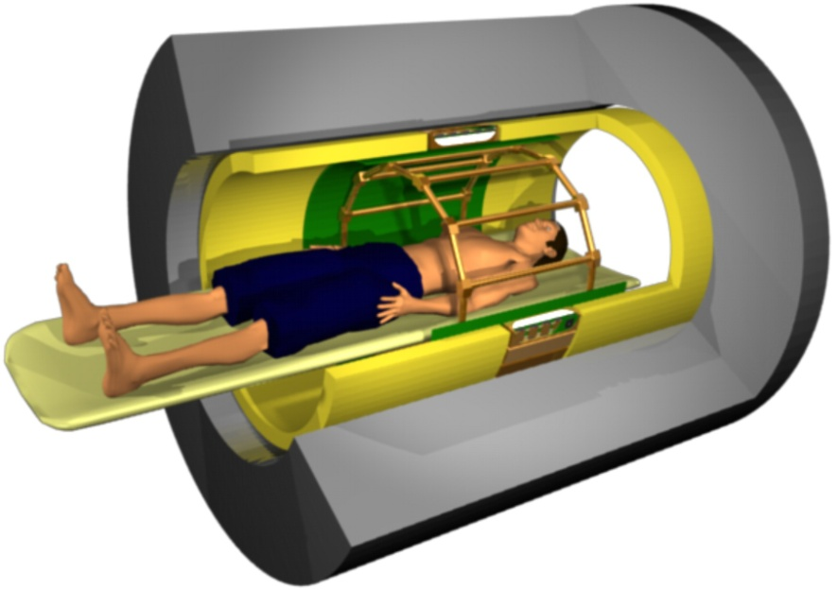
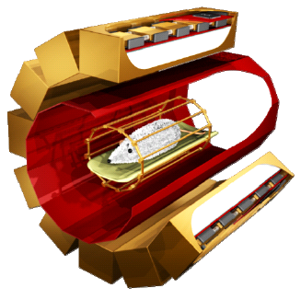
The Two Worlds of PET
PET Ring / Scanner
Clinical PET
(Whole Body PET)
Preclinical PET
(Animal PET)
- For humans
- large diameter Field Of View (>60 cm)
- spatial resolution: few mm
- time resolution CRT≪ 400 ps for ToF
- high sensitivity (low dose) → large area
- For mice, rats, rabbits (& human brain)
- Small diameter FOV (4-15 cm)
- spatial resolution: ≪ 1 mm
- time resolution only for coinc. (few ns)
- Depth-of-Interaction desirable to fight
parallax effect

Slide 8
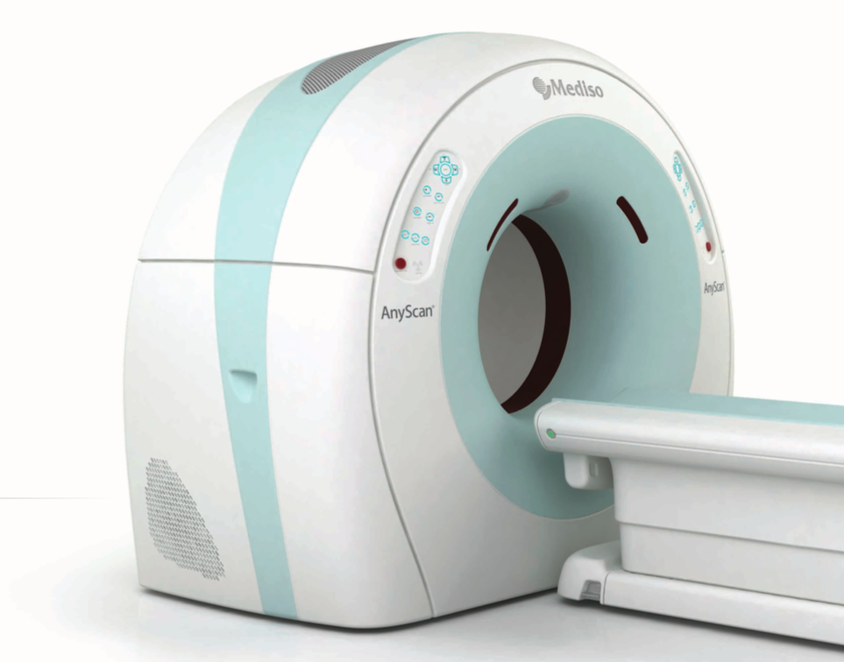
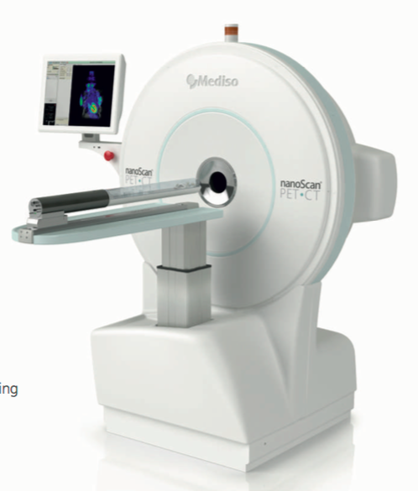
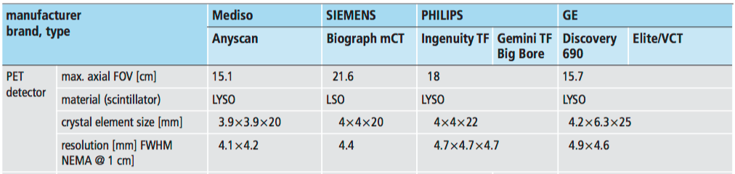
Commercial PET Scanners
Clinical
Preclinical
Mediso Product Catalog
Mediso Product Catalog
(Clinical)
Nuklearmedizin 2012; 51 doi:10.3413/Nukmed-0455-11-12

Slide 9
Readout Principles
Nearly all systems based on readout of (heavy) crystal scintillators:
1:1 coupling
Light spreader
Spatial Resolving
Sensor
Block detector
Tricks
fast
high position resolution / less channels
depth of interaction (DOI)
Photo Detectors can be
  Photomultipliers + external electronics (past commercial systems)
  APDs or Analogue SiPMs + ASICs
  Digital SiPMs = 'SPAD' in CMOS ASICs (not considered here)

Slide 10
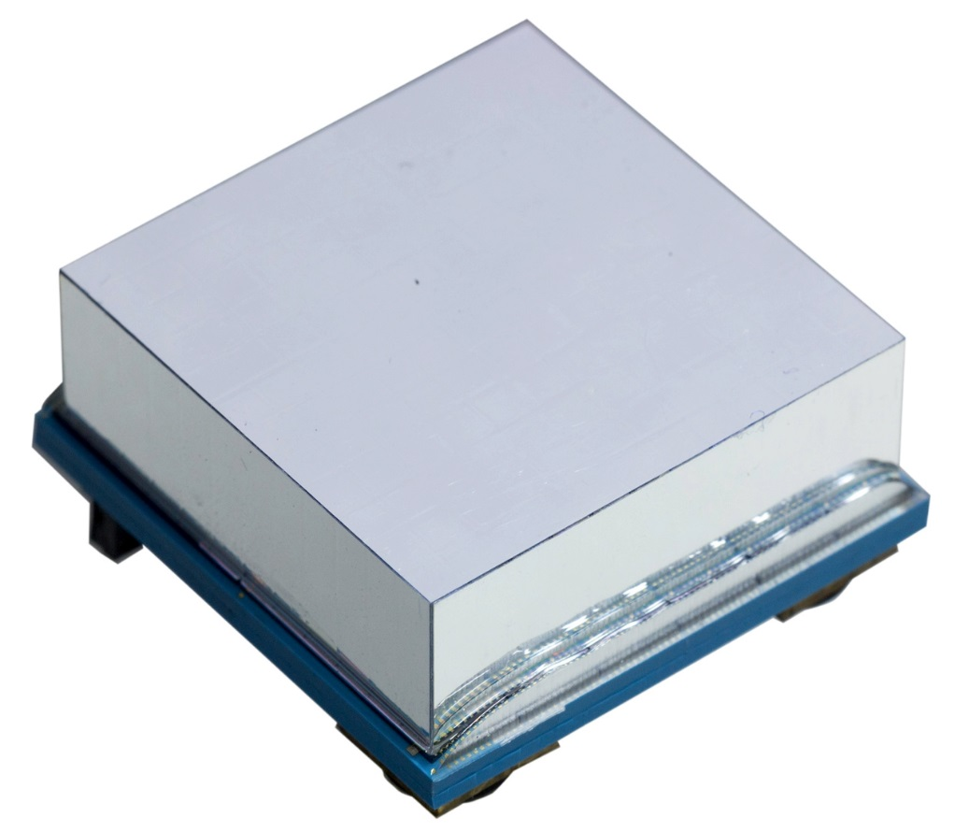
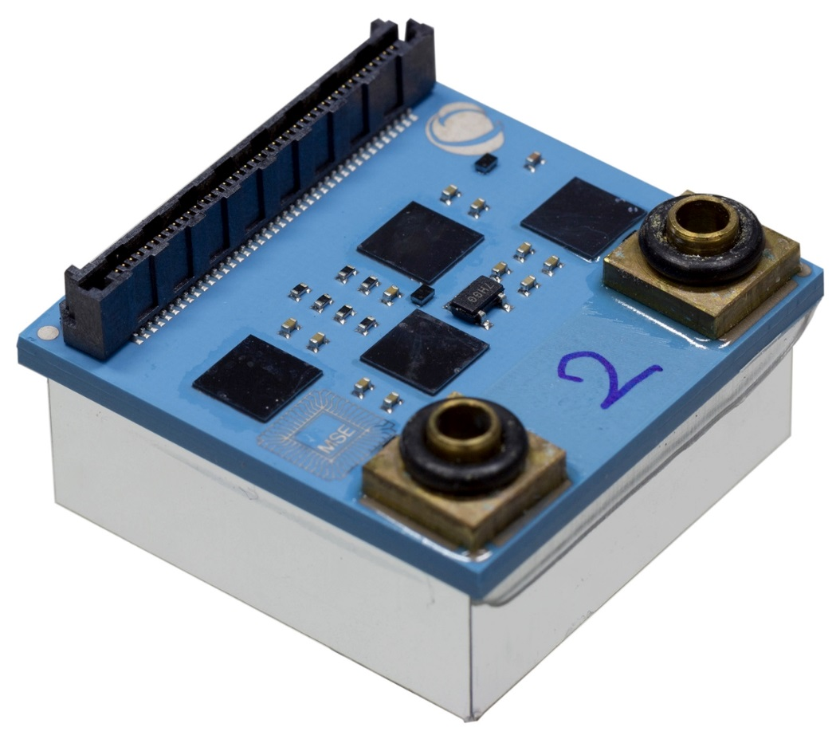
(Our) PET Modules
12 × 12 LYSO crystals in 2.5 mm pitch (10 mm height)
Full readout in 4 ASICs
Water cooled substrate

Slide 11
Factors Affecting Time Resolution

Slide 12
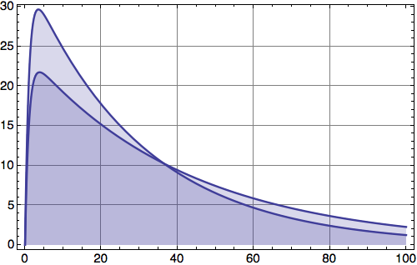
Shape of Light Pulse
Not nice at all!
It’s too slow
for known
materials !
But why does decay time affect time resolution?
- # of photons is fixed
- peak amplitude decreases for slower pulses
 | NaI(Tl) | BGO | LSO | LYSO | LaBr₃:Ce
Att. length @511keV [mm] | 29 | 10.4 | 11.4 | 11.4 | 21.3
Photofraction % | 17-20 | 40 | 32 | 30-35 | 20
Light Yield [photons / MeV] | 41000 | 9000 | 26000 | ≈ 25000 | 70000
Decay time [ns] | 230 | 60/300 (1/10) | 40 ns | 40-44 ns | 15 ns
Refractive Index | 1.77 | 2.15 | 1.82 | 1.82 | 2.25-2.4
Center Wavelength | 410 | 480 | 420 | 420 | 358
Hygroscopic? | yes | no | no | no | yes

Slide 13
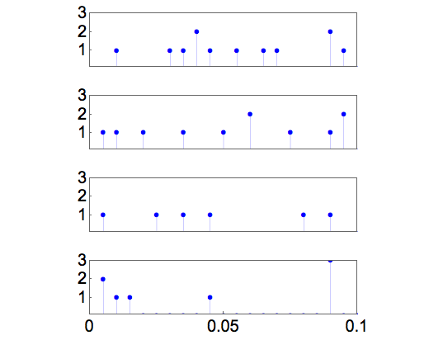
Photons Arrive One-by-One
When zooming into the first few 100 ps, photons arrive 'one after the other'
  4 Monte Carlo Events, 511keV in LYSO, τ_{decay} = 42 ns, 40% overall PDE
# detected
photons
Must maximize number
of (detected) photons!
σ = 33ps
(⟺ CRT = 100ps)
Can improve resolution if
arrival times of multiple
photons are known
(see S. Brunner's talk)
ns

Slide 14
What is the Best Threshold ?
Intuitive Answer: The lowest possible, i.e. trigger on ‘first photon’
But: The first photon has a statistical jitter. Higher Thresholds are BETTER!
  Also, low thresholds are sensitive to dark counts -> lots of fake triggers, deadtime
S. Seifert, H.T. van Dam and D. R. Schaart: The Lower Bound on the Timing Resolution of Scintillation Detectors, Phys. Med. Biol 57, 1797-1814, 2012

Slide 15
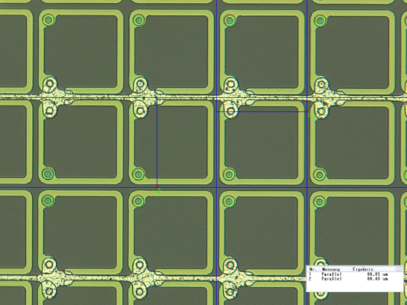
Photon Losses
A lot of light is trapped in crystal by total reflection
  n_{LYSO} = 1.82 , n_{Si} = 3.5
  Long / old discussion:
  specular or diffuse reflection ?
Photons are not absorbed in SiPM (geometric fill factor)
FBK, cells 67 x 67 um²

Slide 16
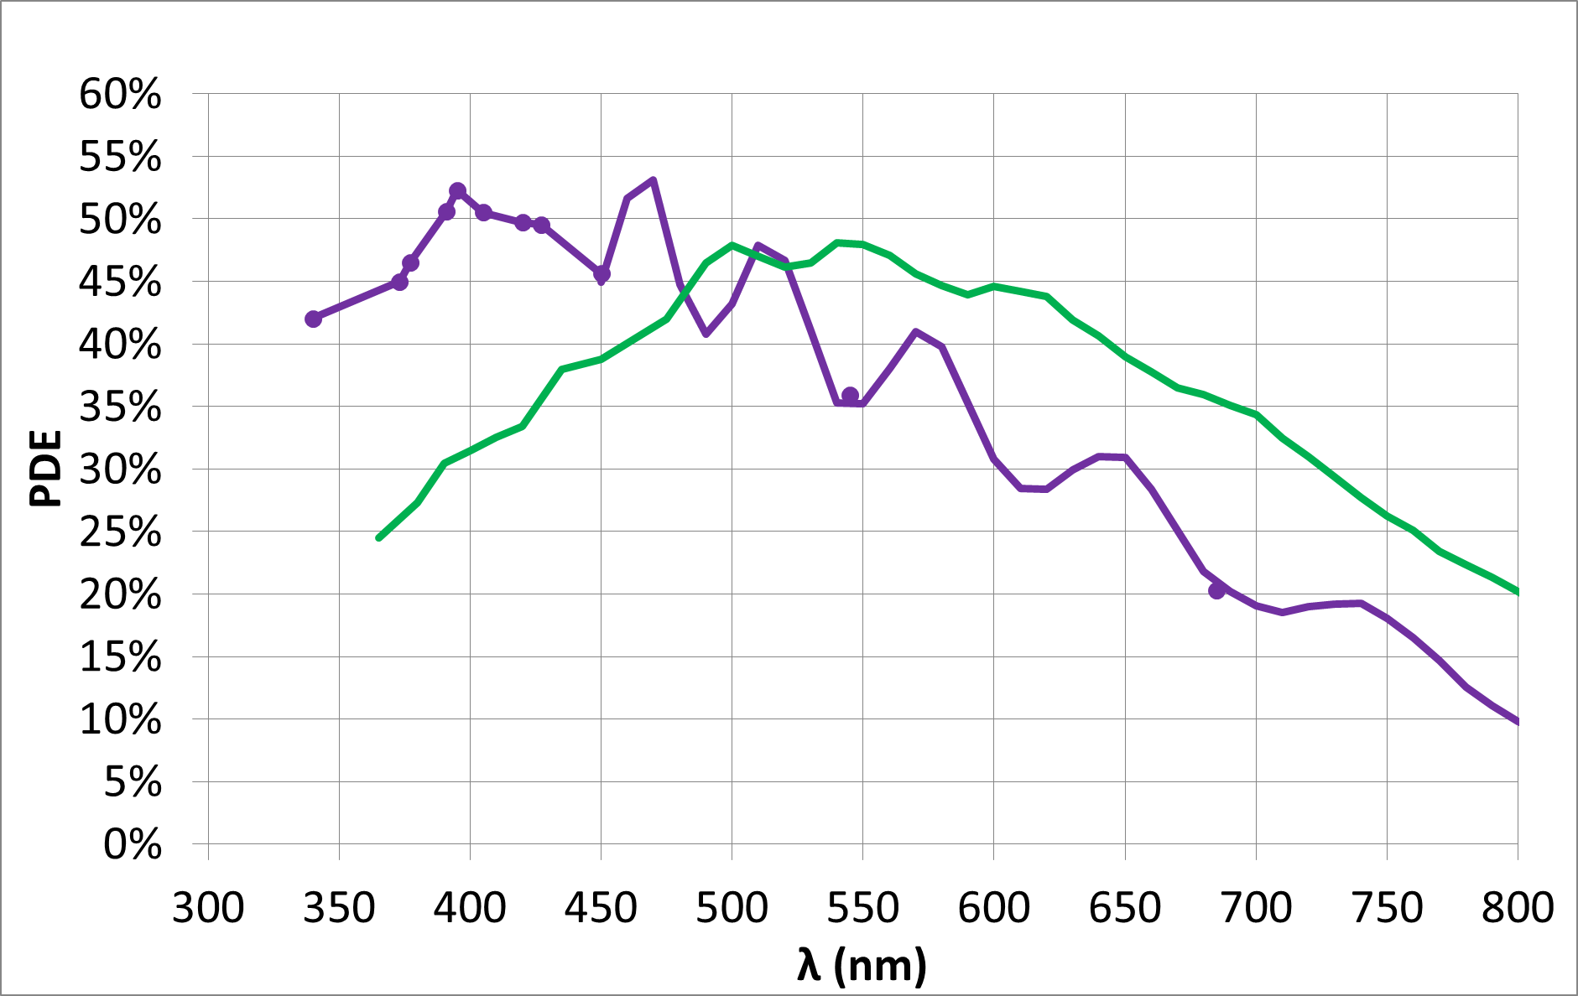
More Photon Losses: Spectral Matching
Spectral response of SiPM must match emission spectrum of crystal
Need UV-sensitivity!
LaBr,
CeBr
LSO,
NaI
CsI(Tl)
FBK devices:
RGB-HD
'OLD'
generation
NUV-HD
NEW
generation
25μm cell pitch
Over-voltage = 9 V

Slide 17
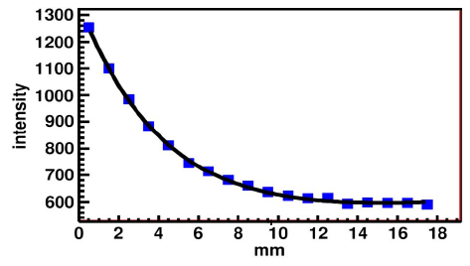
Long Crystal Effect
Consider a ‘long’ crystal (today: 4 x 4 x 20 mm³)
Absorption at top:
Photon travels long
(60 ps for 10mm)
(must compare to
speed of gamma)
few photons arrive
Amplitude variation
leads to time walk
Absorption at bottom:
short path
many photons
arrive
Measurement:
Crystal 2 x 2 x 18 mm
rough sides, gap + white epoxy
polished end, PTFE reflector tape

Slide 18
Summary: Optimizing for Time Resolution
Maximize Number of Photons (in first 100 ps)
  Fast scintillator (LaBr: hygroscopic, bad abs.)
  Short Crystal (bad efficiency)
  Good optical coupling
Use a good SiPM
  High PDE of SiPM (fill factor, wavelength matching)
  Use a SiPM with large cells (fill factor) (bad energy resolution)
  Optimize SiPM for fast signal part (not discussed here)
  Optimize Dark Count Rate (low threshold, high overvoltage)
Measure @ cold (reduce dark count rate)
Optimize Threshold
It's all about the
overall PDE!

Slide 19
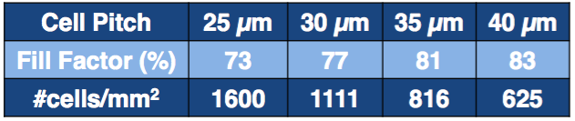
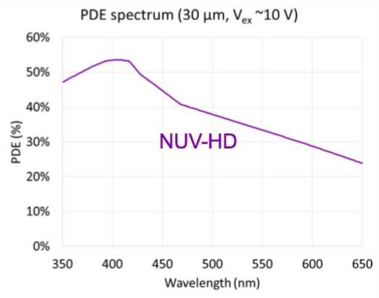
It's all about PDE (1)
Very nice, recent results from FBK (from FAST workshop in March 16)
  Thanks to Alessandro Ferri & Claudio Piemonte for their ok to show a few results!
Comparison of SiPMs with different small cell sizes and (still high) fill factor:
'NUV' technology
sensitive at short
wavelengths:
  matching LYSO
  emission

Slide 20
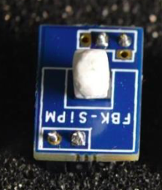
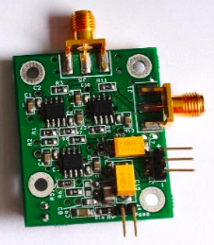
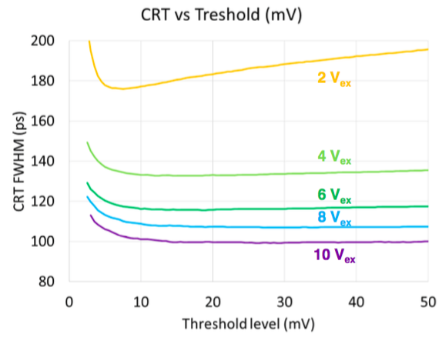
It's all about PDE (2)
CRT measurements with
  Small LYSO crystals of 3×3×5 mm³, τ~40ns
  No SiPM 'overglass' protection
  Optical glue: melt-mount (n=1.54)
  5-10 layers of Teflon
  4×4 mm² SiPMs
  Discrete amplifier or NINO (similar results)
  Readout with sampling Scope
  Energy cut at 511 keV ±FWTM
  Optimal Threshold for best timing:
  Conversion to Photoelectrons via
  1/2/3… PE amplitude spectrum
Parameter:
Overvoltage

Slide 21
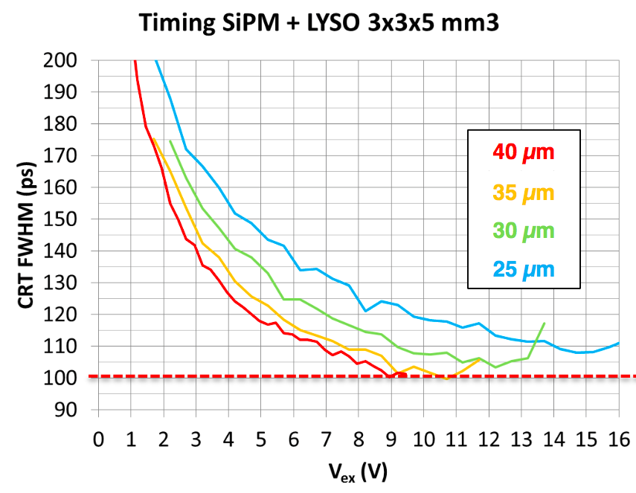
It's all about PDE (3)
CRT vs. overvoltage for the 4 designs: Down to 100 ps!
FBK
How to explain
  Overvoltage dependence
  Differences between designs

Slide 22
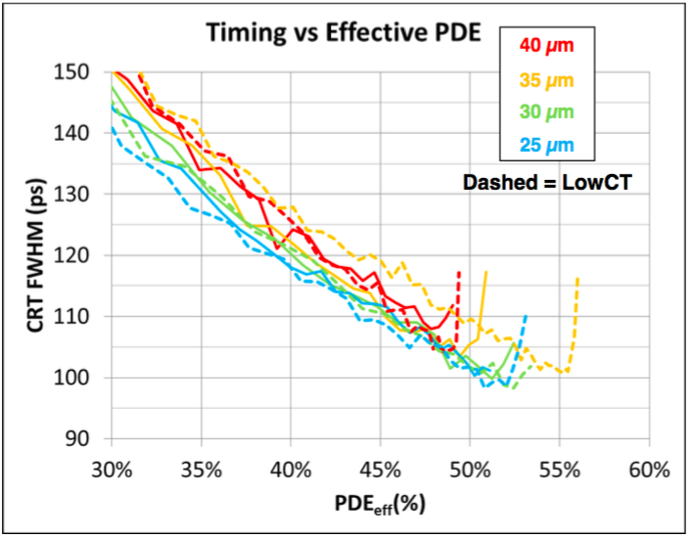
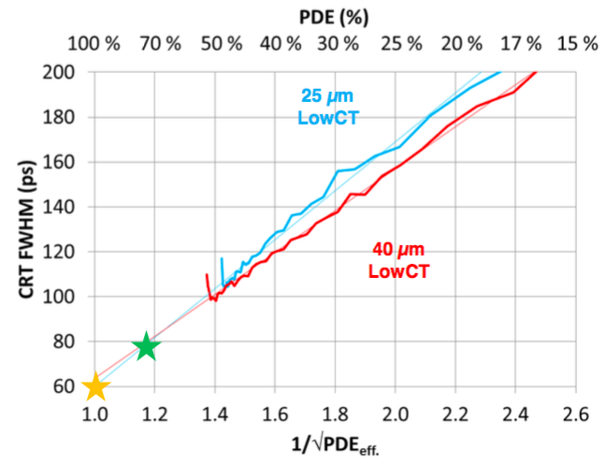

It's all about PDE (showdown)
Plot CRT vs. PDE (instead of overvoltage)
  PDE is measured vs. λ and calculated for LYSO emission spectrum
FBK
FBK
Limit: perfect device
with PDE = 100%:
CRT would be 60ps

Slide 23
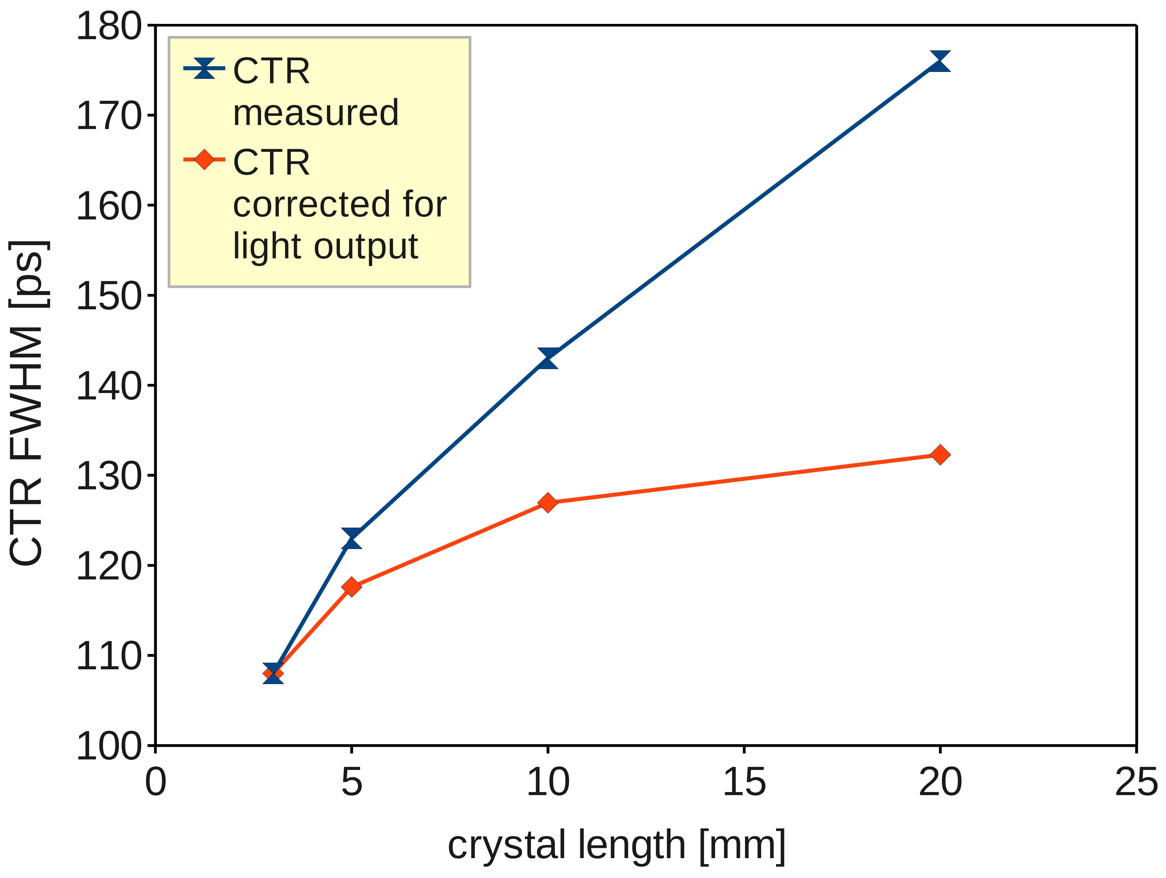
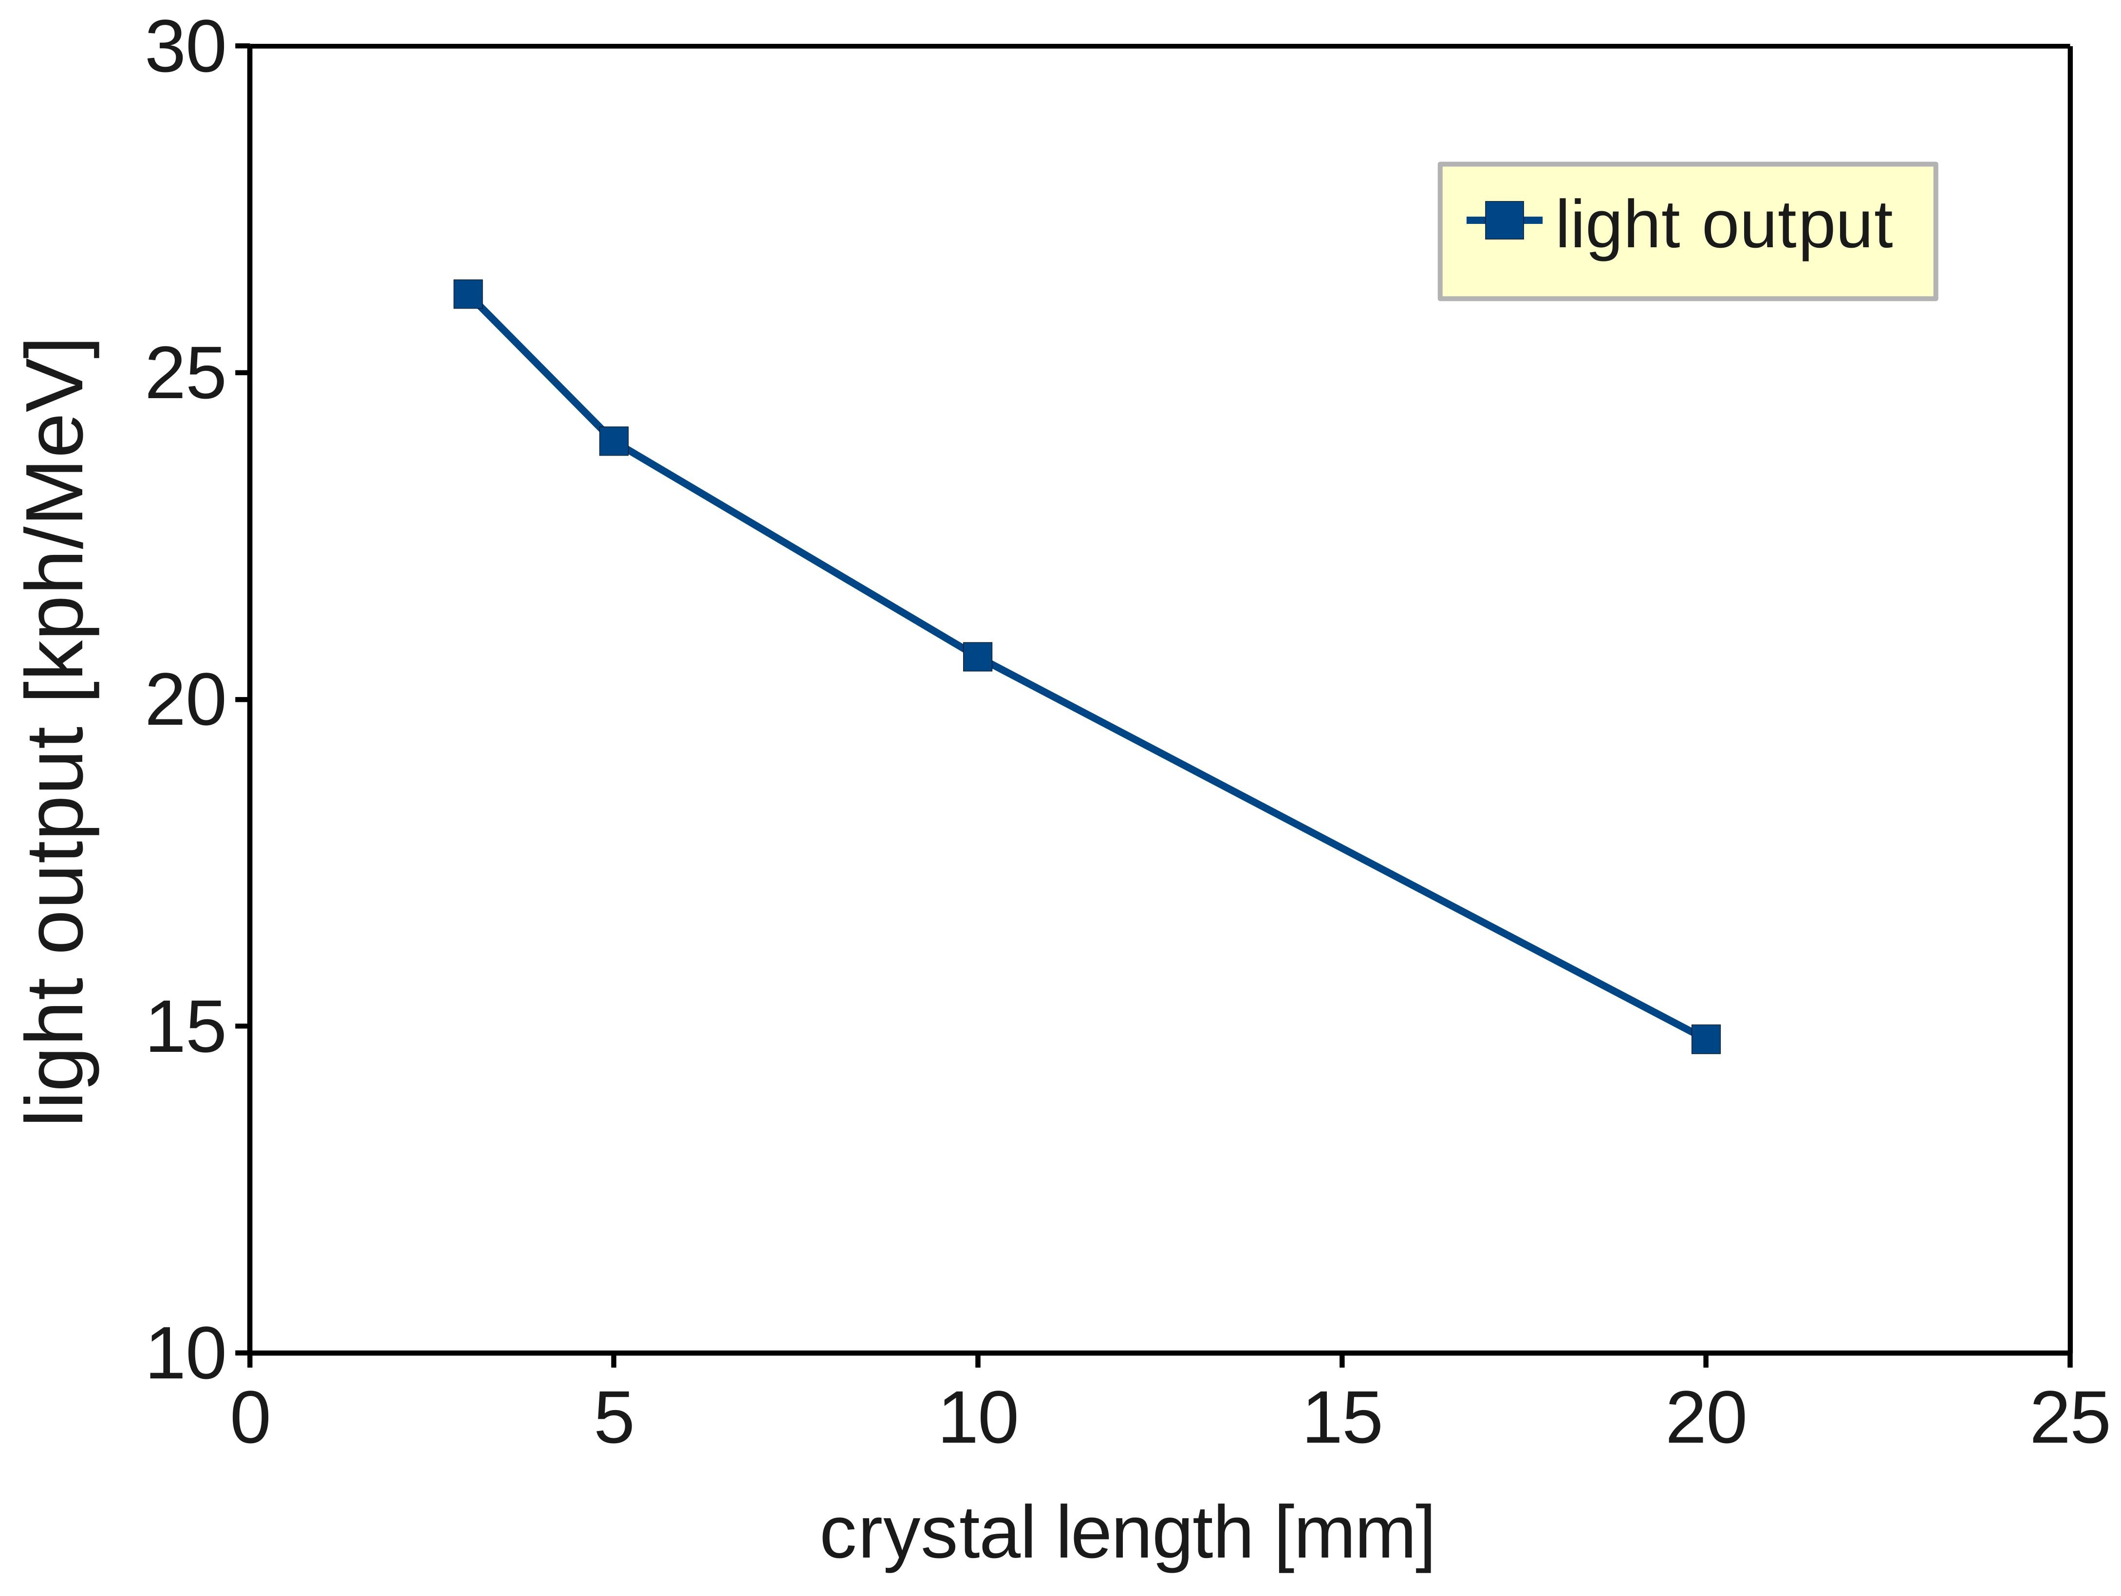
For comparison: 'very small' crystals @ CERN
SiPM: MPPC (Hamamatsu, 3×3 mm²)
Crystal: LSO:Ce, 0.4% Ca (‘best’), 2×2×L mm³, wrapped in Teflon, optical grease
Readout: NINO ASIC
Strong effect of
crystal length
S. Gundacker et.al., NIMA, dx.doi.org/10.1016/j.nima.2013.11.025 (P. Lecoq group)

Slide 24
Full Module Performance

Slide 25
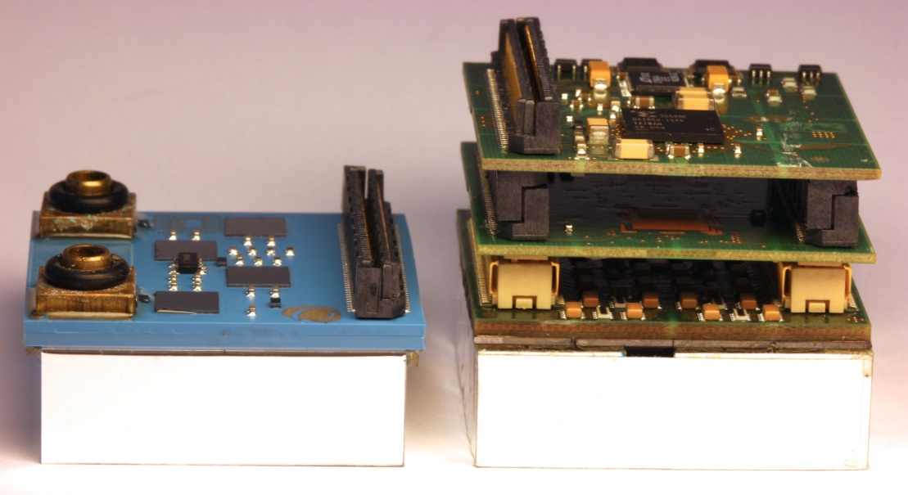
HyperImage vs. Sublima Detector Module
Hyperimage Project
Sublima Project
64 Channels
SiPM pitch 4×4mm²
144 Channels
SiPM pitch 2.5×2.5mm²
Internal liquid cooling

Slide 26
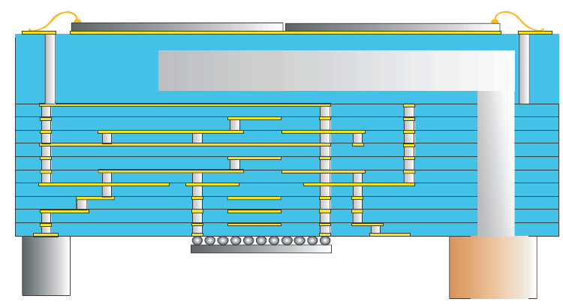
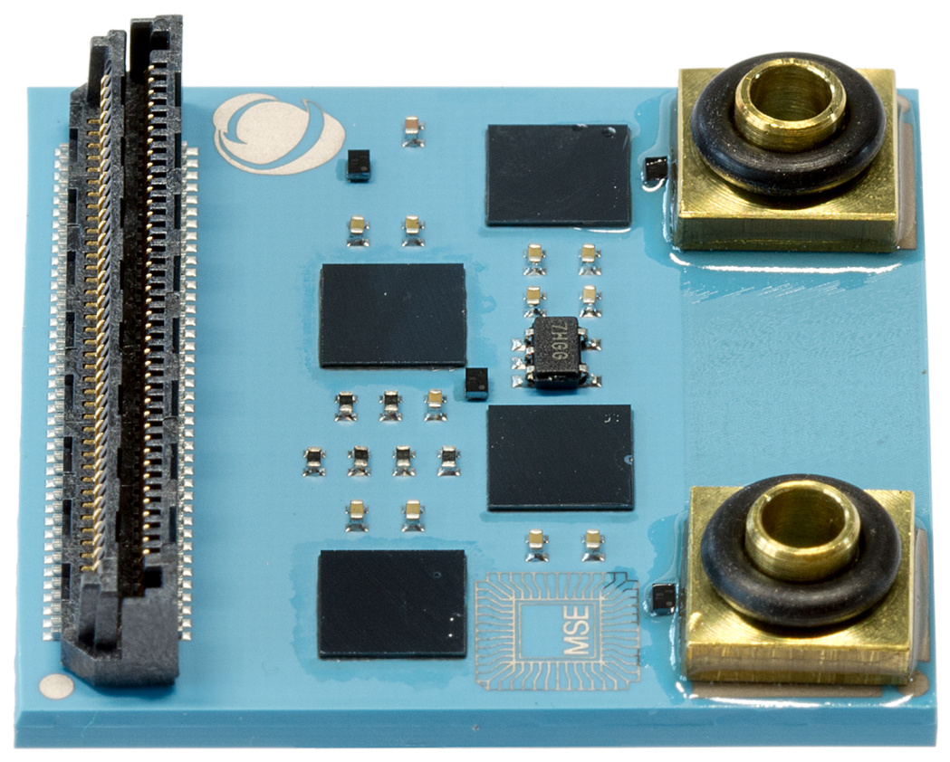
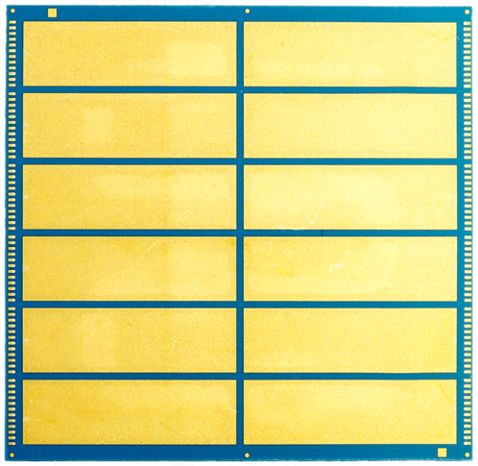
2nd Generation Module
Single ended FE → no more coupling components needed
ONE substrate only (low temperature co-fired ceramics, LTCC)
  SiPMs on top side
  PETA5 on bottom side
Liquid Cooling inside the
substrate (MSE, Germany)
PETA Chips
Flip chip mounting
MR compatible
components and layout
SiPM side

Slide 27
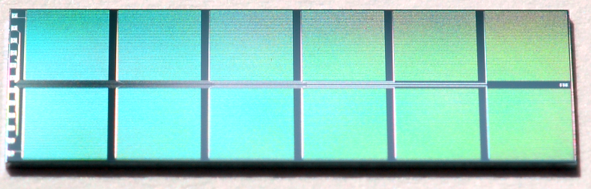
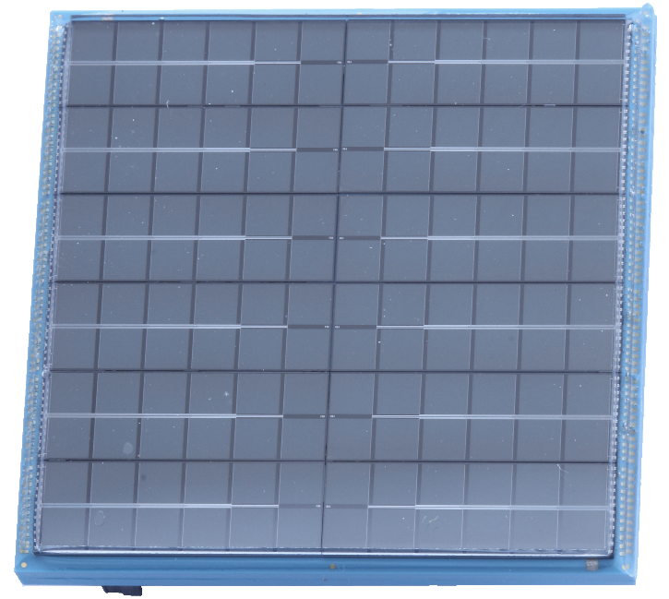

Sensor Geometry
Active area per SiPM 2.25 × 2.25 mm² ('OLD' design, cell size 25×25 µm²)
Rectangular dies with 2 × 6 SiPMs
Wire-bonding pads at the external edge → no gaps in the active region
Device from FBK
5mm
15mm
perfectly regular 2.5mm pitch all over the array

Slide 28
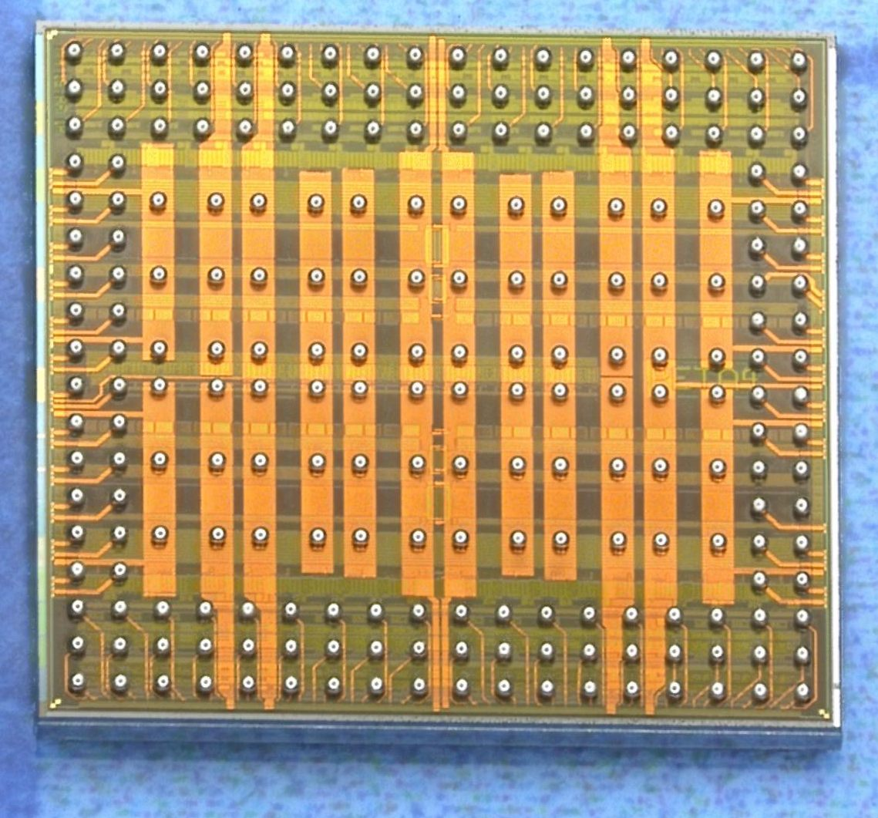
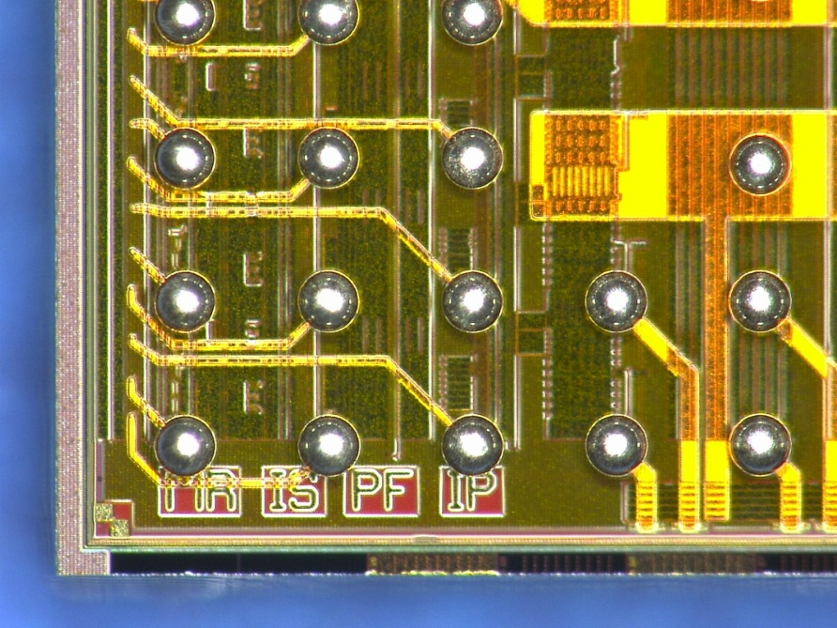
Bumped Chips
Wire bonds take much space → use solder balls in 270 µm pitch
UMC 180nm technology (6 layers)
5 x 5 mm² size
5 × 5 mm²

Slide 29
PETA4-6 Channel
Two FE versions per channel:
Channel
Logic
∫u(t)dt
ADC
Neighbor
triggers
control
IN+
Filter
Disc
IN-
Differential FE
Hit Logic
MUX
Thres
DAC
Single Ended FE
I→I
I→U
Disc
TDC
INSE
Ubias
DAC
∫i(t)dt
ADC
readout
control

Slide 30
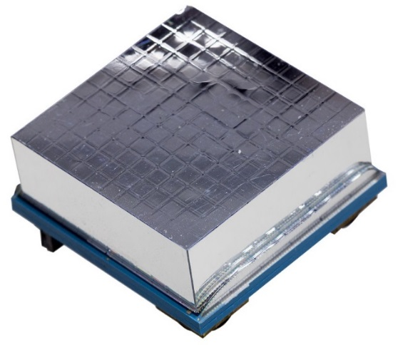
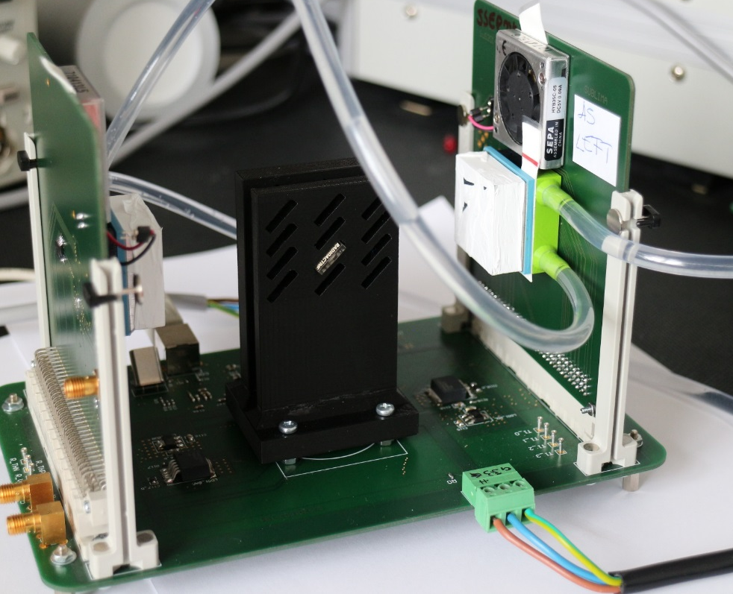
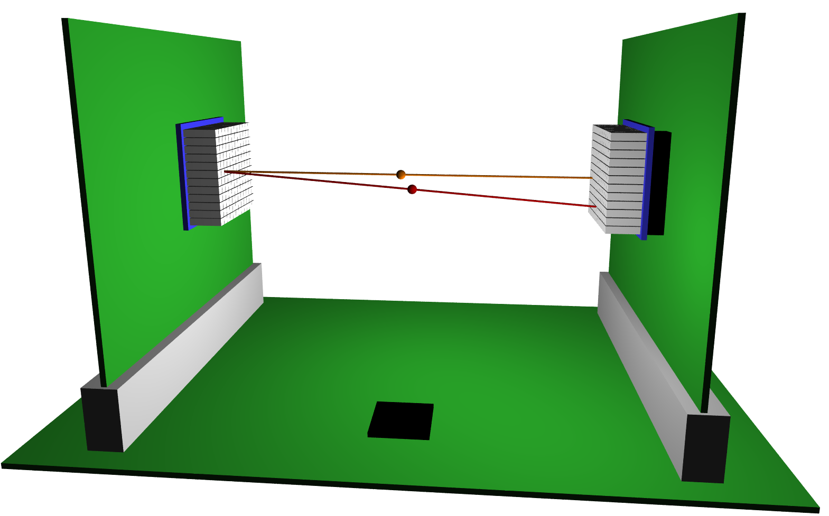
Module Time Resolution
Two 144 channel modules facing each other
1:1 coupling, 10 mm long LYSO, room temperature
²²Na

Slide 31
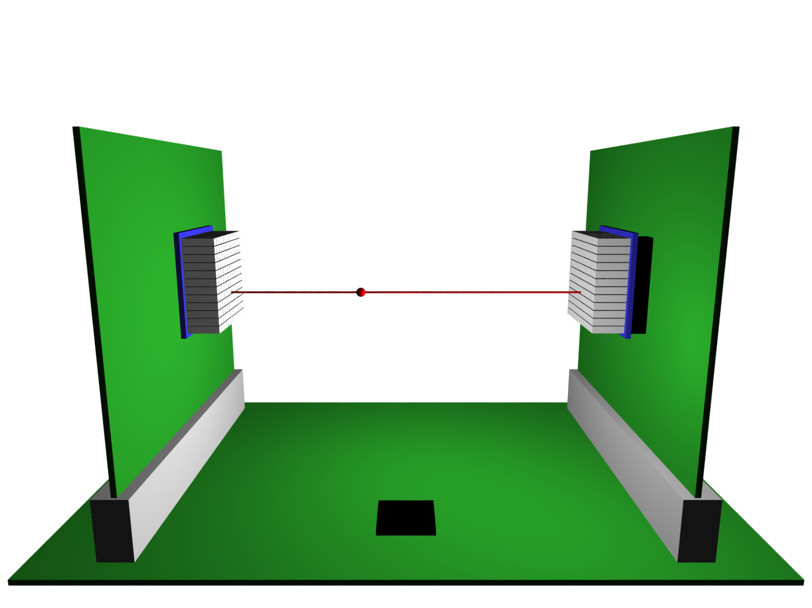
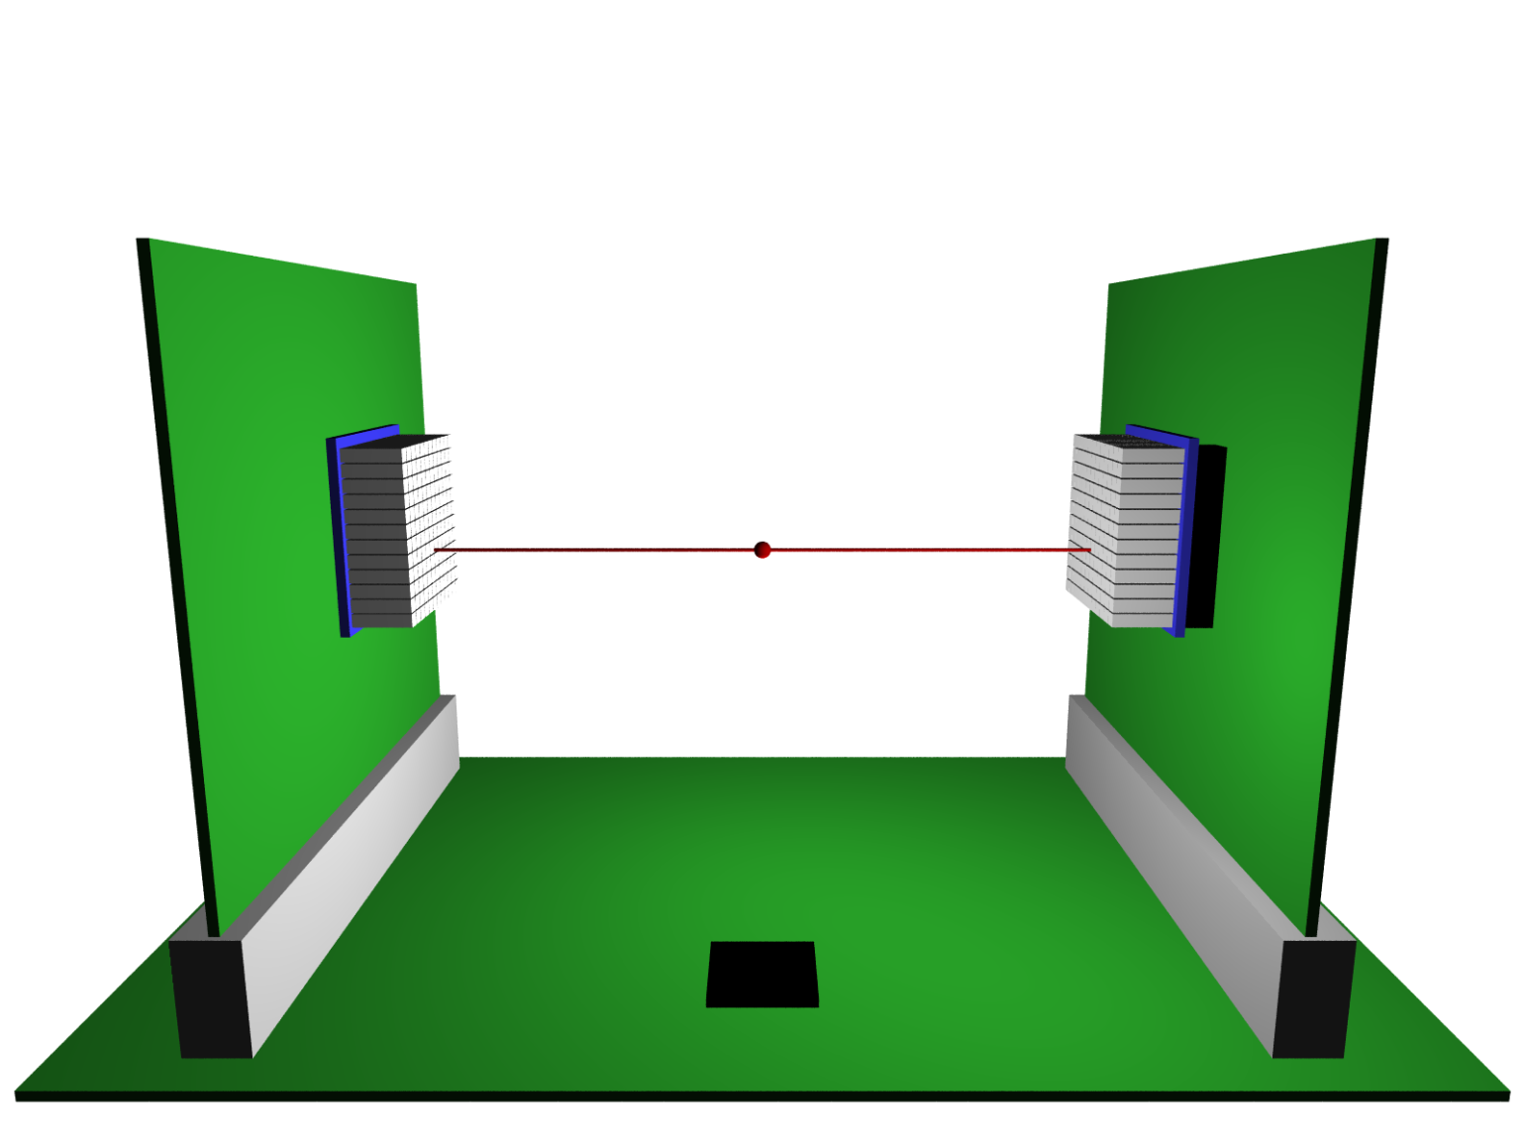


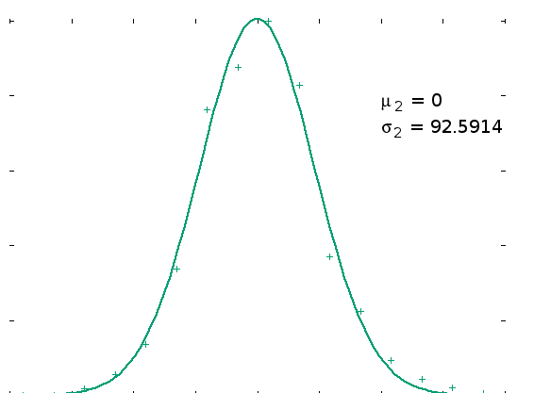
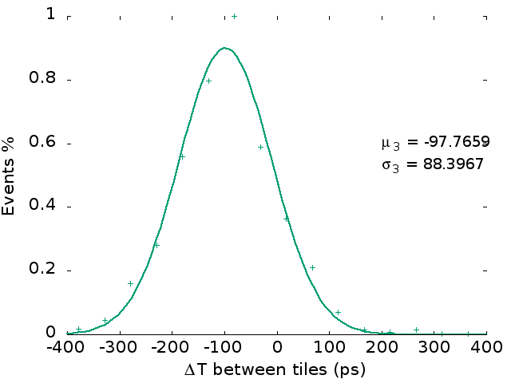
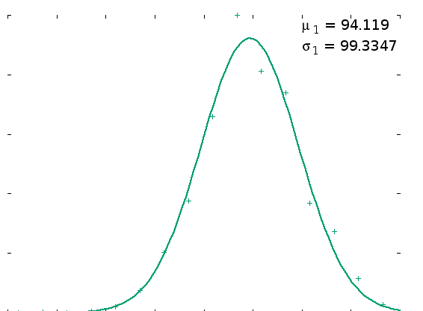
1 channel vs. 1 channel
  One channel per side. Move source along the line of response
15mm 15mm
Δx = 0.5 × ΔT× c
100ps 100ps

Slide 32
Many Channels ('All vs. All')
'Problem':
Our point source only creates coincidences in few crystal combinations
Must therefore use many positions and overly results.
(This explains badly filled 'channel - channel' bins)
A1
B1
B8
B1
A8
B8
A1
A8

Slide 33
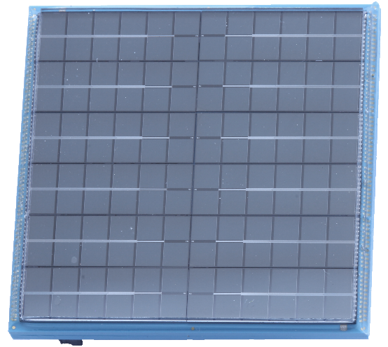
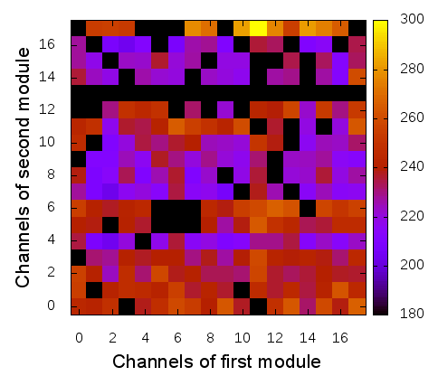
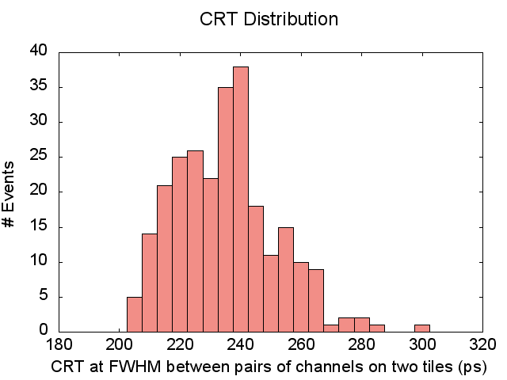
Timing resolution: '18 vs. 18'
OV = 8V (only), 22°C
broken channel
µ ~ 232 ps
missing source positions

Slide 34
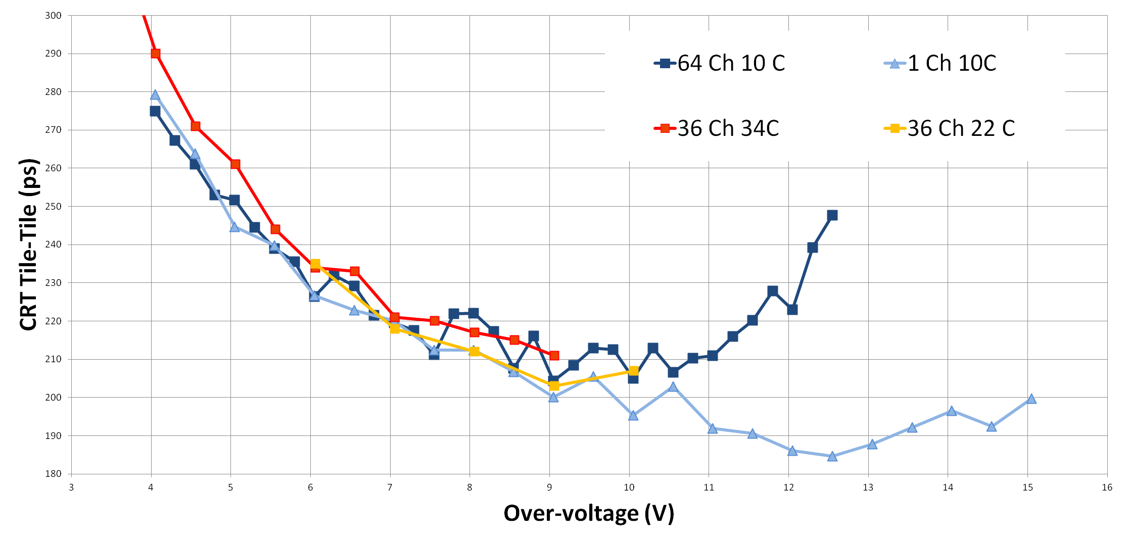
Comparison to FBK results ('gold standard')
SiPM bias voltage scan
Results very close to the limit for 'OLD' RGB-HD technology
Overvoltage can be increases much higher for single crystals
Limitation in array operation also observed in FBK discrete setup!
300 ps
FBK 64 Ch 10°C
FBK 1 Ch 10°C
SiPM 4x4 mm²
LYSO 3x3x5 mm³
Measurements with discrete electronics
PETA 36Ch 34°C
PETA 36Ch 22°C
PETA @ RT
SiPM 2.5x2.5 mm²
LYSO 2.5x2.5x10 mm³
200 ps
180 ps

Slide 35


Summary: Module Performance
Full modules with 'OLD' SiPMs from FBK have an average CRT of 230 ps
  (single side gamma time resolution σ = 70ps)
When comparing to single channel measurements, must consider
  We use with off-the-shelf LYSO
  SiPM (RGB-HD) is not 'latest' SiPM generation
  Many SiPMs operate in parallel
  Crystals are rather small (2.25 mm) (10 mm long)
  Measurement done at room temperature
  Crystal isolation (ESR / Al / ESR) is (probably) worse than Teflon
Spatial resolutions in preclinical arrangements are excellent (<0.8mm)

Slide 36
Summary
ToF improves image quality (or: lowers dose, or: lowers scan time) in PET
Commercial devices have 400-600 ps CRT
CRT close to 200 ps @ RT has been demonstrated (by several groups)
  Multi channel R/O ASIC can cope with this resolution
Progress in SiPMs (fill factor, spectral sensitivity, dark noise) can bring us close to 100 ps
It's all about PDE
  Optimize SiPMs
  Maximize light (geometry, coupling, wrapping,..)
Need faster crystals!

Slide 37
Thank you for your attention!

Slide 38
Example of Improvement by ToF
Slide from A. Ganin, GE Company, CRT ≈ 400 ps, Hot Rods Phantom
Contrast enhancement / resolution increase (@ given dose)
C. Kim et al., ToF PET Detector development with Silicon Photomultiplier, 2012 IEEE NSS and MIC Record

Slide 39

Energy Resolution (@ low overvoltage)
Difficult to determine exactly because FE saturates at high amplitudes
1.275 MeV peak cannot be used well for calibration and nonlinearity correct.
~12 %

Slide 40


Speed of Rising Edge
Has been studied (TU Delft) directly with triggered X-ray pulses
Rise time ≈ 100 ps for LSO:Ce wrapped in black tape (only ‘direct’ photons)
But: White Teflon wrapping (‘to get all the light’ to improve energy resolution) worsens rise time!
Depends very much on Crystal Geometry

Slide 41


SiPMs from FBK + Our Chip (PETA3)
crystal 2
crystal 1
Positron
Source
ASIC
Discrete setup with
‘best’ signal processing

Slide 42
Requirements for Electronics
Low noise obvious
Low system threshold this is the real point…
High bandwidth obvious, but be aware of noise!
High pass filter to eliminate baseline fluctuations
Low input impedance (some 10 Ω) to get a large ‘fast’ SiPM component
Adjustable DC input potential to adjust overvoltage of SiPM
TDC bins ≈ 50ps quadratically < target CRT
Energy resolution 7-8 Bit to cut on 511 keV in 1:1 coupling.
More bits for position reconstruction with light sharing
Fast Abort for false triggers on DCR to avoid large dead time
Hit selection from amplitude (on too much or little light, in 1:1)
Neighbor trigger in light sharing application
Data readout rate ≈ 100 khits / channel
Acceptable power dissipation (continuous operation)
Low Emission in PET / MRI

Slide 43
Summary: PETA chips
PETA is a complete 38-Channel Timing Solution (incl. TDC w. 50 ps bins)
PETA allows compact module designs (flip chip, few external parts)
Choice between Differential FE (both polarities, MRT immune) and
Single Ended FE (low Z_{in}, DC bias adjustment, no external coupling parts)
Channel dead time < 500ns
Readout rates >200 kHz per channel (in all channels)
Power consumption ~30mW / channel (😥)
Special features:
  Neighbour logic (for light sharing concepts)
  Fast abort on 'noise hits' (small signals, before digitization, ⪅100ns)
  Abort on low amplitudes (≪ 511 keV, after digit., ~300 ns)
  Power down input (@ over-temperature, external measurement)

Slide 44
Single Ended Frontend
A low power front-end architecture for SiPM readout with integrated ADC and multiplexed readout, I. Sacco et al., JINST, Volume 8, January 2013, C01023
ADC 'gain'
ADC 'resolution' vs. conversion time
Inject
Inject
Front-End
Charge Integrator & ADC
gain
ampl.
DAC
Finite State Machine (FSM)
Input
V_{REF}
hit
Initial Condition
I_{Ramp}
clear
SiPM
Discriminator
- HV
Z_{in}~ 7Ω
Variable DC
bias @ input
(~0.8V, per ch.)
Th_{N}
TDC
time
V_{CM}
x 4
Th_{P}
No more external
components needed
(I. Sacco)
Same as diff. FE

Slide 45
Readout
Fully self triggered
2 serial outputs per side (2 'spare' if higher rate needed)
Size of one event ~32 Bit
Rates well above 100 kHz simultaneously in each channel are possible
Improved PETA6 architecture has very low dead time:
Output link capacity reached
Theoretical losses for
front-end dead time of 300ns
Simulated losses when using
1 output per side, @ slow clock

Slide 46

FE Chips for SiPM Readout
Requirements vary depending on application
  speed, dynamic range, #channels, resolution,…
So far only few system chips with all features ‘on board’
And more:
PETIROC
RatCAP TSMC 180 32
STiC TSMC180 64
Overview Table from
Wojciech Kucewicz, AGH

Slide 47
SiPM Model
SiPM = parallel connection of many small SPADs
  Size ≈ 50um ➔ N = 6400 for an area of 4x4 mm²
SPADs are biased with individual resistors to a DC potential above the breakdown voltage (20-30V)
When a SPAD is fired by photon, its voltage drops by the Overvoltage
R_{Q}
C_{Q}
R_{Q}/(N-NFire)
(N-NFire)C_{Q}
C_{G}
ΔV
C_{D}
(N-NFire)C_{D}
Firing cells
To understand output signal, caps must be added

Slide 48


SiPM Signal and Input Impedance
few 10 fF
SiPM Model
Amplifier
NFire times
vin
R_{Q}
C_{Q}
R_{Q}/(N-NFire)
(N-NFire)C_{Q}
C_{G}
Z_{in}
ΔV
isig
C_{D}
some 10 fF
(N-NFire)C_{D}
many 10 pF
Current pulse @ resistive input has 2 components
  Fast component by capacitive coupling via C_{Q}s
  Slow component from recharging of C_{D}s via R_{Q}s
The fast component of the input current
becomes larger when input impedance is small!
For timing we NEED this component
➔ we need small Rin
  For very small R_{in} (<10Ω) we are limited by parasitic Rs

Slide 49
Comparing Results
Comparing results from different groups / setups is difficult:
  Scintillator material (selected crystals? Co-doping? LaBr?)
  Scintillator Geometry (small cubes? long needles as required in PET?)
  Wrapping? (Many layer teflon not feasible in arrays? Black wrapping for timing?)
  Operation Temperature (cold allows higher overvoltage)
  Overvoltage / Dark noise rate (high OV gives better CRT, but high Darknoise and is often not feasible in practice due to dead time)
  SiPM Size

