Slide 1
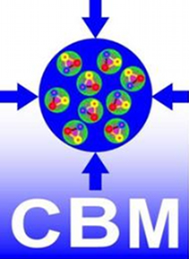
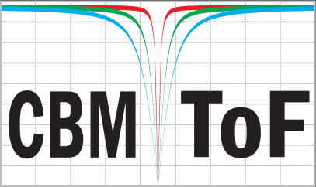
9th Terascale Detector Workshop 2016
(M)RPCs for CBM
Ingo Deppner for the CBM-TOF Group
Outline:
Motivation/CBM-ToF requirements
What is an Multigap Resistive Plate Chamber (MRPC)?
Cosmic test results with float glass MRPC prototype
Low resistive glass as resistive electrodes for MRPCs
Beam test results with low resistive glass MRPC prototype
Module design
ToF – project timeline
Summary / Next steps

Slide 2
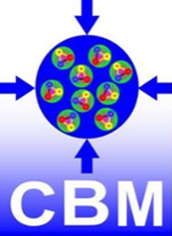
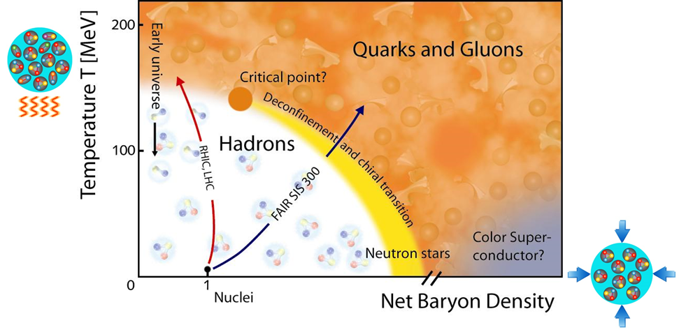


Motivation
Phase diagram of strongly interacting matter
Open questions in nuclear physics:
Is there a 1st order phase transition at high ρ_{B}?
Is there a QCD critical endpoint?
What is the equation-of-state at high ρ_{B}?
What is the property of hadrons in dense medium?

Slide 3
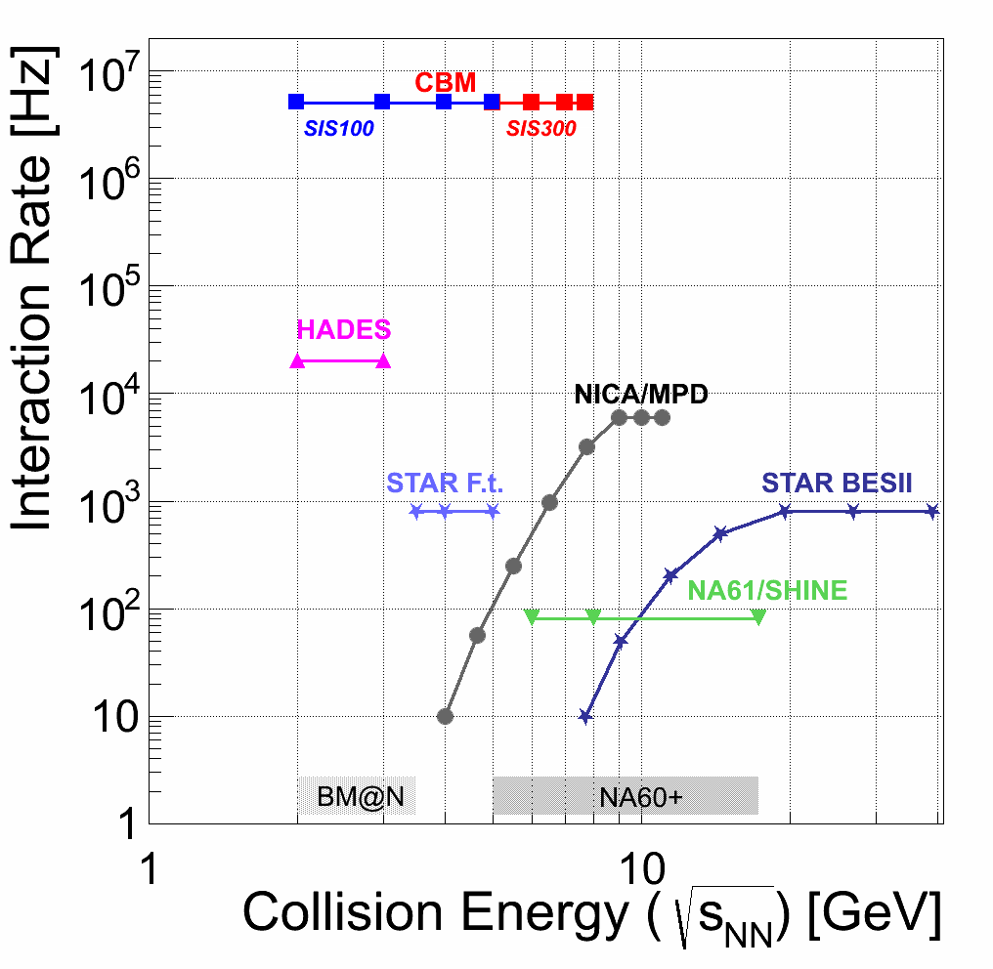
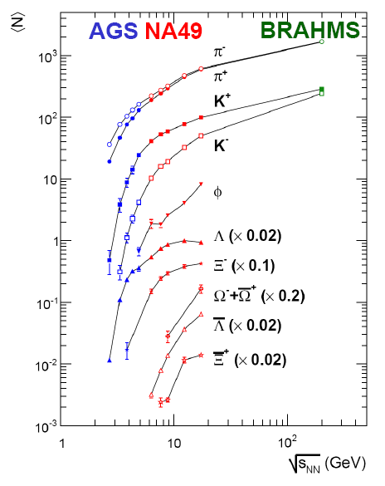
Motivation
Central Au+Au/Pb+Pb collisions, 4π yields
?
Maximal interaction rate in CBM for heavy systems is 5 - 10 MHz

Slide 4

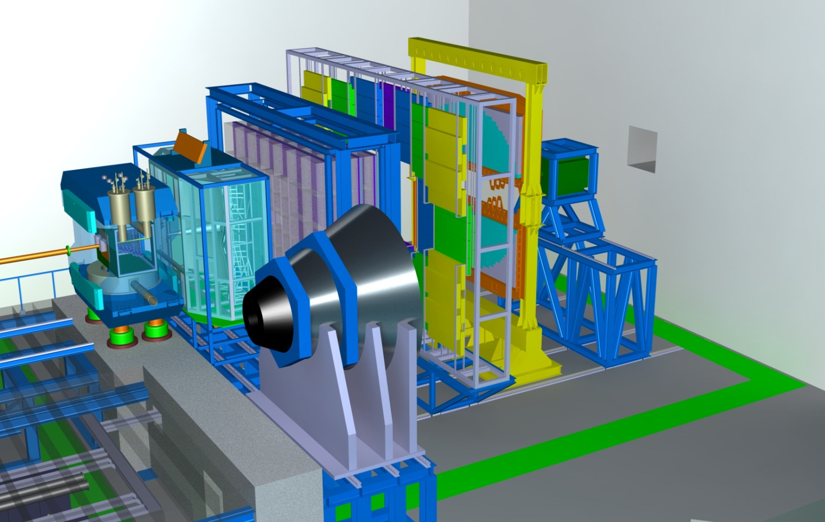
Requirements
Compressed Baryonic Matter Experiment at FAIR facility @ GSI
Dipole magnet
TOF
ECAL
PSD
TRD
RICH
CBM-ToF Requirements
full system time resolution σ_{T} ~ 80 ps
Efficiency > 95 %
Rate capability ≤ 25 kHz/cm²
Free streaming DAQ
Ocupancy < 5%
Low power electronics
(~120.000 channels)
MVD & STS
MUCH
80 Ω
1 ns

Slide 5
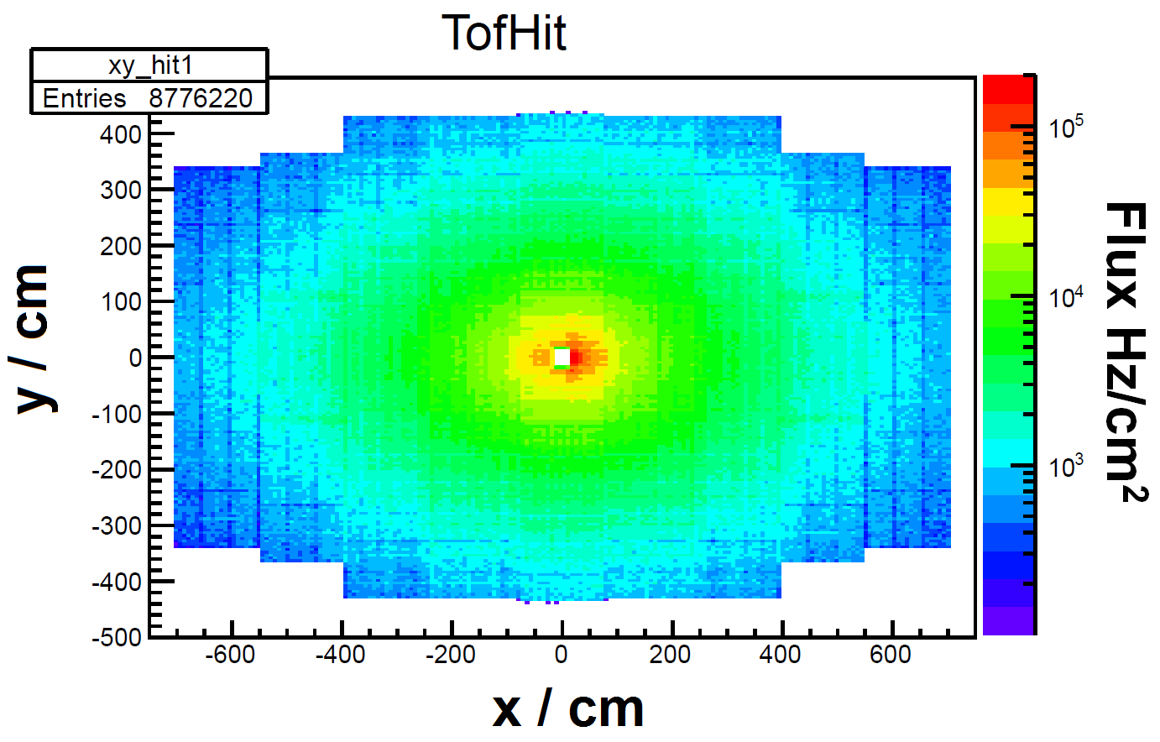
Incident particle flux
URQMD simulated charged particle flux for Au + Au (central) events at 10 AGeV assuming an interaction rate of 10 MHz
kHz/cm²
Area with < 1 kHz/cm²
Flux ranging from 0.1 to 100 kHz/cm²
At different regions MRPC counters with different rate capabilities are needed

Slide 6
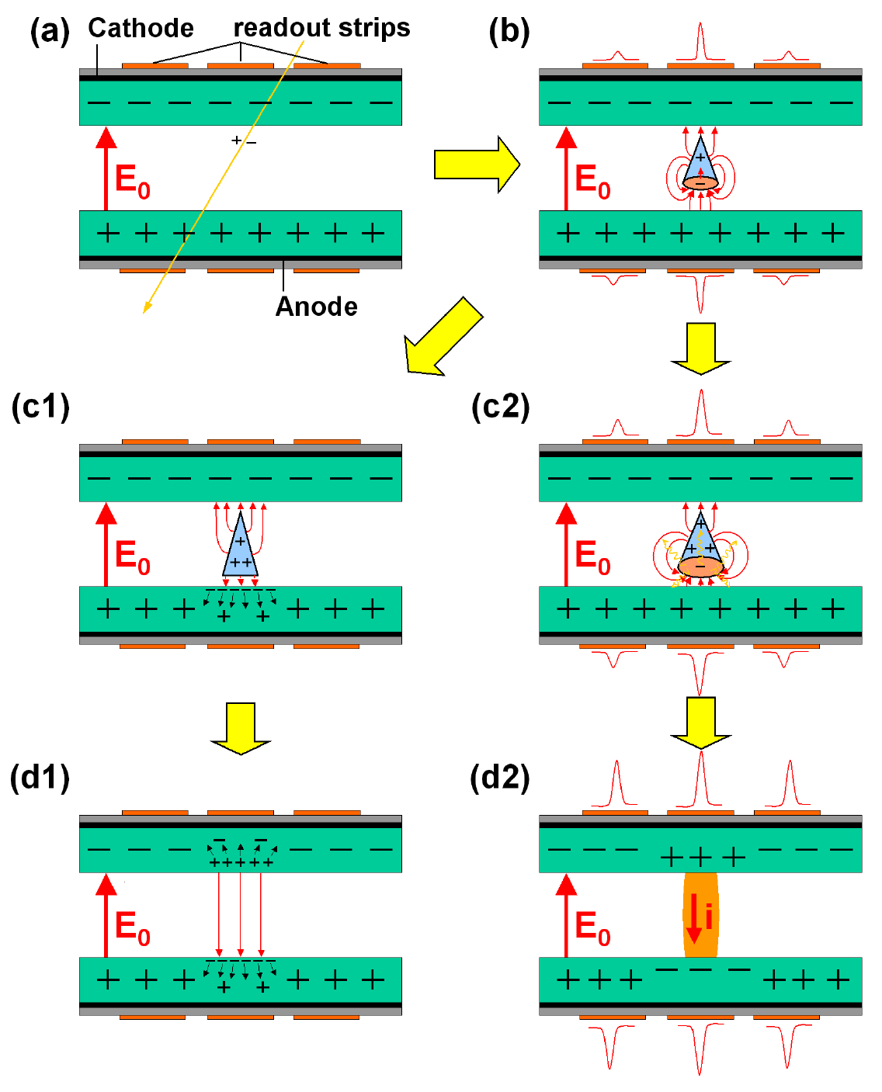
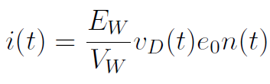




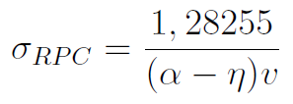

Working principle of an RPC
Induced signal current (mirror charge)
Resistive plate
Gas gap
Shockley-Ramo theorem
Resistive plate
Weighting field:
Typical drift velocity in RPCs
≈ 230 μm/ns
Number of e⁻
per avalanche
Effective Townsend coefficient:
≈ 150 mm⁻¹
Variance of a Landau distribution
Theoretical time resolution
_{D}
E₀ = 120 kV/cm
≈ 40 ps

Slide 7
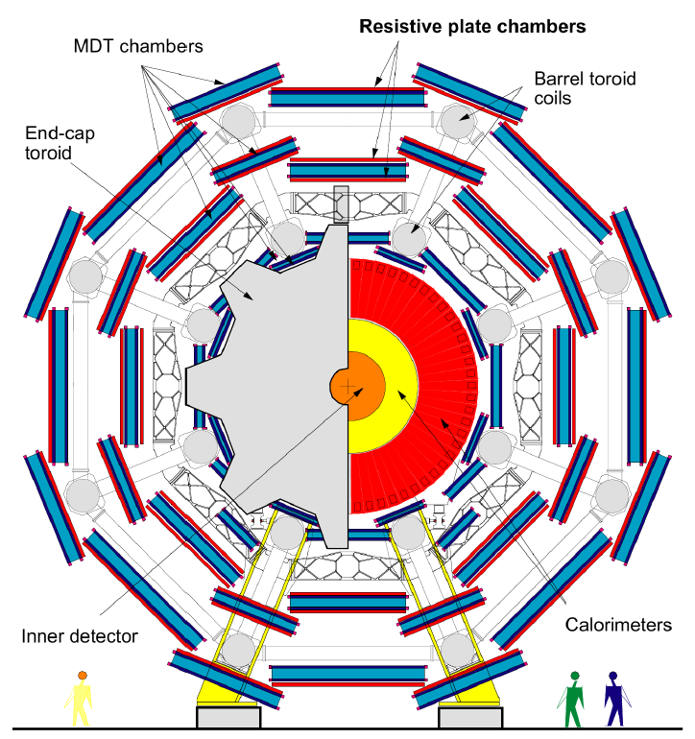
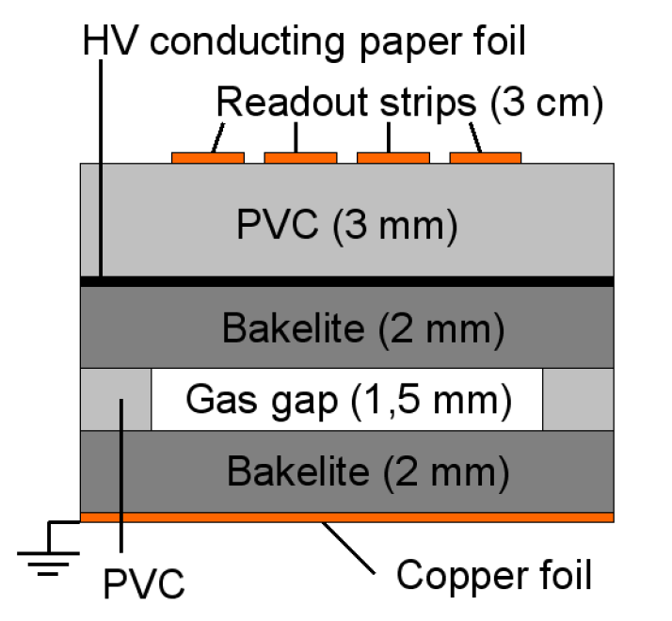
What is an (M)RPC?
First RPC developed 1981 by
R. Santonico and R. Cardarelli,
Nuclear Instruments and Methods 187 (1981) 377 - 380
Example: Atlas with 7300 m²
and 355000 readout channels
Bakelite vol.res. ρ ≈ 10¹⁰ Ωcm
E ≈ 50 kV/cm
σ_{t} ≈ 1 ns
C₂F₄H₂/i-C₄H₁₀/SF₆ (96,7/3/0.3)
Experiments using trigger RPCs:
ATLAS, CMS, Alice, PHENIX, BaBar, ARGO-YPJ, OPERA
80 Ω
1 ns

Slide 8
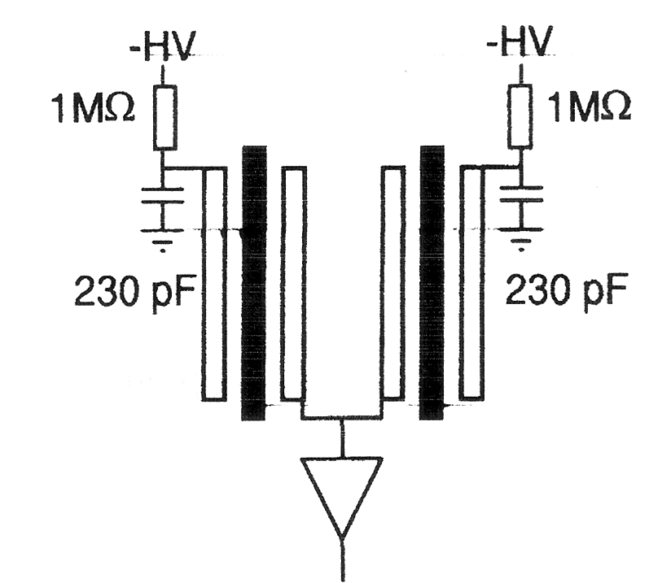
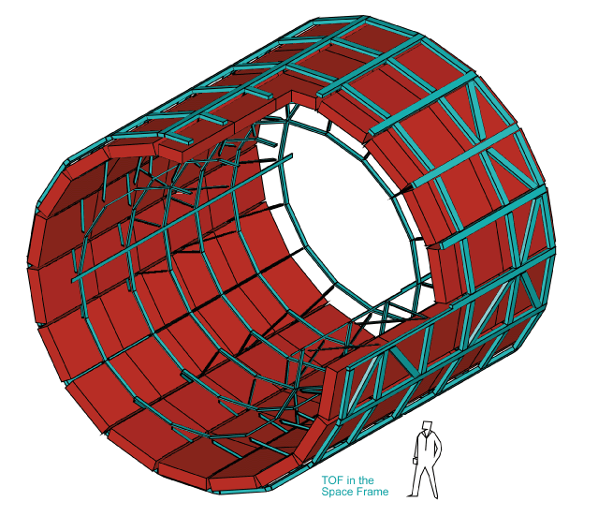
What is an (M)RPC
First Multi-gap RPC (MRPC) introduced 1996 by
E. Cerron Zeballos, I. Crotty, D. Hatzifotiadou, J. Lamas Valverde, S. Neupane, M.C.S. Williams, A. Zichichi Nuclear Instruments and Methods in Physics Research A374 (1996) 132-136
First timing MRPC built in 2000 by
P. Fonte, A. Smirnitski, M.C.S. Williams,
Nuclear Instruments and Methods in Physics Research A 443 (2000) 201 - 204
Example: ALICE with 160 m²
and 160000 readout channels
Al
gas gap 0.3 mm
glass vol.res. ρ ≈ 10¹² Ωcm
E ≈ 100 kV/cm
σ_{t} ≈ 100 ps
C₂F₄H₂/i-C₄H₁₀/SF₆ (85/5/10)
glass
Design used still now by HADES
Experiments using timing MRPCs:
FOPI , ALICE, STAR, HARP, LEPS2

Slide 9
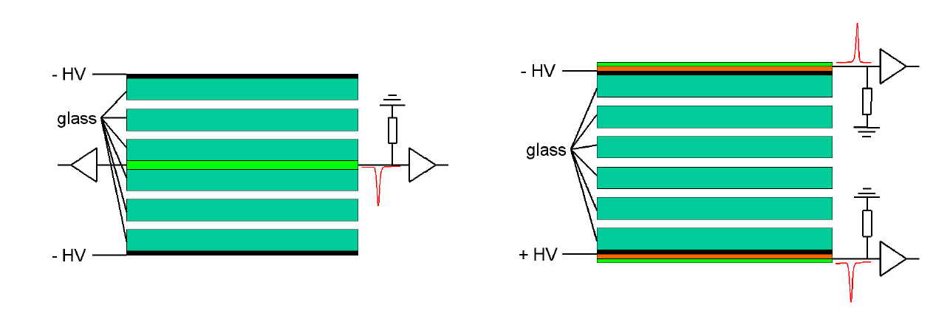
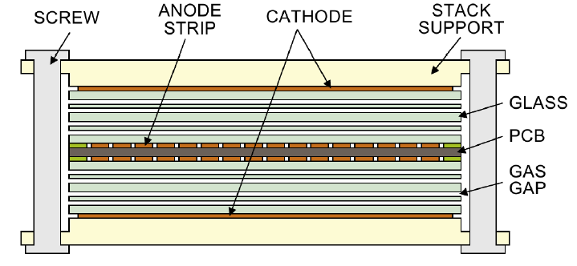
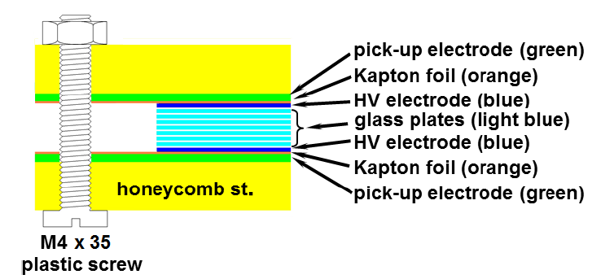
Structure of Multi-gap RPCs
e.g. FOPI
e.g. CBM
Single ended with double stack configuration
Differential with single stack configuration

Slide 10
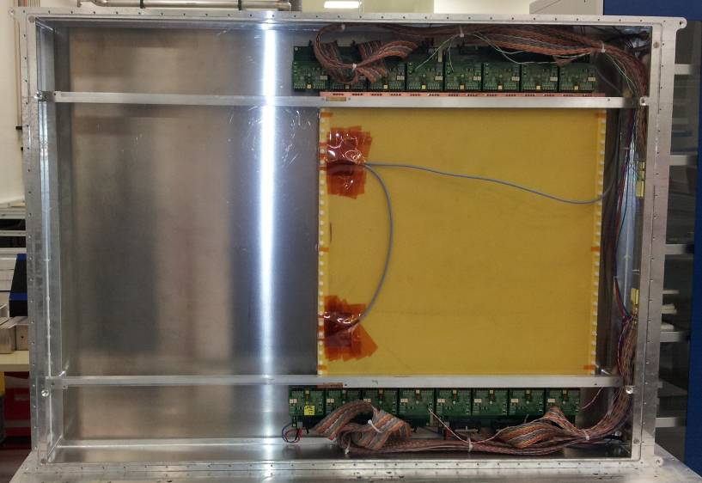
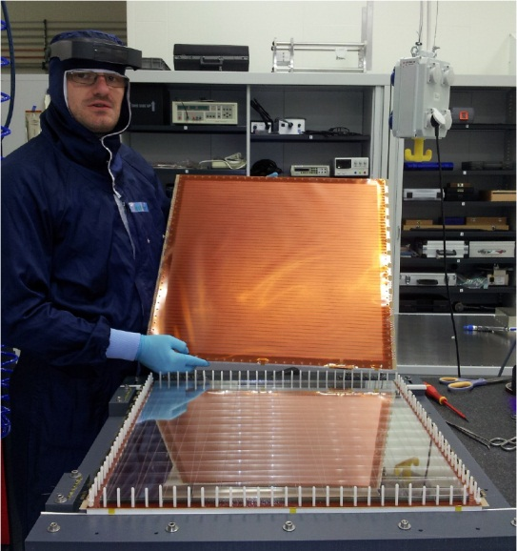
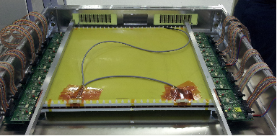
MRPC-P3 prototype
Full size demonstrator with float glass for the low rate region (< 1kHz/cm²)
MRPC-P3 (HD)
MRPC differential
active area 52 x 53 cm²
strips 56
strip / gap 7.6 / 1.8 mm
glass type float glass
glass thickness 0.5 mm
number of gaps 8
gap width 220 μm
Impedance matched to 100 Ω
80 Ω
1 ns

Slide 11
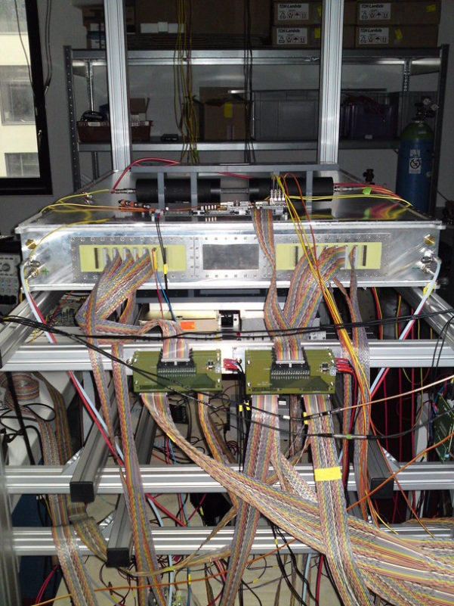
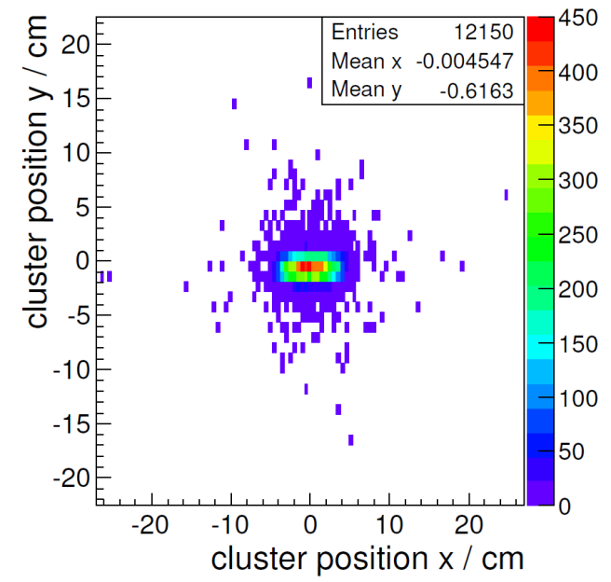
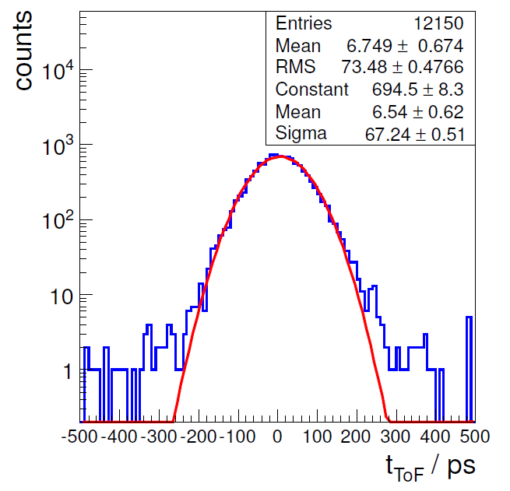
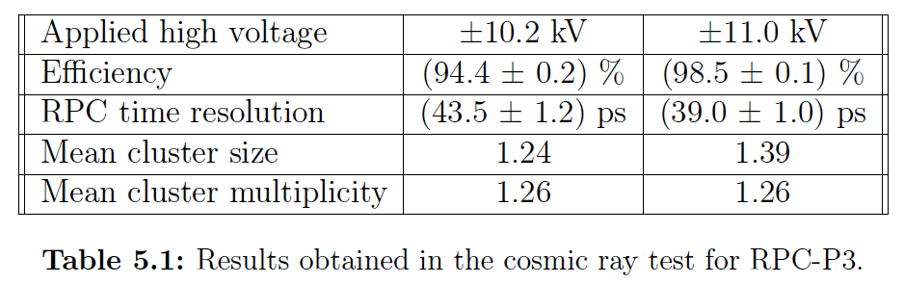
Cosmic ray stand in HD
Setup in our lab. 2014
Cluster distribution
System Time resolution
PMTs
MRPC
MRPC time resolution is about 40 ps including electronics resolution

Slide 12
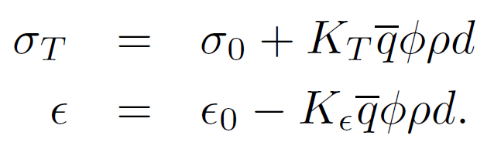
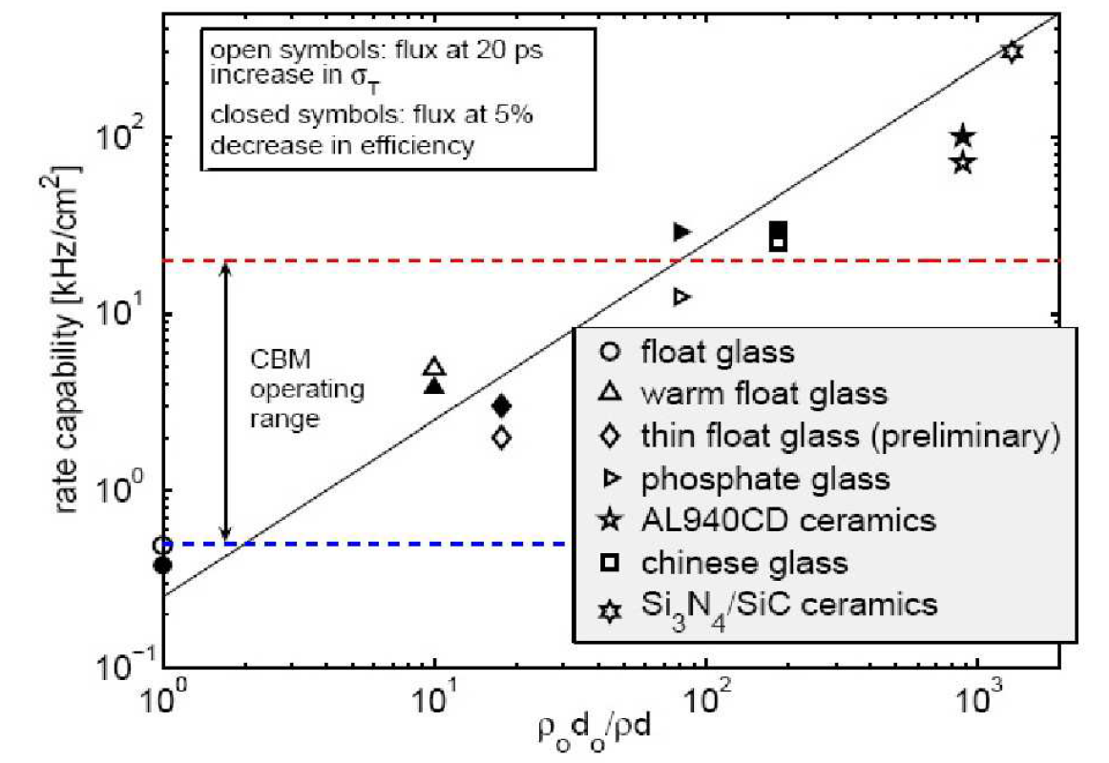
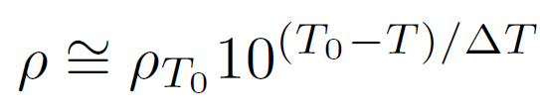
Rate capability of MRPCs
Time resolution:
φ: incident ch. particle flux
ρ: electrode bulk resistivity
d: electrode thickness
Efficiency:
How to increase the rate capability?
Lowering the resistivity of
the electrode material
- different materials
1) float glass: ρ = 3x10¹² Ωcm
2) low resistive glass:
ρ ≈ 10¹⁰ Ωcm
3) ceramics: ρ ≈ 10⁹ Ωcm
- warming the electrodes
Decreasing the electrode thickness

Slide 13
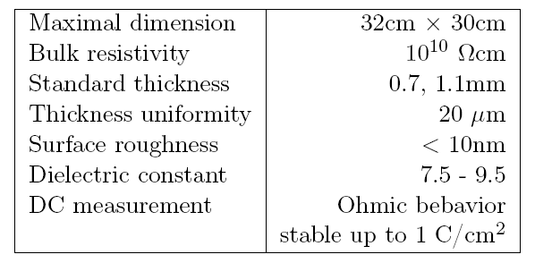
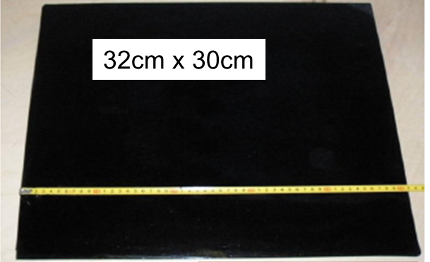
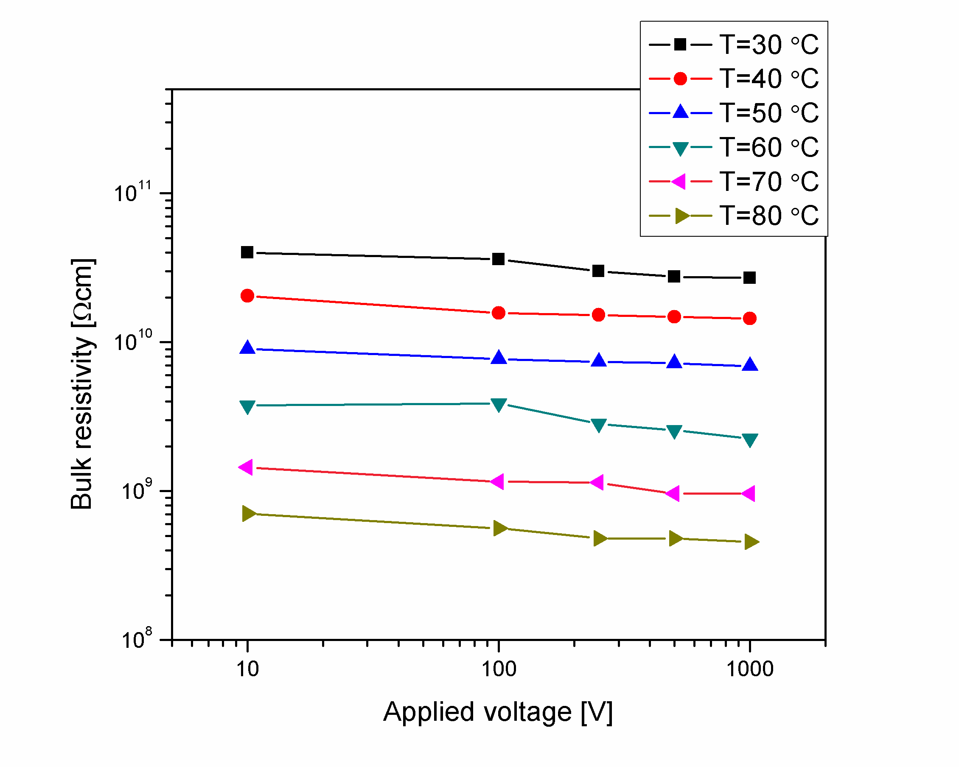
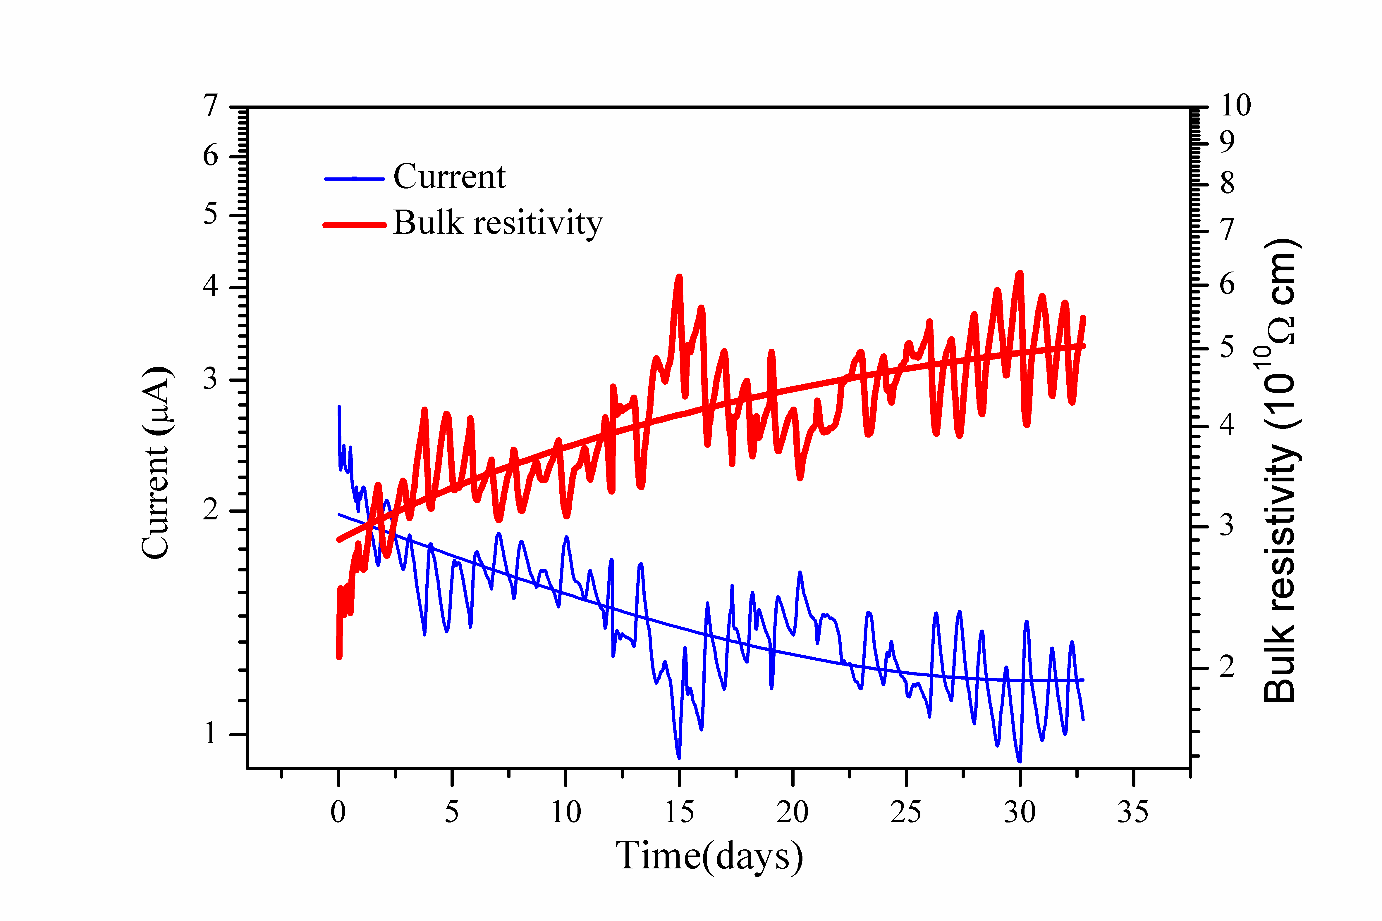
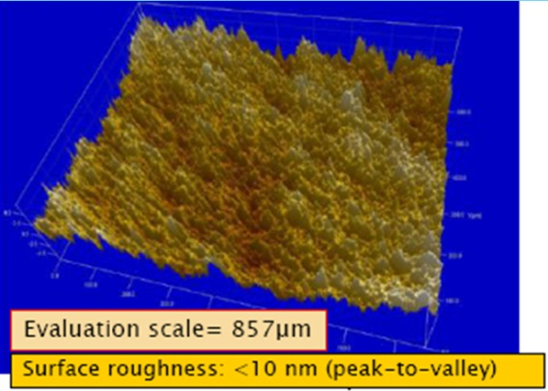
Low resistive glass
Low resistive glass for high-rate MRPCs is developed in Beijing, China (Yi Wang)
Aging tests

Slide 14
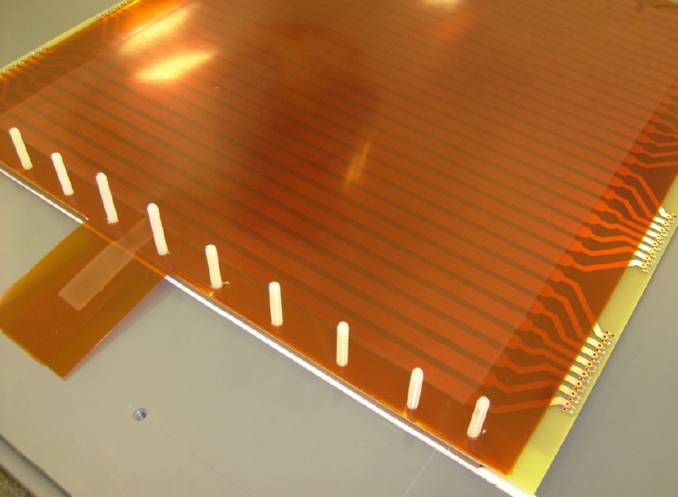
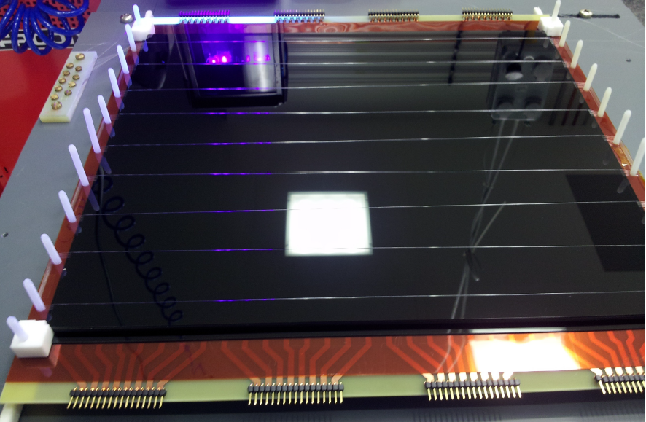
MRPC-P2 prototype
Full size demonstrator for high rates (1 - 10kHz/cm²)
HV electrode (Licron®)
Low resistive glass
27 x 32 cm²
Pickup electrode
Spacers (fishing line)

Slide 15
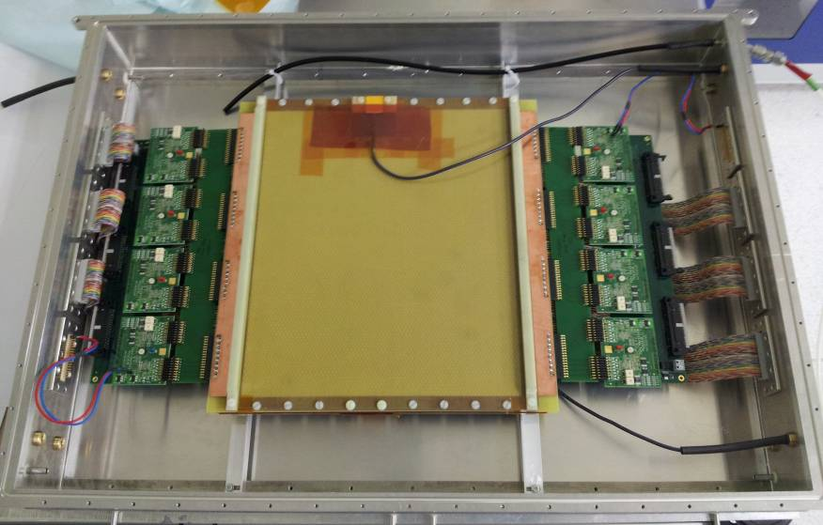
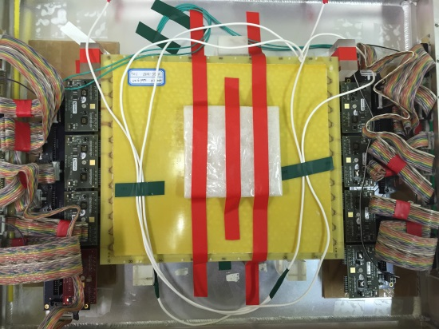
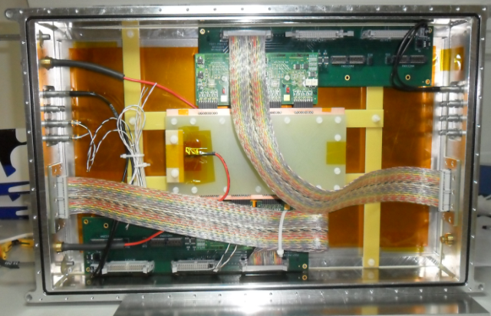
MRPC prototypes
Full size demonstrator and reference MRPC developed in HD and Beijing
MRPC-P2 (HD) THU-strip (Beijing) MRPC-P5 (HD)
MRPC differential differential differential
glass stack single double single
active area 32 x 27 cm² 24 x 27 cm² 15 x 4 cm²
strips 32 24 16
strip / gap 7/ 3 7/ 3 7.6 / 1.8 mm
glass type low resistive glass low resistive glass low resistive glass
glass thickness 0.7 mm 0.7 mm 1.0 mm
number of gaps 8 2 x 4 6
gap width 220 μm 250 μm 220 μm
MRPC-P2 THU-strip MRPC-P5

Slide 16
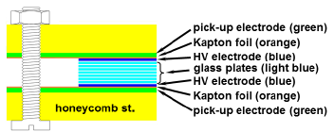
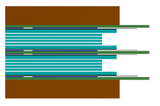
2 MRPC concepts
Differential singel stack MRPC with 8 gaps
vs.
Differential double stack MRPC with 2 x 4 gaps
Advantages
- simpler construction
- symmetric signal path
- fewer glass plates (#9)
- lower weight
- impedance matching easy possible (100Ω)
Disadvantages
- higher High Voltage (> ±10 kV)
- bigger cluster size
Advantages
- lower High Voltage (< ±6 kV)
- smaller cluster size
Disadvantages
- more complex construction
- more glass plates (#10)
- impedance matching hardly
possible (100Ω)

Slide 17
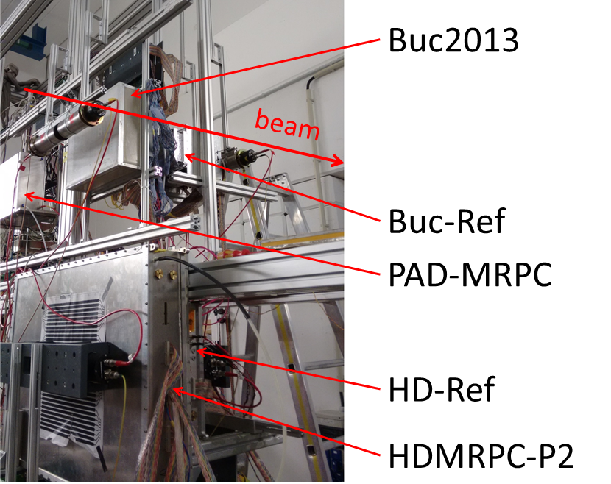
Test beam time @ GSI
Setup
Test beam time in October 2014
at GSI (Hades cave)
Sm beam with 1.2A GeV kin. energy
5 mm thick lead target
„Uniform“ illumination of the counter surface
Flux on the lower part of the setup was about few hundred Hz/cm²
Delivered flux does not meet the CBM requirements
THU-Strip

Slide 18
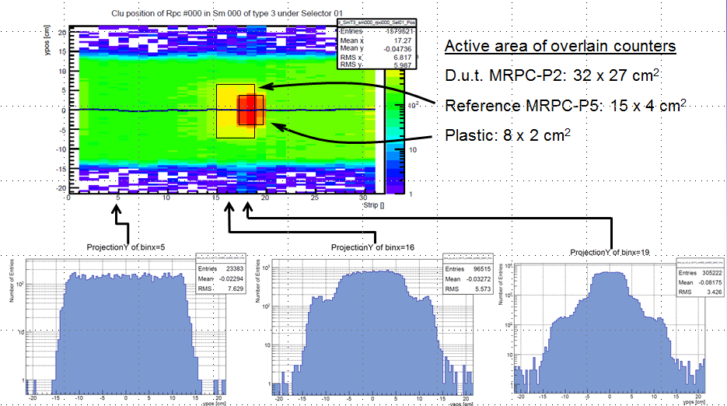
Beam-time @ GSI

Slide 19
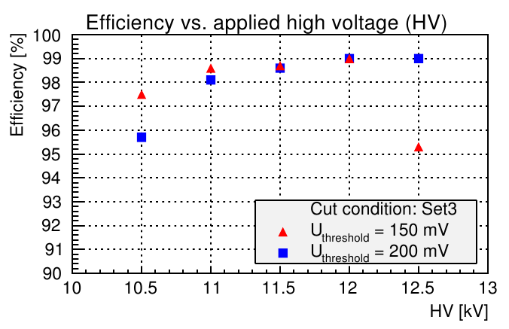
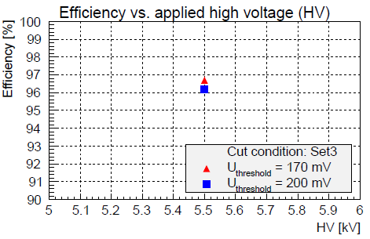
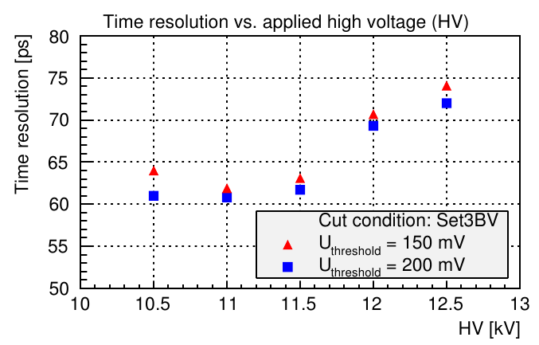
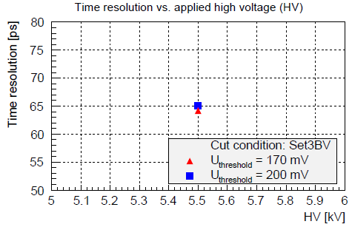
Results
Differential singel stack MRPC with 8 gaps
vs.
Differential double stack MRPC with 2 x 4 gaps
Data points at ±11 kV in the left plot can be compared with ±5.5 kV in the right plot.
Single stack MRPC shows slightly better efficiency and time resolution.
Single counter resolution is in the order of
45 ps including all electronic components.
Efficiency > 98 %
Efficiency > 96 %
Resolution ≈ 62 ps
Resolution ≈ 65 ps

Slide 20
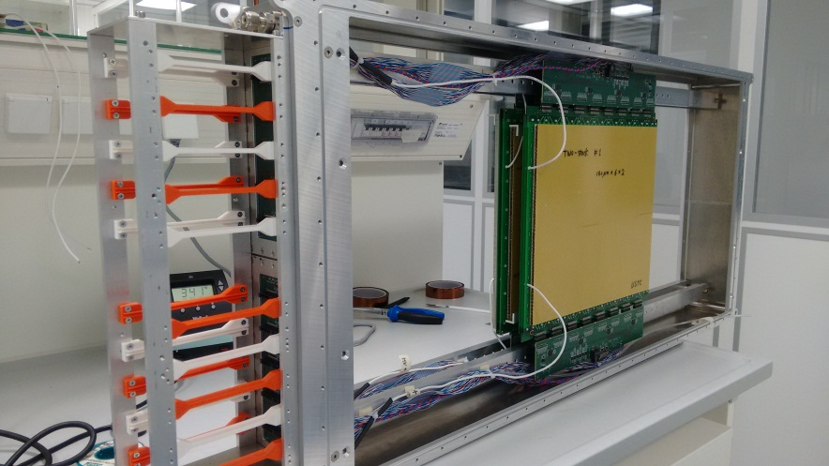
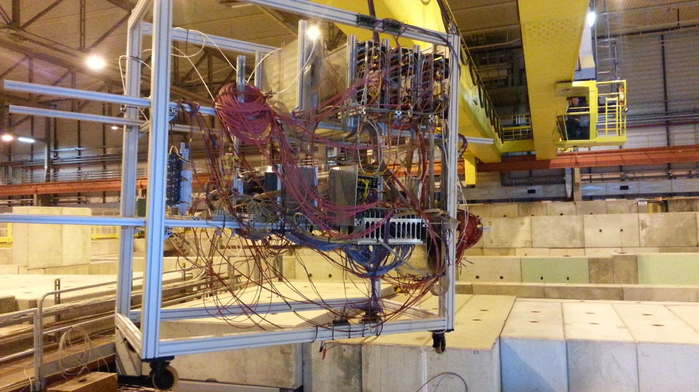
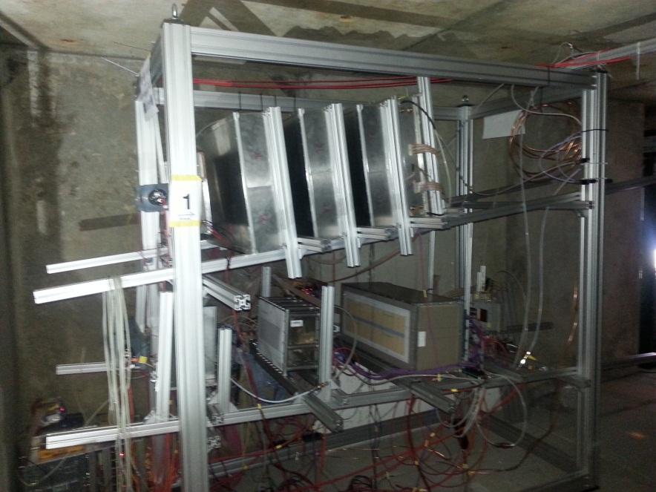
Beam-time @ SPS
Beam-time @ SPS North Area in Nov. 2015
Beam: Lead @ 30A GeV
Target: Lead 1 mm
Intensity: 10⁷ / spill
Spill length: 8 s
Rates: few kHz/cm²
Energy close to SIS300 conditions
“STAR” module
Upper setup
Lower setup
20 MRPC
About 1100 channels

Slide 21


Beam-time @ SPS
Upper setup
Impedance matching
Heidelberg-P5
USTC-SSS (Ω⁻) ( )
USTC-SSU (Ξ⁰) ( )
USTC-DSU (Λ) ( )
Tsinghua-SU (K⁺)
Tsinghua-DS (K⁰)
Tsinghua-DU (π⁺)
Heidelberg-P2
Beam
1 2 3 4 5 6 7 8
)
Tsinghua-PAD (3 counter)
Bucharest2015-SS (ϕ)
Bucharest2015-DS (K^{0*})
Bucharest2012 (4 counter) ( )
Bucharest-Reference
CRPC (2 counter)
Lower setup
9 10 11 12 13 14
21

Slide 22
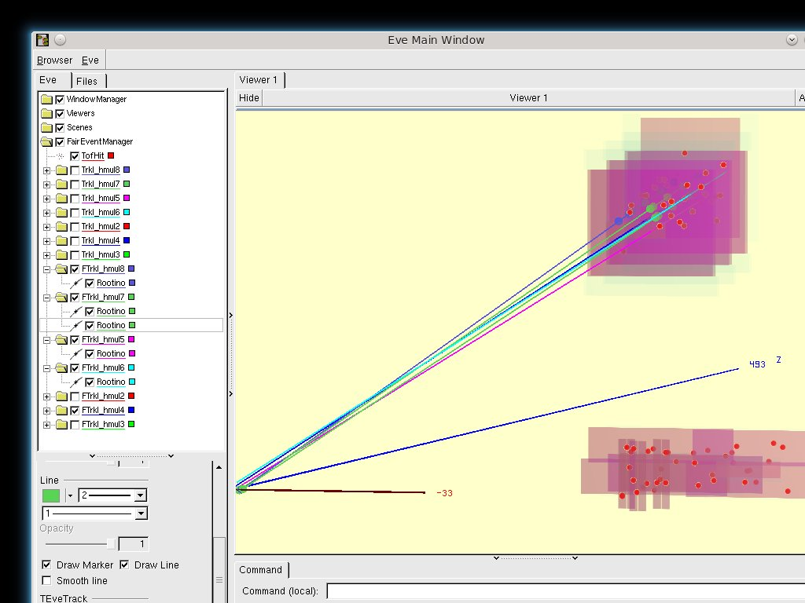
Beam-time @ SPS
Event display after position calibration
1 Track (blue) with hit multiplicity 8
2 Tracks (green) with hit multiplicity 7
1 Track (light blue) hit with multiplicity 6
1 Track (pink) with hit multiplicity 5
Tracks
RPC layers
The opportunity to construct tracks offers new possibilities to analyze and study the counters in much greater detail
RPC Hits

Slide 23








Beam-time @ SPS
2 new types of counters designed
a. Single stack with pitch of 10.1 mm
b. Double stack with pitch of 7.2 mm
Time over Threschold distribution
a.
b.
Cluster matching
System time resolution
RMS = 92 ps σ = 84 ps
Preliminary

Slide 24








Modules
a: MRPC,
b: Preamplifier (PADI),
c: feed-through PCB,
d: connectors,
e: crate,
f: TDC and read out
Preamplifier PADI
Aproved
⇒ 106368 read-out channels
TDC GET4

Slide 25

ToF – Project Timeline
RPC type | res. material | efficiency | time resolution | rate capability
Ceramic MRPC | Ceramic | ≈ 90 % | ≈ 90 ps | ≈ 500 kHz/cm²
Pad MRPC | sem. glass | ≈ 95 % | ≈ 50 ps | > 30 kHz/cm²
Strip | sem. glass | > 95 % | ≈ 50 ps | > 30 kHz/cm²
Strip | float glass | > 95 % | 60 ps – 70 ps | ≈ 1.5 kHz/cm²
The CBM requirements are fulfilled.
Time line
Full-size demonstrator end 2012
TDR approved mid. 2015
Full-size modules mid. 2015
Full-size modules with ‘final’ electronics mid. 2016
Construction of the modules 2016- 2020
Integration in STAR@RHIC@BNL 2017- 2018
eTOF ready for beam 01.01.2019
Integration in CBM@SIS100@FAIR 2019- 2021
ToF ready for beam 01.06.2021

Slide 26






CBM-ToF @ STAR
collider
CBM “STAR” module
Fix target
one sector
STAR eTOF
3 layers
12 sectors
36 modules
6912 channels
Particle flux < 45 Hz/cm², Multi-hit probability < 7.4%

Slide 27
Summary / Next steps
Summary
The high rates in CBM require a special materials for MRPC electrodes ⇒ Ceramics
and Low resistive glass from Beijing, China
MRPC solutions for all rate conditions available.
The design of the MRPC are driven by the free-streaming readout ⇒ impedance
matching is realized.
The single stack MRPC shows slightly better efficiency and time resolution in
comparison to a double stack MRPC.
Single counter resolutions are in the order of 50 ps to 70 ps including all electronic
contributions.
All types of MRPC detectors fulfill the CBM ToF requirements.
Results of the last CERN beam time are still preliminary and analysis is ongoing.
A participation in BES II of STAR @ BNL with about 10% of the full CBM Tof wall is
being planned.
Next steps
Selection of the final layout and counter configurations this year based on the last SPS
beam time results.
Integration of the final electronics and readout until summer this year.
Load test for all available full size prototypes in Nov. 2016 with final electronics with
heavy ions at SPS CERN.
Integration and beam time test of one module at BNL in Feb. 2017

Slide 28



Thank you for your attention
Contributing institutions:
Tsinghua Beijing,
NIPNE Bucharest,
GSI Darmstadt,
IRI Frankfurt
USTC Hefei,
PI Heidelberg,
ITEP Moscow,
HZDR Rossendorf,
CCNU Wuhan,
Special thanks go to:
Norbert Herrmann

Slide 29
Backup
Backup Slides
80 Ω
1 ns

Slide 30

Backup Slides
CBM Physics topics
Deconfinement / phase transition
at high ρ_{B}
QCD critical endpoint
The equation-of-state at high ρ_{B}
chiral symmetry restoration at
high ρ_{B}
Observables
excitation function and flow of strangeness
and charm
collective flow of hadrons
particle production at threshold energies
excitation function of event-by-event
fluctuations
excitation function of low-mass lepton
pairs
in-medium modifications of hadrons
(ρ,ω,φ → e+e-(µ+µ-), D)
D. Kresan Au + Au @ 25GeV
π
p
K
non twisted part
connector
Kaon acceptance depends critically on TOF resolution

Slide 31





Backup
80 Ω
1 ns

Slide 32







Particle identification with Time-of-Flight
Time-of-Flight (ToF) methode:
PID with ToF:
$$v=\frac{L}{t_{Tof}}$$
stop-detector (MRPCs)
$$p=γm_{0}v$$
start-detector (plastic, diamond)
t_{sp}
L
t_{st}
target
t_{ToF} = t_{sp} – t_{st} - offset
80 Ω
1 ns

Slide 33




Separation power
80 Ω
1 ns
A larger distance helps, howewer the efficiency of weakly decaying particles (Kaons) drops

Slide 34


Particle identification with Time-of-Flight
FOPI L=1m
CBM L=6m
measured
simulated
System time resolution 88 ps
System time resolution 80 ps
80 Ω
K⁺ ID up to 1.3 GeV/c
K⁺ ID up to 3 GeV/c
1 ns

Slide 35



Start – T0 determination
Diamond start counter
- use available solutions
- limited to reaction rates of about 100 kHz/cm2
Software solution
- available for all systems
- needs fast particles from reaction
- demonstrated to work for central and semi- central heavy system
Beam Fragmentation Counter
- peripheral HI – reaction have fast particles from projectile fragmentation
- equip inner most region of the ToF wall with timing counters (ceramic MRPCs)
Reaction Counter
- needed for high rate pA - reactions
- reaction counters at polar angles 35 ° < θ < 60°
80 Ω
1 ns

Slide 36



Detector signal properties
Rise time measurement
on the MRPC – P2
Reflectometer measurement
on the MRPC – P2
Impedance = 93 Ω

Slide 37






Experiments at FAIR
CBM
S-FRS
FLAIR
PANDA
APPA
NuSTAR
80 Ω
1 ns

