Slide 1
New Coupling Constrains on Light Bosons Beyond Standard Model
Changbo Fu
Shanghao Jiao Tong University
24Jun2016

Slide 2
Outline
Introduction
  The world needs New Bosons?
  Classifying of New Interactions
  Polarized ³He as New Interactions Probe
New Constrains with Polarized ³He
  Experimental Setup
  Spin-dependent Constrains
  Velocity-dependent Constrains
Summary

Slide 3
New Bosons needed? (CP)
Baryon asymmetry of Universe (BAU) :Baryon/ photon~10⁻¹⁰
CP violation was only observed in kaon&B-meson experimentally: Baryon/photon~10⁻¹⁸
Sakharov 1967, CPV is the Key for BAU
EDM(Electric dipole moment)
Require CP violation beyond SM
Spin-dependent short-range forces?

Slide 4
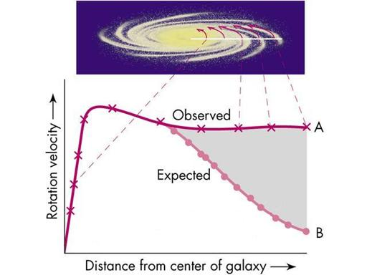
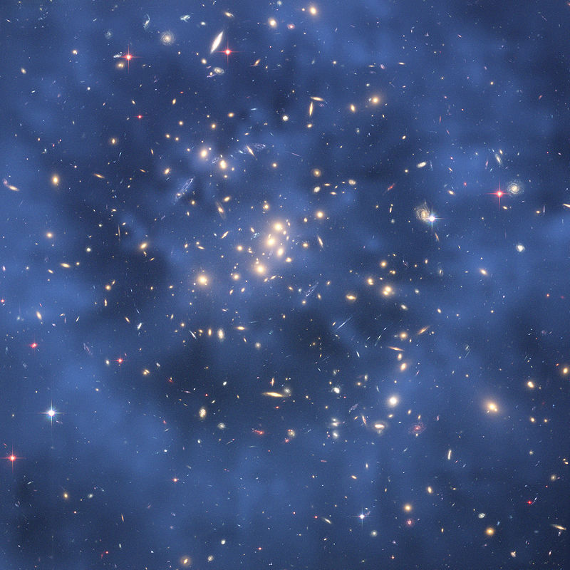
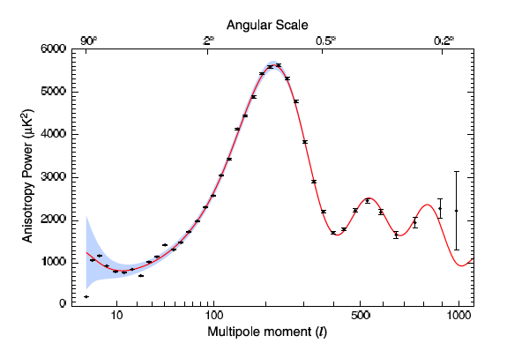
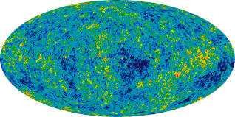
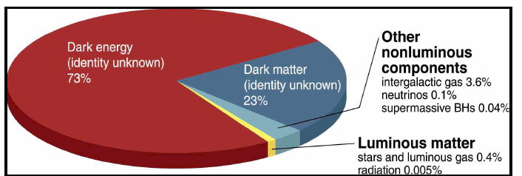
New Bosons and Dark Matter

Slide 5
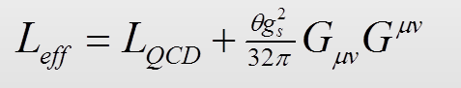
Axion and More…
In 1977, Peccei-Quinn Symmetry;
When the PQ Symmetry breaks
----> Axion
Good Theoretical Solution
Good dark matter candidate

Slide 6
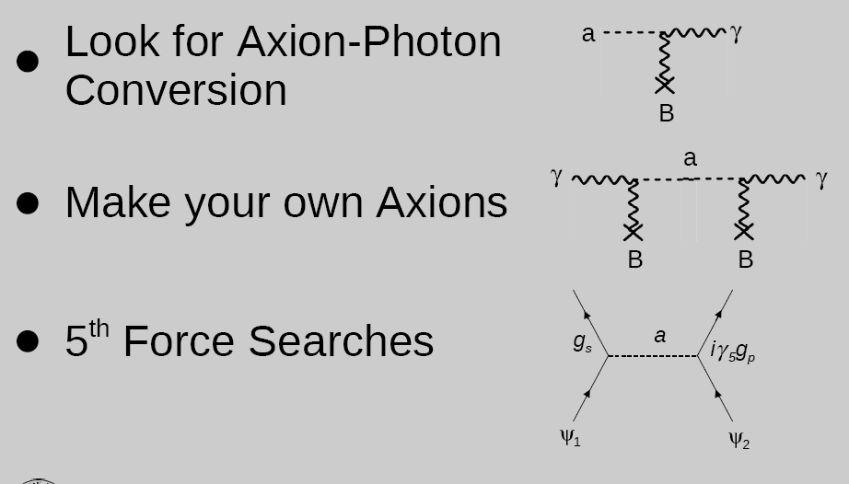
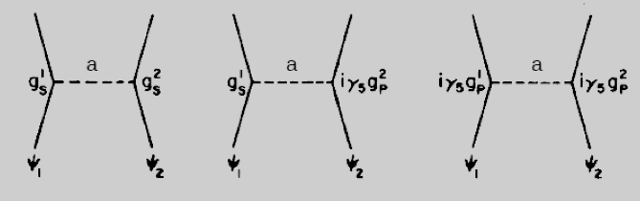
Searching New Medium Bosons
Direct Observaton
Make One
Shining light through a wall
“The 5th Force ”
Yukawa-Like Potential between the two Vertexes must be function of: U(m₁,m₂, S₁,S₂, r₁₂,V₁₂)
Changbo Fu, Dec,2015 @CIAP

Slide 7
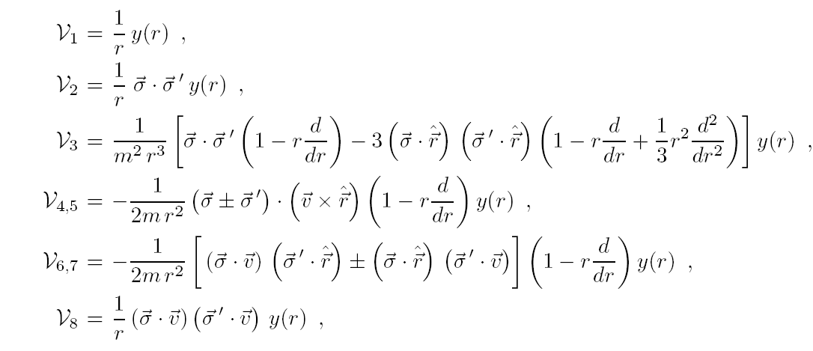
Classifying the Interactions (I)
B. A. Dobrescu and I. Mocioiu, J. High Energy Phys. 11, 005 (2006).

Slide 8
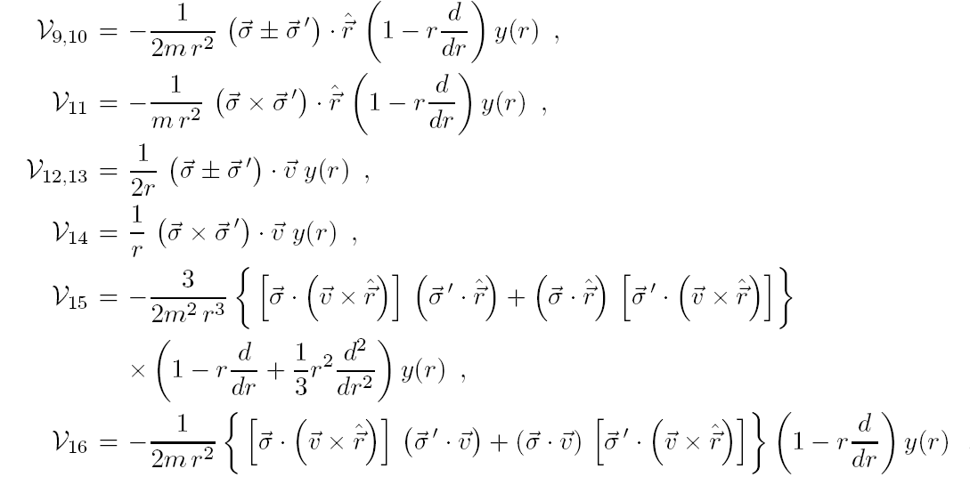
Classifying of Interactions (II)
B. A. Dobrescu and I. Mocioiu, J. High Energy Phys. 11, 005 (2006).

Slide 9
Model Independent of Exp results
Interaction if a function of m_{1,2}, R₁₂, Spin_{1,2}, V₁₂.
The medium Boson could be:
  Scale Boson
  Vector Boson
  Axial-Vector Boson

Slide 10
Road to the 5th Forces
Physics
  Bosons needed
  Spin-dep; V-dep
Math
  16 Forms
Experiments
  NMR: T₁; T₂; Frq; Phase

Slide 11
Advantages of ³He as 5th-F Probe
Noble gas, fully filled shells
Protons in its nuclei is paired
Spin=1/2
³He polarization tech is mature
Polarity is high, 80%
Keeping the polarization is mature（T_{1/2}>3000h）
NMR/SQUID tech are mature

Slide 12
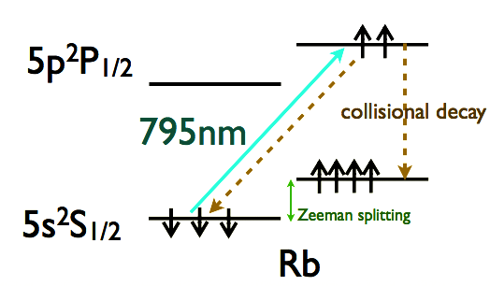
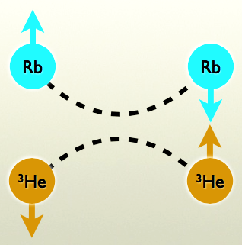
3He Polarization Technology
---SEOP/MEOP
SEOP （Spin-Exchange Optical Pump）
MEOP（Metastibility-Exchange Optical Pump）
Keeping the Polarity
  Uniformity of B-field
  Wall Relaxation

Slide 13
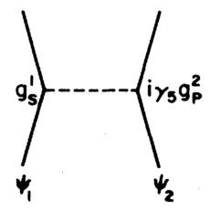
Effective Magnetic Field
m
V=μ•B
Moody et al., PRD30, 130(1984)
B. Dobrescuet al., J. High En. Phys. 11, 005(2006)
New Forces ➔ Behave of NMR
Notes:
Define: n, m, coupling
Explain: lambda

Slide 14
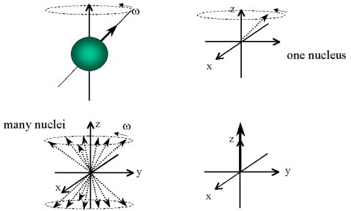
NMR effects induced by 5th Force
Freq
T₁
T₂
Phase

Slide 15
What’s T₁ or T₂?
t
t
x,y plane
z axis
0
Transverse
Longitudinal
0
1
1
t
t
2
2
8
8

Slide 16

Physical Mechanisms for T1 Relaxation Time
N
N
Dipole-Dipole Relaxation.
Calculable function of cell pressure and 3He moments
S
S
Field Gradient
(calculable, can be reduced experimentally)
Wall Relaxation
(not understood, but can be made small using special glass cells
Monopole-dipole force
(calculated like field gradient)
Notes:
Relation

Slide 17
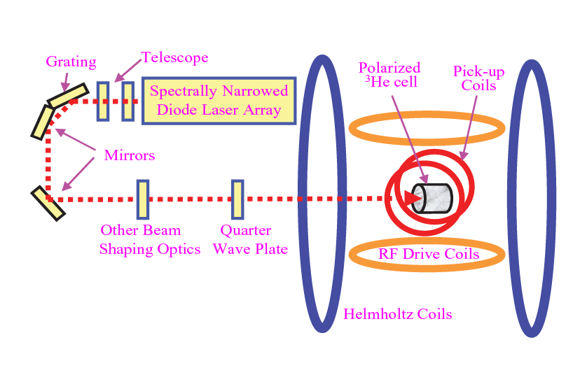
Spin-Exchange Optical Pumping: Experimental Setup
Photon angular momentum → Rb e polarization
→ He3 nuclear polarization

Slide 18
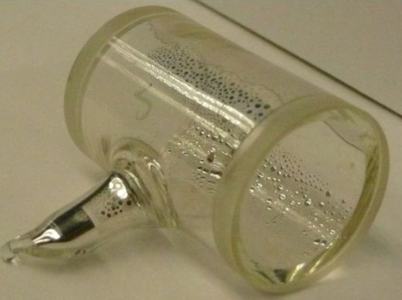
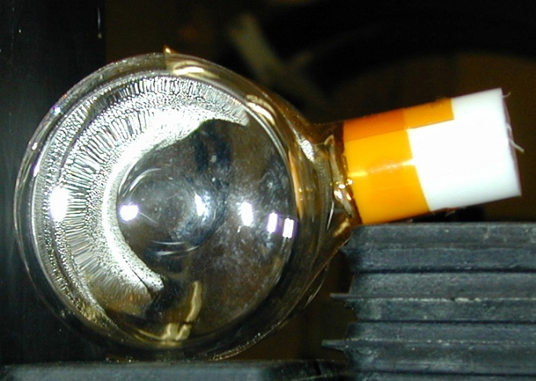
Cells for SEOP Studies
Glass. GE180
  60% SiO₂
  14% Al₂O₃
  7% CaO
  18% BaO
Rb<0.1 g
³He gas
  Cell Diamond: 0.13 bar ³He
  +0.77 bar ⁴He
  +0.07 bar N₂
  Cell Almond: 1.81 bar ³He
  +0.07 bar N₂

Slide 19
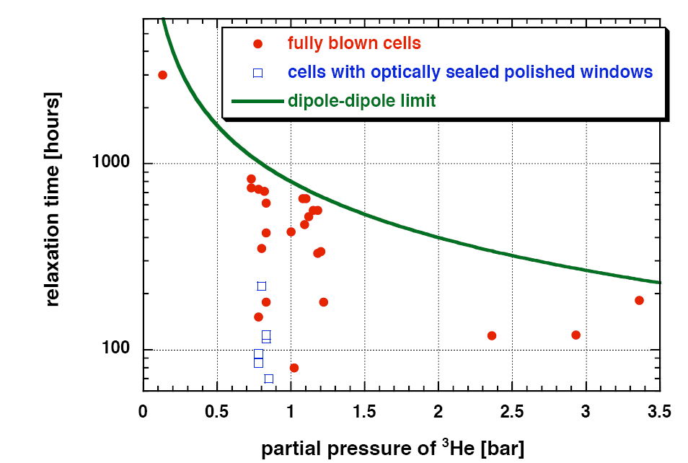
Dipole-Dipole Limit
From NIST
Chen, et al., Physica B 404(2009)2663

Slide 20
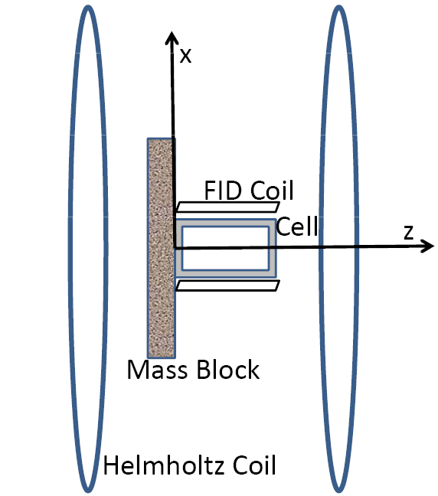
Basic Experimental Setup

Slide 21
Data Analysis
S=S_{b}+S₀
In-out; in-out; In-out ;in-out;…
S_{b}=S_{b0}+a*t
Polarization of 3He
S₀(in)=-S₀(out)
S₁=S_{b0}+0*a+S₀
S₂=S_{b0}+1*a-S₀
S₃=S_{b0}+2*a+S₀
S₄=S_{b0}+3*a+S₀
S₀=(S₁-S₂)/2
S₀=(S₁-3*S₂+3*S₃-S₄)/8

Slide 22
Short History*
Youdin et al., PRL77, 2170(1996) (SDF, Frq, not 3He)
Baessler et al., PRD75, 075006(2006) (SDF, Frq)
Serebrov, Phys. Lett. B 680, 423(2009) (SDF, T1)
Pokotilovski, Phys. Lett. B686, 114(2010) (SDF, T1)
Changbo Fu, et al., Arxiv:1007.5008(2010) (SDF, T2)
Pektukhov et al., PRL105, 170401(2010) (SDF, T1/T2)
Changbo Fu,et al, PRD83, 031504(2011)(SDF, T1/T2)
M. Bulatowicz et al., PRL111(2013)102001
H.Y. Yan, et al, PRL110, 082003(2013)(VDF, Spin)
HY. Yan, et al. PRL115(2015)182001 (VDF, g_{s}g_{v}, T1/T2)
Changbo Fu. HY. Yan et al. preparing, (VDF, g_{A}, T2)
Frequency
NMR T1
NMR T2
V-dependent (v•r）
V-dependent (v×r)
Phase?
SDF: Spin-Dependent;
VDF: Volocity Dependent
*Not complete list, Sorry if not include your works

Slide 23
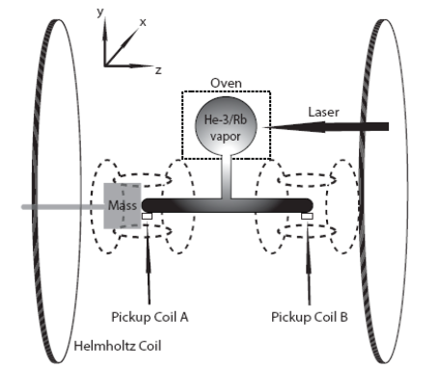
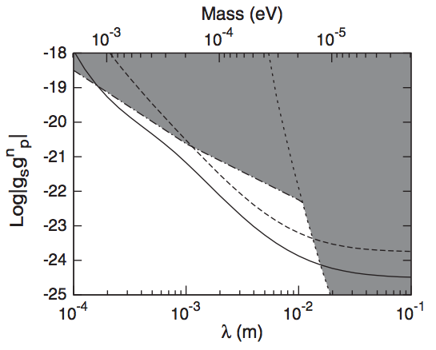
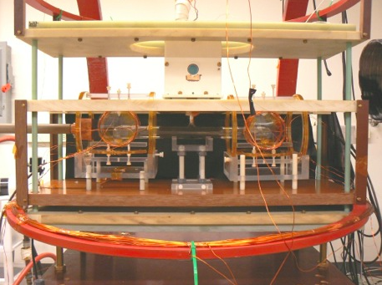
Frequency Shift to Constrain SDSRF
2012, dF=(3±5)×10⁻³Hz
2013, dF=(2.6±1.7)×10⁻⁵Hz
W.Zheng et al., PRD85(2012)061401
P. Chu et al., PRD87(2014)011105
Exp @ Duke U & Indiana U

Slide 24

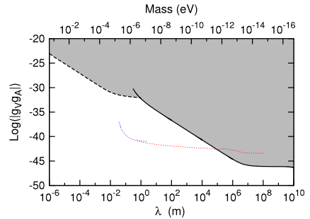


Constrain on VDSRF
Key Point: From <V> to <V²>
SEOP³He, NMR

Slide 25
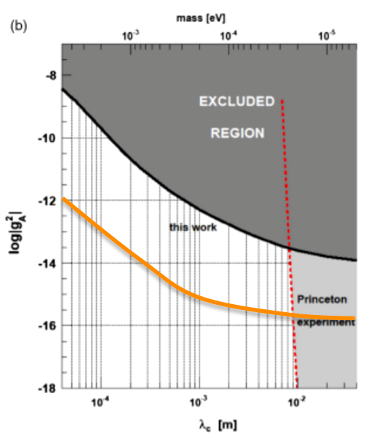

Constrain on VDSRF g_{A}
Preliminary Result:
About 3 order of magnitude improvement than that in PRL 108, 181801 (2012)
C. Fu, H. Yan et al.

Slide 26
Summary
massive bosons may the keys to solve the BAU, CP, Dark Matter etc. puzzles!
Polarized ³He is good probe to detect 5th forces in wide range from 10⁻⁶---10⁶ m.
With this probe, we have constrained the coupling strength to new record levels.
We expect that the “5th Force + NMR” method will keep working in searching new fundamental light particles.

Slide 27
Collaborators
Changbo Fu (Shaihai Jiao Tong U.)
Haiyang Yan (CIAP)
Haiyan Gao (Duke U)
Pinghan Chu (Duke U)
W. Mike Snow (Indiana U)
Thomas Gentile (NIST)
Wangchun Chen (NIST)
W.Z Zheng (Duke U)

