Slide 1
Dark Matter Research Cluster based on Computational Science
12th PATRAS WORKSHOP ON AXIONS, WIMPS AND WISPS
Jeju, Korea
2016. 6. 20 ~ 24
Kihyeon Cho(KISTI)

Slide 2
차례
1. Dark Matter Research Cluster
2. What we need for DM Research
3. Activities
4. Summary

Slide 3
Dark Matter Research Cluster

Slide 4
Project
Title | Dark Matter Research Cluster
Leader | Kihyeon Cho
Host Institute | KISTI
Partner Institutes | KASI and 13 Institutes
Fund | 50,000,000 won/year * 2years
Period | 2015.9.23~2017.9.22
Sponsor | NST (National Council of Science and Technology)

Slide 5
Goal
To make a national project where most of Korean research community working in the field of dark matter
To make synergies and collaborations among the participating groups for searching dark matter in experiments and theories
To study the plausible dark matter candidates and the evolution in the Universe
  to support and analyze the experiments for its detection

Slide 6
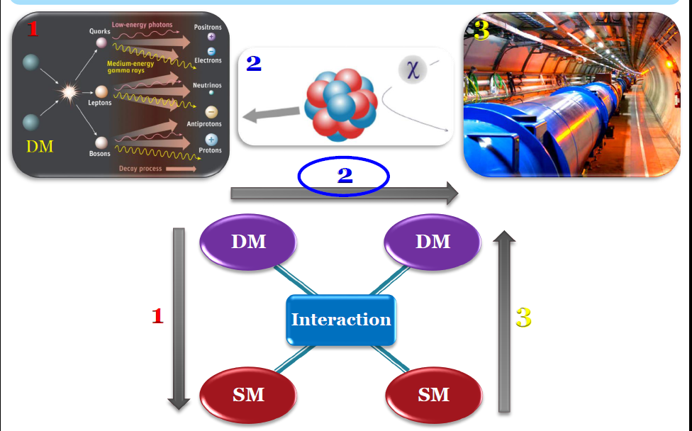
Dark Matter Search
Direct
Indirect
Collider
KISTI (GSDC)⇒Collider Data
KASI ⇒ Astronomical Data
Prof. J.C. Park

Slide 7
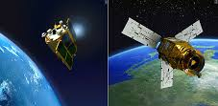

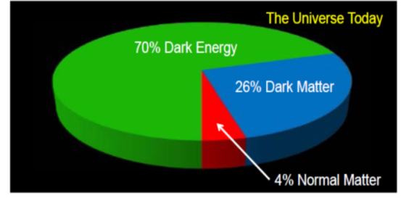
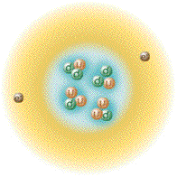
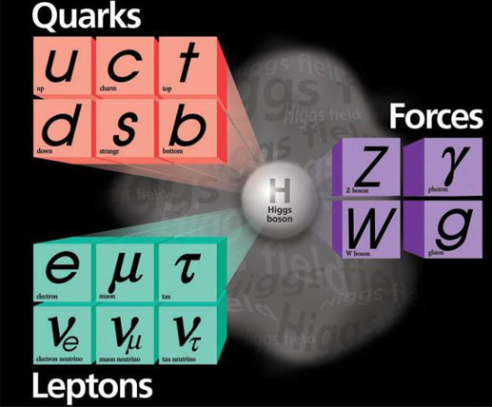

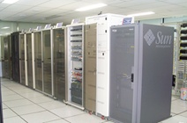
Dark Matter Research Cluster
  From Collider to Astronomy
Dark Matter
Evolution of Universe
Components
Standard Model
KASI ⇒ Astronomical Data
KISTI (GSDC) ⇒ Collider Data
Origin of Matter
Standard Model
Universities (Students)

Slide 8
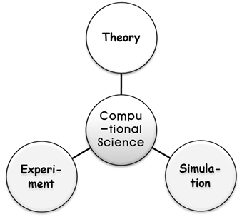
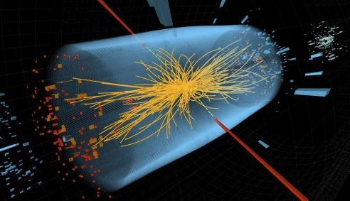
Strategy
Goal
Enabling discovery on Dark Matter
Fusion Research
Content
Cosmology
Accelerator
Experiment
Theory
Simulation
Observation
Theory
Simulation
KISTI
Universities
KASI
Computational Science
7
Big
Data
Belle/Belle II Date, MC simulation, Astronomical Data, etc.
Infra-structure
(KISTI)
Supercomputer, GSDC, KREONET, GLORIAD
Observatory
Infra-structure
(KASI)

Slide 9
What we need for Dark Matter Research
- Computational Science

Slide 10
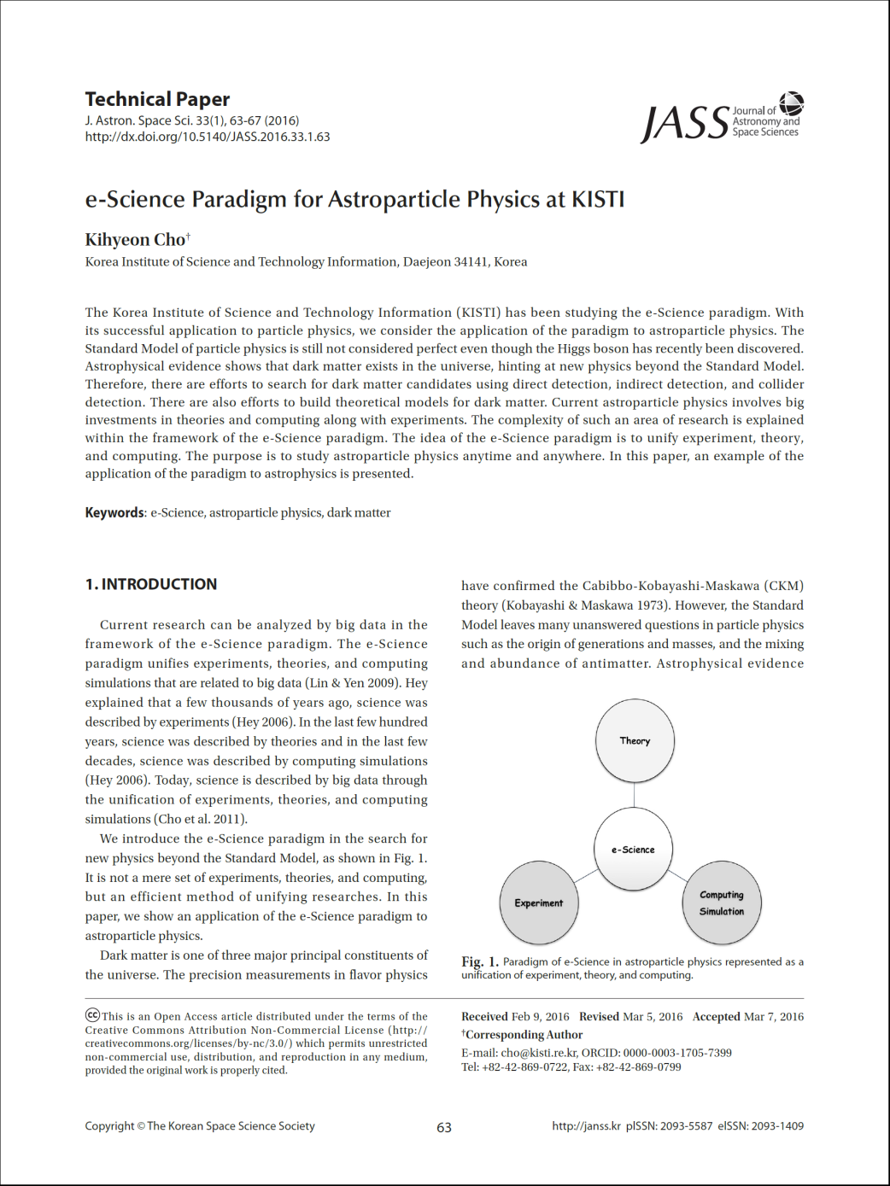
Computational Science
Theory-Experiment-Simulation
=> computational Science

Slide 11
From Experiment
Person Power:
  Dedicated team/scientists for DM search for HW/SW
Networking
  Networking for both Korea experimentalists in local and international institutions in DM search experiments (in Indirect, Direct and Colliders)
  Regular workshop including international workshop
  Enhancement communication between experimental and theoretical community
  ⇒ brain-storming to new ideas
Computing resources for big data :
  HPC (High-Performance Computing) for MC
  Storage for experimental data and theoretical model
Prof. H.D. Yoo & Y. Kwon

Slide 12
From Theory
Rapid update & sharing of information
  Key point summary DB site by specialists
  Regular meeting, Network Feedback between experimentalists and theorists
  ⇒ Through a (new) center
Rapid & Easy comparing check of theoretical model
  Development of new numerical package
  Computing power and Person power ⇒ new jobs
Cross check with astrophysics (theoretical model)
  N- body simulation
  Discussion with Dark Energy survey group
Prof. J.C. Park

Slide 13
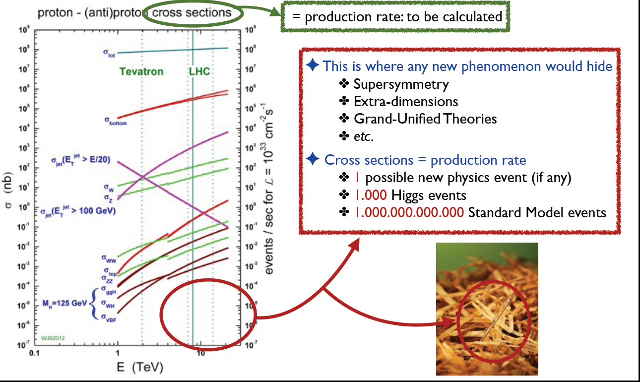
From simulations
Dark Matter

Slide 14
Theory
Experiment
Dark Matter
Physics Model
Data
Physics Simulation
(MadGraph/MadDM)
Compression
Event Simulation
(PHYTHIA)
Reconstruction
Simulation
Detector Simulation
(Delph/PGS/Geant4)
Analysis Tools
(PAW/ROOT)
Result

Slide 15
암흑 물질
탐색 연구
(Physics)
Dark Matter
(Physics)
Simulation tool kit
(MadGraph, Geant4, …)
Evolving computing architecture
(Supcomputer, GSDC, GPU, MIC, …)

Slide 16
Vision for Dark Matter Simulation
To have a massively parallelized particle transportation engine
To comply with different architecture (GPU, MIC and etc.)
To draw community interests for collateral effort
=> Dark Matter Research Cluster

Slide 17
Suggestions
Dark Matter Research Management System
Model DB and Simulation Parameter
  To develop DM System based on computational Science
  Experimental results supports to constrain parameters of theory.
  Theories enhance the accuracy of expected values.
  Automated tools (computing+ manpower) supports
  rapid and accurate results
The development of S/W
  To support various measurements in Indirect, Direct and Collider
Prof. S.C. Park

Slide 18
Activities

Slide 19
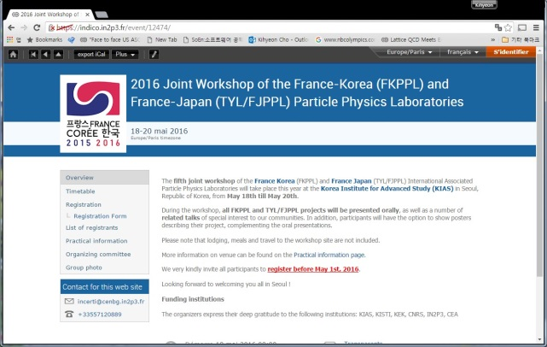
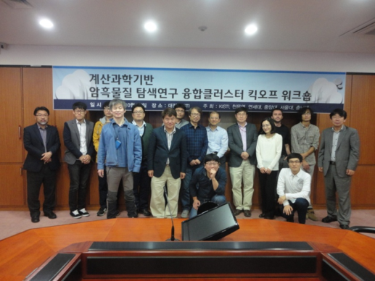
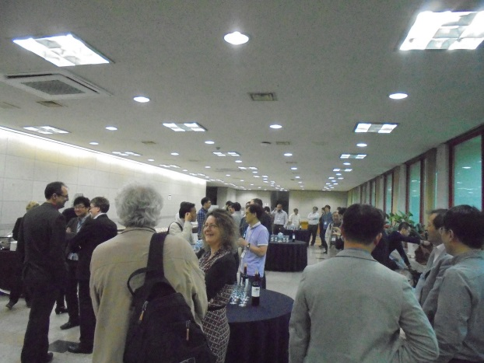
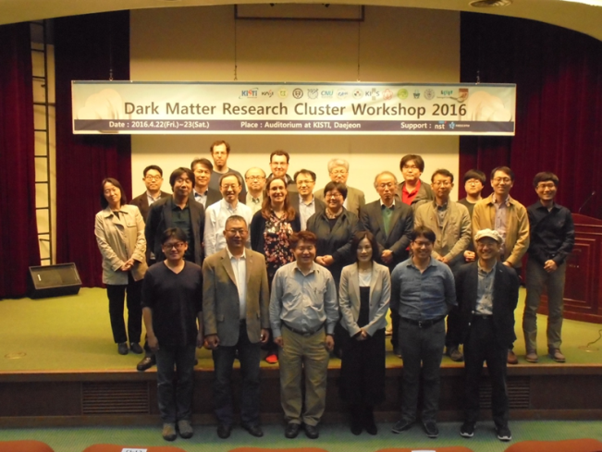
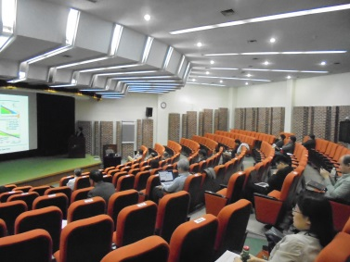
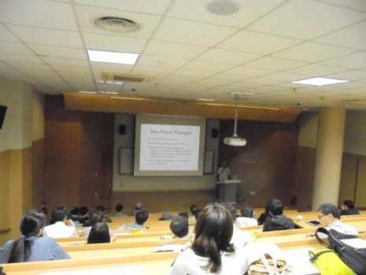
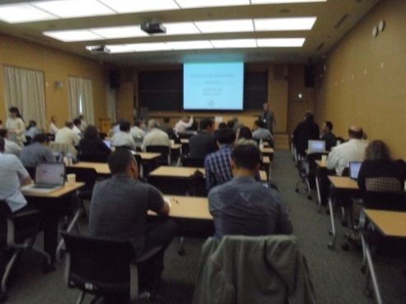
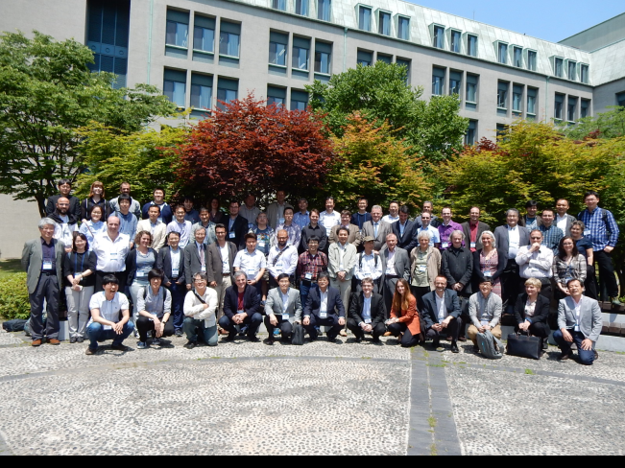
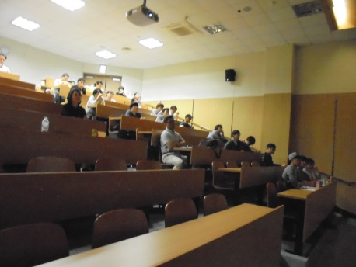
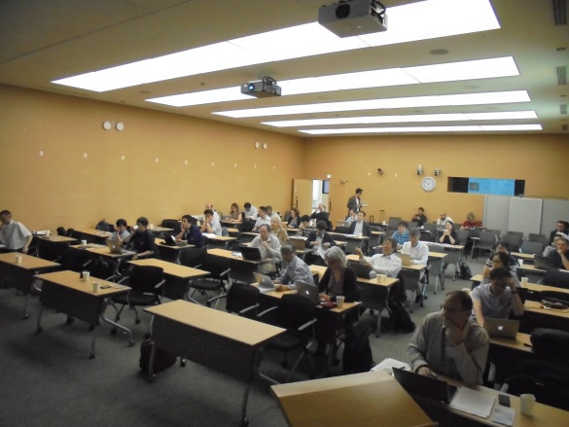
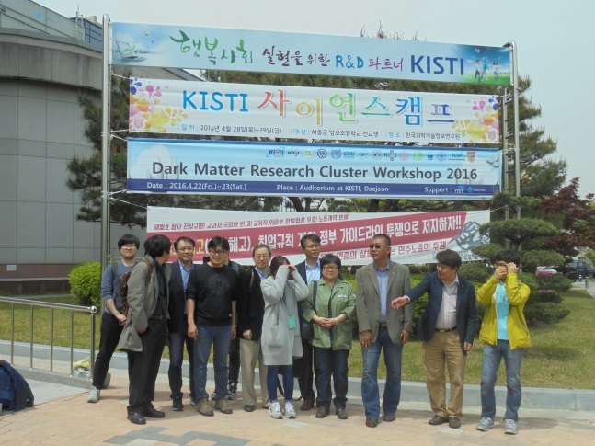
Meetings
Seminar and Meeting: once per month
Dark Matter Research Cluster Kickoff workshop
  KISTI, October 27, 2015, 2:00-6:00 PM
2016 Dark Matter Cluster Workshop
  KISTI, April 22-23, 2016
2016 Joint workshop on France-Korea
and France-Japan Particle Physics Workshop
  KIAS, May 18~20, 2016
  ~100 persons from France, Japan, China, Korea

Slide 20
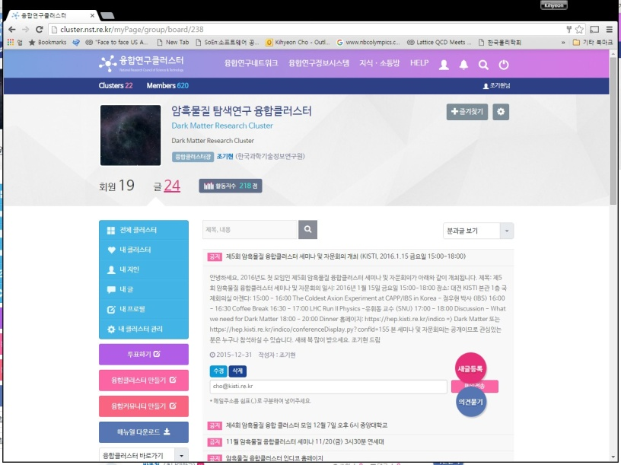
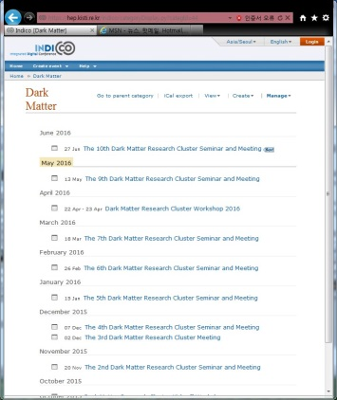
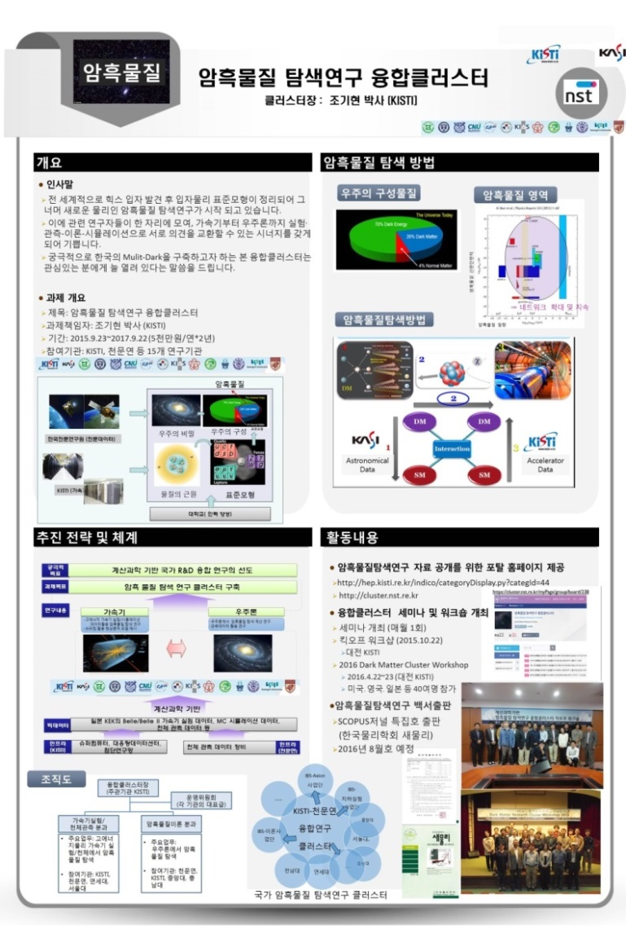
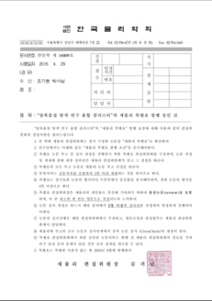
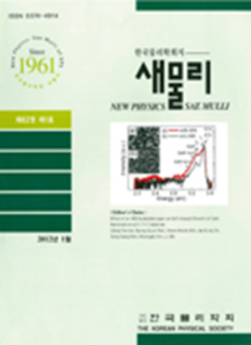
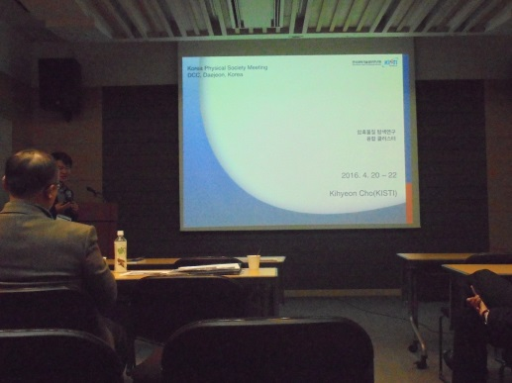
Outreach
Home pages
  http://cluster.nst.re.kr
  https://hep.kisti.re.kr/indico
  ⇒ Dark Matter Portal
Advertisement (panel, conference)
Dark Matter Research White Paper
  SCOPUS Journal(KPS) Special Edition
  2016. 8

Slide 21
Summary

Slide 22
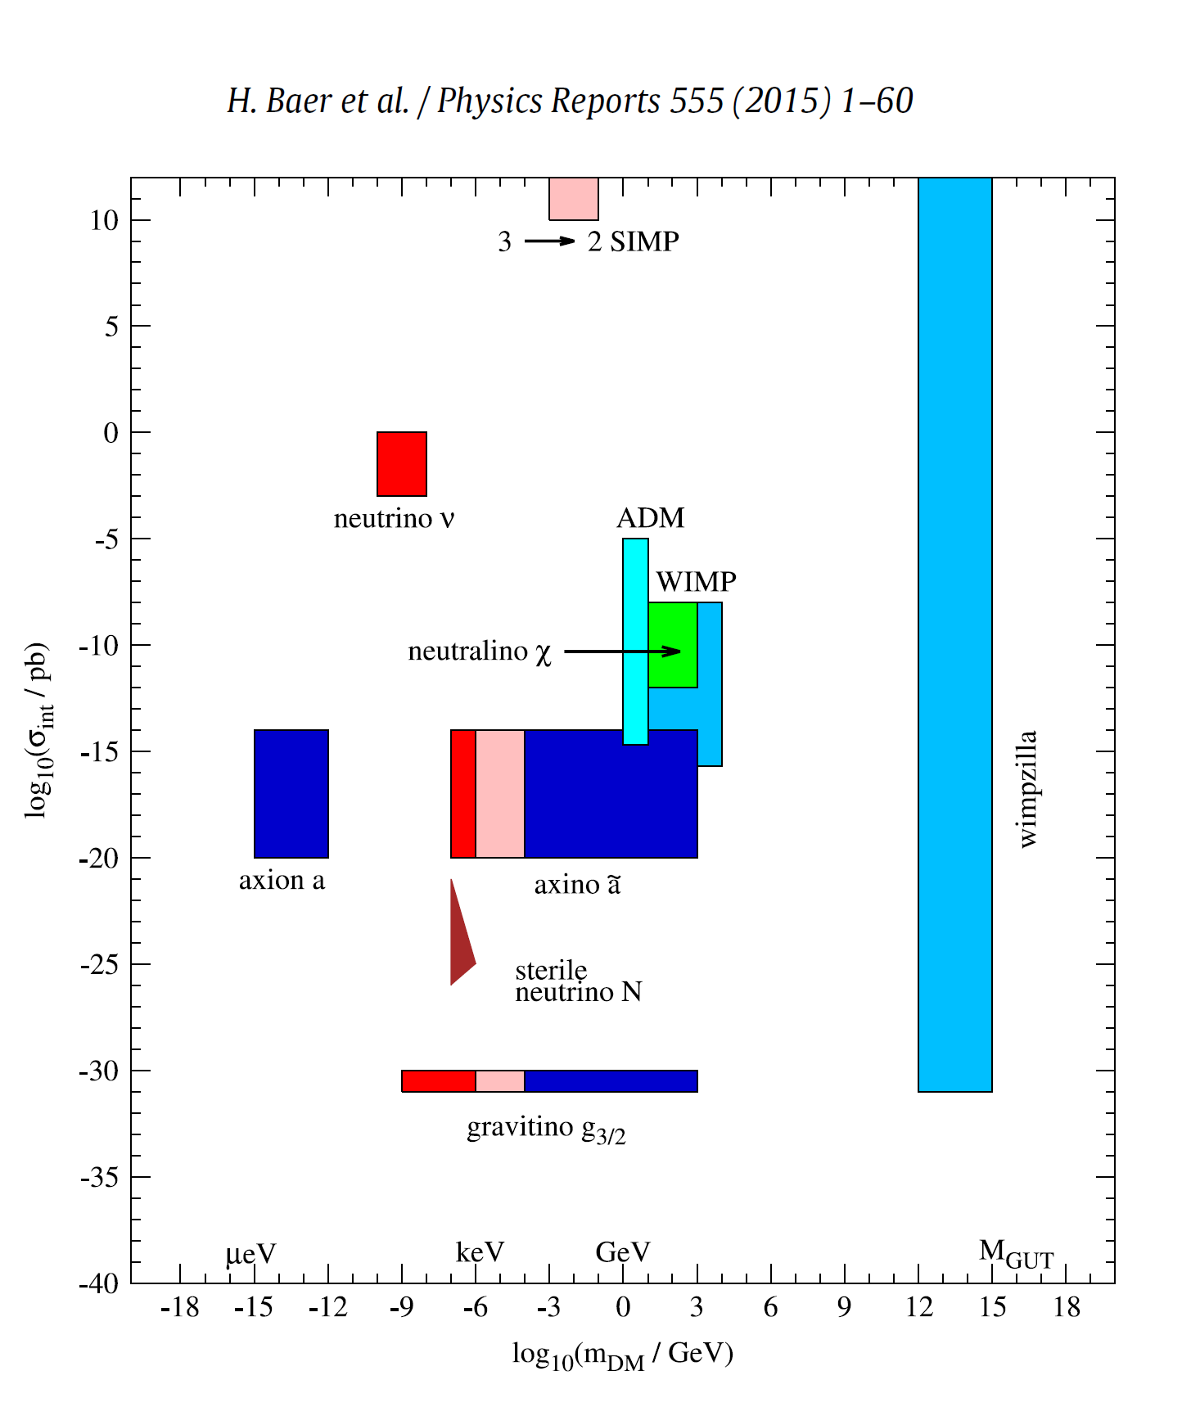
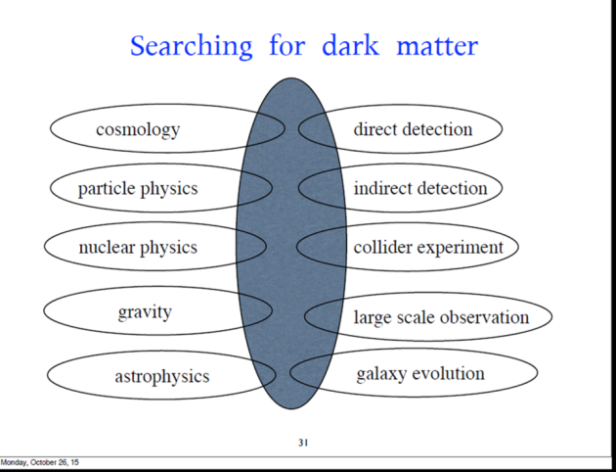
Plan
White Paper(SCOPUS Journal) => Proposal (NST)
Computing Resources => GSDC
Koreas Supercomputing Conference (Seoul‘16.10.5~7)
  Dark Matter research cluster Session
Dark Matter Research Cluster
=> National Multi-Dark
⇒ Network Building
Cross Section
Mass
Prof. K.Y. Choi

Slide 23
“You are welcome to join
Dark Matter Research Cluster.”
Thank you.
cho@kisti.re.kr

