Slide 1
New ideas for axion like particle dark matter search
F. Caspers, K. Zioutas, M. Betz
2012

Slide 2
Tore Supra
From wikipedia:
Tore Supra is the only one of the largest tokamaks to have superconducting toroidal magnets, allowing the creation of a strong permanent toroidal magnetic field
… it allows to test critical parts of equipment such as plasma facing wall components or superconducting magnets that will be used in its successor, ITER.

Slide 3
Tore Supra
The machine might be available for axion search as its successor ITER becomes operational
It is equipped with a big (V = 30 000 l) and strong magnet (B = 4.5 T)
Large active volume for relic axion → photon conversion
We use the Tore Supra chamber as a big microwave resonator

Slide 4
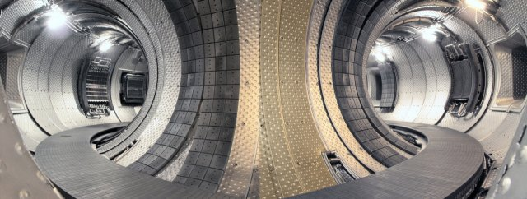
Tore Supra
Outer plasma diameter : | 4.8 m
Inner plasma diameter: | 1.6 m
Plasma volume | 30.3 m³
Toroidal magnetic field at the plasma centre : | 4.5 T
Maximum magnetic field on the conductor : | 9.0 T
Average diameter of a magnet coil : | 2.60 m
Dimension of NbTi superconductor : | 2.8 x 5.6 mm²
Total magnetic energy : | 600 MJ
Plasma current : | 1.7 MA
Potential duration of the discharge : | 1000 s
Cooling power at 80 K : | 40 kW
Cooling power at 4.5 K : | 650 W
Cooling power at 1.75 K : | 300 W
Data and picture from: http://www-fusion-magnetique.cea.fr

Slide 5

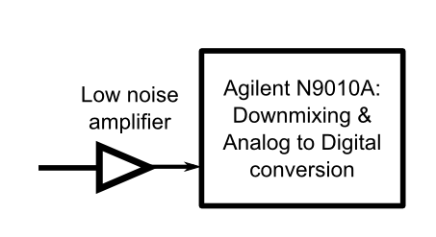

Tore Supra
The magnetic field converts axions to microwave photons,
which excite the TE₀₁₁ mode
axions
Photons
The inner walls might have to be covered by copper sheets, to achieve higher Q factors and better EMI shielding
Test signal
The microwave signal is coupled out by a small antenna and amplified. A commercial spectrum analyzer can be used to detect the axion signal
A test signal might be necessary to proof that the detector is working and to determine resonant frequency over time

Slide 6
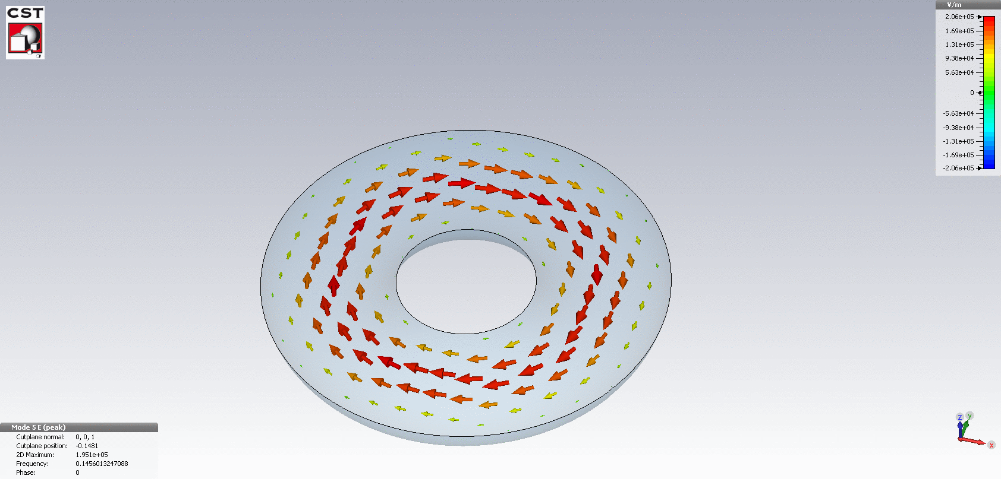
Preliminary simulation results
E – field of the TE₀₁₁ mode in the Tore Supra cavity
Wall material | Conductivity | Unloaded Q - factor
Stainless steel | 9.8e+5 S/m | 19271
Copper | 5.8e+7 S/m | 148250
Inner radius: 0.8 meter, outer radius: 2.4 meter
TE₀₁₁ = H₀₁₁ mode, f= 145.601 MHz
→ Most sensitive to axions with m_{a} = 6 ∙ 10⁻⁷ eV

Slide 7
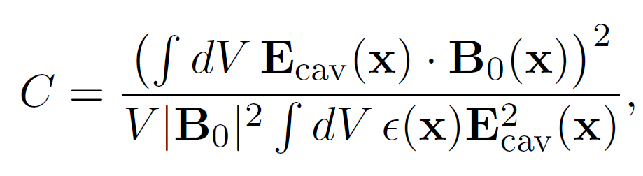
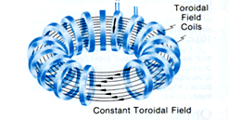
The relic axion overlap integral
To see if the TE₀₁₁ mode is sensitive to relic axions, we must evaluate its geometric form factor C
Essentially: E-field must be parallel to the static magnetic field to couple to axions (dot product!)
This is the case for Tore Supra
C ≈ 0.39 (from numerical calculation)
E – field of TE₀₁₁ mode (E_{CAV})
Static magnetic field of
superconducting magnets (B₀)
P. Sikivie, Phys. Rev. D32, 2988 (1985), [Erratum-ibid.D36:974,1987].

Slide 8
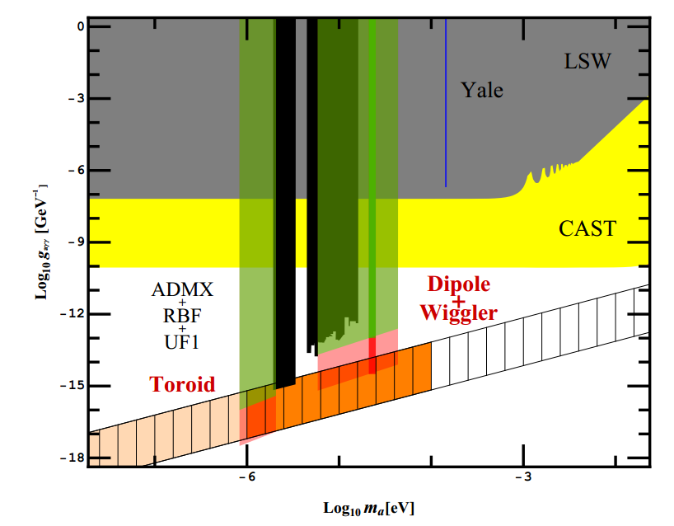
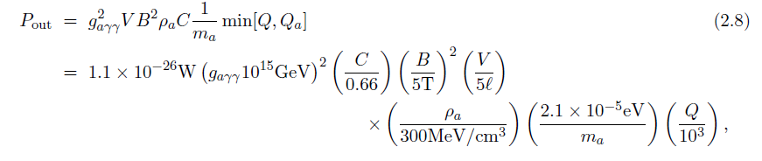
Expected sensitivity
With the rather conservative parameters on the left (Q_{L} = 1000), we could reach
g_{ayy} = 7∙10⁻¹⁶ GeV⁻¹
in a 9 h measurement run

Slide 9
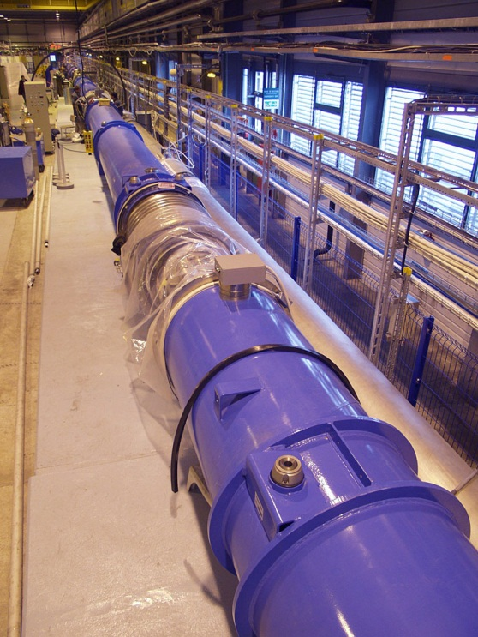
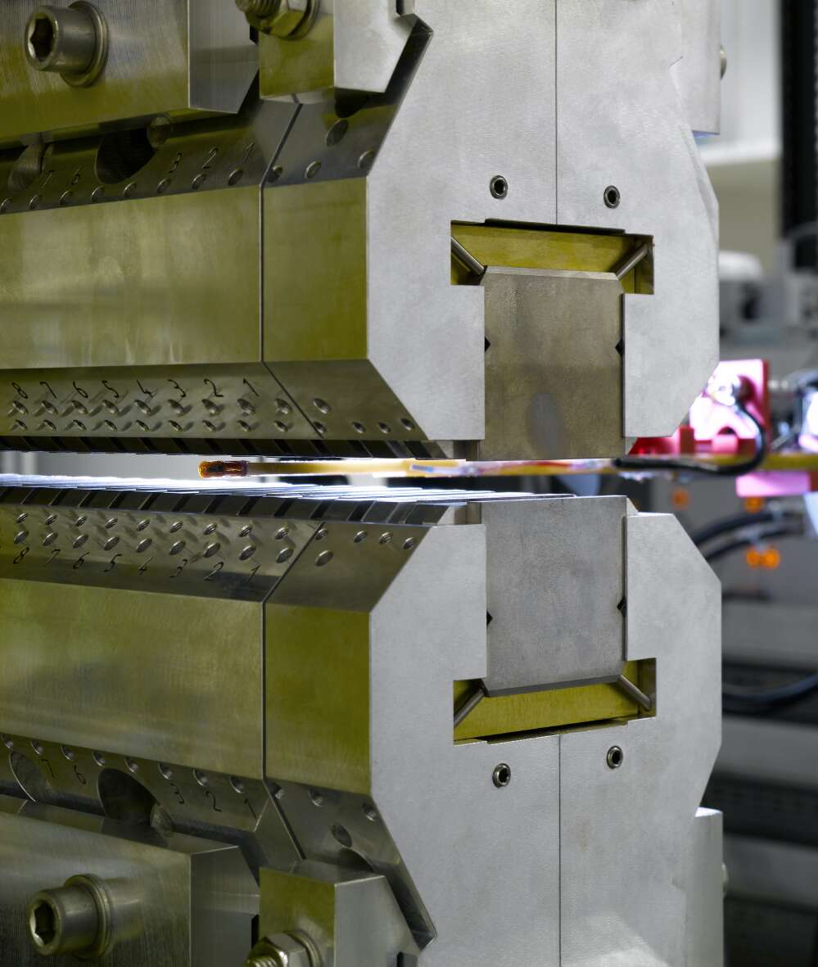
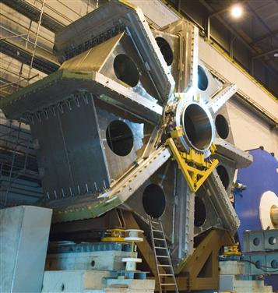
Alternative magnets for haloscopes
Dipole magnets
Wiggler magnets
Toroidal magnets
O. Baker et al., Prospects for Searching Axion-like Particle Dark Matter with Dipole, Toroidal and Wiggler Magnets, Phys. Rev. D 85, 035018 (2012)
Pictures from: CERN, DESY, CERN

Slide 10
Alternative magnets for haloscopes
Up to now all haloscope searches have used solenoid magnets to provide the magnetic field
However, at accelerator and advanced light source facilities a range of magnets are available, that have not yet been exploited for their use in searches for ALP DM (axion like particle dark matter)
In particular we have the typical dipoles used for the accelerator itself as well as toroidal magnets used in particle detectors
In addition we have the wiggler magnets used for creating synchrotron and free electron laser light
Can we use these magnets efficiently in haloscope searches for ALP DM?

Slide 11
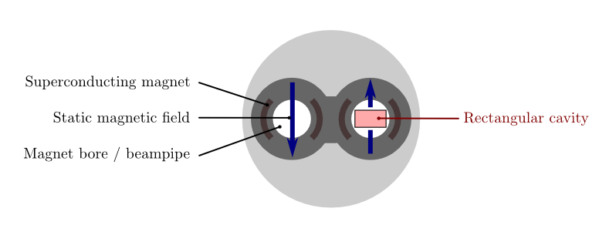
Dipole magnets
Accelerator dipoles offer strong fields (LHC: 9.5 T) in a long region (14 m), with the magnetic field oriented perpendicular to the long direction
A long and thin rectangular microwave cavity could be introduced in the magnet
In this configuration, TE – modes couple to axions
(The E-field is parallel to the static magn. field)

Slide 12
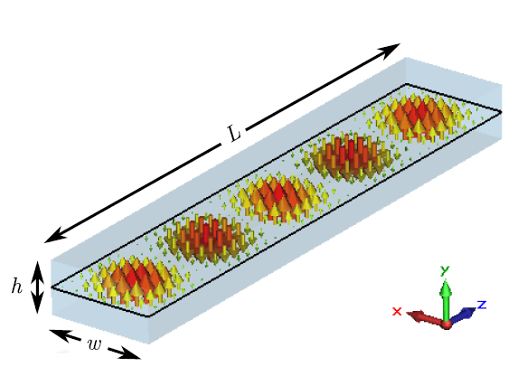
Dipole magnets
The TE₁₀₁ – mode couples strongest to axions (Geometry factor C = 0.66)
In our example configuration it would be resonant at
f_{res} ≈ 5 GHz → m_{a} ≈ 2.1 ∙ 10⁻⁵ eV
(assuming w = 30 mm, h = 20 mm, L = 8 m)
But:
If the aspect ratio L/w becomes this large, the modes in the cavity converge towards a common resonant frequency
Two modes with similar resonant frequency will couple to each other and exchange energy.
This energy is lost!
E-field of the TE₁₀₅ mode
in a rectangular cavity

Slide 13
Dipole magnets
Higher order modes limit the maximum length of one cavity
  L_{max} = 1.5 m for Q = 1000
  L_{max} = 6.7 m for Q = 20000
To solve this problem, we can:
  Use wiggler magnets (next slide)
  Use an array of several cavities with L < L_{max}
Power is coupled out from each cavity and fed to an external power combiner (hybrid)
Our results predict that only a few cavities are needed to fill a typical magnet, making this approach technically feasible

Slide 14
Wiggler magnets
We get maximum coupling to axions, if the TE_{10n} mode is used, where n is the number of magnetic oscillations in the wiggler magnet
An advantage of the wiggler conguration is that the mode spacing grows with n. The problem of overlapping modes is therefore somewhat reduced
Maximum length of one cavity in a wiggler magnet with 1 magnetic oscillation over 30 cm:
  L_{max} = 4.7 m for Q = 1000
  L_{max} = 14.1 m for Q = 3000

Slide 15
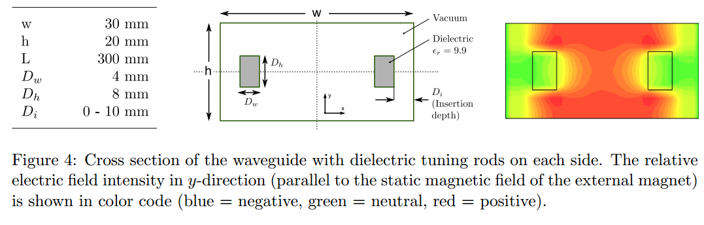
Dipole magnets: tuning
To sweep over a range of values for the axion mass (m_{a}) tuning of the cavity is necessary
This can be achieved by placing movable dielectric rods in the cavity
The geometry depicted below provides 13 % adjustment range over m_{a} while keeping the geometric factor approx. constant

Slide 16
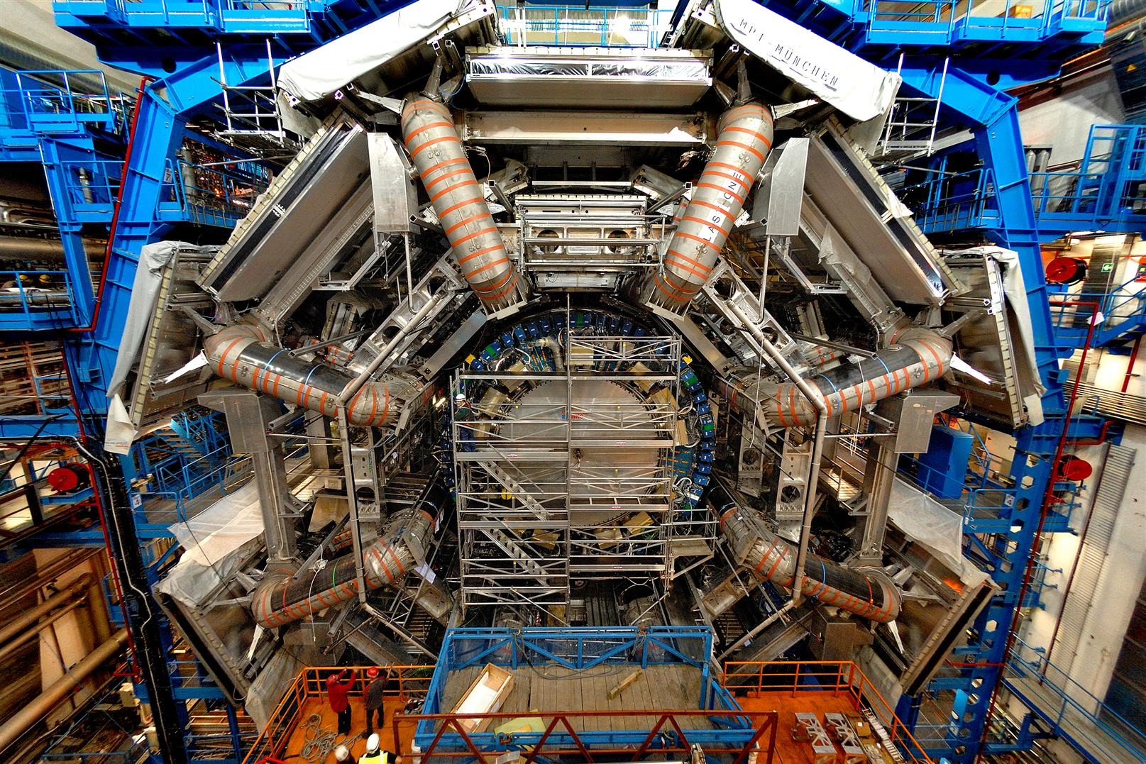
Toroidal magnets: Inspired by Atlas

Slide 17
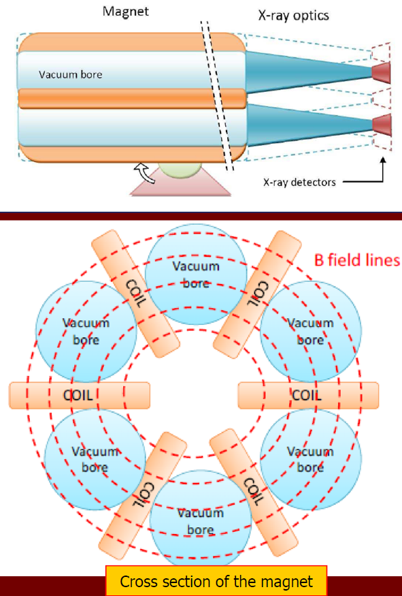
RF cavities in toroidal magnets
Currently used in particle physics detectors such as ATLAS
In certain regions, these magnets provide transverse (to the long side) magnetic fields similar to dipole magnets
But the corresponding bore sizes are significantly larger!
The large volumes provide a significant advantage in sensitivity
Either with single big cavities for low axion mass m_{a} or with an array of smaller cavities for larger axion masses
RF - cavities
or arrays of
RF - cavities

