Slide 1
Multiple-Cavity Detector for Axion Search
12th Patras Workshop
2016. 06. 20~24, Jeju, South Korea
SungWoo YOUN
Young Scientist Fellow
Center for Axion and Precision Physics Research (CAPP)
Institute for Basic Science (IBS)

Slide 2

Introduction
: Magnet bore
: Cavity
Higher
frequency
Larger
Volume
Single large cavity
Single small cavity
Multiple small cavities
Multiple-cavity detector
  Increases experimental sensitivity for axion searches in higher frequency regions
  Requires signal combination in phase: phase-matching

Slide 3
Configurations
 | 1 | 2 | 3
Schematic
Characteristic | N complete readout chains | N amplifiers 1 combiner | 1 amplifier 1 combiner

Slide 4
Configurations
 | 1 | 2 | 3
Schematic
Characteristic | N complete readout chains | N amplifiers 1 combiner | 1 amplifier 1 combiner
Sensitivity* (SNR)
SNR_{sngl} = SNR of single cavity
S
N_{C}
G, N_{A}
* Correlated signal and uncorrelated noise ** N.F. _{comb} = 0

Slide 5
Configurations
 | 1 | 2 | 3
Schematic
Characteristic | N complete readout chains | N amplifiers 1 combiner | 1 amplifier 1 combiner
Sensitivity (SNR)
Pros. | Individual access | Higher sensitivity | Simpler design
Cons. | Lowest sensitivity N complete readout chains | N amplifiers | SNR₃ < SNR₂*
* In reality, N.F._{comb} ≠ 0
ex) G=12, N.F._{amp}=6, N.F._{comb}=0.5 => SNR₃ is lower than SNR₂ by 10%

Slide 6
Configurations
 | 1 | 2 | 3
Schematic
Characteristic | N complete readout chains | N amplifiers 1 combiner | 1 amplifier 1 combiner
Sensitivity (SNR)
Pros. | Individual access | Higher sensitivity | Simpler design
Cons. | Lowest sensitivity N complete readout chains | N amplifiers | SNR₃ < SNR₂

Slide 7
Multiple-Cavity Detector
Introduced in 1990 and exploited by ADMX
  KSVZ with 3.3639 < m_{a} [μeV] < 3.3642 excluded with 90% C.L.
Phase-matching mechanism is challenging
  Failure reduces signal power and degrades SNR
    Broadens the bandwidth of power spectrum
    Decreases the cavity quality factor
5 year IBS Young Scientist program is devoted to develop the system at CAPP

Slide 8
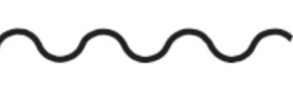
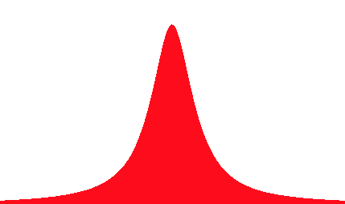
Phase Matching
Coherence of axion field and static magnetic field
  Axion signals are generated in phase
Resonance frequencies of individual cavities
  Cavities must be tuned at the same frequency
  Essential part (most challenging part) of the matching mechanism
Constructive signal combination
  Phase matching at power combiner in the time domain
  Identical cables with the same length
a

Slide 9
Phase Matching
Resonance frequencies of individual cavities
  Cavities must be tuned at the same frequency
  Essential part (most challenging part) of the matching mechanism
Phase matching ~ Frequency matching !

Slide 10
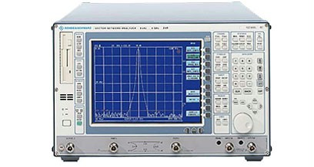
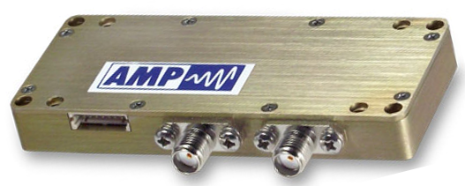
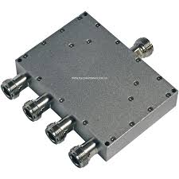
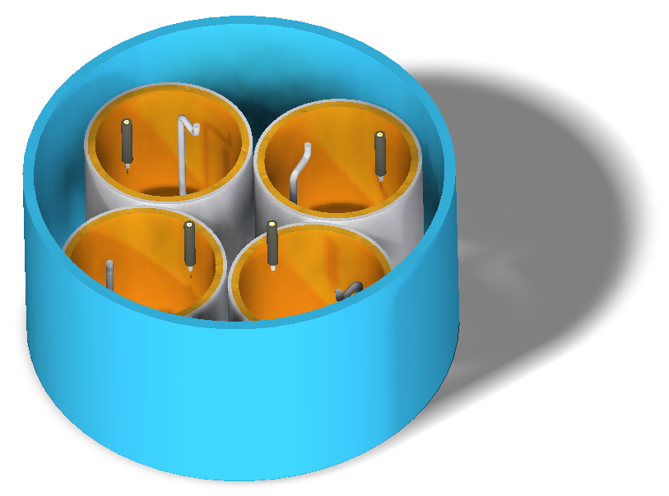
Design of a Multiple-Cavity System
Array of N identical cavities
  Same dimension and same tuning mechanism
N-way power combiner
  Before the first stage of amplification
Remaining RF components are identical with a single-cavity experiment
A quadruple-cavity detector
  For a magnet bore (D) of 10 cm
  Maximum cavity radius (R) of 1.7 cm
    Cavity wall thickness of 4 mm
    46% volume usage
  TM₀₁₀ frequency: 6.75 GHz
S.A.
Cryostat
Amplifier
Combiner
Magnet
R
D

Slide 11
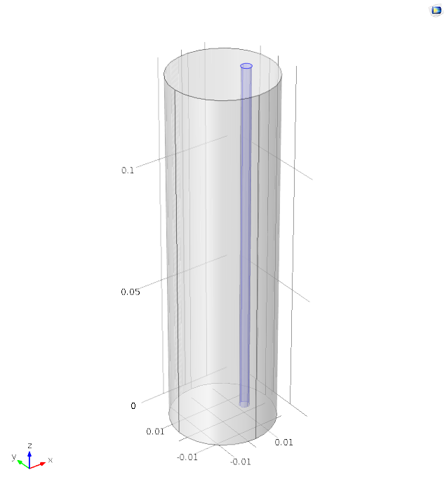
Simulation Study (COMSOL)
Cu cavity
(R=1.7cm,L=10cm*)
Tuning system
(Dielectric rotational rod) (ε=10, r/R=0.1*)
Δf ~1 GHz
δf/δθ ~ 5 MHz/deg
* See poster by Junu Jeong
ΔQ ~ 30%
δQ/δθ ~ 0.15%/deg

Slide 12
Conversion Power and Scan Rate
A quadruple-cavity system
  4 cavities with R = 1.7 cm and L = 10.0 cm => V = 0.36 L
Conversion power
Scan rate

Slide 13
Phase (Frequency) Matching
Source of frequency mismatch
  Machining tolerance in cavity fabrication
    50 μm => 25 MHz
Ideal frequency matching is not possible!
  Position resolution ≠ 0°: 0.1 m° => 0.5 kHz
Realistic approach: Frequency mismatch!
  Up to a certain level where a reduction in the (combined) power is not significant
  Frequency Matching Tolerance, FMT
FMT
f₀
f
f₀: leading frequency

Slide 14
Phase (Frequency) Matching
Source of frequency mismatch
  Machining tolerance in cavity fabrication
    50 μm => 25 MHz
Ideal frequency matching is not possible!
  Position resolution ≠ 0°: 0.1 m° => 0.5 kHz
Realistic approach: Frequency mismatch!
  Up to a certain level where the (combined) power reduction is not significant
  Frequency Matching Tolerance, FMT
  P_{comb} > 0.95 P_{ideal}
Ideal
Combined
FMT
f₀
f
f₀: leading frequency

Slide 15
Frequency Matching Tolerance – I
Pseudo-experiment study
  4-cavity detector, Q_{u} = 10⁵, f₀ = 6 GHz
  Tolerances Under Test (TUT) = (0,) 10, 20 ,30, 60, 100, 200 kHz
  Combined power spectra
  1000 pseudo-experiments
Combined Power Spectra (60 kHz)
Averaged power spectra
TUT = 0 kHz
TUT = 60 kHz
TUT = 0 kHz
10 kHz
20 kHz
30 kHz
60 kHz
100 kHz
200 kHz
Power amplitude from each cavity is normalized to 1.

Slide 16
Frequency Matching Tolerance – II
Averaged power amplitude and width
TUT (kHz) | Power Amp. | Q_{u} | SNR | Scan Rate
0 | 1.00 | 1.00 | 1.00 | 1.00
10 | 0.99 | 0.99 | 0.99 | 0.96
20 | 0.96 | 0.95 | 0.94 | 0.85
30 | 0.93 | 0.91 | 0.88 | 0.71
60 | 0.78 | 0.73 | 0.67 | 0.31
100 | 0.60 | 0.55 | 0.45 | 0.11
For 6.0 GHz axion signal, 4-cavity detector with Q_{u}=10⁵
  20 kHz is the FMT for the system
In general, FMT = 2 GHz / Q_{u}
  For Q_{u}=10⁶, FMT = 2 kHz
  cf. position resolution of 0.1 m° => frequency resolution: 0.5 kHz

Slide 17
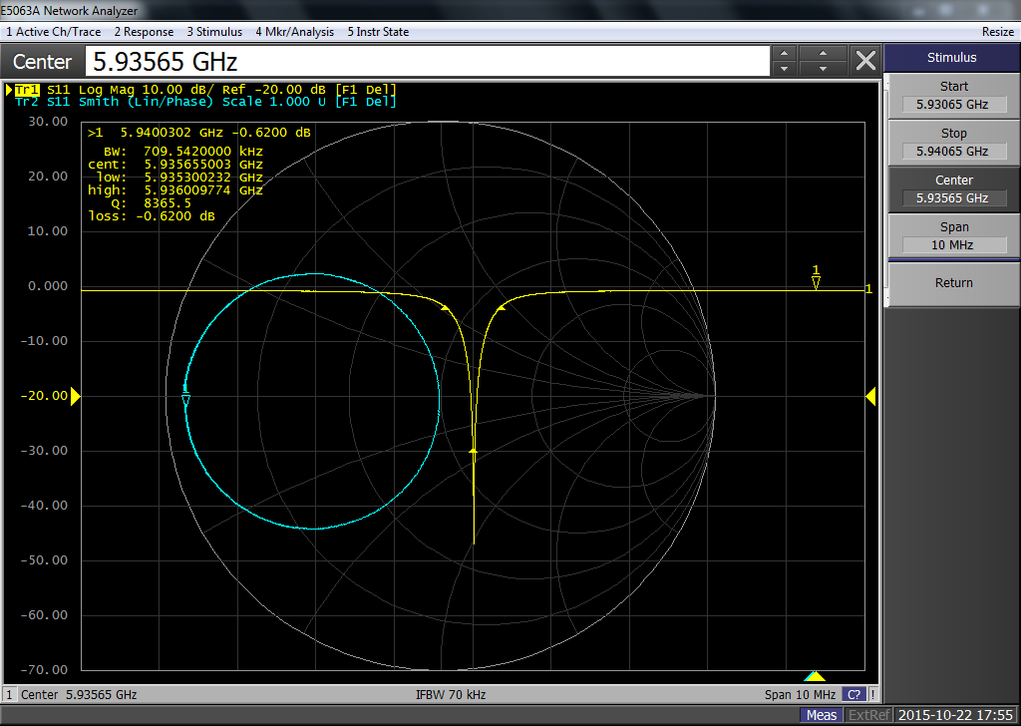
Tuning Mechanism – I
Basic principle – critical coupling
  Minimizing the reflection coefficient (Γ)
  Forming a circle passing through the center of the smith chart
For a single cavity
  Γ is minimized when
    System is critically coupled
For a multiple-cavity system
  Combined Γ is minimized when
    Frequency matching is successful
    Entire system is critically coupled

Slide 18
Tuning Mechanism – II
Frequency matching & critical coupling
Consisting of three steps
  1) simultaneous operation of the tuning systems
    To shift search frequency
  2) finer operation of the individual tuning systems
    To achieve frequency matching
  3) global operation of the antennas
    To achieve critical coupling
    At the sacrifice of sensitivity loss of <0.5%*
Linear piezo
3)
…
Rotational piezos
1)
2)
* Machining tolerance of 50 μm and uncertainty on surface conductivity of 2%

Slide 19
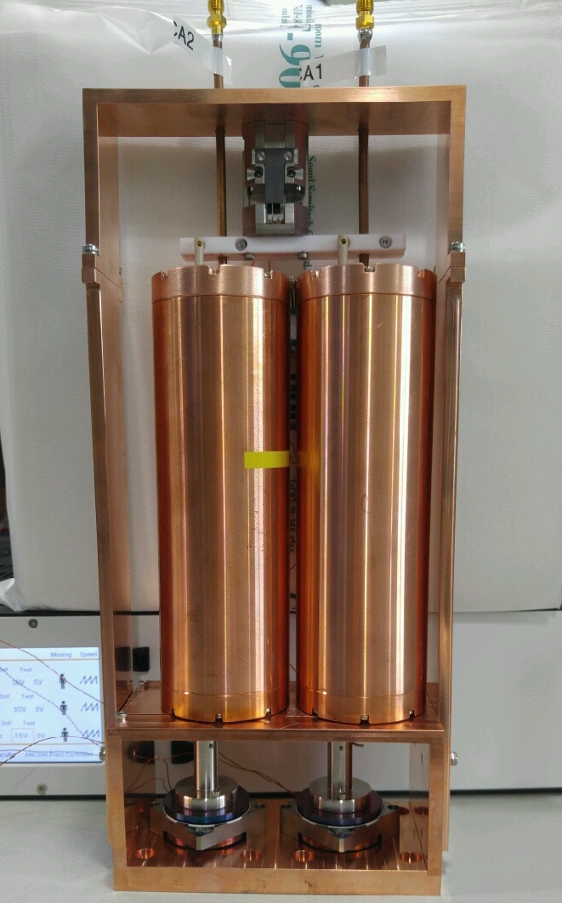
Experimental Demonstration
Couplers
Double-cavity
  O.D.= 5.08 cm
  I.D. = 3.88 cm
  f_{TM010} = 5.92 GHz
  Q_{L} = 9,000 at RT
Tuning system
  Dielectric rods (95% alumina)
    f_{TM010} = 4.54 GHz at center
    Q_{L} = 2,500 at RT
  Two rotators
    Frequency tuning
  One linear positioner
    Global operation of two couplers
Linear Positioner
Coupler
holder
Rotators

Slide 20
Sequence of Demonstration
Assembly of a double-cavity system with a combiner
  Calibrate the system up to the two couplers
Critical coupling at slightly different resonant frequencies
  Measure the initial Q (and S₁₁) values
Assembly of the full system
  See two reflection peaks and two circles
Operation a rotator
  For frequency matching
  Until the combined reflection coefficient is minimized
Operate the linear positioner
  For critical coupling
  Reflection peak becomes further deeper / Smith circle passes through the center
Compare the Q (S₁₁) value with the initial ones

Slide 21
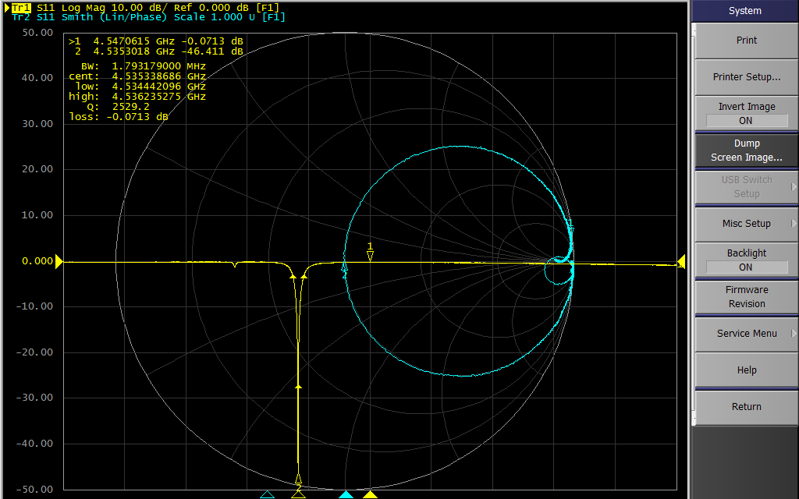
Critical Coupling (Cavity I)
Term.
f₀₁₀: 4.5353 GHz
S₁₁: −46.4
Q : 2,530

Slide 22
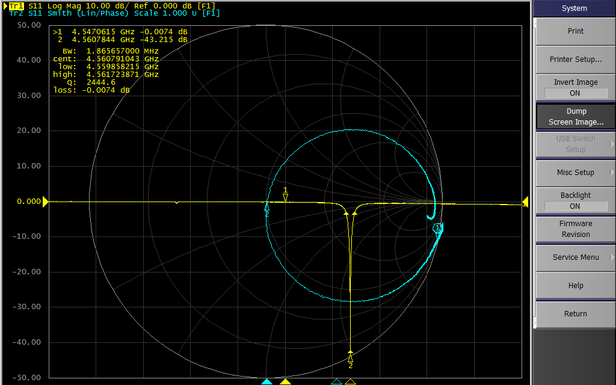
Critical Coupling (Cavity II)
Term.
f₀₁₀: 4.5607 GHz
S₁₁: −43.2
Q : 2,440

Slide 23
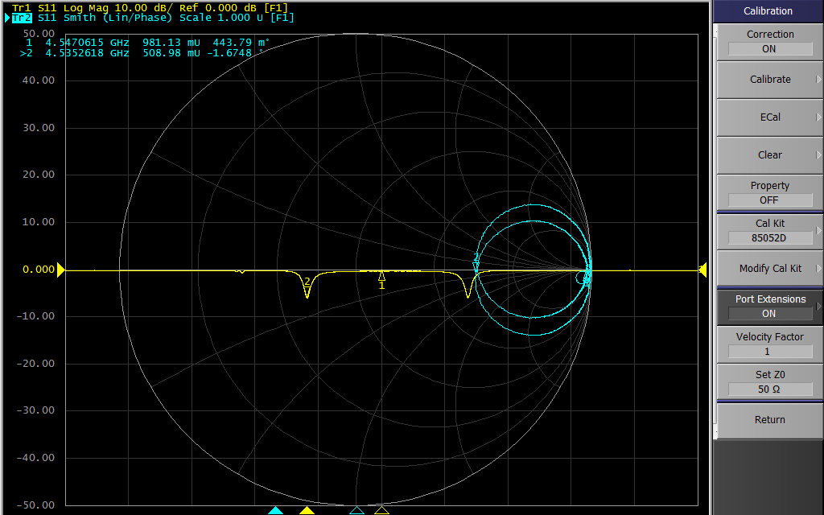
Combining Two Cavities
Marker 1: 981 mU
Marker 2: 508 mU
S₁₁ = −6 dB
I
II

Slide 24
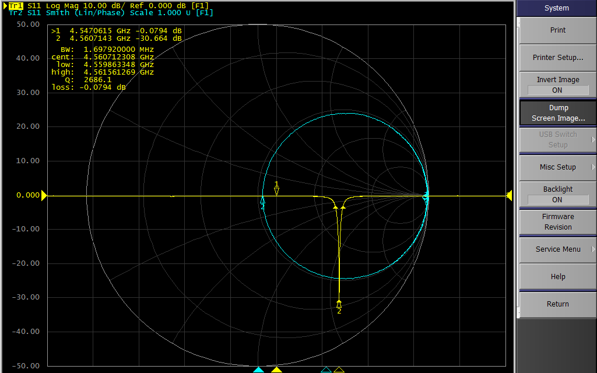
Frequency Matching – Rotator
f₀₁₀: 4.5607 GHz
S₁₁: −30.7
Q : 2,690

Slide 25
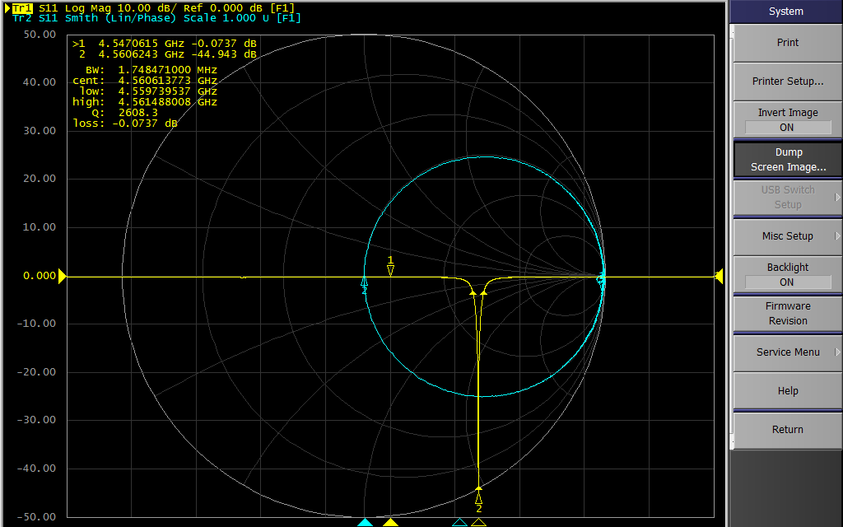
Critical Coupling – Linear
f₀₁₀: 4.5606 GHz
S₁₁: −44.4
Q : 2,610

Slide 26
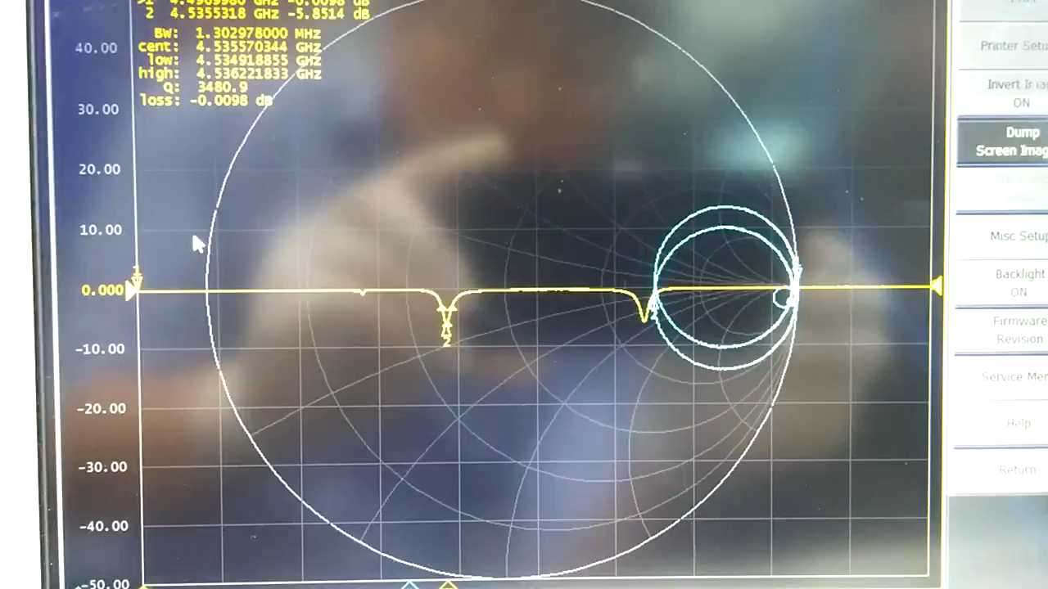
Phase Matching – Movie

Slide 27
Project Plan
Multiple stages
  Depending on cavity multiplicity (#) and cavity quality factor
  1st stage: double-cavity with Q_{u}=10⁴
  2nd stage: quadruple-cavity with Q_{u}=10⁴
  3rd stage: quadruple-cavity with Q_{u}=10⁶
  Final stage: septuplet-cavity with Q_{u}=10⁶
    R=1.3 cm, f(TM₀₁₀)=~8 GHz (with a dielectric tuning rod)
# | Q_{u} | 2015 |  | 2016 |  |  |  | 2017 |  |  |  |  |  | 2018 |  |  |  |  | 2019
2 | 10⁴
4 | 10⁴
4 | 10⁶
7 | 10⁶
Design & Procurement
Construction & Test at RT
Commissioning at CR
Operation & Analysis

Slide 28
Summary
Multiple-cavity detector
  Increases the sensitivity for axion search in higher frequency region
Basic design: signal combination preceding amplification
  Simpler setup with minimal sensitivity degradation
Realistic approach for phase (frequency) matching
  Frequency mismatch within FMT (P_{comb} > 0.95 P_{ideal})
  FMT = 2 GHz / Q_{u} for 6 GHz axion
Tuning mechanism
  To achieve frequency matching and critical coupling
Experimental demonstration
Linear piezo
3)
…
Rotary piezos
1)
2)

Slide 29
Backups

Slide 30
SNR – Configuration 1
Multiple chains
S : signal voltage
N_{C}: cavity noise voltage
G : amplifier gain
N_{A} : amplifier noise voltage

Slide 31
SNR – Configuration 2
Amplification + combination
S : signal voltage
N_{C}: cavity noise voltage
G : amplifier gain
N_{A} : amplifier noise voltage
Noise from the combiner is assumed to be negligible.
Signal is correlated while noise is uncorrelated.
Voltage adds in sqrt.

Slide 32
SNR – Configuration 3
Combination + amplification
S : signal voltage
N_{C}: cavity noise voltage
G : amplifier gain
N_{A} : amplifier noise voltage
Noise from the combiner is assumed to be negligible.
Signal is correlated while noise is uncorrelated.
Voltage adds in sqrt.

Slide 33
Phase-locking (Time)
Source of phase mismatch at the combiner
  Different cable lengths between individual cavities and the combiner
NOTE: Ideal phase matching is difficult!
  Exactly same length of cables
  More realistic to keep the phases within a certain range
    Phase Matching Tolerance, PMT
    Acceptable as long as the reduction in combined power (or SNR) is not significant

Slide 34
Phase-locking (Time)
Determining the PMT
  Consider a tolerance (tolerance under test, TUT)
  Assume that individual signals have phases (φ_{i}) within the tolerance, i.e. |φ_{i} − φ₀ |< TUT when arriving at the combiner
  If the combined power is >95% of the ideal case, i.e. φ_{i} = φ₀ or TUT=0, then take the TUT as the PMT
Pseudo-experiment study
  4-cavity detector, f₀=6 GHz, Q_{u}=10⁵
  TUT = (0,) π/16, π/8, π/4, π/2, π/√2, π
  1000 pseudo-experiments
Ideal
Combined
TUT
φ₀
φ
φ₀: leading frequency

Slide 35
Pseudo-experiment Study
Junu Jeong
Combined Power Spectra (10 kHz)
Combined Power Spectra (60 kHz)
TUT = 0 rad
TUT = π/8 rad
TUT = 0 rad
TUT = π/4 rad
Averaged power spectra
TUT = 0 rad
π/16 rad
π/8 rad
π/4 rad
π/2 rad
π/√2 rad
π rad
Power amplitude from each cavity is normalized to 1.

Slide 36
Pseudo-experiment Study – Summary
TUT (rad) | Power Amp. | Q_{u} | SNR | Sensi-tivity
0 | 1.00 | 1.00 | 1.00 | 1.00
π/16 | 0.99 | 1.00 | 0.99 | 0.98
π/8 | 0.96 | 1.00 | 0.96 | 0.93
π/4 | 0.86 | 1.00 | 0.86 | 0.75
π/2 | 0.54 | 1.00 | 0.54 | 0.29
π | 0.25 | 1.00 | 0.25 | 0.06
For 6.0 GHz axion signal, 4-cavity detector with Q_{u}=10⁵
  π/8 rad is the PMT for this system
  This corresponds to Δl = ~3 mm (λ = 5 cm)
In general, Δl = 1/16*c/f
  For 10 GHz, Δl = ~2 mm
  Can be under good control

Slide 37
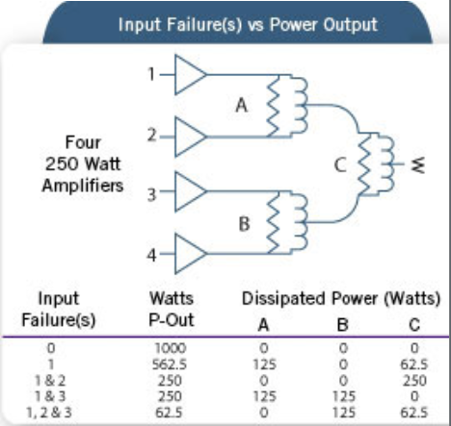
Isolating Termination Dissipation
Isolating terminations enable the dissipation of power due to various unbalances and possible input failures
At reson.
1/2
0
1
Non-reson.
1/2
1/4
1/2
Schematic representation of four 250 W amplifiers feeding a 4-way combiner
Power output and power dissipation associated with various input failure scenarios

