Slide 1
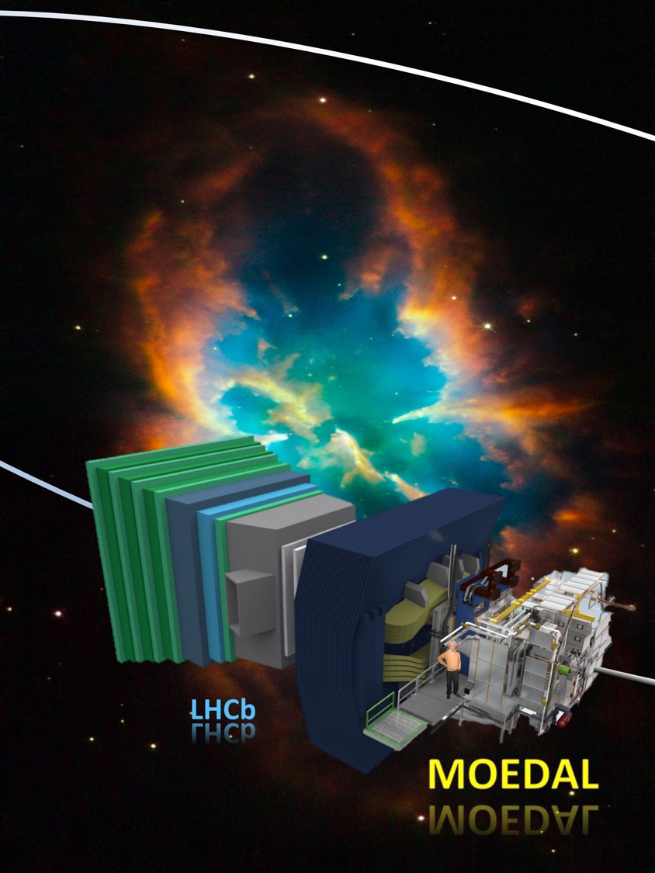
MoEDAL – A New Experiment at the LHC’s Discovery Frontier
James L. Pinfold, For the MoEDAL Collaboration
The 12th Patras Workshop

Slide 2
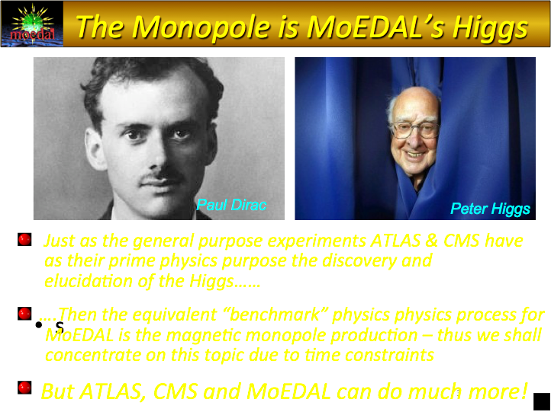
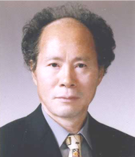
Yongmin Cho

Slide 3
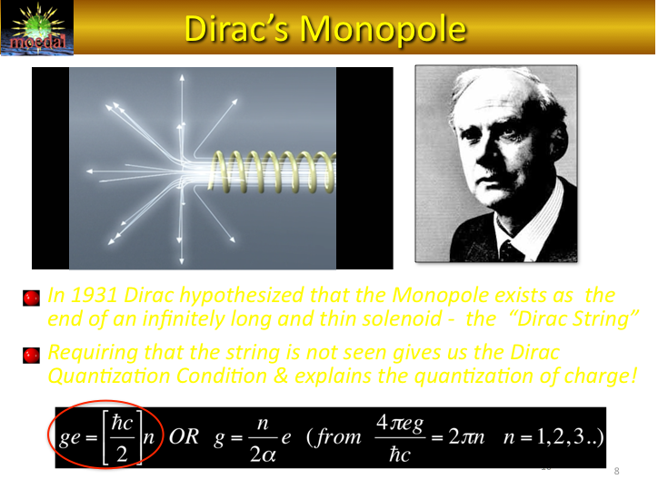

Slide 4
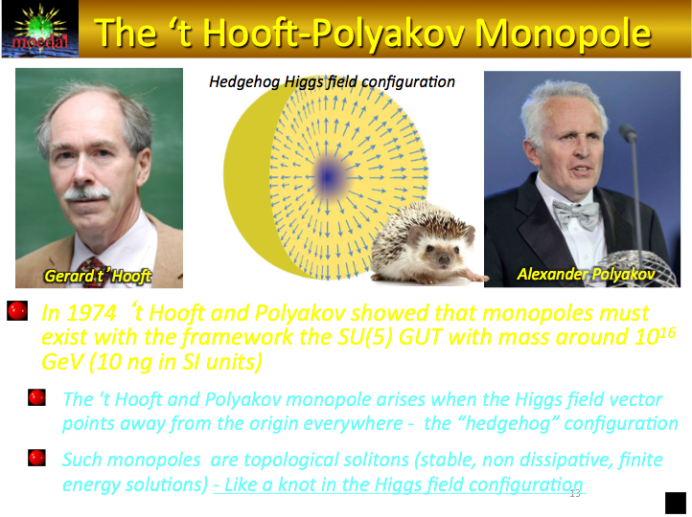

Slide 5
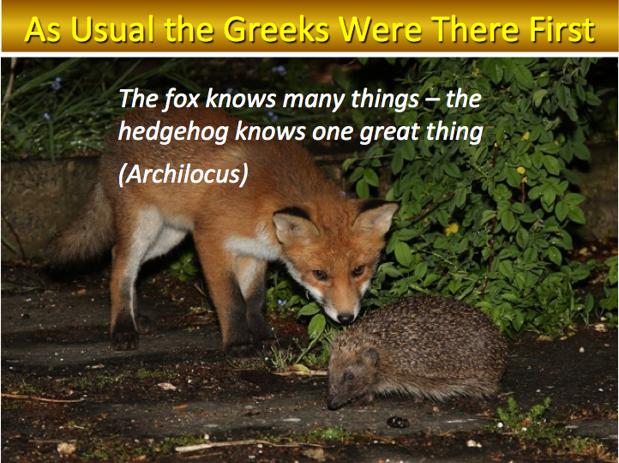

Slide 6
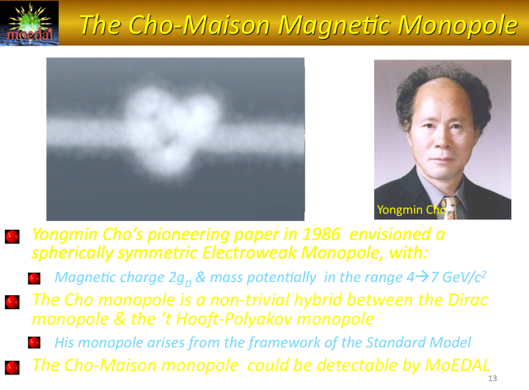

Slide 7
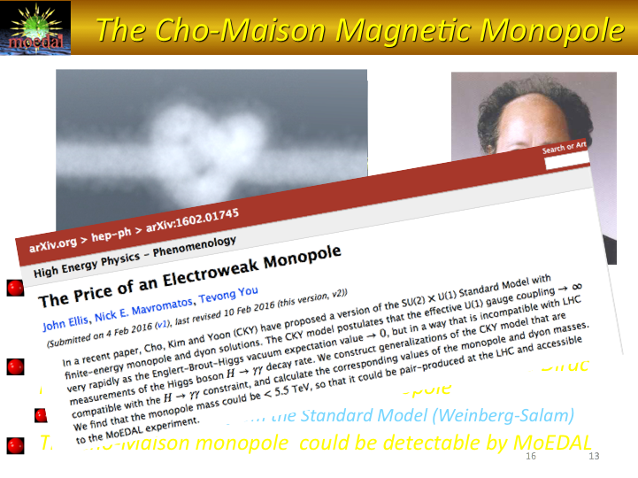

Slide 8

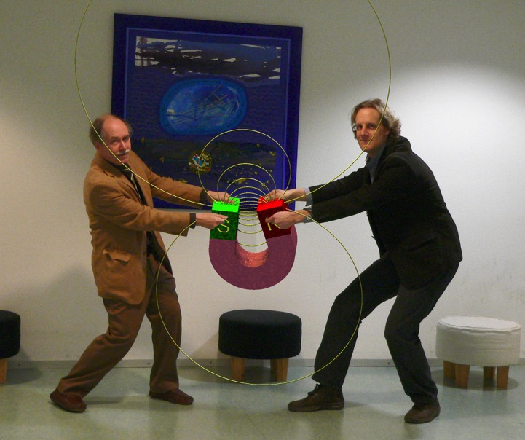
Magnetic Monopole Properties
Magnetic charge = ng = n68.5e
(if e→1/3e; g→3g)
HIGHLY IONIZING
Coupling constant = g/Ћc ~ 34. Spin ½?
Energy acquired in a magnetic field =2.06MeV/gauss.m = 2TeV in a 10m, 10T solenidal field
The monopole mass is not predicted within the Dirac’s theory, ~
4-7 TeV EW monopole

Slide 9
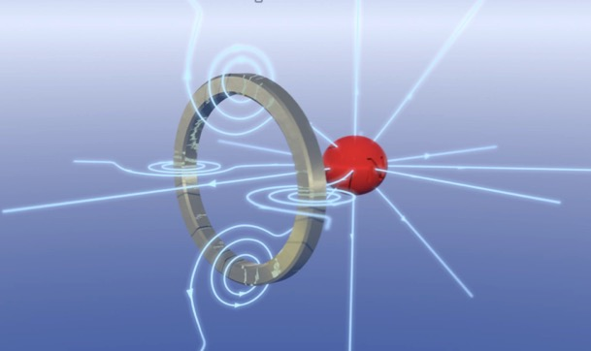
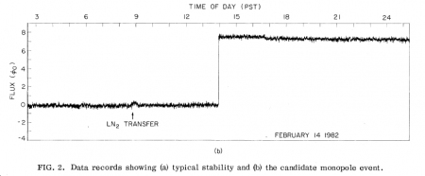
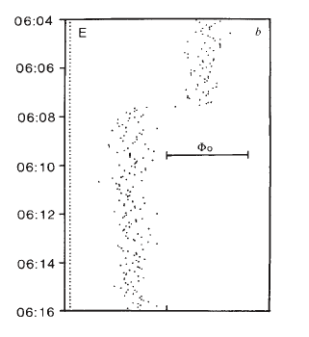

Induction Experiments - Evidence?
Cabrera’s Event
A monopole traversing a SQUID coil
Data from Cabrera’s apparatus taken on St Valentine’s day in 1982 (A=20 cm²).
  The trace shows a jump – just before 2pm - that one would expect from a monopole traversing the coil.
In August 1985 a groups at ICL reported the:“observation of an unexplained event” compatible with a monopole traversing the detector (A= 0.18 m²
SAME TECHNOLOGY IS UTILIZED BY MoEDAL
ICL
Event

Slide 10


SEVENTH
They fought on the high energy frontier
MoEDAL is installed and started to take data in
p-p and p-A running at ~13 TeV in 2015
ATLAS
LHCb
TOTEM
MoEDAL
CMS
ALICE
LHCf

Slide 11
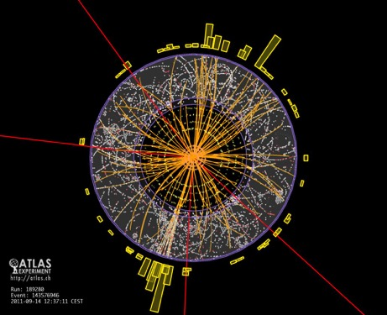
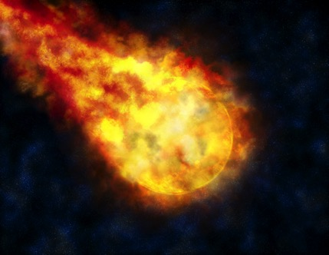

Highly Ionizing Particles – Avatars of New Physics
Avatar [av-uh-tahr]: An incarnation, embodiment, or manifestation of a person or idea:
MoEDAL – Highly Ionizing Particles directly detected as messengers of new physics – no SM backgrounds
ATLAS & CMS – New physics largely reconstructed from SM particles – large SM backgrounds

Slide 12

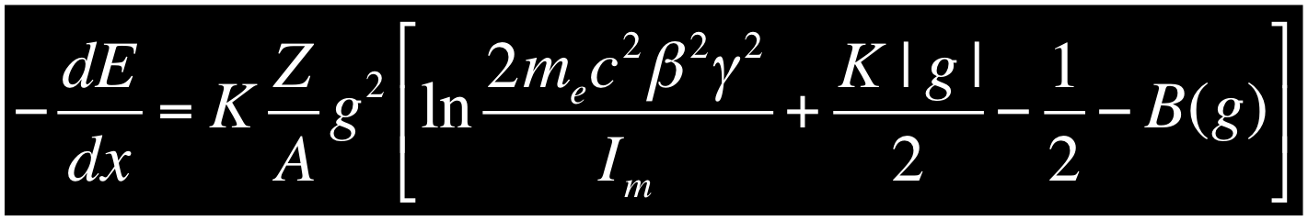
The Ways to Get Anomalous Ionization
Electric charge - ionization increases with increasing charge & falling velocity β (β=v/c) – use Z/β as an indicator of ionization
  If Z ~ 0.001e (millicharged) we get anomalously low ionization
Magnetic charge - ionization increases with magnetic charge g = ng_{d} and decreases with velocity β – a unique signature
  The velocity dependence of the Lorentz force cancels 1/β² term
  As g = 137e/2 = 68.5e the ionization of a rel. monopole is 4700n²!! (n=1) that of a MIP. But n could be larger!
12

Slide 13


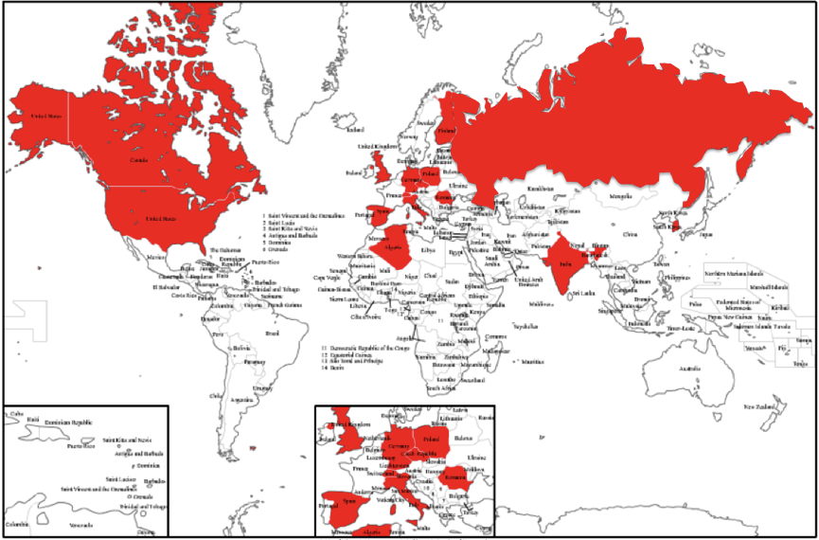

























The MoEDAL Collaboration
66 physicists from 14 countries & 24 institutes. on 4 continents:
U. Alberta, UBC, INFN Bologna, U. Bologna, CAAG-Algeria, U. Cincinatti, Concordia U., CSIC Valencia, Gangneung-Wonju Nat. U., U. Geneva, U. Helsinki, IEAP/CTU Prague, IFIC Valencia, Imperial College London, ISS Bucharest, King’s College London, Konkuk U., U. Montréal, MISiS Moscow, Muenster U., National Inst. Tec. (india),Northeastern U., Simon Langton School UK, Stanford University [is the latest ( associate) member of MoEDAL], Tuft’s.

Slide 14
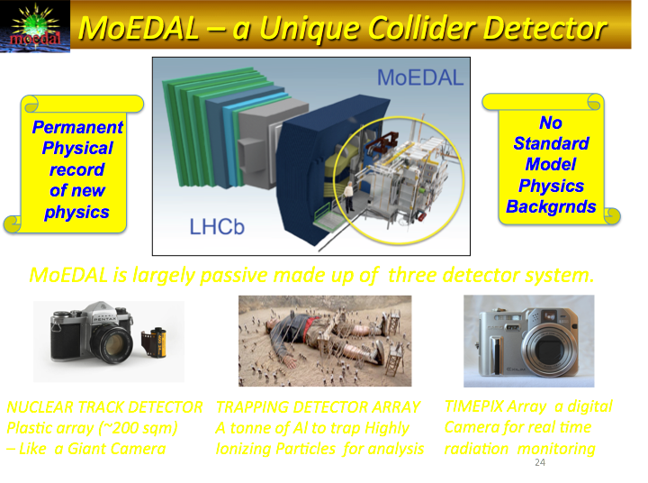
(with film)

Slide 15
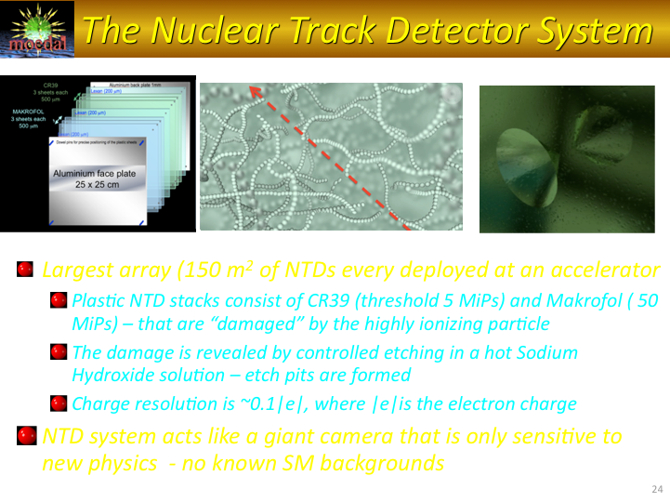

Slide 17
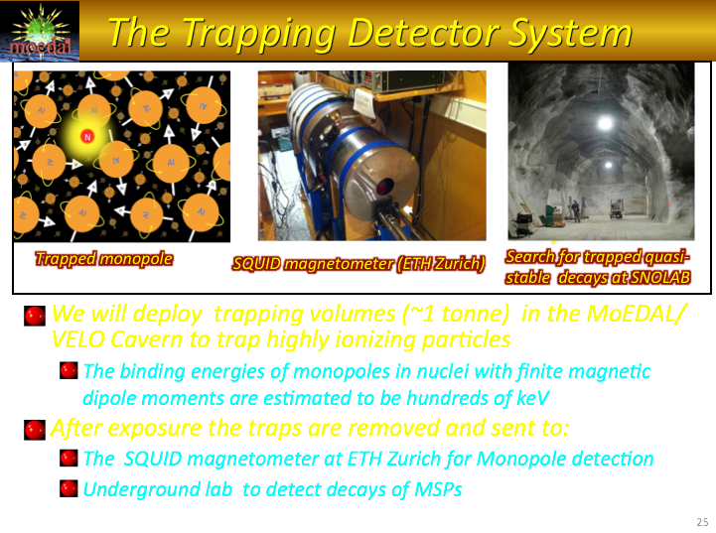

Slide 18
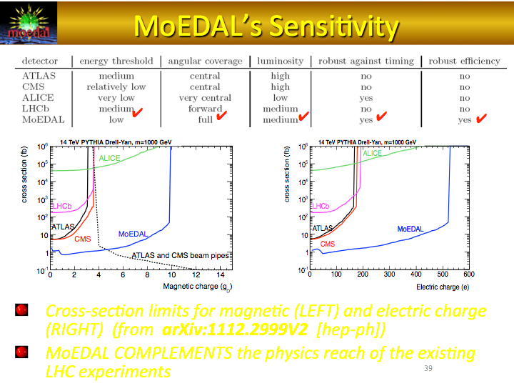

Slide 19
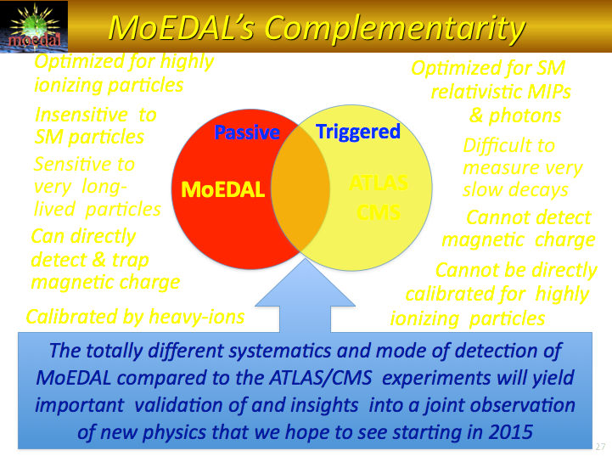

Slide 20
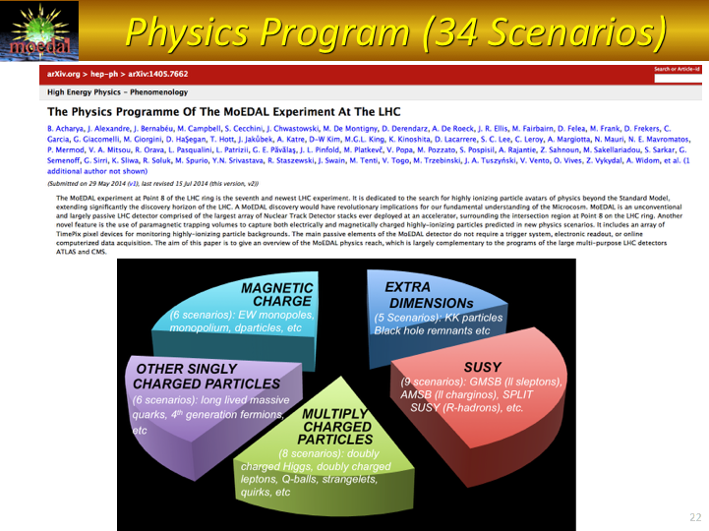

Slide 21
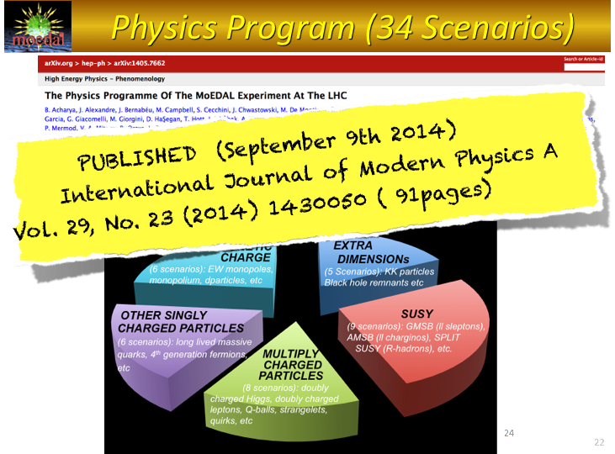

Slide 22
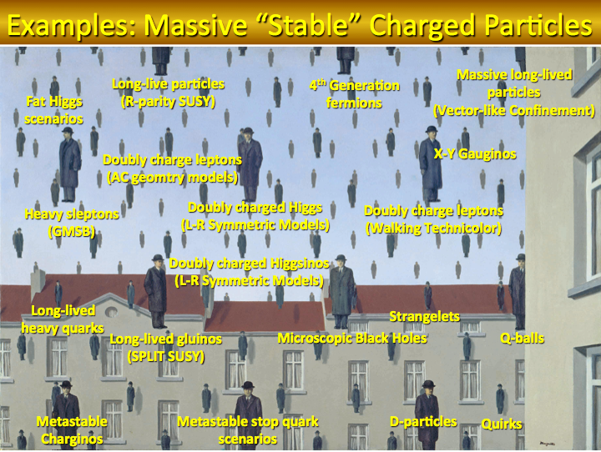

Slide 23
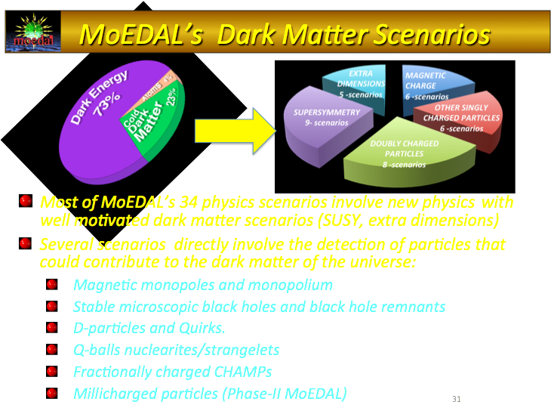

Slide 24
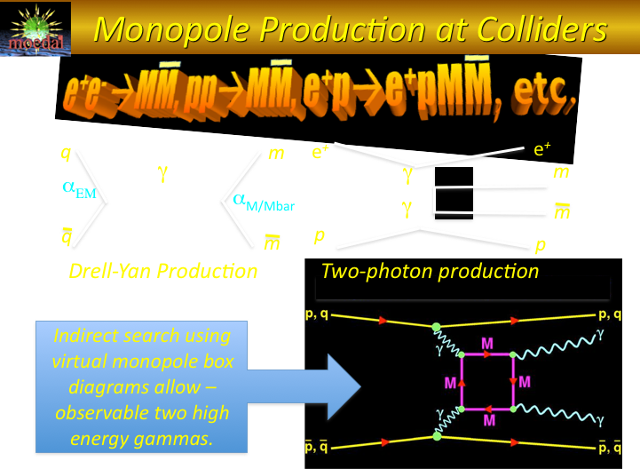

Slide 25


Slide 26
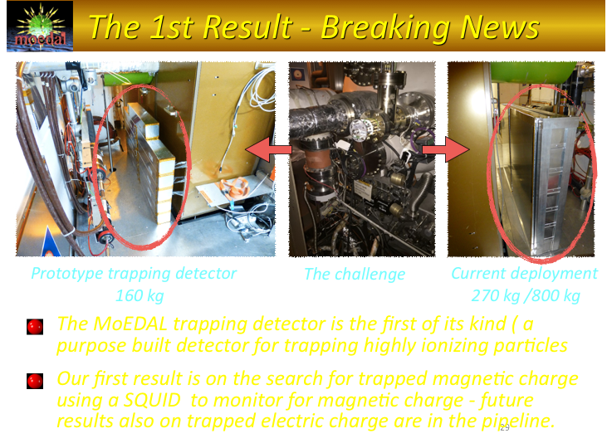

Slide 27
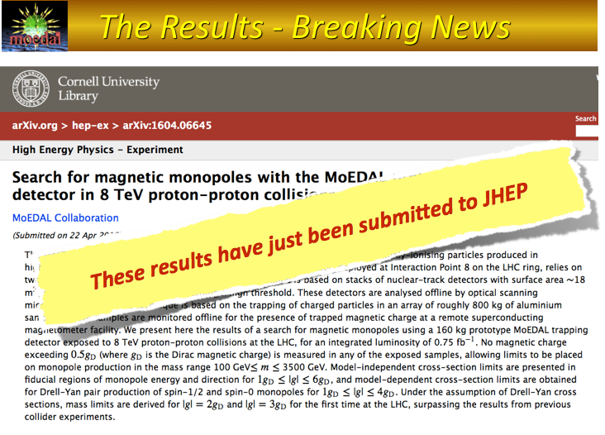

Slide 28
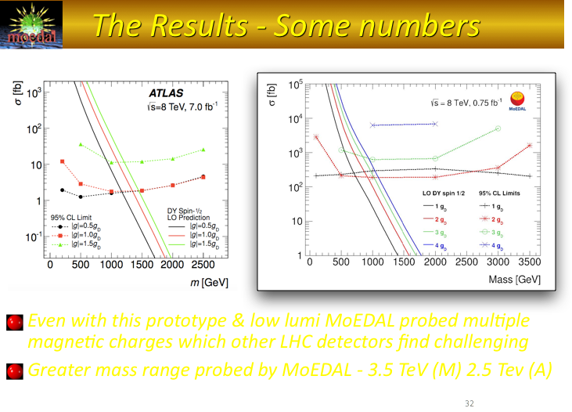

Slide 29

These first results will be presented at an EP-LHC seminar in the main auditorium on July 12th

Slide 30
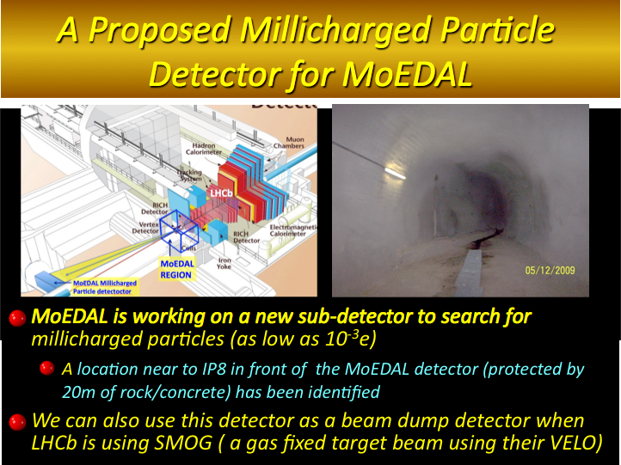
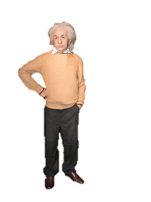

Slide 31
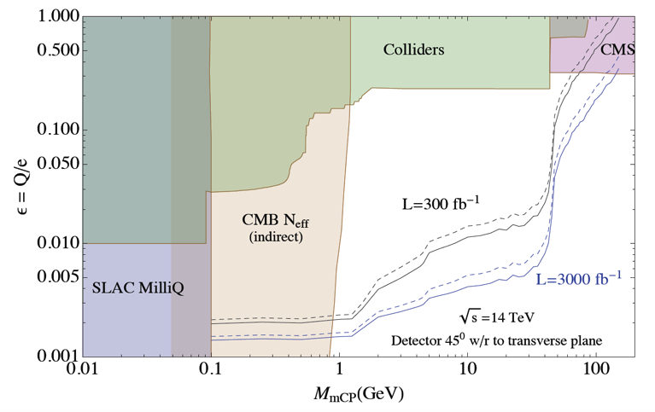
mQPs a Physics Rationale
Search for millicharged particles – a dark matter candidate - to which the standard LHC detectors are not sensitive
  New dark sectors can have new particles which appear “milli-charged” to the Standard Model
  Charges typically in the range 10⁻¹ to 10⁻³ e
  No direct constraints above 100 MeV
A MoEDAL millicharged detector could probe up to 100 GeV

Slide 32
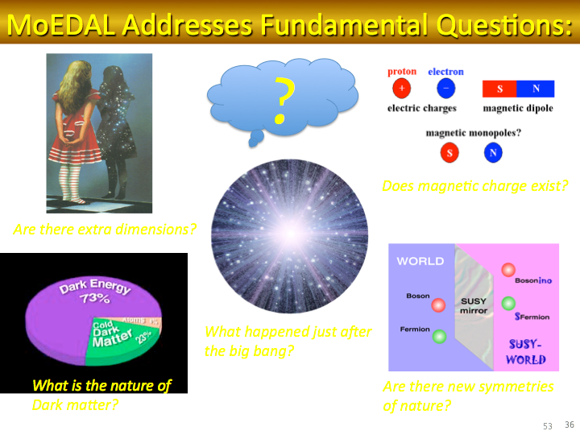

Slide 33
Stay tuned for many, potentially revolutionary, MoEDAL results to come

Slide 34
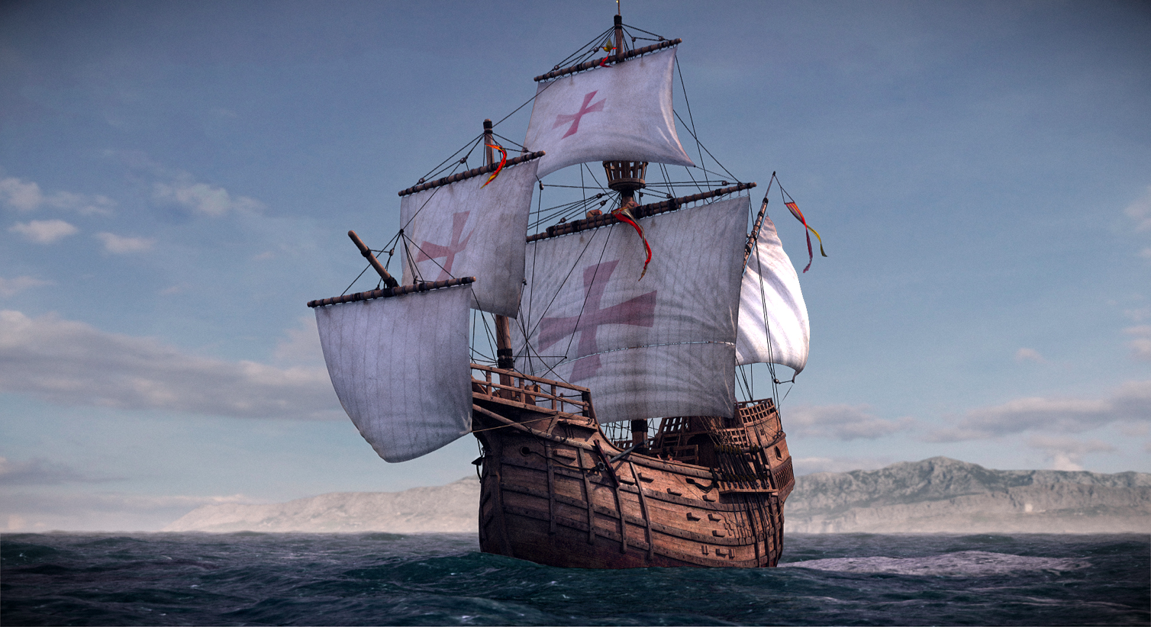
The Importance of High Risk Research
"So many centuries after the Creation, it is unlikely that anyone could find hitherto unknown lands of any value." - Spanish Royal Commission, rejecting Christopher Columbus' proposal to sail west.

Slide 35
EXTRA SLIDES

Slide 36
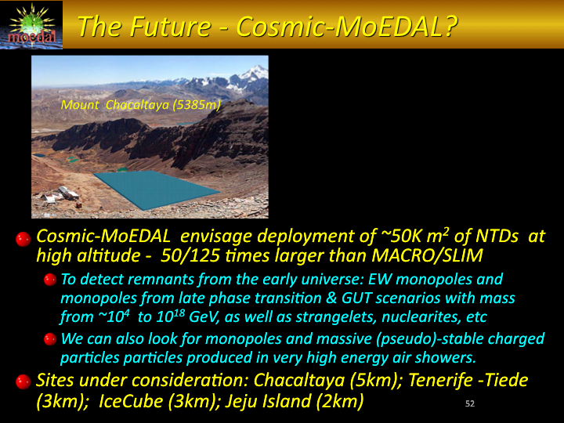
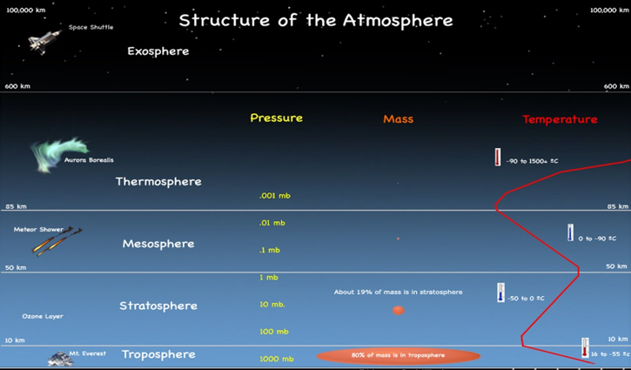

Slide 37
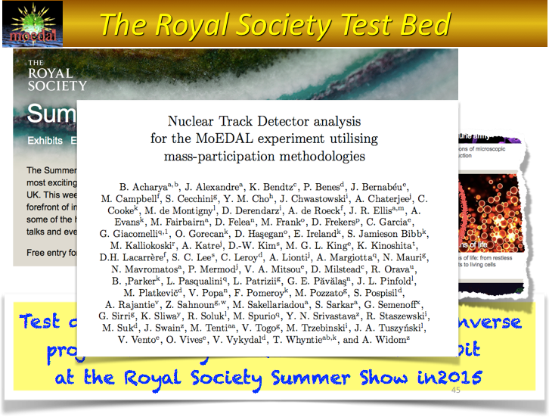

Slide 38


Slide 39
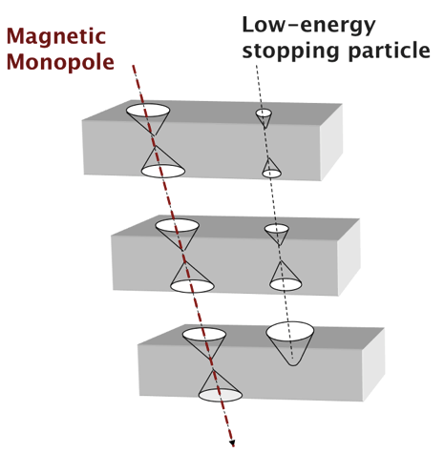
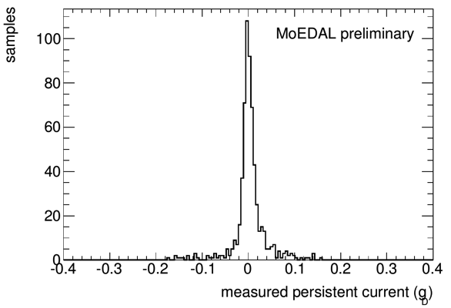
Detector Resolution
Nuclear Track Detectors
Tracking resolution: 10μm/pit (~10 pits)
Pointing resolution (to the IP): ~1 cm
Charge resolution: 0.1e
Trapping Detector SQUID
Magnetic charge resolution < 0.1g_{D}
TimePix Chips (2cm x 2cm)
Each pixel instrumented (TOT/Cnt
/Arr.Time
Pixel size: 55mm x 55mm
Silicon thickness 300 μm → 1mm

Slide 40
Examples of Refereed MoEDAL Publications
B. Acharya et al., “The Physics Programme Of The MoEDAL Experiment At The LHC”, MoEDAL Collaboration May 29, 2014. Int.J.Mod.Phys. A29 (2014) 1430050
J. Ellis, N. E. Mavromatos, T. You. “The Price of an Electroweak Monopole” Feb 4, 2016. Phys .Lett. B756 (2016) 29-35
M. Fairbairn and J. L. Pinfold, “MoEDAL – A New Light on the High Energy Frontier”. To be published in Contemporary Physics.
B. Acharya et al., “Search for magnetic monopoles with the MoEDAL prototype trapping detector in 8 TeV proton-proton collisions at the LHC”, MoEDAL Collaboration. CERN-EP-2016-101 e-Print: arXiv:1604.06645 [hep-ex]. To be published in JHEP
B. Acharya et al., “Search for magnetic monopoles with the MoEDAL trapping detector in 13 TeV proton-proton collisions at the LHC”, MoEDAL Collaboration. In preparation.
B. Acharya et al., “The MoEDAL LHC Detector”. In preparation.

Slide 41
Milestones Since the Last LHCC Report
Data taken in p-p & HI running in 2015. Data taking continues in 2016 after fresh detectors elements were deployed etc.
  Initial plan is to carry on until 10 fb⁻¹ of data is taken
Two Collaboration Meetings held June 2015, December 2015 .
  Upcoming collaboration meeting in Valencia June 27th - 28th.
MoEDALwas invited to present at the Royal Society Summer Exhibition in July 2015 and “Behind the Scenes at the Royal Society” exhibition in March 2016
15 International presentations given to date.
  Upcoming talks include: a presentation at LHCP in Lund in June, the EP-LHC seminar at CERN in July; and, SUSY 2016 in Melbourne in June/July
National University of Science and Technology( MISiS) in Moscow was admitted in December 2015
  The University of Alabama applied to join MoEDAL in June 2016.

Slide 42


