Slide 1
Edge TCT Measurements with Chess 1 – Status Update
ATLAS Strip CMOS Regular Meeting, 19 January 2016
Bojan Hiti, Igor Mandić
Jožef Stefan Institute, Experimental Particle Physics Department (F9)

Slide 2
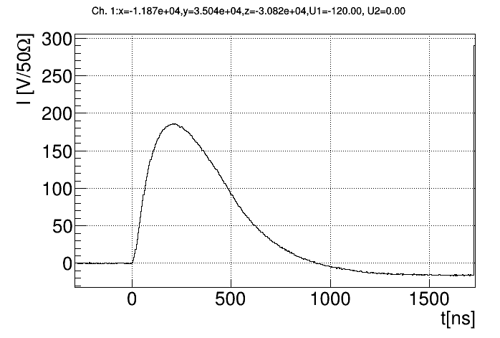
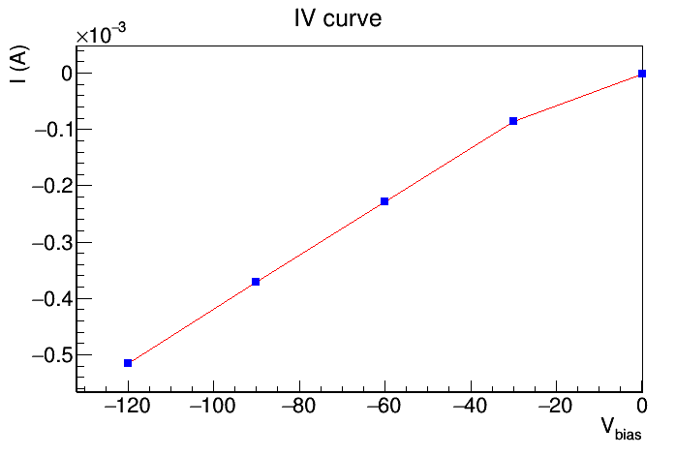
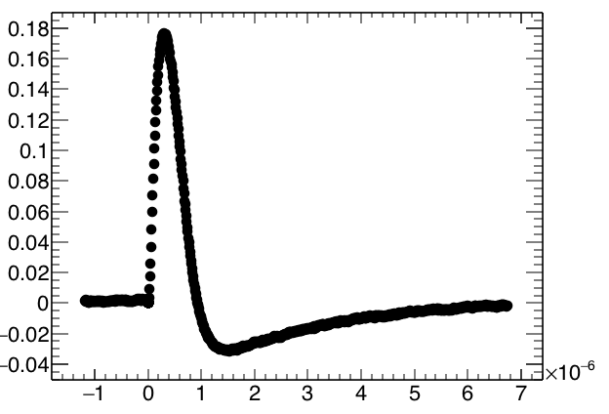
Chess 1 status
  Chess 1 chip returned from fixing at UCSC (I_{leak}(120 V) = 0.5 mA)
Remeasured APA02 with bias voltage applied (unirradiated)
  3x3 pixel array 100 x 45 µm
  Two pixels read out (pixel 3 and pixel 4 – motherboard channel 49, 50)
Pulse shape (config 8)
Pulse by Zhijun

Slide 3
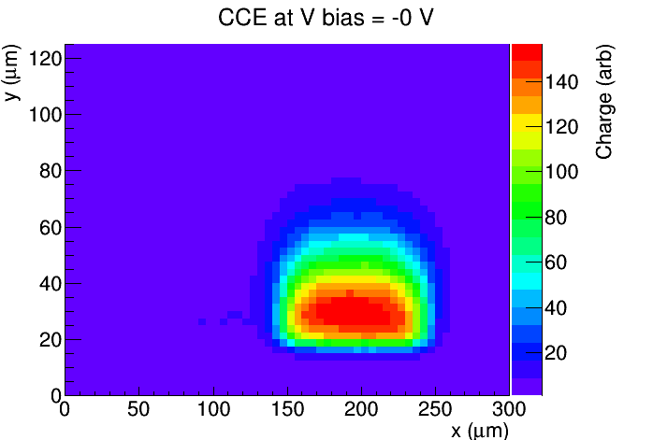
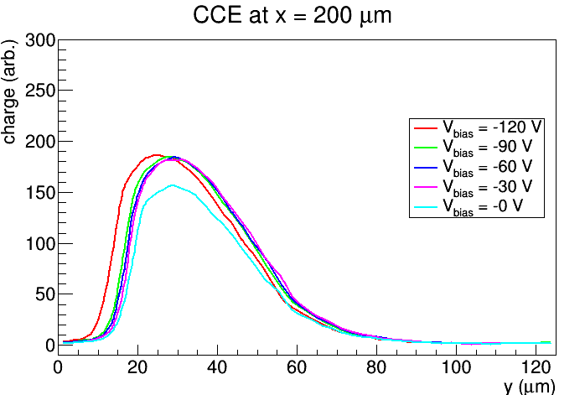
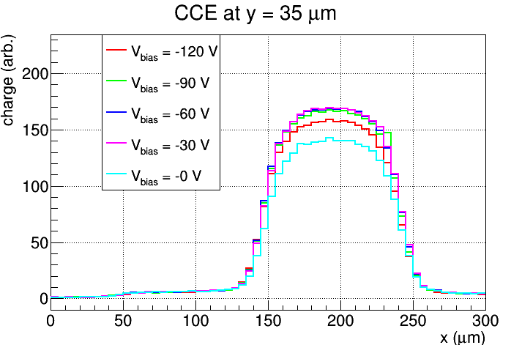
Charge Collection Efficiency (APA02 pix 4)
CCE at V bias 0 V
CCE at V bias 60 V
CCE at V bias 120 V
Depth
Chip surface
Slice at fixed x (depth profile)
Slice at fixed y (cross profile)
120 V seems to be displaced by 5 µm (measurement bug)

Slide 4
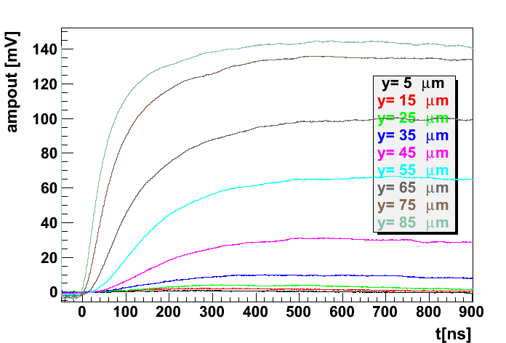
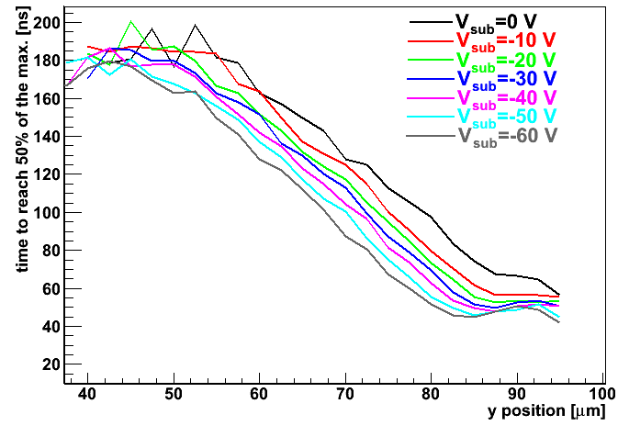
Depletion depth from amplifier curve
x in the middle of the pixel
t_{th} as a function of y position at different voltages
V_{sub}=-60 V
depleted region
Different times needed to cross 50% of the max charge
Flat part close to the surface (hockey stick like shape) indicates depleted region:
at 0 V – hard to estimate – if, only few μm at most
at 60 V some 10-15 μm
Shift in y-position for the required t_{th} is related to change in the depleted region – less distance for carriers to cross by diffusion. 60 V amounts to around 10 μm of depleted region (blue arrow)
Delay needed to cross the “threshold” is mainly due to carriers arriving by diffusion (any contribution from the drift is on this time scale prompt)
Shift in “threshold time” t_{th} with voltage at given y can be used as an indication of the depletion depth.
By G. Kramberger, IJS

Slide 5
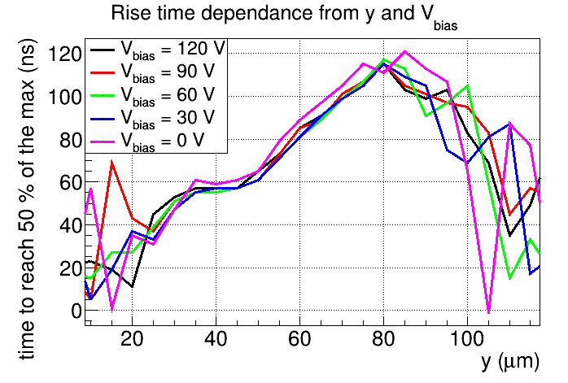
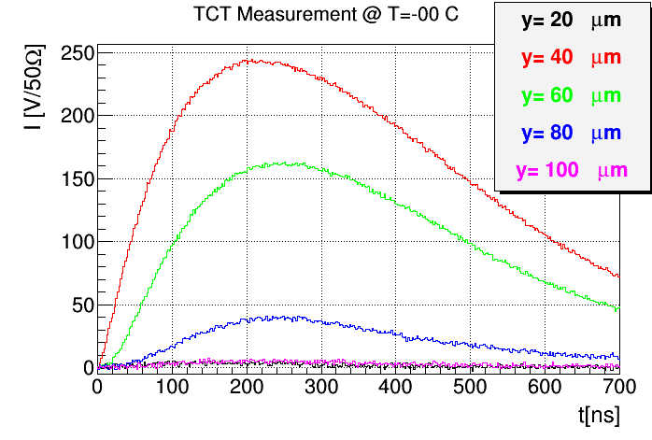
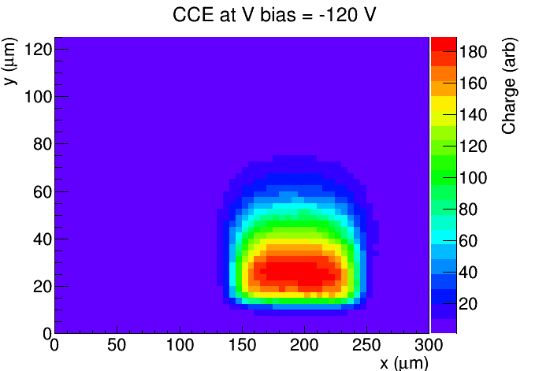
Drift Contribution
Time of crossing the threshold
“Hockey stick“
Difficult to observe changes of the depletion depth
Maybe more significant measurements of depletion depth from irradiated samples (low diffusion)

Slide 6
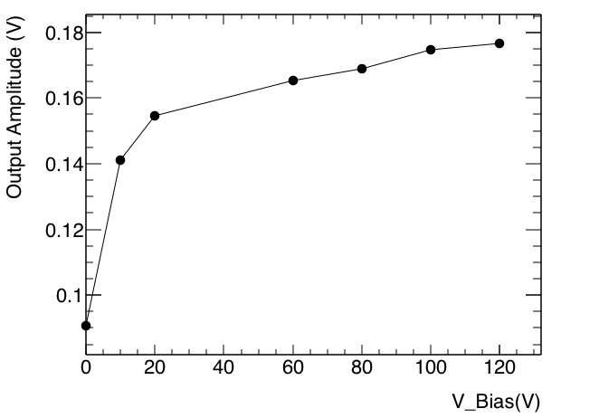
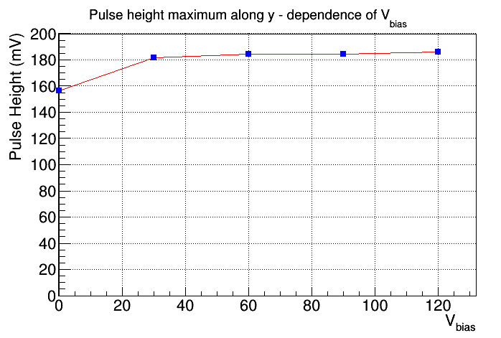
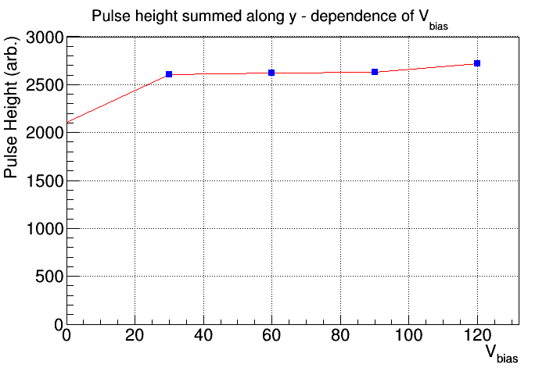
Pulse Height dependence from V_{bias}
By Zhijun
Method 1:
Maximum pulse height at any y
Method 2:
Integral along y of all pulses
Rough simulation of top TCT

Slide 7
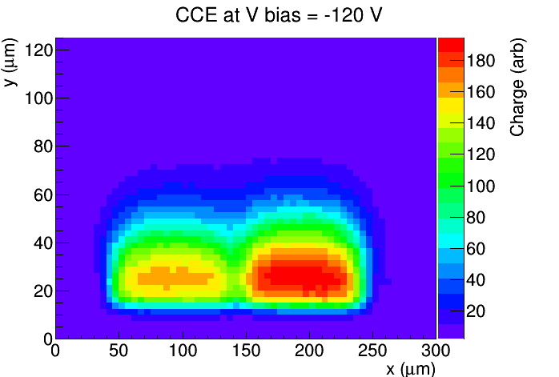
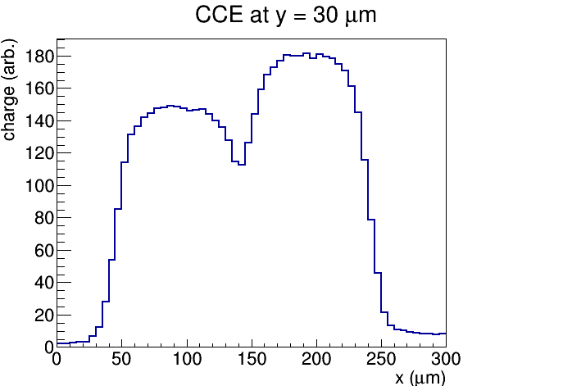
Two pixels combined
pixel 3
pixel 4
5
3
6
9
2
8
1
4
7
Beam direction
cross section
Difference in the amount of collected charge comes from absorption in silicon
(l = 1 mm for λ = 1064 mm)

Slide 8
Summary
Measured charge collection efficiency in APA02 by e-TCT
  Diffusion is dominant charge collection mechanism
  Only a small influence of V_{bias} on pulse height – less than expected
    (significant between V_{bias} = 0 V and V_{bias} ≠ 0 V)
  Difficult to estimate depletion depth
Next steps:
  Repeat the tests on APA08
  Comparison to proton irradiated chips

