Slide 1
Photon System Controls and DAQ
Burkhard Heisen
On behalf of many people from WP9x and WP75
Commissioning Meeting, Hamburg, January 20, 2016
Notes:
How to edit the title slide
Upper area: Title of your talk, max. 2 rows of the defined size (55 pt)
Lower area (subtitle): Conference/meeting/workshop, location, date,
your name and affiliation,
max. 4 rows of the defined size (32 pt)
Change the partner logos or add others in the last row.

Slide 2
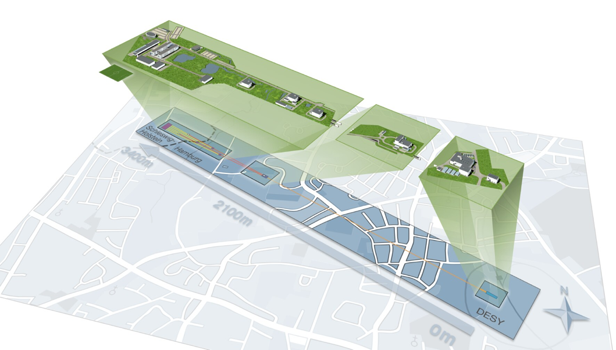

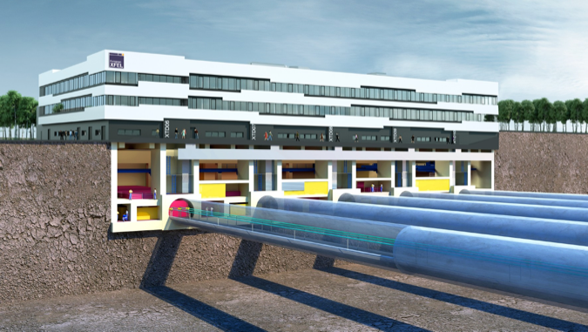
Agenda
Beckhoff
COTS devices (heaters, cameras, etc.)
MicroTCA (digitizers, timing, read out, etc.)
DAQ integration
Calibration integration
Graphical visualization
Detector end-to-end test layout
Karabo
DOOCS Tine EPICS

Slide 3
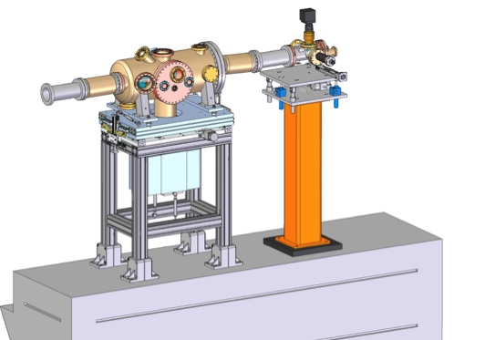
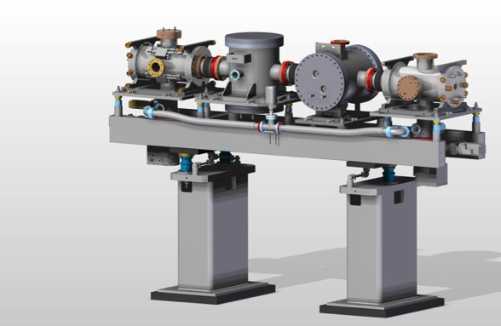
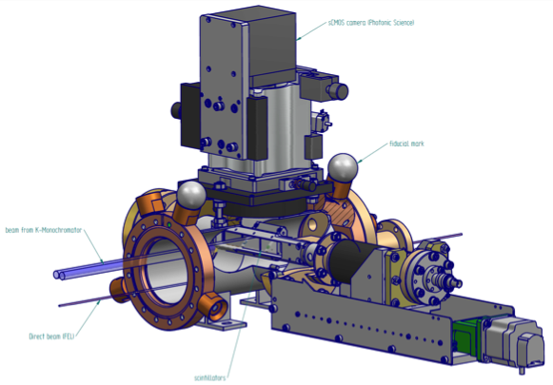
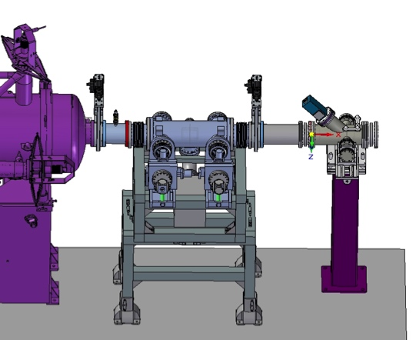
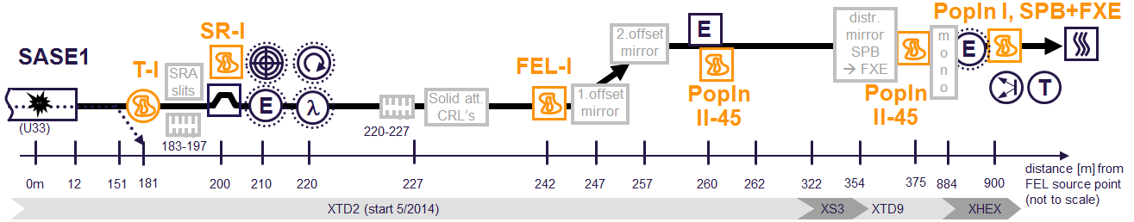
Photon Tunnels

Slide 4
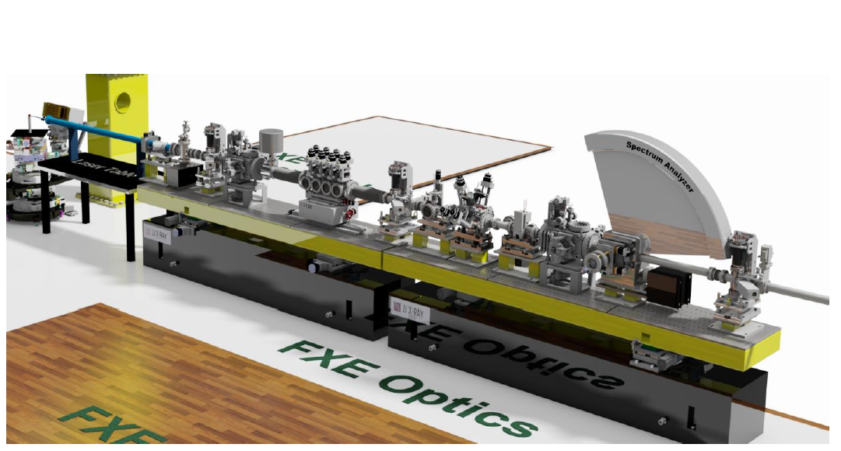
Instruments

Slide 5

Divide and rule – Things to be controlled
Motors (Stepper, Piezo, Servo, etc.)
Pumps (Ion, Turbo, Scroll, etc.)
Valves (Angle, Gate, etc.)
Sensors (Temperature, Pressure, Flow, etc.)
Interlocks
Cameras (COTS like Andor, Basler, etc.)
Digitizers, ADCs, Timing boards
Power Supplies, Heaters, Chillers, Laser Amplifiers, Robots, etc.
Detectors (LPD, DSSC, AGIPD, FastCCD, Epix, Gotthard, etc.)
Interfaces / Gateways (DOOCS, EPICS, TANGO, Interlock System)
Computing (Calibration, Image Processing, Data Analysis, etc.)

Slide 6

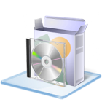
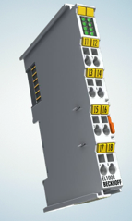
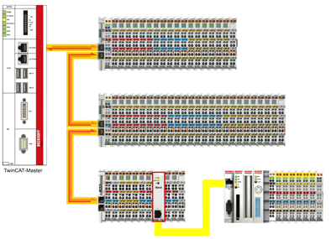

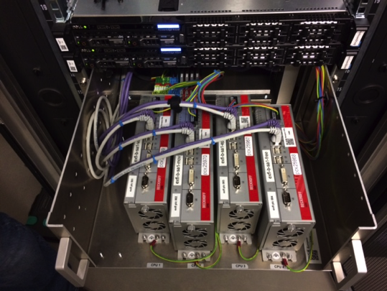
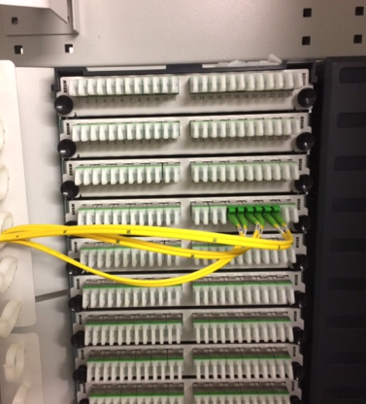
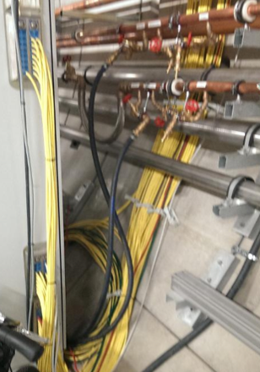
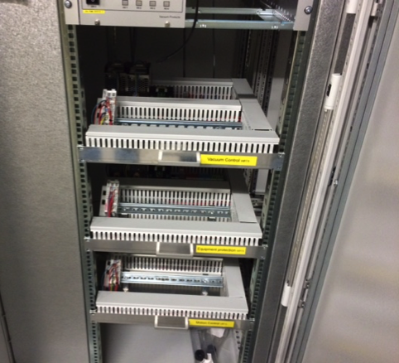
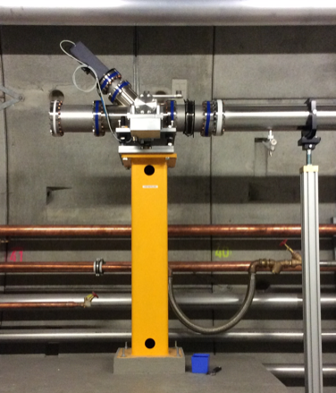
Beckhoff integrated equipment
PLC-CPU
Terminals
Patch Panel
Karabo - GUI
Karabo - Devices
PLC - Devices
Balcony Rack
Balcony Fiber Patch Field
Tunnel cables
Tunnel rack
Equipment

Slide 7

Beckhoff integration is understood and working
The notion of a “device” (driver) exists both on the PLC CPU and in Karabo
There is a limited set of different device classes (i.e. motor, valve, turbo, temp-sensor). Finally maybe not more then ~20
The Beckhoff-Program is more or less a sequence of this driver code blocks
Assembling such a program using known drivers is fast. However, adding / changing the connected hardware requires re-coding, re-building and re-deploying the Beckhoff Program
Hardware interlocks must be coded manually and take considerably more time
In Karabo each device is mapped and once coded the corresponding mapping to the given PLC can be configured (no programming needing). New drivers can initially be auto-generated, but later will be properly coded.
Motor1
Motor2
Pump1
Beck
Com
Gather/Scatter
TCP (own protocol)
PLC-CPU
EtherCAT
Motor1
Motor2
Pump1

Slide 8
Beckhoff during installation and commissioning
Install hardware, e.g. motor
Wire hardware via patch-panel (instruments) or directly to Beckhoff terminals (tunnels)
Wire the terminals to the PLC-CPU and the PLC-CPU to control PC
Low level test the hardware piece by piece with Windows Laptop running TwinCAT (Beckhoff – Product) connecting to Beckhoff-PLC to check for correct cabling
Once checked, assemble PLC program and install to PLC-CPU
Start Karabo Server on control PC
Prepare the initial configuration using the Karabo GUI
System is ready. Browse the individual devices and operate the hardware using auto-generated dialogs.
Optionally, create expert panels by drag & drop

Slide 9
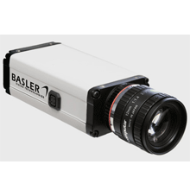

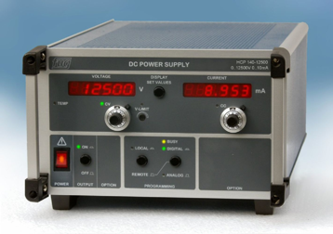
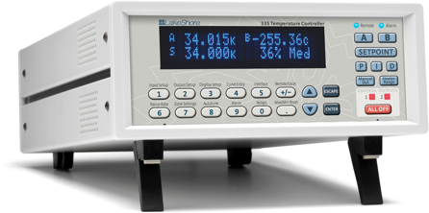
Cameras, power supplies, heaters…
Supported standards
  GenICam (generic interface for cameras) - industry standard
  Lima (library for image acquisition) – ESRF project
  SCPI (Standard Commands for Programmable Instruments)
Cameras
  Basler (all GigE), Photonic Science (sCMOS)
  IMPERX (Bobcat B4020), Andor (Neo)
  AVT (all Prosilica), Axis (all)
Other devices
  FUG, Heinziger (power supplies), TEM (beam lock)
  Amphos (laser power stage)
  EnergyMax (laser sensors)
  Lakeshore (heater), STS (spectrometer)

Slide 10
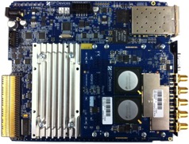
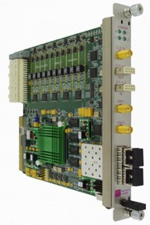

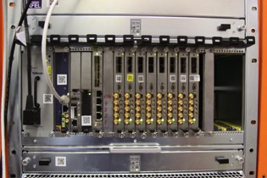
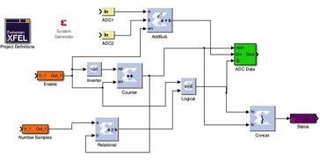


Digitizers, ADCs, Timing interfaces…
Digitizers (used in XGMs, PESs)
Fast ADCs (analog to digital converters)
Timing interfaces (in progress)
Simulink/Matlab based FPGA programming framework with Karabo integration
ADQ 412 (SP-Devices)
SIS8300 – ADC AMC
(Struck Innovative Systems)
MicroTCA crate
XML FILE
  User Registers and Memories Description
Software
(Karabo)
Source Files
  with script
Final Design
  Bus protocol logic generated automatically
Courtesy of P. Geßler
FPGA compiler/tool

Slide 11
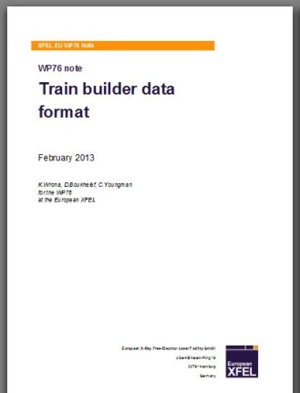
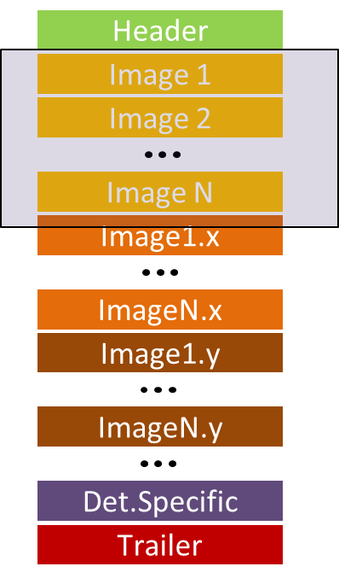
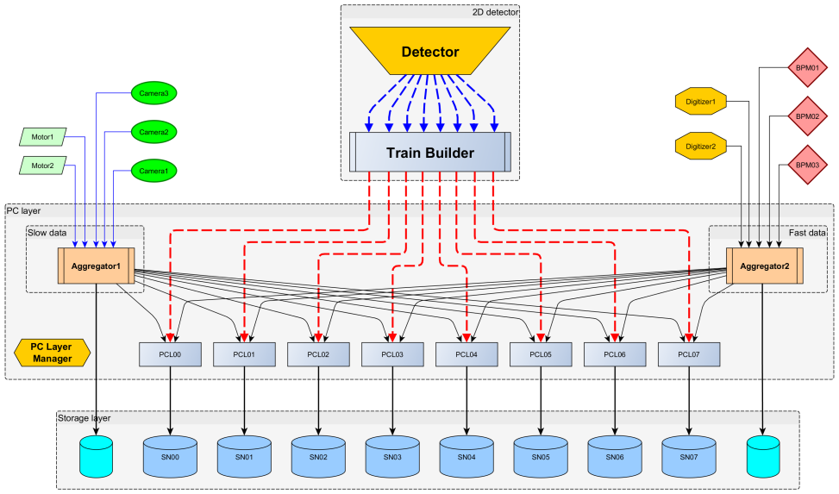
DAQ - Software strategy
High speed data acquisition including semi real time O(sec) data processing and formatting
  XFEL train data format (XTDF) defined to ensure coherent handling of data from 3 types of 2D detectors
  Network UDP protocol over 10Gbps switched network to receive data from FPGA based data sources
  TCP based protocol (Karabo P2P) for data sources managed by software (e.g. slow cameras)
  PC layer h/w and s/w receiving, processing, formatting and recording data (up to 1GByte/s per single data channel)

Slide 12
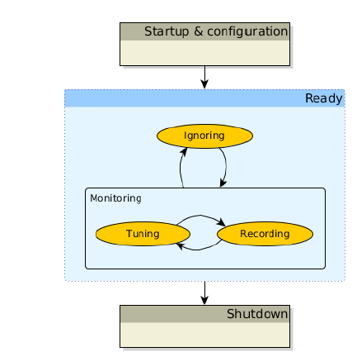
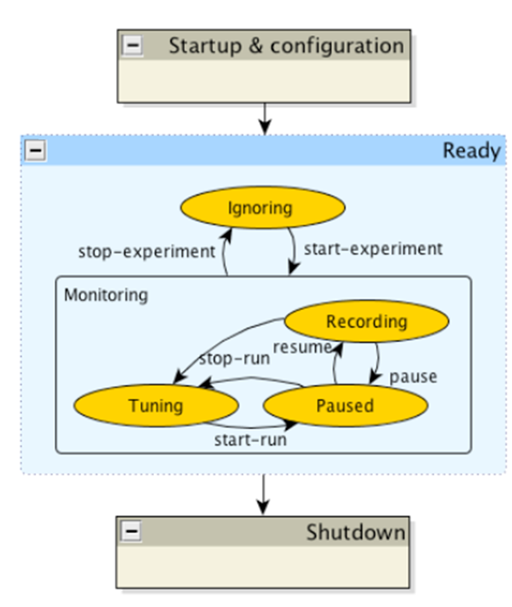
DAQ – Taking data in runs
  Passive recording vs. active (scan-)script driven recording
    Passive mode: Data acquisition is performed until the end of run, i.e. in one way
    Active mode: A central script defines segments within the run process when data is to be recorded, otherwise (e.g. changing devices parameters, moving motor, etc.) data is only monitored
Access to run data within the same run for conditional (scan-)script execution should be possible

Slide 13
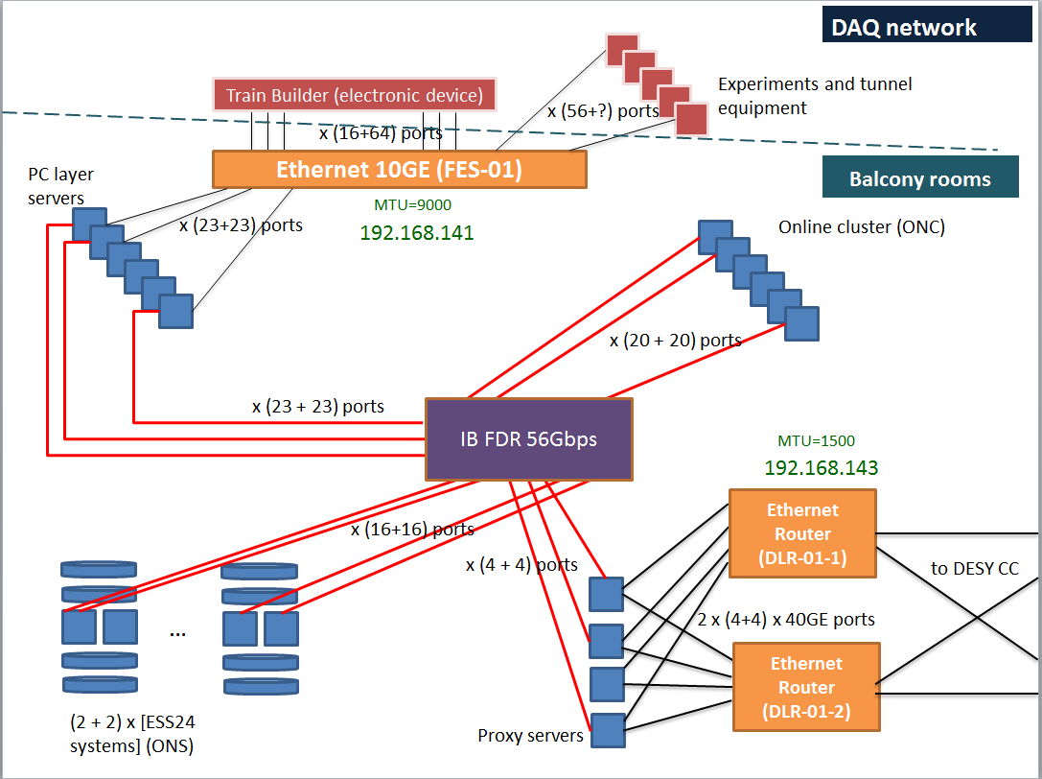
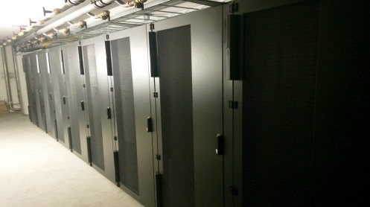
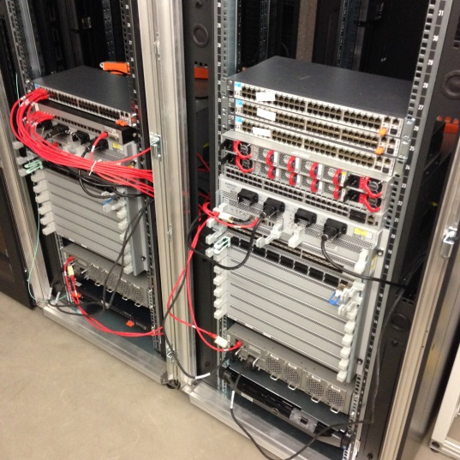
DAQ – Network strategy
Incoming/outgoing data streams over 10GE/40GE ethernet based network
Locally IB network for transferring data between computing and storage nodes
Control and DAQ network are separated

Slide 14
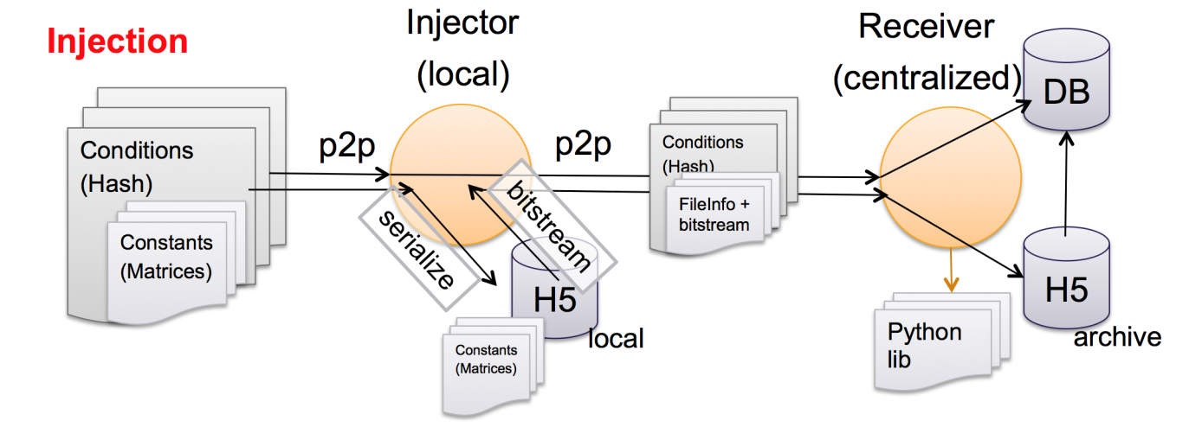
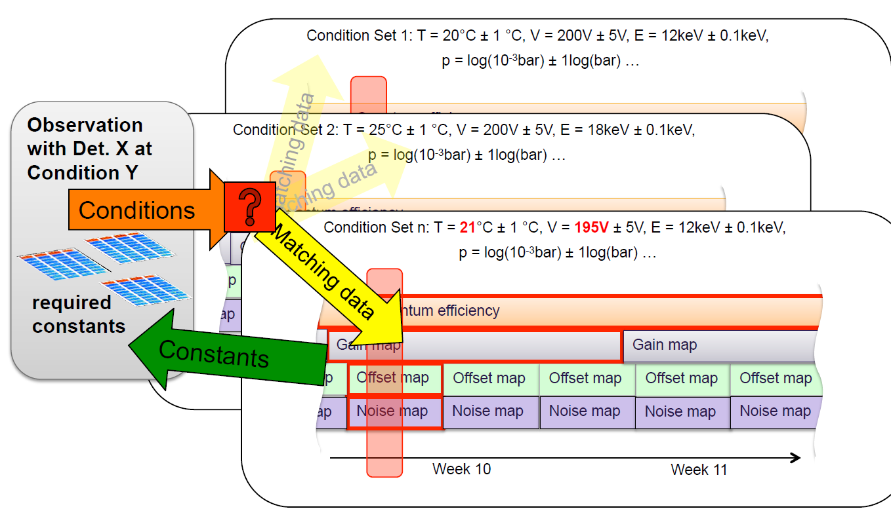
Calibration strategy
Calibration constants injection and retrieval controllable by Karabo devices
Huge systems in the back-end
Initial system exists and is functional
More work for simplifying the configuration via Karabo is needed

Slide 15
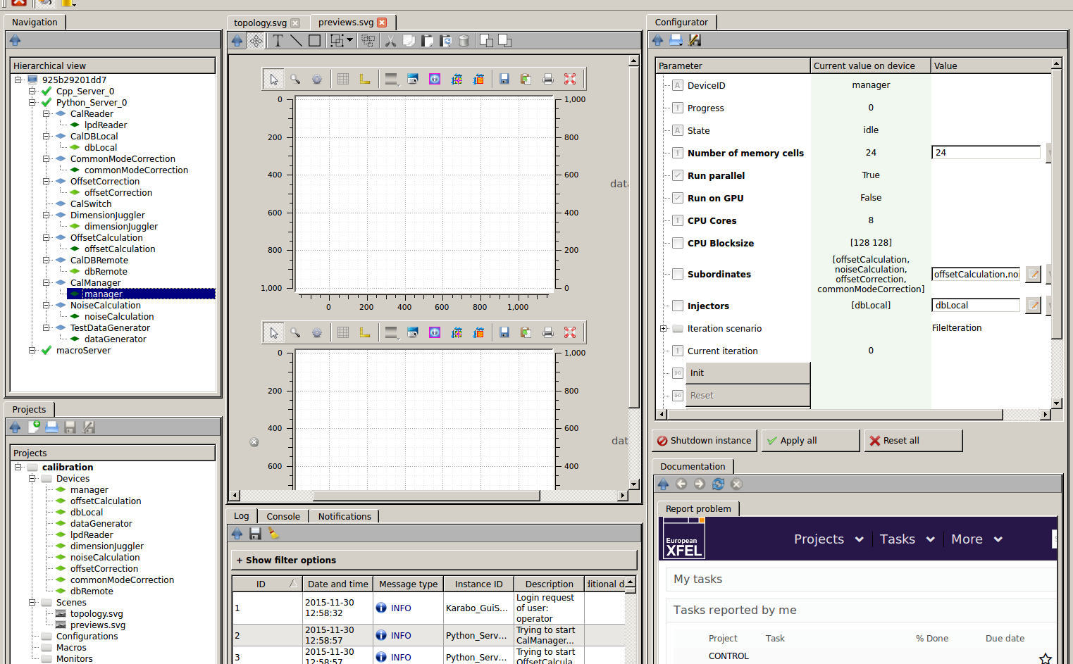
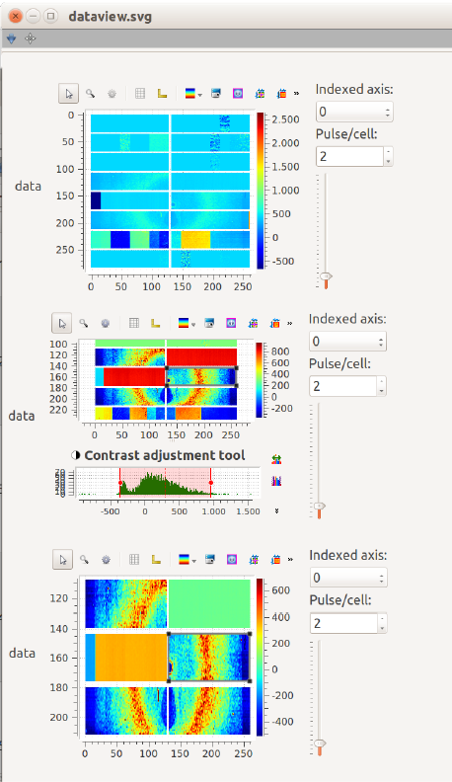
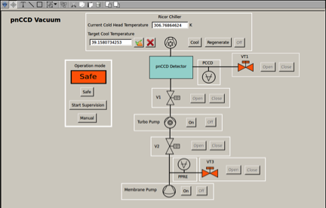
User interfaces – GUI

Slide 16
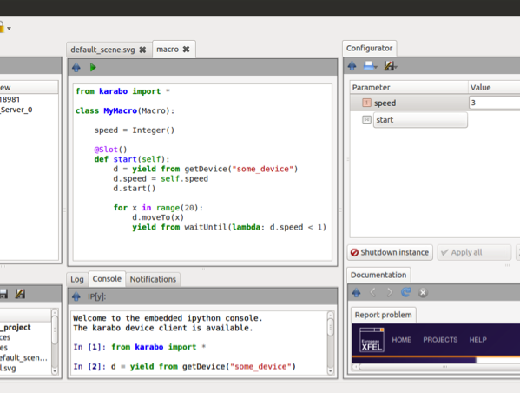
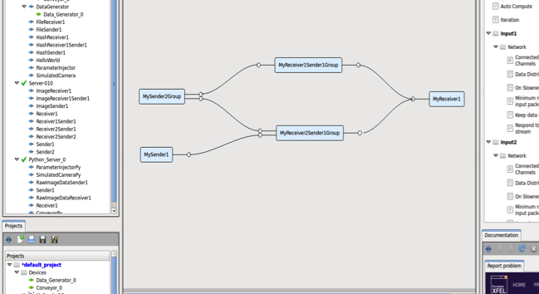
User interfaces – Macros and Pipelines
Macro editing
  Editing and execution from within GUI or using regular terminal
  Macro parameters and functions integrate automatically into configuration panel
  Macro API can be interactively executed in embedded IPython interpreter
  Macro writing is something we hope our users can easily do themselves
Pipeline configuration
  Whole devices can be dragged (from left side) as pipeline nodes
  Dragging individual parameters from right is still possible (e.g. control parameters)
  Devices can be grouped and edited as group (connections and configurations)
drag & drop

Slide 17
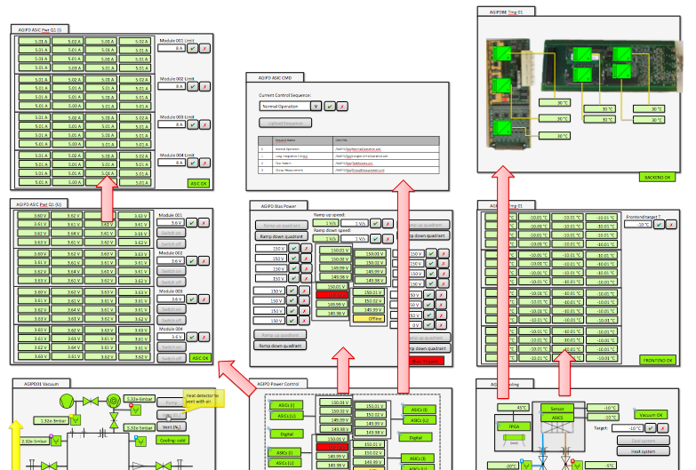
Detector Integration – Story Board

Slide 18
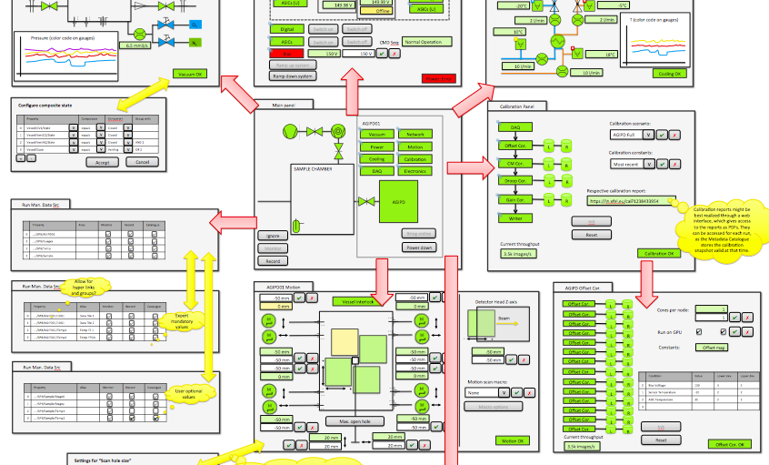
Detector Integration – Story Board
End-to-end test scheduled for May, 2016

Slide 19
Conclusions
Software layer (Karabo) will be ready and usable for simple control during installation and commissioning
Much effort goes into the graphical user interface of Karabo (scene-scene linkage, powerful configuration, etc.)
Beckhoff firmware is currently under extensive testing and stabilization and will be ready for installation and commissioning
Many interfaces have to be aligned into a big picture (fast electronics, slow control, detector read out, calibration)
The detector end-to-end tests will force this alignment and test the system as a whole

Slide 20

Thank you for your kind attention.
Contact details: burkhard.heisen@xfel.eu

Slide 21
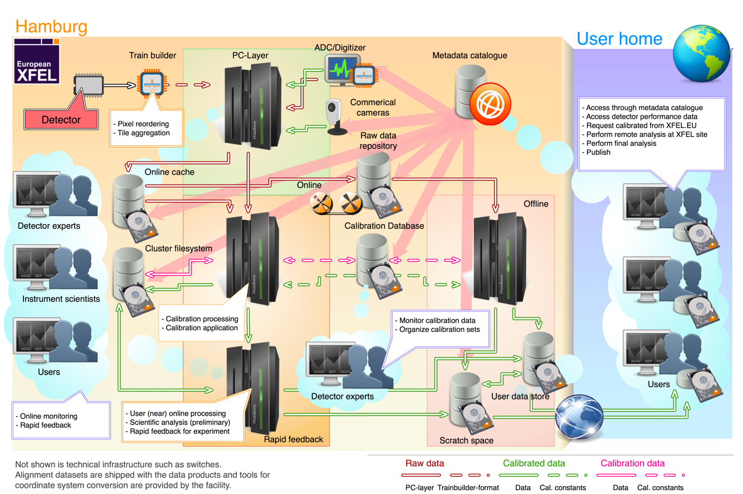
Logical (data) infrastructure
Courtesy of S. Hauf

Slide 22
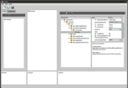


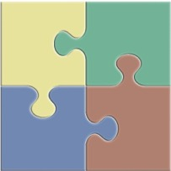
Technical realization (Karabo)
DAQ
Equipment
Equipment
Control
DAQ
Equipment
User interface(s)
Service
Device
e.g. 2D-detectors (AGIPD, LPD, DSSC)
e.g. motor, pump, valve, sensor
DAQ
Control
e.g. commercial camera
e.g. calibrationManager, configurationManager
Data Storage
Node
DM
DA
Message Broker
Composite
Device
Analysis
Node
e.g. storage of data from runs
e.g. calibrationManager, projectManager, GUI server
e.g. complex detector motion control

Slide 23
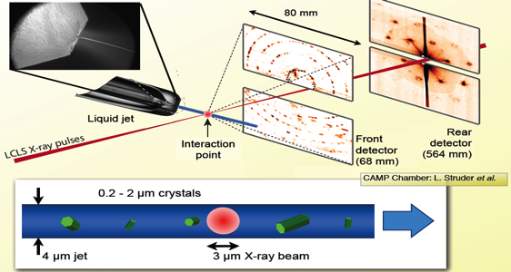
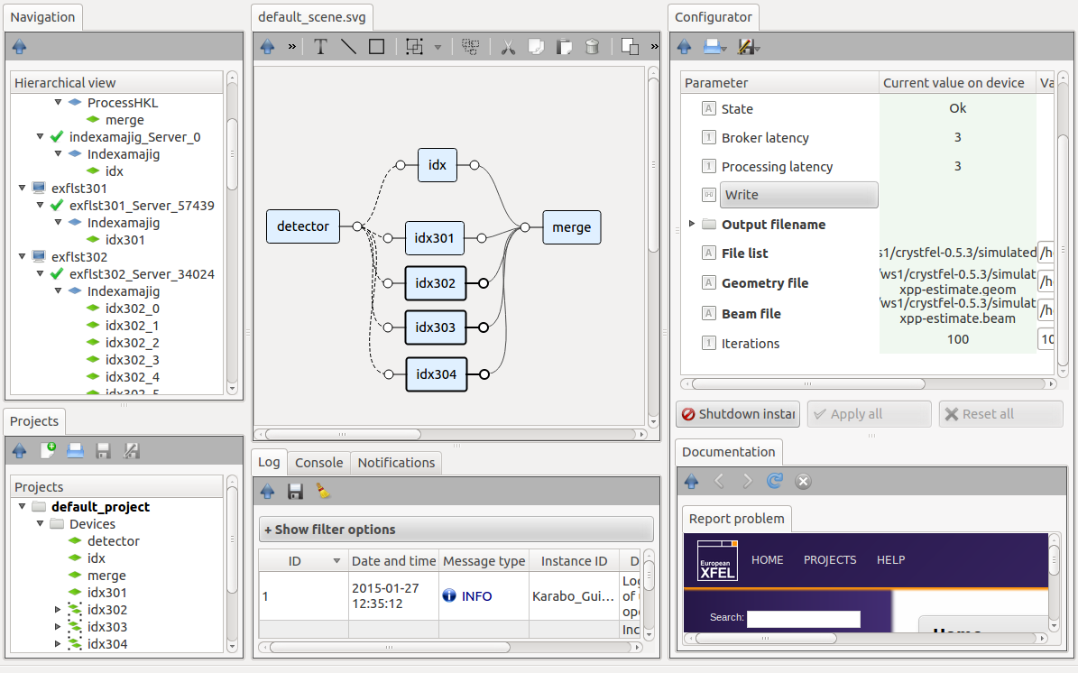
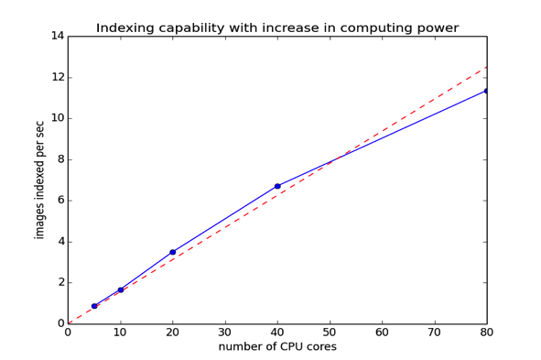
Online computing, data analysis…
Serial femtosecond crystallography
  Aim is to build an SFX data processing pipeline to match the high repetition rate offered at the European XFEL
  5000 images/sec
  @ 2.3 sec per image
  30% hit rate
  3500 cores needed
Linear speed up with number of cores!
Courtesy of C. Yoon

Slide 24
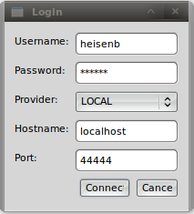
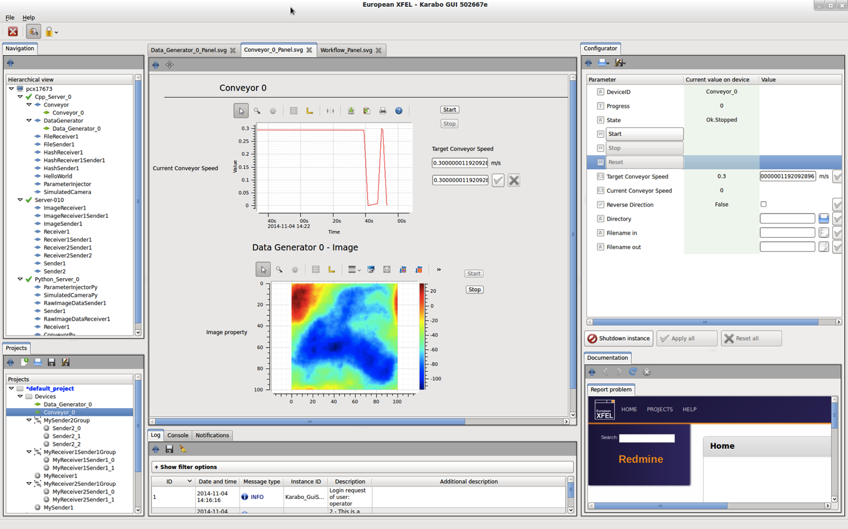
Graphical interface - Overview
Live Navigation
drag & drop
Configuration
Custom Scene
User centric and access-controlled setup (login at startup)
Dock-able and resizable multi-panel, all-in-one user interface
Live navigation showing all device-servers, plugins, and device instances
Automatically generated configuration panel, allowing to read/write/execute
PowerPoint like, drag & droppable, tabbed custom scene
Project panel for persisting configurations, macros, scenes, resources, etc.
Centralized logging information, notification handling, documentation, etc.
Log Messages
Interactive Command Line
Documentation
Bug Reporting
Project

Slide 25
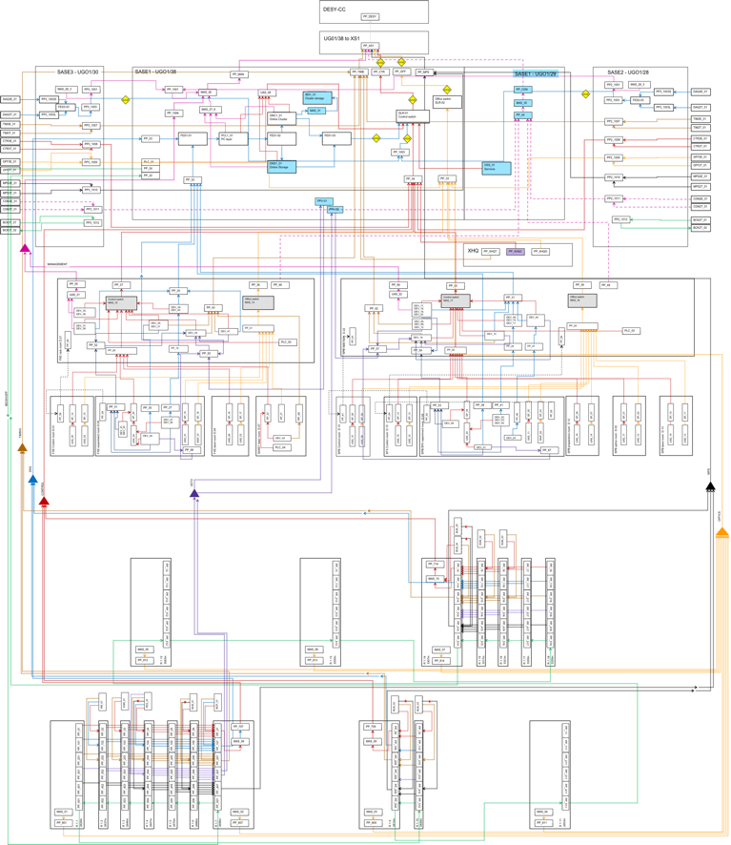
Physical (network) infrastructure (i.e. SASE1)
DESY Computer Center / XS1
Balcony Rooms
Rack Rooms
Experiment/Control/Laser Hutches
Tunnels
Courtesy of C. Youngman

Slide 26
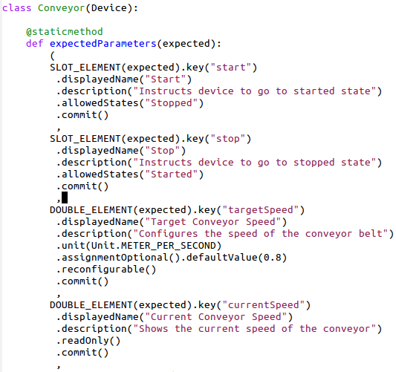

Device – As controllable object
  Device classes can be loaded at runtime (plugin technology)
  Can be written in C++ or Python
  Devices completely describe themselves. Allows automatic GUI creation
  Runtime-extension of properties, commands and attributes is possible
  Hierarchical groupings of parameters are possible
  Any property setting or command execution can be restricted to a set of allowed states
  The GUI reflects state limitations by enabling/disabling buttons and properties dynamically
Command
Attribute
Property
auto generated

Slide 27
Device – As pipeline module
Devices can act as modules of a streaming data pipeline
  Configurable generic input/output channels on devices
  Developers just need to code the onData and (optionally) the onEndOfStream method
  IO system is decoupled from processing system (process whilst transferring data)
  Input channels configure whether they share the sent data amongst all input channels or whether they receive a copy of each data token
  Broker-based communication transparently establishes a point-to-point connection
  Any pipeline device has full access to the live control-system (feedbacks easily possible)
Memory
Multi-threaded processing
TCP
Distributed processing

