Slide 1



High field studies for CLIC accelerating structures development
Iaroslava Profatilova
CERN/Institute of Applied Physics NAS of Ukraine
Supervisor: Walter Wuensch
23 August 2016 CERN-BINP workshop

Slide 2
OUTLINE
MOTIVATION
SIMPLE BREAKDOWN MODEL
STUDYING BREAKDOWNS IN DC AT CERN
COMPARISON OF CONDITIONING PROCESSES
FUTURE PLANS

Slide 3
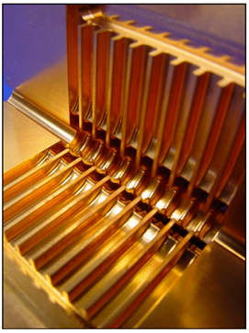
MOTIVATION
CLIC is a CERN-based e+e- future linear collider, a high accelerating gradient of 100 MV/m using a novel two-beam method should be achieved.
Accelerating concepts for the CLIC machine have been demonstrated at a dedicated test facility at CERN (CTF3).
The maximum accelerating gradient that can be achieved is limited by:
Ohmic losses in the conductor surface;
Breakdown
The CLIC accelerating gradient target of 100 MV/m, pulse length of around 200 ns and breakdown rate (BDR, i.e., number of pulses with breakdown divided by total
number of pulses) in the range of 10⁻⁷ 1/pulse/m is now routinely achieved in prototype CLIC accelerating structures.

Slide 4
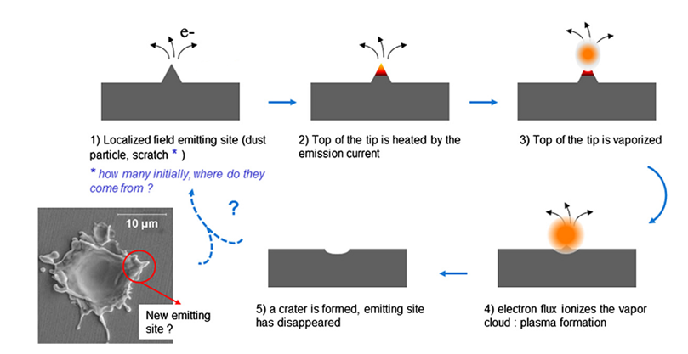
Mechanism of Breakdown
The understanding of breakdown phenomena may help to find the way for minimize the breakdown probability.
Notes:
The current flowing through this tip heats it up when the electric field is applied. With ohmic heating of the field emitter caused by the emitted current flowing through the tip, field emission of neutral atoms into vacuum starts.
Ionization of the liberated neutrals by collisions with emitted and accelerated electron current. The surface impact ionization and the resulting increase in electron current will then lead to a fast increase in the ionization density of the gas above field emitter.
The increases the ion and neutrals density and creates a fast growing plasma sheath above the field emitter tip.

Slide 5
Advantages of study breakdowns in DC
Complement for RF
Simple electrodes
Simple generator
Easier diagnostics
Inexpensive
Faster tests
Main question:
Are they really comparable?

Slide 6
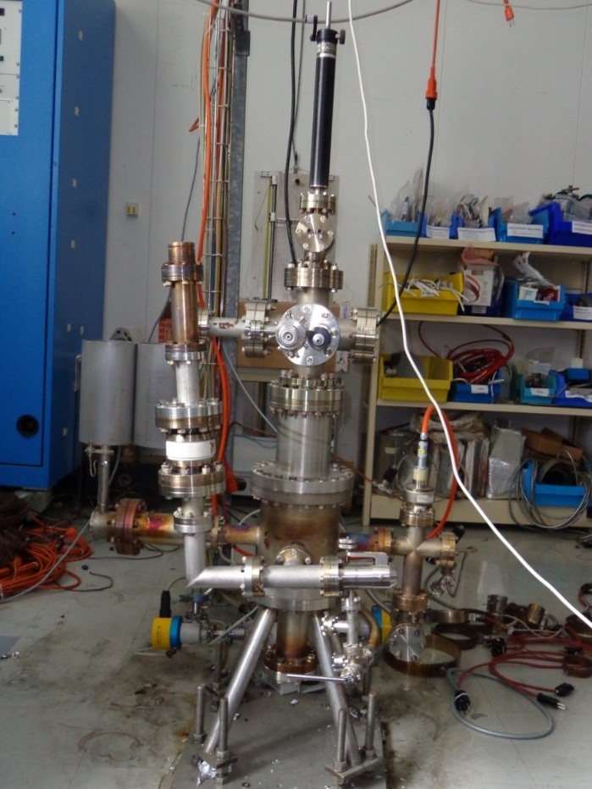
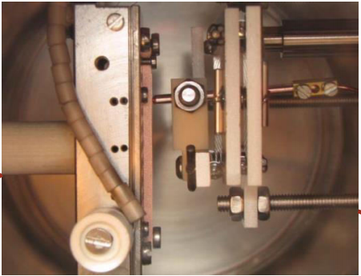
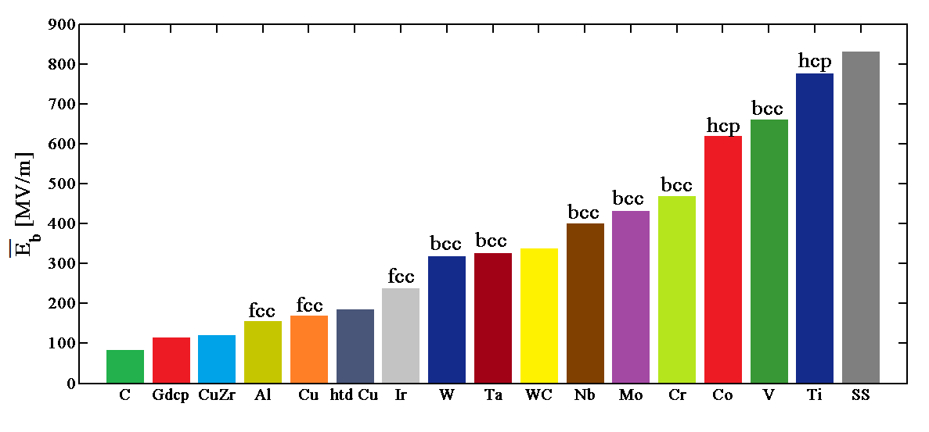
DC breakdown study at CERN
Main results:
Electrical breakdown strength for different materials.
Field emission measurements.
Optical spectroscopy.
Fig. 6. 1. Old DC-spark system at CERN.
Fig. 6.2. Previous experiments performed in the CERN DC Spark Systems have ranked materials by their electrical breakdown strength. For pure metals, their crystal structures are indicated (fcc = face-centred cubic, bcc = body-centred cubic, hcp = hexagonal closest packing) on the top.

Slide 7
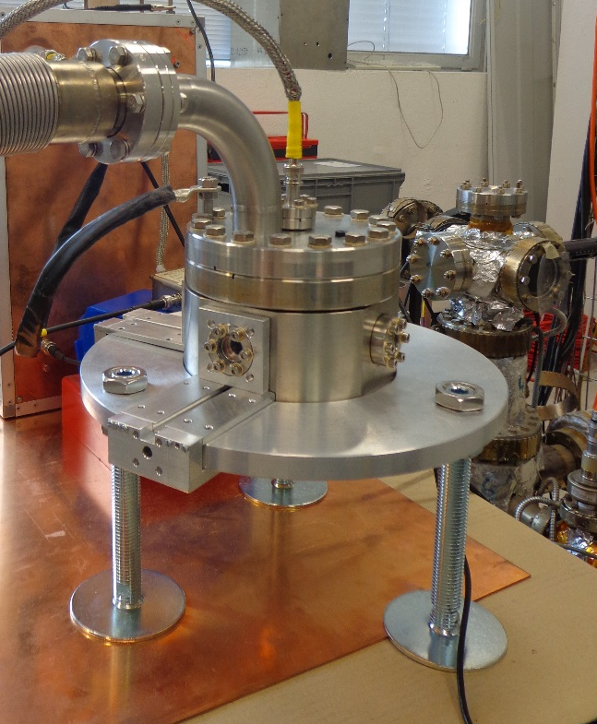
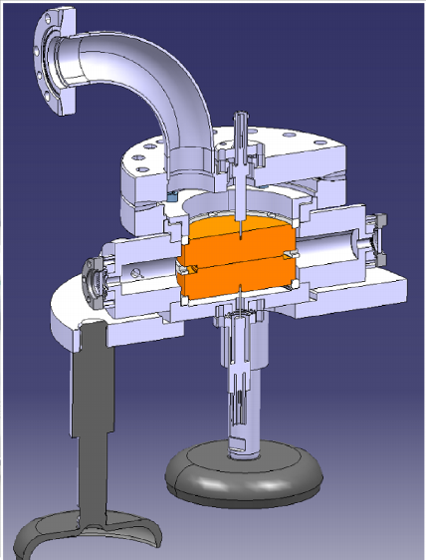
New DC pulsed systems at CERN
Vacuum system | Generator
Working surface is 60 mm² | Max voltage is 12 kV
Usual gap distance is 60 µm | Frequency up to 1kHz
Pressure in the chamber is ~ 1×10⁻⁹ mbar | Pulse length ~ 20 us

Slide 8
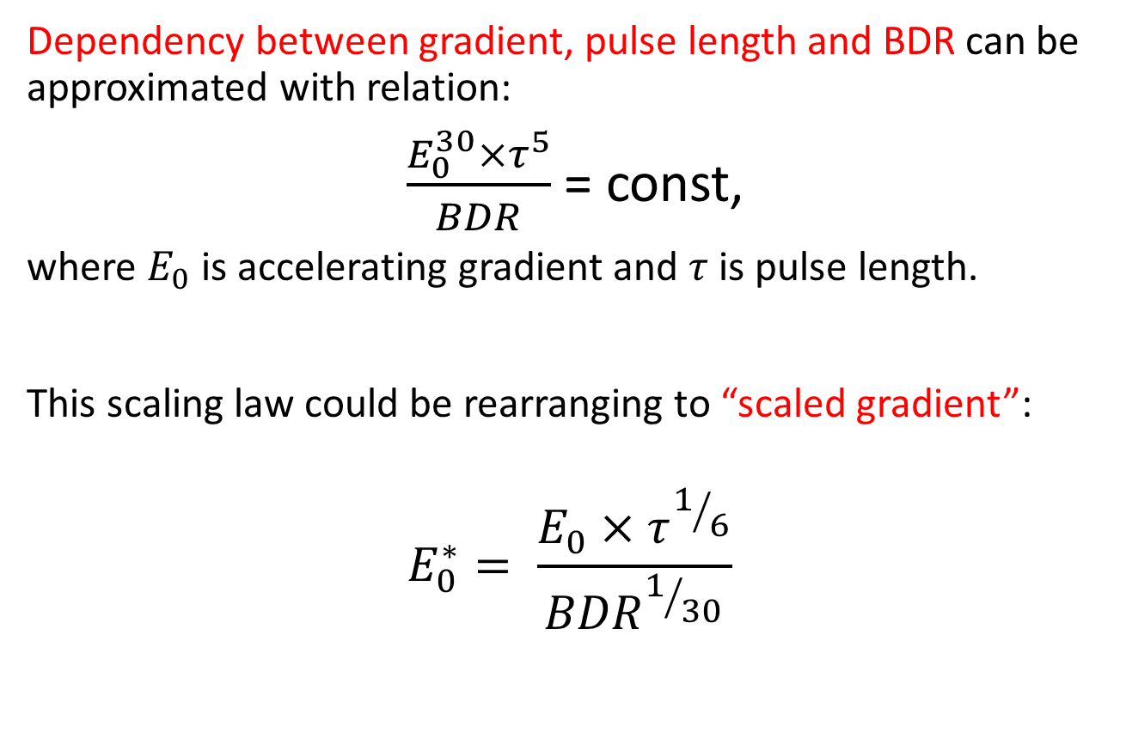
DATA ANALYSIS BACKGROUND
Dependency between gradient, pulse length and BDR can be approximated with relation:
$\frac{E_{0}^{30}×τ^{5}}{BDR}$ = const,
where $E_{0}$ is accelerating gradient and $τ$ is pulse length.
This scaling law could be rearranging to “scaled gradient”:
$$E_{0}^{∗}= \frac{E_{0}×τ^{1/6}}{{BDR}^{1/{30}}}$$

Slide 9
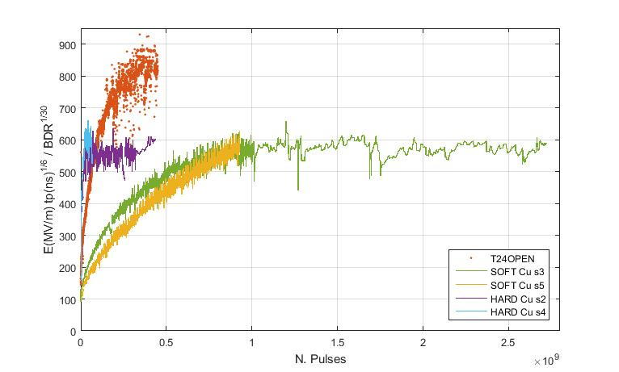
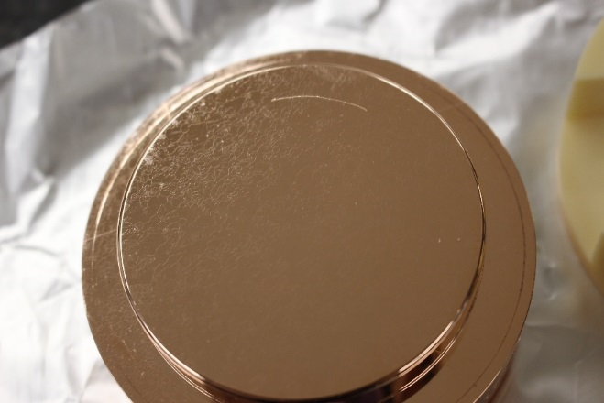
COMPARISON OF CONDITIONING PROCESSES
From this figure we can see that both, RF and DC conditioning, have a similar tendency. The overall difference of the field level still has to be resolved.
For references whithout appliyng scaled the electric field in DC correspond to 70 MV/m and in the RF 220 MV/m.
RF
DC
Fig. 9. Comparison of RF and DC Scaled electric field vs the number of pulses.
… courtesy of Jourge Giner Navarro, Anders Korsback
and Laura Mercadé Morales

Slide 10
Future plans DC pulsed systems
Pulse length dependency with a new generator.
Comparison of conditioning process.
Field emission measurements.
Test different materials (Cu with different methods of treatment, Diamond Like Carbon Coated Cu, Nb, He⁺ implanted Cu, 3D-printed Ti electrodes etc.
Breakdown localization (using cameras, using accelerometers).

Slide 11
Thank you!

Slide 12
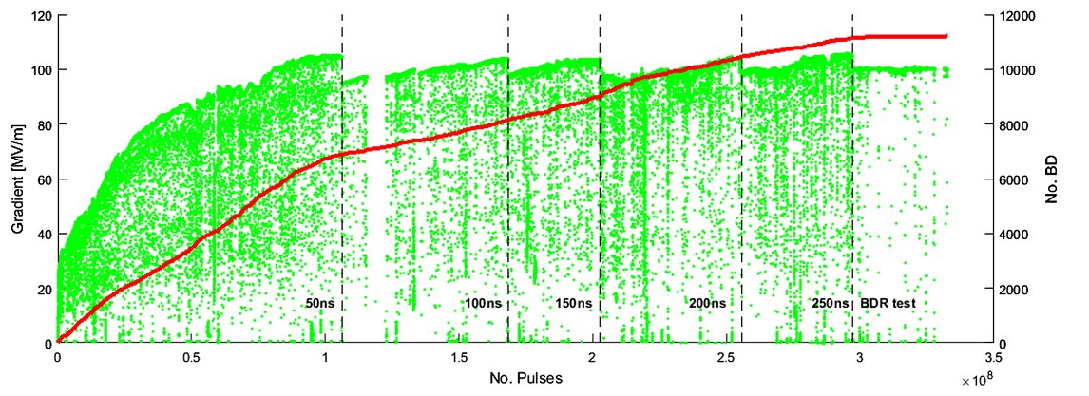
Data from Conditioning process in RF
FIG. 12. Summary of CERN TD26CC raw data. The green dots represent the unloaded gradient (left axis) excited into the structure as a function of the number of pulses. The red solid line indicates the cumulated number of breakdowns (right axis). The dots that fall below the envelope are due to the power ramping applied after a breakdown event. For the rest of the analysis these points have been discarded. The changes in pulse widths are indicated by vertical lines. (A. Degiovanni, W. Wuensch, J. Gi. Navarro, PHYSICAL REVIEW ACCELERATORS AND BEAMS 19, 032001 (2016)).

