Slide 1
Status of the Detector Development Program M. Kuster for WP75
May 23, 2016 20th Meeting of the European XFEL Detector Advisory Committee European XFEL GmbH, Hamburg

Slide 2
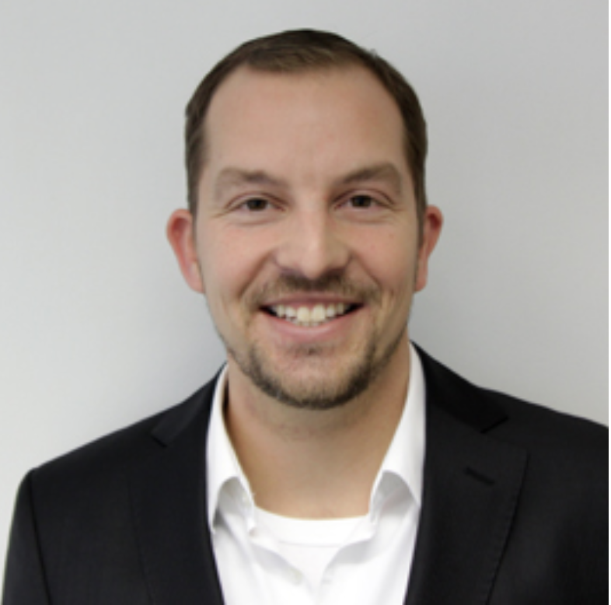
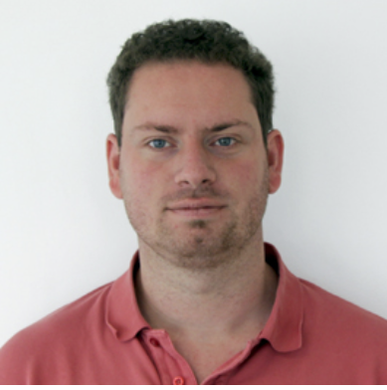
Changes in CAS and Impact on WP75
B. Heisen resigned from group leadership position of CAS and as Karabo chief architect.
As interim solution the Karabo architecture tasks have been transferred to S. Hauf (WP75 Software and Analysis)
Works part time for WP75 in order to keep his activities there alive and stays affiliated with WP75
Consequences for WP75 to be evaluated as soon as Karabo plans and priorities are defined
Agreed with XFEL management
Review of the scope and time line of the measure by the ma-nagement board in August 2016 and decision by the MB about the next steps

Slide 3
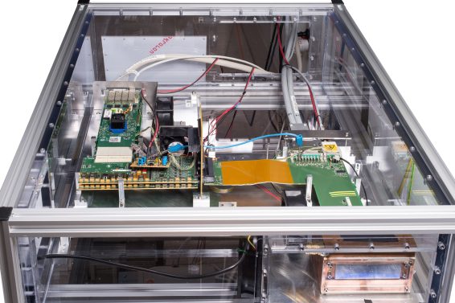
Adaptive Gain Integration Pixel Detector – AGIPD
Achieved Progress (Management)
Monthly project status reports (November 2015 – April 2016) have been delivered to XFEL
Contract about the 2nd 1MPix + spare parts has been signed
Cost neutral prolongation for 1st AGIPD detector finalized and signed
Project review with XFEL management April 26th
Achieved Progress (Technology)
Basic interlock concept defined
Dry N₂ box produced and cooling installed in HERA South (for operation of module at low temperatures)
Motion system tests are planned for June and preparation of control hardware is ongoing
C&C tests with single module in preparation
Veto test setup with LED prepared and first tests are in progress (feasibility demonstrated)
AGIPD Single Module in N₂ Box at HERA South

Slide 4
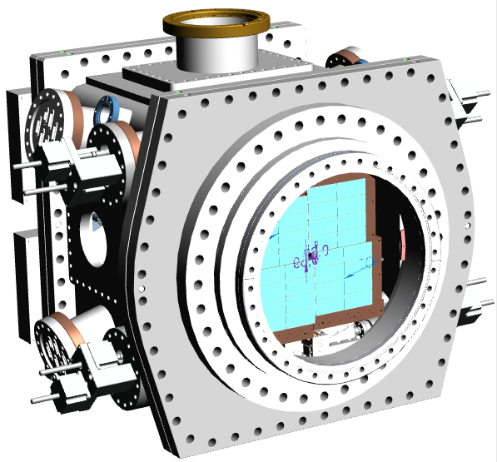
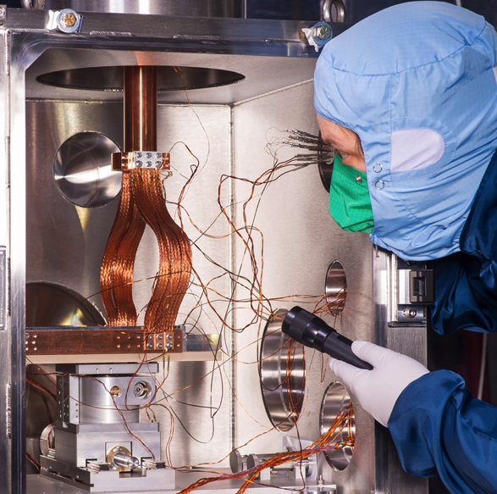
DePFET Sensor with Signal Compression – DSSC
Achieved Progress (Management)
Project report 12(1) + updated project plan and DSSC Phase II D19: Draft calibration plan delivered to XFEL (work on update is in progress)
Project status reports have been delivered to XFEL
Project review with XFEL management April 26th
Achieved Progress (Technology)
Mechanics design of the vessel is about to be completed
The DSSC ladder vacuum test stand, FENICE, assembled, commissioned and operational
Vacuum qualification measurements of DSSC ladder components
and other general components routinely ongoing
DSSC 1 Mpx MiniSDD camera integration plan and schedule is
under preparation
Beam times at PETRA III and LABEC are under preparation
DSSC mechanics
FENICE and Ladder Module

Slide 5
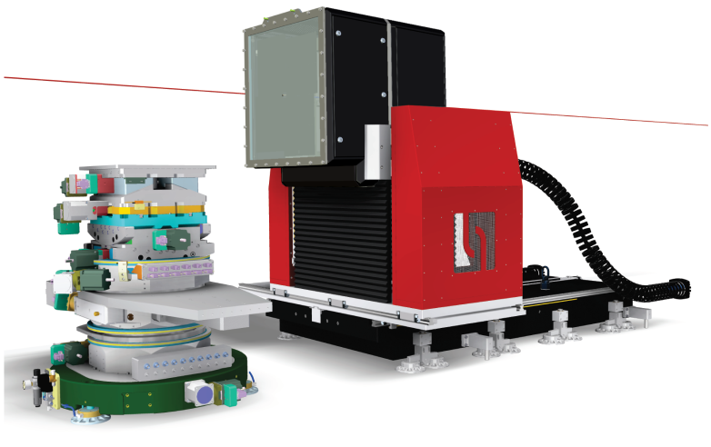
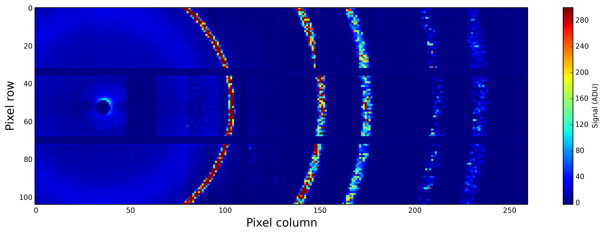
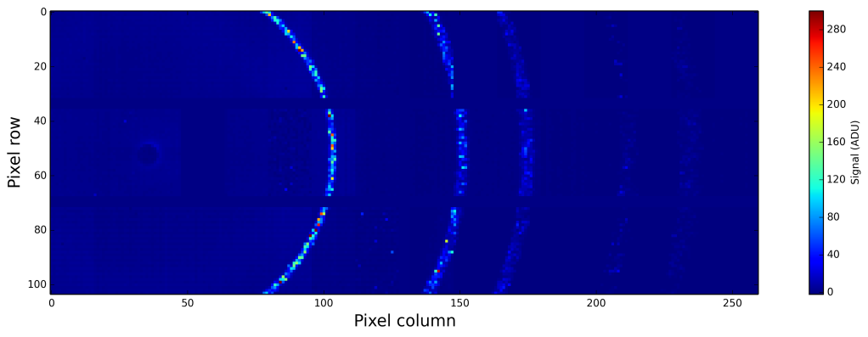
5
Large Pixel Detector – LPD
Achieved Progress (Management)
Project status reports have been delivered to XFEL
Project review with XFEL management April 19th
Achieved Progress (Technology)
Design of revised detector housing reviewed and approved – implementation started
Beam time at ESRF and APS analysis of data is finished
Demonstrated improved noise performance with new power card.
End-to-End test preparations are in full swing
Test of internal charge injection circuit for gain
calibration is in progress
Final Installation of LPD at FXE
Si Powder Diffraction Pattern in x10 and x1 gain

Slide 6
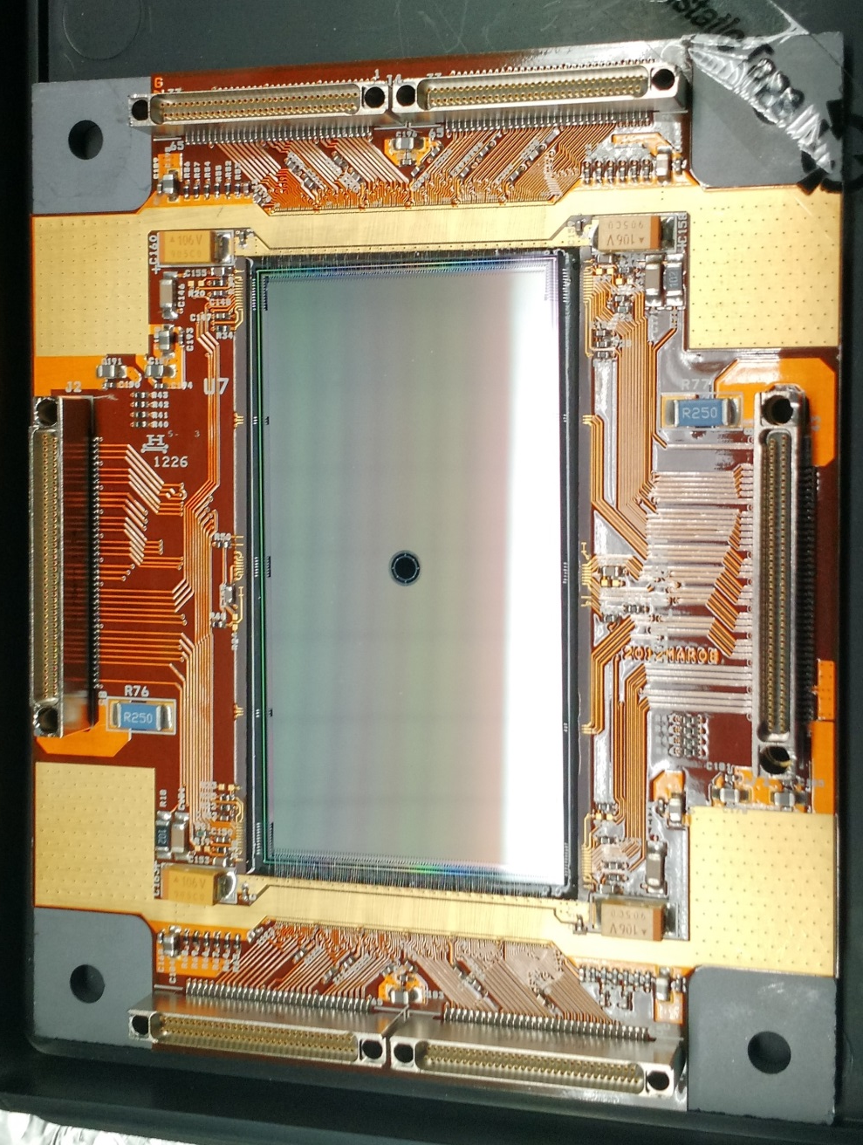
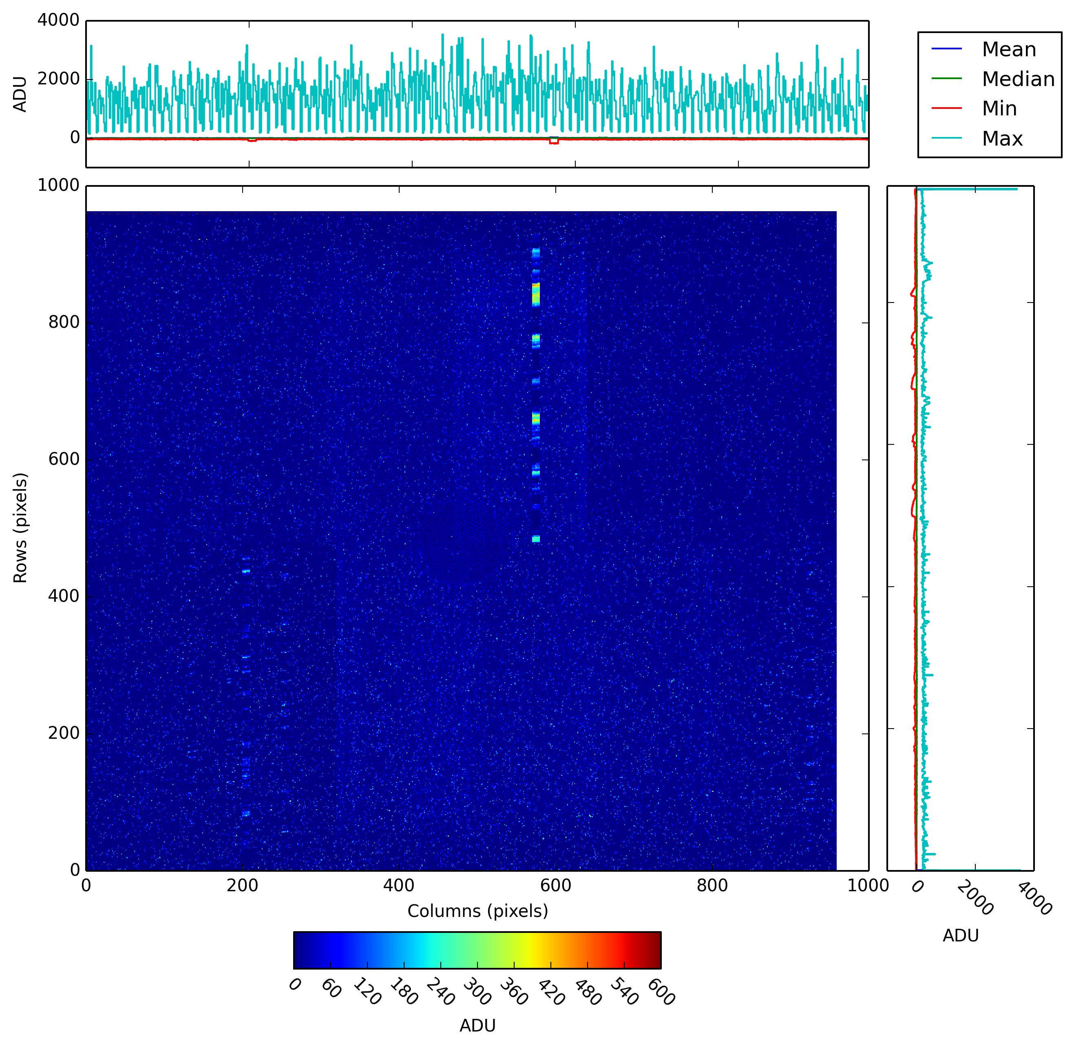
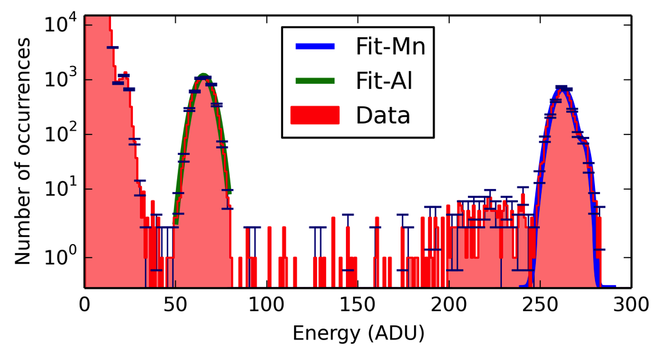
FastCCD
Achieved Progress
Camera assembled and tested (works with hole)
Data from tests available and being analyzed at XFEL
Camera to arrived at XFEL last week, commissioning is in progress
Detector integration into SCS experiment
Interface for SCS produced at LBNL and integration into SCS is under preparation at XFEL
Additional cooling adapter for more flexibility being designed at XFEL
Assembled Camera & Chip
Fe⁵⁵ Image
Fe⁵⁵ Spectrum
Vacuum chamber

Slide 7
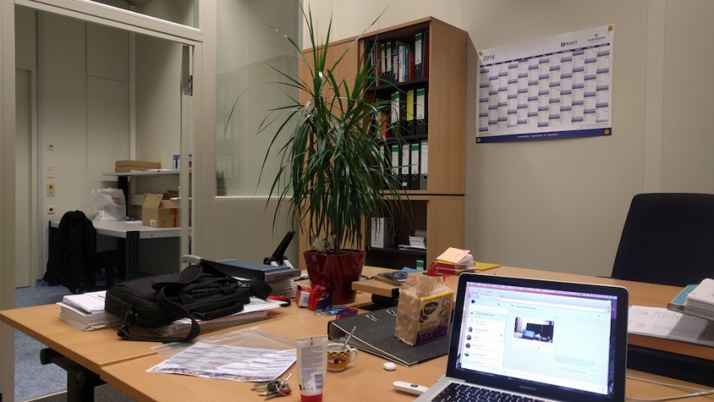
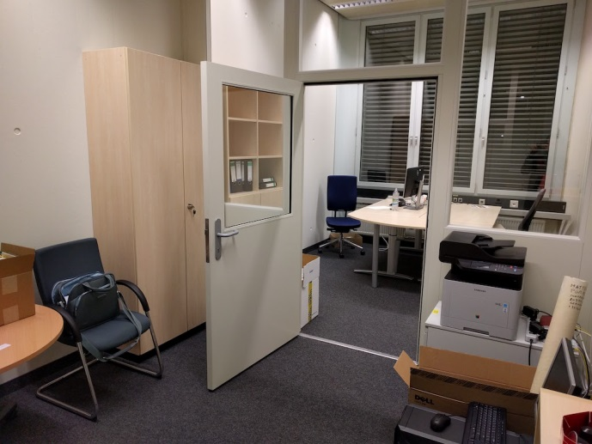
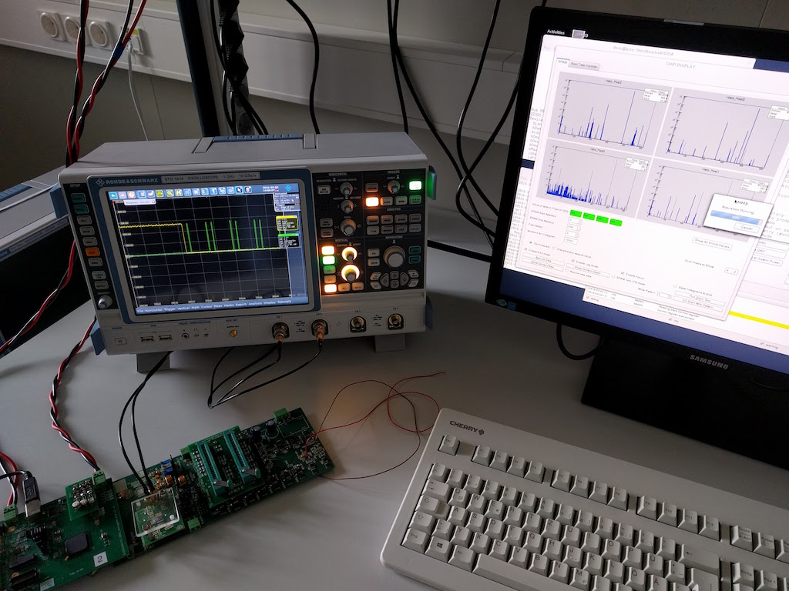
Detector Laboratory Munich
Achieved Progress (Management)
Rental contract for offices and laboratory signed
Application for usage of radioactive sources finalized
Achieved Progress (Technology)
Offices and laboratory refurbished
Munich group moved to Siemens Campus
IT infrastructure is installed
Small DSSC prototype test set-up working
Office and Laboratory in Munich (Siemens Campus)

Slide 8
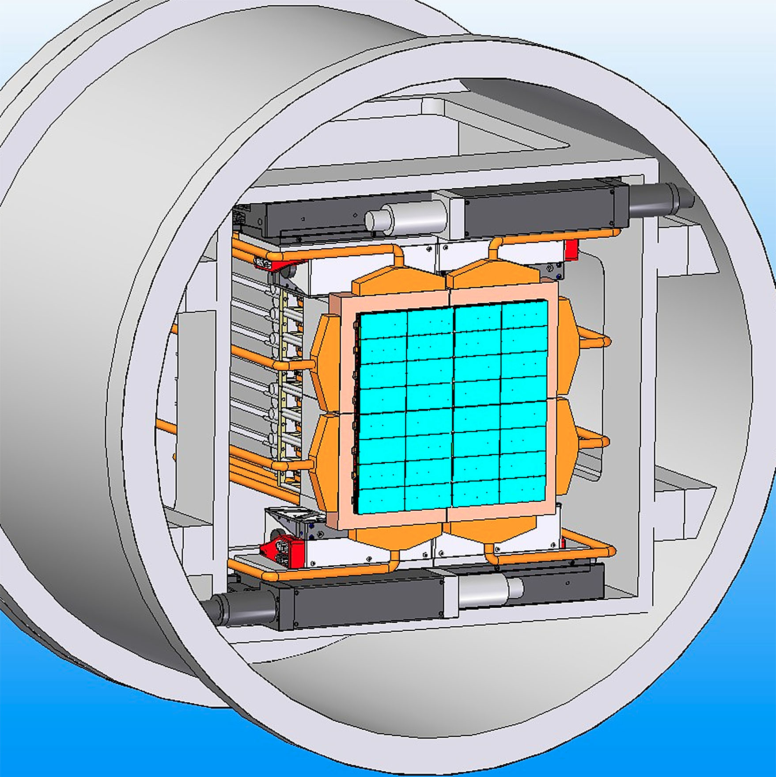
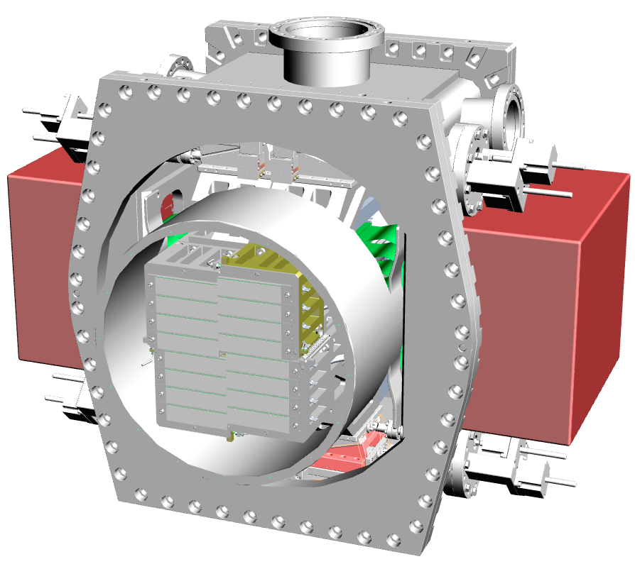
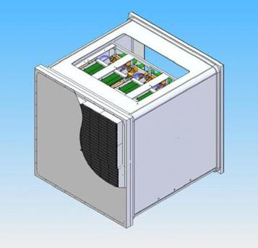
Reminder Base Line Detector Operation Modes – First Day
DSSC
AGIPD
LPD
 | Mode I | Mode II | Mode III
Read Out Frequency | 4.5 MHz
Photon Energy | 1 keV | 1.5 keV | 0.7 keV
Max # of ph/pulse/pixel | 3 x 10³ @1keV (maximum achievable)
Read Out Geometry | Full Frame
Single Photon Sensitivity | No
Alignment Precision | 1/10 of the pixel size (quadrant level)
Veto Capability | Yes
Memory | 800 Cells (full memory)
Mode I | Mode II | Mode III
4.5 MHz
8.3 keV# | 15 keV | 7 keV
10⁴ @12.4 keV (maximum achievable)
Full Frame
Yes 0.15 ph RMS Noise |  | No
1/10 of the pixel size
Yes
352 Cells (full memory)
Mode I | Mode II | Mode III
4.5 MHz |  | < 4.5 MHz
12 keV* | 20 keV | 12 keV*
> 10⁴ @12.4 keV (maximum achievable)
Full Frame
Yes 0.35 ph RMS Noise | Yes 0.21 ph RMS Noise | Yes$ < 0.21 ph RMS Noise
1/10 of the pixel size
Yes
512 Cells (full memory)
#Same performance is expected for 7 – 12 keV
*Same performance is expected for 7 – 9 keV
$Feasibility to be confirmed

Slide 9
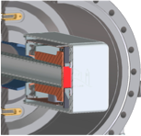
Reminder Base Line Detector Operation Modes – First Day
DSSC
AGIPD
FastCCD
 | Mode I | Mode II | Mode III
Read Out Frequency | 4.5 MHz
Photon Energy | 1 keV | 1.5 keV | 0.7 keV
Max # of ph/pulse/pixel | 3 x 10³ @1keV (maximum achievable)
Read Out Geometry | Full Frame
Single Photon Sensitivity | No
Alignment Precision | 1/10 of the pixel size (quadrant level)
Veto Capability | Yes
Memory | 800 Cells (full memory)
Mode I | Mode II | Mode III
4.5 MHz
8.3 keV# | 15 keV | 7 keV
10⁴ @12.4 keV (maximum achievable)
Full Frame
Yes 0.15 ph RMS Noise |  | No
1/10 of the pixel size
Yes
352 Cells (full memory)
Mode I | Mode II | Mode III
10 Hz
1 keV | 1.5 keV | 0.7 keV
2.5 x 10² @1 keV (maximum achievable)
Full Frame
Yes
1/10 of the pixel size
Not available
Not available
#Same performance is expected for 7 – 12 keV

Slide 10
Reminder Commissioning – Pulse Patterns
Required Pulse Patterns
Nominal Pulse Pattern
Single Pulse per Train
2700 Pulses
Pulse Train
Pulse Train
Pulse Train
Pulse Train
Time
100 ms (10 Hz)
Time
100 ms (10 Hz)
221.5 ns
598.4 μs
Two or More Pulses per Train
One Pulse Every Second Train
(10 Hz Detectors)
Pulse Train
Pulse Train
Pulse Train
Pulse Train
Pulse Train
100 ms (10 Hz)
Time
100 ms (10 Hz)
Time
221.5 ns or n x 221.5 ns

Slide 11
Commissioning – Start Up Operation
Start-Up 1.128 MHz Operation
Nominal Pulse Pattern
Multiple Pulses per Train 60-70
2700 Pulses
Pulse Train
Pulse Train
Pulse Train
Pulse Train
Time
100 ms (10 Hz)
Time
100 ms (10 Hz)
4x 221.5 ns = 886 ns spacing
598.4 μs
Minimize calibration effort ➔ operate detectors at nominal speed of 4.5 MHz
Use veto capability to adapt to different pulse patterns (discard empty frames to reduce data volume)
Full veto functionality required for end-2-end test, commissioning phase and day-1 operation!

Slide 12
Reminder – Detector Tests at HERA South
End-To-End Test
Goal of the Test
Demonstrate the functionality of the detector system including all subcomponents and identify potential problems before system acceptance and integration at beam line.
What will be Tested?
Vacuum, cooling and movement system
Detector control system
C&C and veto system
DAQ and data management system including calibration data base
Data processing pipeline and calibration pipeline
Detector operation modes I-III for first day operation (priority)
Data and calibration data quality checks
Where and How will be Tested?
HERA South: Big Amber
Data taking with and without X-rays
Sequentially all four quadrants of a detector at full speed 4.5 MHz
What is required?
Vacuum, cooling and movement system
Detector control, C&C and veto system
DAQ/data management system including calibration data base
Data processing pipeline and calibration pipeline

Slide 13
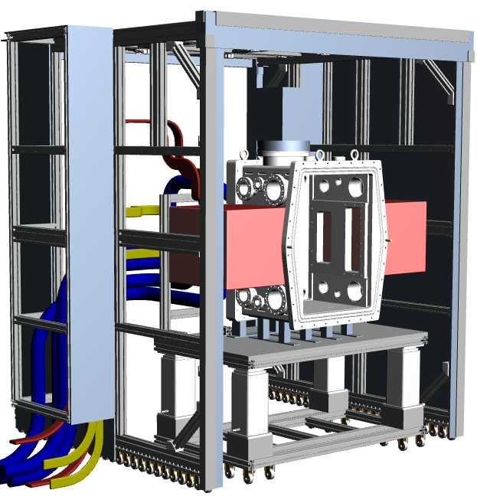
End to End Test – Test Scenario
Step 1: Transport of detector to HERA South
Mechanically install detector, connect to power supplies and control system, functional tests of all components
Step 2: Detector vacuum system tests
Pump system to nominal operation pressure, cool detector, determine leak rate of vessel, RGA analysis
Step 3: Test of safety system and procedures
Detector shutdown procedures, SIB/interlock logic or other safety mechanisms implemented in the detector
Step 4: Detector motion system tests
Test of control system interplay with motion mechanics, limit and safety switch tests, maintenance positions, operation positions etc.
Step 5: Timing and Clock & Control system tests
Test of C&C system, synchronisation and veto mechanism
Step 6: Performance verification measurements without X-rays
Test of interplay with data bases, control/DAQ system, data taking macros, performance of baseline operation modes (dark, noise, bad/noisy/dead pixels, internal calibration circuit …), analysis of data …
Step 7: Measurements with X-rays
Test of interplay with data bases, control/DAQ system, analysis of data, performance measurements as far as possible with continuous X-ray source
AGIPD 1M Installed in Big Amber
AGIPD X-ray Window Flange

Slide 14
End to End Test – Preparation in HERA South
LPD/AGIPD DAQ and power cables: specified and procurement is in progress
Support table for LPD/AGIPD 1Mpix in Big Amber: designed, components are ordered and assembly is ongoing
C&C System: installed in Hera South and first tests with LPD were successful
Macros: first LPD test are adapted and implemented
Veto system: first tests were performed and test setup for LPD/AGIPD is in preparation
AGIPD control system: power supplies integrated in Karabo and hardware tested
AGIPD laboratory vacuum system: procurement of vacuum components on-going and control system requirement document finalized (different to beam line)
AGIPD laboratory cooling system: design finalized and procurement is in progress
AGIPD motion system: design of the final control system is in progress
AGIPD 1M Installed in Big Amber

Slide 15
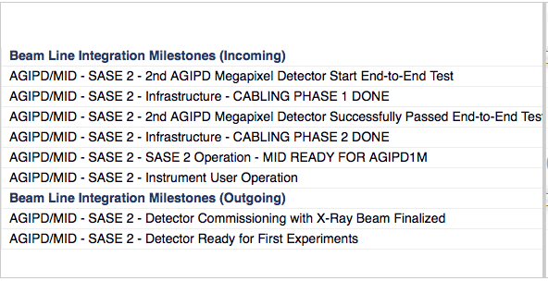
Detector Integration Milestones SASE I – III
AGIPD 1 Mpixel Detector at SPB
Start AGIPD
Installation at SPB
AGIPD
End-To-End Test
HERA South
Delivery 1st AGIPD
LPD 1 Mpixel Detector at FXE
Start LPD
Installation at FXE
AGIPD
Ready for First Experiments at SPB
SPB Instrument User Operation
LPD
End-To-End Test
HERA South
Delivery LPD
LPD
Ready for First Experiments at FXE
FXE Instrument User Operation
AGIPD 1 Mpixel Detector at MID
MID Instrument User Operation
2nd AGIPD
End-To-End Test
HERA South
Delivery 2nd AGIPD
Start AGIPD
Installation at MID
AGIPD
Ready for First Experiments at MID

Slide 16
Detector Integration Milestones SASE I – III
AGIPD 1 Mpixel Detector at SPB
Start AGIPD
Installation at SPB
AGIPD
End-To-End Test
HERA South
Delivery 1st AGIPD
LPD 1 Mpixel Detector at FXE
Start LPD
Installation at FXE
AGIPD
Ready for First Experiments at SPB
AGIPD Instrument User Operation
LPD 1 Mpixel Detector
01.10.2016 Start end-to-end test in HERA South
+12 weeks Finish end-to-end test in HERA South and start installation at FXE
1st AGIPD 1 Mpixel Detector
31.08.2016 Start end-to-end test in HERA South
+12 weeks Finish end-to-end test in HERA South and start installation at SPB
LPD
End-To-End Test
HERA South
LPD
Ready for First Experiments at FXE
FXE Instrument User Operation
AGIPD 1 Mpixel Detector at MID
MID Instrument User Operation
2nd AGIPD 1 Mpixel Detector
January 2017 start end-to-end test in HERA South (to be confirmed)
+12 weeks Finish end-to-end test in HERA South and start installation at SPB
2nd AGIPD
End-To-End Test
HERA South
European XFEL urgently needs reliable detector delivery dates based on realistic estimates!!!
Start AGIPD
Installation at MID
AGIPD
Ready for First Experiments at FXE

Slide 17
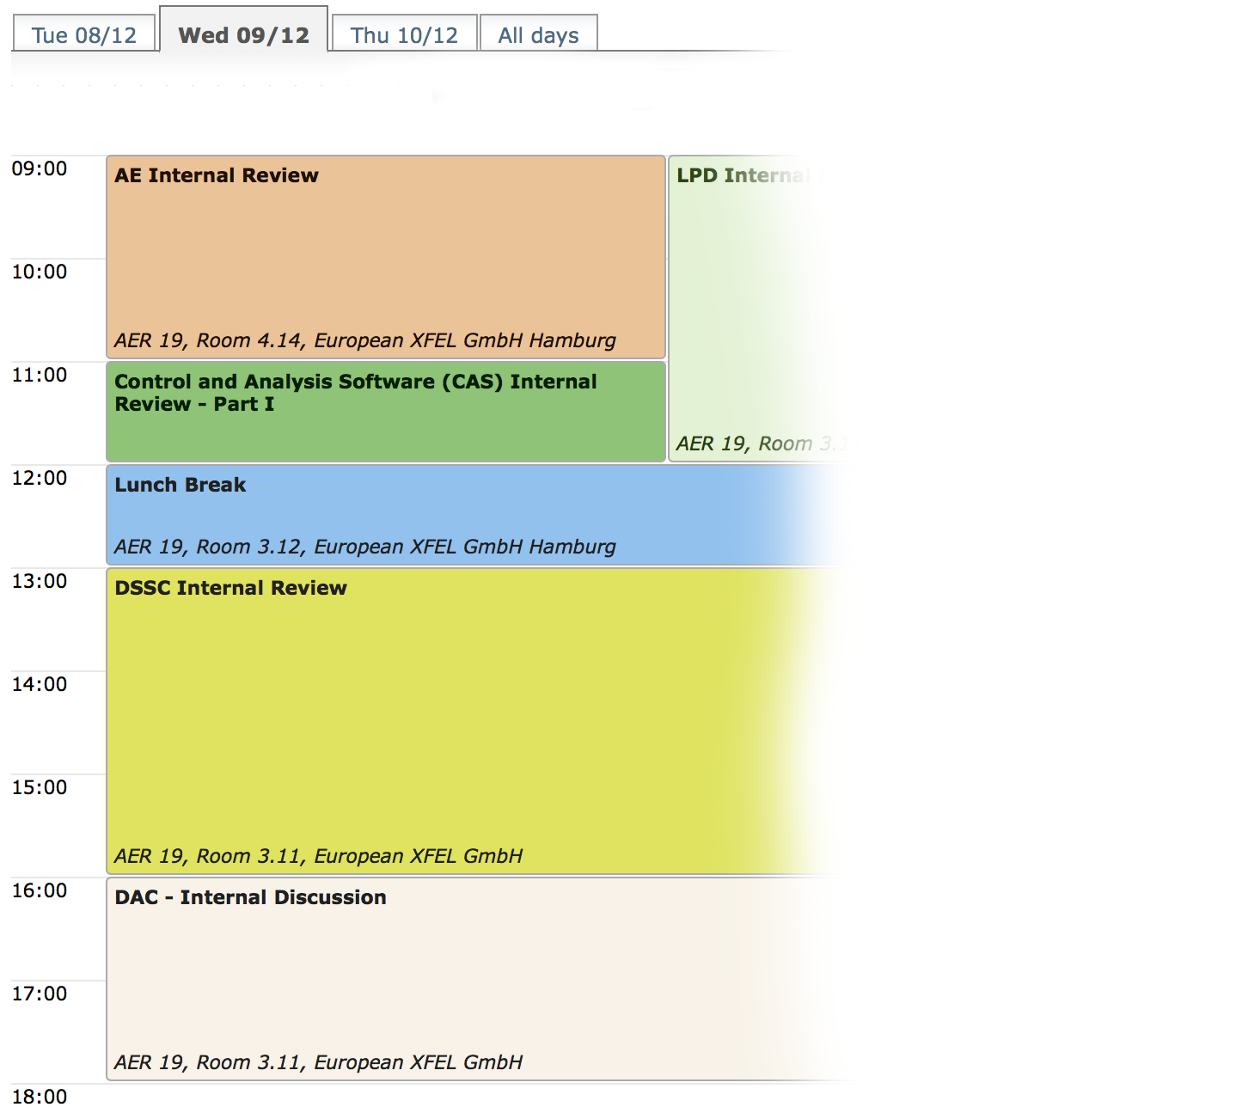
21th XDAC – Organization and Dead Lines
Format of the Meeting
More development projects
More time for the commit-tee
Avoid splitting of software/hardware sessions
No parallel sessions
Reduce session length
Deadlines for the 21st Meeting of the DAC
Submission of project reports
November 11th 2016
Submission of presentations
December 7th 2016
DAC Meeting
December 14th till 16th 2016

Slide 18
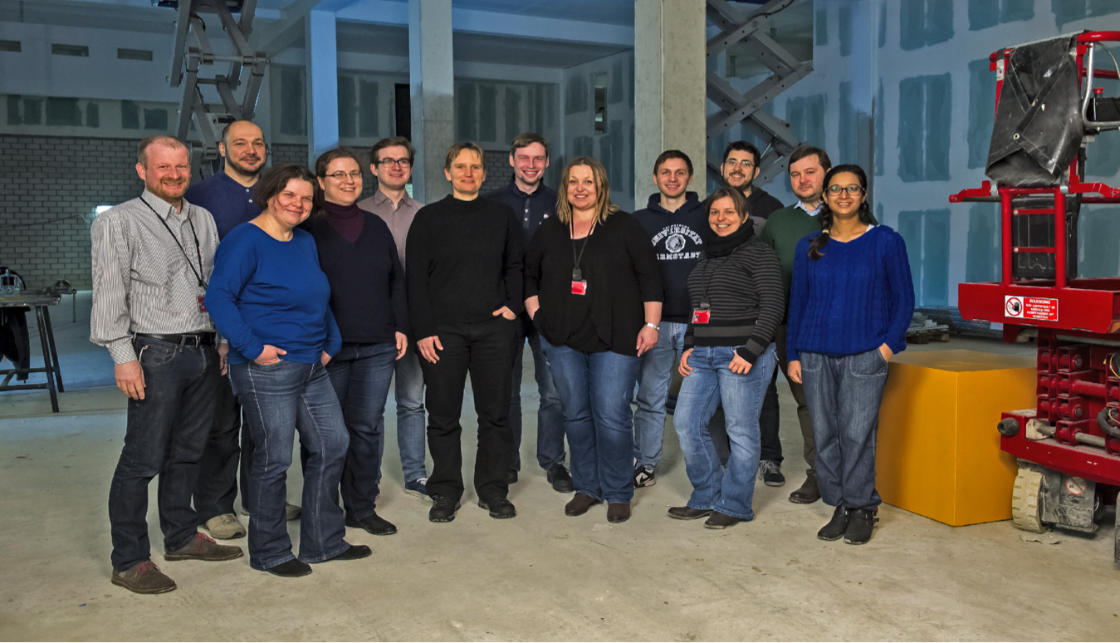
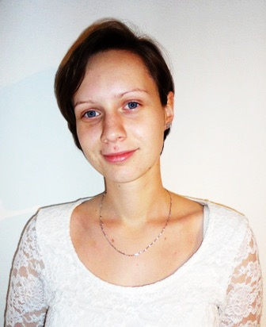
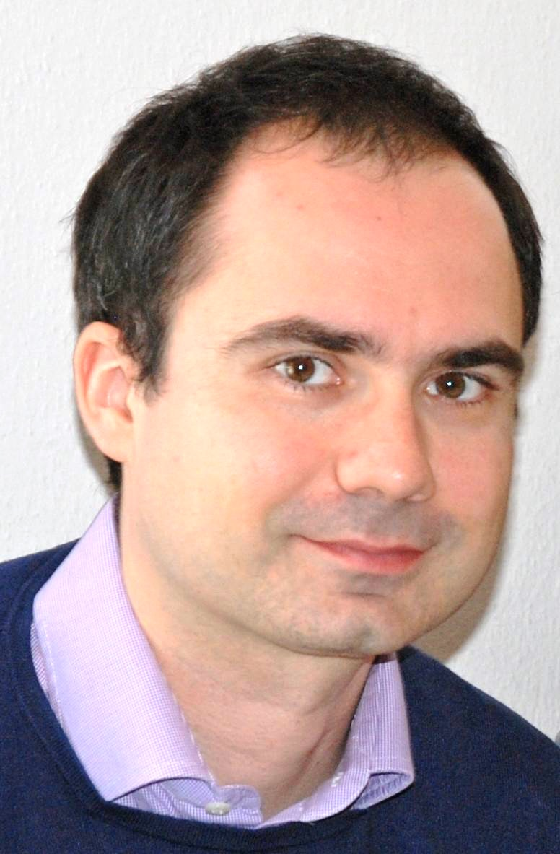
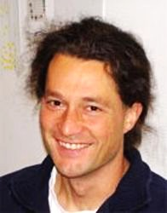
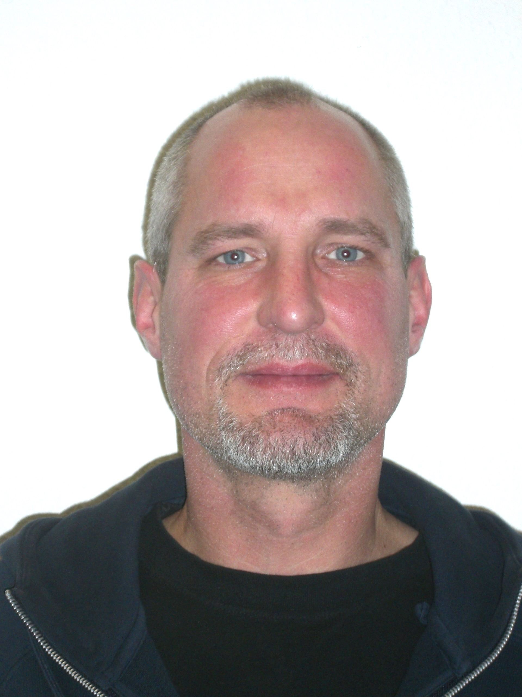
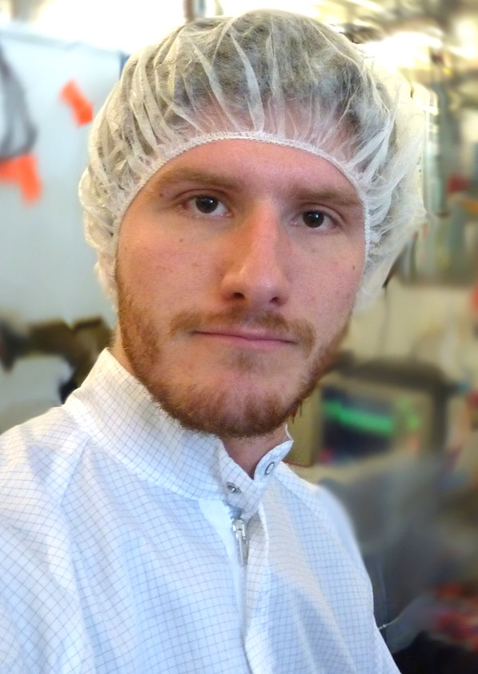
Detector Group at the European XFEL
Thank you for your attention!

