Slide 1
The AGIPD Project May 2016 – XDAC

Slide 2
The AGIPD system
2

Slide 3
The AGIPD Read Out-Principle
Sensor
Electronics per pixel
Pixel matrix
…
HV
Analog Mem
CDS
Read Out bus
+
SW
RO Amp
…
-
CTRL
DAC
Analog Mem
THR
Calibration circuitry
ASIC periphery
Chip output driver
Mux
Adaptive gain amplifier
352 analog memory cells
3
Notes:
Mention random vetoing possibility.

Slide 4
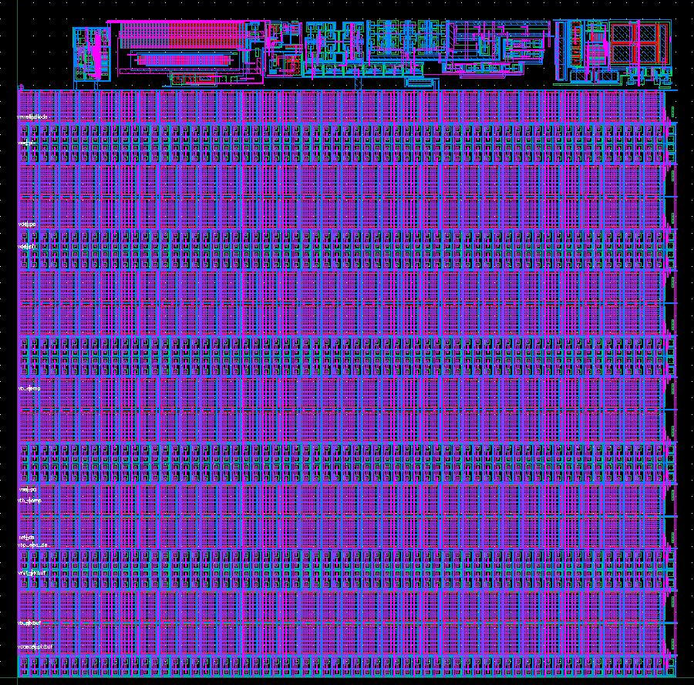
The AGIPD Pixel
200 x 200 micron² pixels
352 storage cells + veto possibilities.
Minumum signal ~ 300 e⁻ =
0.1 photon of 12.4keV
Maximum signal ~ 33x10⁶ e⁻ =
10⁴ photons of 12.4keV
4.5 MHz frame rate
64 x 64 pixels per ASIC
2 x 8 ASICs per module (128x512 pixels, no dead area)
4 modules per quadrant
First version AGIPD 1.0 extensively tested / debugged for > 2 years!
4

Slide 5
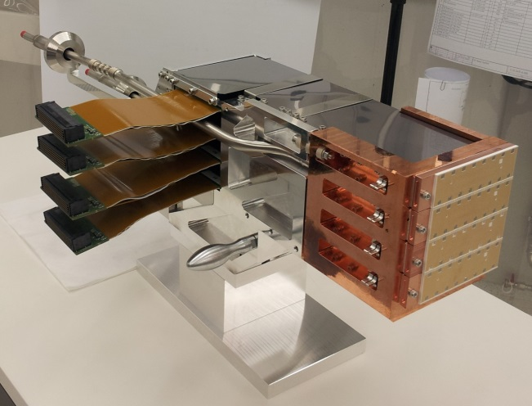
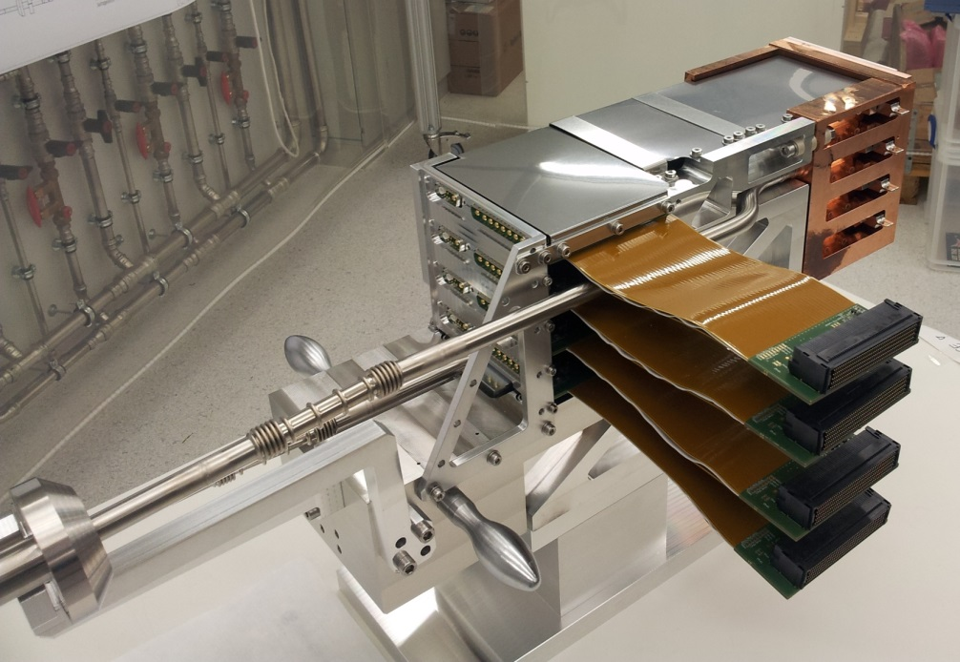
Fully assembled quadrant
5

Slide 6
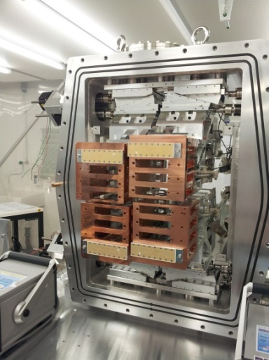
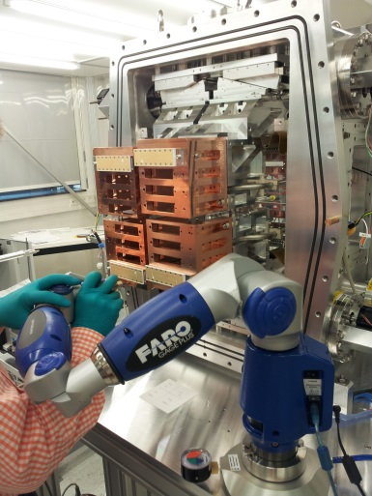
Current mechanics
6

Slide 7
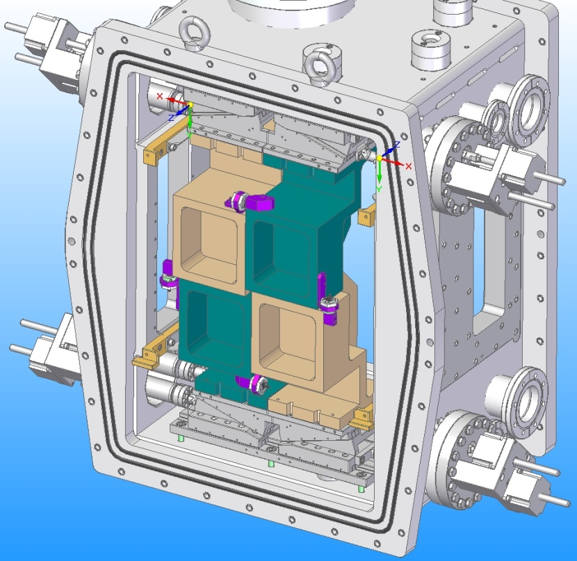
Motion stage commissioning
Use 2nd chamber (for MID):
Mounting motion stages and actuators.
Mounting dummy quadrants.
Mounting of limit and collision switches.
Scheduled to be ready for XFEL to set-up motion control end of May / beginning of June.
7

Slide 8
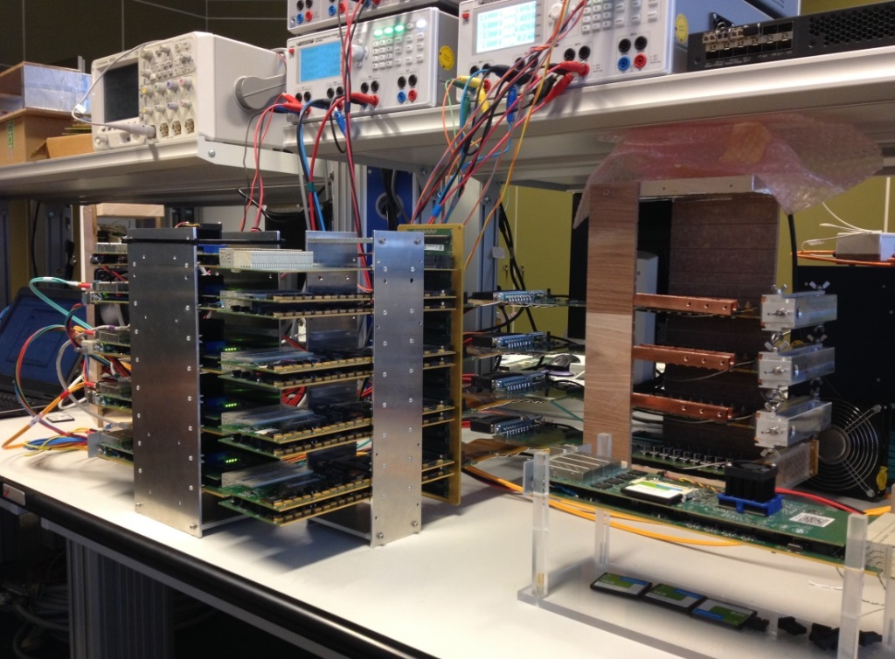
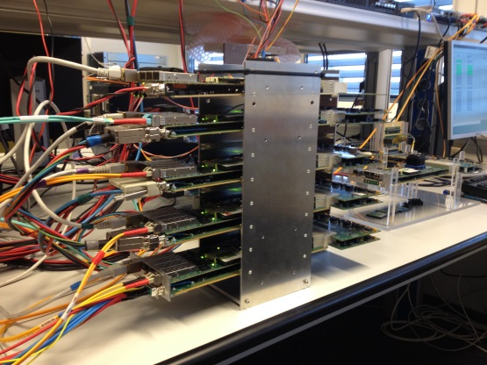
Functional tests of
Multi-Module System
Quadrant Module Setup
Control FPGA←→ 4x Readout FPGA
Control FPGA←→ 4x ASICs Modules
I2C Control
Software control with Tango
8

Slide 9
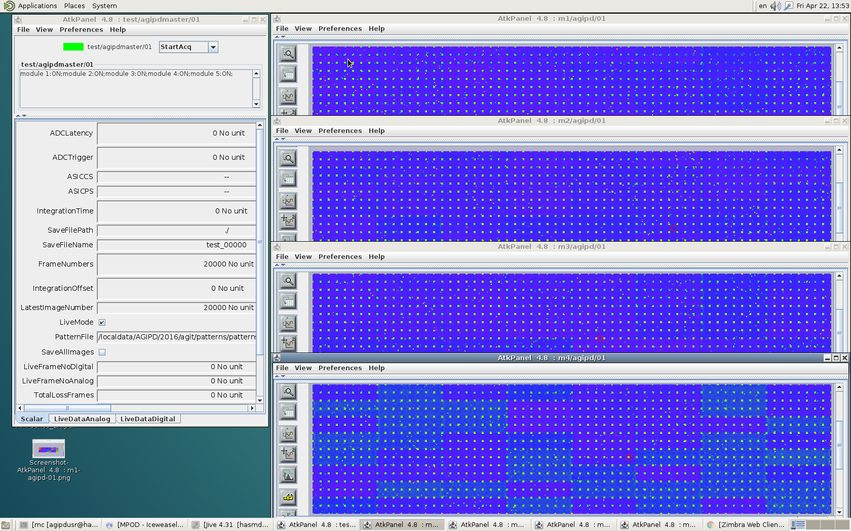
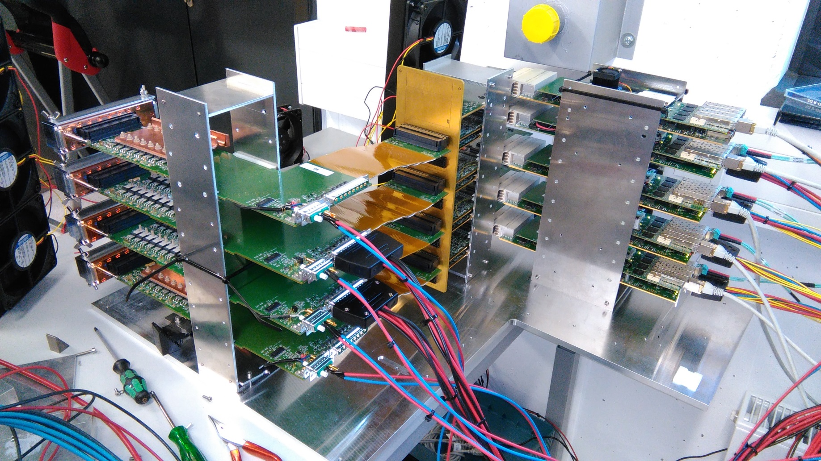
Multi-Module System tests
9

Slide 10
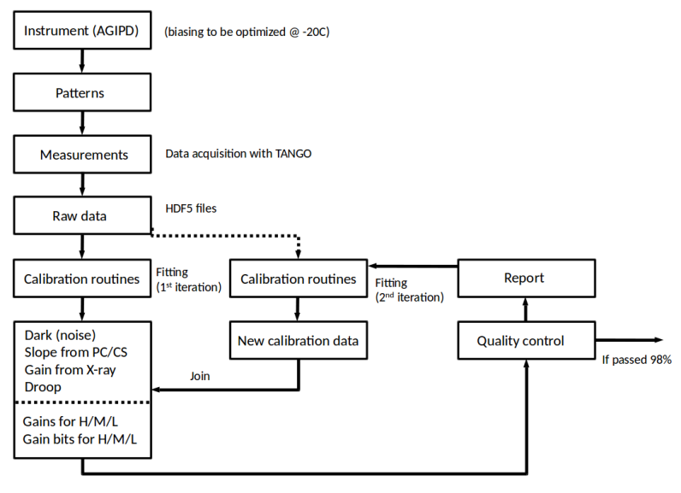
Calibration Framework
focus on being able to go through first iteration of calibration
Optimize fitting and reiteration
Adapt analysis to take NeXus (HDF5) input files
Adjust fitting and output files to XFEL requirements (IMinuit)
Already existing for binary files and scipy
10

Slide 11
Status of the Framework
Quantity | Data exists | .nxs ready | iMinuit fits
X-ray | ✓ | ✓
DR-CS | ✓ | ✓
DR-PC | ✓ | ✓
Dark | ✓ | ✓ | ✓
Droop | (✓) | ✓ | N/A*
Quality control cuts defined, still to be implemented
X-ray data taken before dismantling of old X-ray Hutch
* Droop negligible for unirradiated – not important for initial calibration, but maybe later!
11

Slide 12
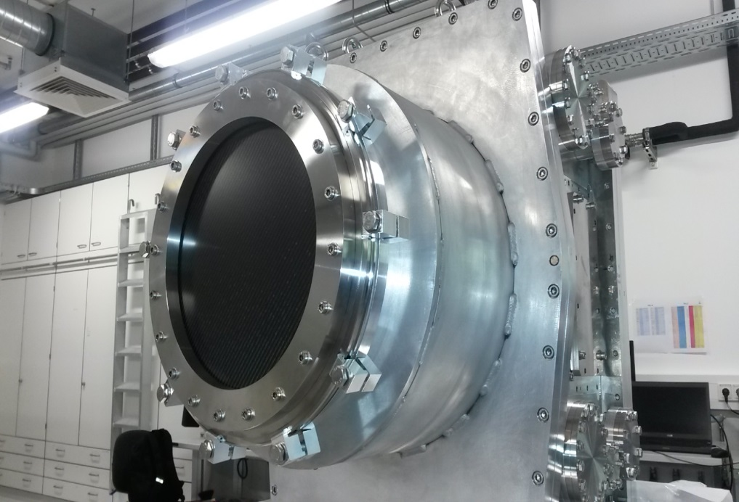
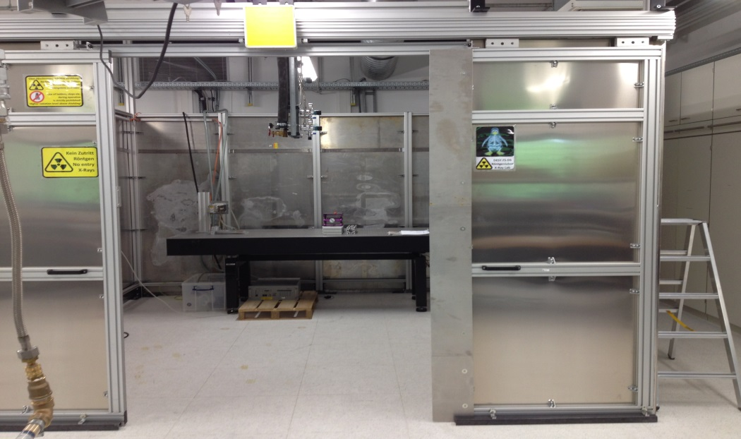
How to calibrate the 1Mpix?
The calibration will be performed quadrant wise, inside the final AGIPD 1Mpix chamber, in the new hutch.
saves time
allows calibration under „real conditions“ (i.e., cooling, vacuum)
Bug fixing and „pre-FAT“ on the fly
12

Slide 13
Calibration Time – upper limit
Measurement | Data Taking |  | Data Processing
 | Before | Now | Before | Now
X-ray fluorescence | 3 h | 1 h | < 5 min | < 5 min
Dynamic Range – Pulse Cap. | 8 h | 4 h | 6 h | 6 h*
Dynamic Range – Current Source | 2 h | < 1 h | 6 h | 1 h
Dark | 7 h (10k frames) | 1 h (1k frames) | 18 h** | 5h
Droop | 3 h | 3 h* | < 5 min | < 5 min
Total | 23 h | 10 h | 31 h | 12 h
* “Old” times – not yet redone with improved setup (10G link, multi-threading, HDF5 input files)
** Gaussian fits
4 modules can be calibrated simultaneously at -20C in vacuum
13

Slide 14
Current status 1st 1M
Mechanics
Vacuum vessel(s): finished and accepted
Motion stages: installed in vacuum vessel and tested
4 quadrant blocks finished and tested
Installation in vacuum vessel ongoing
External housing: in production
Modules (sensor tiles)
7 tiles produced and 6 tested
8 more tiles in production at PSI (before end of May)
6 tiles in production at IZM Berlin (end of May)
Firmware + Software
Running for multi-module system under Tango
Debugging will (always) continue
Calibration
Framework in place; and all routines tested
Waiting for X-rays to come back
14

Slide 15
Current optimistic planning 1st 1M
Assembly of in-vacuum components next 2 weeks
First cold tests mid June (full external housing not needed)
Assembly of all external components by end of June
First full calibration runs by end of June
Commissioning and debugging by end of July (August)
Transport to HERA-South August / September
BUT: this is a development, and we have gotten used to surprises!
15

Slide 16
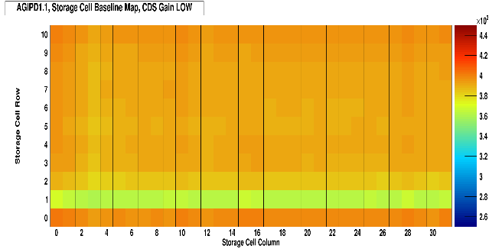
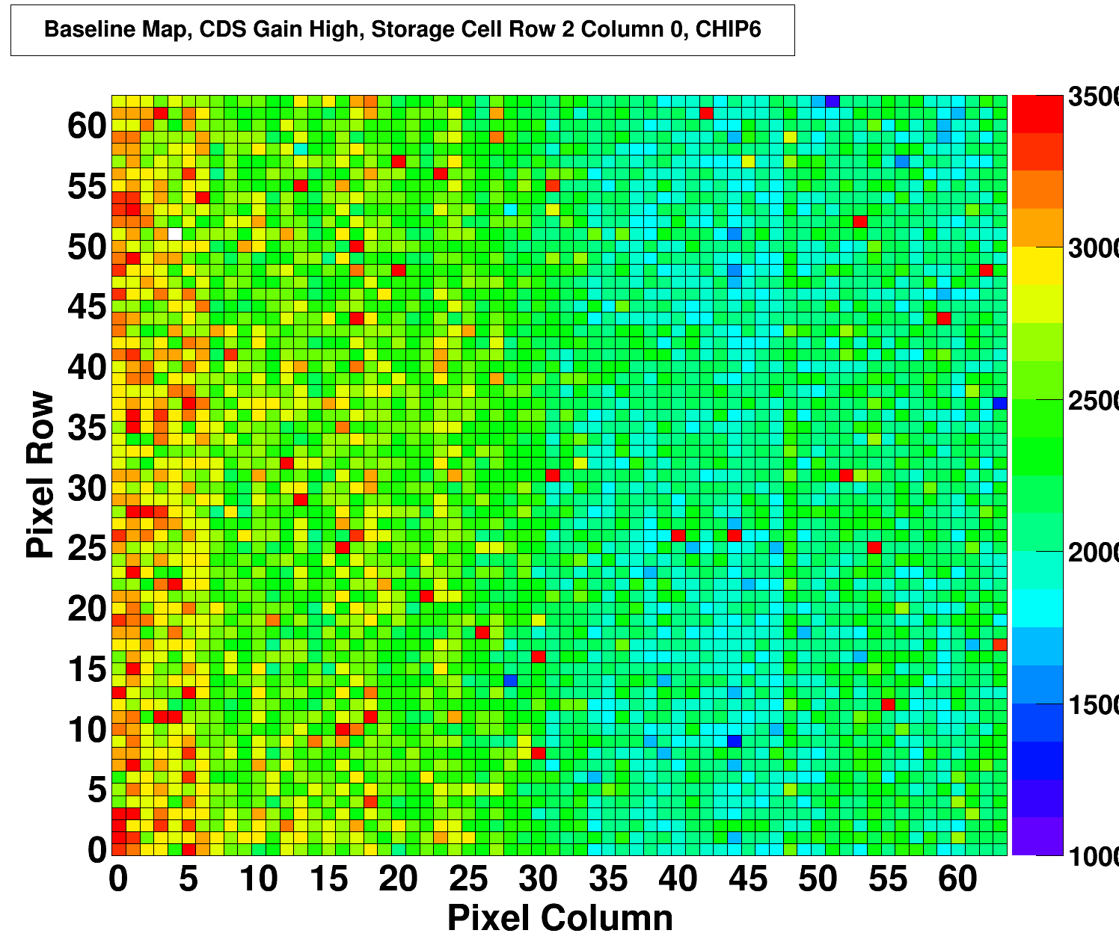
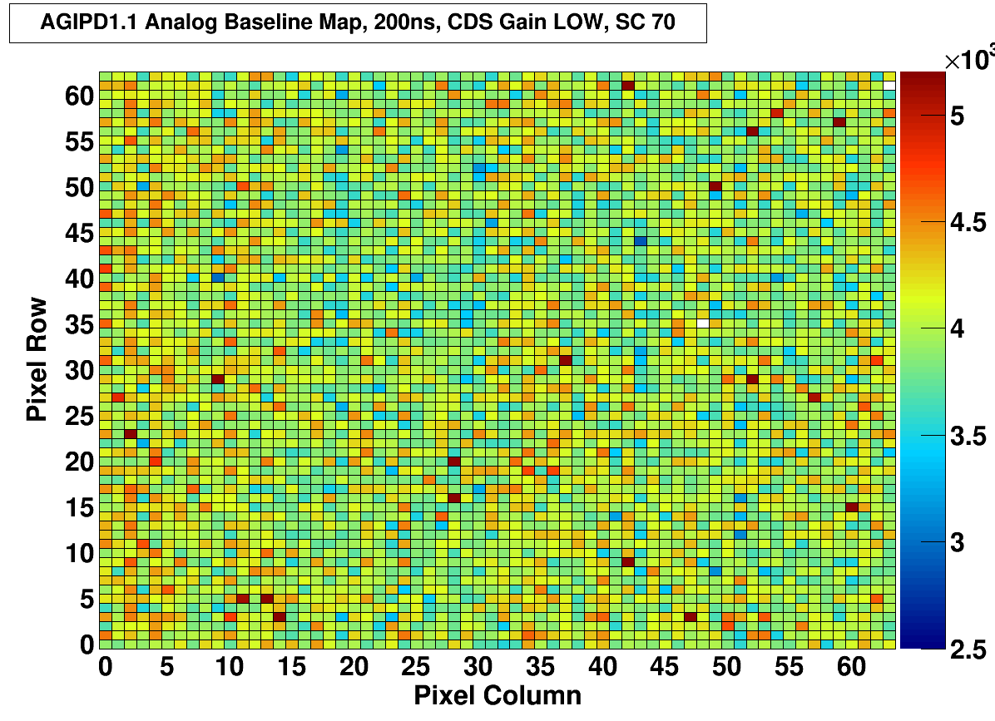
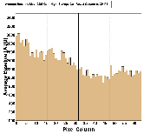
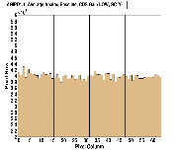
Second version of chip: AGIPD1.1
AGIPD 1.0 | AGIPD 1.1
Memory Map (Baseline)
Pixel Map (Baseline)
Output Speed (Rise Time)
Back from foundry end of February 2016
New calibration circuits
Better range & granularity
Different encoding & readout of gain signals
Easier discrimination
No level adjustment for readout
Improved routing inside the pixel
Lower crosstalk
Homogeneous pedestal map
No interference with calibration circuit
Improved power distribution
Lower gain dispersion
Better pedestal homogeneity
Shorter (CDS) settling times
Reworked readout lines
Lower capacitance & resistance
Higher readout speed
Lower speed dispersion between analogue ports
Individual buffering of off-chip driver reference voltage
Eliminates ‘Ghosting’ crosstalk
On-chip filter caps
Improved stability
New Power-up reset
Stronger buffers for MUX clock and token
……
Preliminary
ADC1
ADC2
ADC3
ADC4
ADC1
ADC2
ADC3
ADC4
16

