Slide 1
Status of the DSSC Project
Matteo Porro
For the DSSC Collaboration

Slide 2
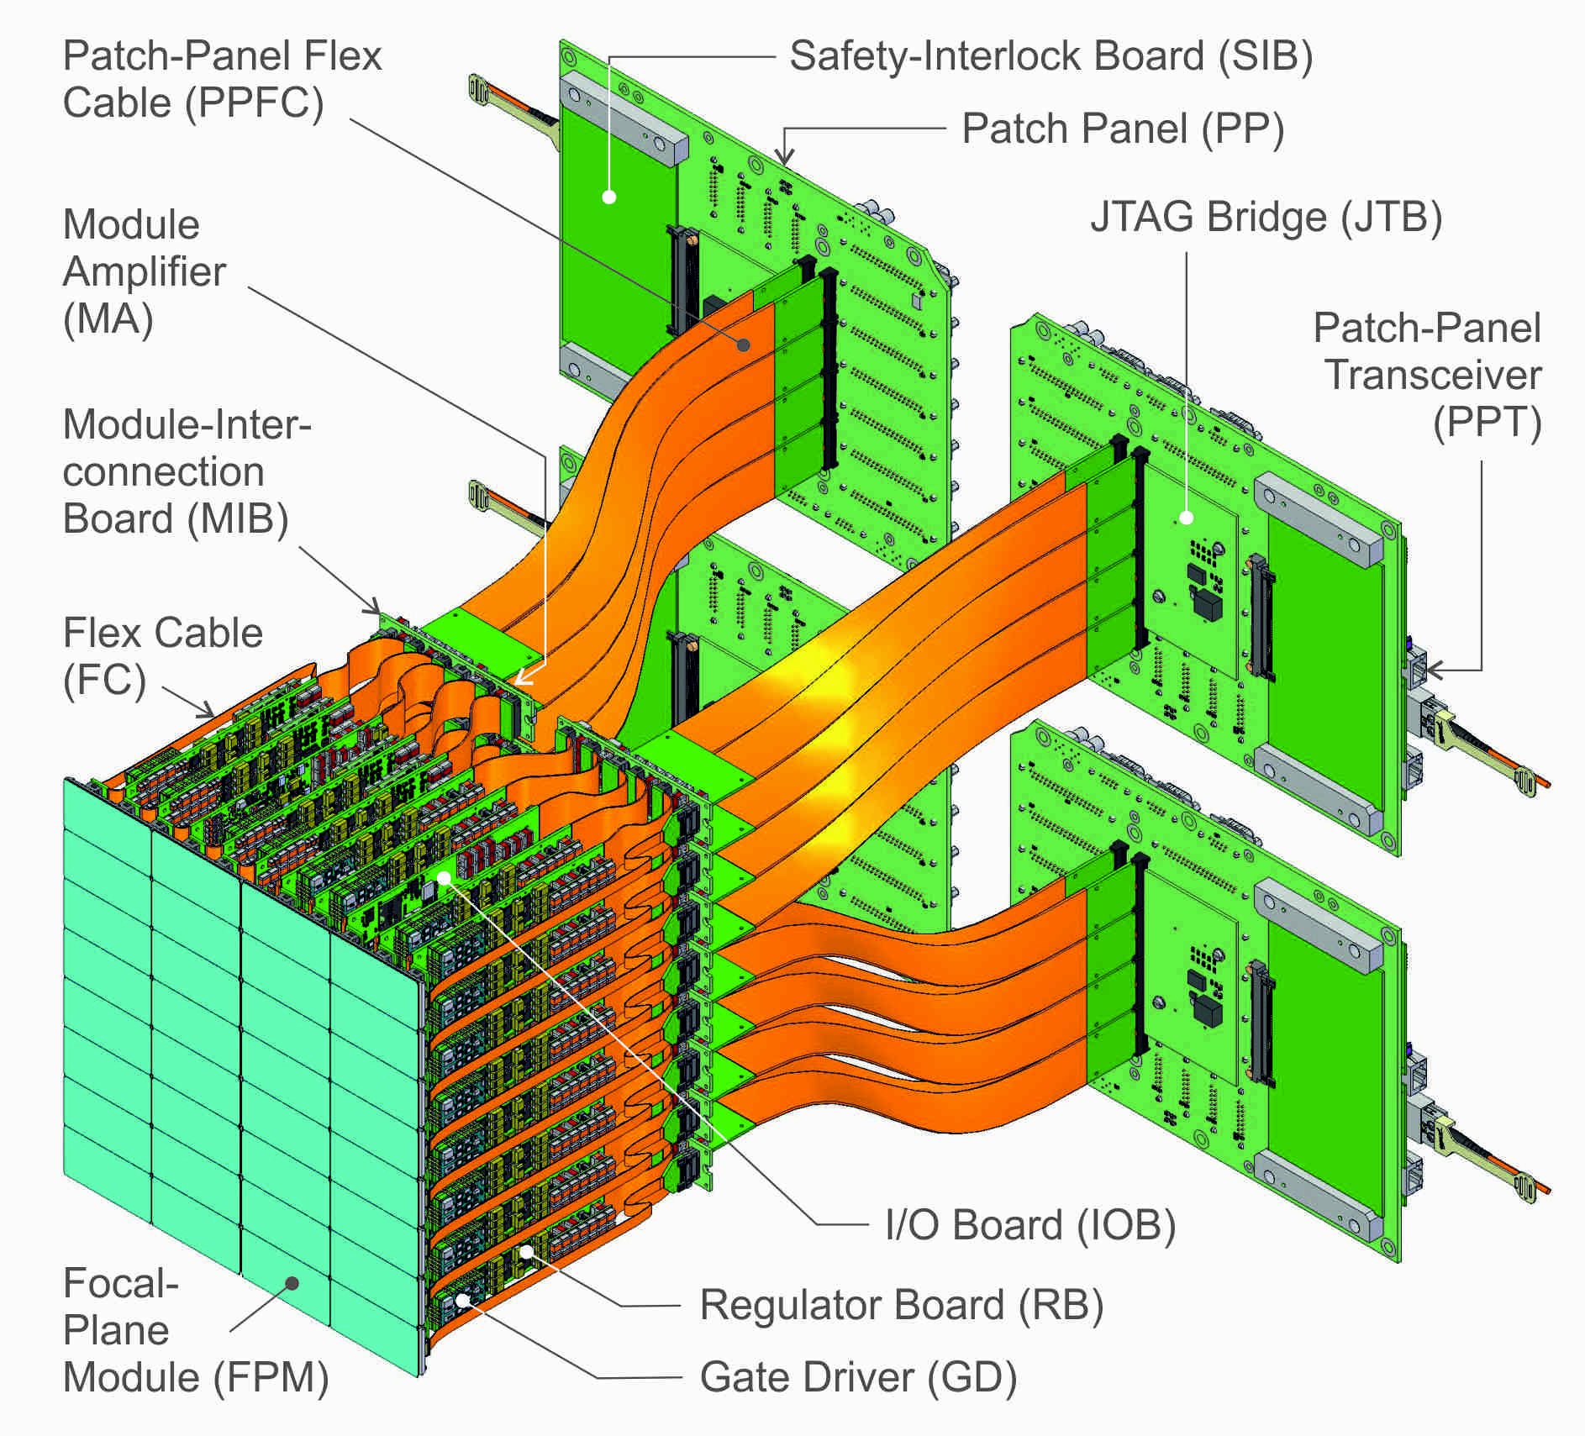
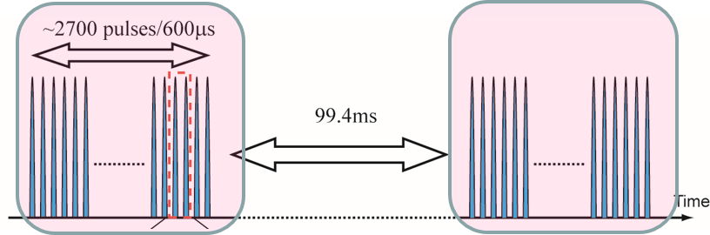
Sensor and focal plane architecture
Mini SDD array
Linear response
Simplified technology
Readout concept
Full parallel readout
Analog shaping
8-9 bit digitization in pixel
In-pixel digital memory (800 frames)
Power cycling
10.7 kW peak power
240 W average power
Focal Plane composition
1024x 1024 pixels
16 ladders (512 x 128)
32 monolithic sensors 128x256
256 Readout ASICS 64 x64

Slide 3
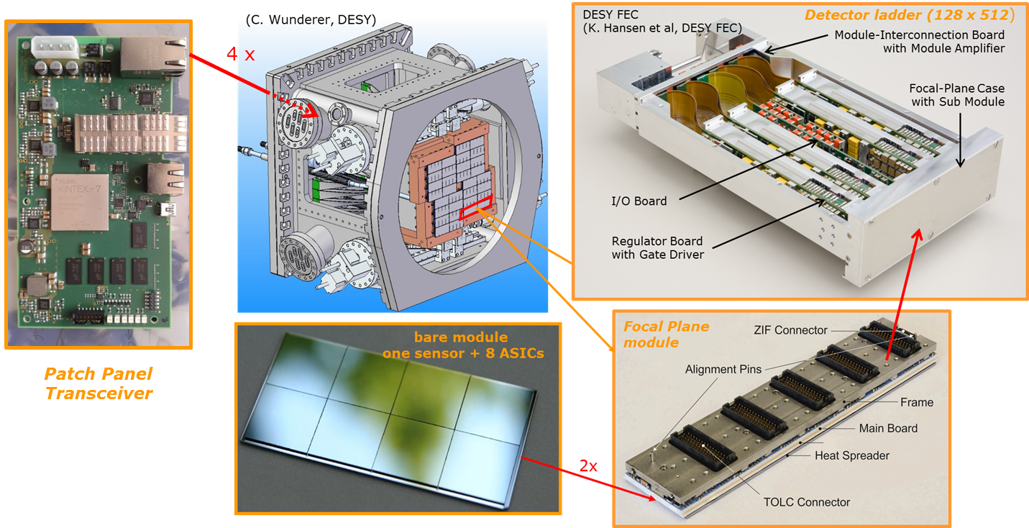
MiniSDD camera components overview
All camera component prototypes are available and fully qualified. They will be used for:
The ladder camera (512 x 128) to be delivered in summer 2016
The quadrant camera (512 x 512 – 10 x 10 cm²) foreseen by September 2016
For the MiniSDD MegaPixel camera foreseen by December 2017:
The DAQ components are available
The ladder electronics boards are in mass production phase and will be available by December 2016
The ASIC requires a new production in order to achieve full specs. It will be available in February 2017
The vacuum test stand for the ladder camera is available (modifications required for the quadrant)
The design of the M-pixel vacuum vessel is almost complete. The vessel will be available in March 2017

Slide 4
MiniSDD 1-Mpixel camera specs
 | XFEL 1st day requirements | MiniSDD 1-Mpixel
Number of pixels |  | 1024 x 1024
Sensor Pixel Shape |  | Hexagonal
Sensor Pixel pitch |  | ~ 204 x 236 µm²
Energy (keV) | 0.7, 1, 1.5 | 0.5, 0.7, 1, 1.5, 3
Single photon detection | NO | Selectable threshold
Dynamic range | 3 x 10³ @ 1 keV other E not specified | worst case(*): linear response – 8 bit (4.5MHz) 2560 ph – 10 ph. th. 1280 ph. - 5 ph. th.. 256 ph. - 1 ph. th.
Noise | - | ~50 el. rms. with 1ph. th.
Frame rate | 4.5 MHz | 4.5 MHz, 2.2 MHz, 1 MHz
Veto capability | YES | YES
Memory | 800 Frames | 800 Frames
Two possible implementations for the front-end of the F2 ASIC for the Mpixel camera will be compared. The most conservative design has a linear response
Low noise properties have been verified with MiniSDD and small format ASIC prototypes ( 8 x 8)
Expected performance of the first ladder and quadrant camera is being investigated and depend on properties of F1 ASIC

Slide 5
Focal Plane Module Assembly

Slide 6
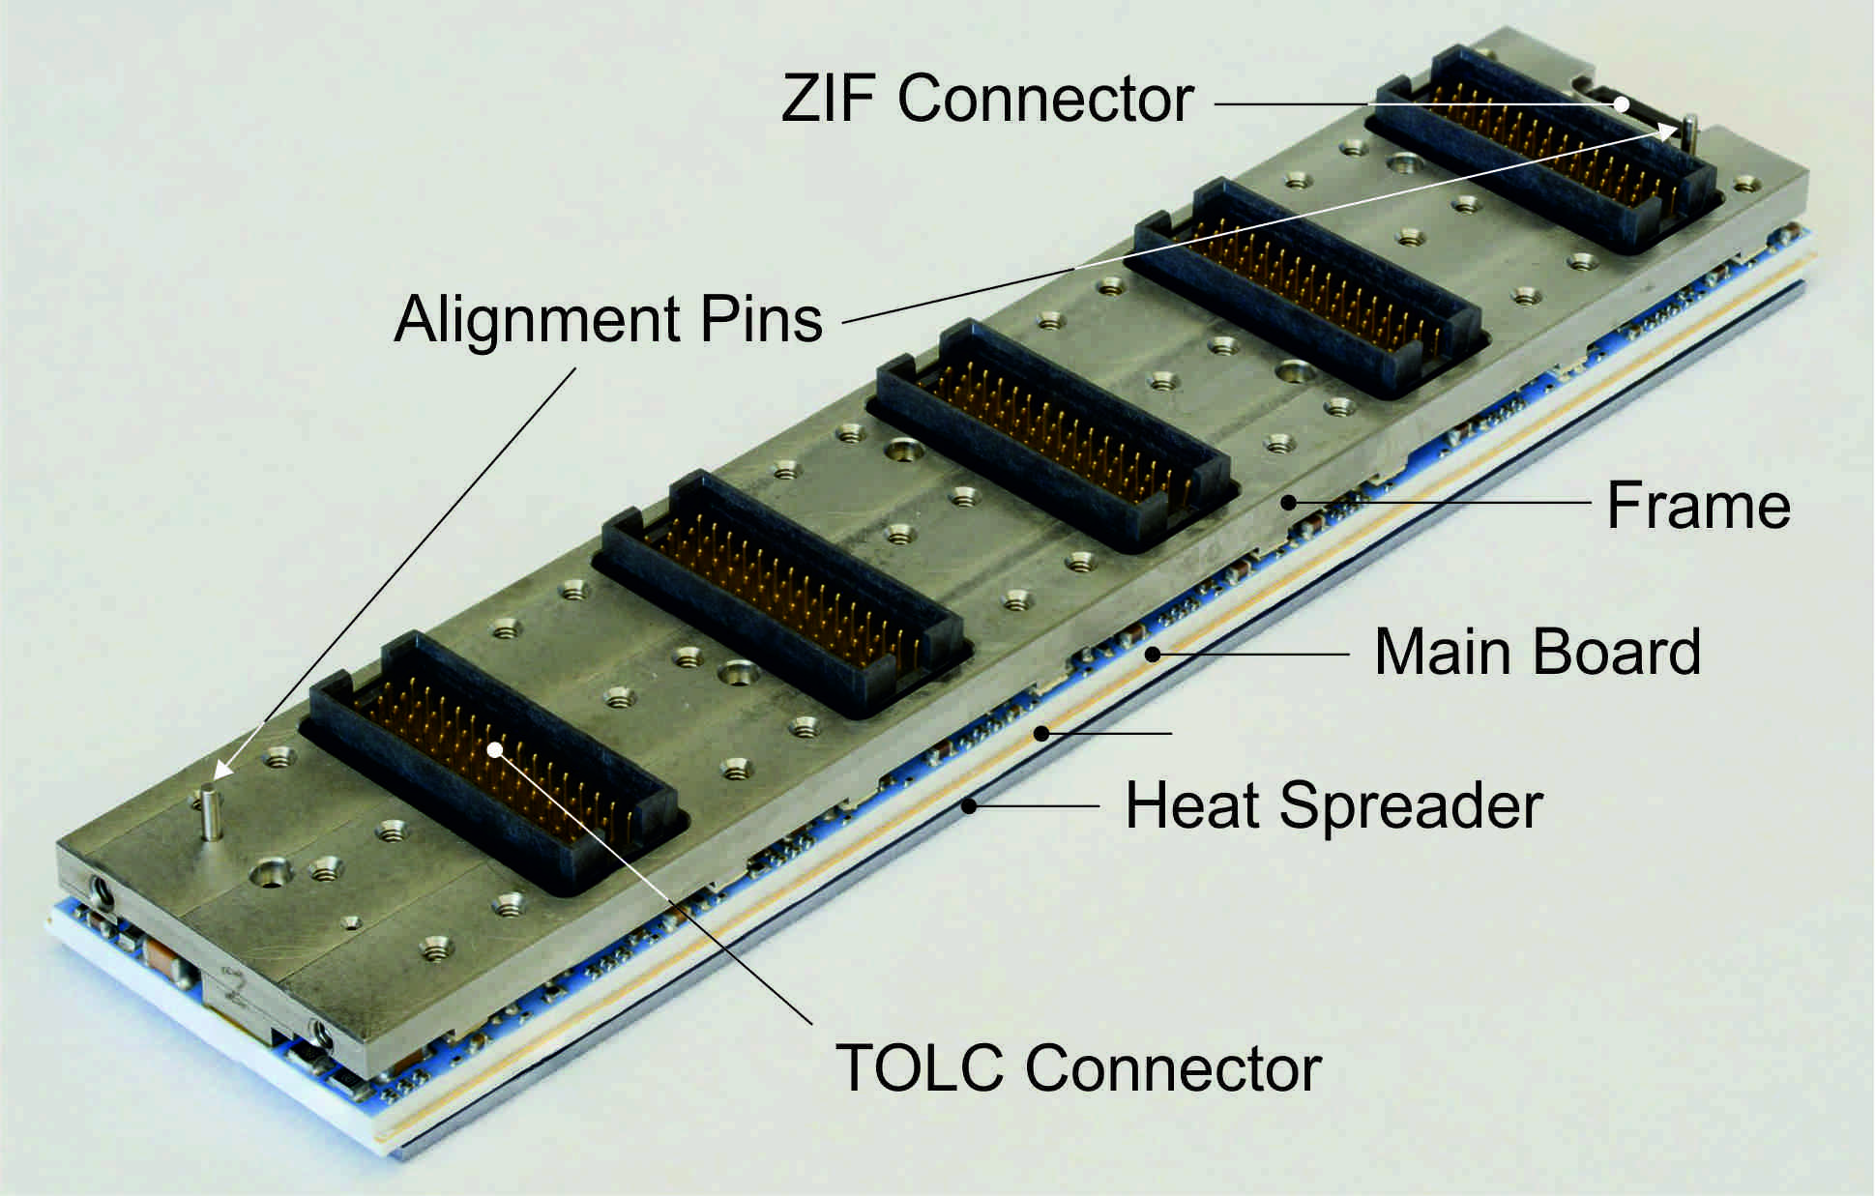
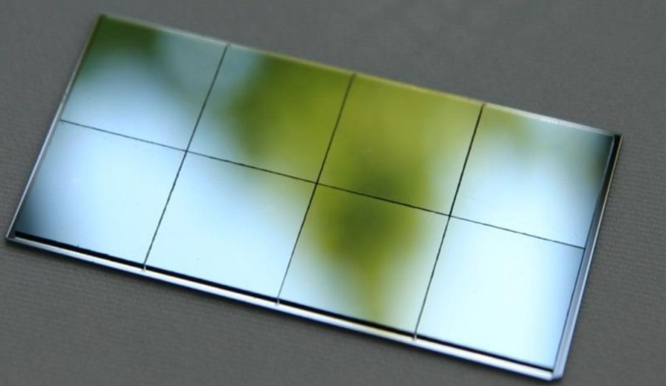
Focal Plane Module Assembly
bare module
one sensor + 8 ASICs
Focal Plane
module
2x
In late summer 2014 we had to reorganize the bare module assembly and the macro assembly work-packages. At the time of the last XDAC (December 2015) we were in the process development phase.
Now the bare module assembly is successfully established. Mounting phase is successfully completed:
11 large format (128 x 256)
21 small format (64 x 64)
The macro assembly process is almost established
Gluing successfully performed
Wire-bonding under test but seems not problematic
First FPM module completely assembled expected by June
Several quality control steps are present in the assembly procedure

Slide 7
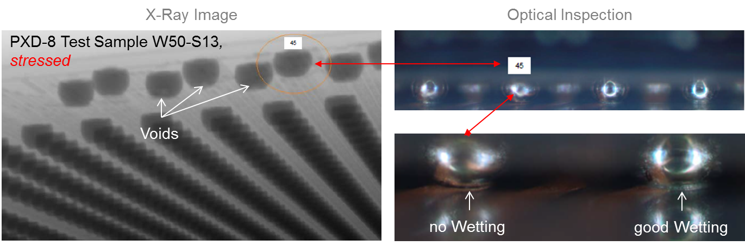
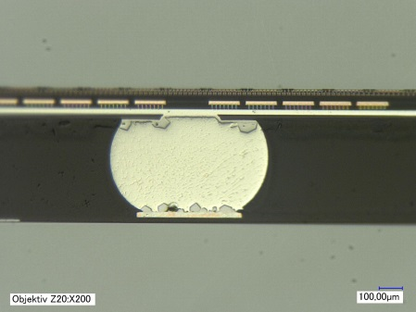
Bare module assembly at AEMtec
The consortium is in strict contact with AEMtec and follows the activities step by step with weekly phone meetings
For process qualification and quality control the following tests are performed:
Cross sections
X-ray analysis
Thermal cycling
Outgassing tests
Cross-section
Outgassing tests passed
applied thermo-mechanical Stress (195 fast Cycles between -40°C &125°C)
no additional missing Connections after Cycling found
→ Bump Connection is mechanically very robust
With the established process it is possible to produce 20 modules / week
For the 1 M-pixel camera production 3 weeks are needed (including yield loss)

Slide 8
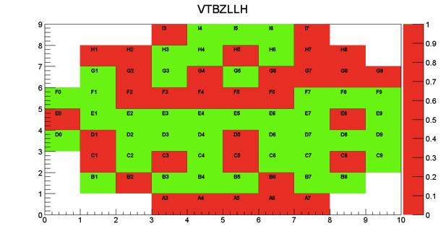
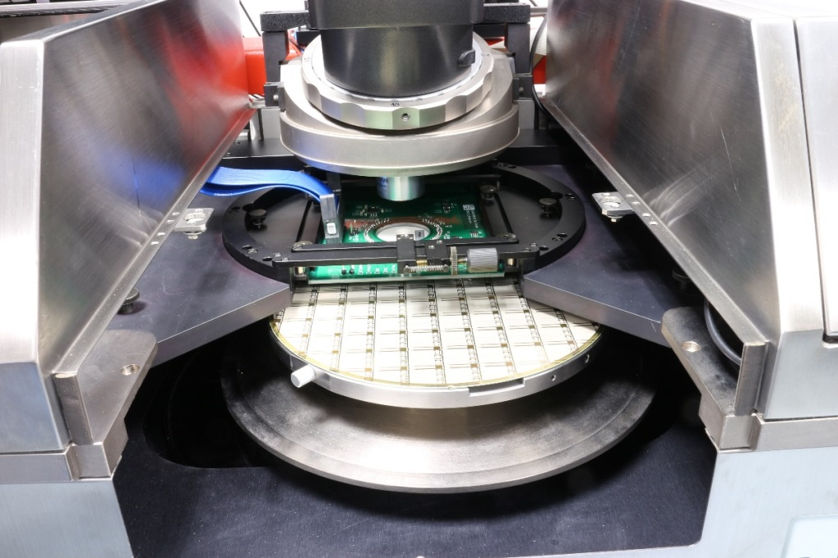
ASIC Known Good Dies selection
Chip qualification and wafer testing procedure is established in Mannheim
Results are documented, stored in a database and quick access is given in form of a pixel map.
It takes 1 week to test 1 wafer (72 ASICs).
Full camera needs 8x2x16=256 ASICs, 8 wafers considering a 50% yield.
8 weeks shall be considered for wafer testing
1 month for dicing is needed according to past experience.
Semi Automatic Süss PM5 Prober available in Mannheim

Slide 9
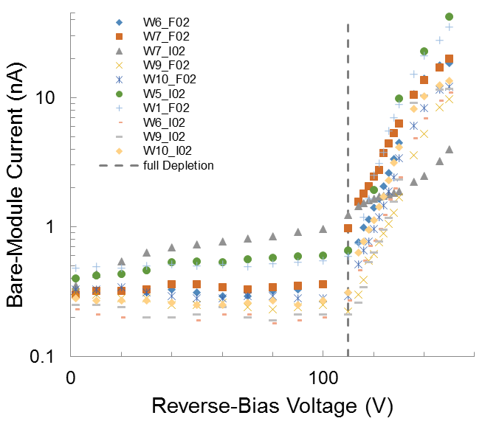
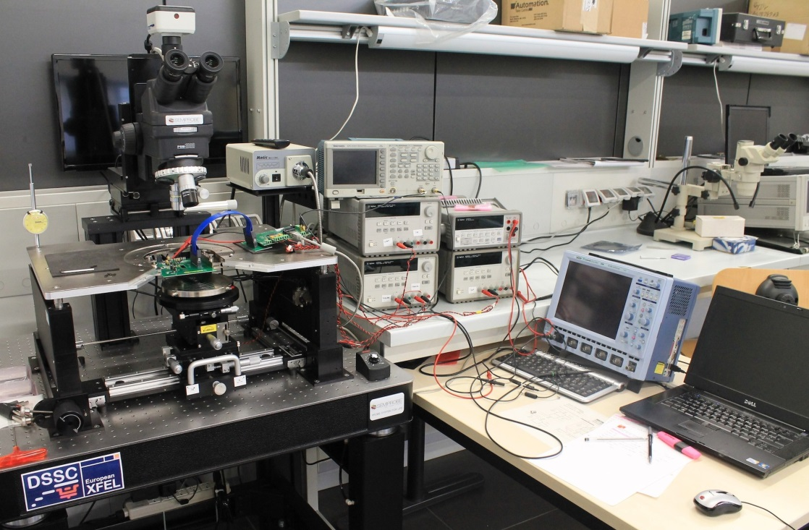
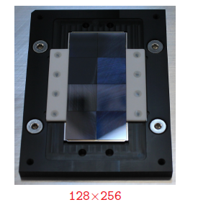
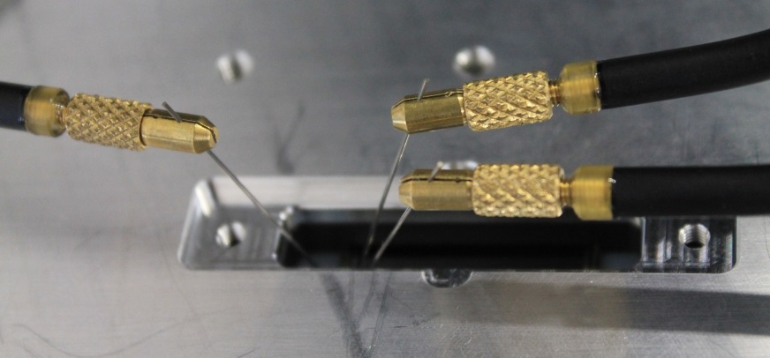
Bare Module tests in Bergamo (quality control)
A measurement setup has been set up in Bergamo
Backside current is measured in order to check that entrance window has not been damaged by chip flipping
ASIC tests are repeated though sensor connections and compared with tests performed in Mannheim
First yield estimate appears very high
testing speed 5 modules / week → 7 weeks are needed for the full camera
Higher speed could be achieved reducing the number of tests on the ASIC
Bare module
Fixed to a storage container

Slide 10
Full Format ASIC F1 + MiniSDD

Slide 11
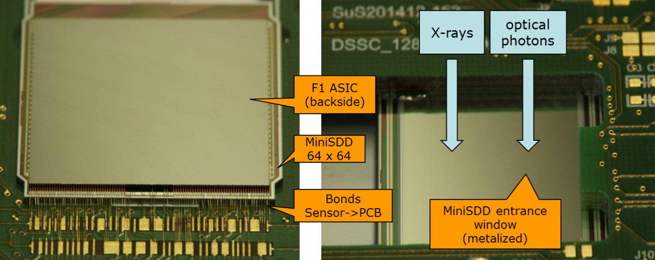
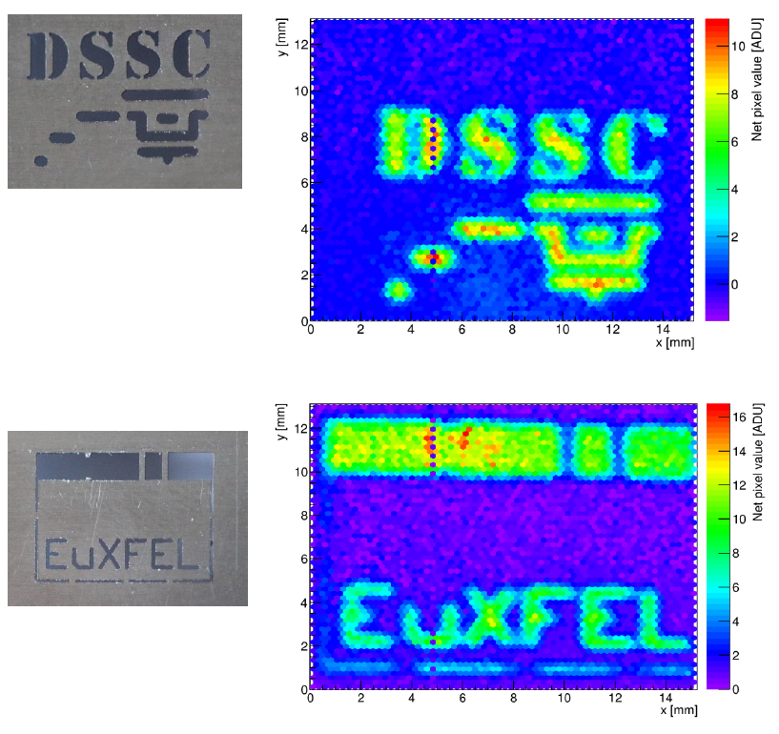
F1 + MiniSDDs first images with LED light
Realistic operating conditions:
All pixels active in parallel
4.5 MHz operation except flat-top
Power cycling (10 burst / second)
Full memory depth used (800 frames)
The full system works
Large area optical injection via triggered LED
Rough gain setting of few 1keV ph. per bin
It is very challenging to equalize the gain settings and the dynamic range across the matrix (due to reported voltage drops).
The noise and the homogeneity with all pixels working in parallel has to be evaluated: Setup are now available in Mannheim, Milano and Munich in order to increase the testing effort

Slide 12
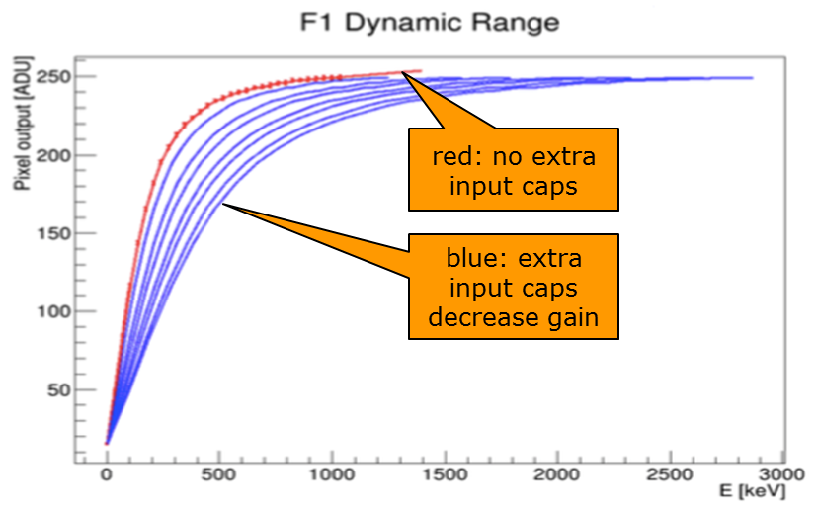
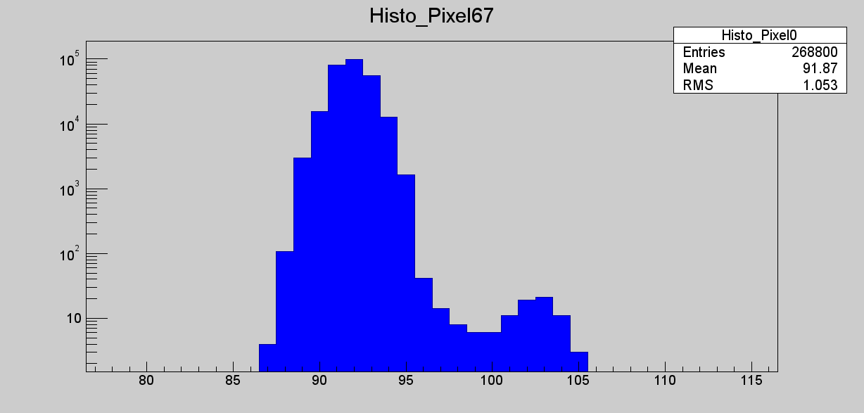
Available Full Format ASIC F1
F1 is being tested and it is fully functional. Tests with MiniSDD could start only in February due to the lack of assembled sensors
Some additional design limitations of the MiniSDD front-end were discovered after submission and first tests:
Large cross-talk due to power lines
Power supply rejection worse than estimated
Higher noise due to parasitic input capacitance
Measured input cap 1 pF instead of 0.4 pf (easy to correct in next iteration)
Measured noise on a single active pixel ~ 160 el. rms (target noise ~ 50 – 80 el. rms)
Large gain inhomogeneity across the ASIC pixels due to voltage drops on power lines. Calibration appears very challenging
A test ASIC (8 x 16) with the final pixel electronics has been submitted on May 16
The full format ASIC F2 for the 1-Mpixel camera will be submitted in November 2016
Dynamic range and Noise measured on a single active pixel of F1 coupled with a miniSDD
^{Noise peak}
⁵⁵Fe

Slide 13
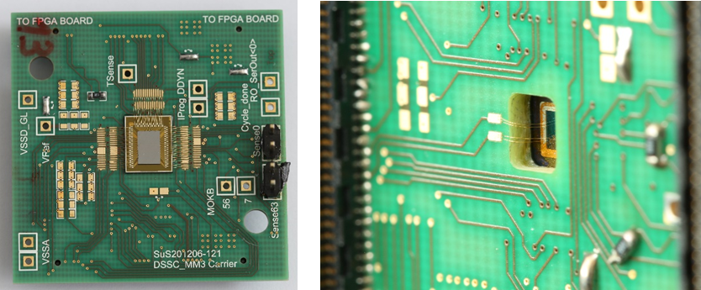
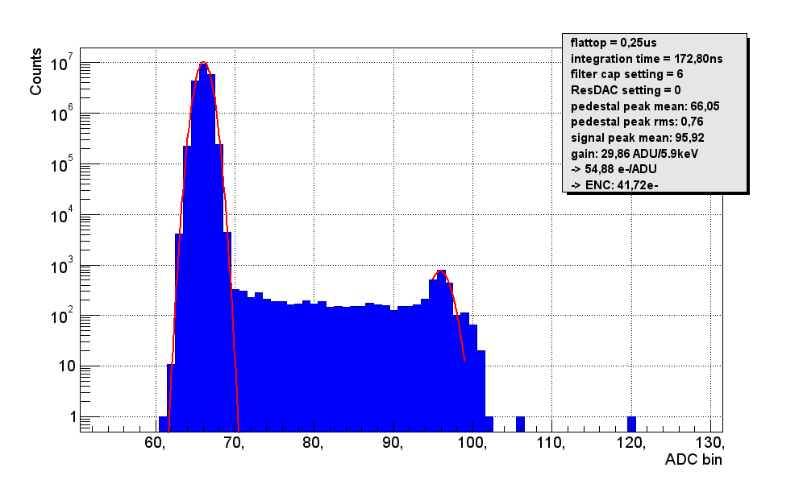
Roadmap to second large format ASIC F2
Since F1 submission (april 2014) all the ASIC design team (5 engineers) is dedicated to the optimization of the MiniSDD front-end and the global ASIC blocks.
Several small format-test ASICs have been submitted and tested
Optimized version of the MiniSDD front-end are able to provide better performance
Lower noise – target value 50 – 80 electrons rms for single photon sensitivity operation
Lower cross talk
More stability and homogeneity
Small test ASICs coupled with MiniSDD mini-matrices have already shown good performance
MiniSDD prototype bump-bonded to ASIC mini-matrix (8x8)
All pixels operated in parallel
ENC ~ 42 el. rms
Equivalent operating speed 2.2 MHz

Slide 14
DAQ

Slide 15
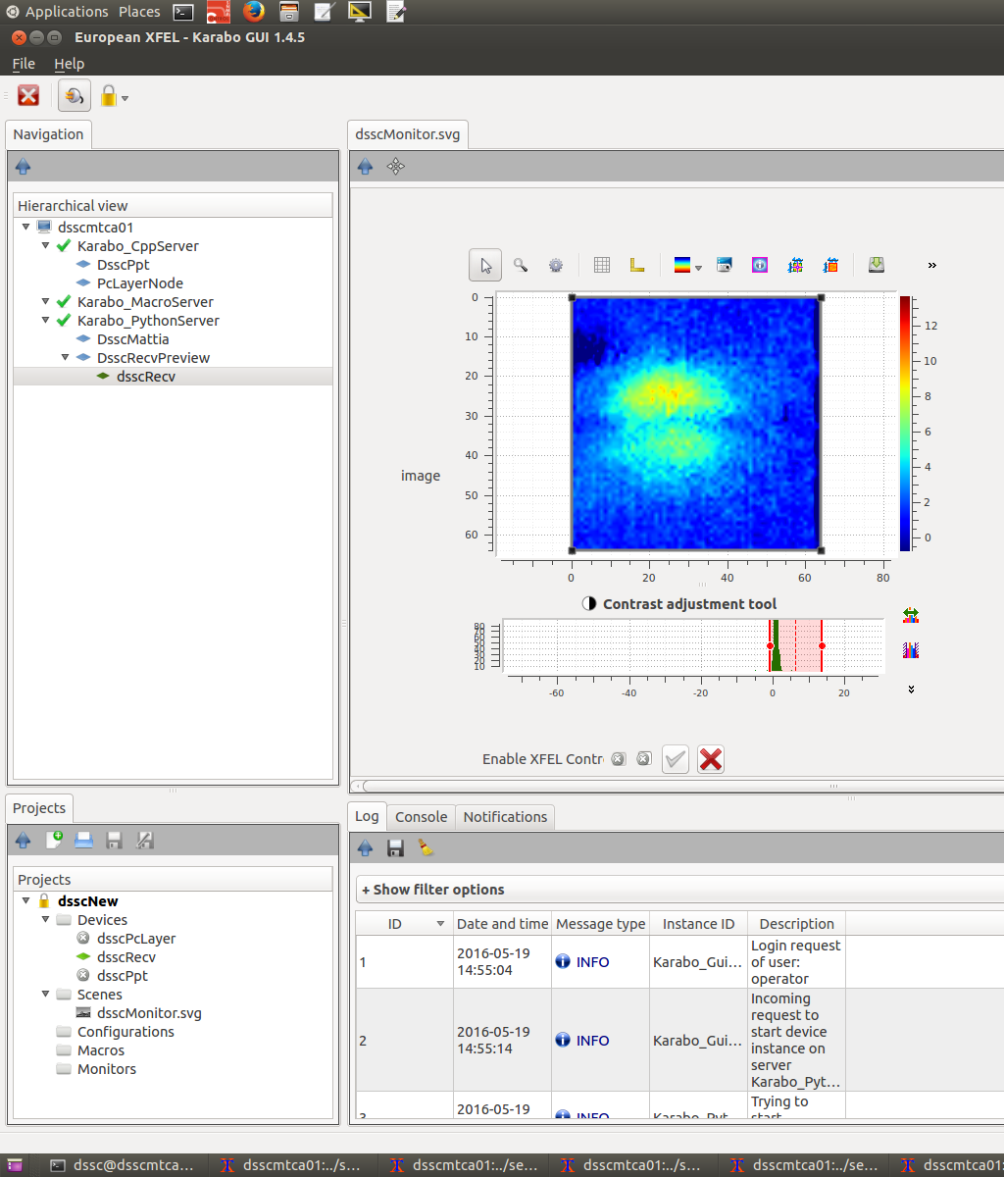
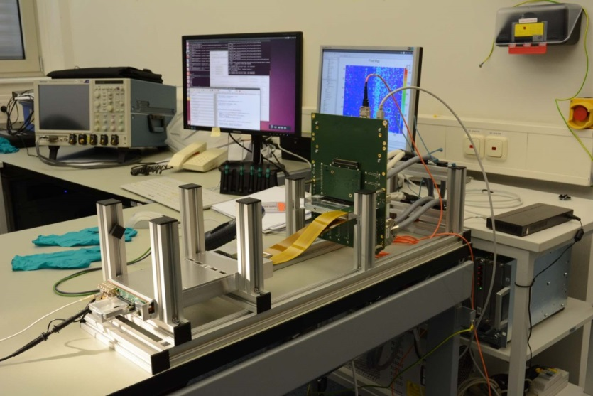
DAQ
We have the components (IOBs, PPTs) for 1 Camera, 1 quadrant, 2 ladders + spares
The VETO functionality has been verified in simulations and real hardware
The basic software to operate the full ladder is functional. It is already being used at DESY to operate one F1 ASIC + 64 x 64 sensor together with the full electronics chain
Moving on to Karabo version
Image taken with F1 + 64 x 64 Sensor + LED in Karabo environment
Full ladder electronics at DESY

Slide 16
Ladder test Stand and 1-Mpixel Mechanics

Slide 17
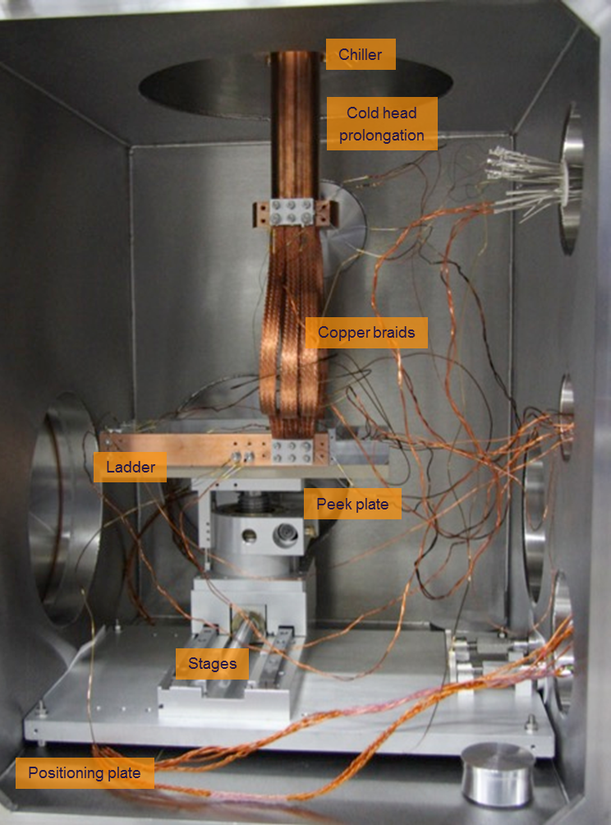
Status of FENICE ladder test stand
FENICE is the DSSC ladder vacuum test-stand.
A vacuum level of ~10⁻⁷ mbar is routinely achieved. We have inside:
Movement stages, to the able to span the full active area of the ladder
Cooling system, to bring the sensor to the operating temperature of -20 C
Isolating plate, to ensure thermal insulation between the ladder and the rest.
Ladder mechanics with heaters, to mimic the thermal behaviour of the real ladder.
FENICE is ready for the installation of the ladder, to happen in Summer…
Notes:
The DSSC ladder test stand, FENICE, has been commissioned in the last month. The picture shows the present status of the FENICE internal setup, including the ladder mechanics mounted on the motion stages and the connection to the cooler via copper braids. The thermal insulation of the ladder is realised with a 10 mm thick peek plate, screwed on the motion stages by peek screws. A thin vacuum layer is established between the plate and the stages via thin (2 mm) spacers, to ensure even better thermal insulation.

Slide 18
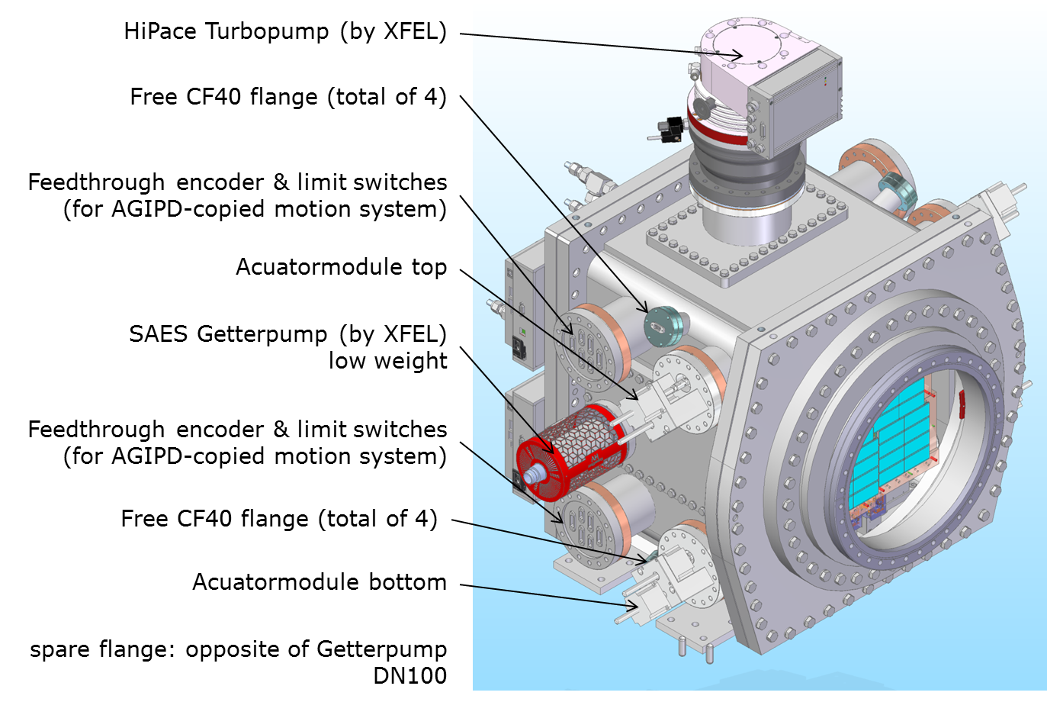
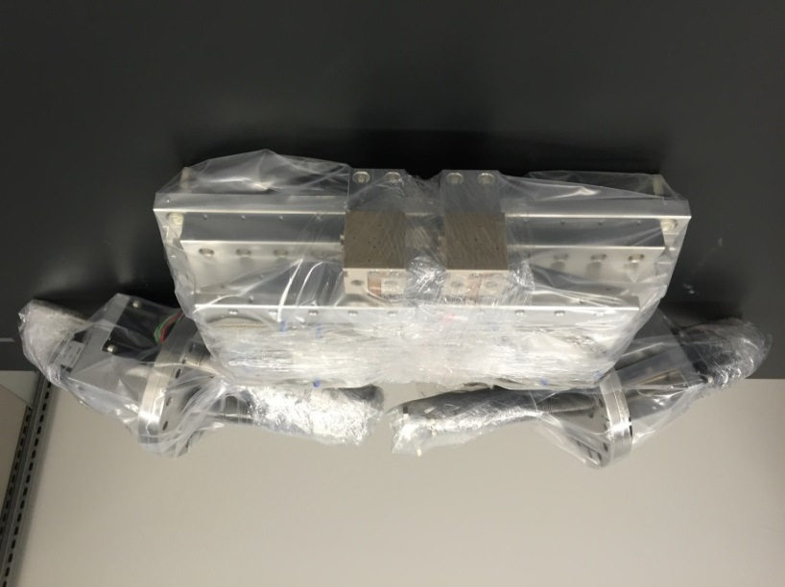
1-Mpixel Camera Mechanics
Cooling blocks design complete. Final components expected by the end of the year
Design options for the full chamber have been presented to XFEL in April.
The complete 1-Mpixel mechanics is foreseen for March 2017
XY stages are already available at DESY
Two sets of existing XY stages

Slide 19
Outlook:
Industrial CMOS process based DEPFET for Second 1-Mpixel Camera

Slide 20
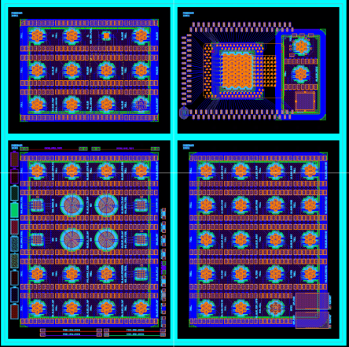

CMOS process based DEPFETs
      Industrial-Scale CMOS Fab
      8 inch process
      Double sided polished
      High process stability
      Fast turnaround times ( < 6 months)
      Significant cost reduction
      Increased availability of DEPFETs
First CMOS based DEPFET prototype production started in December 2015 and has been completed
  7-cell clusters
  Macropixels
  3x3 matrix (smaller pixels)
  8x8 matrix (UBM required)
First sample has been delivered last Friday

Slide 21
Summary
All the components to build the MiniSDD ladder and quadrant camera are in our hands
The Bare module assembly has been accomplished successfully
The first Focal Plane Module is expected by June 2016
The first MiniSDD ladder camera will be available in Summer
The full electronics chain is already successfully working
The vacuum Ladder test stand is available
The quadrant camera will be available in Autumn.
The fist Full Format ASIC F1 is operational and test with the sensors have started
The ASIC is fully functional but a second version F2 is needed in order to get full specs with the 1-Mpixel Camera. This second version was always foreseen in our planning.
A test ASIC MM7 with the final optimized MiniSDD front-end has been submitted on May 16.
The submission of the F2 ASIC is foreseen by November 2016
The design of the 1-Mpixel mechanics is almost complete.
The full mechanics is expected by March 2017.
XY stages are already available
More resources have been attributed to the calibration WP
The F1 + MiniSDD chain can now be simulated
A path toward the calibration of the full camera has been identified
The MiniSDD 1-Mpixel camera is foreseen by December 2017

Slide 22
BACKUP SLIDES

Slide 23
Calibration and System Simulation

Slide 24
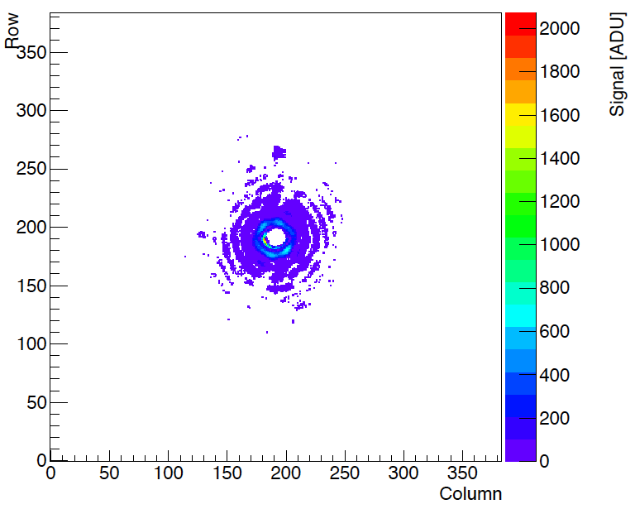
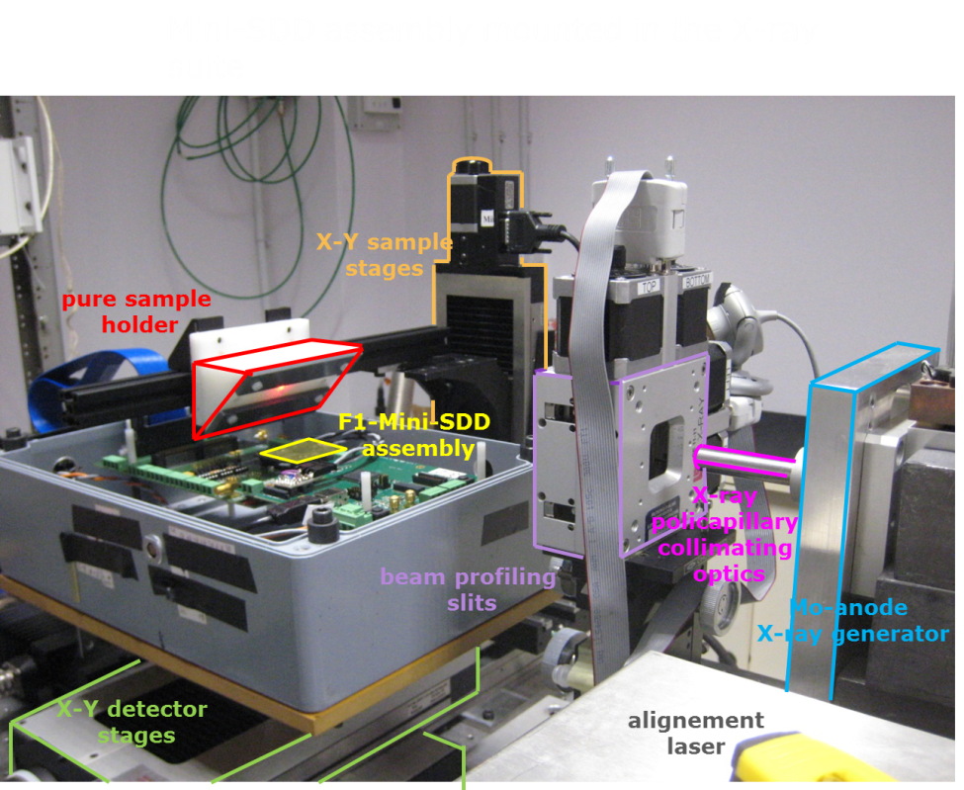
System simulation and calibration
The calibration effort has been increased assigning more tasks and more resources to the group at Polytechnic in Milan
Two setups for F1-MiniSDD assemblies are available and in operation in Milan and Munich
The full acquisition chain is now modeled in the simulation software
The MiniSDD + F1 output nominal characteristic together with all the trim knobs have been implemented
The linearity and the stability of the LED used to calibrate the first DSSC prototype system has been verified -> LED array suitable for calibration of pixel matrix
For the full calibration of the pixel arrays multiple sources have to be used
Array of LED for curve shape determination
X-ray source for low-deposited charge absolute calibration
Proton source for high-deposited charge calibration (beamtime at LABEC scheduled, see calibration slides)
Reconstructed Photons
Photons

Slide 25
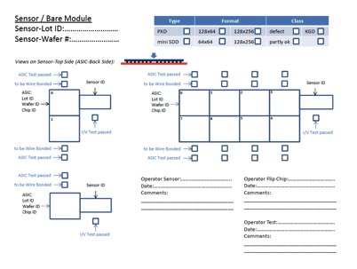
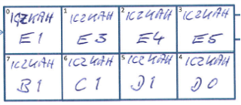
Assemblies list
Each bare module and each FPM is accompanied by a circulation letter (stored at DESY FeC)

Slide 26
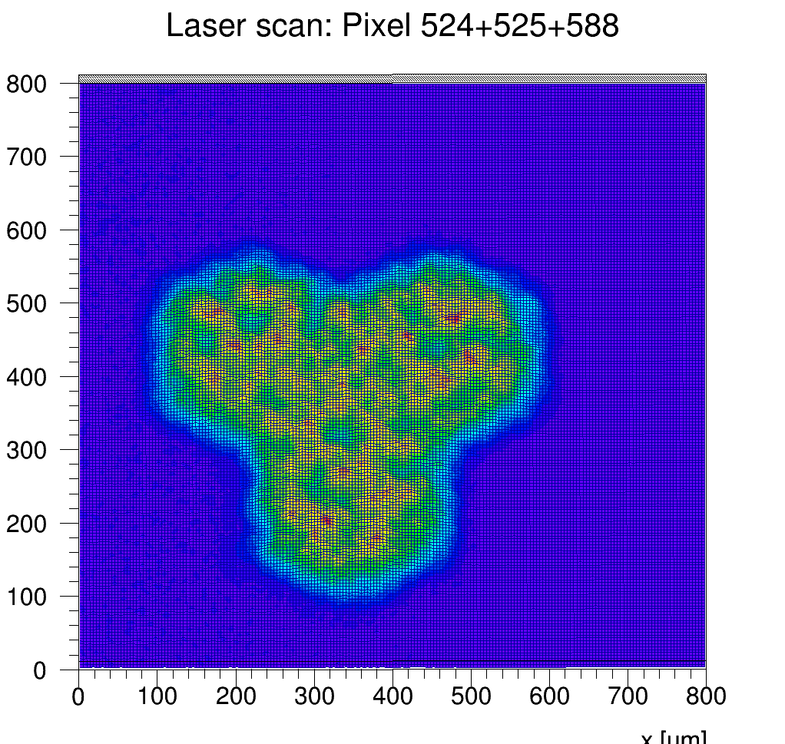
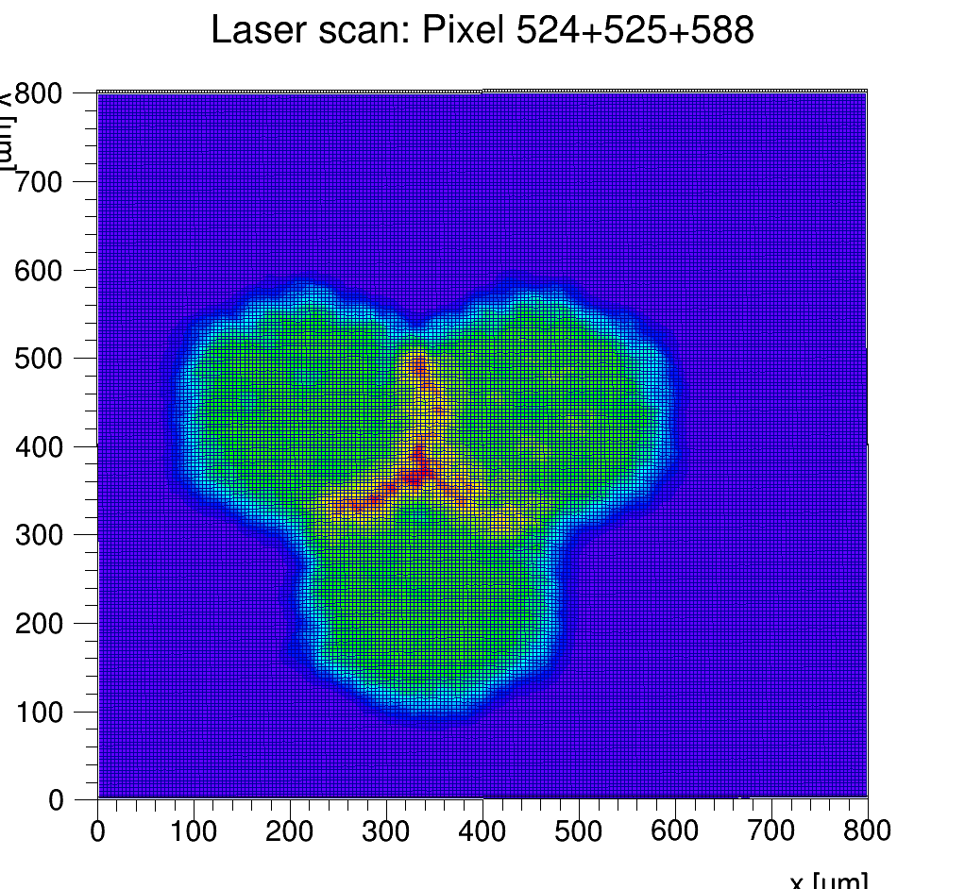
2D Layer Scans
Precisely focussed laser spot (few µm) was used to scan the pixel acceptance:
Hexagonal acceptance obvious
No efficiency loss between pixels ☺
Compression at high charges leads to increase of sum at edges ☺
Sum in 3 pixels
Low charge injection
Sum in 3 pixels (rescaled)
High charge injection

Slide 27
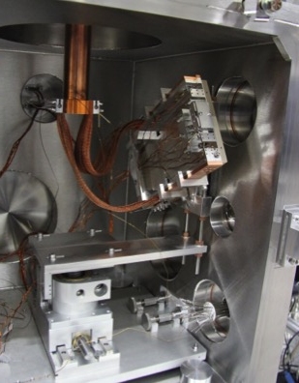
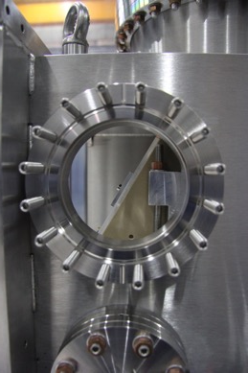
FENICE for the 64x64 sensor
Ladder mechanics repositioned in order to allow illumination of the 64x64 sensor (placed horizontal and not vertical)
System still connected to the motion stages.

