Slide 1
Calibration Data Processing and Simulation 20th Detector Advisory Committee Meeting
Notes:
How to edit the title slide
Upper area: Title of your talk, max. 2 rows of the defined size (55 pt)
Lower area (subtitle): Conference/meeting/workshop, location, date, your name and affiliation, max. 4 rows of the defined size (32 pt)

Slide 2
Overview
Progress since last XDAC
Highlights
Outlook, Open Issues, Conclusion

Slide 3
Progress Since Last XDAC - Overview
PyDetlib is seeing increased usage in WP-75
Analysis of LPD Data (P. Lang)
Analysis of AGIPD Module Data (J. Sztuk)
Analysis of FastCCD Data (I. Klackova)
Analysis of Simulation Data (T. Rüter)
Features added:
Cython code for CPU split-event correction → speed increase
Karabo-interoperatability
Report generator foundation
Central access to publication quality plots
Other than that code relatively stable (which is good)

Slide 4
Progress Since Last XDAC – Report Generator
Base classes in PyDetLib and Karabo integration now foresee inclusion of report generator
Central service device in Karabo
Reports are written in reStructuredText → render to PDF and HTML
Thus can be made available on a web-server
While foundations are laid, currently a bit on hold, as I focus on CAS-related work → not a technical problem, implementation of reports just requires a few days of focused work

Slide 5
Progress Since Last XDAC – Simulation
T. Rüter will continue in group as PhD student after successfully completing his master
Tonn was in Berlin the majority of the last six month to finish lectures → accordingly slower progress on simulations
Work started on releasing the Detector Simulation Pipelines framework to users by early summer
In discussions with SPB to include advanced detector simulations in the SIMEX toolchain (C. Fortmann-Grote)
Initial simulations on angle-of-incidence dependency of detector response

Slide 6
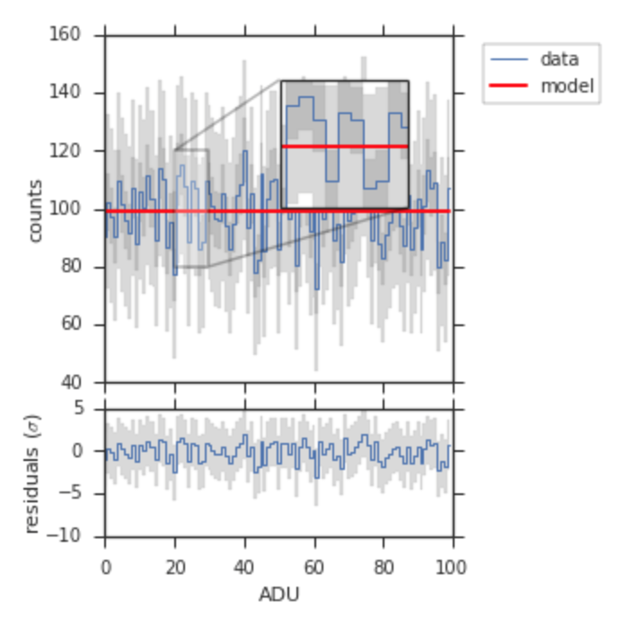
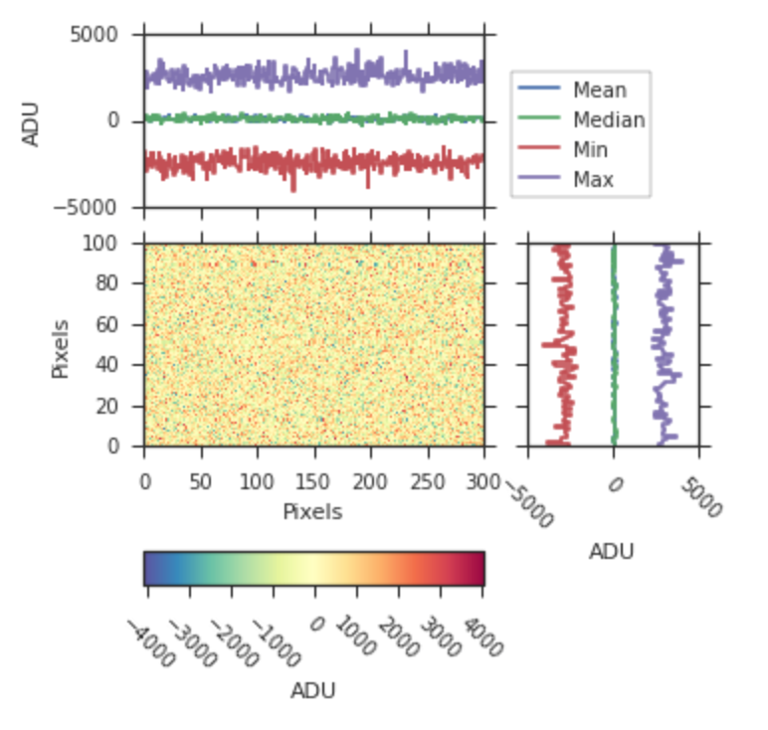
Plotting Library: feel free to use
Driven by requests from group members
The documentation can be found here

Slide 7
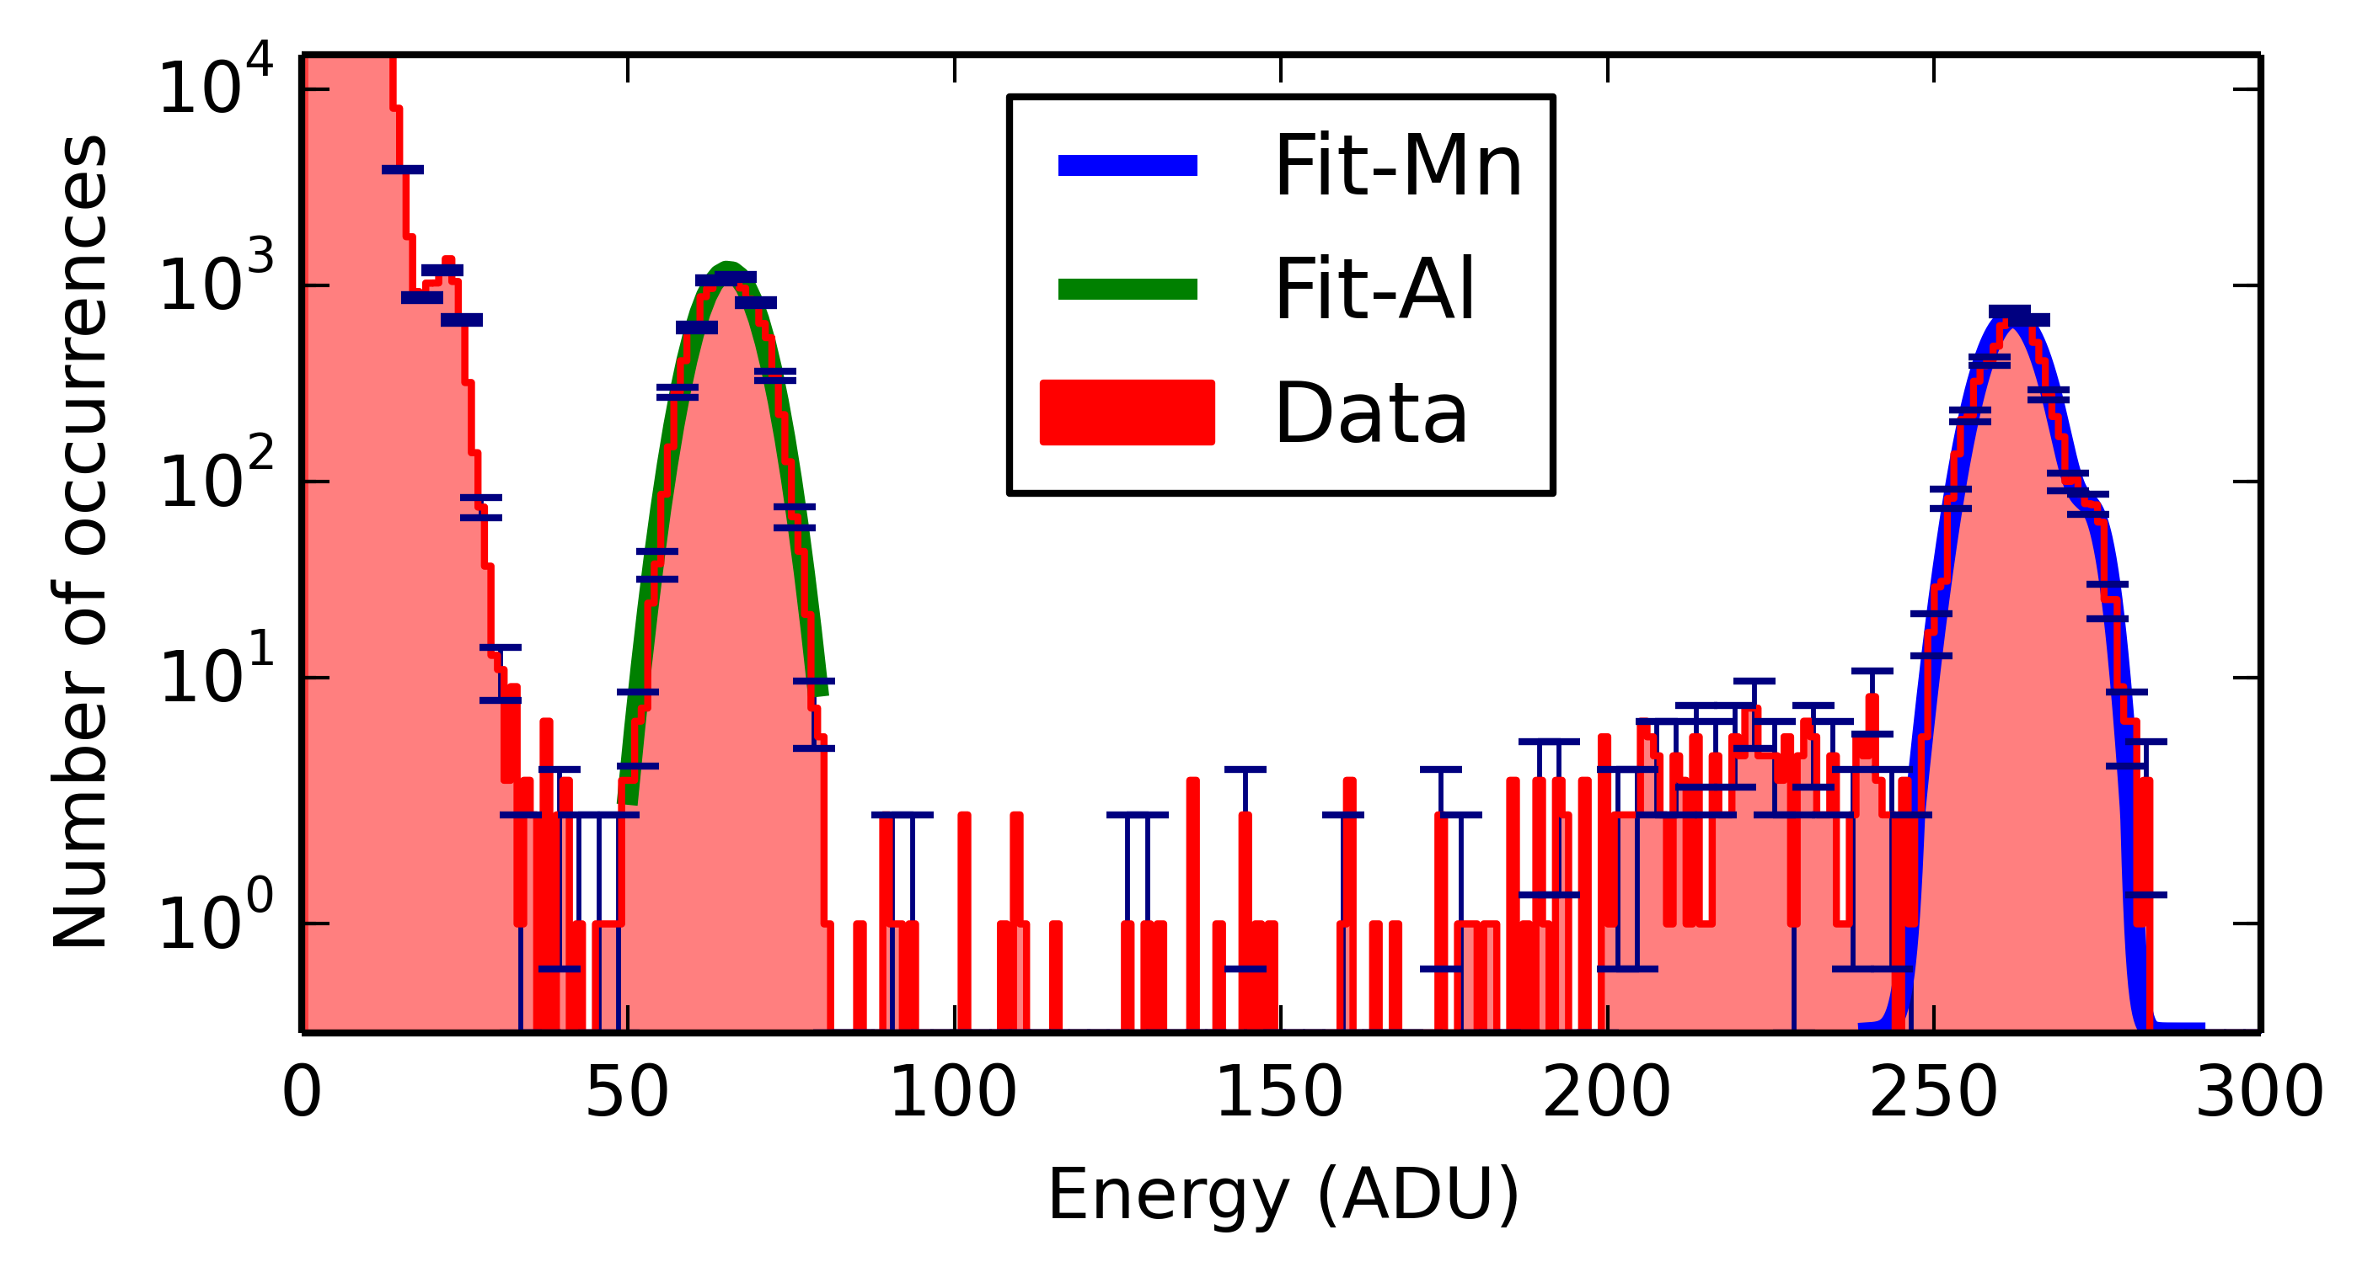
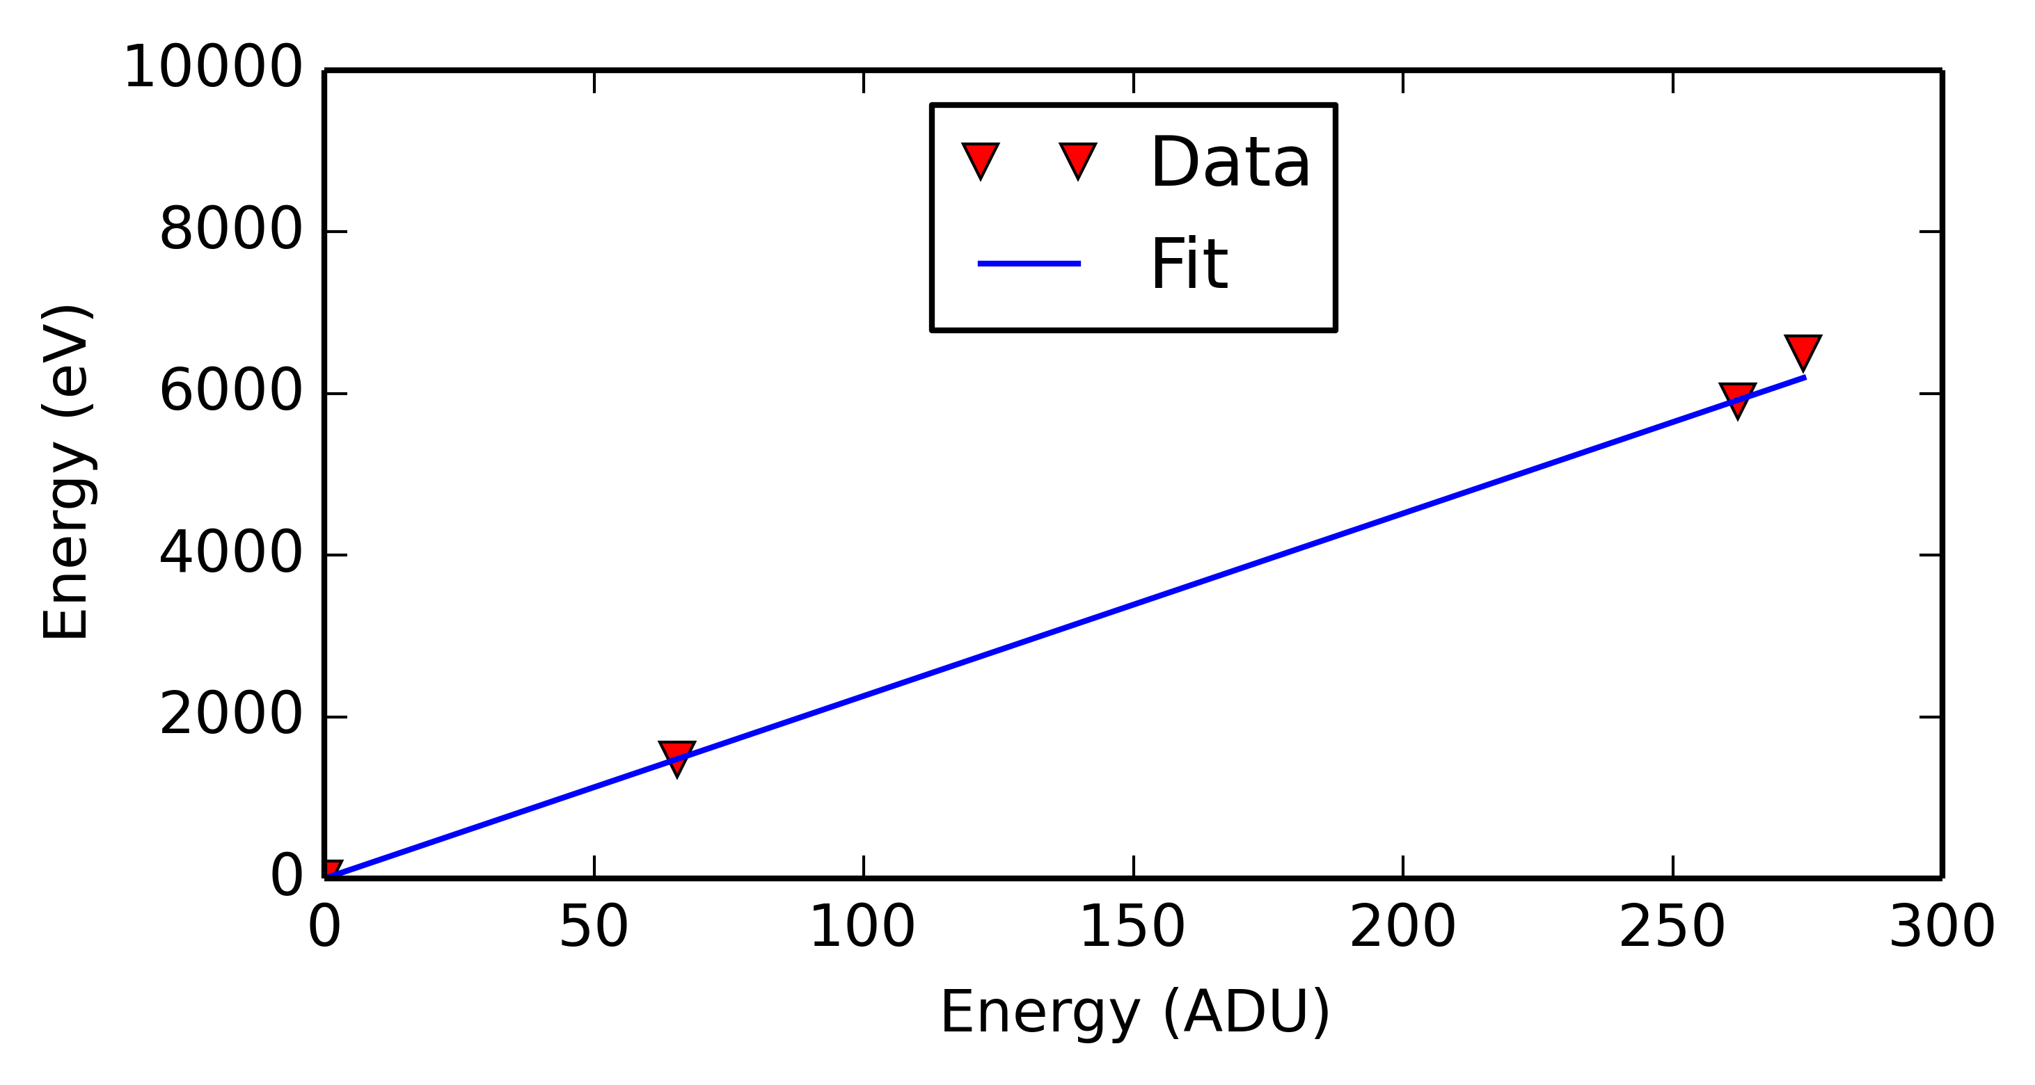
Calibration Analysis – Fast CCD
Characterization and acceptance test is done using PyDetLib
Initial characterization by I. Klackova shows that device fulfills EU.XFEL requirements:
Dark noise: 23.83 e⁻
Energy resolution: 233.68 eV +- 0.11 eV @ 5.9 keV
Detector noise: 23.97 e⁻ @ 5.9 keV
→ ~5.7σ peak sep. at 500 eV

Slide 8
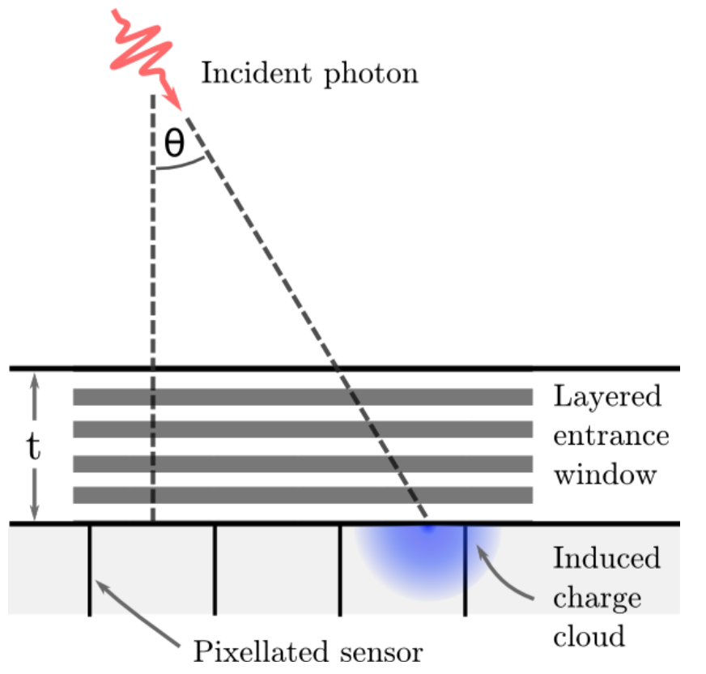
Angle-of-incidence Dependency of Detector Response
Question: how is the charge distribution in pixels affected for high angles of incidence
In Mpix detector split-event probability is low, how large is the contribution of the AOI dependency in forming multi-pixel events
Is an analytic treatment sufficient, or are full simulations needed
Work by T. Rüter

Slide 9
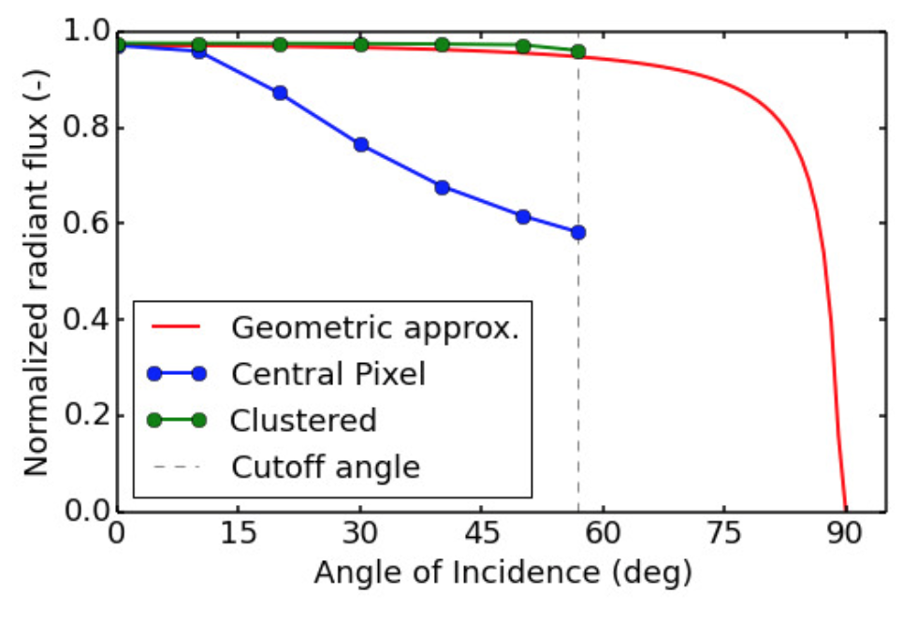
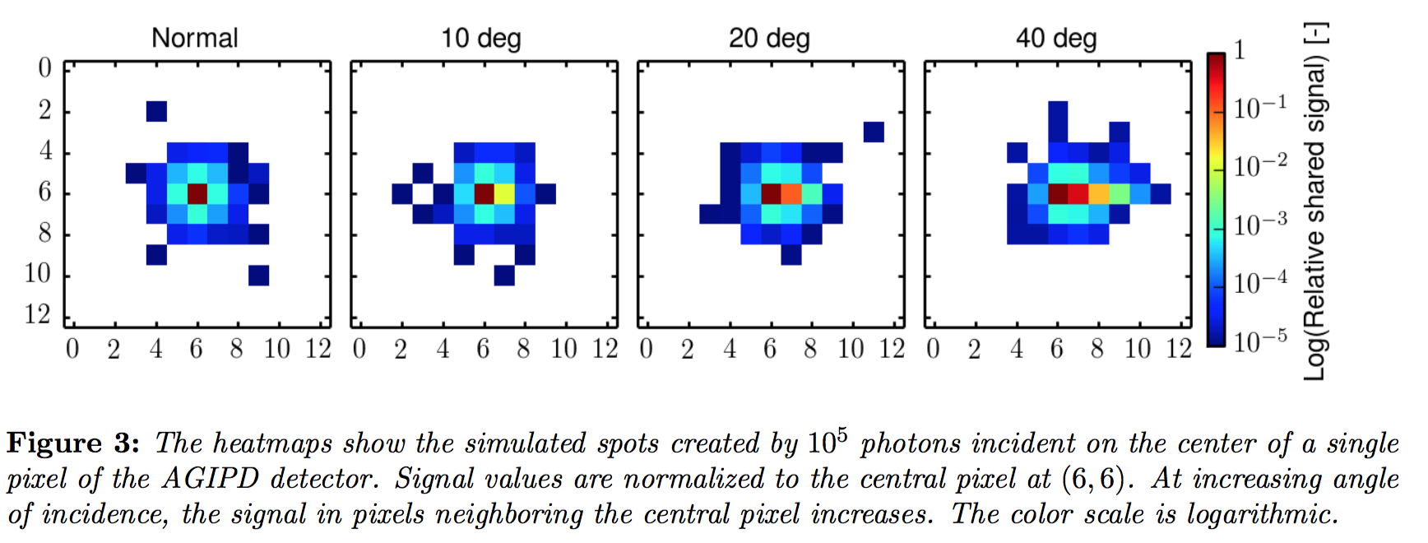
Angle-of-incidence Dependency of Detector Response
Question: how is the charge distribution in pixels affected for high angles of incidence
In Mpix detector split-event probability is low, how large is the contribution of the AOI dependency in forming multi-pixel events
Full scale simulations are needed

Slide 10
Recommendations for Integration of Calibration Software at XFEL
From experience and concept definition:
Python is quickest, use if possible
You can use the PyDetLib base classes if you need to implement stream data processed in a concurrent, thread parallel way
For fitting suggest to use iMiniut: scipy.optimize does not produces reliable quality-of-fit results and uncertainties
Concerning Karabo integrations:
Not started yet: suggestion is to wait for the consolidated version for now (Fall 2016)
Ongoing: work with 1.4.6 upon its release

Slide 11
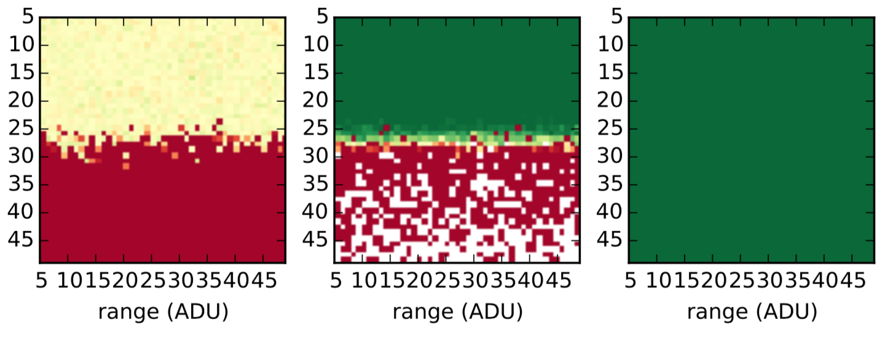
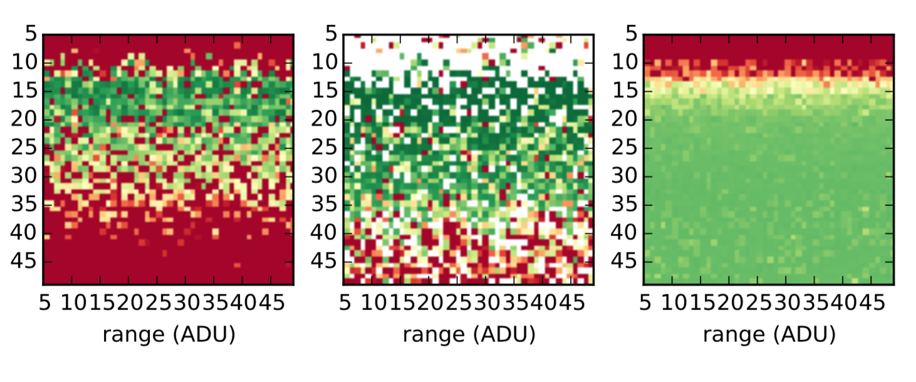
scipy.optimize vs. iMinuit: overlapping gaussian peaks, with random estimate quality
scipy.optimize
iMinuit

Slide 12
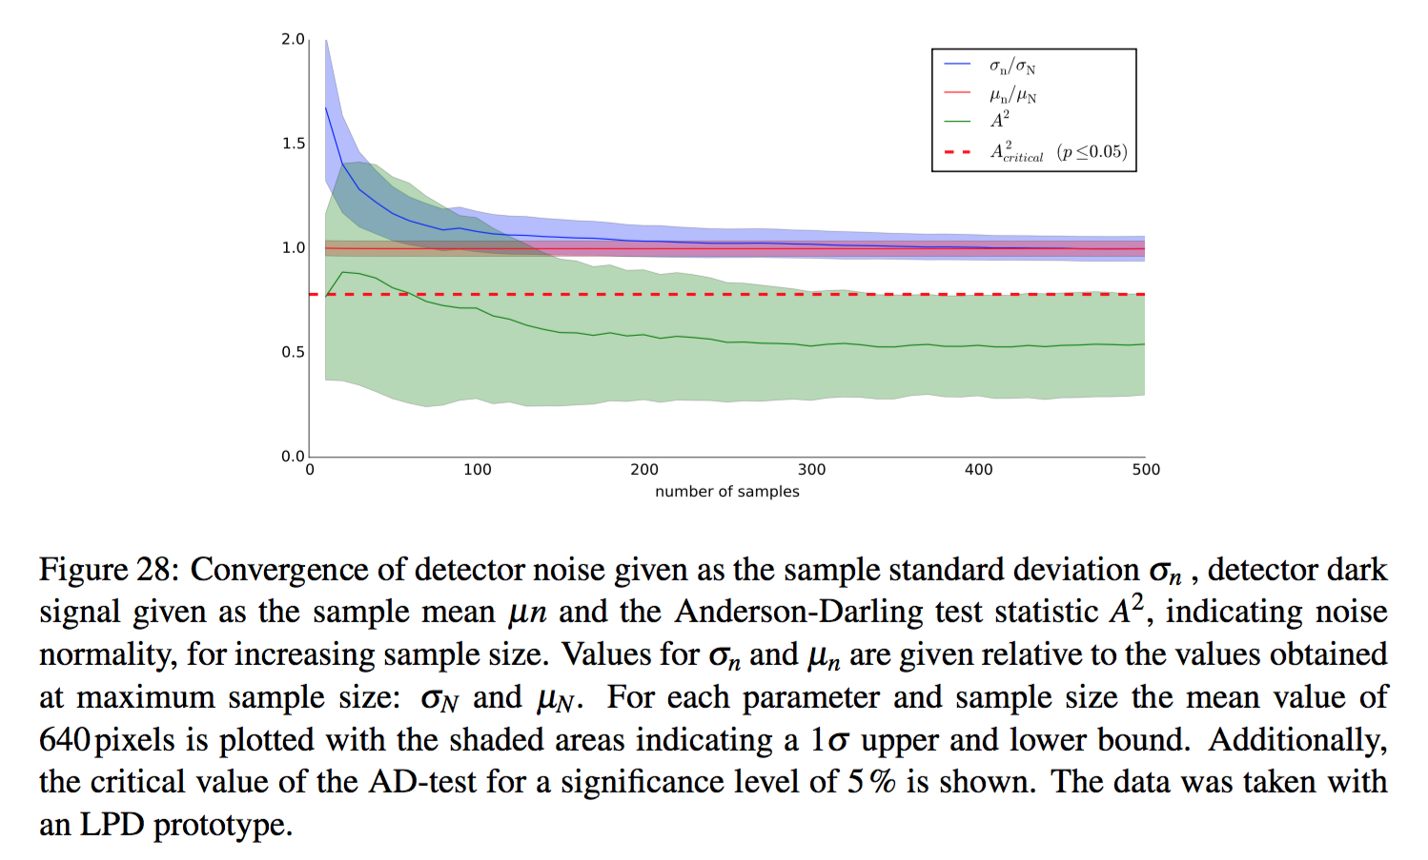
How much data for a 10⁹ parameters space?

Slide 13
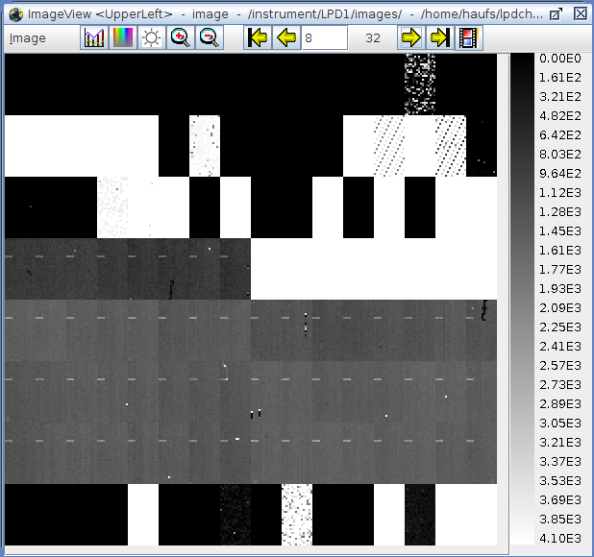
Efficient Storing for Pixel Scans
Problem: charge injection on LPD can only work on small number of pixels simultaneously → fully automated thru macro code by A. Münnich
ITDM supplied DAQ in Karabo
Inefficient storage if full images are stored: pixels with charge injected are known a-priori: just store these.
Similarly for pixel scans
Reduction for LPD: 64x as 2x32 scans are required to cover entire sensor
Implemented small writer in h5py working with numpy MaskedArray
Integrated as pipelined processing in Karabo
Maybe of general usefulness – code can easily be used outside Karabo.

Slide 14
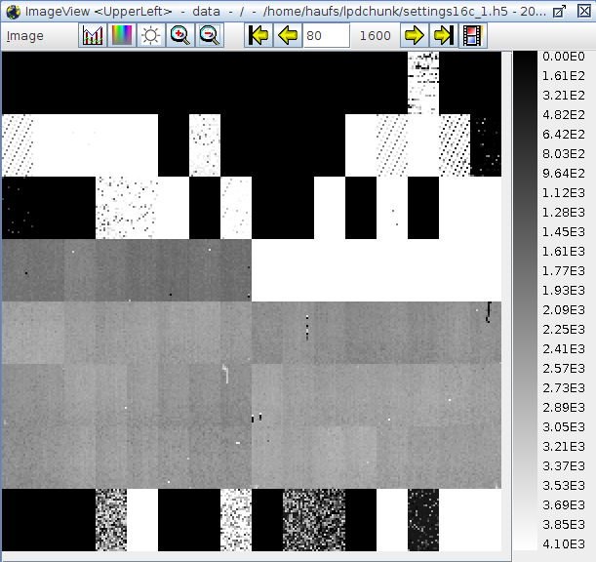
Efficient Storing for Pixel Scans
Problem: charge injection on LPD can only work on small number of pixels simultaneously → fully automated thru macro code by A. Münnich
ITDM supplied DAQ in Karabo
Inefficient storage if full images are stored: pixels with charge injected are known a-priori: just store these.
Similarly for pixel scans
Reduction for LPD: 64x as 2x32 scans are required to cover entire sensor
Implemented small writer in h5py working with numpy MaskedArray
Integrated as pipelined processing in Karabo
Maybe of general usefulness – code can easily be used outside Karabo.

Slide 15
Open Issues
Integration of PyDetLib, the DAQ system and meta-data/calibration catalogues into Karabo has been halted until pre-release of consolidated version.
Some delays due to B. Heisen’s resignation as Karabo lead architect
Concepts for consolidated version have been worked out and documented
CAS is now starting with implementation, follow-up on prelease seams to be feasible from approx. July on
Approximate delay ~ 2 months, but hope to reduce delay afterwards by implementing against stable, documented and scalable day-1 Karabo solution

Slide 16
Outlook and Next Steps
Calibration tools:
Follow up on Karabo as soon as possible
Implement report generator functionality
Simulation tools:
Release initial version of simulation framework to in-house users (June 2016)
Start on integration in SIMEX
Bring pnCCD back online and use for further validation
Finalize AOI dependency work and validate were feasible.

