Slide 1
Detector Error Modes – a general picture
S. Hauf
Notes:
How to edit the title slide
Upper area: Title of your talk, max. 2 rows of the defined size (55 pt)
Lower area (subtitle): Conference/meeting/workshop, location, date,
your name and affiliation, max. 4 rows of the defined size (32 pt)

Slide 2
Generally three types of errors
Per-pixel errors
  Dead pixels, pixel is “broken”, cannot detect X-rays
  Bad pixels, pixel has abnormal noise, baseline etc. but generally capable of detecting X-rays
Per-module errors (for modular detectors)
  Module is “broken”, e.g. power supply defective, but rest of detector still functioning and can be safely operated, data-taking is still possible
Critical detector errors
  Detector cannot be safely operated, maintenance is necessary

Slide 3
Per-Pixel Errors
Impossible to avoid:
  Dead pixels: non-connected pixels from bump bonding process, Pixel front-end in ASIC defective
  Bad pixels: abnormal noise or offset through manufacturing tolerance, parasitic signals, radiation damage, …
Number will increase over time:
  Radiation damage
  Damage from sample debris
  Detector handling mishaps
  …

Slide 4
Per-Pixel Errors – Dead Pixels
To fully identify need:
  Dark image data set: defective ASIC electronics show zero noise, constant value above/below threshold
    Can be done relatively inexpensively and often at beamline
  Illuminated data set: non-connected pixels will “float” at certain value, still fluctuate though and thus may seam okay in a dark image evaluation
    Consortia do checks on integration
    Re-characterization likely requires dedicated flat field setup, or do in-situ from data. In either case, should be compared to upon-integration check

Slide 5
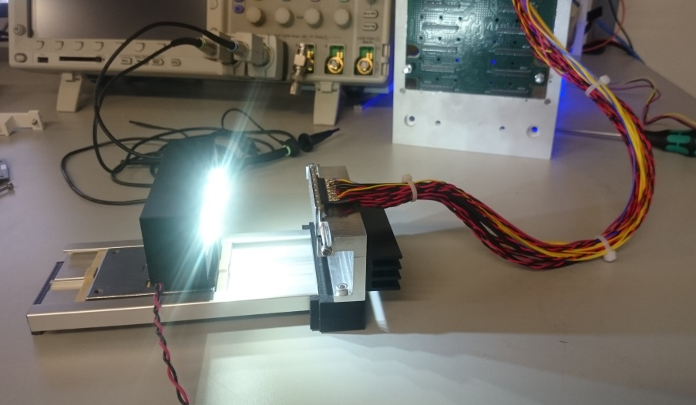
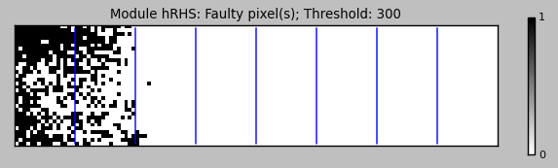
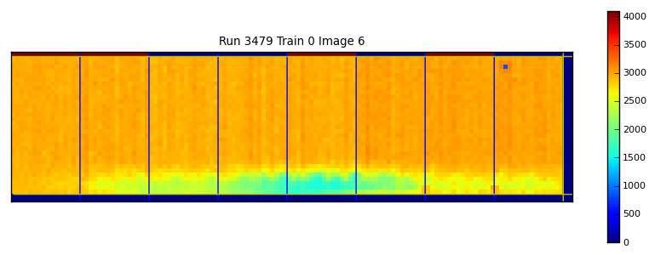
Example. Post-production qualification LPD
Full test as in ASIC wirebond check plus sensor interconnect quality verification
LED array used to highlight unconnected pixels. Long exposure
Test routine also automatically detects and counts shorted pixels.
Rapid feedback into next batch
Tile 10R GOOD – basic illumination from below
Slide courtesy of M. Hart, RAL

Slide 6
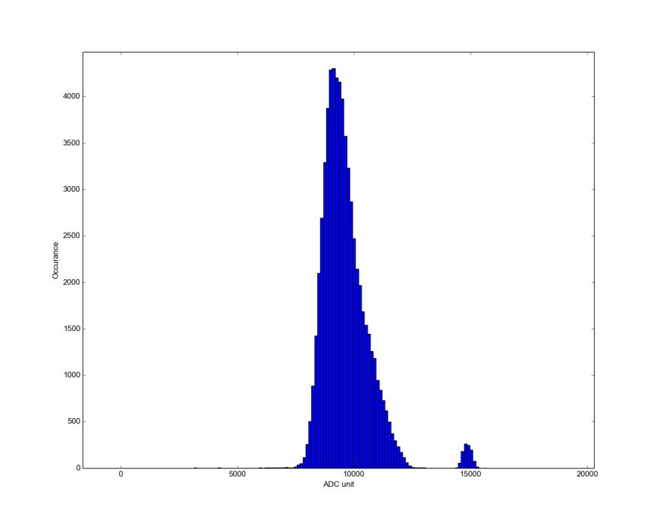
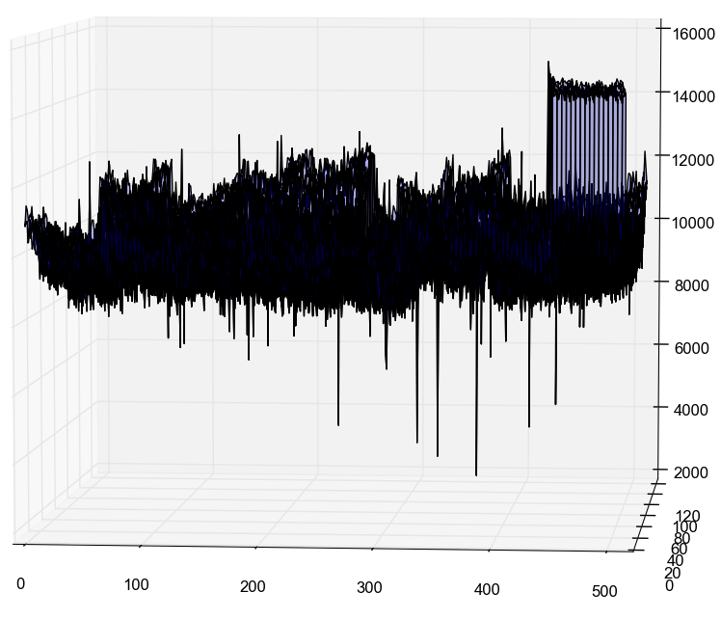
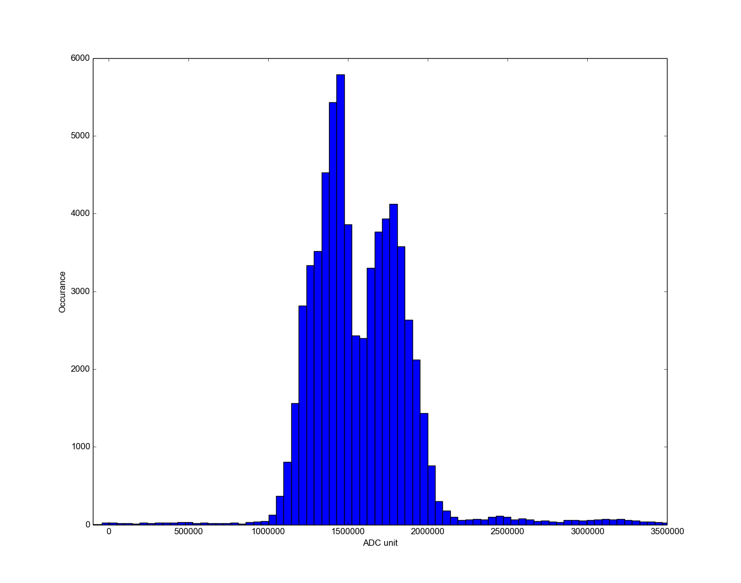
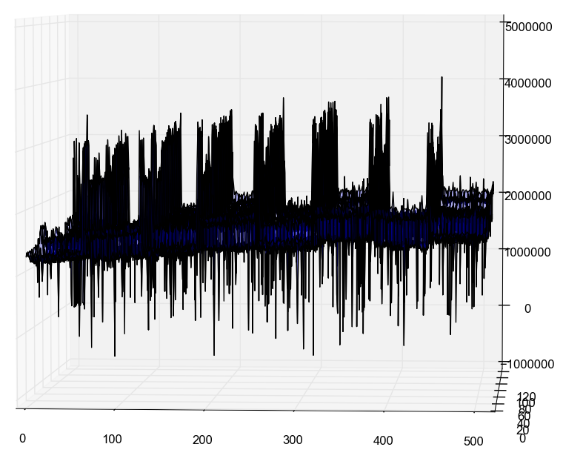
Example: AGIPD post-assembly qualification, which dark frames/current inj. is insufficient
Current injection
~0.1%
X-ray illumination
~0.8%
Slide courtesy of A. Allahghoni, AGIPD consortium

Slide 7
Per-Pixel Errors – Bad Pixels
Readily identifiable by applying thresholds to offset and noise maps → can be repeated often
  Noisy pixels: show an unusual high noise
  Cold pixels: show an unusually low baseline → gain might be lower than usual
  Hot pixels: show an unusually high baseline
Pixels with unusual gain characteristics require flat-field images → more involved procedure

Slide 8
Example: LPD Bad Pixels

Slide 9
Example: PnCCD Bad Pixels
Detector-specific knowledge is required: here, evaluation has to happen per readout-channel, otherwise BP are masked

Slide 10
Questions and Open Issues
Thresholding evaluation can be implemented once
  Threshold to be set by whom?
  What should be the output:
    Bad pixel map
Dead pixel detection is more difficult
  Consequence of this is that a flat field is needed before/after each beam-time.

Slide 11
Per-Module Errors
One or multiple modules on a modular detector are defunct, but the device can still operate safely
  Detector experts define under which conditions safe operation is still possible
  Users and instruments must decide if such operation still makes sense (loss of data vs. loss of beam-time)
Mandatory status fields located in the “pulse data” and “train data” entries in data stream mark defective modules.
  Is this sufficient information for analysis?
  Should the dead pixel map be updated to reflect this?

