Slide 1
Configuration of the online calibration pipelines - throughput limiting factors
S. Hauf
Notes:
How to edit the title slide
Upper area: Title of your talk, max. 2 rows of the defined size (55 pt)
Lower area (subtitle): Conference/meeting/workshop, location, date,
your name and affiliation, max. 4 rows of the defined size (32 pt)

Slide 2
Before monitoring starts - Interfacing to the calibration database
(optional) update calibration database with new data from dark images (offset, noise, subset of bad pixel parameters) → will be configured and available as an automated procedure, processing time of < 5 minutes expected.
(mandatory) load the calibration and correction constants pertinent to the current detector operating conditions → needs to be done only if settings are changed, and even then relatively quick: tens of seconds.

Slide 3
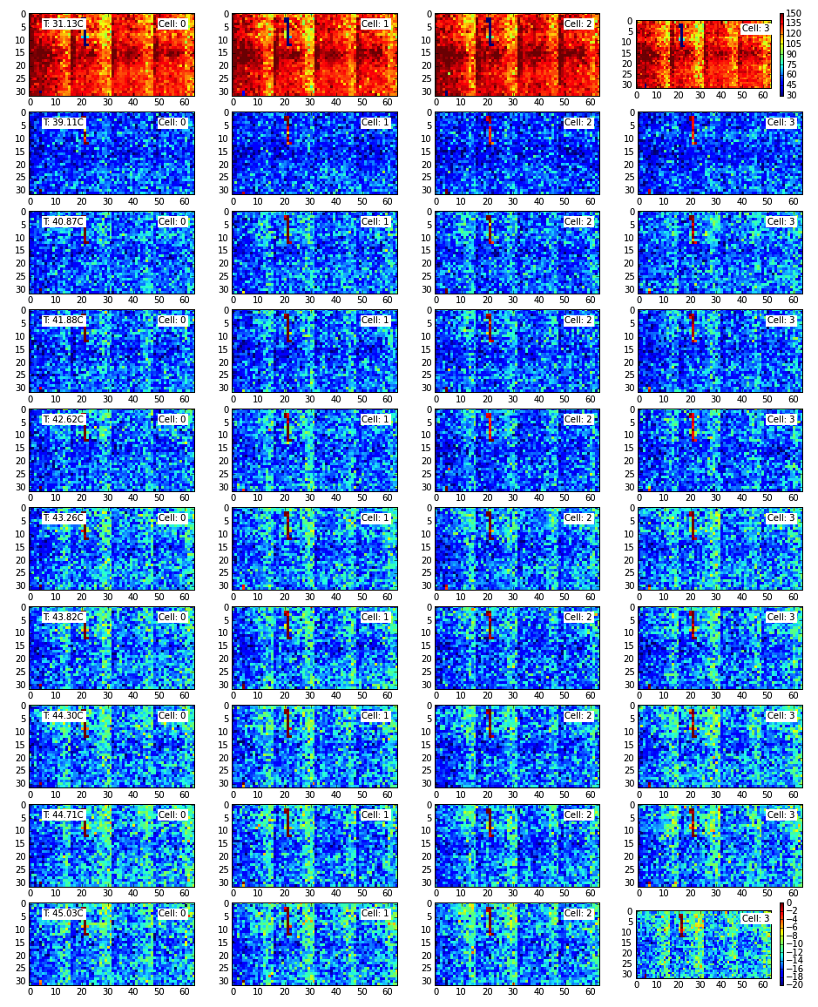
Before correction starts – retrieving the right constant
Cal. Measurement 1
Condition Set 1: T = 20°C ± 1 °C, V = 200V ± 5V, E = 12keV ± 0.1keV,
p = log(10⁻³bar) ± 1log(bar) …
Quantum efficiency
Condition Set 2: T = 25°C ± 1 °C, V = 200V ± 5V, E = 18keV ± 0.1keV,
p = log(10⁻³bar) ± 1log(bar) …
Cal. Measurement 2
Gain map
Gain map
Offset map
Offset map
Offset map
Offset map
Offset map
Offset map
Quantum efficiency
Updates CS1
Noise map
Noise map
Noise map
Noise map
Noise map
Noise map
Condition Set n: T = 21°C ± 1 °C, V = 195V ± 5V, E = 12keV ± 0.1keV,
p = log(10⁻³bar) ± 1log(bar) …
Gain map
Gain map
Offset map
Offset map
Offset map
Week 10
Week 11
Cal. Measurement n
Offset map
Offset map
Offset map
Noise map
Quantum efficiency
Noise map
Noise map
Noise map
Noise map
Noise map
Gain map
Gain map
Offset map
Week 10
Week 11
Offset map
Offset map
Offset map
Offset map
Offset map
Noise map
Noise map
Noise map
Noise map
Noise map
Noise map
Week 10
Week 11

Slide 4
Calibration Database – Versioning and Detector-Condition-based Injection & Querying
Condition Set 1: T = 20°C ± 1 °C, V = 200V ± 5V, E = 12keV ± 0.1keV,
p = log(10⁻³bar) ± 1log(bar) …
Observation with Det. X at Condition Y
Quantum efficiency
Condition Set 2: T = 25°C ± 1 °C, V = 200V ± 5V, E = 18keV ± 0.1keV,
p = log(10⁻³bar) ± 1log(bar) …
Gain map
Gain map
Conditions
Offset map
Offset map
Offset map
Offset map
Offset map
Offset map
Quantum efficiency
Noise map
Noise map
Noise map
Noise map
Noise map
Noise map
Condition Set n: T = 21°C ± 1 °C, V = 195V ± 5V, E = 12keV ± 0.1keV,
p = log(10⁻³bar) ± 1log(bar) …
Gain map
Gain map
Offset map
Offset map
Offset map
Week 10
Week 11
Offset map
Offset map
Offset map
required constants
Quantum efficiency
Noise map
Noise map
Noise map
Noise map
Noise map
Noise map
Gain map
Gain map
Offset map
Week 10
Week 11
Offset map
Offset map
Offset map
Offset map
Offset map
Noise map
Noise map
Noise map
Noise map
Noise map
Noise map
Week 10
Week 11

Slide 5
Calibration Database – Versioning and Detector-Condition-based Injection & Querying
Condition Set 1: T = 20°C ± 1 °C, V = 200V ± 5V, E = 12keV ± 0.1keV,
p = log(10⁻³bar) ± 1log(bar) …
Observation with Det. X at Condition Y
Matching data
Quantum efficiency
Condition Set 2: T = 25°C ± 1 °C, V = 200V ± 5V, E = 18keV ± 0.1keV,
p = log(10⁻³bar) ± 1log(bar) …
Gain map
Gain map
Matching data
Conditions
Offset map
Offset map
Offset map
Offset map
Offset map
Offset map
Quantum efficiency
Noise map
Noise map
Noise map
Noise map
Noise map
Noise map
Condition Set n: T = 21°C ± 1 °C, V = 195V ± 5V, E = 12keV ± 0.1keV,
p = log(10⁻³bar) ± 1log(bar) …
Gain map
Gain map
Matching data
Offset map
Offset map
Offset map
Week 10
Week 11
Offset map
Offset map
Offset map
required constants
Quantum efficiency
Noise map
Noise map
Noise map
Noise map
Noise map
Noise map
Gain map
Gain map
Offset map
Week 10
Week 11
Offset map
Offset map
Offset map
Offset map
Offset map
Noise map
Noise map
Noise map
Noise map
Noise map
Noise map
Week 10
Week 11

Slide 6
Calibration Database – Versioning and Detector-Condition-based Injection & Querying
Condition Set 1: T = 20°C ± 1 °C, V = 200V ± 5V, E = 12keV ± 0.1keV,
p = log(10⁻³bar) ± 1log(bar) …
Observation with Det. X at Condition Y
Matching data
Quantum efficiency
Condition Set 2: T = 25°C ± 1 °C, V = 200V ± 5V, E = 18keV ± 0.1keV,
p = log(10⁻³bar) ± 1log(bar) …
Gain map
Gain map
Matching data
Conditions
Offset map
Offset map
Offset map
Offset map
Offset map
Offset map
Quantum efficiency
Noise map
Noise map
Noise map
Noise map
Noise map
Noise map
Condition Set n: T = 21°C ± 1 °C, V = 195V ± 5V, E = 12keV ± 0.1keV,
p = log(10⁻³bar) ± 1log(bar) …
Gain map
Gain map
Matching data
Offset map
Offset map
Offset map
Week 10
Week 11
Offset map
Offset map
Offset map
required constants
Quantum efficiency
Noise map
Noise map
Noise map
Noise map
Noise map
Noise map
Constants
Gain map
Gain map
Offset map
Week 10
Week 11
Offset map
Offset map
Offset map
Offset map
Offset map
Noise map
Noise map
Noise map
Noise map
Noise map
Noise map
Week 10
Week 11

Slide 7
Calibration Database – Versioning and Detector-Condition-based Injection & Querying
Condition Set 1: T = 20°C ± 1 °C, V = 200V ± 5V, E = 12keV ± 0.1keV,
p = log(10⁻³bar) ± 1log(bar) …
Observation with Det. X at Condition Y
Matching data
Quantum efficiency
Condition Set 2: T = 25°C ± 1 °C, V = 200V ± 5V, E = 18keV ± 0.1keV,
p = log(10⁻³bar) ± 1log(bar) …
Gain map
Gain map
Matching data
Conditions
Conditions
Offset map
Offset map
Offset map
Offset map
Offset map
Offset map
Quantum efficiency
Noise map
Noise map
Noise map
Noise map
Noise map
Noise map
Condition Set n: T = 21°C ± 1 °C, V = 195V ± 5V, E = 12keV ± 0.1keV,
p = log(10⁻³bar) ± 1log(bar) …
Gain map
Gain map
Matching data
Matching data
Offset map
Offset map
Offset map
Week 10
Week 11
Offset map
Offset map
Offset map
required constants
Quantum efficiency
Noise map
Noise map
Noise map
Noise map
Noise map
Noise map
Constants
Constants
Gain map
Gain map
Offset map
Week 10
Week 11
Offset map
Offset map
Offset map
Offset map
Offset map
Noise map
Noise map
Noise map
Noise map
Noise map
Noise map
Week 10
Week 11

Slide 8
Calibration Database – Version Management
Condition Set 1: T = 20°C ± 1 °C, V = 200V ± 5V, E = 12keV ± 0.1keV,
p = log(10⁻³bar) ± 1log(bar) …
Observation with Det. X at Condition Y
Matching data
Quantum efficiency
Condition Set 2: T = 25°C ± 1 °C, V = 200V ± 5V, E = 18keV ± 0.1keV,
p = log(10⁻³bar) ± 1log(bar) …
Gain map
Gain map
Matching data
Conditions
Conditions
Offset map
Offset map
Offset map
Offset map
Offset map
Offset map
Quantum efficiency
Noise map
Noise map
Noise map
Noise map
Noise map
Noise map
Condition Set n: T = 21°C ± 1 °C, V = 195V ± 5V, E = 12keV ± 0.1keV,
p = log(10⁻³bar) ± 1log(bar) …
Gain map
Gain map
Matching data
Matching data
Offset map
Offset map
Offset map
Week 10
Week 11
Offset map
Offset map
Offset map
required constants
Quantum efficiency
Noise map
Noise map
Noise map
Noise map
Noise map
Noise map
Constants
Constants
Gain map
Gain map
Offset map
Week 10
Week 11
Offset map
Offset map
Offset map
Offset map
Offset map
Noise map
Noise map
Noise map
Noise map
Noise map
Noise map
Week 10
Week 11

Slide 9
Online Calibration
Karabo-online views of scattering in a ferrous solution imaged by LPD
Calibration of the data in the online monitoring stream often makes sense.
Possible limiting factors:
  I/O rate
  Processing rate
  Latency

Slide 10
I/O Limitations
Should especially for monitoring data (~1Hz update interval) not be an issue:
  1Mpixel * 512 Memory Cells * 4B(float) = 16Gbit/s
  Network connection: Infiniband@56Gbit/s
  → Limitation rather on processing side?

Slide 11
Possible components of correction pipelines
granularity
pixel
row/column
image
Droop
correct.
Split
events
Offset
sub.
CM
correct.
CTI correct.
Gain correct.

Slide 12
Possible components of correction pipelines
granularity
pixel
row/column
image
Droop
correct.
Split
events
Offset
sub.
CM
correct.
CTI correct.
Gain correct.

Slide 13
Possible components of correction pipelines
granularity
pixel
row/column
image
Droop
correct.
Split
events
Offset
sub.
CM
correct.
CTI correct.
Gain correct.

Slide 14
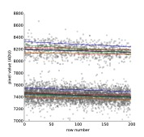
Possible components of correction pipelines
granularity
pixel
row/column
image
Droop
correct.
Split
events
Offset
sub.
CM
correct.
CTI correct.
Gain correct.

Slide 15
Possible components of correction pipelines
granularity
pixel
row/column
image
Droop
correct.
Split
events
Offset
sub.
CM
correct.
CTI correct.
Gain correct.

Slide 16
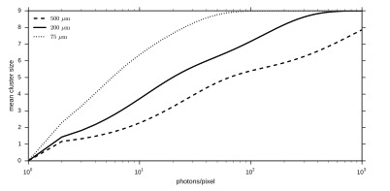
Possible components of correction pipelines
granularity
pixel
row/column
image
Droop
correct.
Split
events
Offset
sub.
CM
correct.
CTI correct.
Gain correct.

Slide 17
Possible components of correction pipelines
granularity
Experience shows that the two most expensive corrections are:
  Common mode: needs to calculate a per-row median, involves sorting → sorting network fastest implementation
  Split-events: need to scan a 25 pixel box for each pixel
pixel
row/column
image
40%
7%
Droop
correct.
Split
events
7%
40%
7%
Offset
sub.
CM
correct.
CTI correct.
Gain correct.

Slide 18
Possible components of correction pipelines – and importance on throughput
granularity
pixel
row/column
image
40%
7%
Droop
correct.
Split
events
7%
40%
7%
Offset
sub.
CM
correct.
CTI correct.
Gain correct.

Slide 19
Possible components of correction pipelines – and importance of throughput
granularity
pixel
row/column
image
This is sufficient for 10Hz operation using all correction steps
40%
7%
Droop
correct.
Split
events
7%
40%
7%
Offset
sub.
CM
correct.
CTI correct.
Gain correct.

Slide 20
What about alignment?
For online displays, approximate accuracy should often be sufficient, e.g. accurate to the pixel size of the display.
  Use rendering routines of Karabo-GUI (underlying GuiQwt) to apply geometry information
  Negligible penalty if no geometry does not change often (updates in position)

Slide 21
Conclusion
Quite confident the online calibration will not limit throughput but:
  How critical is latency? Longer correction pipelines will add roughly 100-500ms of per component
  Pipelines are configured to “drop on slowness” to allow PC-layer to prioritize persisting of data.
    The slowest pipeline step will limit the throughput

Slide 22
Conclusion
    The slowest pipeline step will limit the throughput
  Do not do heavy processing in the GUI (widgets) as this will be limited to ~1Hz of update rate.
  If latency is not an issue consider elongating the pipeline, i.e. split processing into concurrent tasks an let the pipeline act as “cache”
  Keep in mind that we do not foresee persisting in the midst of the monitoring stream, once data is dropped due to slowness it will only be available offline.

