Slide 1
An Introduction into foreseen dataflows at the European XFEL
(and common vocabulary)
S. Hauf
Notes:
How to edit the title slide
Upper area: Title of your talk, max. 2 rows of the defined size (55 pt)
Lower area (subtitle): Conference/meeting/workshop, location, date,
your name and affiliation, max. 4 rows of the defined size (32 pt)

Slide 2
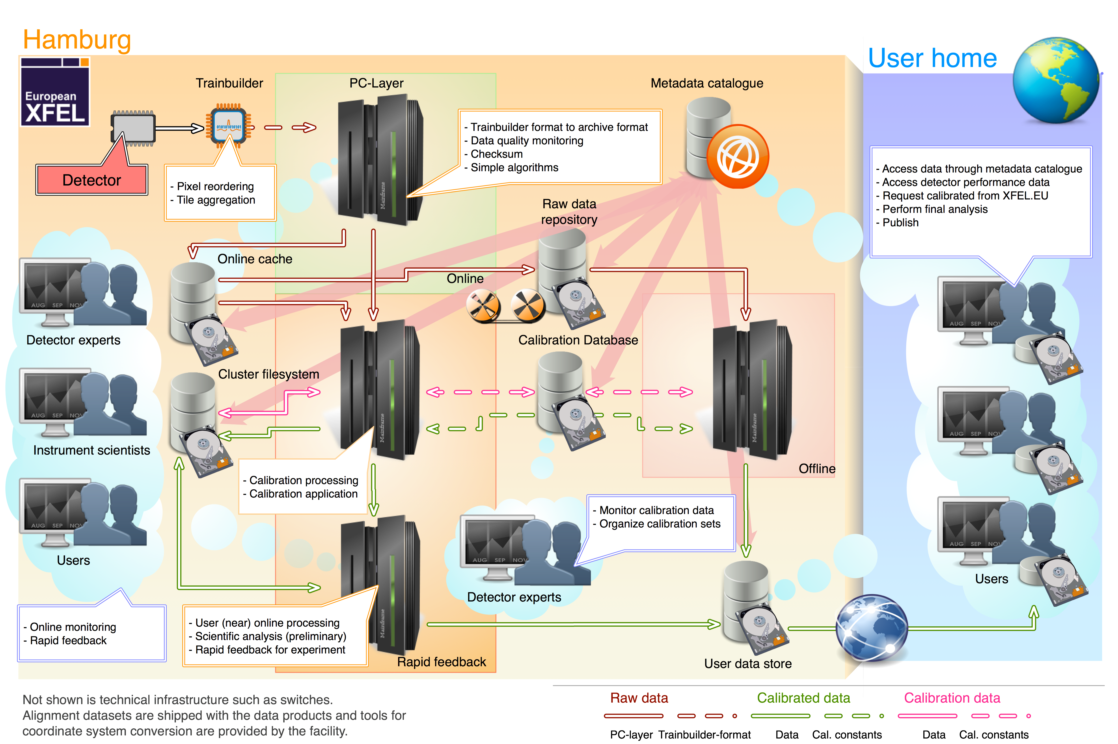
The Big Picture

Slide 3
The Big Picture
Data products from the fast 2D detectors: raw and calibrated data

Slide 4
The Big Picture
The hierarchical data format

Slide 5
The Big Picture
The PC-Layer: where data hits the disks

Slide 6
The Big Picture
The HDF5 format to be used at European XFEL

Slide 7
The Big Picture
Retrieving and querying data as a user

Slide 8
The Big Picture
Concurrent processing in Karabo

Slide 9
The Big Picture
The XFEL calibration pipeline

Slide 10
The Big Picture
At the end of the workshop we will have visited most components in this diagram
Notes:
----- Meeting Notes (02.02.16 16:57) -----
Add pictures of devices

Slide 11
Common Vocabulary – Data products
Definitions as published in Kuster, Markus, et al. "Detectors and Calibration Concept for the European XFEL." Synchrotron radiation news 27.4 (2014): 35-38.
Raw data represents digitized detector signal, not altered by detector-specific corrections or calibrations; e.g., it is in the form of detector units such as analogue digital units (ADU). Vetoing, either by hard- or software triggers and zero-value suppression (e.g., by transferal to event lists), may have been performed and is irreversible. Raw data is the main archival data product at the European XFEL. It is not foreseen to be ex- ported outside the facility, and is not meant to be directly user-accessible.

Slide 12
Common Vocabulary – Data products
Definitions as published in Kuster, Markus, et al. "Detectors and Calibration Concept for the European XFEL." Synchrotron radiation news 27.4 (2014): 35-38.
Calibrated data is generated from raw data by applying detector- specific corrections and transformation to physical units (calibration)— e.g., photons per pixel. Calibrated data is the standard data product with which users will be provided. It is not archived; instead, if a calibrated dataset is not accessible through the online-cache or user-space anymore it is requested, it will be reprocessed on the fly from the raw data repository using the appropriate calibration parameters provided by the calibration database.

Slide 13
Common Vocabulary – Data products
Definitions as published in Kuster, Markus, et al. "Detectors and Calibration Concept for the European XFEL." Synchrotron radiation news 27.4 (2014): 35-38.
Calibrated data – distinctions
Calibration and correction constants are used to correct and calibrate raw data. Correction involves “removing” detector specific components to the signal. Calibration is the process of converting detector units to physical units, e.g. photons.
Calibration data production it the process of producing calibration and correction constants
Correction and calibration application is the process of correcting and calibrating raw data into calibrated data
Notes:
----- Meeting Notes (02.02.16 16:57) -----
constants -> parameters

Slide 14
Common Vocabulary – Data products
Definitions as published in Kuster, Markus, et al. "Detectors and Calibration Concept for the European XFEL." Synchrotron radiation news 27.4 (2014): 35-38.
Alignment data is generated from dedicated alignment measurements, providing the position of each detector pixel and detector module in three-dimensional space. It is stored in the detector coordinate system (i.e., as pixel coordinates) and no additional interpolation or coordinate transformation will be applied. Alignment data is part of the standard data products with which users will be provided.

Slide 15
Common Vocabulary – Data products
The previous definitions are mainly meant for (non-commercial) 2D-detector data (and strip detectors such as Gotthard).
Commercial cameras might already provide calibrated data as output
For digitizers etc. the notion of calibration will be much more application-specific, i.e. depending on use-case “raw” data might be provided.

Slide 16
Common Vocabulary – Karabo Hash
In essence the Karabo-Hash is a associative data structure, which maps values to keys. Keys can be organized as hierarchical paths. Values have types preserved.
    C++ - equivalent: std::map<string, T>
    Python –equivalent : dict()
    Markup: XML ← best conceptual match
Actually, more like boost::any
In more detail in the concurrency session

Slide 17
Calibration and Correction Parameters of XFEL Detectors

Slide 18
Why we plan on supplying calibrated data only
AGIPD image of a pen-drive, corrected with PyDetLib
(offset, common-mode, relative gain, bad-pixel masking)
Raw
~10⁹ correction and calibration constants, evaluated for the correct detector operating conditions.
~ Gigabytes of calibration constants needed
Corrected
Arbitrary units
Data courtesy of AGIPD consortium

Slide 19
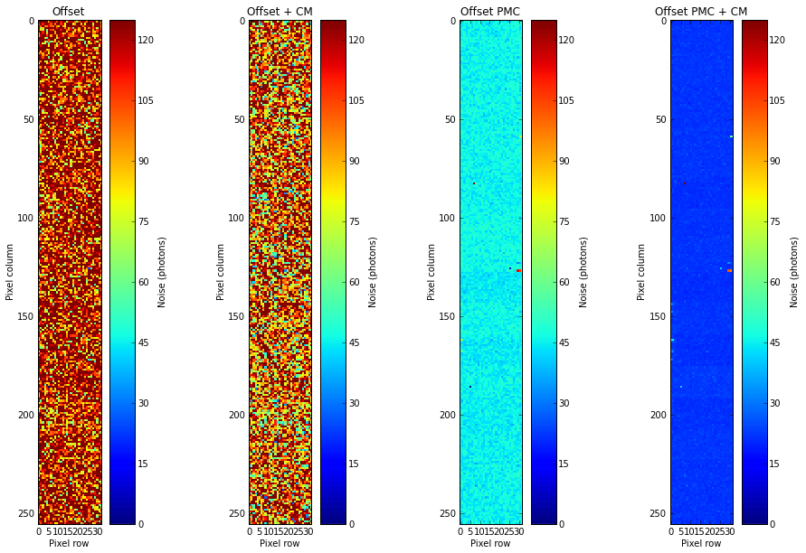
Why we plan on supplying calibrated data only
Example LPD: In terms of e.g. offset correction the LPD is 1.5 Gpixel detector: 1 Mpx x 512 memory cells x 3 Gains
→ “Offset map” will have approx. 3 GB in size
Raw
~10⁹ correction and calibration constants, evaluated for the correct detector operating conditions.
~ Gigabytes of calibration constants needed
Corrected

Slide 20
Benchmarking calibration routines: pnCCD
CAST pn-CCD
200x64 pixels
150 μm x 150 μm pixel size
300 μm sensor thickness
71.775 ms cycle time
Comparison of existing, proven and validated CAST pipeline to XFEL implementation
Parameter | CAST | XFEL | Diff. (%)
Min (median) | 296.0 | 296.0 | 0
Max (median) | 1372.0 | 1372.0 | 0
Noise (median) | 5.3 | 5.2 | 1.8%
Peak pos (ADU) | 986.3 | 979.1 | 0.7%
Peak FWHM (eV) | 198.6 | 207.0 | 4.1%
ADU/eV | 0.17 | 0.17 | 0%
Slightly better optimized event threshold
Different (not as good)
Implementation
– remedied

Slide 21
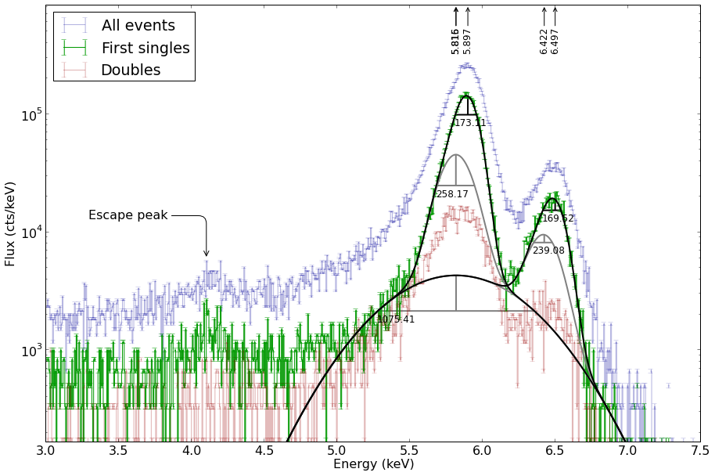
XFEL pipeline now exceeds performance of CAST pipeline
FWHM
173.1 ± 0.7 eV vs. 189.0 ± ?.? eV
at same efficiency

Slide 22
Why we plan on supplying calibrated data only
Facility-side calibration means:
Users neither have to provide large amounts of computing resources nor have to have in-depth expertise on detector physics to obtain state-of-the-art corrected and calibrated datasets for their experiments and can thus focus on their scientific analysis. Additionally, data aggregation of different experiments and instruments are simplified as calibration becomes user-independent.
Raw
~10⁹ correction and calibration constants, evaluated for the correct detector operating conditions.
~ Gigabytes of calibration constants needed
Corrected

Slide 23
The Big Picture

Slide 24
Why we plan on supplying calibrated data only – benefits for online monitoring
Karabo-online views of scattering in a ferrous solution imaged by LPD
Pipelined correction routines can be used in offline and online processing
Full or partial correction of (subset of) data before passing it on to dedicated monitoring/quick analysis routines

Slide 25
The Big Picture

Slide 26
Detector Alignment Data
Hierarchical concept for local detector alignment (not global instrument alignment)
Discussions with instruments yielded understanding that alignment of components, which may be moved on a per-run basis (i.e. quadrants), require input and support from instrument side (e.g. using powder samples)
XFEL photon system coordinate system (WP-73) is used
Alignment data will be shipped with calibrated data
WP-75 will provide transformation from pixel to Cartesian coordinates
Technical note exists with requirements from each instrument: https://bib-pubdb1.desy.de/record/222635
Instruments + WP 75
WP 75
Detector normal x,y,z
Module x,y,z
w.r.t. panel reference
Detector
reference origin
Absolute lab reference
Panel reference origin

Slide 27
Detector Alignment Data
For centralized processing (e.g. calibration) this means
  Data stays in pixel coordinates as long as possible → no interpolation, thus more accurate
  Alignment data is stored (and versioned) in a calibration database
  Alignment data is provided along with measurements, users use it as needed of request conversion of pixel data to aligned data set → point for discussing, see next slides
  Alignment data can be applied (to lesser accuracy) also in the online previews
LPD data with alignment information applied in online view

Slide 28
Open questions
Calibrated data sets easily allow for zero-suppression by thresholding → lower data volumes.
  Should this be enabled by default?
  How configurable (for users) should it be?

Slide 29
Open questions
If zero-suppression is used, sparse data can be converted to event lists, e.g. (x, y, z, pulse, intensity). X, Y, Z can be expressed in pixel or Cartesian coordinates
  Is there are need for a centralized service for this?
  Who decides how sparse data must be for this to make sense
  What happens if data is suddenly not “sparse” anymore

Slide 30
Open questions
After alignment data application, how should data be output?
  Supersampled?
  Event-list type?
  Others?

