Slide 1
The PC-Layer: where data hits the disks
Djelloul Boukhelef
Data processing workshop
Eu-XFEL, 03-04 Feb. 2016

Slide 2
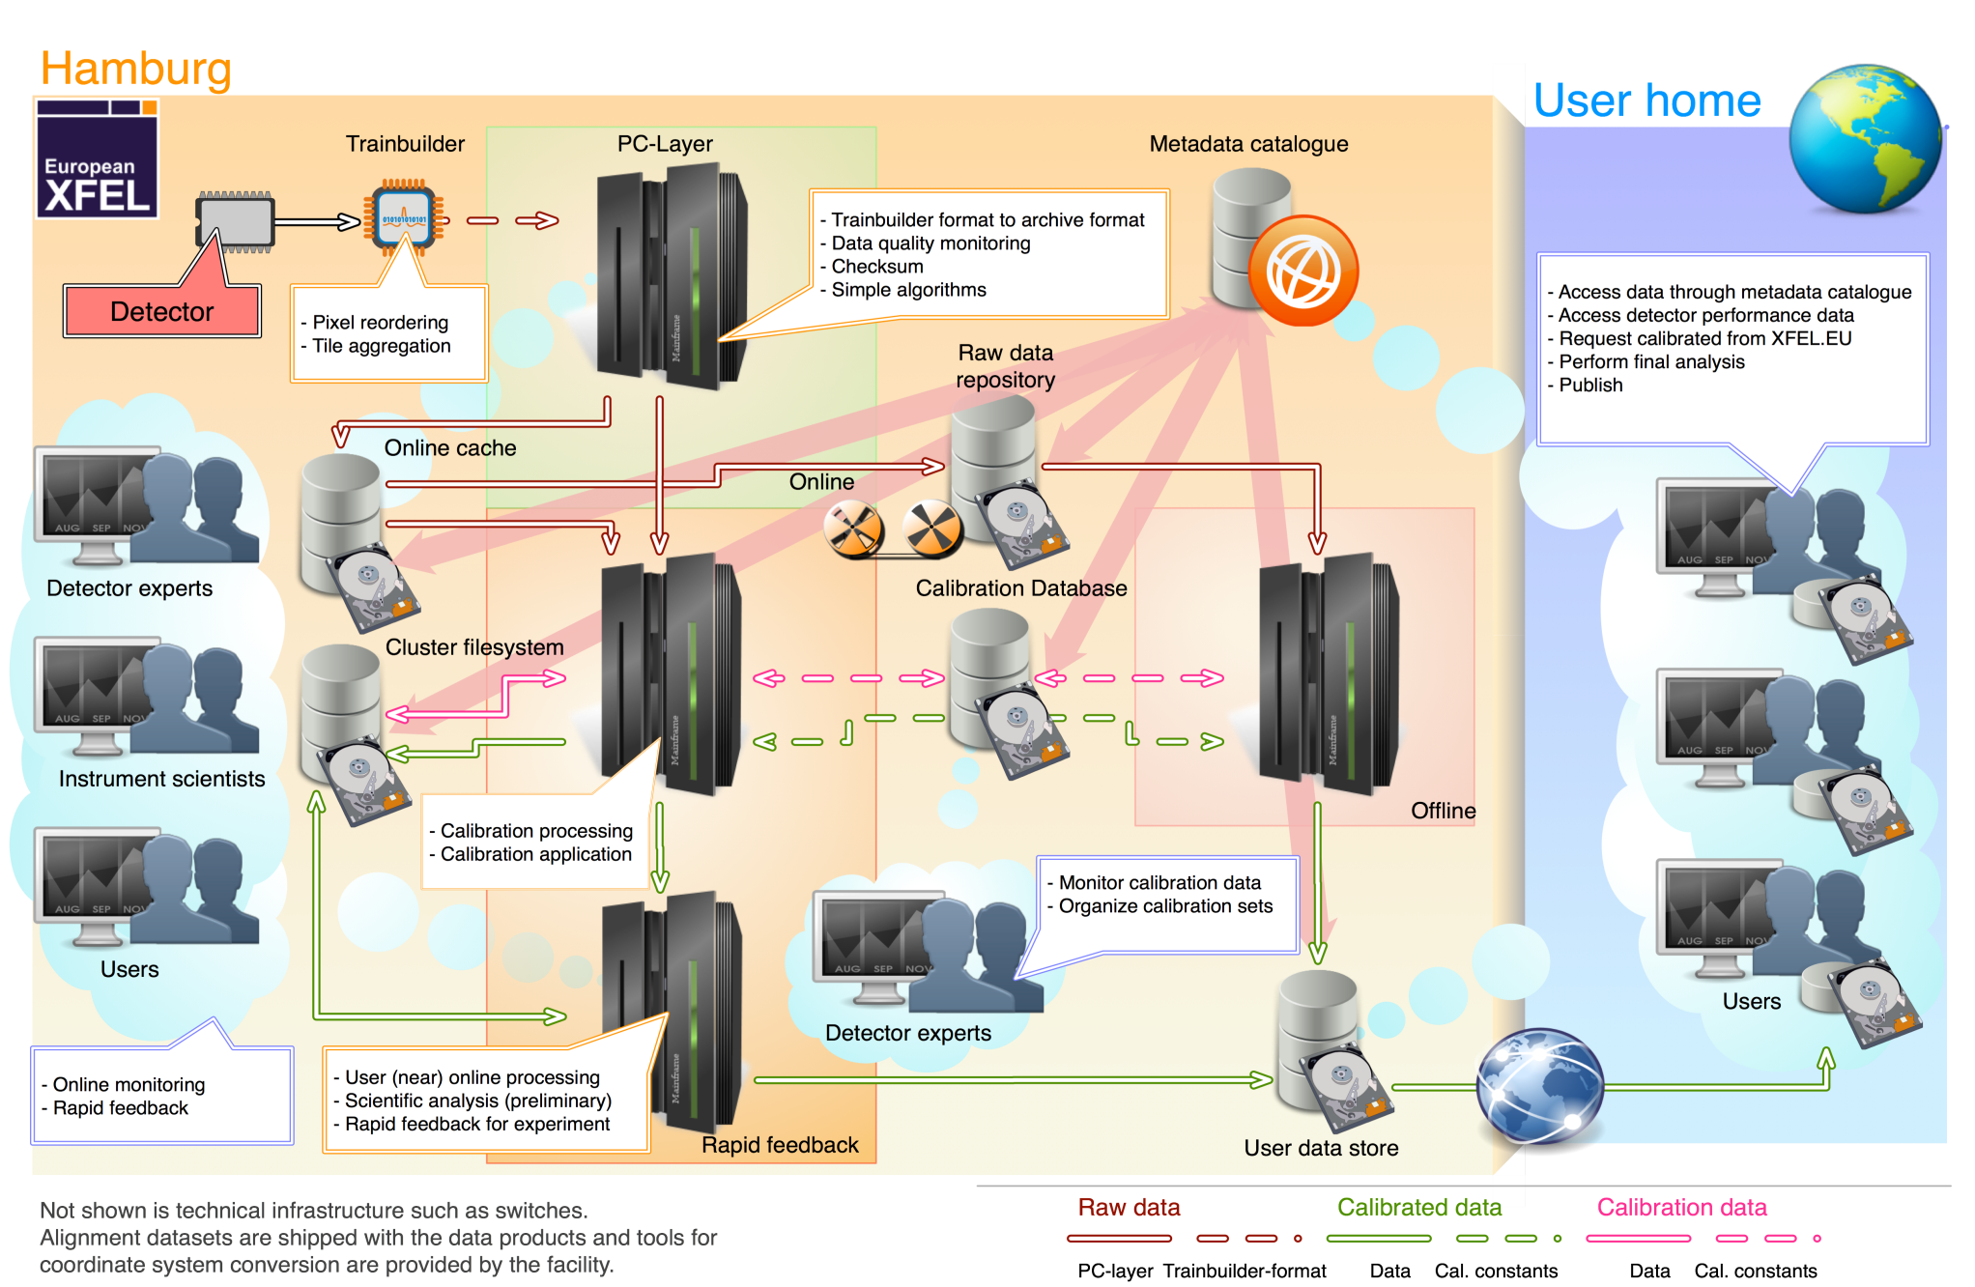
The Big Picture
The PC-Layer: where data hits the disks

Slide 3
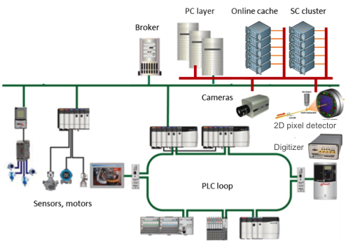
Challenges
Many devices continuously push data to the PC layer
Image data: 2D detectors → big & fast
Pulse data: BPMs, digitizers → fast
Monitor data: sensors, motors → slow
Data creation and flow yield inherently parallel and distributed processing of data
E.g. one 2D detector dispatches data over 16 nodes
Processing and storage requires consolidating multiple fast/slow, small/big data streams based on train-id
All XFEL data is tagged with train-id
Run management service
Control and coordinate all activities on data performed at PC layer: collection, monitoring, analysis, formatting and recording

Slide 4
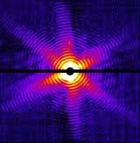
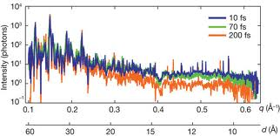
Data acquisition, processing and management
Data acquisition, processing and management pipeline
Detectors
Receive
T1
T2
Train builder
Scientific computing
Train Transfer Protocol (TTP)
Online analysis
Build train
T1
T2
Send
T1
T2
Fast 2D pixel detector data
3D reconstruction
Data generation
Receive
T1
T2
PC Layer
Process
T1
T2
Format
T1
T2
Karabo P2P
Send
F1
F2
Slow & fast data streams
TCP
Aggregation, integration & dispatching
Receive
F1
F2
Acquisition, aggregation, consolidation
Processing, monitoring, dispatching
Formatting, recording
Write
F1
F2
Storage and archive
Notes:
The data generated and stored in the ONS can be transferred to the offline storage system (dCache) and tape archive at DESY Computer Center.
The full software chain managing data acquisition and its integration with catalogs is planned for deployment by end of June.

Slide 5
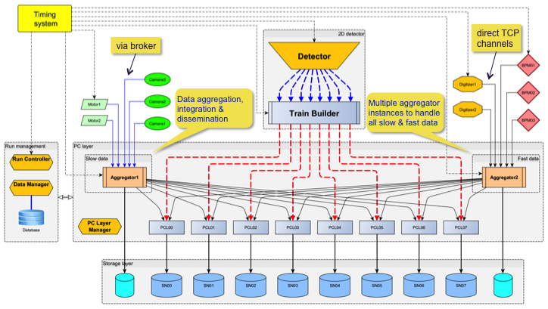
PC layer concept revisited
PC layer as data hub
Cluster of high-performance computers where all experiment data are collected, validated and saved to files
PC layer’s operations on data
Correct receiving of data from fast and slow data sources, using TCP/UDP or via broker → Tuning and performance tests
Consolidation: data collection and integration from several data sources → Data aggregators for slow and fast data
Validation, monitoring, fast-feedback analysis, rejection and reduction (selected experts’ algorithms) → PC layer pipeline concept
Formatting and recording to data files → HDF5 file structure, file naming schema, file system
Data dissemination to scientific computing pipeline
Notes:
Devices = datasources

Slide 6
Data acquisition and management services
Metadata Catalog
Register data files and metadata
List of files
Run-number
PCL0
PCL1
PCL2
PCL3
AGG0
Reader
/r0001/r0001.h5 /pcl0 /pcl1 /pcl2 /pcl3 /agg0
0 1 2 3 4 5 …
0 1 …
Full images
Dispatcher
Match train-id to filename using Seq(T₀,N_{C},N_{TF})
Match filename to node/folder using inverted index
Using symbolic links
Using reverse formula (discovered from data)
Using dictionary (filename→location)
Modules-wise
Cal0
Cal1
Cal2
Cal3

Slide 7
Run management

Slide 8
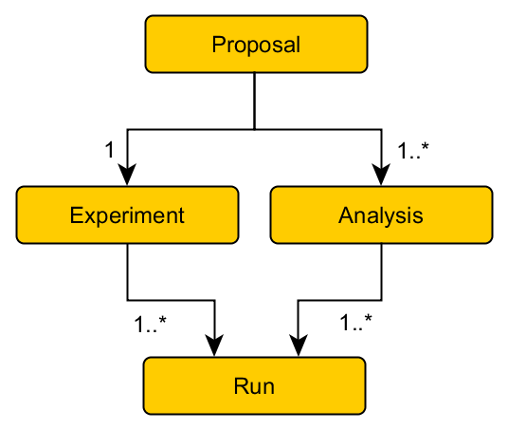
Model of scientific activities
Proposal → Experiment and Analysis → Runs
Experiment is an investigation into the physical behaviour of the environment usually to test an hypothesis, typically involving an instrument operating under some instrumental settings and environmental conditions, and generating data sets in files (*)
An experiment consists of series of runs, where at each run some environment conditions or instrumental settings are altered or varied
* Yang, E.; Matthews, B.; Wilson, M.; , "Enhancing the Core Scientific Metadata Model to Incorporate Derived Data," e-Science (e-Science), 2010 IEEE Sixth International Conference on , vol., no., pp.145-152, 7-10 Dec. 2010 doi: 10.1109/eScience.2010.48
Notes:
Study is accomplished through a series of investigations
An investigation can be an experiment, a simulation, a measurement or a software execution

Slide 9
Experiment
An experiment is the first entry point to user data
Has a globally unique ID, to which are associated all meta-data identifying or describing the object of the experiment, e.g. name, sample description, PI/users, date/time/shift, …
May span over several beam-times slots that are not necessarily contiguous in time
Divided into a series of runs identified by unique run-ids (i.e. an increasing sequence number)
Several independent experiments may take place in parallel
Experiment configuration specifies list of all the necessary data source devices

Slide 10
Run
A run belongs to one experiment
Has a unique ID with the experiment, i.e. an increasing sequence number that starts from 0 for each experiment
Run configuration specifies a sub-list of pairs <device,property>, which produce all the bits and pieces of data of interest, which should be included in the generated dataset files
Concurrent runs within the same experiment are NOT allowed
No interactions between runs from different experiments
But, common or shared data sources between experiments and runs are possible

Slide 11
Concepts and Requirements (1)
“Run control” acts on data management devices at PC layer
It instructs when to begin or cease considering input data for processing and storage.
External actor (human) is needed to trigger the start/stop of run
Run start/stop can be triggered independently of the start/stop of other sub-systems
Start of run, identified by a reference train number T0, designates a logical point in time from which incoming data are potentially relevant to the experiment and thus should be stored into files.
Depending of when a run is started, some data might be lost (late run start), or some irrelevant data might be included in data files (early run start). Idem for the run stop event.

Slide 12
Concepts and Requirements (2)
Electronic/software devices continuously stream data out independently of who are listening/making use of their data (controlled independently)
Data might not be always useful or meaningful for monitoring, processing and, especially, for storage.
DAQ/DM system might be in one of the following modes
Setup: start devices, load configurations, probe hardware, establish connections with other devices, etc. → The system is unstable as not all devices might be up
Stable/data ready: devices are up and running, and able to acquire data and stream it out.
Data received by PC layer can be either: simply ignored, only monitored, or also stored to files.

Slide 13
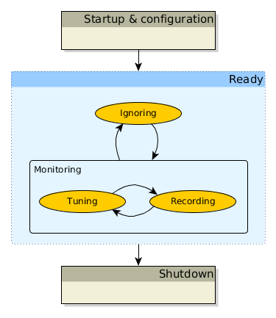
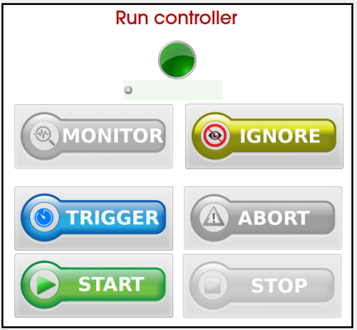
Run control – state machine
Ignoring state
No action is taken on data received at PC layer
Device instantiation/configuration are done here
Monitoring state
Received data is only monitored
Tuning state: Adjust device’s parameters
Recording state: besides monitoring, input data are also stored to files
DAQ devices should be at the same state→ coherency

