Slide 1
Hierarchical data organization
Djelloul Boukhelef
Data processing workshop
Eu-XFEL, 03-04 Feb. 2016

Slide 2
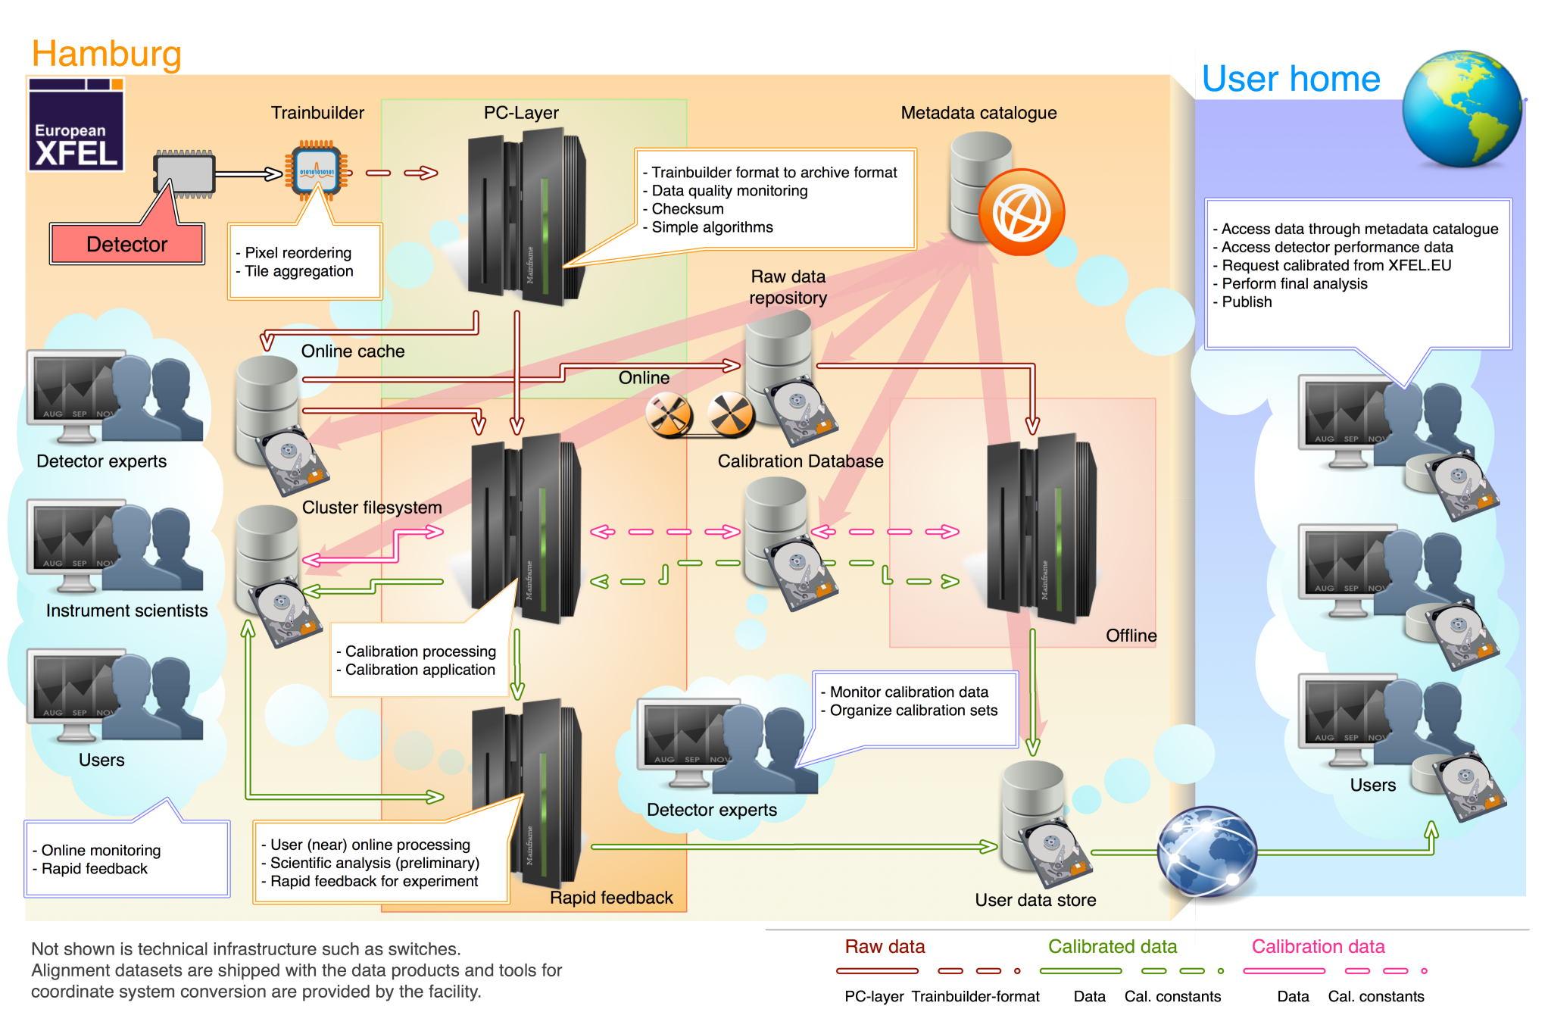
Hierarchical data organization

Slide 3
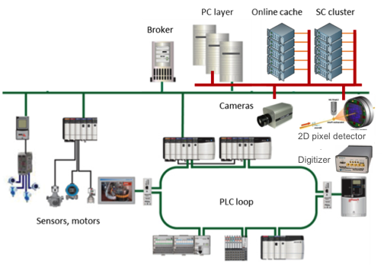
Introduction
Many devices continuously push data to the PC layer
  Image data: 2D detectors → big & fast
  Pulse data: BPMs, digitizers → fast
  Control data: sensors, motors → slow
Data handling and processing requires
consolidating multiple fast/slow,
small/large data streams based on train-id
  Data is received by software devices at 10Hz (train rate) at most
  All data, in XFEL, are tagged with train-id (globally unique 64bits id)

Slide 4
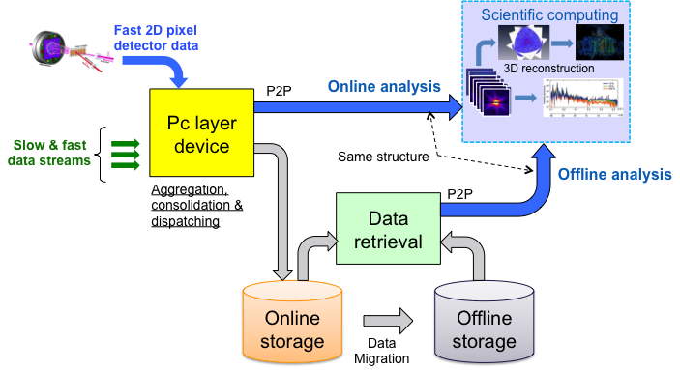
Common in-memory and in-file data layout
Goal: Common data layout
  In-memory container (key-value dict.) ≈ file structure (hdf5)
Data dissemination from PC layer to storage and SC cluster
  Common data interface with users’ scientific algorithms:
  (online, real-time, from PCLayer) vs. (offline, differed, from files)

Slide 5
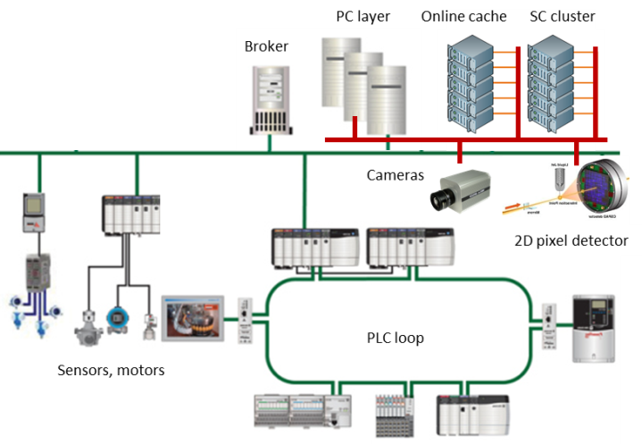
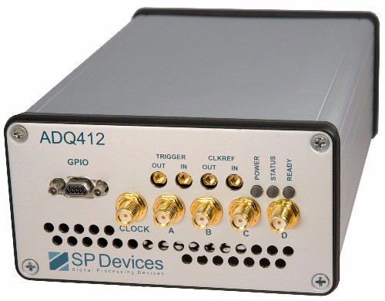

Hierarchical data organization
Pulse data
eg. Pulse digitizer, BPM, …
Variable pulse data
eg. 2D pixel detector images
Deterministic push
2D pixel detector
Digitizer
Train data
eg. 2D pixel detector train info
Variable train data
eg. Slow camera
Train control data
Event driven
eg. Sensors, actuators, motors, …
Run data
eg. 2D detector configuration
Data integrated over multiple trains

Slide 6
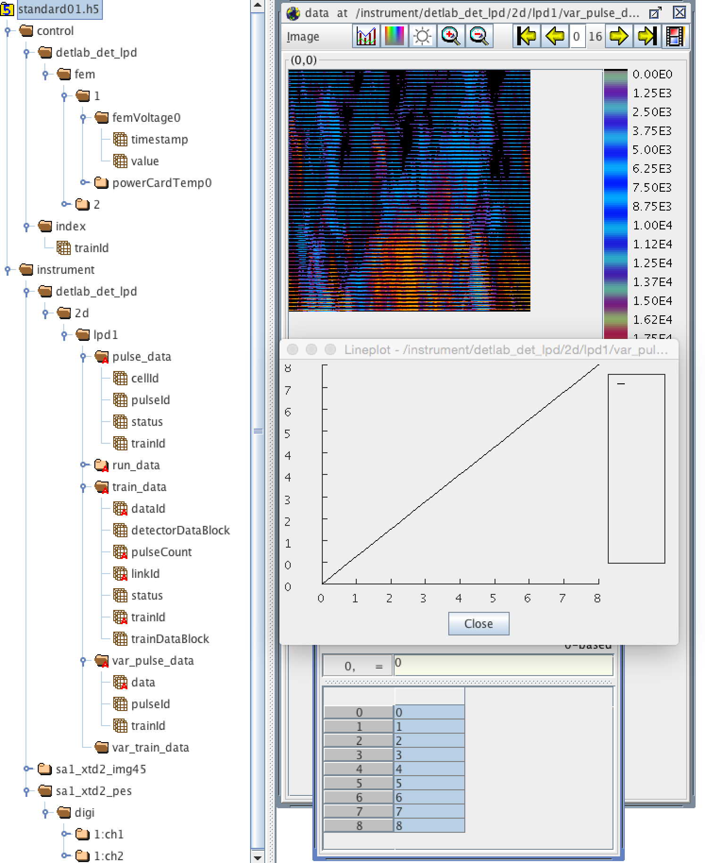
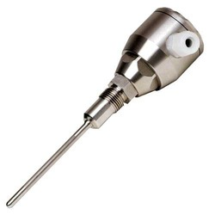
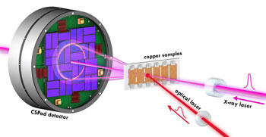
Data categories and Naming convention
Naming convention
  /detlab_det_lpd/fem/1/femVoltage0
Control data
Instrument data
Domain
Type
Instance
property
FEM Ctrl device
header
images
PC layer device
descriptor
detector
raw
Digitizer device
processed

Slide 7
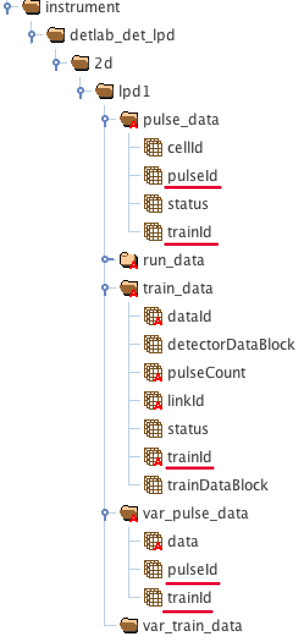
Instrument data
Properties
  Monotonically increasing trainId
  Monotonically increasing pulseId within same train
Instrument data
  Pulse data: data for all entries in pulseId are present
  Variable pulse data: data for some entries
  in pulseId are missing
  Train data: data for all entries in trainId are present
  Variable train data: data for some entries
  in trainId are missing
  Run data: run-wide configuration of a data source
    Needed for correct interpretation of data,
    e.g. module size, ROI, etc.
Mandatory

Slide 8
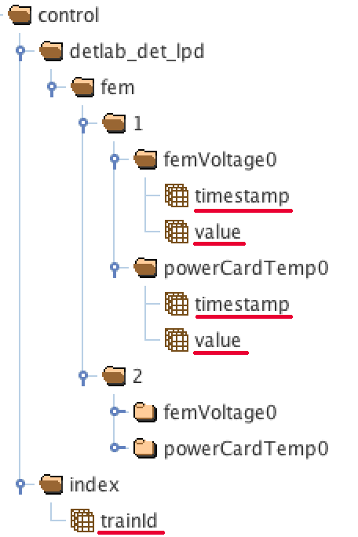
Control data
Slow data sources: e.g. motors, valves, etc.
Control data
  Value
  Timestamp: indicates when was the value read-out
    Better correlation if timestamp resolution is
    higher than train-id: e.g. when within train?
  Train-id: all train-ids in a run
Event-driven data pushing
  Value is not available for every train
    Propagate previous value and keep the same timestamp
    Timestamp=0 to mean error situation (e.g. device is down)
  All properties should have the same number of entries in “timestamp” and “value”, which is the same as in “trainId”

Slide 9


