Slide 1
Retrieving queried data as a user
Djelloul Boukhelef
Data processing workshop
Eu-XFEL, 03-04 Feb. 2016

Slide 2
User access to experiment data
Online (near-real-time)
On a best-effort basis, selected experiment data is streamed out directly from PC layer to online analysis pipeline using Karabo P2P, for processing by users’ algorithms and visualization.
“Go-back” to earlier experiment/run data is possible via dedicated reading service → tightly controlled
Offline (on-site)
Now, that experiment data is made persistent, user can access raw data, for an extended time period using the reading service
Data calibration is performed, on the-fly, where necessary
Off-site
Export service will provide mechanism to export experiment data that can be downloaded and accessed by users on their premises
Defined user view???

Slide 3
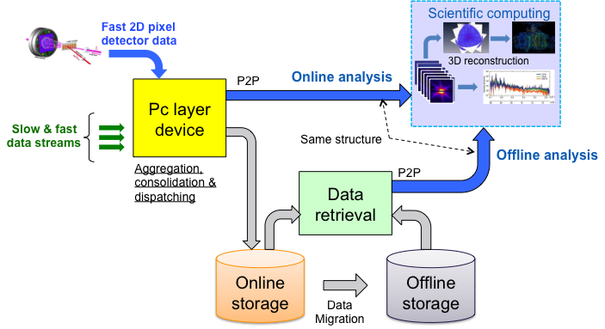
Access to data during experiment
Selected fraction of experiment data is streamed out directly from PC layer to online analysis using Karabo P2P (near-real-time) .
Experiment data stored in online cache can be accessed immediately for fast-feedback in the online computing cluster.
Standard set of algorithms will be made available on the online computing cluster to monitor data streams and calibrate images according to the detector state.
Users can plug in their own algorithms to the pipeline by implementing them as Karabo devices.
Alternatively calibrated detector data can be stored in the online cluster file system (user storage space) in HDF5 files and then accessed by user software.
Notes:
Selected experts’ algorithms can be plugged in at PC layer for fast feedback and data reduction.

Slide 4
Data retrieval service
User query (e.g. via web interface)
Resolved by MDC into run-number(s)
Run-number is resolved into list of files (full path)
Query answer granularity at MDC is files
Query model at the reader service defines the level of details (query granularity)
Given a data file, stream all datasets out
Given a list of files, stream out all datasets (order?)
Retrieve one train, range of trains, etc.
Retrieve selected datasets
Retrieve partial data, e.g. modules from images
Metadata Catalog
User query
List of files
List of files
Retrieve data
Reader
Access data
pipeline
Datasets

Slide 5
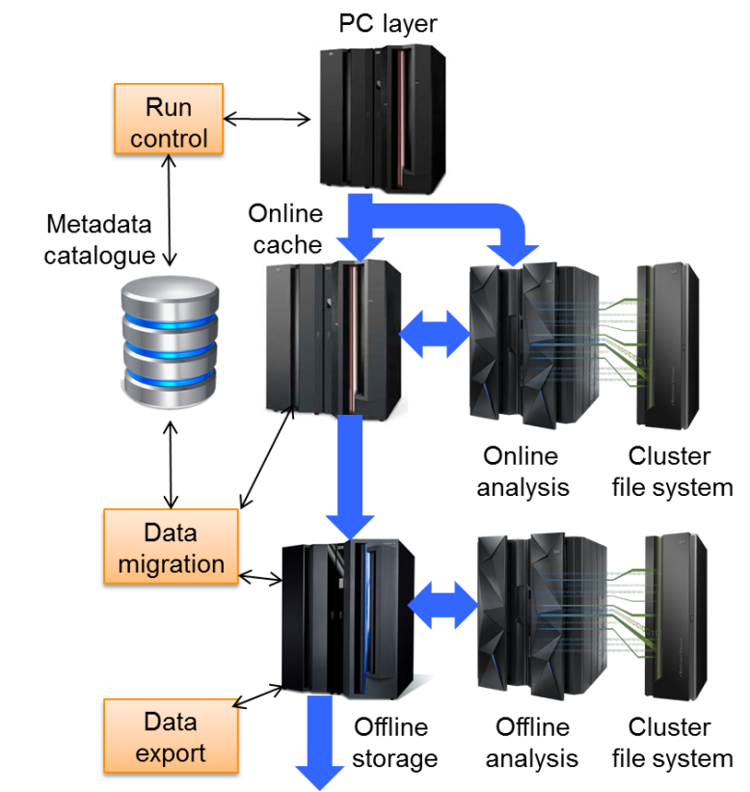
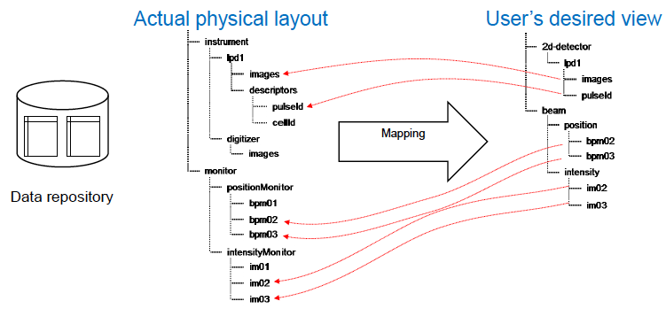
Data export service
Export calibrated, slow/fast data to users outside the European XFEL facility
Only calibrated data will be exported
User-personalized view
Users may want to rearrange data groups in the new dataset according to the users’ needs (user-defined view)
E.g. grouping by location, renaming entities, horizontal/vertical data partitioning, etc.
Predefined templates can be provided (for major use-cases)
Another use case
Mapping of internal physical entities to data entities used by standard (commonly used) analysis tools
Notes:
Selective, i.e. allow users to select which data parameters they want in the export file.

Slide 6
Data migration
Migration service
Move/copy experiment data to offline storage and archive system, and back.
Migration service is synchronized with the Metadata catalogue to reflect coherent and valid state of the DM system

Slide 8
Data retention and access policy (PANData)
Raw data and associated metadata obtained as a result of publicly funded projects are open access
Access to the raw data is restricted to the experimental team for the period of at least 3 years
European XFEL will strive for long-term data storage, subject to available funding
Raw data is by default removed from the offline storage one year after the experiment has been performed
Calibration constants are archived without time limits i.e. "forever”
Access to raw data in the archive system is protected using NFS4.1 ACL according to the specification provided by experiment PI.
Access to raw data is granted to European XFEL staff only for instrument related investigation (diagnostic, upgrade, etc.)
Access to calibration constants is open to all facility users
Notes:
Note that currently assumed archiving period of 3 years effectively means no open access.
. They are not allowed to publish scientific results out of experiments data

