Slide 1
The XFEL calibration pipeline
An example of Karabo-p2p distributed computing mixed with thread-level parallelism in Python and GPU computing
S. Hauf
Notes:
How to edit the title slide
Upper area: Title of your talk, max. 2 rows of the defined size (55 pt)
Lower area (subtitle): Conference/meeting/workshop, location, date,
your name and affiliation, max. 4 rows of the defined size (32 pt)

Slide 2
Calibration and Correction Parameters of XFEL Detectors

Slide 3
Possible components of correction pipelines
granularity
pixel
row/column
image
Droop
correct.
Split
events
Offset
sub.
CM
correct.
CTI correct.
Gain correct.

Slide 4
Possible components of correction pipelines
LPD offset map
granularity
pixel
row/column
image
Droop
correct.
Split
events
Offset
sub.
CM
correct.
CTI correct.
Gain correct.

Slide 5
Possible components of correction pipelines
granularity
LPD Common Mode
pixel
row/column
image
Droop
correct.
Split
events
Offset
sub.
CM
correct.
CTI correct.
Gain correct.

Slide 6
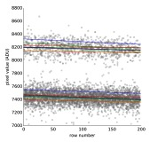
Possible components of correction pipelines
PnCCD Charge Transfer Inefficiency
granularity
pixel
row/column
image
Droop
correct.
Split
events
Offset
sub.
CM
correct.
CTI correct.
Gain correct.

Slide 7
Possible components of correction pipelines
Uncorrected and corrected Fe-55 spectrum taken with FastCCD
granularity
pixel
row/column
image
Droop
correct.
Split
events
Offset
sub.
CM
correct.
CTI correct.
Gain correct.

Slide 8
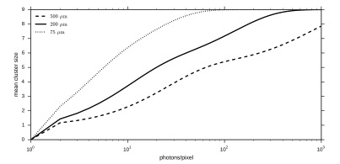
Possible components of correction pipelines
granularity
Mean Cluster Size depending on Photon Intensity and Pixel Size
(Events in a 9x9 pixel field)
pixel
row/column
image
Droop
correct.
Split
events
Offset
sub.
CM
correct.
CTI correct.
Gain correct.

Slide 9
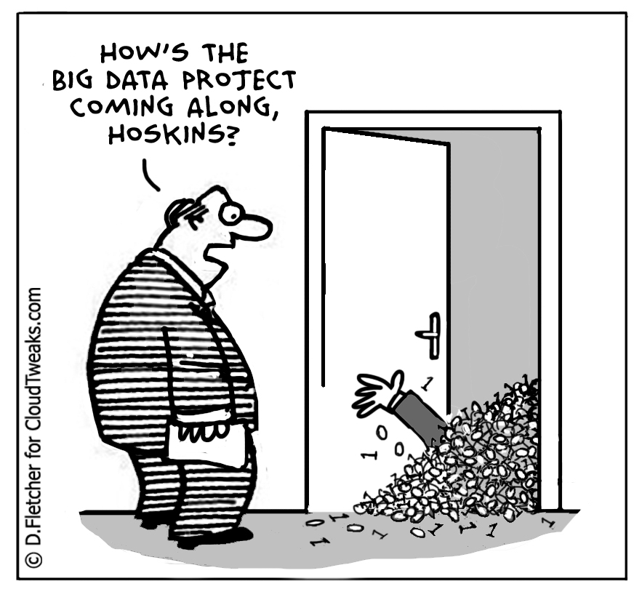
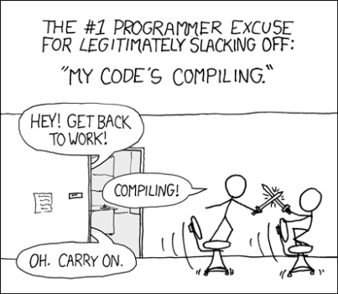
Python-based Calibration and Data Analysis Suite - Motivation
Data analysis commencing for different detectors (LPD, AGIPD) has shown that interactive analysis quickly becomes problematic on large datasets (>10GB) and that common functionality is needed → similar requirements to pipelined calibration/correction
Moved to iPython/Numpy with adaptions for streaming data to allow interactive analysis within iPython notebook and faster development
PyCUDA readily exposes GPU acceleration → allows testing if real-time corrections are feasible on GPU
Common framework prevents code duplication and eases maintenance
gdfm.me

Slide 10
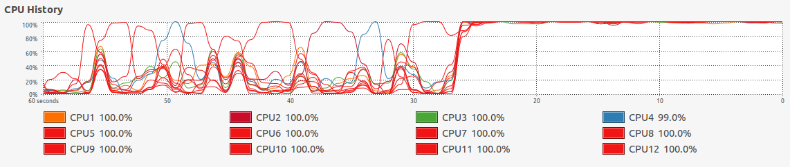
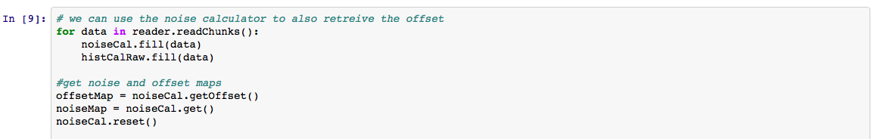
Python-based Calibration and Data Analysis Suite - Specifics
iPython library which transparently handles concurrency using ipcluster (local) either per image (x, y, z_{n}), or per image region (x_{n}, y_{n}, z)
Functionality implemented as calculator objects which work on streaming data

Slide 11
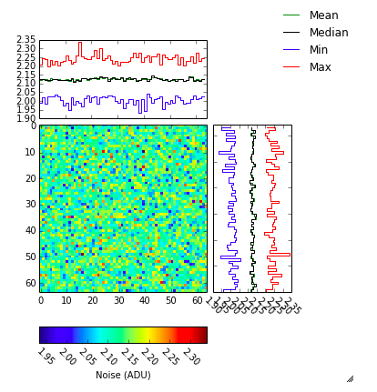
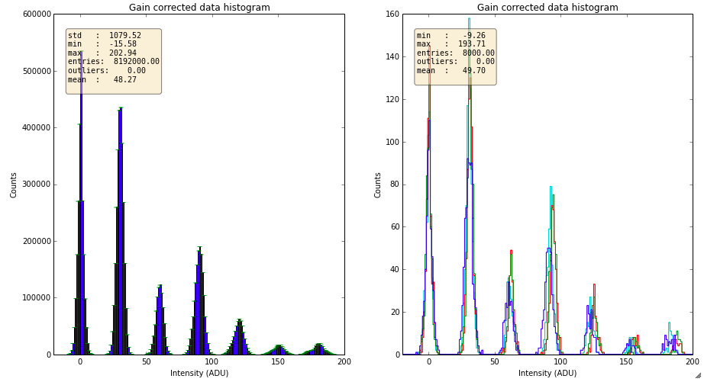
Python-based Calibration and Data Analysis Suite - Specifics
Common plotting using “smart” objects which can interpret the output of the calculator objects.

Slide 12
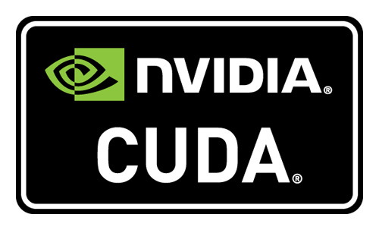


Python-based Calibration and Data Analysis Suite - Specifics
Seamlessly integrates into Karabo
(the Cal-DB test pipeline runs this way)
Karabo device with sub-concurrency handled by python:
Karabo p2p
Karabo p2p

Slide 13

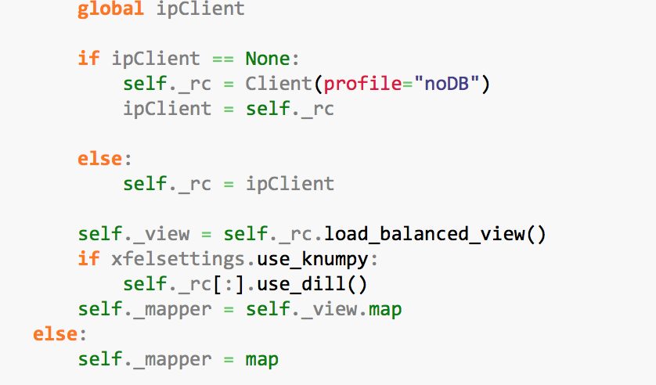
Python-based Calibration and Data Analysis Suite – Usage of Ipython.Parallel
Configure a parallel client to use a load-balanced view
Use provided parallel map function or sequential fallback

Slide 14
Python-based Calibration and Data Analysis Suite – Usage of Ipython.Parallel
Use in algorithms
Algorithm | CPU | GPU
Offset map calculation | X
Noise map calculation | X
Gain map calculation | X
Streaming histogramming | X | X
Statistics calculation | X | X
Offset Correction | X | X
Gain Correction | X | X
Common Mode Correction | X | X
Pattern Detection | X | X
Configure a parallel client to use a load-balanced view
Use provided parallel map function or sequential fallback

Slide 15
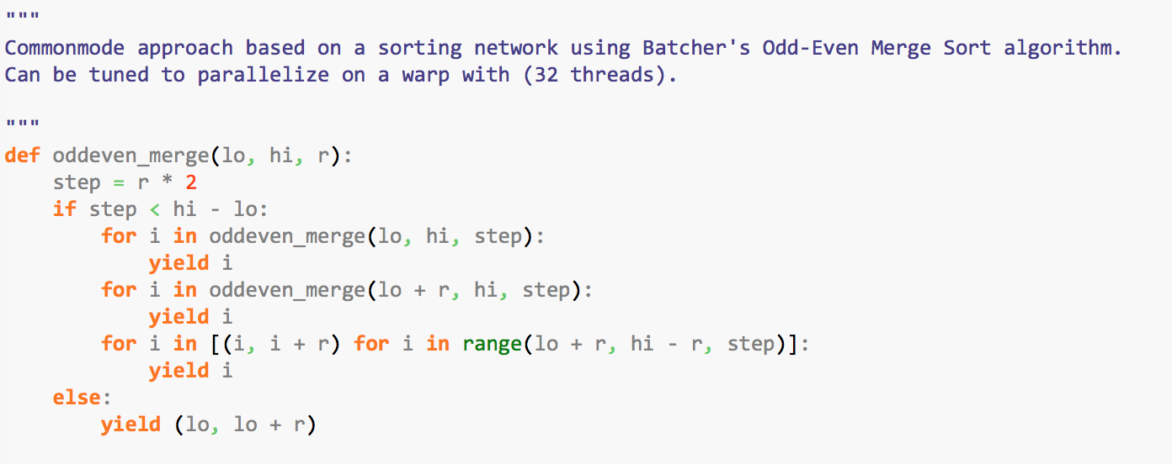
Python-based Calibration and Data Analysis Suite – GPU usage
Using CUDA via pyCUDA
Klöckner, Andreas, et al. "PyCUDA and PyOpenCL: A scripting-based approach to GPU run time code generation." Parallel Computing 38.3 (2012): 157-174.
Allows for instance to run-time optimize GPU-kernels, e.g. the sorting networks used for common-mode computation

Slide 16
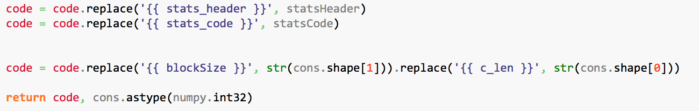
Python-based Calibration and Data Analysis Suite – GPU usage
Using CUDA via pyCUDA
Klöckner, Andreas, et al. "PyCUDA and PyOpenCL: A scripting-based approach to GPU run time code generation." Parallel Computing 38.3 (2012): 157-174.
Allows for instance to run-time optimize GPU-kernels, e.g. the sorting networks used for common-mode computation
….

Slide 17
Python-based Calibration and Data Analysis Suite – GPU usage
Performance-optimization for correction and calibration routines → near real-time performance seams possible
GPU-based for “near-realtime” corrections:
Offset, common-mode, split-event, statistics)
(scaled from Nvidia K2200 to K40, requires approx. 1 GPU per 10G line)
Corresponds to one 10G line

Slide 18
Where Karabo comes into play
Chose Karabo p2p for distributed computing
  Allows for native integration of Karabo-data formats
  Allows for easy integration into Karabo-GUI
  Direct access to control-system where needed, e.g. detector
  operating conditions
Karabo p2p

Slide 19
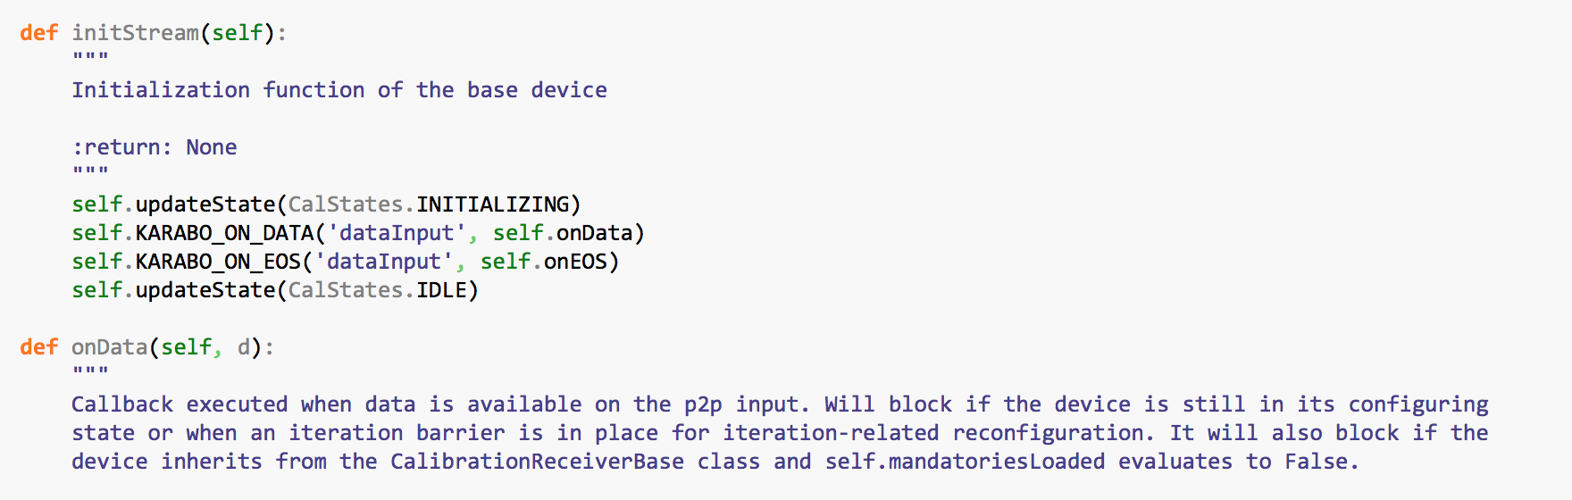
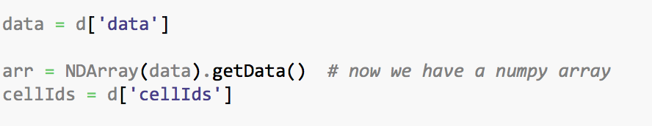
Getting data out of Karabo

Slide 20
Getting data out of Karabo
Define callbacks to use when data is available

Slide 21
Getting data out of Karabo
Define callbacks to use when data is available
Retrieve data by path

Slide 22
Getting data out of Karabo
Define callbacks to use when data is available
Retrieve data by path
Check for availability of optional data

Slide 23
Getting data out of Karabo
Define callbacks to use when data is available
In all cases: reassignment to local variables which map to non-karabo code (here PyDetLib) and its data types (here Python + numpy)
Retrieve data by path
Check for availability of optional data

Slide 24
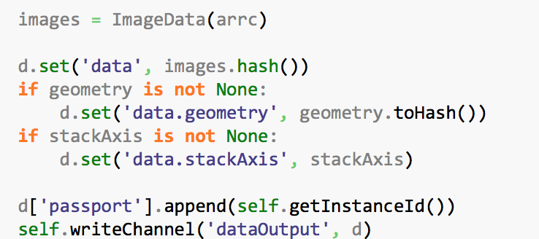
Getting data back to Karabo
The numpy array should convert to a specific data format, that for images/arrays → mandatory fields in hierarchical structure presented earlier
If we had optional data set it, as it was modified
Modifying the original input data structure → fields I didn’t touch are preserved
Finally, write back to a p2p output I can address by ID

Slide 25
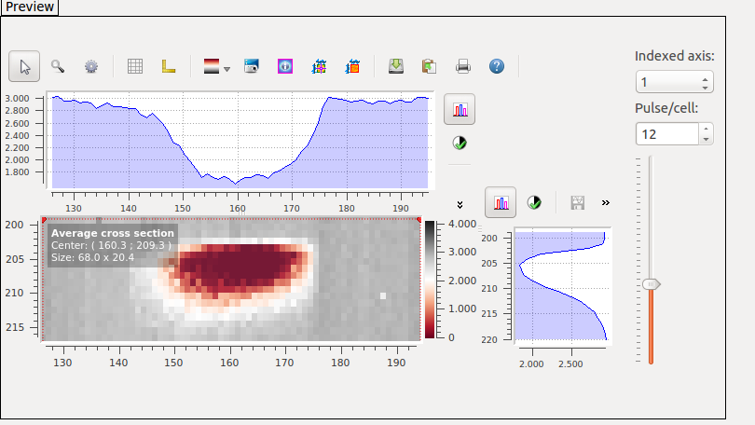
Additional benefit for using Karabo p2p – Can connect the GUI to any output to monitor
Karabo-online views of scattering in a ferrous solution imaged by LPD
Online view of APS direct beam on LPD

Slide 26
Additional benefit for using Karabo p2p – Can connect the GUI to any output to monitor
Karabo-online views of scattering in a ferrous solution imaged by LPD
Online view of APS direct beam on LPD
Connected to the outputs of the individual correction stages
Connected to raw data online output on PC layer

Slide 27
Where Karabo comes into play
Link: Show documentation of CalibrationBase
Link: Show documentation of PyDetLib

