Slide 1
X-ray detectors and diagnostics for HED instrument
3rd Feb. 2016
M. Nakatsutsumi, S. Goede, U. Zastrau

Slide 2
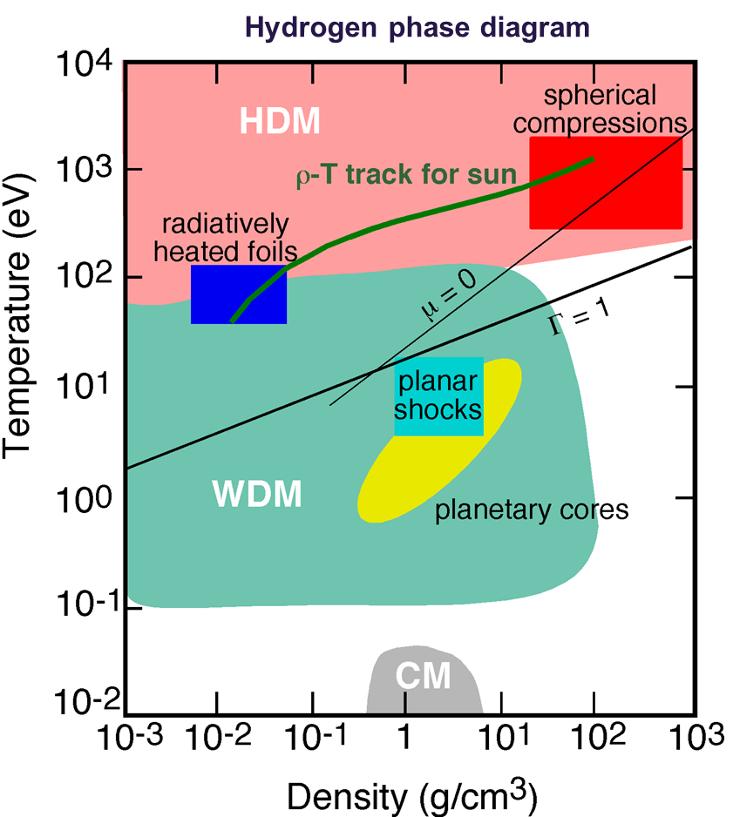
Drive capabilities at HED
Three optical lasers (2x HIBEF)
  Pump-Probe (PP) >10¹⁷ W/cm²
    ~mJ , > MHz
Δt
10⁷
  High-Intensity (HI) >10²⁰ W/cm²
    ~5 J, ~25 fs, 10 Hz on sample
(Kelvin)
  High-Energy (HE)
    ~100 J, 2–15 ns, 1-10 Hz
    ~3x compression, ~10 Mbar
10³

Slide 3
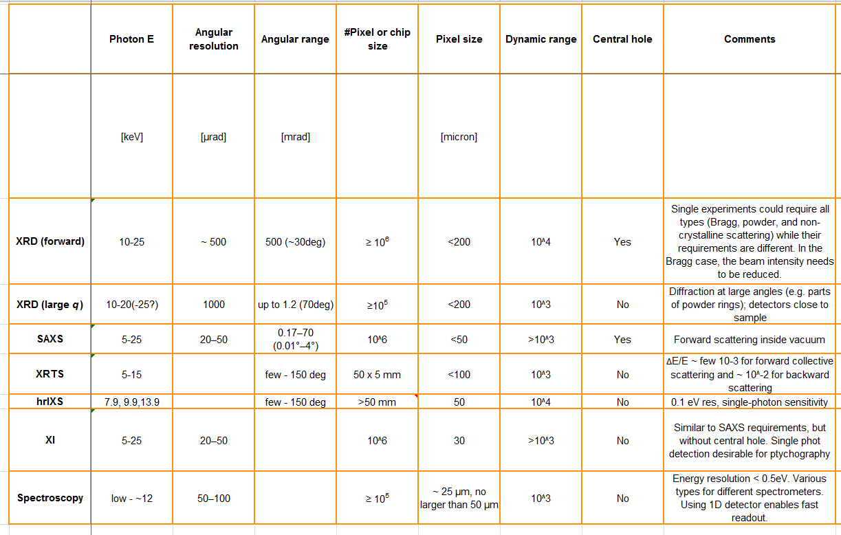
Detector specification requirements
ePix10k / Jungfrau (high dynamic range)
ePix100 (high resolution, single photon sensitivity)

Slide 4
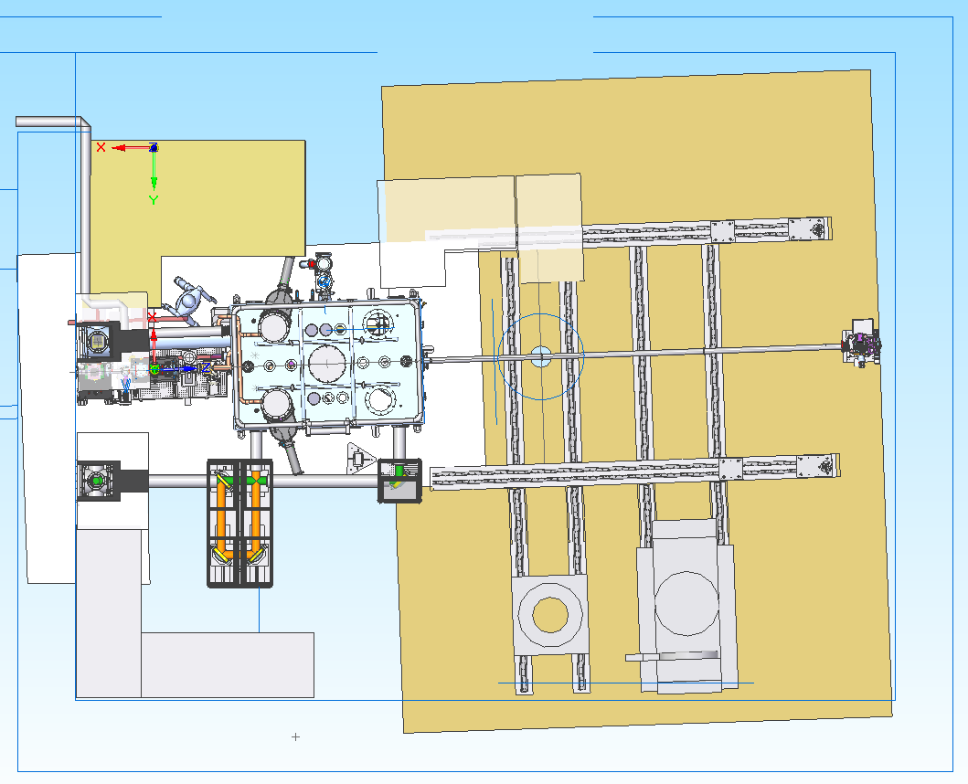
HED experimental hutch layout
4100mm
X-ray
2 high power lasers
(max 10Hz)
2nd interaction point
>> 10Hz
(HIBEF)
Main interaction vacuum chamber
Detector bench on rail
(HIBEF)

Slide 5
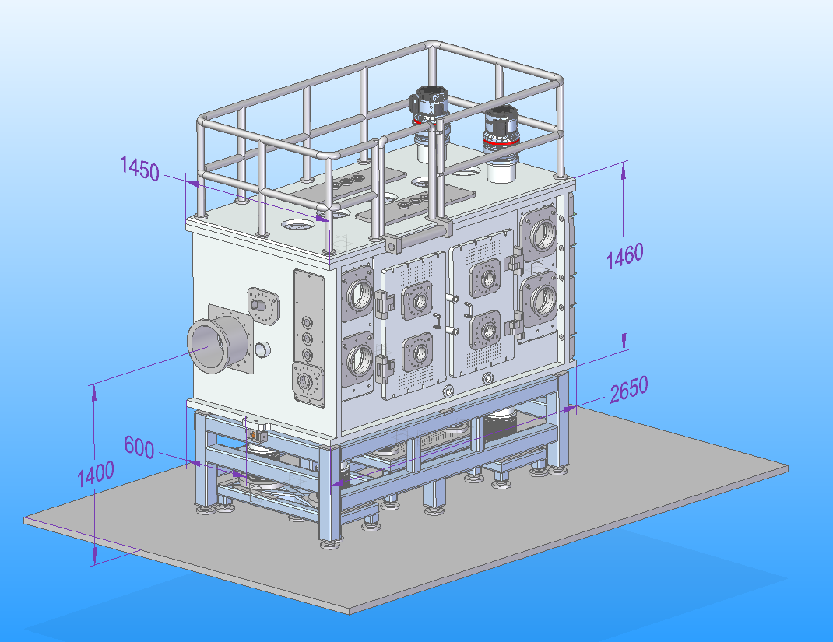
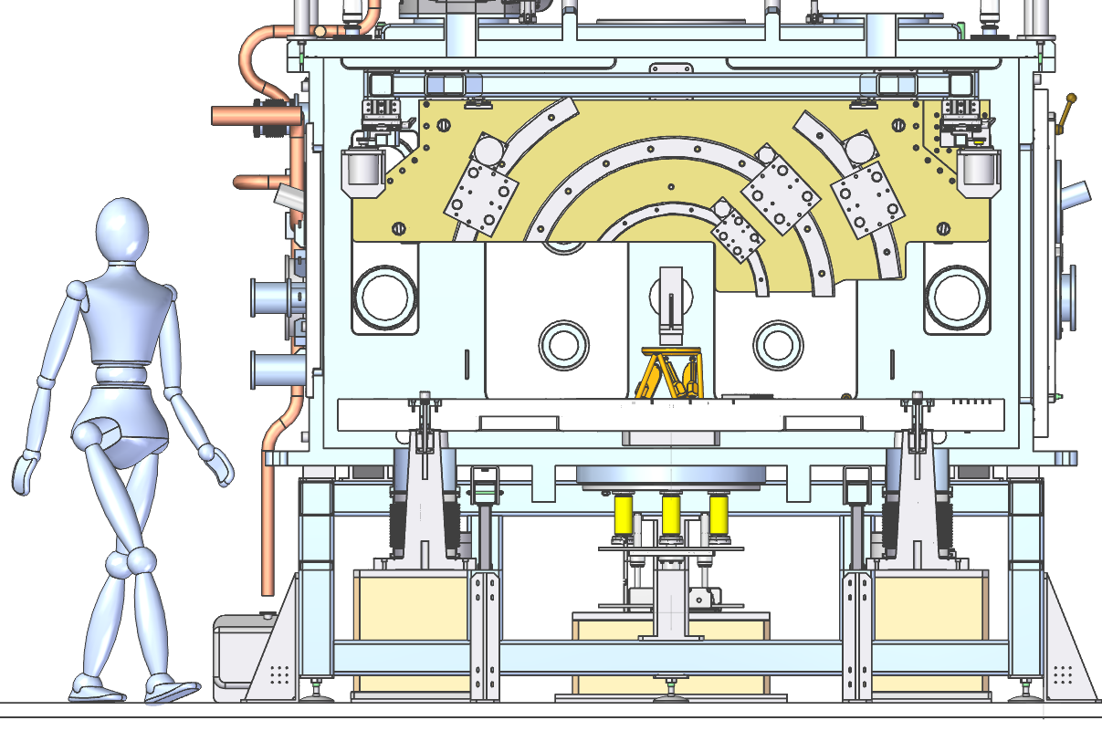
Main vacuum interaction chamber to accommodate versatile setups
~10^-6mbar
Side cut
X-ray
1.2m
2.4m
In-vacuum diagnostics
Vertical breadboard for
detector motion control
Sample stage at centre

Slide 6
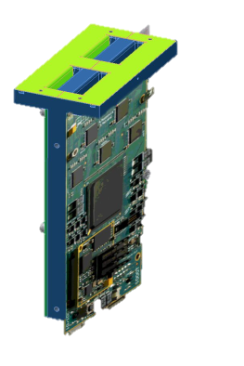
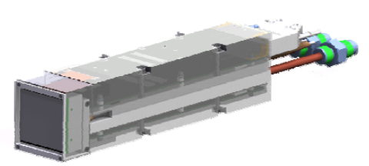
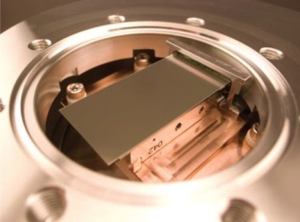
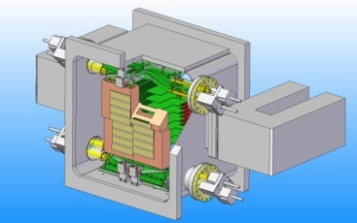
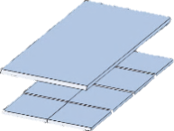

X-ray 2D detector choices for the main chamber
Parameter | ePix100 /10k | Jungfrau | MPCCD | AGIPD
 | LCLS | PSI | SACLA | PSI
Sensor | 500 µm Si | 450 µm Si | 300 µm Si | 500 µm Si
Repetition | 120 Hz | 2000 Hz | 60Hz | 4.5 MHz
Pixel size | 50/100 µm | 75 µm | 50 µm | 200µm
Dyn. range at 12keV | 10²/10⁴ | 10⁴ | 10³ | 10⁴
Noise | ~0.4 keV | ~0.4 keV | ~ 1.2 keV | ~1.5 keV
Size | Small | Small | Medium | (very) Big
Experiments are operated at 10 Hz limited by rep rate of pump laser (HE, HI)
HIBEF (>2018)

Slide 7
Detector bench (HIBEF)
  2 Positions for detector
  Travel range perp. beam ca. 140 mm
  AGIPD permanently
  Second position is flexible equipped.
  Second table behind the detector bench
Detector | Sensor | Pixel | Repetition | Misc. | Method
AGIPD | GaAs (Si) | 200 µm | 4.5 MHz | 300kg; in vac. | XRD; high Q-range
Pelkin E. 0822 | amorph. Si | 200 µm | 25-100 Hz | only 2.2 cm thick | XRD; high Q-range
Gotthard | Si | 25/50µm | MHz |  | Reference spectrum, XAS
Jungfrau | Si | 75 µm | 2kHz |  | PCI/XRD
FLI / PCO | 4k*4k CCD | 9 µm | 0.3 Hz |  | PCI
PIXIS 2048b | 2k*2k | 13 µm | 0.3 Hz |  | PCI / SAXS

Slide 8
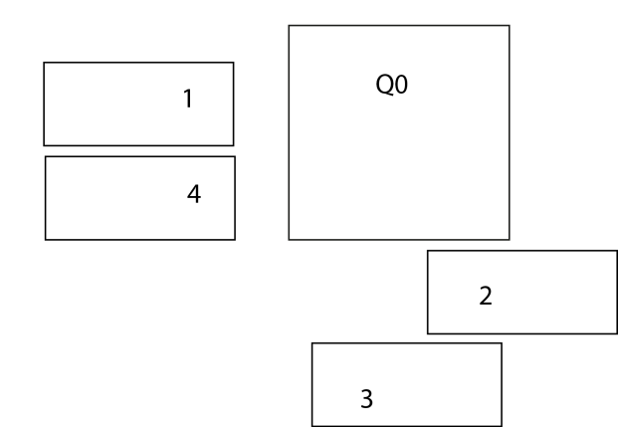
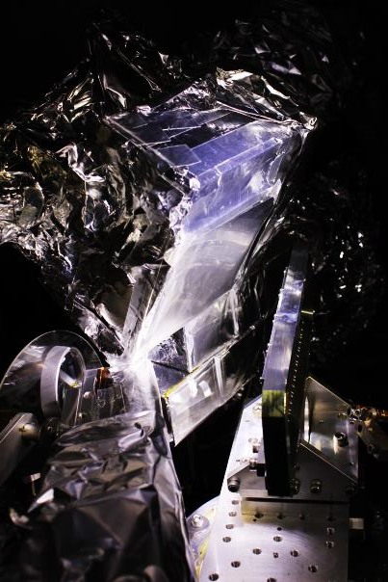
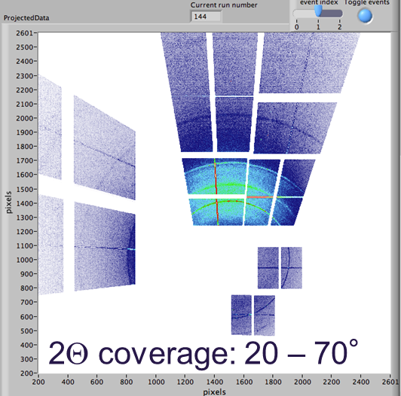
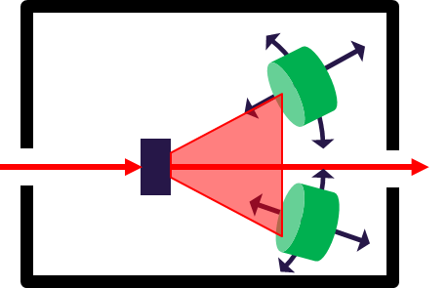
XRD – large area coverage / scanning
Functionality on detector level
Calibrated pictures (photons/pixel)
Group multiple detector modules to retrieve larger images
Mapping of detector position and orientation to retrieve a scaled image
Position scanning (rail motion system)
Typical data post processing
Background subtraction
Convert real space to reciprocal space
Integrate diffraction rings to plot I=f(2θ)
Commonly used languages
Matlab, Python, C++, …
(Several) detector segments
LCLS, PI: R. Smith 5 CSPAD

Slide 9
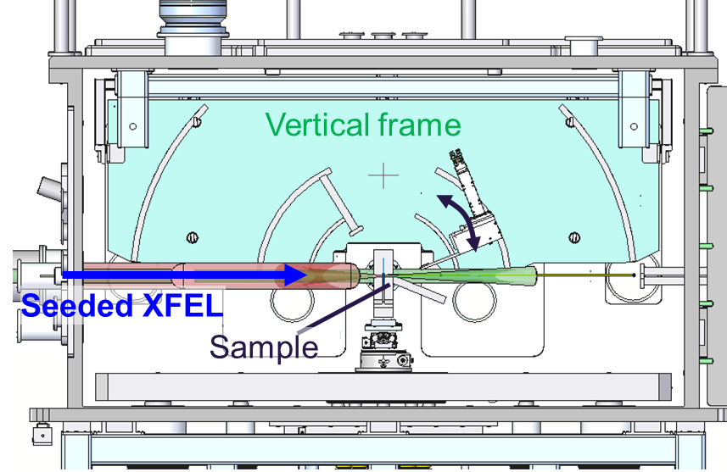
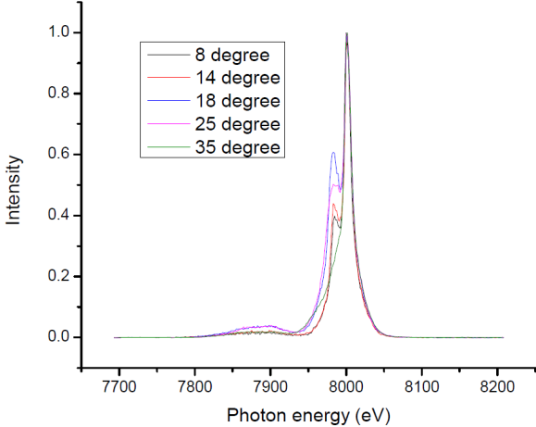
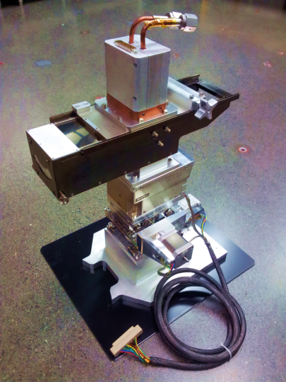
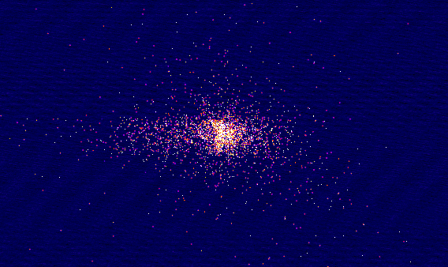
XRTS, hr-IXS, XAS
Horizontal profile
Functionality on detector level
Calibrated pictures (photons/pixel)
Group multiple detector modules to retrieve larger images
Mapping of detector position and orientation to retrieve a scaled image
Position scanning (rail motion system)
Typical data post processing
Background subtraction
Energy calibration
Peak integration, Peak fitting, etc.
Peak identification
Commonly used languages
Matlab, Python, C++, …
Typical HAPG IXS spectrometer
(taken at MEC, LCLS)

Slide 10
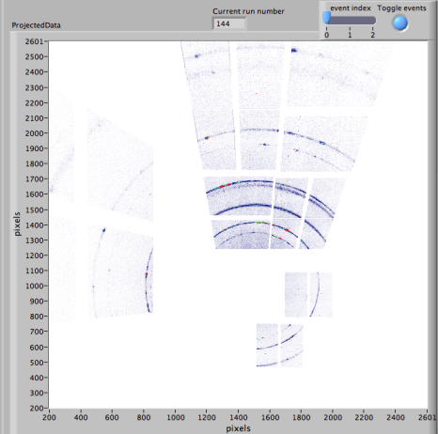
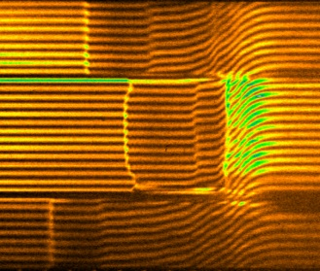
User file format
HDF5
Raw Data (images, waveforms):
Observables: XRD, XRT, …
X-Ray diag.: beam profile, pulse duration, …
Opt. laser diag.: beam profile, pulse duration, …
Exp. parameters: target position, pp-timing, pp-jitter, VISAR, FDI, …
Parameter | Value | Unit
Bunch ID
Laser parameters
X-ray parameters
pp-Delay
Target position, timing, etc.
Pre-analysed parameters (Shock velocity, peak intensity, etc.)
…
VISAR

Slide 11
Thank you

