Slide 1
Common approaches to data reduction in time-resolved XDS on liquids
Dmitry Khakhulin, FXE instrument (WP-81)

Slide 2
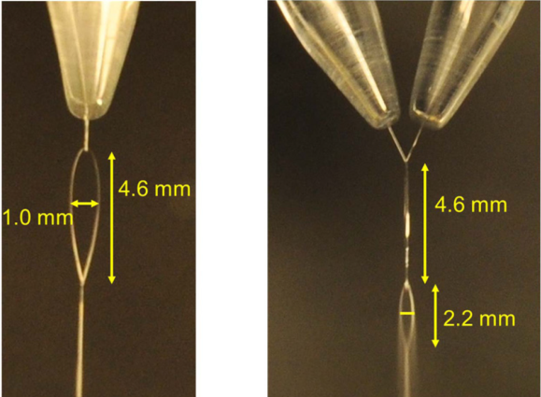
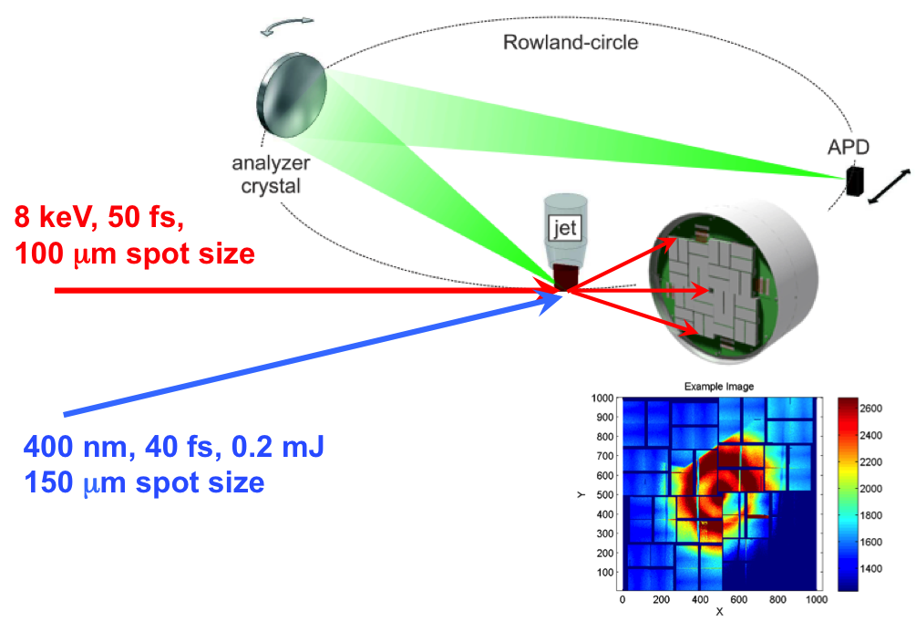
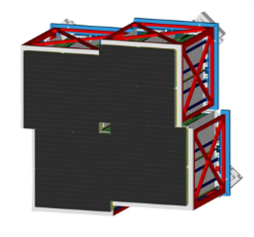
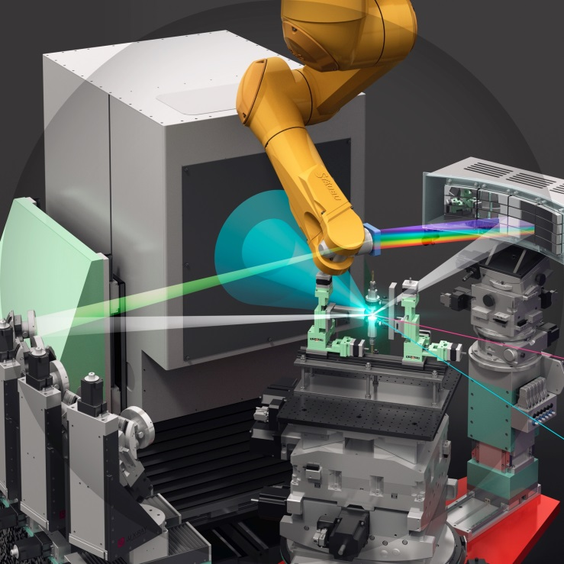
Towards a High-Speed Molecular Camera for tracking chemical reaction dynamics at FXE
XES
XFEL beam
XDS
Struct. Dyn. 2, 054301 (2015)
Diode
Optical laser beam
XAS
A Suite of Simultaneous X-Ray Tools available:
- XAS
- Non resonant XES
- Resonant XES (RIXS)
- X-Ray Raman Scattering
- Wide(Small)-Angle X-ray Scattering
- …
Courtesy by European XFEL/Rey.Hori

Slide 3

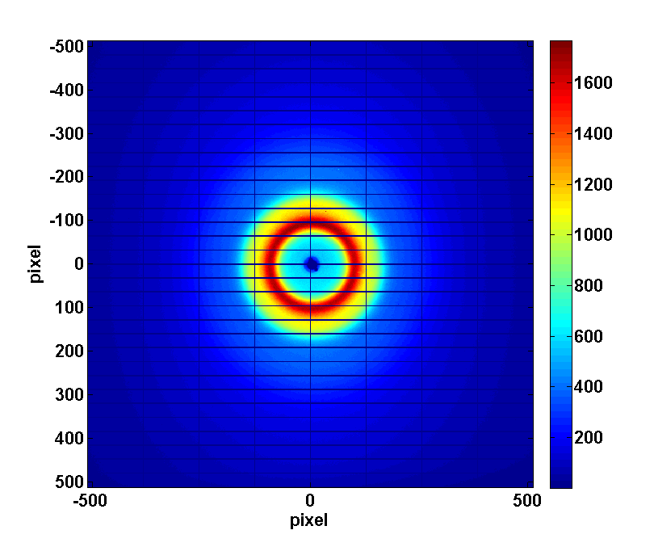
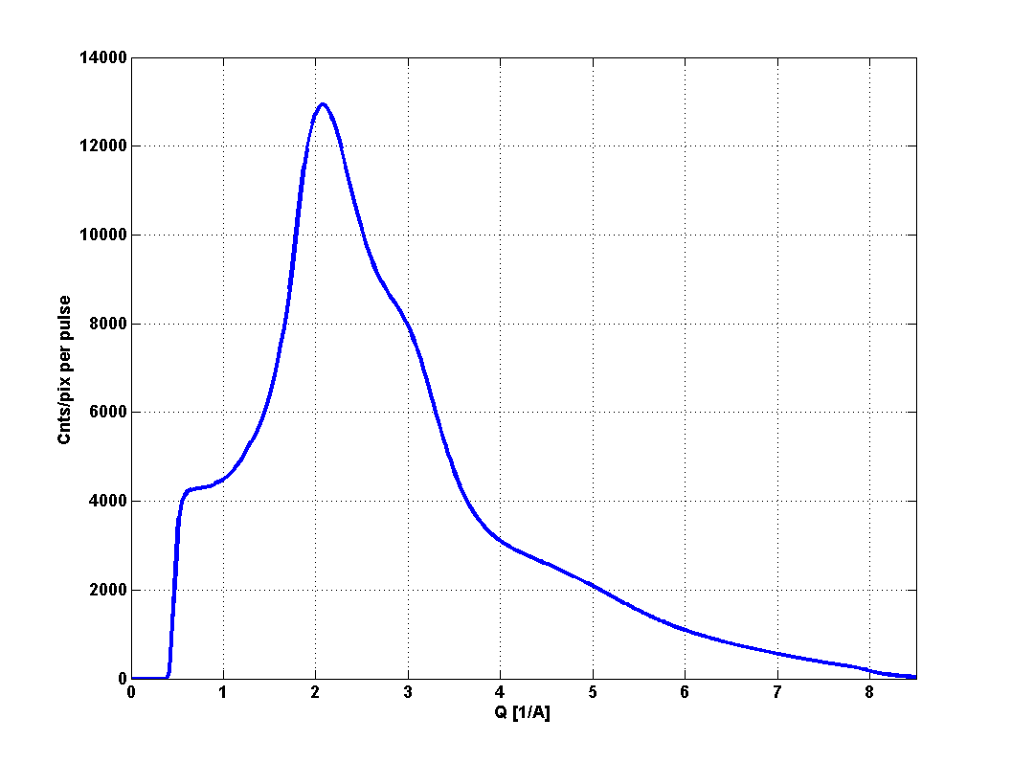
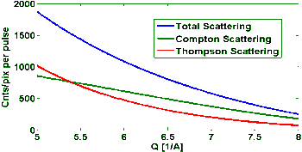
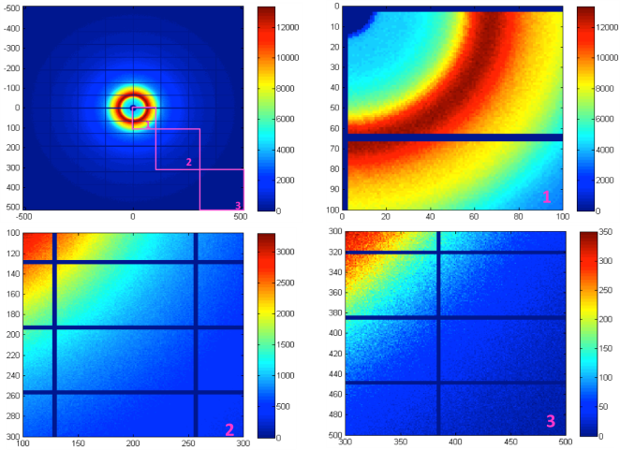
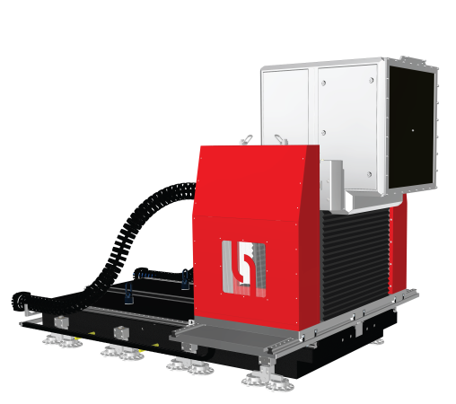
Liquid WAXS for probing the solvation
Wide-Angle X-ray Scattering (WAXS) delivers global geometric structural dynamics of the solute and the surrounding solvent
Scattering from 10 um flat water jet,
10¹² photons/pulse @ 15keV
Sample-to-detector distance120mm
Raw data
No monochromatization needed → pink beam compatible
Moderate focusing requirements → < pixel size (0.5 mm)
High repetition rate
High dynamics range (single photon→10⁵ photons/pixel)
High energy scattering - unique for XFEL
Reliability of the WAXS difference signal – optimization of the experiment
Notes:
Systems:
1 Mpix with adjustable central hole (in construction)
2-Tile prototype: 32 x 256 pixels.
Super-module prototype: 256 x 256 pixels.
Technology: Hybrid pixel detector constructed from 4-side buttable sensor modules. 86% active area.
Pixel size: (500 μm)², 500 μm thick Si.
Energy range: 5 – 20 keV.
Frame rate: 4.5 MHz, output rate: 5120 images/s.
512 images analogue on-chip storage.
Read noise: 1000 e⁻ rms, referred to sensor input.
Dynamic range: 10⁵ 12 keV photons
Amplifier architecture: 3 parallel gain settings merged off chip within DAQ system, 0.03 lsb/ph to 30 lsb/ph.

Slide 4
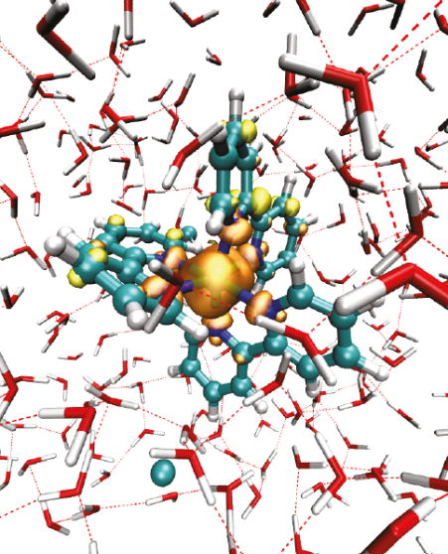
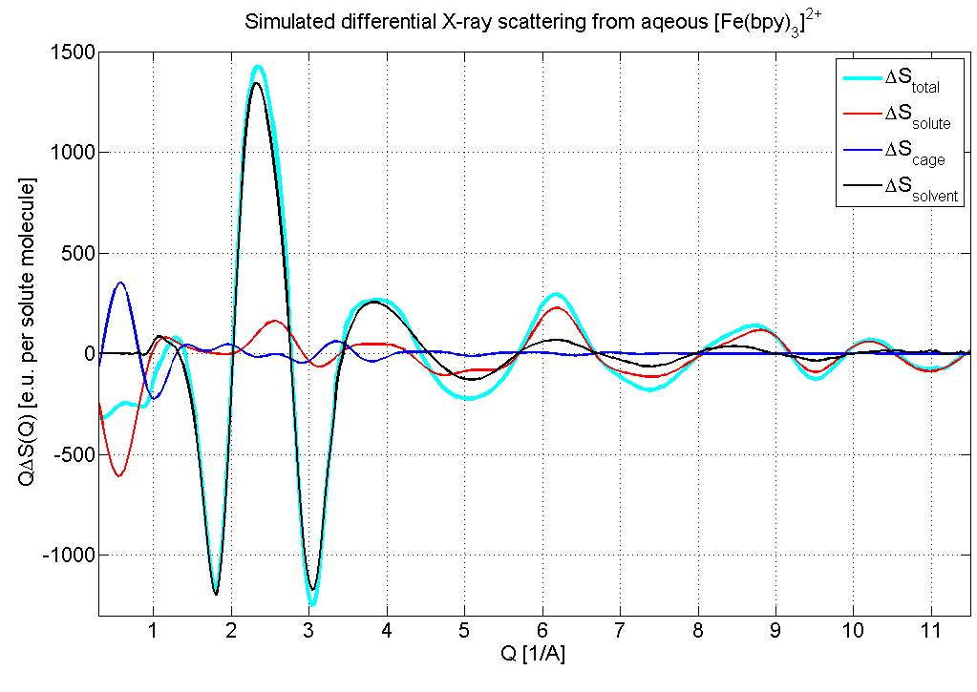
Solvation dynamics in Fe(II) complexes
Differential diffuse scattering:
Difference signal ΔS (Q, t) = S(Q, t > 0) - S_{ref}(Q, t < 0)
ΔS (Q, t) = ΔS_{solute}(Q, t) + ΔS_{cage}(Q, t)
[Fe^{II}(bpy)₃]²⁺/ H₂O
Lawson Daku, L. M. J PCL, 2010, 1, 1830
solvent
solute
cage+solute

Slide 5
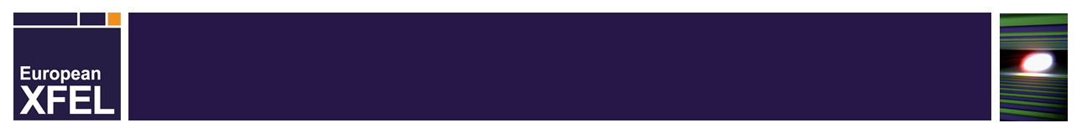
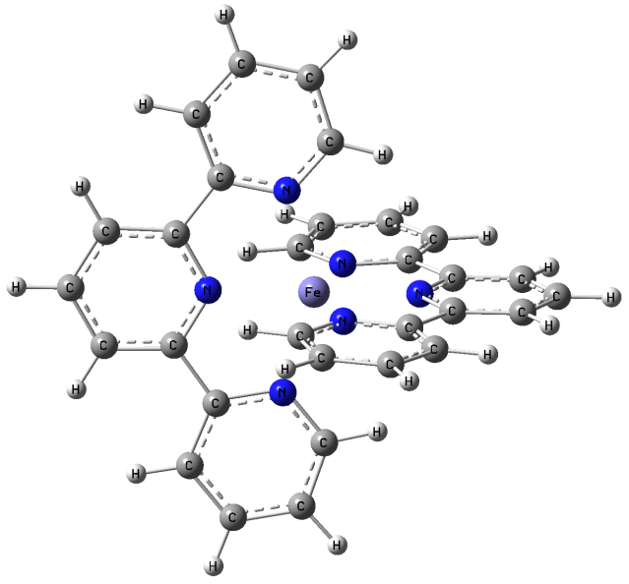
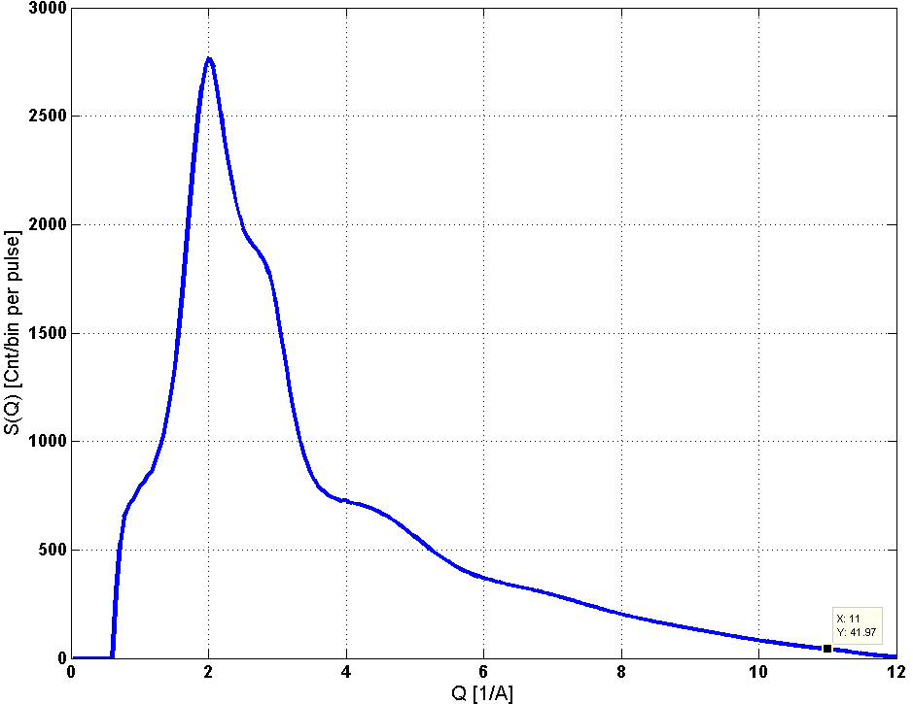
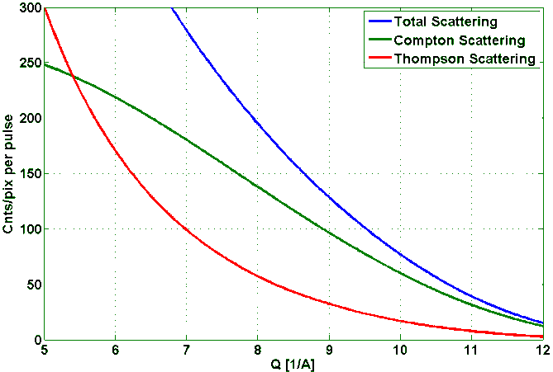
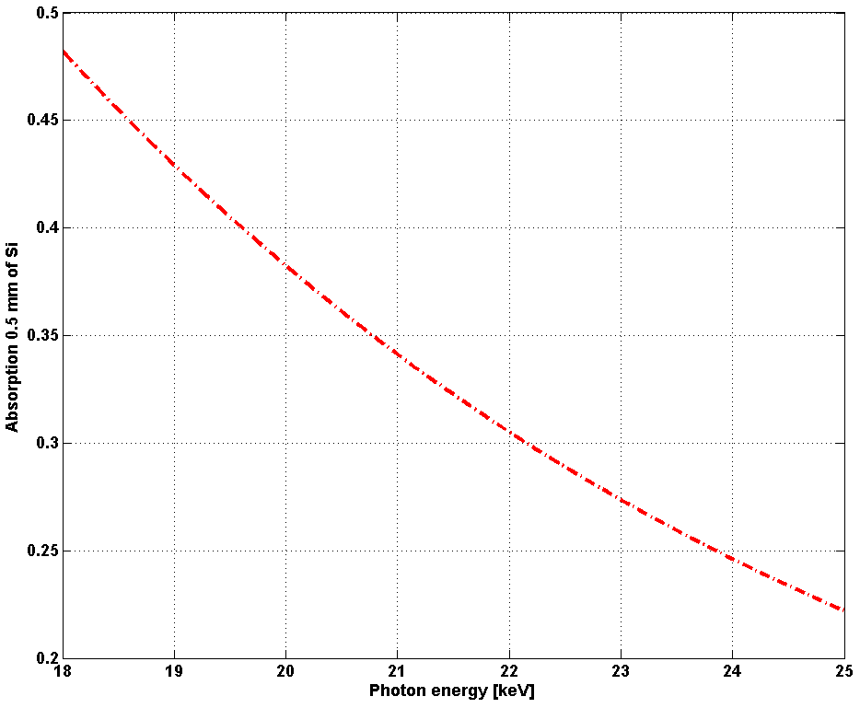
HR WAXS with LPD
N_{eq}
Scattering from 10 um flat water jet,
10¹² photons/pulse @ 20keV
Sample-to-detector distance100mm
N_{ax}
LS->HS
10 cm
10um jet
http://henke.lbl.gov/

Slide 6
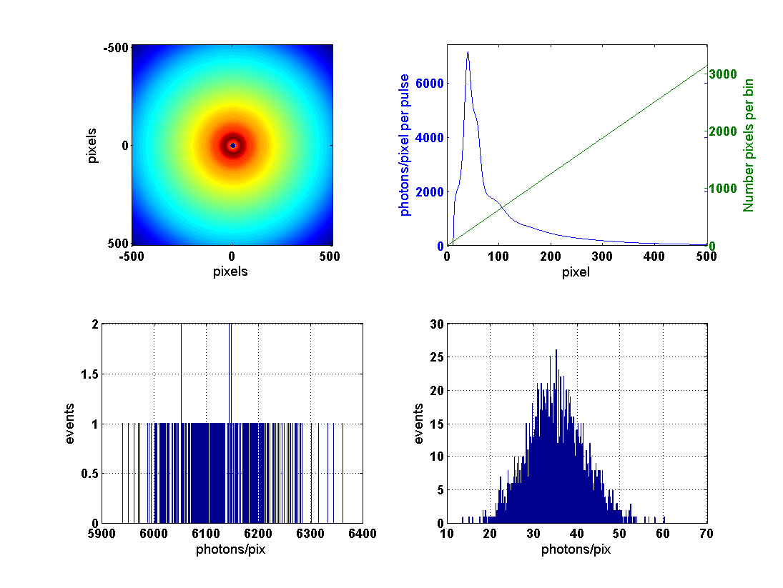
Scattering at 10¹² photons/pulse incoming (20keV), detx=100mm,
Noise ~0.4 photons, space angle corrected I/cos³(2*theta)
Poisson’s distribution for counting:
for the pattern maximum (radius = 40 pixels)
for the pattern periphery (radius = 450 pixels)
Notes:
High energy scattering will quickly become popular and benefit from the reprate

Slide 7
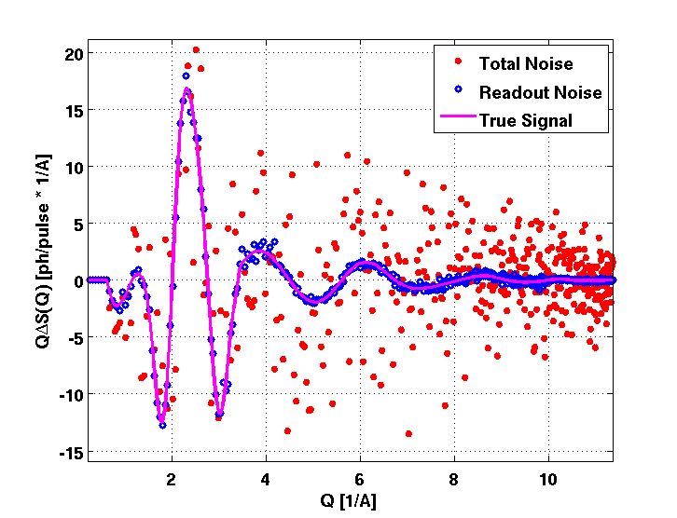
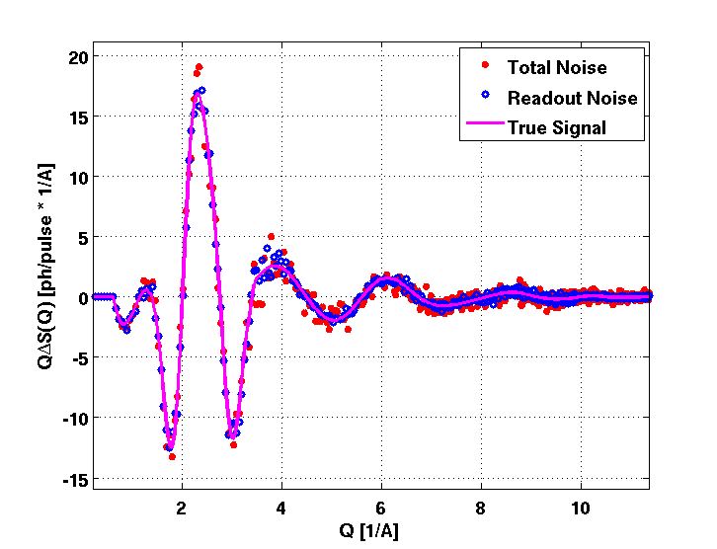
Spin crossover in aqueous Fe(II) complexes
N_{eq}
Aqueous solution, 15 mM
10 um jet, 50% excitation fraction
10¹² ph/pulse@20keV
LS→ HS
N_{ax}
10 cm
10um jet
1 pulse
100 pulses

Slide 8
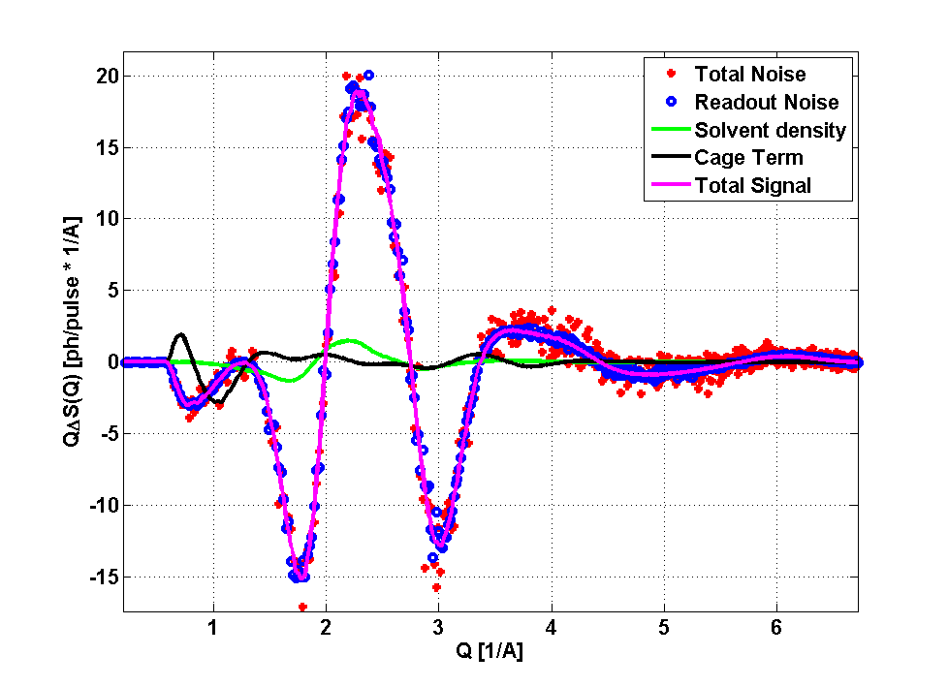
Preparing the acquisition: Figure Of Merit (FOM) scans
The most critical step of the experiment -
optimization of experimental parameters
laser/x-ray overlapped in space at well positive delay
temporal overlap
a laser power scan
Water
Acetonitrile
This signal is always there no matter if sample works or not,
it just has to absorb some laser light

Slide 9
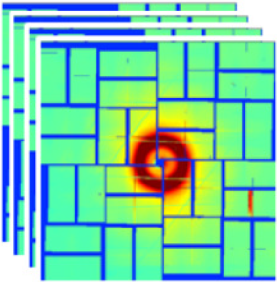
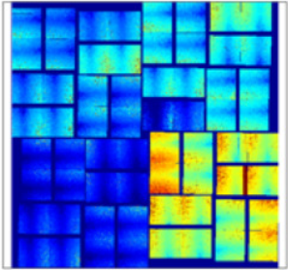
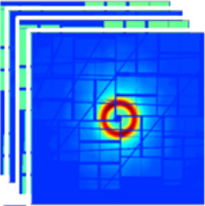
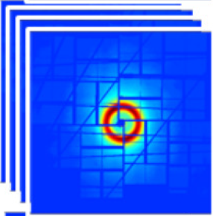
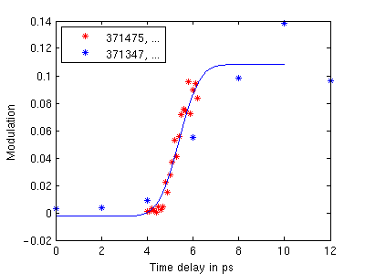
Possible workflow for optimization of exp. conditions
Raw images set
Dark images set
Masked and Corrected (optionally) images
~ 1000 x 2D
~ 4 GB
~ 1000 x 2D
~ 4 GB
~ 10 x 2D
~ 40 MB
Basic normalization
(optional)
Fastest possible feedback needed,
Drop most of the expensive corrections,
i.e. no ADU->photons conversion,
only basic normalization and image calibration
A few images is usually enough, drop frames
Robustness and reliability is preferred over exact accuracy, as the signal is typically very strong
The most important first step, defines the success of entire experiment
~ 1000 x 1D
~ 4 GB
FOM calculation
and averaging
~ 1 x 1D
~ 10 kB
Signal optimization

Slide 10
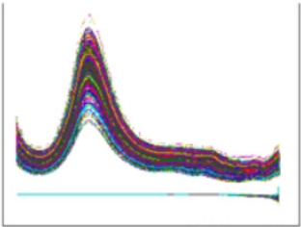
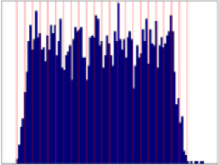
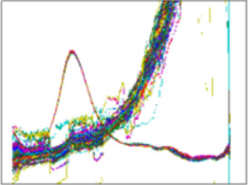
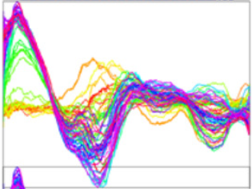
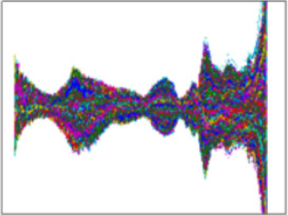
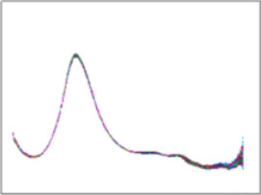
Typical data processing workflow
Raw images set
Dark images set
Masked and Corrected (2D ) images
dark
dark
LPD
X-ray
~ 10000 x 2D
~ 40 GB
laser
~ 10000 x 2D
~ 40 GB
~ 250 x 2D
~ 1 GB
Azimuthal
Integration
+ 1D corrections
Whenever possible keep the raw images:
non-assembled/corrected, in ADU
~ 10000 x 1D
~ 100 MB
TimingTool
Resorting (optional)
Normalization
~ 10000 x 1D
~ 100 MB
Filtering and
outlier rejection
Analysis
~ 8000 x 1D
~ 80 MB
~ 100 x 1D
~ 1 MB
Averaging
~ 5000 x 1D
~ 50 MB
Producing difference
(OFF subtraction)
via Tim van Driel (DTU)

Slide 11
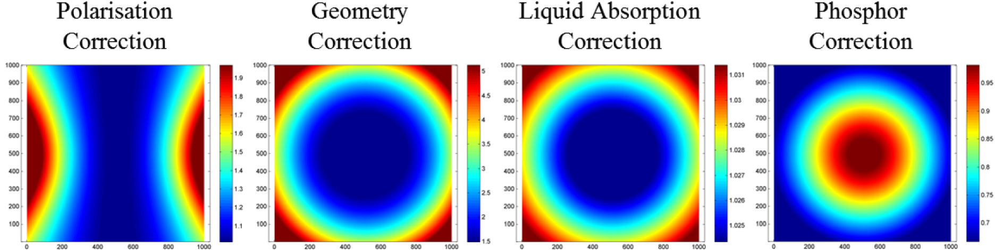

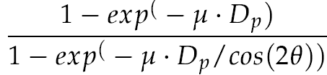
Scattering corrections
2D corrections
- Flat-field (gain map), CM corrections
- Distortion (image in lab. frame)
- Dark subtraction
- Polarization correction
- Sample absorption (if not normal)
1D corrections
2θ
D
1D corrections
- Space angle (geometry)
- Sample absorption (if normal)
- “Phosphor” correction
2θ
D_{p}
sample
P (horiz.)
dΩ
dΩ × P

Slide 12
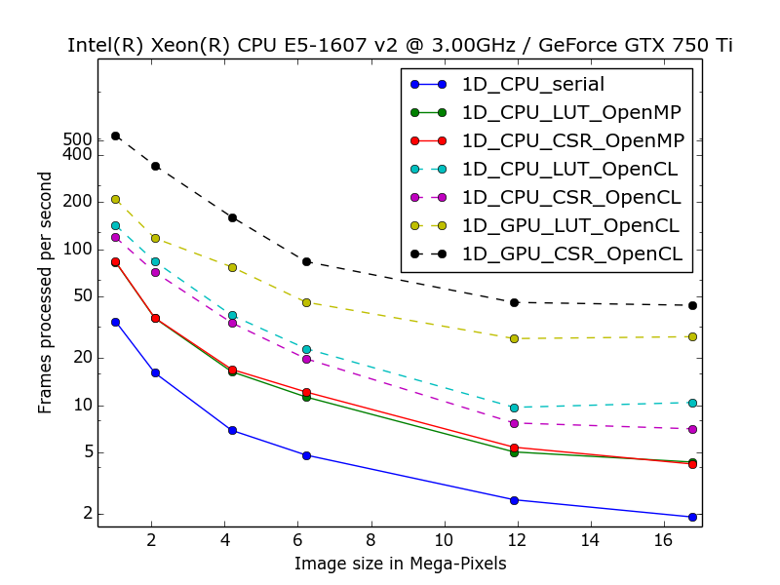
Fast Azimuthal Integration – PyFAI
Developed by J. Kieffer (ESRF)
Python Implementation
(4M image example, no readout overheads):
- Image slicing (loop+mean) 40 s
- Histogram (scatter operation - no parallelization)
cheap memory-wise 800 ms
- Look-up-table LUT (“scatter to gather” transformation)
memory costly 150 ms
on GPU 15 ms
- Compressed sparse row (CSR) representation of
LUT – optimal for GPU parallelization and memory
consumption <150 ms
on GPU 6 ms
Features
- Pixel splitting implemented - expensive but important for
large pixels like on LPD
- Supports masking, dark and polarization corrections
- Seemingly supports non-regular pixel grids of tiled detectors,
h5 in NeXus definition
- Optimized for GPU parallelization, good performance
- Python library (C-based ) of functions relevant for scattering
Goal – 200 Hz

Slide 13
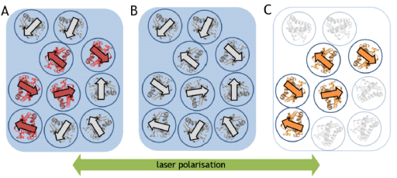
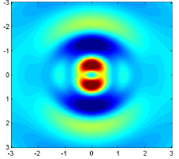
Data processing workflow for anisotropic scattering

Slide 14
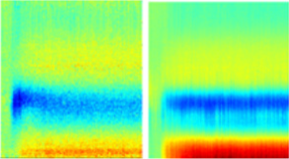
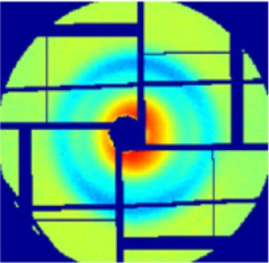

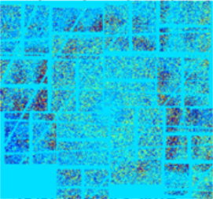
Data processing workflow for anisotropic scattering
Raw images set
Dark images set
Masked and Corrected (2D ) images
~ 10000 x 2D
~ 40 GB
~ 10000 x 2D
~ 40 GB
~ 10000 x 2D
~ 40 GB
Normalization
~ 10000 x 2D
~ 40 GB
TimingTool
Resorting (optional)
Filtering and
outlier rejection
~ 8000 x 2D
~ 32 GB
Azimuthal
segmentation
and integration
OFF subtraction
Analysis
~ 100 x 2 x 1D
~ 2 MB
~ 100 x 2D
~ 40 MB
Averaging
~ 5000 x 2D
~ 20 GB
via Tim van Driel (DTU)

Slide 15
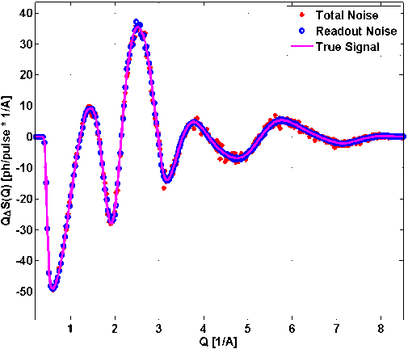
Summary
Fast user feedback is crucial (FOM scans)
The raw images (in ADU) should be kept and provided to users
The standard XDS data reduction loops (to 1D) should exist
and be available for users
Ideally, more advanced reduction tools like e.g. for anisotropic scattering or scattering during phase transitions
Thank you for attention!

