Slide 1
Data Processing Requirements of the SQS Instrument
XFEL Data Processing Workshop 2016
Thomas M. Baumann
03.02.2016

Slide 2
The Small Quantum Systems (SQS) Instrument at European XFEL
Scientific Scope:
Soft X-ray beamline SASE3: 260 eV to 3000 eV photon energy,
Study of Atoms, small Molecules, Clusters and Biomolecules,
Nonlinear multi-photon processes,
Molecular dissociation dynamics,
Coincidences (Electron-Ion, Electron-Electron),
Imaging of Molecules and Nano particles.

Slide 3
Overview of the Detectors at SQS
Scienta detector
Imaging MCP detector
Magnetic bottle spectrometer
MCP detector
XUV photon spectrometer
MCP with double delay line
Scattering Detectors
DSSC detector
FastCCD detector
Imaging MCP
Six Electron Time-Of-Flight
Spectrometers (eTOF)
MCP detector
4.5 MHz readout
Coincidence with eTOF or VMI
Velocity Map Imaging Spectrometer (VMI)
MCP with Phosphor screen (10 Hz)
Alternative: Delay-line anode (4.5 MHz)
Coincidence with eTOF
Reaction Microscope (REMI) / COLTRIMS
2 MCP detectors with delay-line anodes
4.5 MHz readout
Electron – Ion Coincidences

Slide 4
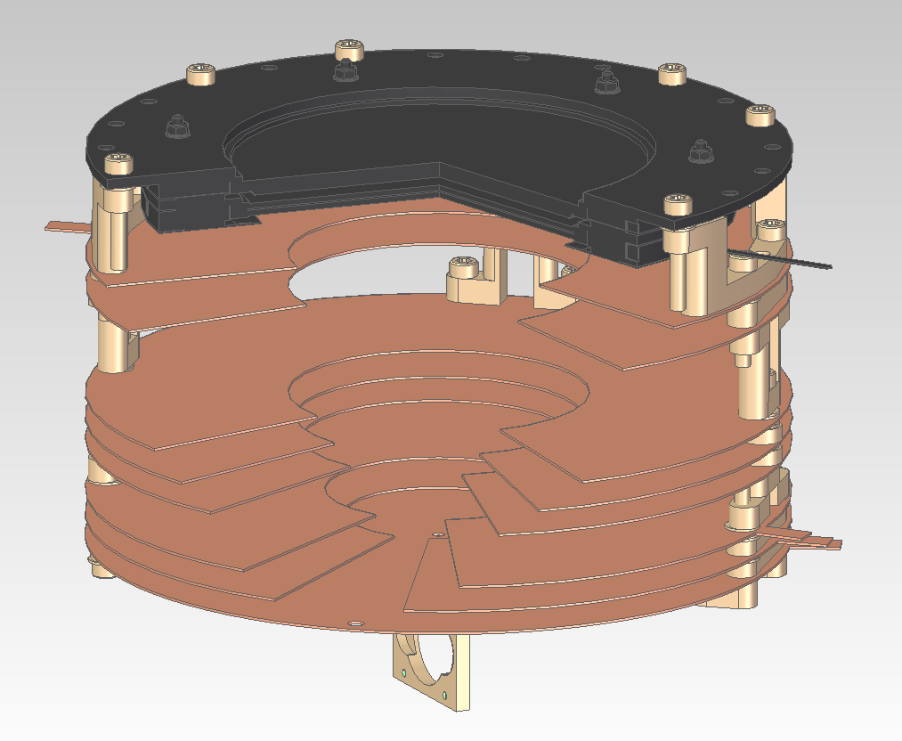
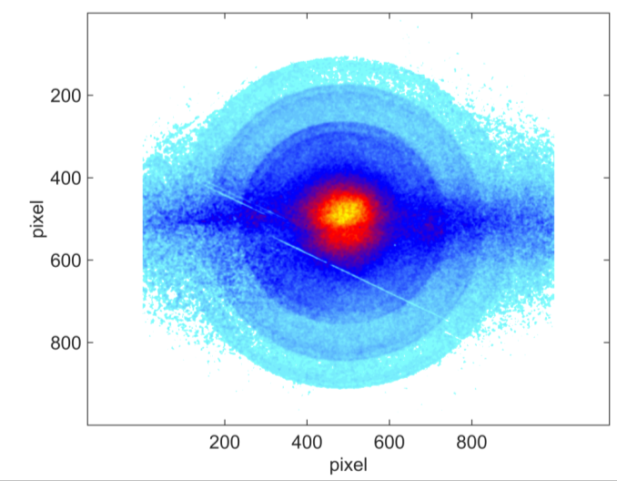
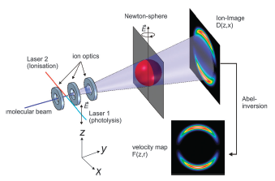
Velocity Map Imaging Spectrometer (VMI)
MCP + Phosphor screen
hν = 280 eV, E_{kin} = 30, 32 eV
Detector image
hv = 270 eV, E_{kin} = 20, 22 eV
Parabolic electrode stack
P04 (PetraIII): Ar 2p photoelectrons
Electrons
FEL
Target
hv = 260 eV, E_{kin} = 10, 12 eV
MCP + Phosphor screen,
Photonic Science sCMOS camera:
2048 x 2048 Pixel, 16 bit, 30 fps -> 10 Hz operation
May later be replaced by MCP + delay-line -> 4.5 MHz.
Target is ionized in interaction zone,
VMI optics project 3d velocity map on 2d detector plane,
Reconstruction of velocity map from images needed,
One common method: Inverse Abel-Transform:
B. Dick, Phys. Chem. Chem. Phys. 2014, 16, 570

Slide 5
VMI Data Processing: Online analysis
Current development status
Karabo program for camera control and readout is available,
Online data processing devices are under development (thanks to Andrea Parenti!):
Background subtraction
Summing / averaging
Region of interest definition
Processing: e.g. sum, ratio,…
Implemented pipeline:
Next performance test during run at P04 in March.
Abel-Transform algorithm:
Collaboration with Gregor Hartmann (DESY)
Inversion of pre-processed data (sum of several runs)
Parallel processing on GPU or multiple CPUs
Python code (using pyopencl, pycuda, mpi4py)
master
camera
bkg.sub
average
mask1
img.proc.1
slave
mask2
img.proc.2
Single image Ar Auger @ P04

Slide 6
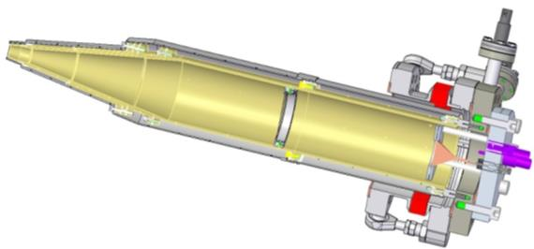
Electron Time-of-Flight spectrometer (eTOF)
High resolution kinetic energy measurement on electrons produced in Target – FEL interaction.
MCP detectors.
Data acquisition on 4.5 MHz timescale,
Digitizer: SP device, 10 GS/s,
TOF resolution limited by digitizer resolution.
6 eTOF spectrometers
Port aligner
Mesh
Drift region
Online data processing (in electron counting mode):
Peak search / discrimination,
Calculation of time between trigger and signal,
Counting of pulses vs TOF (histogram),
Disregard of traces w/o signal (optional),
Coincidence plots,
Define and project regions of interest,
Display of histograms,
Storage of traces and histograms.
Electrodes
MCP detector
Trigger
TOF < 220 ns
< 1 ns
Online data processing (in current mode):
Summing of traces.
Current development status:
Karabo program for recording, displaying and storing digitizer traces is available.

Slide 7
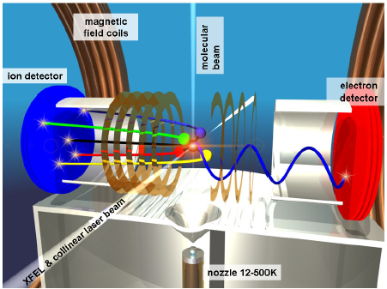
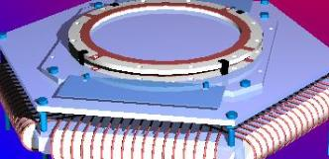
MCP Detector with Delay Line Anode
REMI and NQS:
Detection of electrons and ions after interaction with the FEL,
Full reconstruction of interaction dynamics from particle positions on the detector,
Two MCP detectors with delay line anodes,
Coincidence measurements,
Collaboration with Uni Frankfurt (R. Dörner) and RoentDek.
MPIK
MCP stack with delay line anode:
Delay line anode in two or three directions (Hexanode),
Multi-hit capability,
Digitizer: SP Device, 2 GS/s,
Data acquisition on 4.5 MHz timescale.
RoentDek Detector

Slide 8
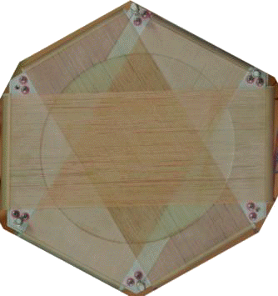
Delay Line Detector Data Processing
T_{v1}
Position calculation performed by RoentDek software
T_{u1}
Hexanode coordinates:
T_{w1}
Cartesian coordinates:
T_{w2}
T_{u2}
Sorting algorithm:
T_{v2}
RoentDek Hexanode
Search for „good“ signal combinations.
Tolerance window e.g
Position uv similar to uw.
Position must be within MCP active area.
Trigger (MCP)
Delay line several 10 ns
< 10 ns

Slide 9
Summary
VMI requirements
Karabo programs under development
Next test run in March/April at P04
Digitizer requirements
Karabo program for digitizer readout is available
Implementation needed:
pulse discrimination
Trigger to Pulse time delay determination
1D and 2D histogram creation
Coincidence of several channels
Possible test of eTOF spectrometer in March/April at P04

