Slide 1
XPCS data analysis and requirements on the data treatment
J. Hallmann, Th. Roth, A. Madsen
MID Instrument

Slide 2
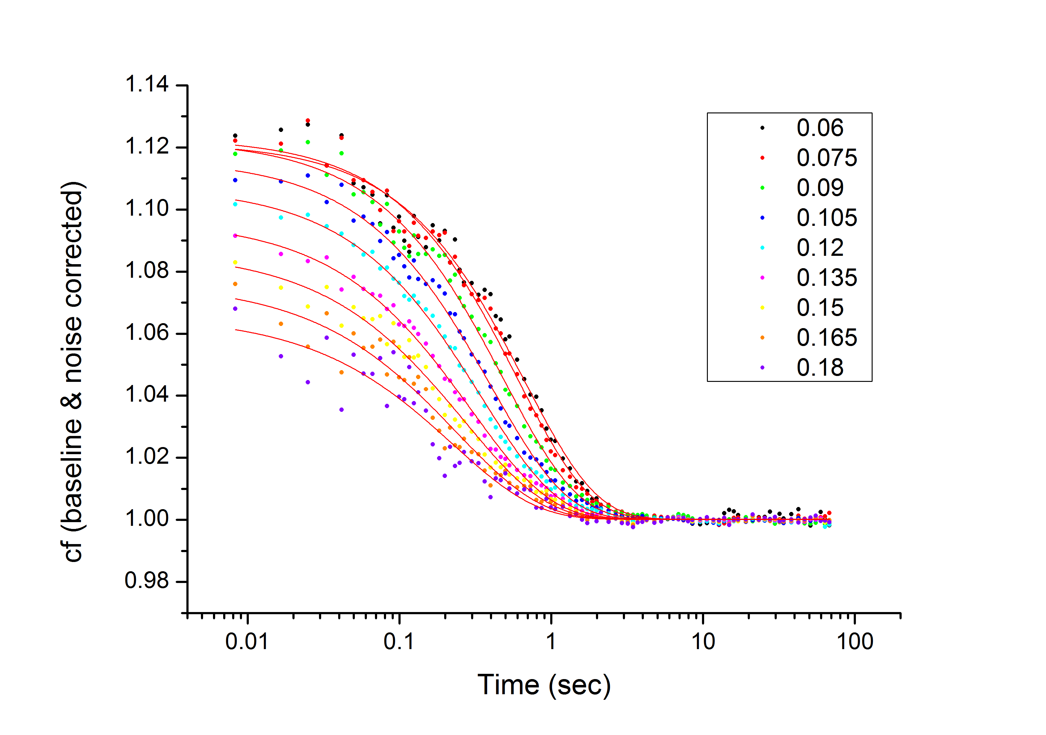
What is XPCS?
X-ray Photon Correlation Spectroscopy
Scattering with coherent X-ray photons
„life time“ of speckles determines the dynamics in a system
q-dependent information in SAXS is of importance
Averaged over time and pixels
q [nm⁻¹]

Slide 3
Probability analysis (XSVS)
Calculate the contrast of one image using the probabilities of 0-, 1-, 2-photon events etc.
Analysis steps:
Converting the ADU into photons (Important: a malfunction in the conversion will kill the entire result! → Medipix P10)
Summing images and counting photon events
Calculate the contrast using the probabilities and the average intensity on the image
Reason:
Sum images with different Δt to get dynamic information
Preferred analysis methode to investigate dynamics on the ps time scale (using split and delay technique)

Slide 4
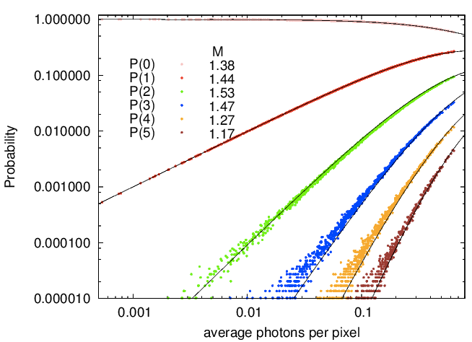
Probability analysis (XSVS)
Use Poisson-Gamma!

Slide 5
XPCS on SAXS
Overview (average over 100-200 images)
S(Q) curve (determine if the sample shows a good scattering behaviour)
Q-rings (define the size & position of the q-rings for the analysis)
XPCS code (all based on python)
Necessary packages:
Numpy, pylab, cPickle, pickle, scipy.ndimage, gaussian_filter
psana pa, commonmode, numpy.ma

Slide 6
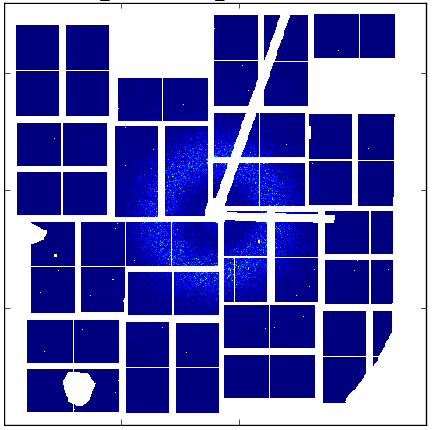
Steps of XPCS analysis in SAXS
Loading the 32 detector modules (185x388pxls out of .xtc or .hdf-files) & position them in a master array (1800x1800 pxls)
Apply mask, dark subtraction & common mode correction (identify the 0-photon peak and shift it to 0 ADUs), etc.
Redo everything for the required number of images, average & correlate
Get out the results….
time

Slide 7
XPCS on WAXS
Compared to SAXS
only a few photons per image expected (~0.01-0.001 ph/pxl)
No q-rings/q-areas of relevance
No average, S(Q), & ring location necessary but the pure WAXS-XPCS code (Python & Fortran)
Necessary packages:
Same as for SAXS + implementation of Fortran parts to fasten up selective processes

Slide 8
Steps of XPCS analysis in WAXS
Loading the 32 detector modules (185x388pxls out of .xtc or .hdf-files) & position them in a master array (1800x1800 pxls) (not really necessary but helpful to prepare masks)
Apply mask & common mode correction (identify the 0-photon peak and shift it to 0 ADUs), dark subtraction etc.
Dropletize and get out an Event list (Fortran package)
Redo this for a certain number of images
Use an event correlator (Fortran package)
Get out results!
Lower threshold = 17
ADU/photon = 37
Event list
((0,3),(0,3),(1,0),(3,2),(4,0))
0 | 0 | 0 | 2 | 0
1 | 0 | 0 | 0 | 0
0 | 0 | 0 | 0 | 0
0 | 0 | 1 | 0 | 0
1 | 0 | 0 | 0 | 0
0 | 0 | 0 | 50 | 20
37 | 0 | 0 | 18 | 0
0 | 0 | 0 | 0 | 0
18 | 0 | 40 | 0 | 0
22 | 0 | 0 | 0 | 0
0 | 0 | 0 | 50 | 20
1 | 0 | 0 | 18 | 0
0 | 0 | 0 | 0 | 0
0 | 0 | 1 | 0 | 0
1 | 0 | 0 | 0 | 0
10 | 11 | 4 | 50 | 20
37 | 7 | 0 | 18 | 2
3 | 2 | 2 | 2 | 4
18 | 6 | 40 | 6 | 4
22 | 2 | 0 | 1 | 9
0 | 0 | 0 | 50 | 20
1 | 0 | 0 | 18 | 0
0 | 0 | 0 | 0 | 0
18 | 0 | 40 | 0 | 0
22 | 0 | 0 | 0 | 0
0 | 0 | 0 | 50 | 20
1 | 0 | 0 | 18 | 0
0 | 0 | 0 | 0 | 0
0 | 0 | 40 | 0 | 0
1 | 0 | 0 | 0 | 0
((0,3),(1,0),(5,2),(5,5))
((0,3),(1,0),(1,2),(1,5),(5,3),(5,5))
:
:
:
Chushkin et al. J. Appl. Cryst. (2012). 45, 807-813

Slide 9
What do we need for online analysis?
Implementation of different Python packages
Implementation of Fortran (100times faster for some applications than Python)
Image treatment (position of the modules, darks, masks, corrections like common mode correction, etc.)
Entire pure images (no initial conversion to event list)
Veto criterias (beam position, intensity, energy etc.) to discard certain images
Well understood detector which works reliably and is constant (e.g. no sensitivity fluactuation upon incident intensity or blinking pixels)

