Slide 1
StripCMOS programme for ATLAS
Parameter | Planar Detectors | stripCMOS
r-φ resolution | 20μm – 23μm* | 11μm
z-resolution | 850μm | 162μm**
Two hit resolution in r-φ | 160μm-240μm*** | 80μm
z-element length | 2.5cm | 1.8cm
Fraction of two hit clusters | 15% - 20% | 2%-3%
Geometry inefficiency on stave | ~0.7% | ~1%
Radiation Lengths per stave | 1.8% | 1%
Insensitive crossings after a hit | 1 BC | 0.1 (1/32 of strip is dead 3BC)
Also ~27MCHF
cheaper
Why:
^{[1]} With thinned sensors – see https://indico.cern.ch/event/295996/contribution/0/material/slides/1.pdf
Why not: Only one fundamental reason: time to develop
There is extremely high confident that this technology will be suitable for use once developed. It is already in use.
Approach: Aggressive time-driven development programme
Not optimised to fully exploit possibilities of CMOS
Attempt to secure above benefits for phase-II upgrade

Slide 2
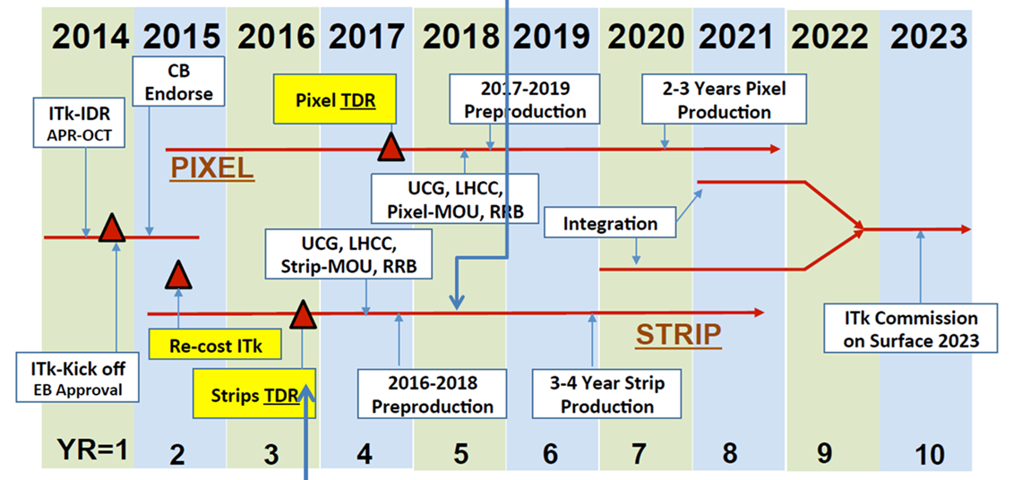
Some pre-pro OK, some not
{
Second Review
large scale chip, ABCn’ read-out
First review
candidate technology, good results
If S/N ok, likely to pass this review
Pass second review
‘excellent chance will be chosen’
3 months to work into TDR as ‘fall forward’
9 months to produce
Full size sensors
Modules on staves/petals
Choose before
MOU
Pre-production
Mid 2018
Delay of 6mo to programme, retool, finalise & large scale testing

