Slide 1
SCRF R&D at DESY
Hans Weise
DESY-KEK Meeting – 7/8 March 2016

Slide 2
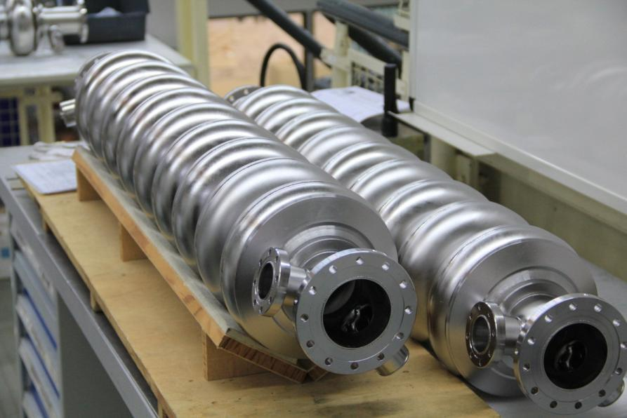
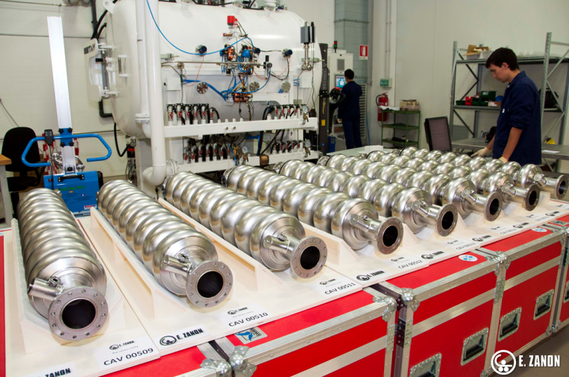




800 Superconducting Cavities and RF Power Couplers

Slide 3
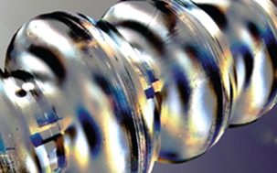

800 Superconducting Cavities

Slide 4
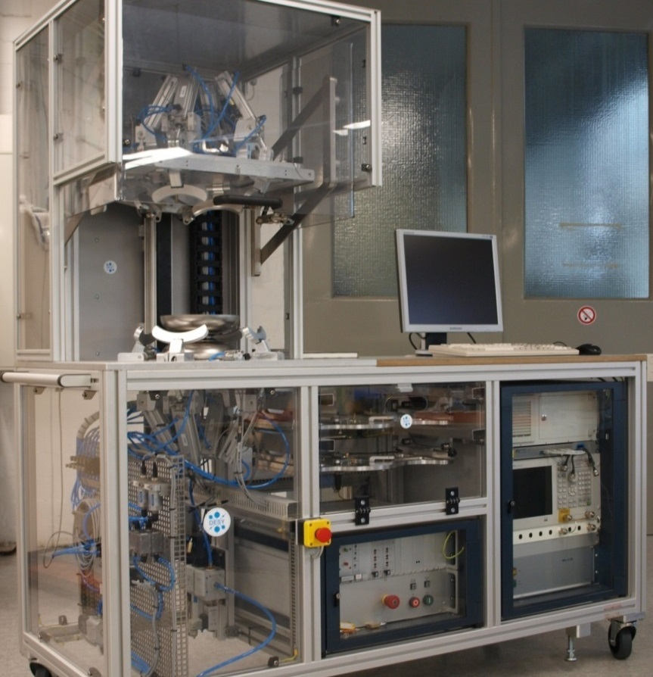
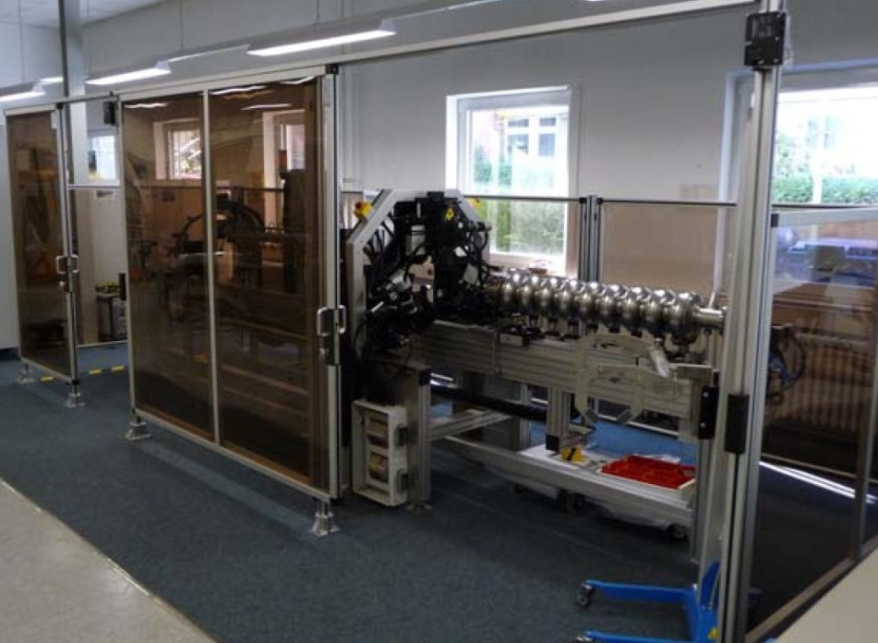
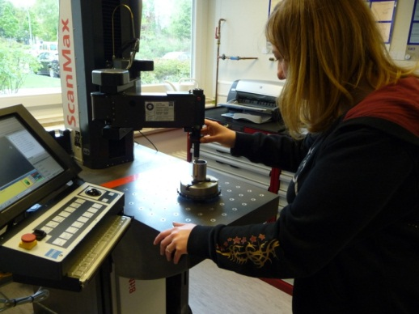
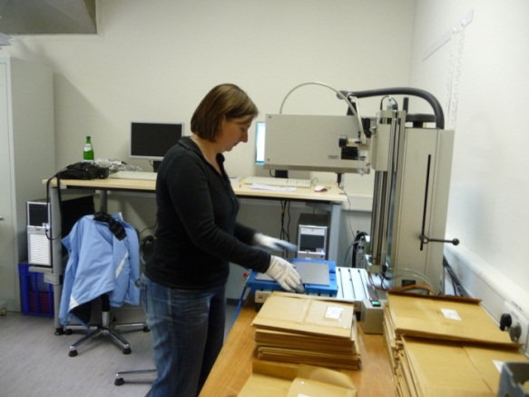
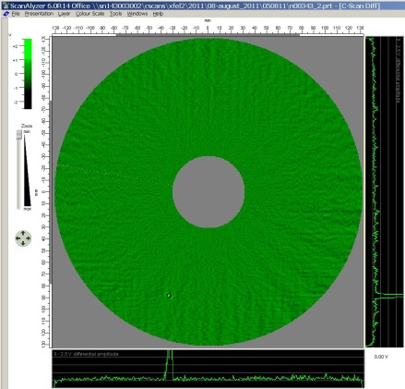
Cavity Production in Industry Based on DESY & INFN Supervision

Slide 5
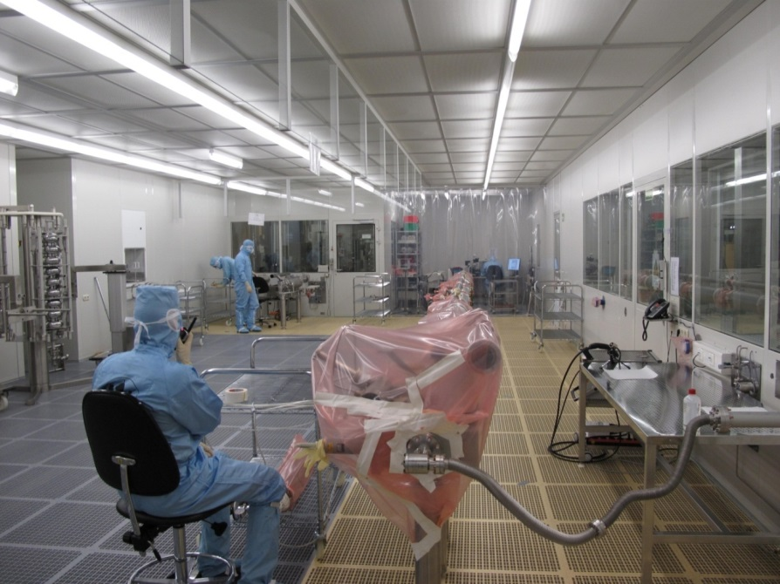
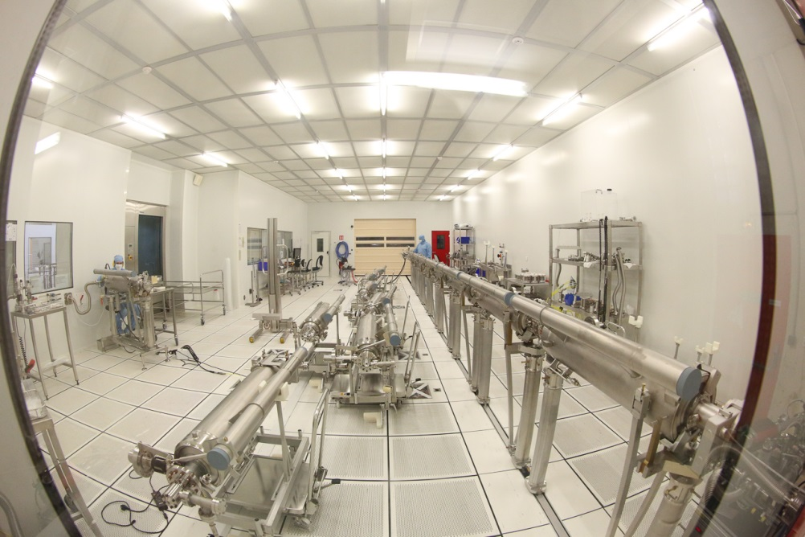

DESY Support and Supervision of Assembly

Slide 6
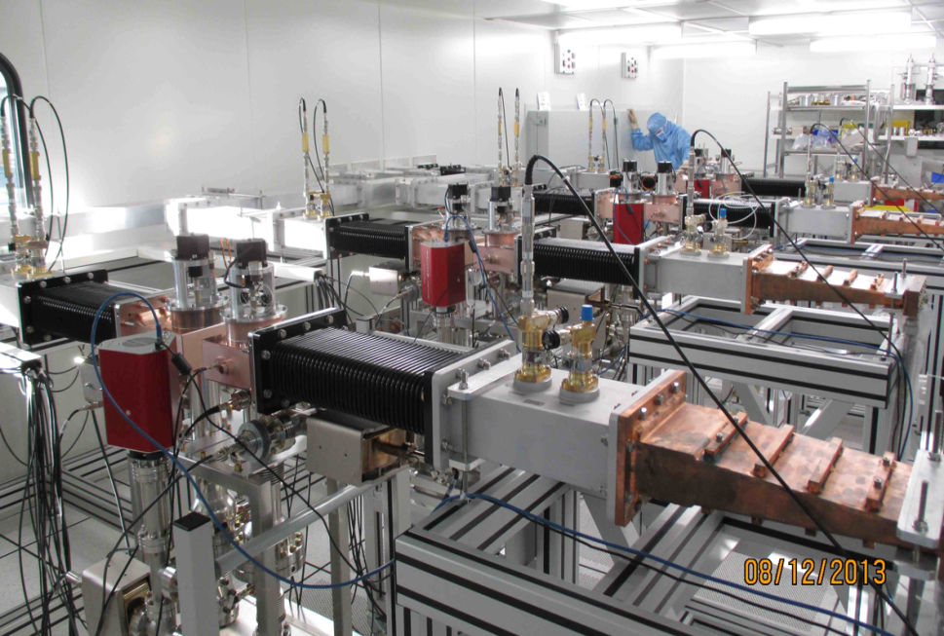
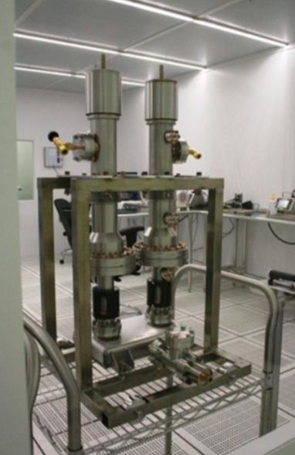
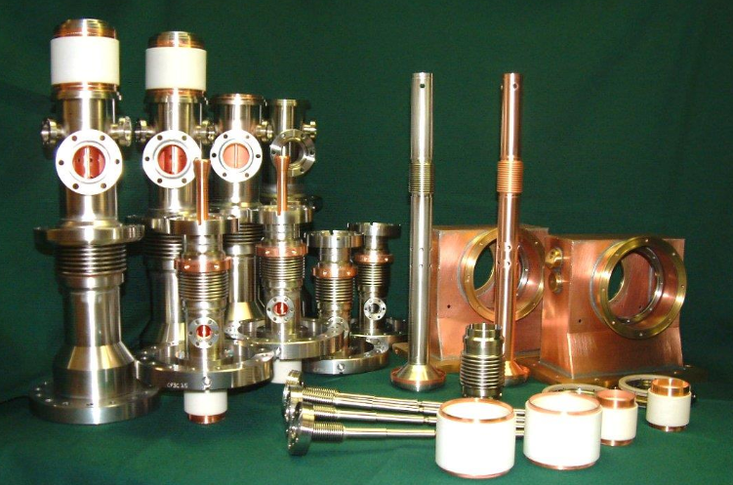

RF Power Coupler

Slide 7





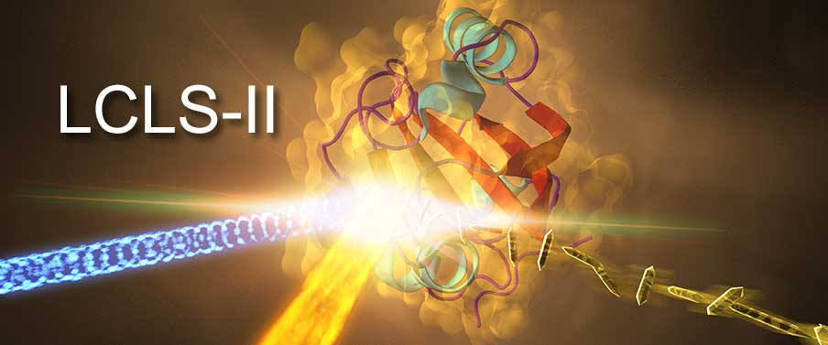




DESY is Collaborating with Many Partners
niobium
cavity Specs
accelerator module design
vacuum specs
installation procedures
diagnostics
infrastructure
rf power coupler know-how

Slide 8
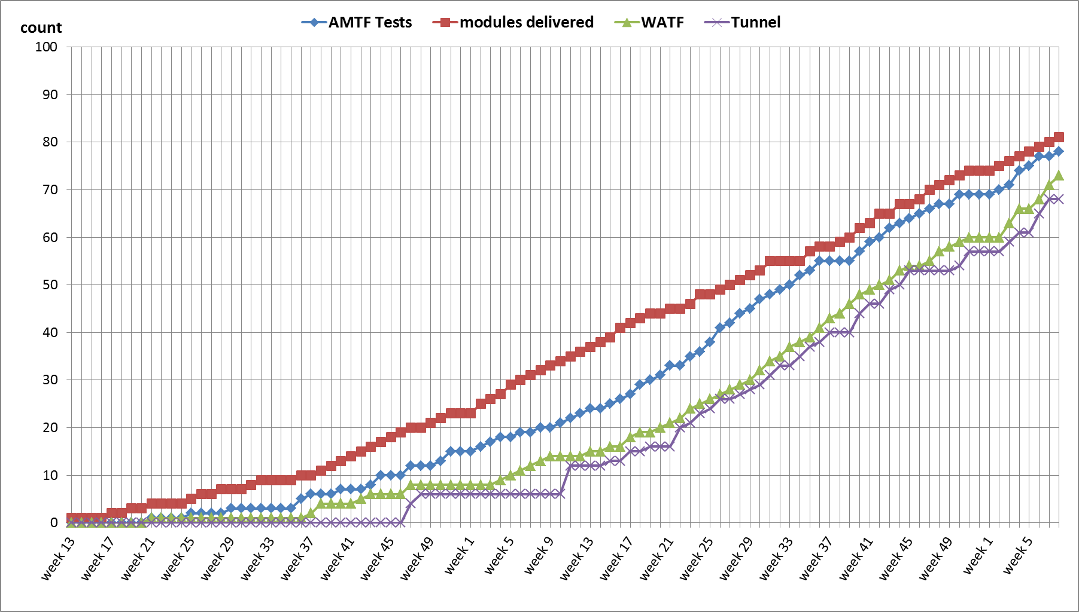
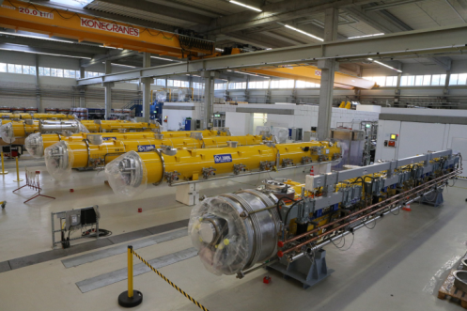


Accelerator Module Rates

Slide 9
SRF R&D following the XFEL Project
With the end of the XFEL construction period there is
    Time
    Chance
    Possibility
    Challenge
to reconsider R&D topics.
We should remind us about our fields of expertise.
What is our interest?
    project / facility driven
    Interest driven

Slide 10
Some Accelerator R&D related comments
ARD discussions started under the label of pushing SRF limits
  CW operation of SRF accelerating modules
  Adding IOT amplifier operating in an cw and/or near-cw mode (pulse length ~100 ms) to the pulsed rf used for TESLA technology accelerating modules may allow the provision of beams with a bunch spacing larger 1 us but with lower energy. The study will help to determine technical limits in the amplitude and phase stabilization at high loaded quality factors and it is relevant for the possible future upgrades.
  Single crystal multi-cell cavities and substrate samples
    Development of manufacturing chain that yields multi-cell single crystal cavities with defined crystal orientation. Large grain cavities show higher Q-values that fine grain cavities. The Q-values of single crystal cavities is expected beeing even higher. For a given cryogenics design higher Q-values enable higher gradients at cw operation. This activity will also provide single crystal sample material and cavities with defined crystal orientation as substrate for thin SISI layer coating.
  Thin SISI layer coating
    Experimental verification of vortex pinning in SISI layers with the goal of raising the Q-value and the RF critical magnetic field well above the limit for pure Niobium. Both single crystal samples and coated materials are to be examined. The research should be extended to other type II superconductors resorting to the techniques developed earlier.
In view of long-term perspective of our s.c. facilities the clear statement was to emphasize CW as the topic.

Slide 11
General Statements wrt. CW
CW operation has several aspects
  CW testing of XFEL modules (as exisiting)
  CW testing of a 3.9 GHz module
  CW, i.e.(?) SRF gun
    Construction
    Iterative rf testing
    Testing with beam
  Improvements of
    Cavity, coupler, cryogenics, others? Or even Niobium?
    How does an optimized CW module looks like?
    Can we tell this in some few years?

Slide 12
ARD ST1 work packages w/ DESY actvities

Slide 13
Use and Modification of our Dedicated Infrastructure
CMTB will remain available
Hall 3 RF testing will be stopped and needs to be completely moved to AMTF
AMTF
  Two RF test stands can be used for
    all our 1.3 GHz test programs
    (R&D projects need to co-finance operation)
    Service for e.g. ESS but also industry
    (full cost to be carried by external ‚orderers‘)
  Approx. 2 horizontal test stands are a must; perhaps the third as housing for HZDR gun cryostat and also CHECHIA(?); installation cost!
All other SRF infrastructure, e.g. hall 3, should be state of the art and remain operational after the end of the XFEL construction period
Special infrastructure like 800 deg oven to be re-activated; 1400 deg?

Slide 14
Infrastructure of DESY MPL Laboratory is Under Discussion
  Residual Resistivity Ratio
  Thermal conductivity
  Eddy current method
  Gas analysis
  X-ray element analysis
  Hardness HV
  Thickness
  Bulging test
  Tensile test
  Roughness
  Surface profile
  Metallography
  Light microscopy
  3D Imaging
electrical & thermal properties
The dedicated infrastructure had a huge impact on
  DESY R&D and
  XFEL series production
  now also LCLS-II
Many devices aged with its operator…
Comparable infrastructure is hardly available outside DESY
It clearly would be advantageous to preserve in-house knowledge
impurities
mechanical properties
surface analysis

Slide 15
Use of XFEL components
What is available after tunnel closure?
  Niobium et.al.
  Material from cavity vendors
  Coupler parts
  Cryostats
  Modules
  Others
Complete lists are under preparation

Slide 16
DESY CW R&D PROGRAM Motivation
The European XFEL and FLASH originate from the TESLA collider and therefore their nominal operation is the short pulse (sp) mode, with very low duty factor (DF).
Duty Factor of the nominal sp operation
RF-pulses | Max RF pulse length [ms] | Rep. Rate [Hz] | Max RF DF [%]
 | 1.4 | 10 | 1.40
Time structure of the nominal E-XFEL electron beam at 17 GeV
E-XFEL beam | Bunches/RF pulse | Rep. Rate [Hz] | Bunches/s
 | 2700 | 10 | 27000
Both accelerators are based on SRF technology and therefore they have potential for much larger DF, up to 100% (cw).
The additional cw and long pulse, lp, (100÷800ms, rep. 1Hz) modes will allow for more flexibility in the time structure of the photon beams and will make both facilities even more attractive to the users (vide LCLS II project at SLAC with beam energy of 4 GeV).
Jacek Sekutowicz

Slide 17
DESY CW R&D PROGRAM First Results
We envisioned the DF upgrade of E-XFEL ca. 8 years ago. Therefore, in all 101 E-XFEL cryomodules (CM) cavities have been equipped with especially developed end-group components allowing for stable cw/lp operation.
The cw/lp tests of CMs are ongoing. For these tests, two ~100kW, cw operating IOT amplifiers have been developed and built (funding via EUROFEL and DESY ARD).
Accelerating gradient <Eacc> in [MV/m] demonstrated for 3 operation modes
CM No. | sp | lp | cw | Comments
XM-3 | 33.5 | 14.7** | 9.5** | Prototype CM, large grain Nb, high Qo*=4.7E10@9.5MV/m@1.8K, (cw/lp)
XM4 | 31.8 | 19 | 15 | Standard E-XFEL CM, fine grain Nb, Qo=3.3E10@15MV/m@1.8K, (cw/lp)
*Higher Qo means less dissipation at 1.8K, resulting in lower investment and operation costs of the cryogenic plant.
** one of the very first tests, in which total cryogenic load was intentionally limited to 20W and thus the performance was not fully explorated.
Jacek Sekutowicz

Slide 18
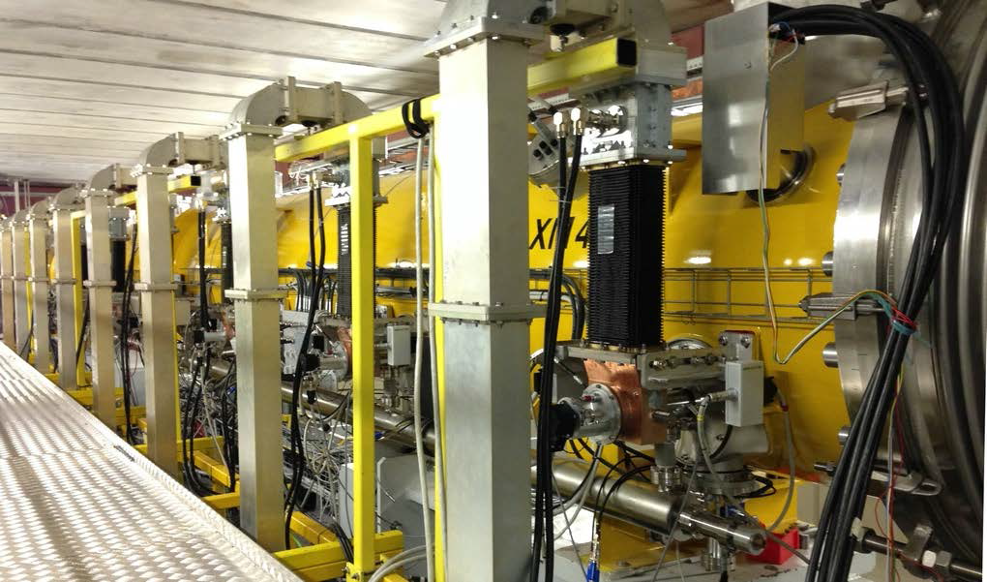
DESY CW R&D PROGRAM First Results
XM4 data at 1.8 and 2K in cw/lp modes. Vert. test data for XM4 cavities is shown for comparison
XM4 installed in the CMTB
(Cryo-Module Test Bench)
Waveguides distributing the
IOT output power
Jacek Sekutowicz

Slide 19
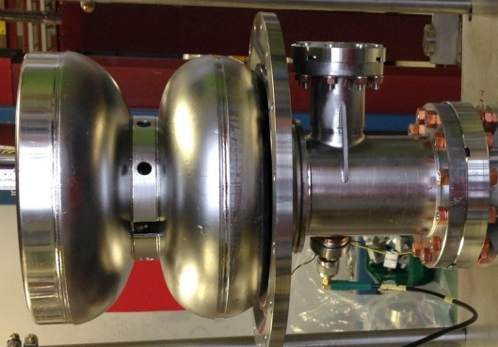
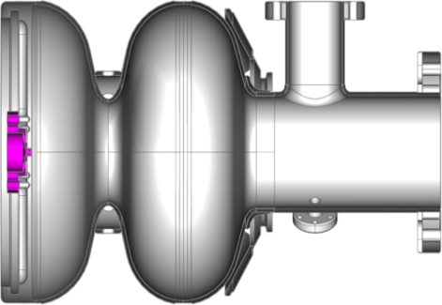
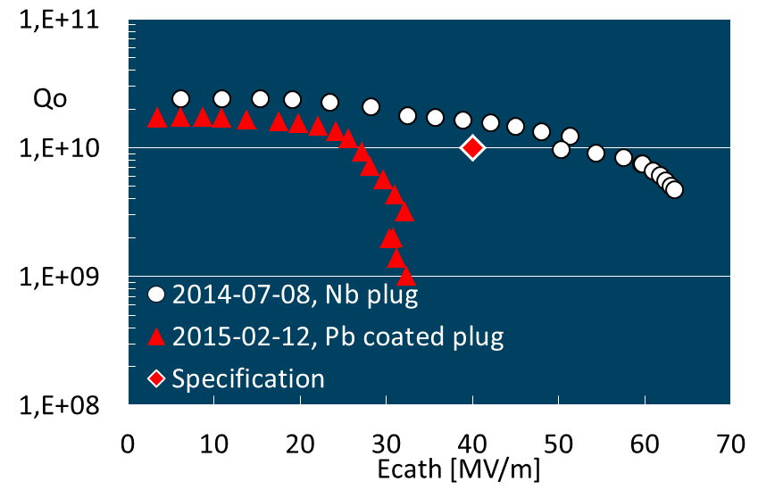
CW Operating Electron Injector Studies
The CW operating electron source is indispensable for the cw/lp operation.
DESY investigates a novel, all superconducting electron gun, integrating a
Pb superconducting cathode in a Nb superconducting cavity.
Nb plug
1.5-cell , 1.3 GHz
Pb coated cathode tip
Nb cavity
Parameter | Unit | -
Bunch charge | pC | 100
Bunch rep. rate | kHz | 100
Trans. slice ɛ_{n} | µmrad | < 0.7
Energy | MeV | 3.7
Meas.QE@260nm | % | 0.03
Max. E on cath. | MV/m | 40
Laser P at cath. | W | 0.12
Jacek Sekutowicz

Slide 20
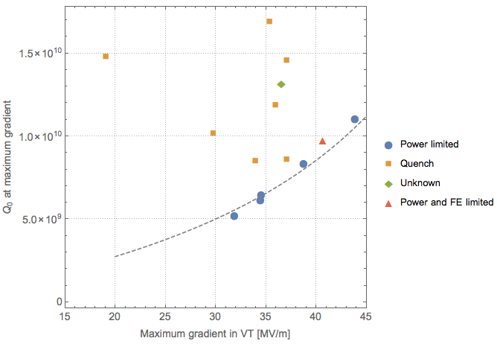
ILC HiGrade 1.8K Test Programme @ DESY
15 cavities available for further R&D
Proposed to re-test down to 1.8K
Look for improvements in Q₀ and E_{quench}
test at 2K
ILC spec
200 W power limit
Nick Walker

Slide 21
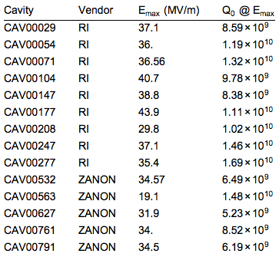
ILC HiGrade 1.8K Test Programme
9 RI cavities are ‘ILC recipe’ surface preparation
  final EP
  ZANON used ‘flash BCP’
Pushing available VT power limit needs careful discussion and some investigation
Exact program and schedule being discussed
  cavities require HPR and re-mounting work (blocked by XFEL for the next few months)
LCC request will form part of a more extensive R&D program
  under discussion
Nick Walker

Slide 22
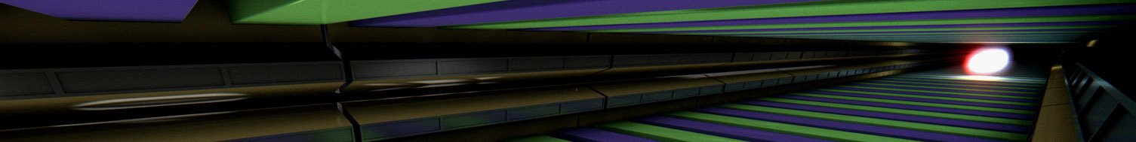


Installation Progress XTL
Prognosed Status: end of 03/2016
CS1
L001
A2.1.L1
L002
A2.2.L1
L003
A2.3.L1
L004
A2.4.L1
CS2
L005
A3.1.L2
L006
A3.2.L2
L007
A3.3.L2
L008
A3.4.L2
L1
BC1
L2
XM 5
XM 1
XM 2
XM -1
DEMACO Cryo-connection
XM 62
XM 61
XM 71
XM 76
P
P
A2
P
P
x
A3
Cryo stage
CS2
L009
A4.1.L2
L010
A4.2.L2
L011
A4.3.L2
L012
A4.4.L2
L013
A5.1.L2
L014
A5.2.L2
L015
A5.3.L2
L016
A5.4.L2
L2
BC2
XM 73
XM 57
XM59
50
XM 72
XM44
XM 43
XM47
XM42
DEMACO Cryo-connection
x
A4
32
x
A5
Cryo stage
P
CS3
L017
A6.1.L3
L018
A6.2.L3
L019
A6.3.L3
L020
A6.4.L3
L021
A7.1.L3
L022
A7.2.L3
L023
A7.3.L3
L024
A7.4.L3
L025
A8.1.L3
L026
A8.2.L3
L027
A8.3.L3
L028
A8.4.L3
L3
XM 7
XM 6
XM11
XM 3
XM 13
XM 9
XM 10
XM 19
XM 27
XM 18
XM 30
XM 20
SCB 1
51
52
53
A6
54
55
56
57
A7
58
59
60
61
A8
P
62
63
L029
A9.1.L3
L030
A9.2.L3
L031
A9.3.L3
P
UV XTL-2AV
L033
A10.1.L3
P
CS4
L032
A9.4.L3
L034
A10.2.L3
L035
A10.3.L3
L036
A10.4.L3
L037
A11.1.L3
L038
A11.2.L3
L039
A11.3.L3
L040
A11.4.L3
L3
XM 31
XM 28
XM 34
XM 14
XM 39
XM 37
XM 40
XM 41
XM 26
XM 38
XM 36
XM 35
SCB 2
<<< Rack cabling >>>
A10
< < < Rack cabling > > >
75
64
65
66
A9
67
68
69
70
P
71
72
73
74
A11
P
76
CS5
L041
A12.1.L3
L042
A12.2.L3
L043
A12.3.L3
P
L044
A12.4.L3
L045
A13.1.L3
L046
A13.2.L3
L047
A13.3.L3
L048
A13.4.L3
L049
A14.1.L3
L050
A14.2.L3
L051
A14.3.L3
L052
A14.4.L3
L3
XM 56
XM 32
XM 25
XM 53
XM 17
XM 51
XM 15
XM 52
XM 45
XM 16
XM 33
XM 49
SCB 3
79
x
A12
P
x
A13
P
x
A14
P
CS6
L053
A15.1.L3
L054
A15.2.L3
L055
A15.3.L3
L056
A15.4.L3
L057
A16.1.L3
L058
A16.2.L3
L059
A16.3.L3
L060
A16.4.L3
L061
A17.1.L3
L062
A17.2.L3
L063
A17.3.L3
L064
A17.4.L3
L3
XM 64
XM 68
XM 70
XM 21
XM 69
XM 60
XM 63
XM 66
XM 12
XM 23
XM 58
XM 48
SCB 4
x
A15
< < < Module connection > > >
CR
x
A16
x
A17
CS7
L065
A18.1.L3
L066
A18.2.L3
L067
A18.3.L3
L068
A18.4.L3
CR
L069
A19.1.L3
CR
L070
A19.2.L3
L071
A19.3.L3
L072
A19.4.L3
L073
A20.1.L3
L074
A20.2.L3
L075
A20.3.L3
L076
A20.4.L3
L3
XM
XM
XM
XM
XM 77
XM 74
XM -2
XM 79
XM 4
XM 67
XM55
XM65
Container for condensed water
625 ltr.
CS8
L077
A21.1.L3
L078
A21.2.L3
L079
A21.3.L3
L080
A21.4.L3
L081
A22.1.L3
L082
A22.2.L3
L083
A22.3.L3
L084
A22.4.L3
L085
A23.1.L3
L086
A23.2.L3
L087
A23.3.L3
L088
A23.4.L3
L3
XM
XM
XM
XM
XM
XM
XM
XM
XM
XM
XM
XM
xxxxx
CS9
L089
A24.1.L3
L090
A24.2.L3
L091
A24.3.L3
L092
A24.4.L3
L093
A25.1.L3
L094
A25.2.L3
L095
A25.3.L3
L096
A25.4.L3
L097
A26.1.L3
L098
A26.2.L3
L099
A26.3.L3
L100
A26.4.L3
L3
XM
XM
XM
XM
XM
XM
XM
XM
XM
XM
XM
XM
1.508 m
2.130 m
DACHS
door
TMPL
Hitch for hanging machine
Impression of component mounting
Container for condensed water
250 ltr.
<<< Mounted: 9 Dipol (XBE)
4 Dipol (XBD) 45 BPM 4 XBZ
4 Quadrupols (QXE) 6 OTR 2 XQK
36 Quadrupols (QXF) 2 XCE 2 TORA
12 Quadrupols (XQH) 11 XCF
25 Sextupols (XSA) 2 XCH
69 Ionen-Getterpumps 2 XBL >>>
143
144
145
146
147
148
149
150
151
152
153
155
154
156
158
159

