Slide 1
Status of PF-ring, PF-AR and cERL
Yukinori Kobayashi
Accelerator Laboratory, KEK
DESY-KEK collaboration meeting
2016-03-07

Slide 2
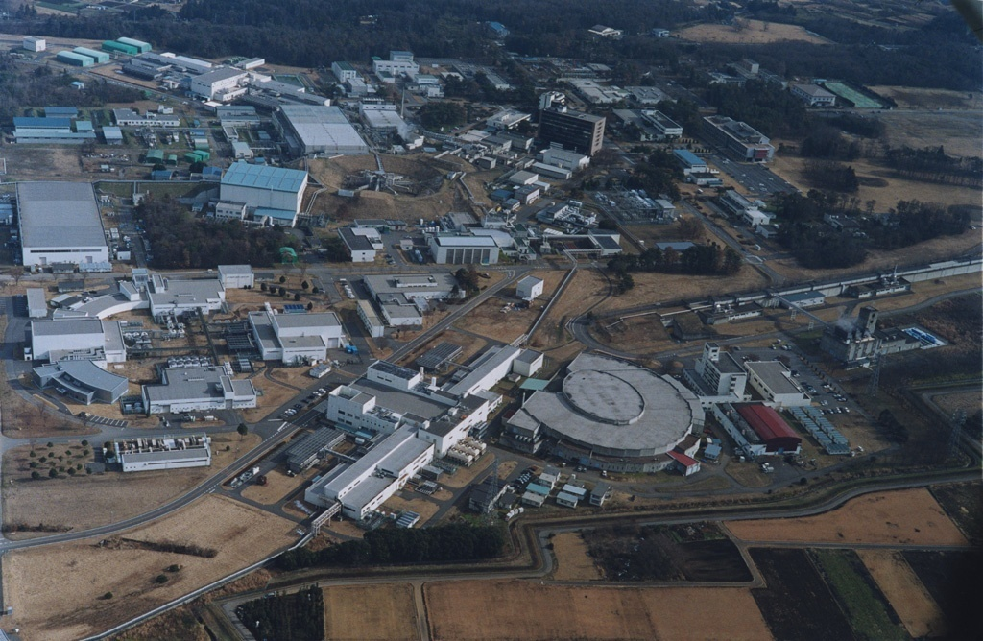
Future Light Source
Compact ERL (cERL)
LINAC (7GeVe-,4.0GeVe+)
Present beam transport line
Direct beam transport line for PF-AR
PF-AR(6.5GeV e-)
underground
PF ring (2.5GeV e-)
Two rings and one R&D machine for light source in KEK Tsukuba Campus

Slide 3
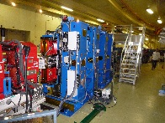
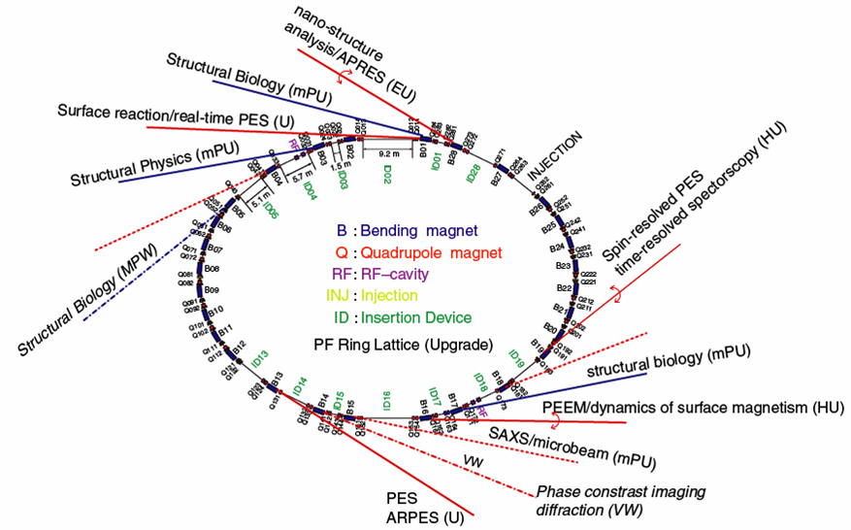
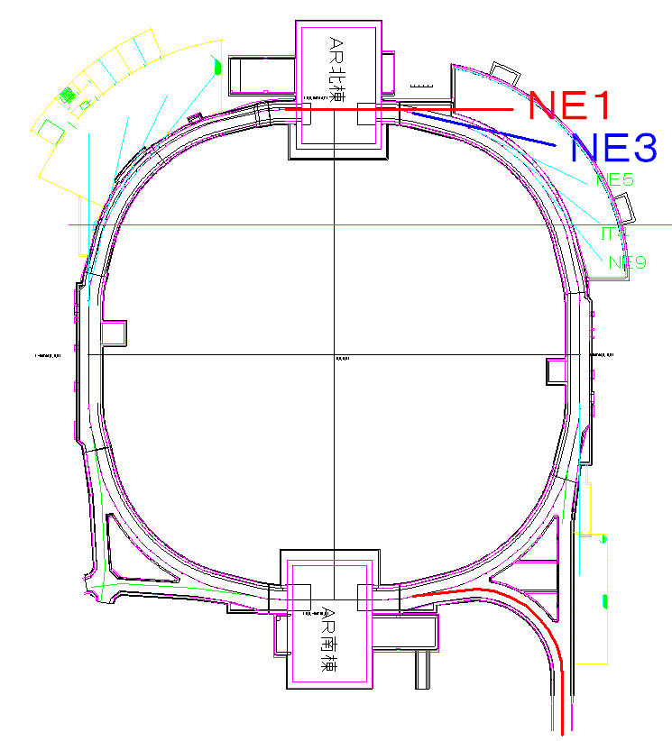
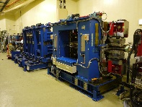
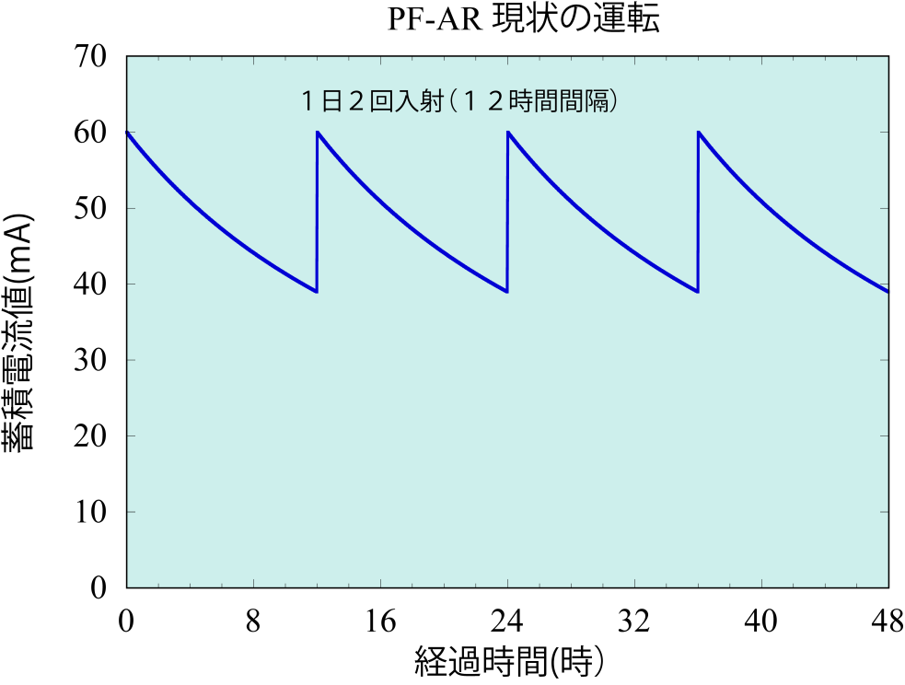
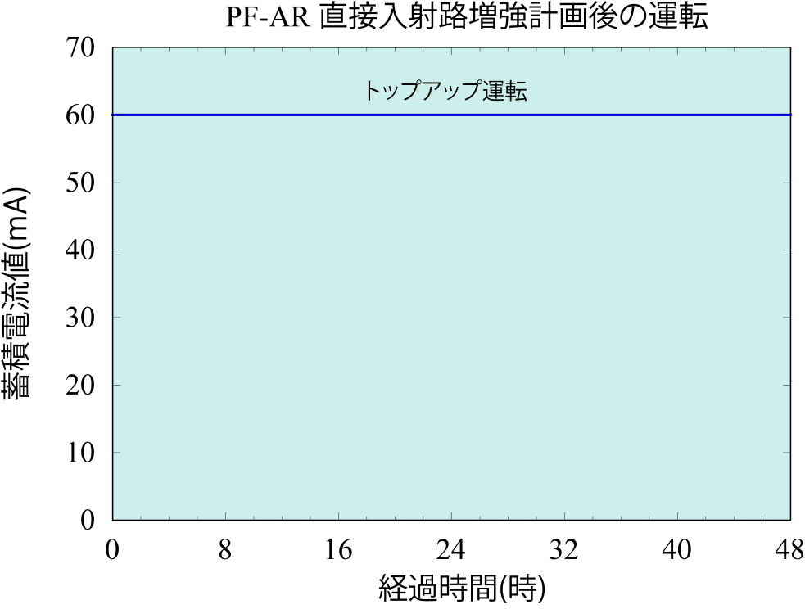
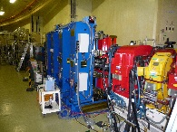
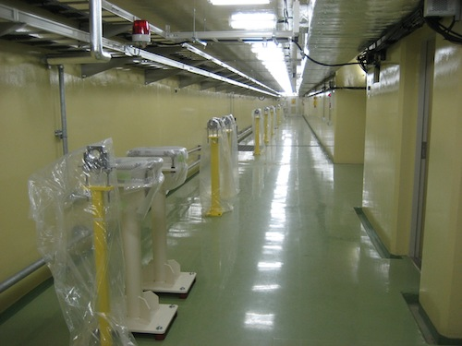
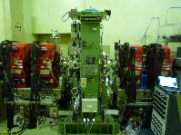
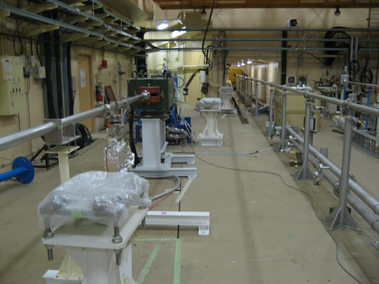
Status in PF-ring and PF-AR
2.5 GeV PF ring
6.5GeV PF-AR
BL-28
NW10
NW2
BL-1
NW12
BL-2
BL-19
NW14
NE3
NE5
BL-3
NE7
BL-17
BL-5
BL-16
BL-15
BL-13
BL-14
Present
BT
・Operation time 3,024 h（FY2014）
・Top-up mode
  I=450mA: multi-bunch (280)、
  I=450mA：hybrid ( 1 + 130)
・ID BL （11）, Bend. BL （11）
・Upgrade of ID-BL was completed with renewal of four undulators.
（BL-15,BL-2, BL-13, BL-28)
New direct BT
・Operation time 2,352 h（FY2014）
・Decay mode
I=40-60mA: always single-bunch
future Top-mode
・ID BL （5）,Bend. BL(3）
・Upgrade of beam transport line for 6.5GeV e- full energy injection will be completed in next December.

Slide 4
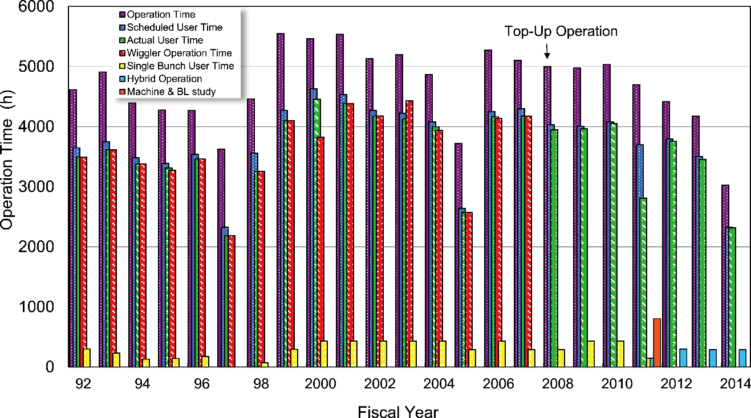
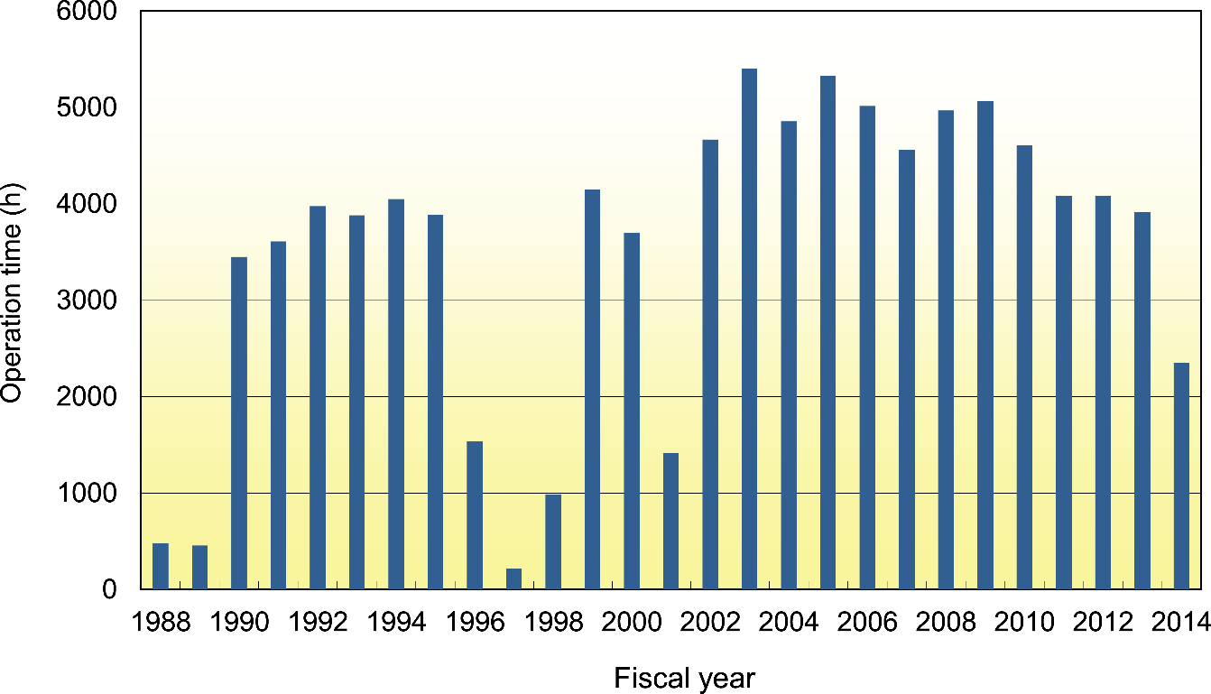
Operation time of PF-ring and PF-AR
PF ring
FY2014
3024 h
PF-AR
FY2014
2352 h

Slide 5
Brief summary of PF-ring and PF-AR
Both old rings have been stably operated, but operation time suddenly decreased from FY2014 due to the effect of an electric charge jump in Japan.
Recent upgrade of undulator beamlines in PF-ring was completed and stably operated in FY2014. However, as old undulators still remained in both rings, they should be replaced as possible as early.
Direct beam transport line for full energy injection in PF-AR is going to construct and will be operated in January 2017, then top-up operation will start in PF-AR during FY2017.

Slide 6
Plan of 3 GeV Ring-type new light source
Horizontal emittance [nm rad]
HMBA (Hybrid Multi Bend Acromat)
(Energy)²/(Circumference)³ (GeV² m⁻³)
By K.Harada
3 GeV 0.15 nmrad (at 0mA) about 600m Circumference was designed by using HMBA. 0.3 nmrad of 500mA is design value because the intra beam scattering. 10^22 brightness is within target.

Slide 7
Status of Compact ERL (cERL)

Slide 8




cERL Team
High Energy Accelerator Research Organization (KEK)
M. Adachi, S. Adachi, T. Akagi, M. Akemoto, D. Arakawa, S. Araki, S. Asaoka, K. Enami,K. Endo,
S. Fukuda, T. Furuya, K. Haga, K. Hara, K. Harada, T. Honda, Y. Honda, H. Honma, T. Honma,
K. Hosoyama, K. Hozumi, A. Ishii, X. Jin, E. Kako, Y. Kamiya, H. Katagiri, R. Kato, H. Kawata,
Y. Kobayashi, Y. Kojima, Y. Kondou, T. Konomi, A. Kosuge, T. Kubo, T. Kume, T. Matsumoto,
H. Matsumura, H. Matsushita, S. Michizono, T. Miura,T. Miyajima, H. Miyauchi, S. Nagahashi, H. Nakai, H. Nakajima, N. Nakamura, K. Nakanishi,K. Nakao, K. Nigorikawa, T. Nogami, S. Noguchi [on leave],
S. Nozawa, T. Obina, T. Ozaki, F. Qiu,H. Sagehashi, H. Sakai, S. Sakanaka,S. Sasaki, K. Satoh,
M. Satoh, Y. Seimiya, T. Shidara, M. Shimada, K. Shinoe, T. Shioya,T. Shishido,M. Tadano, T. Tahara,
T. Takahashi, R. Takai, H. Takaki, O. Tanaka, T. Takenaka,Y. Tanimoto, N. Terunuma, M. Tobiyama,
K. Tsuchiya,T. Uchiyama, A. Ueda, K. Umemori, J. Urakawa,K. Watanabe, M. Yamamoto, N. Yamamoto, Y. Yamamoto, Y. Yano, M. Yoshida
Japan Atomic Energy Agency (JAEA)
R. Hajima, S. Matsuba [on leave], M. Mori, R. Nagai, N. Nishimori, M. Sawamura, T. Shizuma
Hiroshima University
M. Kuriki
The Graduate University for Advanced Studies (Sokendai)
E. Cenni [on leave]
cERL is developed with the collaboration
among KEK, JAEA and Universities.

Slide 9

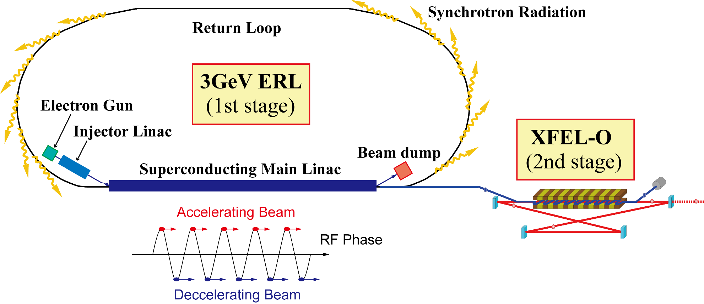
Future Plan: ERL Light Source Project at KEK
From 2005
Recirculation Loop
(Ref.) “Energy Recovery Linac
Conceptual Design Report”,
KEK Report 2012-4.
6 (7) GeV
λ_{rf}/2 path-length
changer
Normalized emittance | 0.1 - 1 mm-mrad
Beam current | 10 - 100 mA
Bunch charge | 7.7 - 77 pC
RF frequency | 1.3 GHz
3 GeV ERL
The Compact ERL
Diffraction-limited X-ray source
Ultra-short-pulse light source
Driver for XFEL-O (2nd stage)
demonstrate
Injector (low ε, high I₀)
Main linac (CW, ~15 MV/m)
Beam dynamics
Beam losses
9

Slide 10
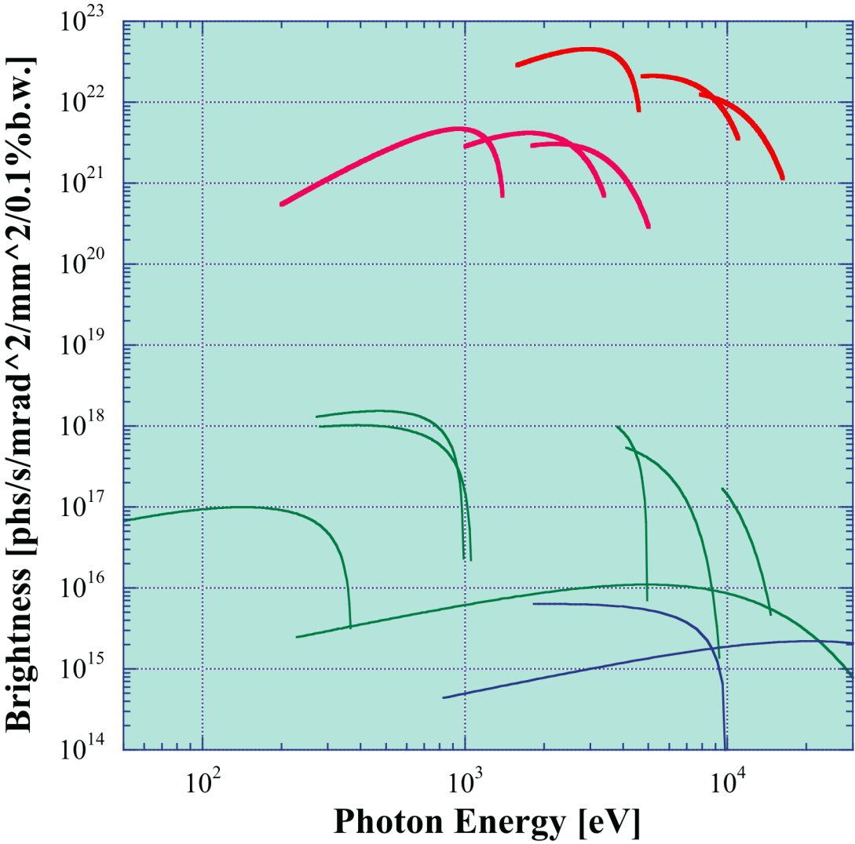
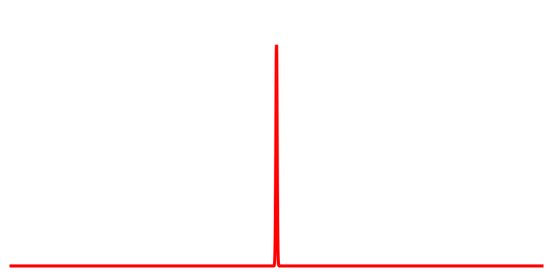
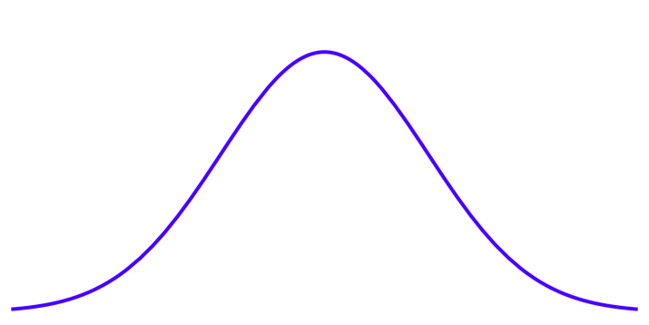
Light Source Performance
Spectral Brightness
SR Pulse length
10²⁶⁻²⁷ by XFEL-O
3-GeV ERL
λ_{u} =1.8cm
L = 30m
λ_{u} =6cm
L = 30m
3-GeV ERL
50 - 100 fs
PF Ring
undulators
PF/PF-AR
30 - 60 ps
PF-AR
undulators
Calculated by K. Tsuchiya

Slide 11
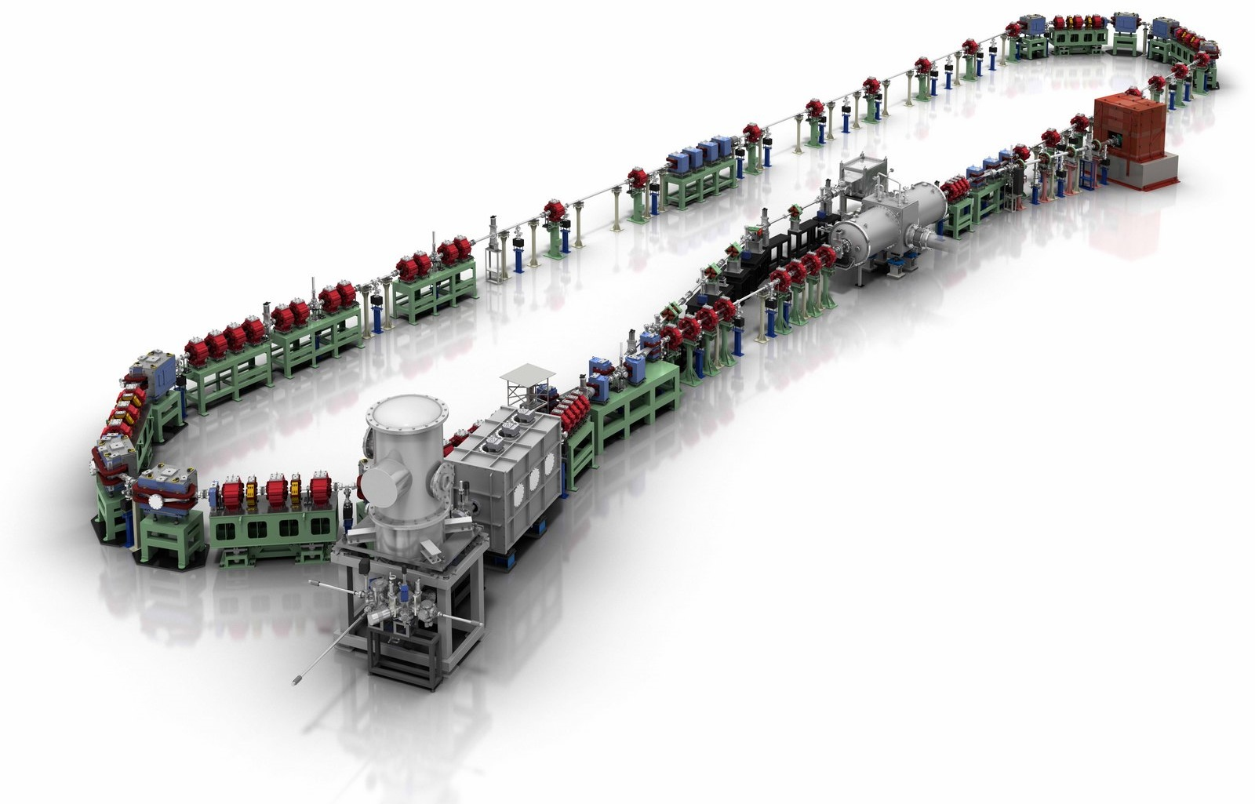
The Compact ERL (cERL)
The cERL contains all important technologies.
The first arc
Injector diagnostic beamline
Recirculation loop
Beam dump
Dump chicane
Main-linac cryomodule
Merger
Parameters of the cERL
 | Design | In operation
Beam energy E | 35 MeV | 20 MeV
Injector energy E_{inj} | 5 MeV | 2.9 - 6 MeV
Gun high voltage | 500 kV | 390 kV
E_{acc} in main linac | 15 MV/m | 8.2 MV/m
Beam current | 10 mA | 300 μA
Normalized emittance [mm⋅mrad] | 1.0 @7.7 pC | See, page 16
Repetition frequency of bunches | 1.3 GHz | 1.3 GHz (usual) 162.5 MHz (for LCS)
RMS bunch length | 1-3 ps (usual) ~ 100 fs (compress.) | 1-3 ps (usual)
Max. heat load at 2K | 80 W | 80 - 100 W
The second arc
Injector cryomodule
©Rey.Hori/KEK
Photocathode DC gun
(JAEA)
Circumference: ~ 90 m
11

Slide 12
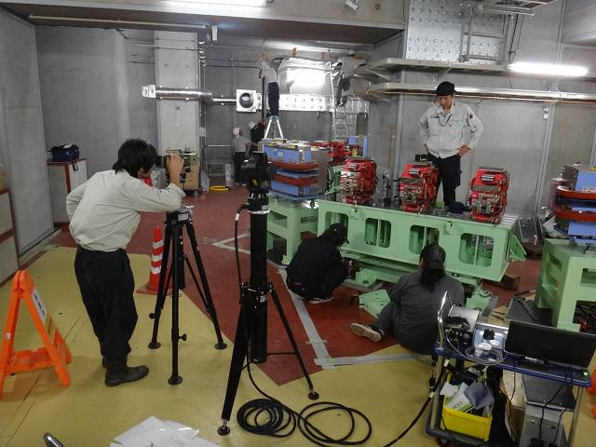
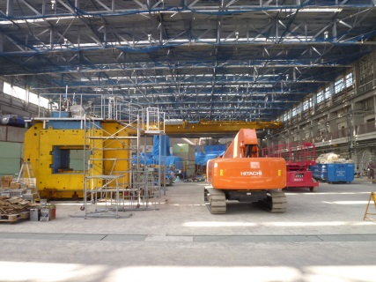
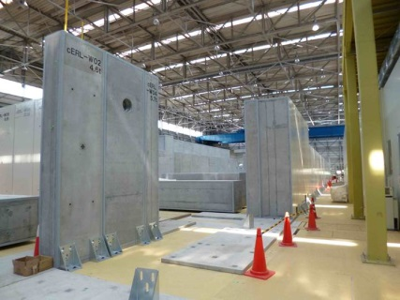
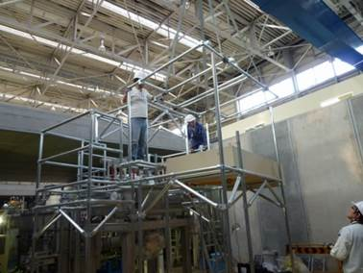
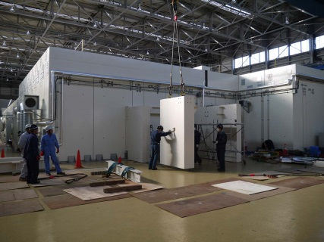
Construction and Commissioning of cERL
2008 | 2009 | 2010 | 2011 | 2012 | 2013 | 2014 | 2015
Refurbishment
of building
Clearing radioactive
materials
Construction of
radiation shielding
Construction of
injector
ERL2013
Commissioning of injector
Construction of recirculation loop
Commissioning of cERL (with loop)
Construction of LCS system
ERL2015
Construction
Commissioning of LCS system
Commissioning/Operation

Slide 13
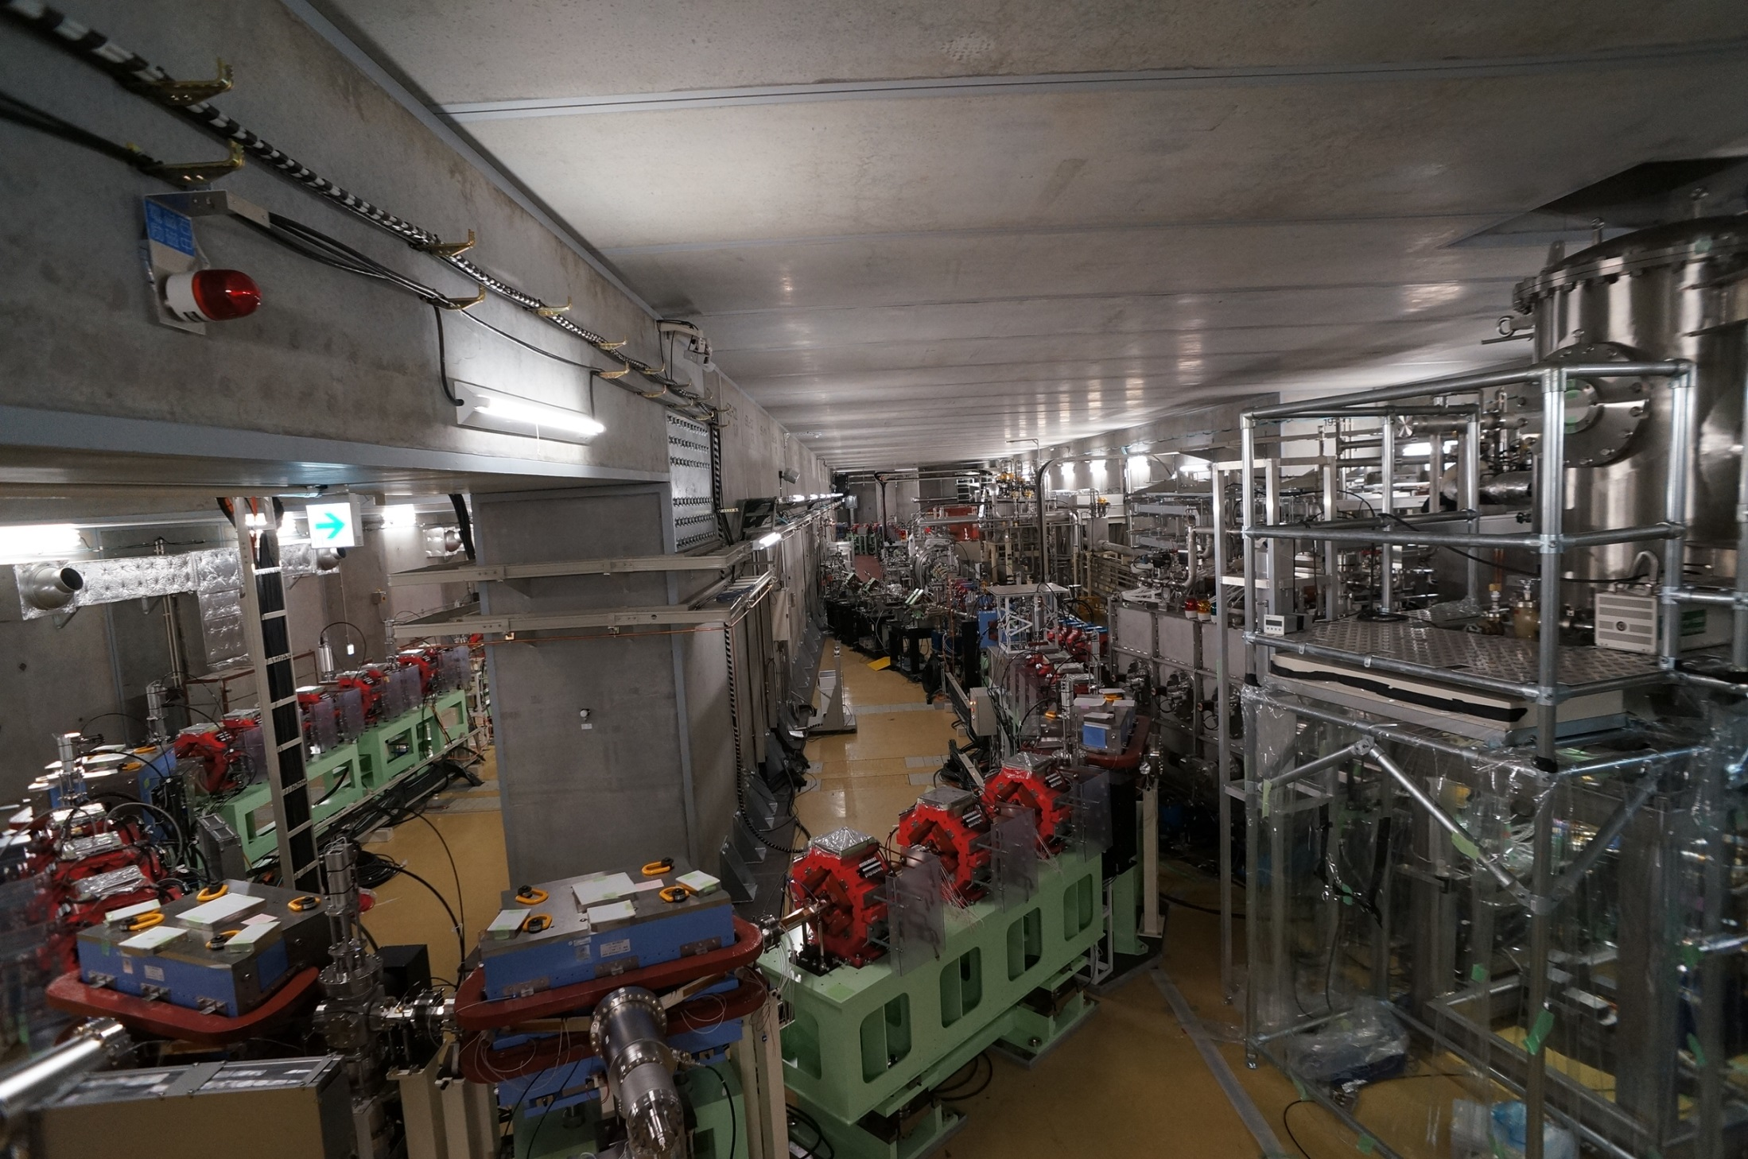
Picture of the cERL
Photocathode DC gun
Injector diagnostic beamline
Main-linac cryomodule
Recirculation loop
Injector cryomodule
13

Slide 14
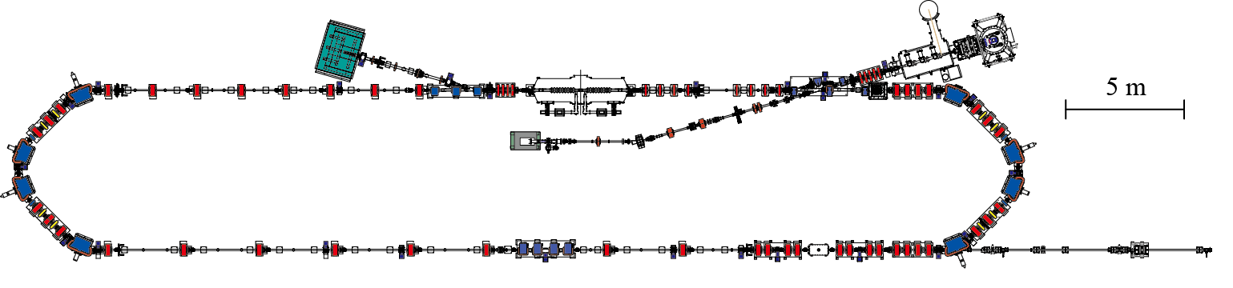
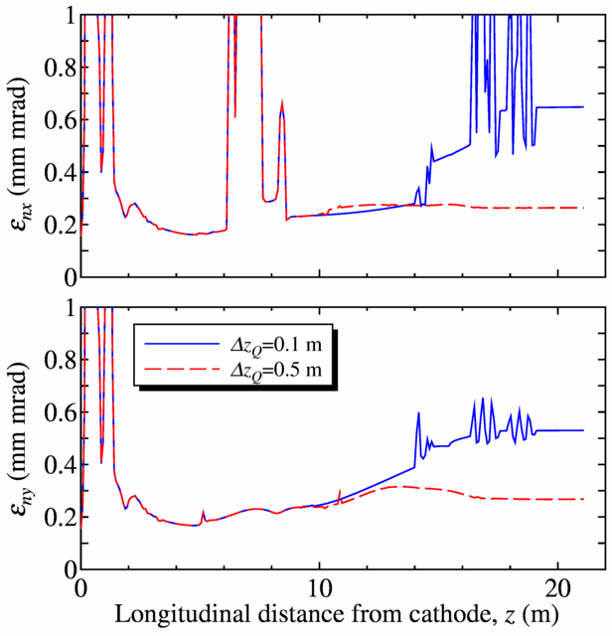
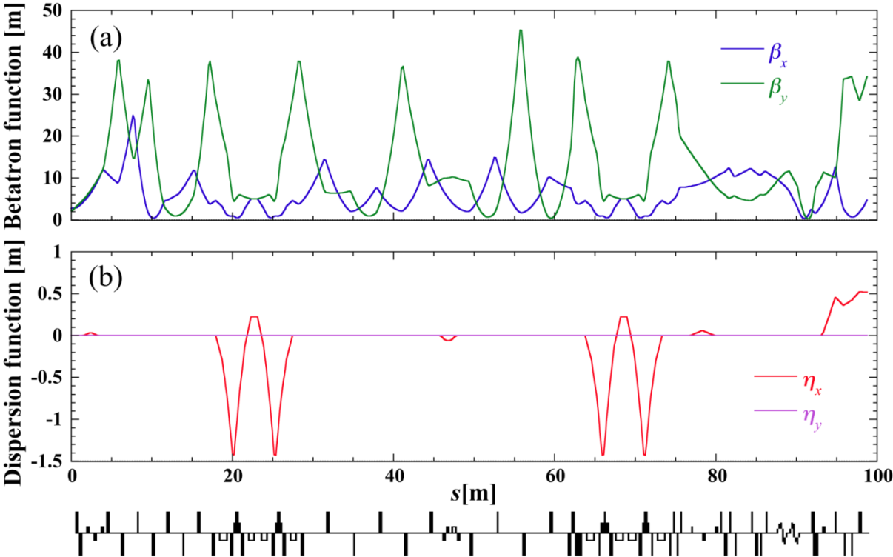
Beam Optics of cERL
dipoles
quadrupoles
Beam dump
Injector
module
Main-linac (ML)
module
Gun
Dump chicane
Injection chicane
The first arc
Injector diagnostic line
The second arc
Path-length control chicane
LCS interaction point
X-ray beamline
South straight section
Normal optics
1st arc
2nd arc
Dump line
ML
Exit of ML cavities
14
Injector (gun → exit of main linac).
Recirculation loop (exit of main linac → beam dump).

Slide 15
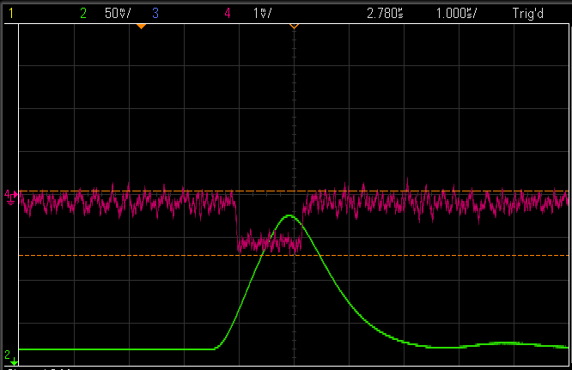
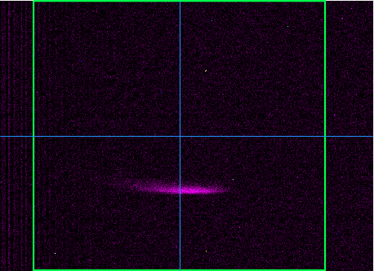
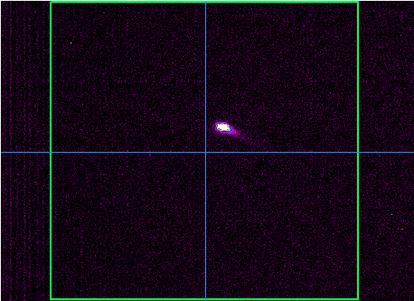
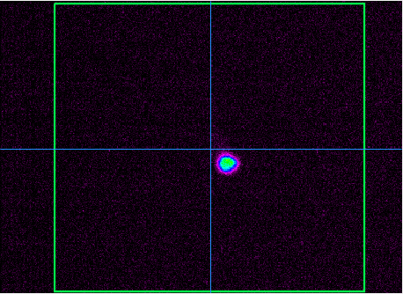
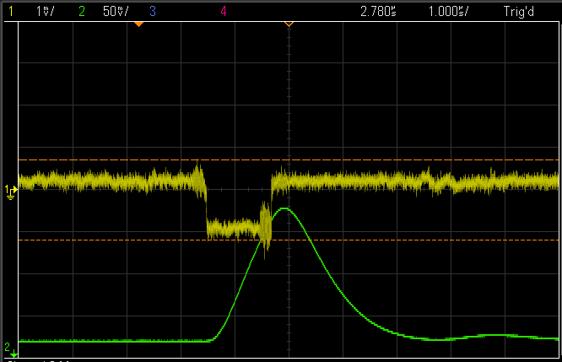
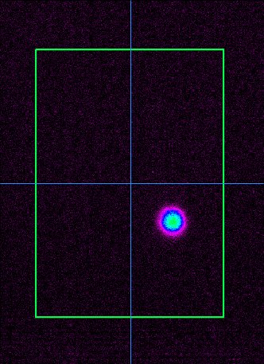
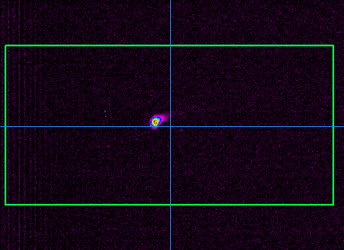
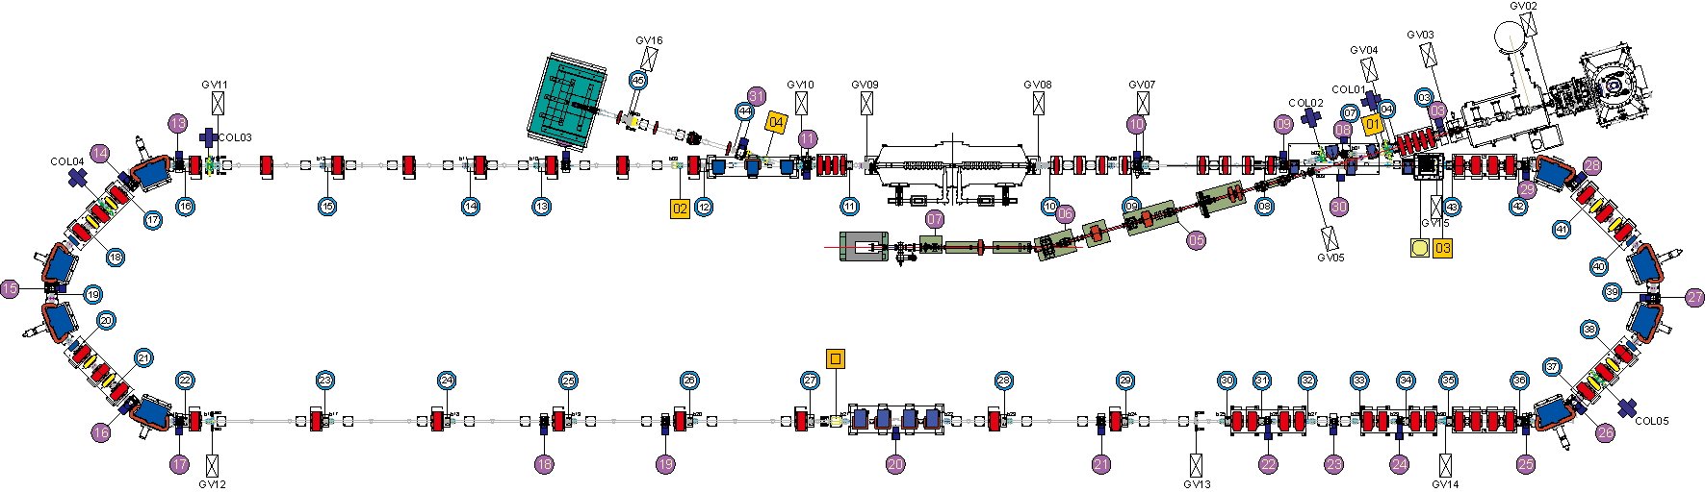
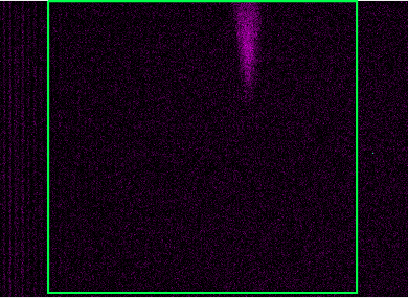

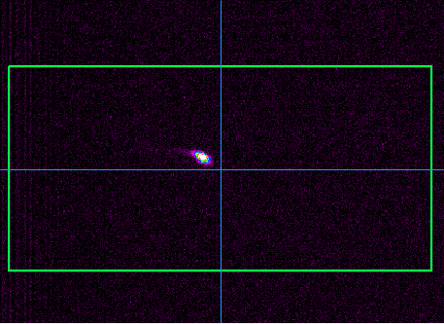
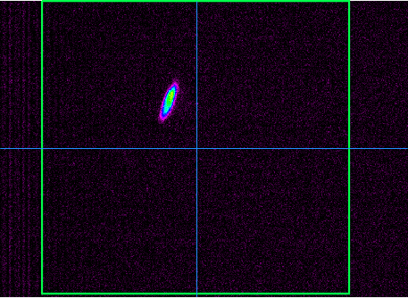
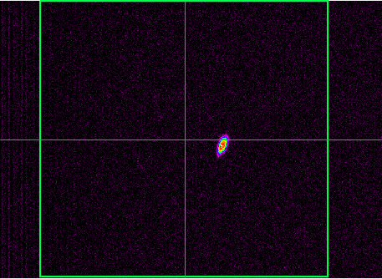
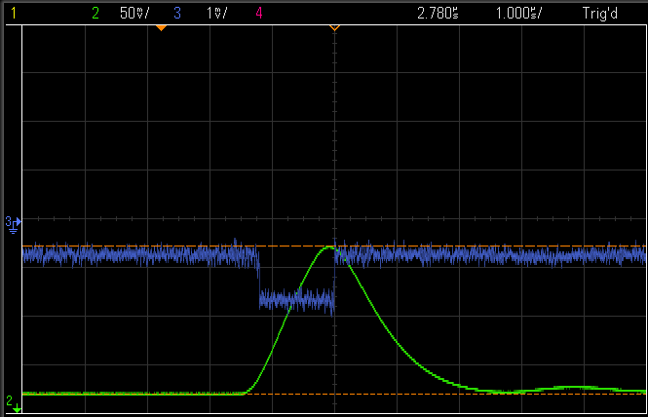
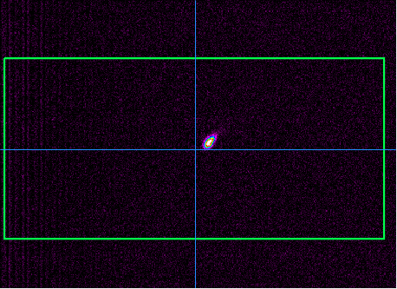
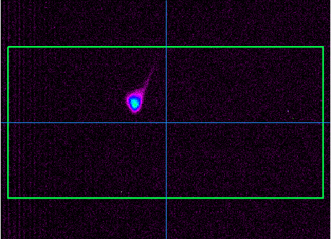
The First Transportation of Beams to the Dump (Feb. 6, 2014)
Parameters
Gun voltage: 390 kV Buncher: OFF
Injector cavities: E_{acc} = (3.3, 3.3, 3.1) MV/m
Main-Linac cavities: Vc = (8.57, 8.57) MV
Beam pulses (macropulse)
peak current: ~24 μA
macropulse width: 1.2 μs
repetition of bunches: 1.3 GHz
repetition frequency: 5 Hz
average beam current: ~ 140 pA
Beam energy (E)
Injector: 2.9 MeV
Recirculation loop: 19.9 MeV
Dump FC
MS31 (dump line)
Beam profiles on screen monitors.
beam current
MS11
MS3
Gun FC (faraday cup)
MS1
beam current
MS14
Dump line
Main linac
Injector
The 1st arc
The 2nd arc
MS29
beam current
15
MS15
MS17
MS19
Movable FC
MS26
MS27

Slide 16
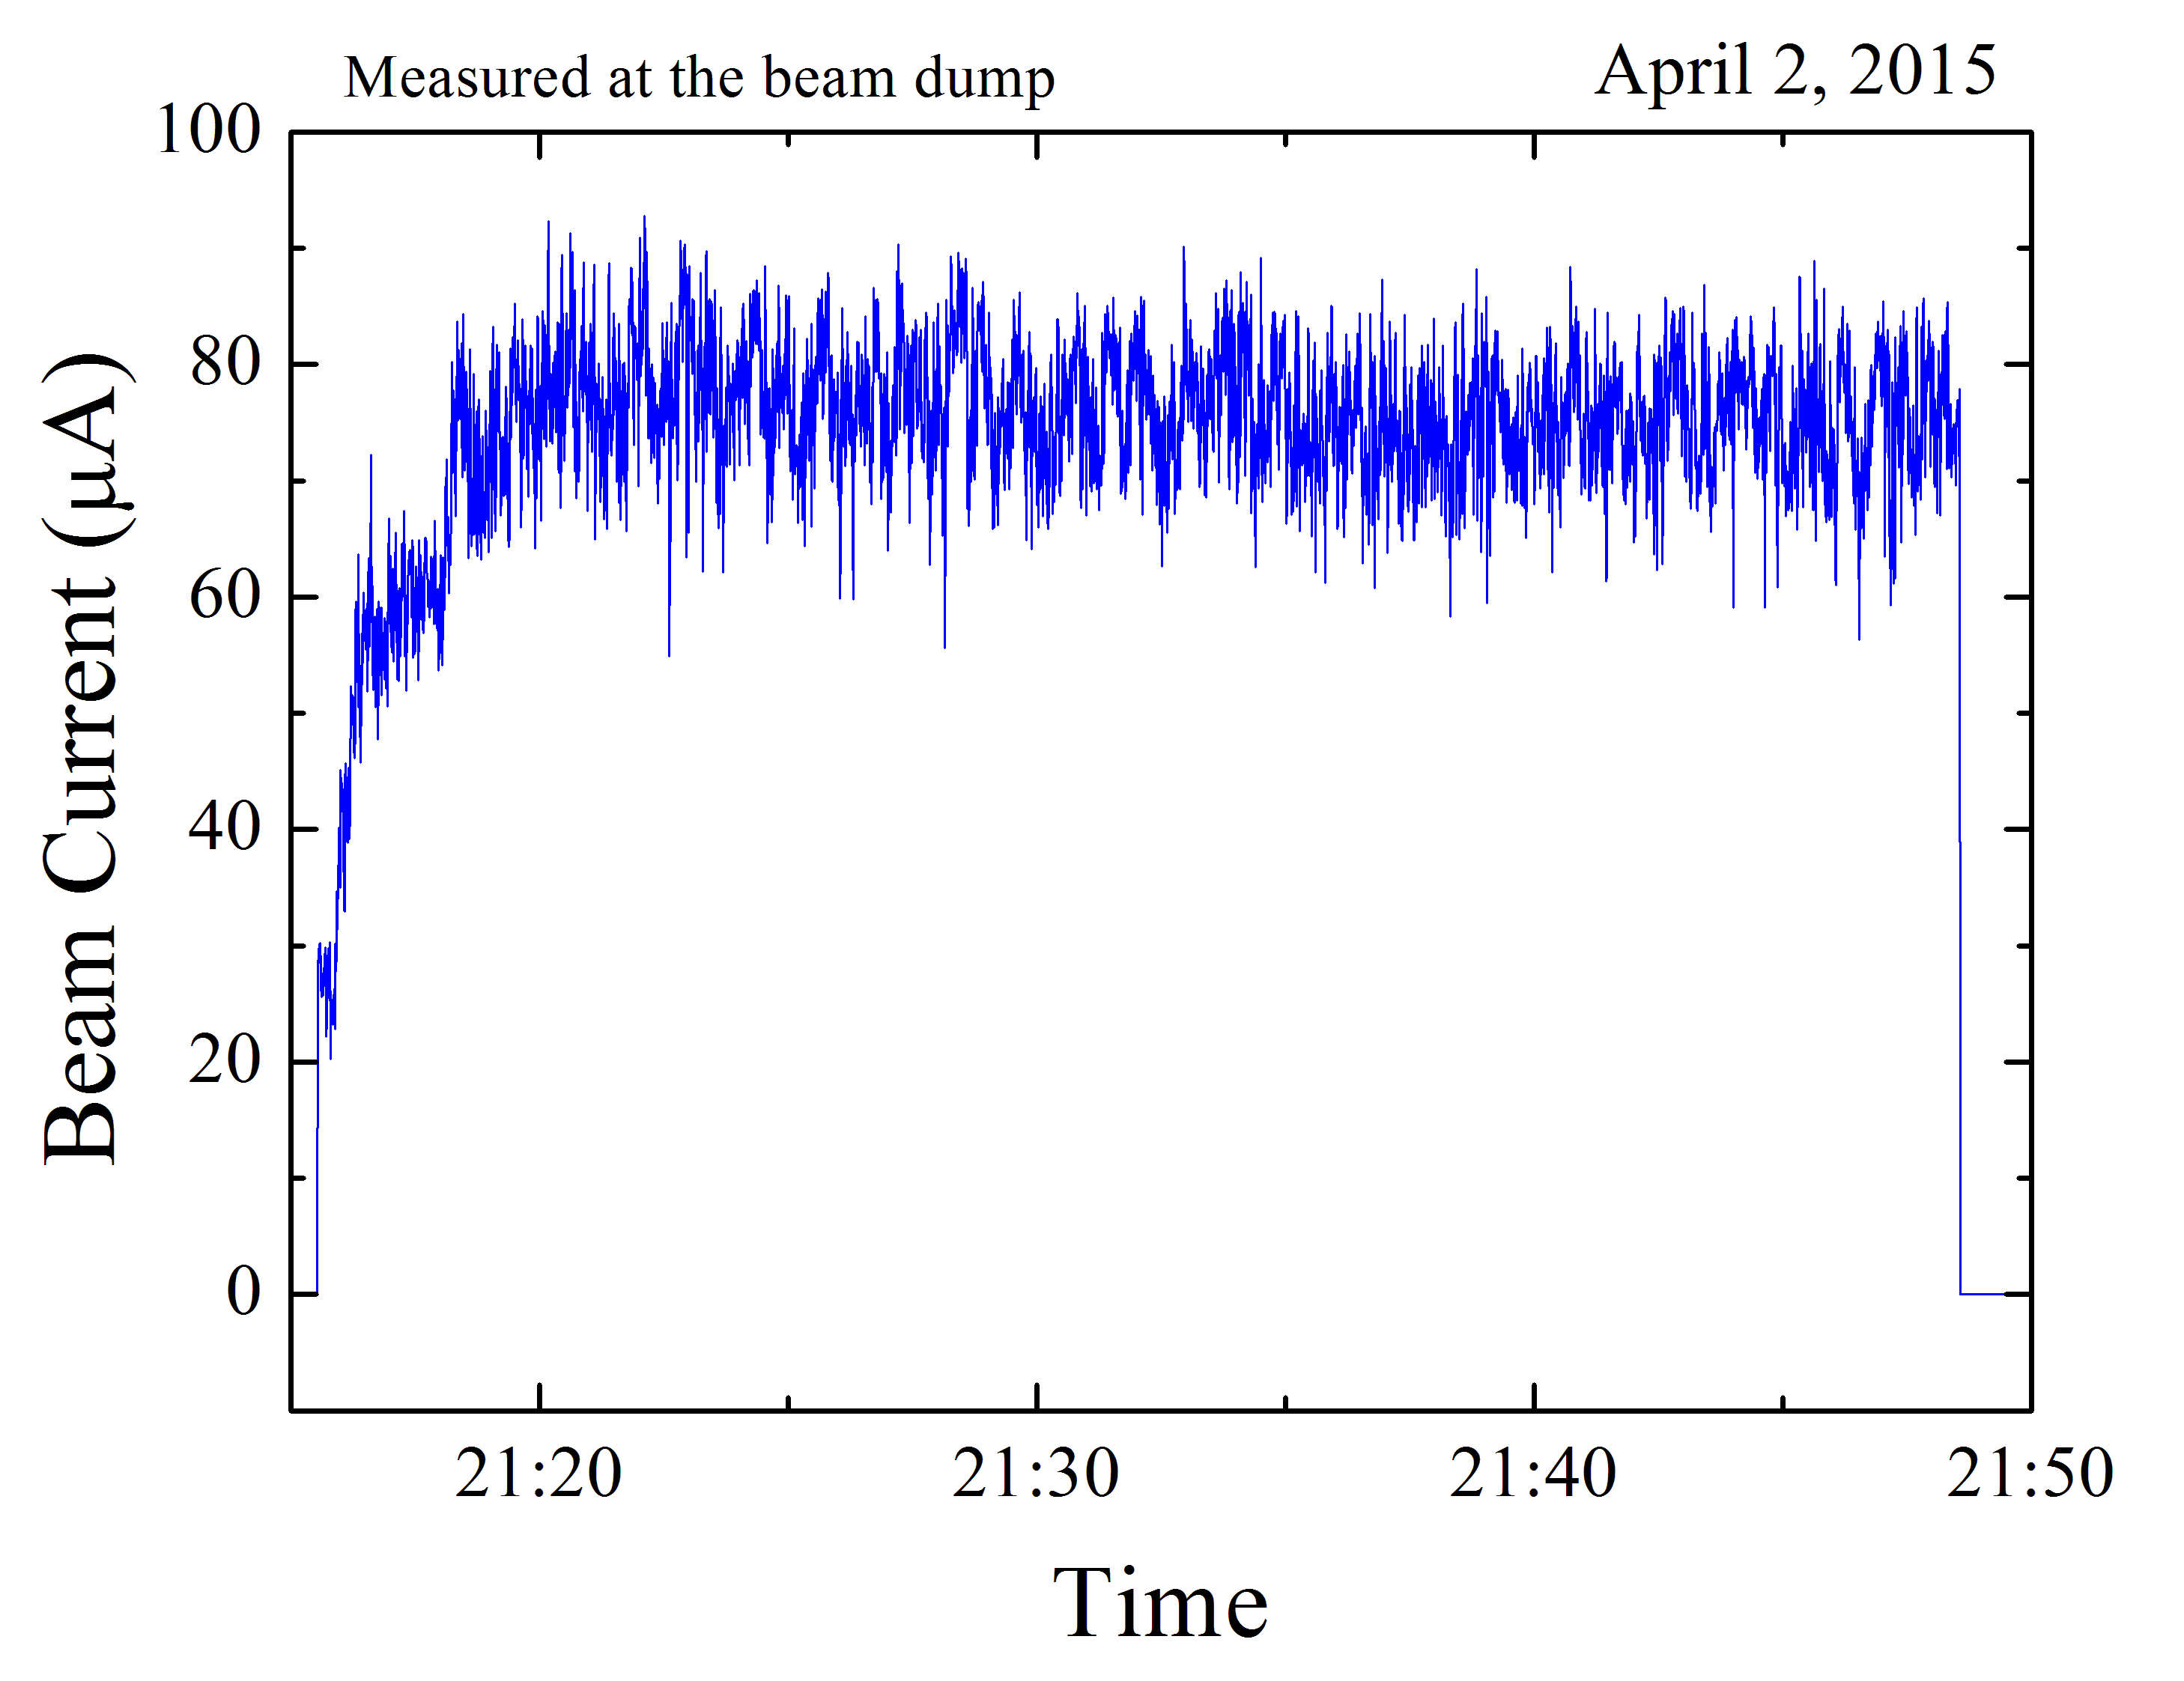
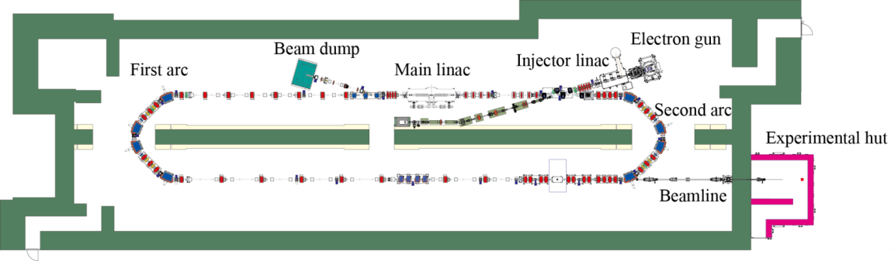
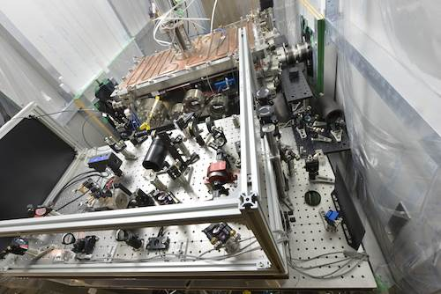
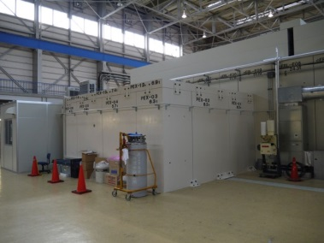
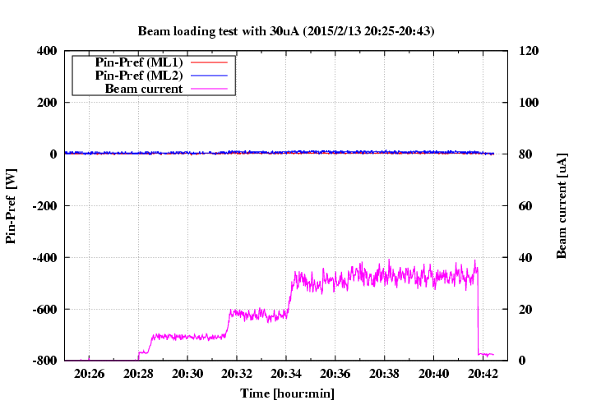
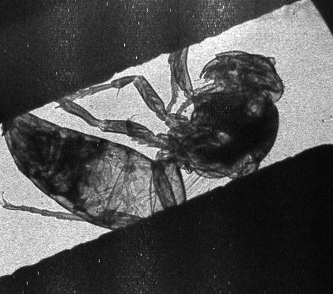
Recent Achievements
Beam current of 80 μA (CW) was recirculated.
Successful production of 7-keV X-ray from laser Compton scattering and precious imaging picture.
Laser enhancement cavity
Demonstration of energy recovery
Cavity 2: P_{in}-P_{ref}
Cavity 1: P_{in}-P_{ref}
Beam current
30 μA
Image of a sample (wasp) by produced X-ray
A. Kosuge et al.,IPAC2015, TUPWA066.

Slide 17
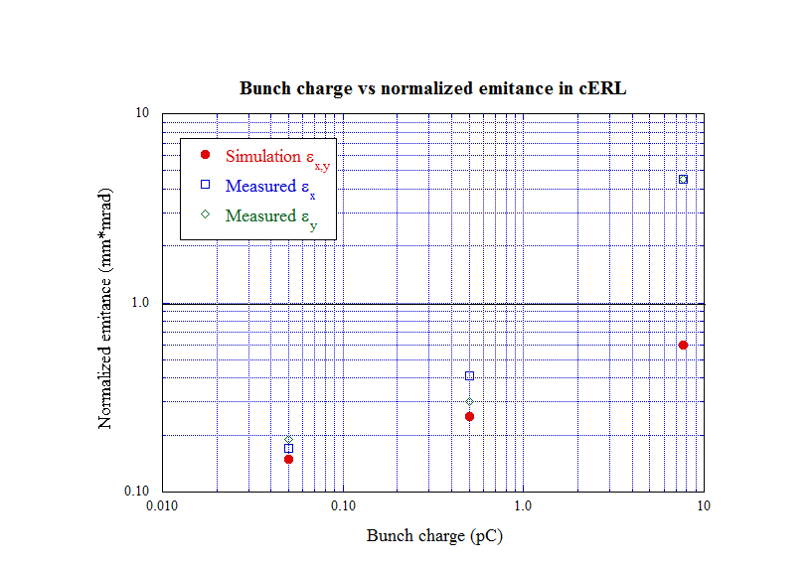
Measured normalized emittance
(10mA
@1.3GHz)
7.7 pC
0.5 pC
0.05 pC
Achieved low beam emittance (< 1 mm⋅mrad) at lower bunch charges (< 0.5 pC),
but not yet at higher bunch charge of 7.7 pC dut to the lack of commissioning.

Slide 18
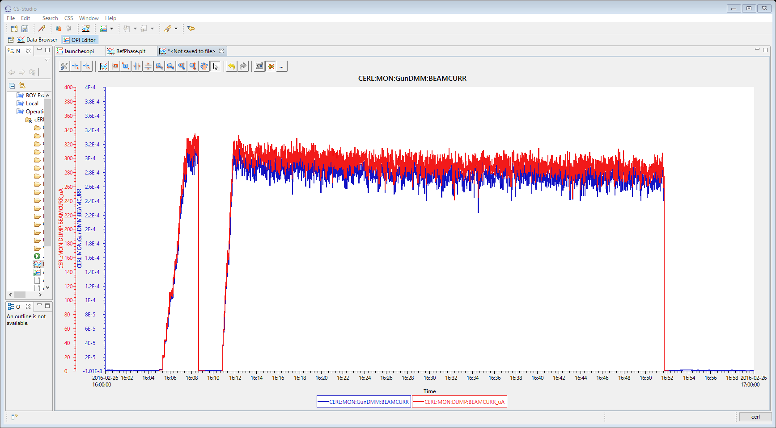
Beam Current of 300 μA (CW) was achieved on 2/29/2016
We confirmed that the radiation level outside of the shield
was sufficiently cleared even in a beam current of 1 mA
0.23pC/bunch
300 μA
40 min
Radiation check will be carried out by Nuclear Regulation Authority of Japan on 3/8/2016.
After pass of the check, we will try to increase beam current up to near 1 mA.

Slide 19

Beam Currents: Achievement and Prospect
At present
10 mA
Prospect
1 mA
Soon near 1mA
300 μA
With recirculation
loop
100 μA
10 μA
Injector
1 μA
19

Slide 20
Summary and Prospect for cERL
The Compact ERL was commissioned and is in stable operation.
Learned many lessons from the commissioning.
The photocathode DC gun and both (injector and ML) SC cavities are operating very stably.
Achieved beam current of 300 μA and will be achieved near 1 mA during this March.
Achieved low beam emittance (< 1 mm⋅mrad) at low bunch charges (< 0.5 pC), but not yet at higher bunch charge of 7.7 pC. So, we need more operation time to achieve it !
X-ray production from Laser Compton Scattering was successfully demonstrated.
Subjects in the near future
Lower emittance (<1 mm⋅mrad) at higher bunch-charges ( ≥ 7.7 pC)
Beam current: 1 mA ( → 10 mA)
Bunch compression (σ_{t} ~ 100 fs) and THz production
We have established many important technologies for the ERL light source.
We would like to continue to conduct R&D efforts on remaining issues such as:
  Improved cavity-assembly technique for higher accelerating gradient
  Mass-production technique for main-linac cavities

Slide 21

Thank you for your attention!

Slide 22
Backup

Slide 23

Spectral average brightness
Targets for ERL
XFEL-O
ERL/ USR
Figures are cited from: R. Hettel, “Performance Metrics of Future Light 13 Sources”, FLS2010, SLAC, March 1, 2010.

Slide 24
Beam Parameters for Operational Modes
3 GeV ERL
XFEL-O
 | High Coherence (HC) mode | High Flux (HF) mode | Ultimate (UL) mode | Ultra-Short Pulse (US) mode | XFELO mode
Beam Energy | 3 GeV |  |  |  | 7 (6) GeV¹⁾
Beam Current | 10 mA | 100 mA | 100 mA | 77 μA (typ.) | 20 μA
Bunch Charge | 7.7 pC | 77 pC | 77 pC | 77 pC | 20 pC
Repetition Rate | 1.3 GHz | 1.3 GHz | 1.3 GHz | 1 MHz | 1 MHz
Norm. Emittance | 0.1 mm·mrad | 1 mm·mrad | 0.1 mm·mrad | - | 0.2 mm·mrad
Emittance | 17 pm·rad | 170 pm·rad | 17 pm·rad | - | 15 pm·rad
Energy Spread | 2×10⁻⁴ | 2×10⁻⁴ | 2×10⁻⁴ | - | 2×10⁻⁴
Bunch Length | 2 ps | 2 ps | 2 ps | ≤ 100 fs | 1 ps

Slide 25


Compact ERL (cERL)
Demonstrating reliable operations of our ERL components
(electron guns, SC-cavities, ...)
Demonstrating generation and recirculation of ultra-low emittance beams at high currents
1st target : 1 mm·mrad for 10mA @ 35 MeV
70 m
ERL development building
(cERL building)
S. Sakanaka et al., MOPPP018
ERL Test Facility

Slide 26



Correction of Path Length for Optimum Energy Recovery
Two measures for path-length correction were prepared
Path length was corrected so that the beam momentum took a minimum at the dump line
Position at a screen monitor in the dump line
Dump line
∝ (momentum at the dump line)
Optimum
Determination of an optimum path length
Path-length control chicane
Orbit bump in the arc
Tuning range: ±5 mm
Large hysteresis
Currently fixed
Tuning range: ±10 mm/arc
Routinely used
26

Slide 27


Demonstration of Energy Recovery (I₀ = 30 μA)
ERL operation
Non-ERL operation
Cavities 1 and 2: acceleration (1st pass) and
deceleration (2st pass)
Cavity 2: deceleration
Cavity 1: acceleration
(Vc=8.57 MV/cavity)
(Vc=8.57 MV/cavity)
E=2.9MeV
E=2.9 MeV
E=2.9 MeV
E=2.9 MeV
E=19.9 MeV
No beam loading
Energy recovery: 100-98.6%
(within accuracy of the measurement)
Beam loading (+ and -)
Cavity 1:
P_{in}-P_{ref}
Cavity 2: P_{in}-P_{ref}
275W
-294W
Cavity 1: P_{in}-P_{ref}
Beam current
Cavity 2:
P_{in}-P_{ref}
30 μA
Beam current
30 μA
(Power lost in cavity) = (P_{in} : input power to cavity) - (P_{ref} : reflected power from cavity)

