Slide 1
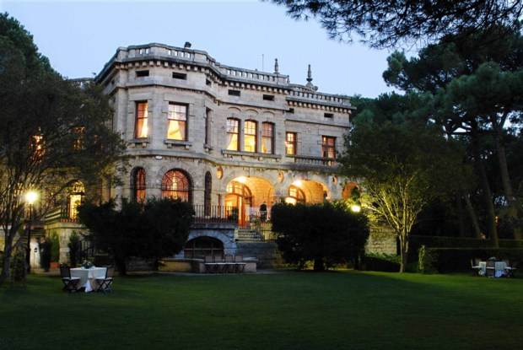
4th Workshop on the QCD Structure of the Nucleon (QCD’N 16)
July 11-15, Getxo, Spain
The nucleon spin :
decomposition & access to the contributions
Cédric Lorcé
CPHT
July 11, Palacio San Joseren, Getxo, Spain

Slide 2
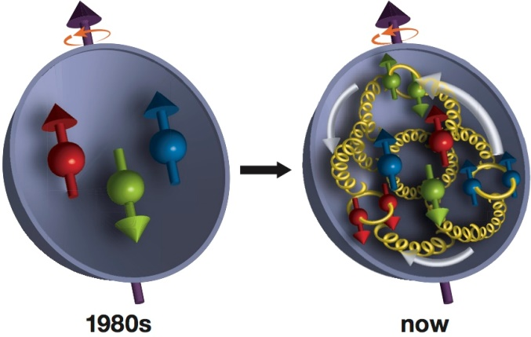
Outline
Modern spin decomposition
Accessing the contributions
Density level
Conclusions

Slide 3
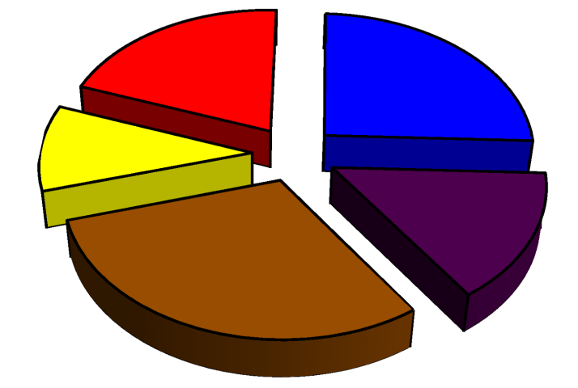
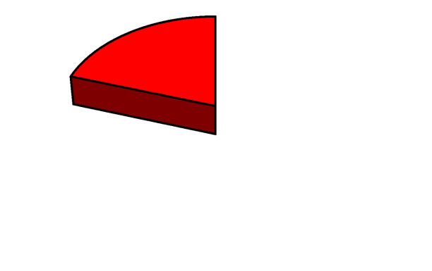
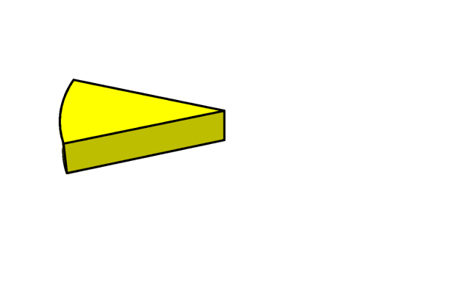
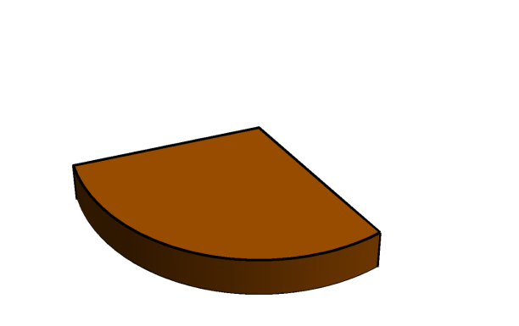
Modern spin decomposition
[Leader, C.L. (2014)]
L_{q}
S_{q}
L_{pot}
S_{G}
L_{G}
Canonical
Kinetic
[Jaffe, Manohar (1990)]
[Chen et al. (2008)]
[Ji (1997)]
[Wakamatsu (2010)]
L_{q}
L_{q}
L_{pot}
L_{pot}
L_{G}
L_{G}

Slide 4
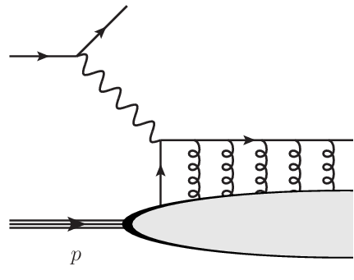
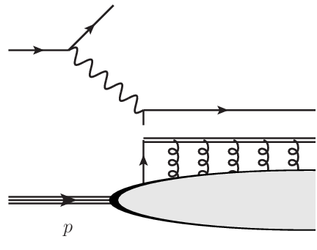
Ambiguity in Chen et al. approach
Longitudinal
Transverse
w.r.t. what?
Longitudinal direction provided by
gluon wave number
[Chen et al. (2008)]
[Wakamatsu (2010)]
hard probe
[Hatta (2011)]
[C.L. (2012)]
Factorization
Wilson line
~ background field
Local
Non-local

Slide 5
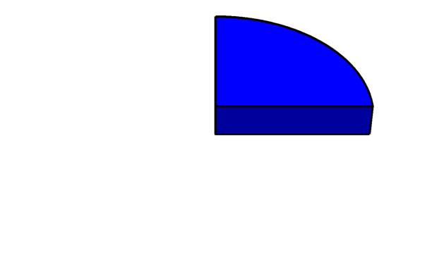
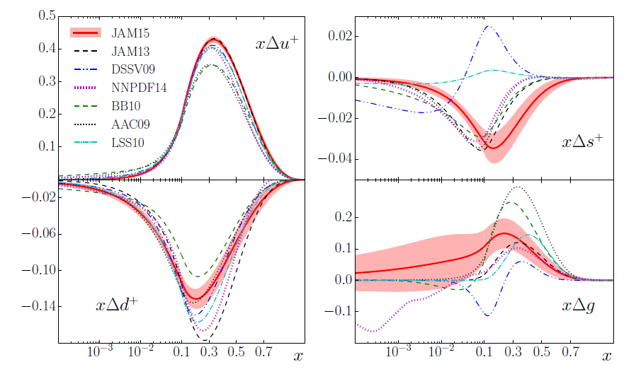
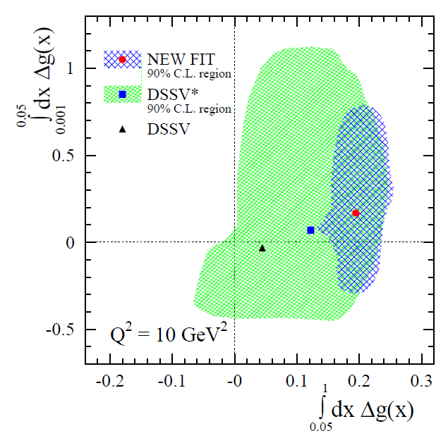
Accessing the contributions with PDFs
S_{q}
S_{G}
Inclusive DIS data
RHIC data on double-spin asymmetries
[de Florian et al. (2014)]
[JAM (2016)]

Slide 6
Accessing the contributions with GPDs
L_{q}
S_{q}
Ji relation
L_{pot}
S_{G}
[Ji (1997)]
L_{G}
PPSS relation
L_{q}
[Penttinen et al. (2000)]
[Kiptily, Polyakov (2002)]
[Hatta, Yoshida (2012)]

Slide 7
Accessing the contributions with TMDs
Transversity relation
Model-dependent !
L_{q}
L_{pot}
[Ma, Schmidt (1998)]
Pretzelosity relation
Model-dependent !
[She, Zhu, Ma (2009)]
[Avakian et al. (2010)]
[Efremov et al. (2010)]
[C.L., Pasquini (2012)]
Lensing relation
Model-dependent !
L_{q}
[Burkardt (2004)]
[Bacchetta, Radici (2011)]

Slide 8
Accessing the contributions with GTMDs
L_{q}
Orbiticity relation (staple gauge link)
L_{pot}
L_{G}
[C.L., Pasquini (2011)]
[Hatta (2011)]
Orbiticity relation (straight gauge link)
L_{q}
[Ji, Xiong, Yuan (2012)]
[C.L. (2012)]
[Liu, C.L. (2015)]

Slide 9
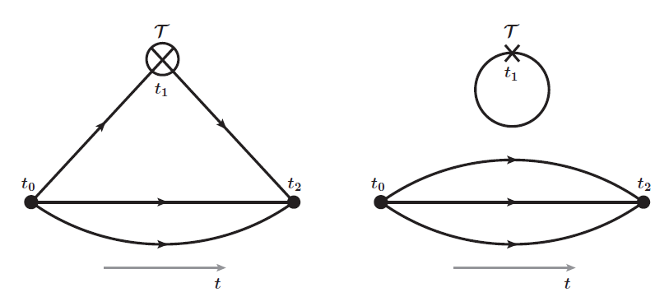
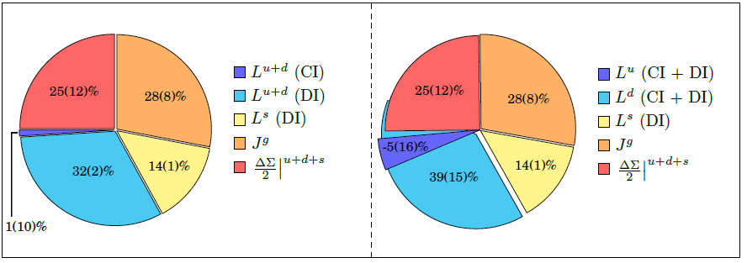
Accessing the contributions with EMFFs
Ji relation
L_{q}
S_{q}
L_{pot}
[Ji (1997)]
S_{G}
L_{G}
Lattice
CI
DI
χQCD collaboration
[Deka et al. (2015)]

Slide 10
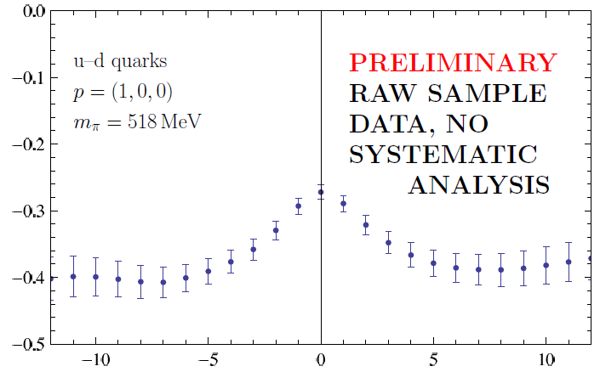
Accessing the contributions with quasi-distributions
L_{q}
Large momentum effective theory
S_{q}
L_{pot}
S_{G}
[Ji (2013)]
[Ji, Zhang, Zhao (2015)]
[Zhao, Liu, Yang (2016)]
L_{G}
M. Engelhardt, POETIC6 (2015)
Staple length

Slide 11
Density level
At the density level
[C.L., Pasquini, Yuan (2012)]
but …
[Hatta, Yoshida (2012)]
[C.L. (2012)]
[C.L., Liu (2016)]
Lorentz invariance relation
[Rajan et al. (2016)]

Slide 12
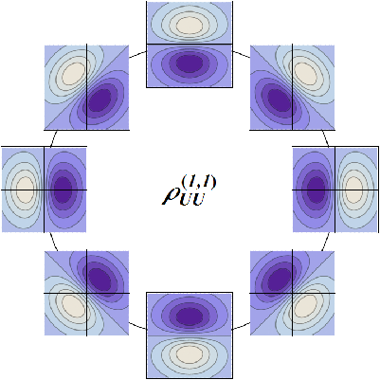
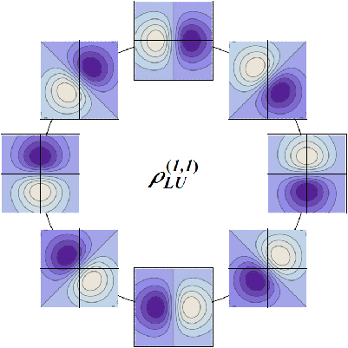
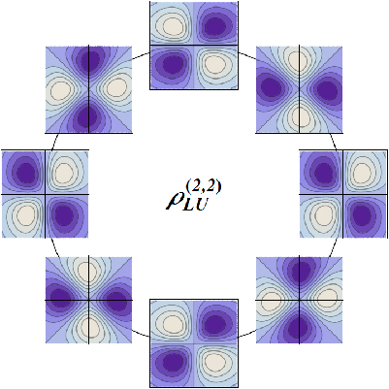
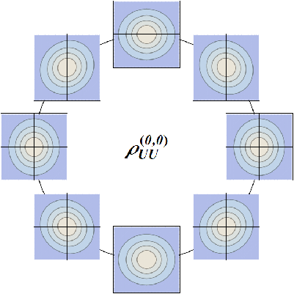
Density level
OAM phase-space density
[C.L., Pasquini, Xiong, Yuan (2012)]
[C.L. (2013)]
ISI/FSI
ISI/FSI
Density mode
Inflation mode
Orbital mode
Spiral mode
[C.L., Pasquini (2016)]

Slide 13
Density level
OAM phase-space density
[C.L., Pasquini, Xiong, Yuan (2012)]
[C.L. (2013)]
ISI/FSI
ISI/FSI
Density mode
Inflation mode
Orbital mode
Spiral mode
[C.L., Pasquini (2016)]

Slide 14
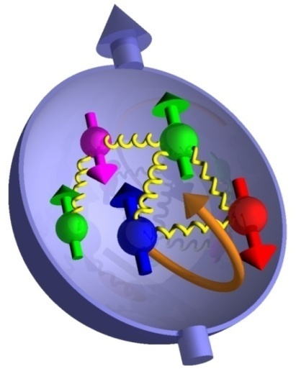
Conclusions
Complete spin decomposition has 5 contributions aand depends on how nucleon is probed (in our case on the light front)
Contributions accessible directly via PDFs, GPDs, EMFFs, GTMDs a and indirectly via TMDs
Canonical quantities unambiguously defined at the density level awhere strict locality is sacrificed to preserve gauge invariance

Slide 15
Backup slides

Slide 16
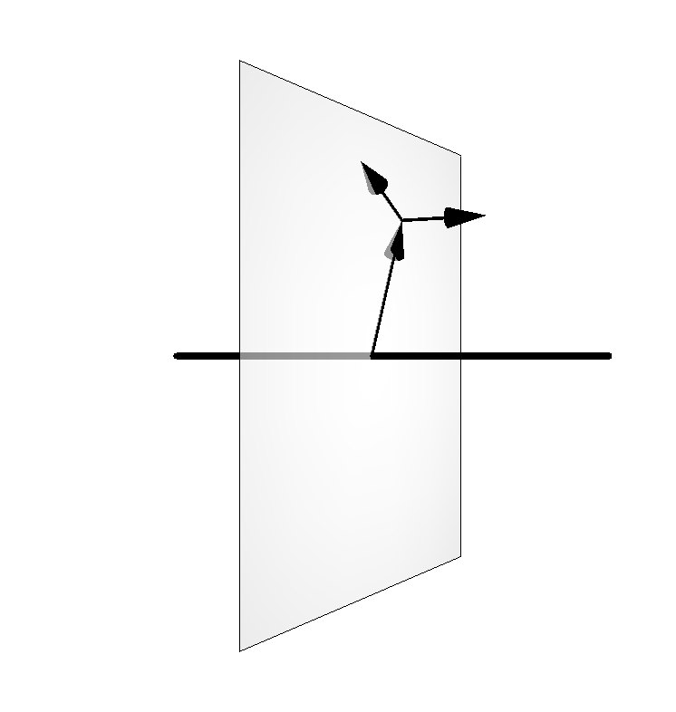
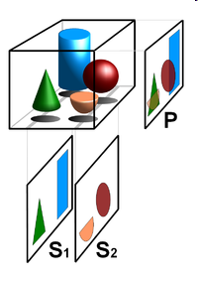
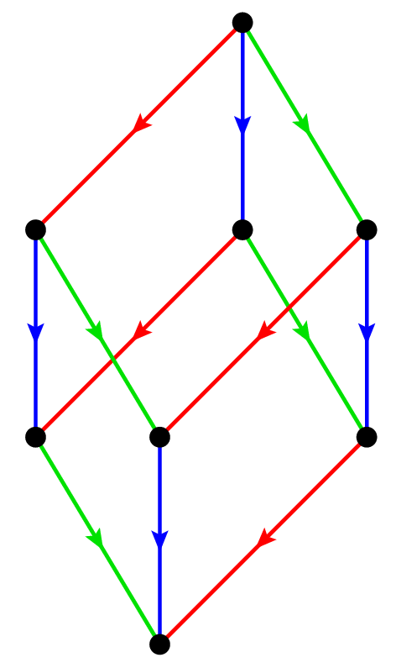
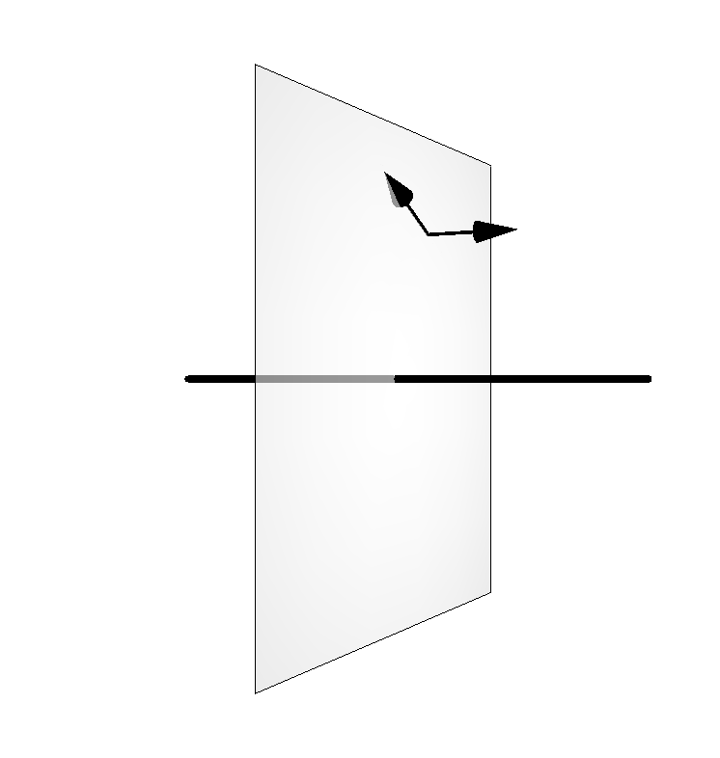
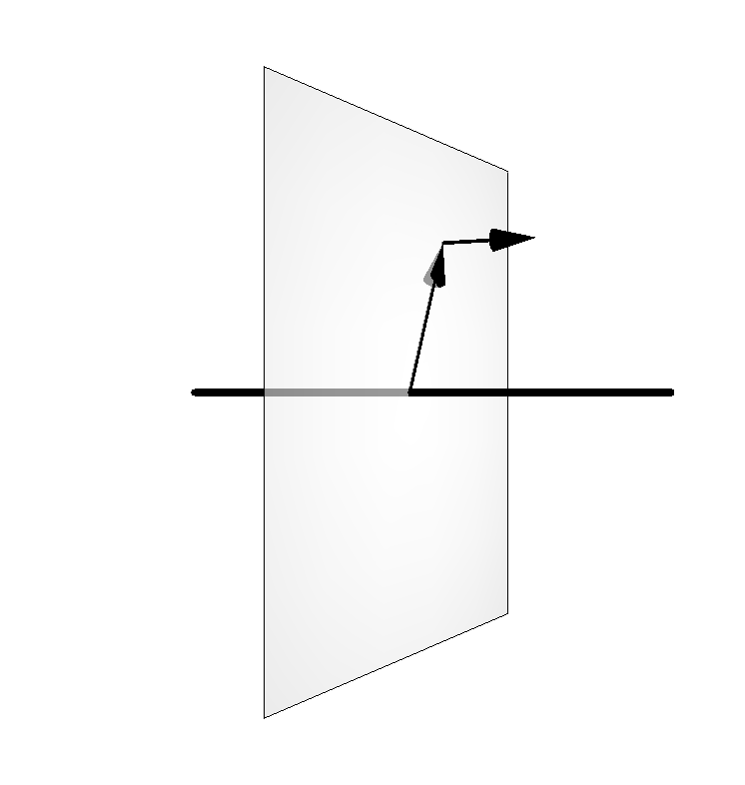
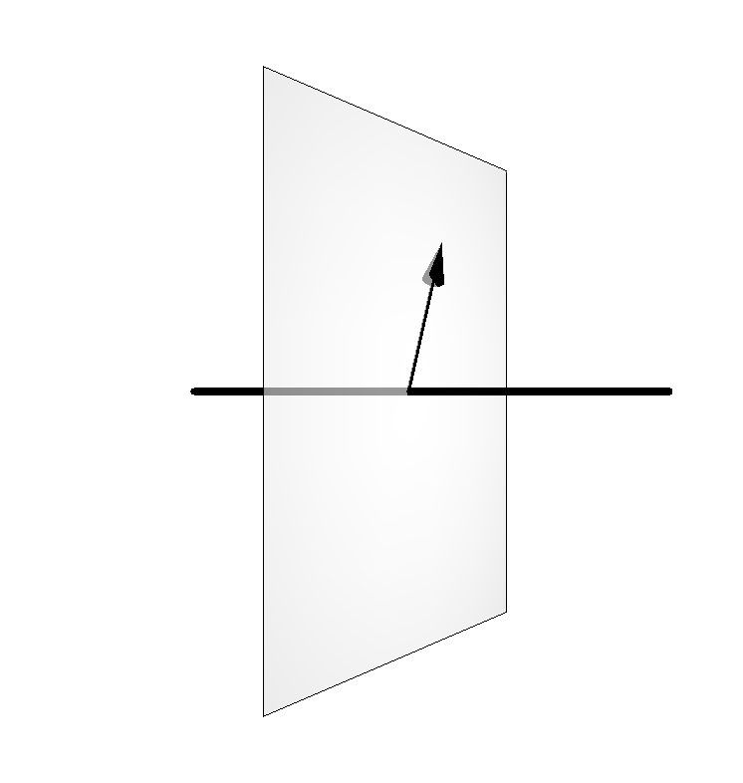
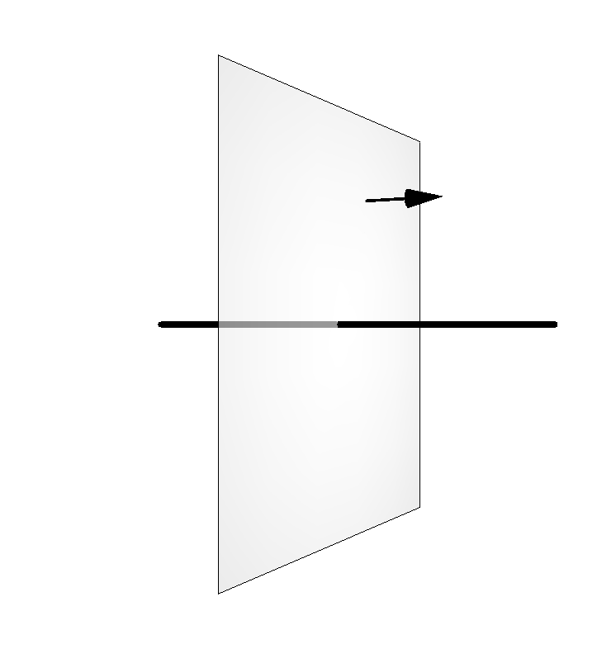
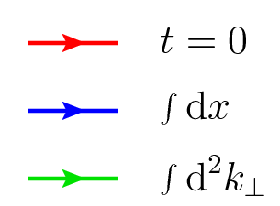
Parton distribution zoo
LFWF
Phase-space (Wigner) distribution
Theoretical tools
GTMDs
2+3D
TMDs
GPDs
0+3D
2+1D
PDFs
FFs
«Physical» objects
2+0D
0+1D
Charges
[C.L., Pasquini, Vanderhaeghen (2011)]

Slide 17
Gauge link dependence
Canonical
Drell-Yan
SIDIS
ISI
FSI
[C.L., Pasquini (2011)]
[C.L., Pasquini, Xiong, Yuan (2012)]
[C.L. (2013)]
ISI/FSI
[Liu, C.L. (2015)]
[C.L., Pasquini (2016)]
But
[Hatta (2012)]
[Hatta, Yoshida (2012)]
[Ji, Xiong, Yuan (2013)]
[C.L. (2013)]
[C.L. (2015)]

Slide 18
Gauge link dependence
Kinetic
[C.L. (2013)]
But
[Ji, Xiong, Yuan (2012)]
[C.L. (2013)]
[Liu, C.L. (2015)]
NB :

Slide 19
Myths and facts
Transverse densities
[Burkardt (2000-2003)]
Generalized Ji relation
[Polyakov (2003)]
[Leader, C.L. (2014)]
Divergence term !

Slide 20
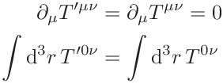
Energy-momentum tensor
Canonical EMT
[Jaffe, Manohar (1990)]
Gauge transformation
Superpotential
Freedom of the EM distribution
satisfies
Total EM is gauge invariant and conserved

Slide 21
Energy-momentum tensor
Ji EMT
QCD EOM
Gauge invariant
[Ji (1997)]
Belinfante-Rosenfeld EMT
QCD identity
Gauge invariant
and symmetric

