Slide 1
Towards the Strip CMOS Demonstrator Module
11 February 2016
J. J. John, Oxford

Slide 2
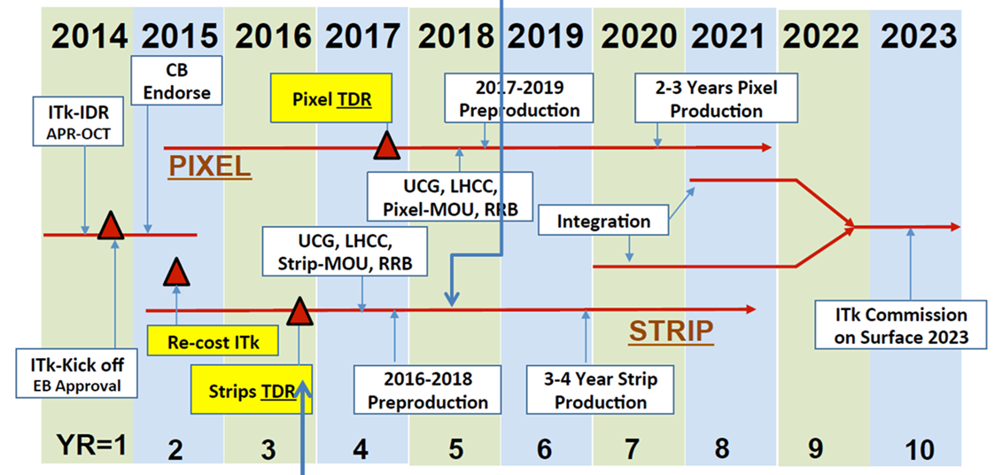
Reminder of Schedule
Demonstrator module by time of Strips TDR
-- R. Nickerson
Pre-production
Mid 2018
First review
candidate technology, good results
If S/N ok, likely to pass this review
Second Review
large scale chip, ABCn’ read-out

Slide 3
Demonstrator module first thoughts
Production concept for the module exists, based on a future CHESS-3 - see this talk for details.
By the Strips TDR though (Q4 2016), we need to demonstrate readout of CHESS-2 sensors arranged in a larger object, with an FPGA version of the ABCn’
Very rough concept:
CHESS-2
ACDC
ABCn’ → ACDC
(ATLAS CMOS Digital Chip)
CHESS-2
ACDC
CHESS-2
ACDC
HCC
hybrid
DAQ s/w
DAQ h/w

Slide 4
Possible alternatives
The ACDC for this first demonstrator could be based on the ABC130 or ABC130*
Green = already exists. Yellow = in progress or to be adapted. Orange = to start.
1. Base ACDC on ABC130:
1. Base ACDC on ABC130*:
CHESS-2
ACDC
CHESS-2
ACDC*
CHESS-2
ACDC
CHESS-2
ACDC*
CHESS-2
ACDC
CHESS-2
ACDC*
HCC
HCC*
hybrid
hybrid
DAQ s/w
DAQ h/w
DAQ s/w
DAQ h/w
SCTDAQ
e.g. Atlys
SCTDAQ with * added
e.g. Atlys – new firmware

