Slide 1
Two Dimensional SR-Interferometer at PETRA III
Artem Novokshonov
DESY, Tomsk Polytechnic University
DEELS 2016 Workshop DESY

Slide 2
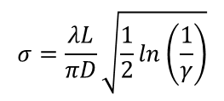
SR-Interferometer at PETRA
Schematic of the Interferometer
Mirror
Slits
CCD Camera
Source point
Lens
500 nm Bandpass Filter
Magnificating Lens
Polarizer
SR
Mirror
14.2 m
≈ 0.88 m

Slide 3
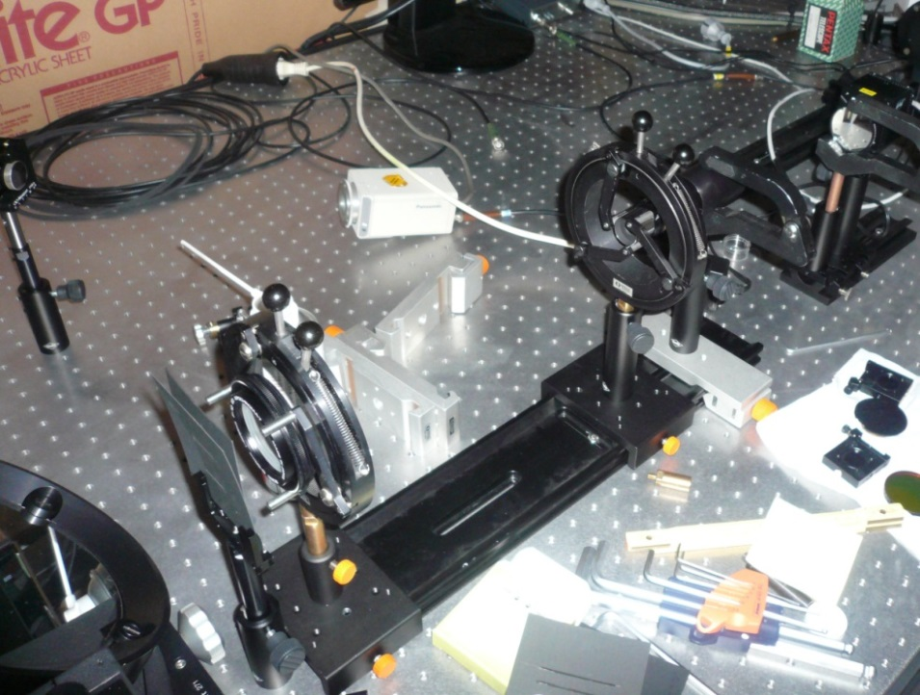
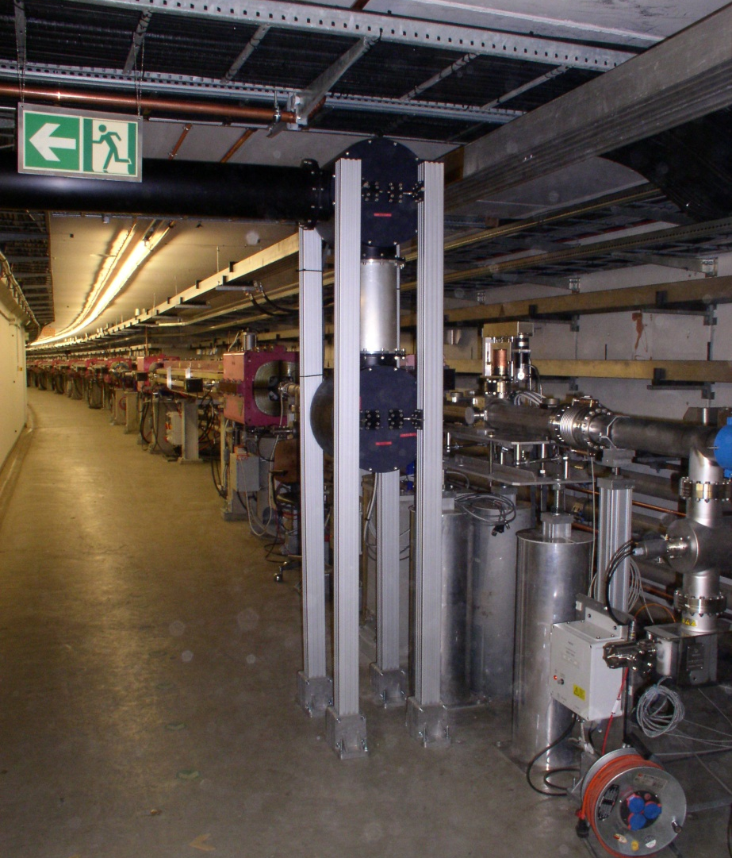
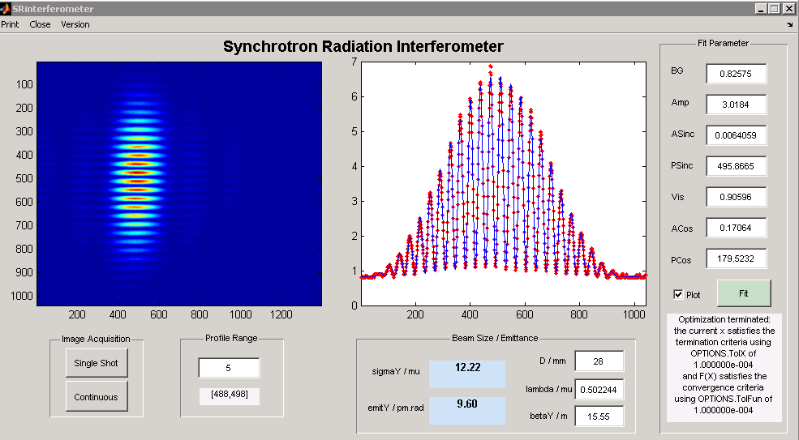
SR-Interferometer at PETRA
Setup in optical hutch
Optical beamline (bunch length diagnostics)
Glan-Thomson polariser
Ü
magnification lens
lens
visible light beampipe
mirror boxes
double slit
bandpass filter & CCD
synchrotron light from
bending magnet NL 50
alignment mirror
vertical design emittance confirmed
30 m beam transport via relay optical system
Gero Kube, DESY / MDI
DEELS 2014 Workshop @ ESRF, 12.05.2014

Slide 4
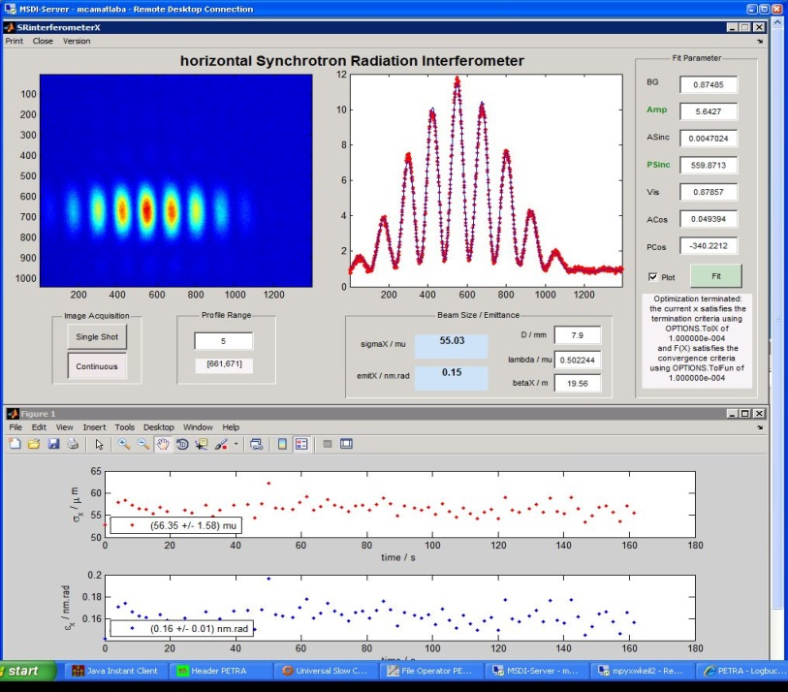
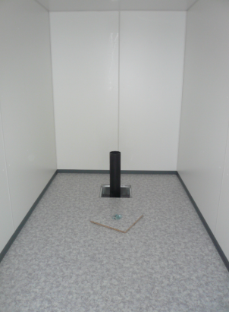
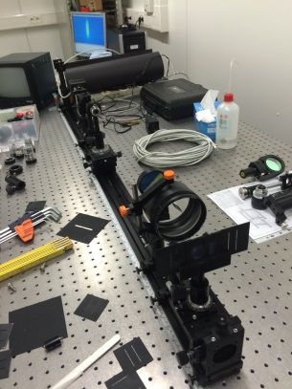
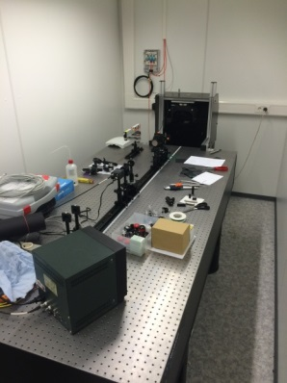
SR-Interferometer at PETRA
USR studies
Drawbacks
confirmation of 3 GeV hor. emittance
beamline with relay optics
→ additional uncertainties (lenses)
setup blocks Streak camera system
→ dismount interferometer for bunch
length measurement
space for only one interferometer
→ modify setup for measurement in
other transverse plane
beamline originally not designed for interferometric measurements
status 06.05.2014
status 22.06.2016

Slide 5
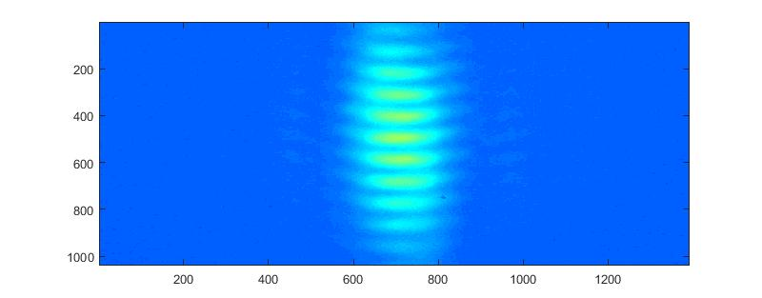
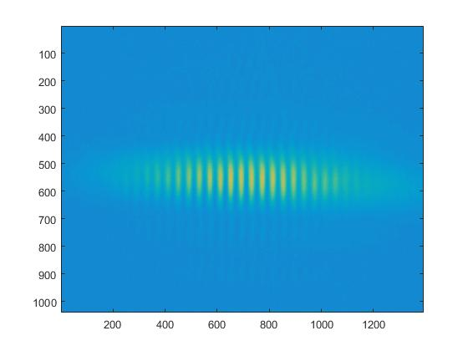
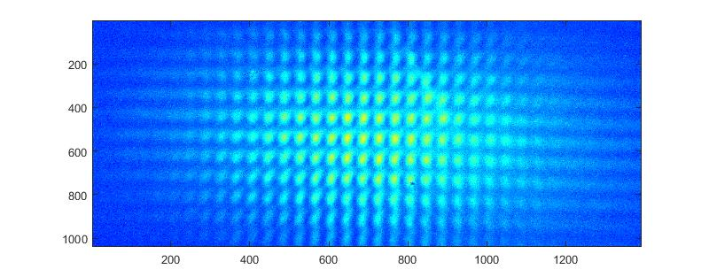
SR-Interferometer at PETRA
Horizontal interferogram
First interferograms from the new one interferometer
Vertical interferogram
Two dimensional interferogram

Slide 6
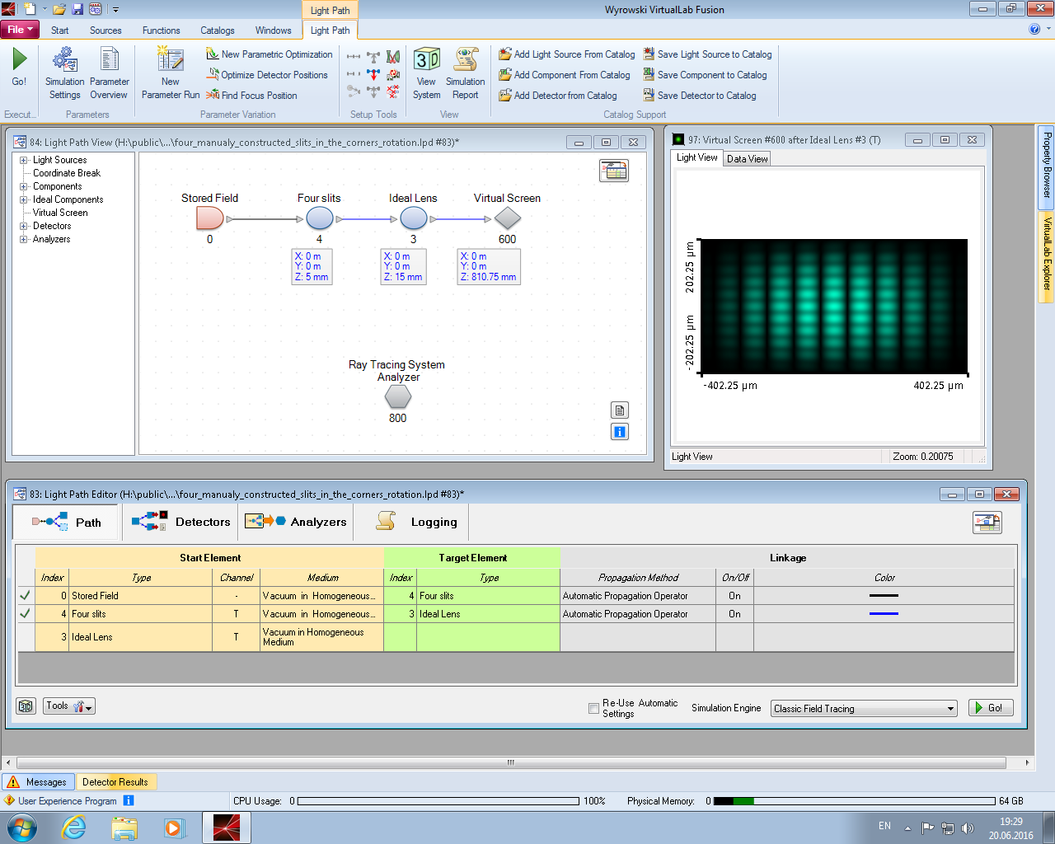
Virtual Lab Modelling
Virtual Lab Fusion (VL) – is an optical design software made by Light Trans company. Using VL one can simulate his own optical system with optical elements from the simplest (ideal lens, ideal mirrors, slits etc) up to structures made himself.
Advantages of VL for SR – interferometer modelling:
User can define any slits constructions
Parameter run can be performed
Disadvantages:
VL is not performed for synchrotron field calculations
Points to observe using VL:
Different kinds of slits (pinhole and rectangular)
Beam size determination mistake caused by shifting or rotating of slits

Slide 7
Virtual Lab Modelling
Vertical comparison of VL results with results of SRW
At a first stage, VL results of interferometer modelling had to be compared with results of already existing code. For this case a Synchrotron Radiation Workshop (SRW) software was chosen.
Stages of the comparison:
Synchrotron radiation field was calculated by SRW
This field was propagated via double slit optical system in VL and SRW
Beam sizes were determined from both programs
 | VL results | SRW results | Real size
$$σ_{hor}$$ | 170 μm | 169 μm | 169 μm
$$σ_{vrt}$$ | 10 μm | 9.4 μm | 9.75 μm

Slide 8
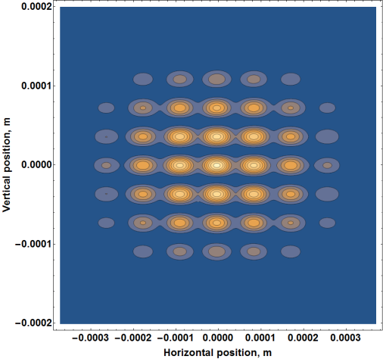
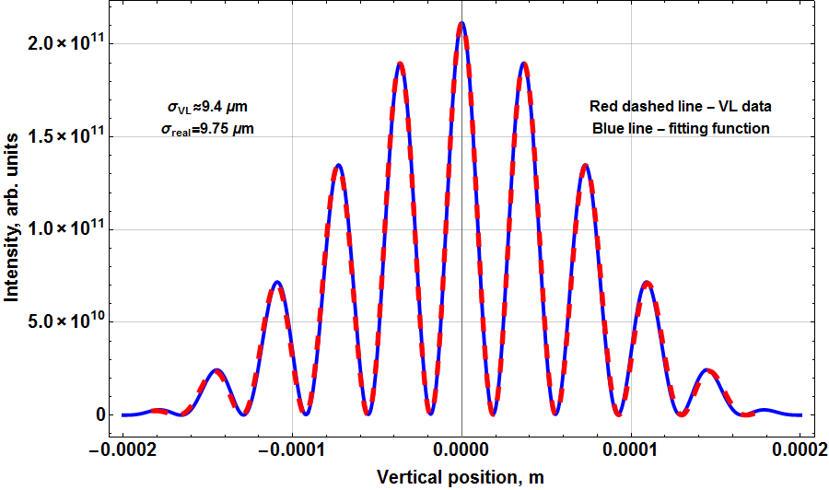
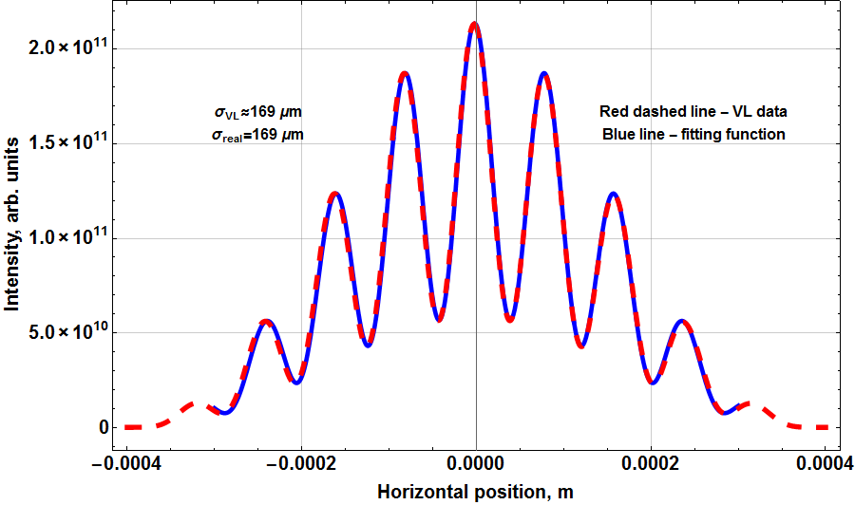
Virtual Lab Modelling
Two dimensional VL interferogram (rectangular slits)
$$σ_{VL}=9.4 μm$$
$$σ_{real}=9.75 μm$$
$$σ_{VL}=169 μm$$
$$σ_{real}=169 μm$$
Parameters of the slits:
Horizontal distance between slits – 6 mm
Vertical distance between slits – 11 mm
Half of horizontal slits width – 0.5 mm
Half of vertical slits width – 0.5 mm

Slide 9
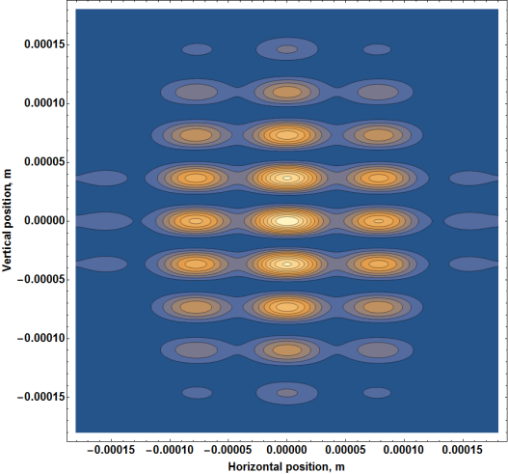
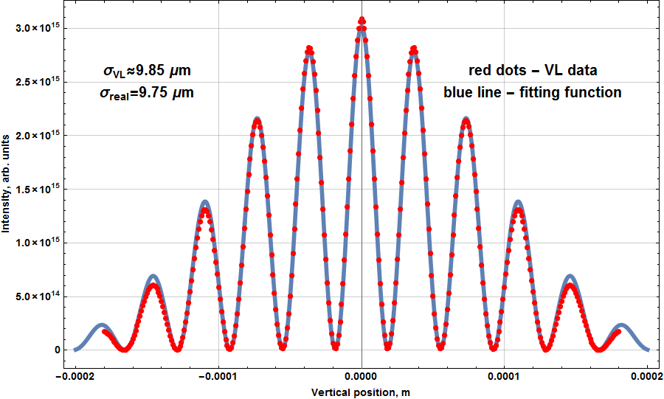
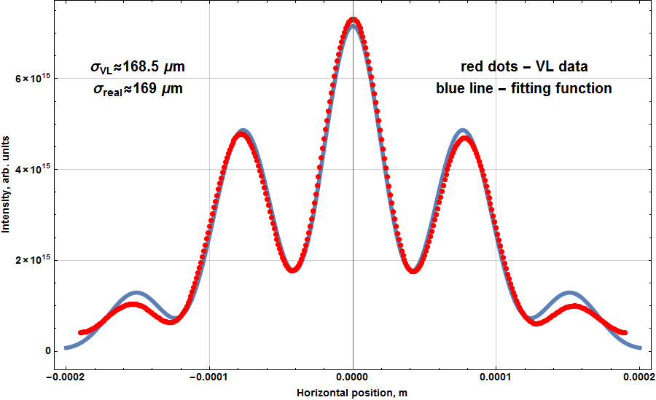
Virtual Lab Modelling
Two dimensional VL interferogram (pinholes)
$$σ_{VL}=9.85 μm$$
$$σ_{real}=9.75 μm$$
$$σ_{VL}=168.5 μm$$
$$σ_{real}=169 μm$$
Parameters of the slits:
Horizontal distance between pinholes– 5 mm
Vertical distance between pinholes– 11 mm
Radius of the pinhole – 1 mm

Slide 10
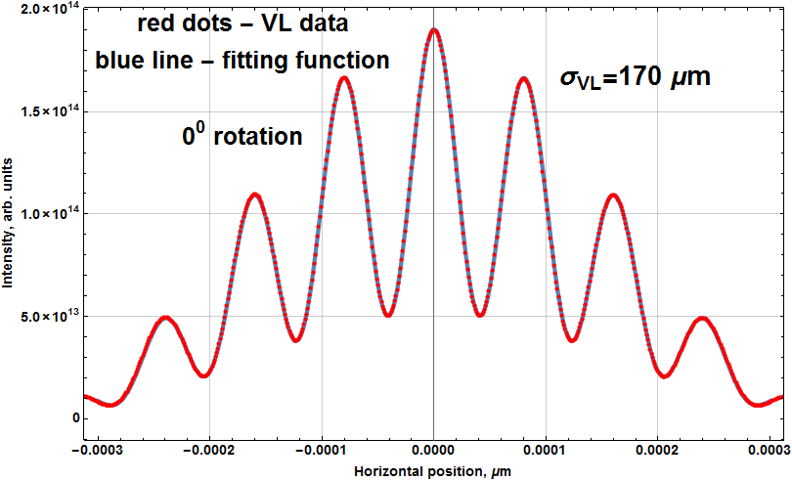
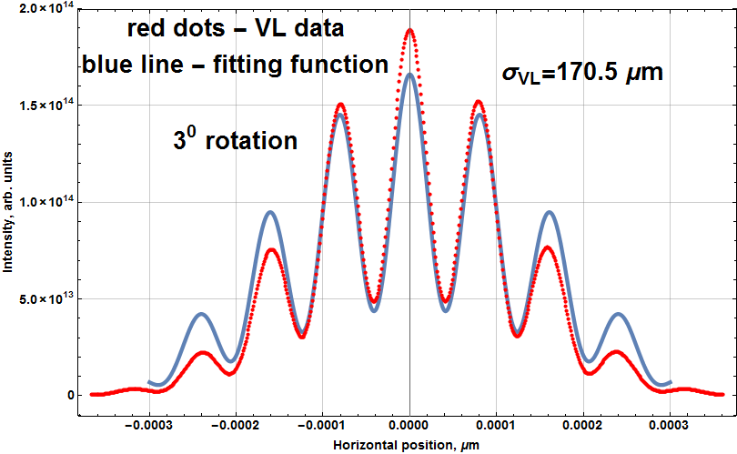
Virtual Lab Modelling
Slits rotating. Horizontal size determination
Let us consider that our slits are rotated at some angle to the “not tilted” position. In this case there must be some mistake of beam size determination.
α
Non rotated interferogram
3 degree rotated interferogram

Slide 11
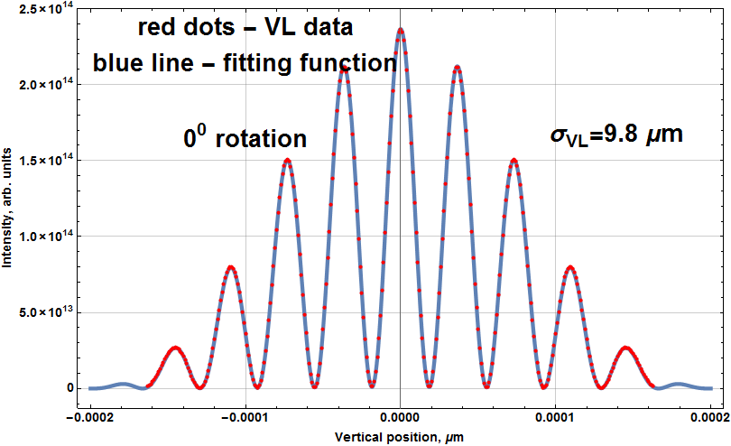
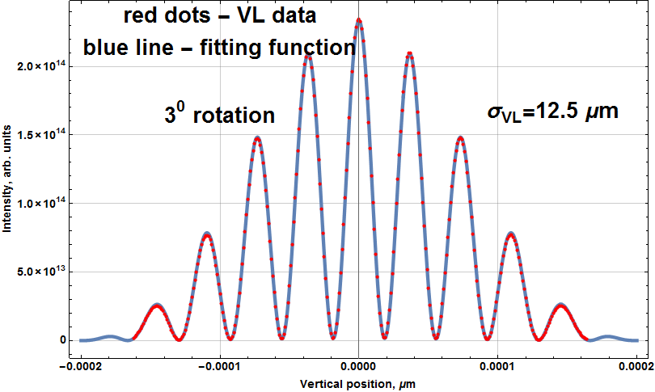
Virtual Lab Modelling
Slits rotating. Vertical size determination
Not rotated vertical interferogram →
3 degree rotated
← interferogram

Slide 12
Conclusion During this month the Interferometer will start to operate Using Virtual Lab we can calculate some mistakes and then to check it experimentally on the interferometer

Slide 13
Thank you for your attention!

